Slide 1
_x0014_Exploring EMF
What is the Eclipse Modeling Framework?
Notes:
Version 0.1, Sept. 2008
Toby McClean, Zeligsoft, 2008

Slide 2
Overview
Learn about the Eclipse Modeling Framework the basis for modeling related technologies in Eclipse
Notes:
Version 0.1, Sept. 2008
Toby McClean, Zeligsoft, 2008
The EMF is the basis for:
UML,
Model transformations, and
Model analysis
The primary goal of this module is to provide a sufficient understanding of the EMF in order to be able to build a new metamodel, explore an existing metamodel (e.g. UML2) and to be able to manipulate the model both via modeling in RSx and programatically.

Slide 3
Agenda
EMF models
  Meta-model
  Creating models
  Testing models
Generating code from EMF models
  Model manipulation
  Model Editors
EMF architecture and run-time
Transactions
Queries
Notes:
Version 0.1, Sept. 2008
Toby McClean, Zeligsoft, 2008

Slide 4
Eclipse Modeling Framework
Originally based on the OMGs’ MOF
  Supported a subset of the MOF
Is now an implementation of EMOF
  Essential MOF is part of MOF 2
Used as a framework for
  Modeling
  Data integration
Used in commercial products for 5+ years
Notes:
Version 0.1, Sept. 2008
Toby McClean, Zeligsoft, 2008
Allows to generate some of the code that we write over and over again
Creates a basis to build more complex model driven solutions
Generated source can be mixed with hand-written code
Aims to extract the intrinsic model that is often hidden in code and to automatically generate some if not all of the implementation code
Has other mature components (services):
Transaction
Query
Validation
Complementary tools and services
Teneo
CDO
Compare
Search
Temporality
Ecore tools, …
Large open source community

Slide 5
What is an EMF Model?
Description of data for a domain/application
  The attributes and capabilities of domain concepts
  Relationships between the domain concepts
  Cardinalities of attributes and relationships
It defines the metamodel or abstract syntax for your domain
Defined in the Ecore modeling language
Notes:
Version 0.1, Sept. 2008
Toby McClean, Zeligsoft, 2008
Capabilities of objects in the EMF is captured through operations

Slide 6
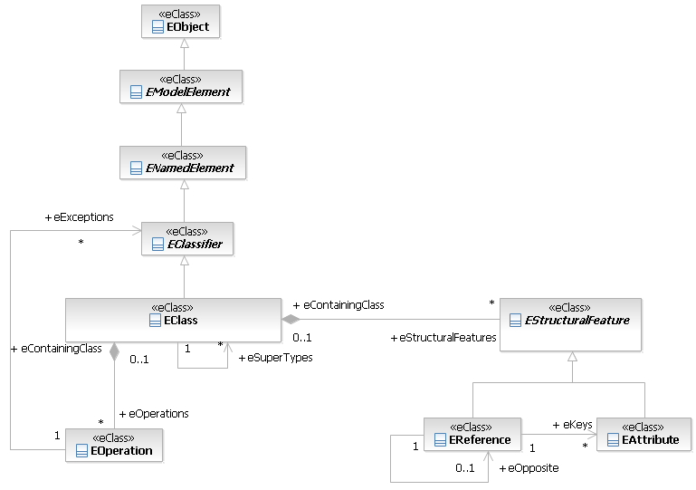
The Ecore Metamodel
Notes:
Version 0.1, Sept. 2008
Toby McClean, Zeligsoft, 2008
Persistence format XMI ( can configure to be MOF XMI .emof)

Slide 7
Ecore Metamodel Concrete Types
EPackage
  A named grouping of concepts, the domain
EClass
  A concept or class of object in a domain
EAttribute
  An attribute used to describe or define a concept
EReference
  Relationship with another concept
EOperation
  Behavior of a concept
EEnum
  A type whose possibilities are defined by a list of literals
EDataType
  Defines the types of attributes

Slide 8
EPackage
name
  Friendly label that need not be unique
nsURI
  Used to uniquely identify the package,
  Used by serialization as the XML namespace
nsPrefix
  The namespace prefix that corresponds to the XML namespace in the serialized instance models
eClassifiers
  Contains a set of EClass and EDataTypes
eSubPackages
  May contain a set of nested EPackages

Slide 9
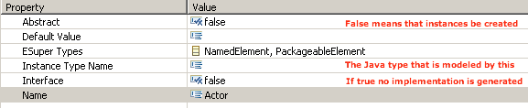
EClass

Slide 10
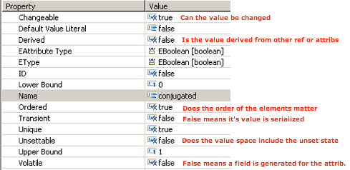
EAttribute

Slide 11
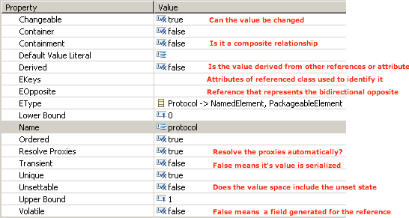
EReference

Slide 12
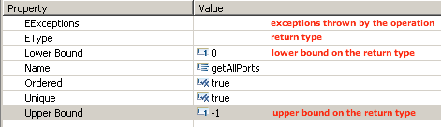
EOperation

Slide 13
Creating an EMF Model
UML
Model
EMF models can be created from
  Java Interfaces
  UML Class diagram
  XML Schema
  Ecore Diagram Editor
With EMF if you have one of the above then you can generate the others
Supports both
  EMFizing a legacy data model
  Greenfields development
Ecore
Model
XML
Schema
Java
Model
Java
Edit
Java
Editor
Notes:
Version 0.1, Sept. 2008
Toby McClean, Zeligsoft, 2008
There are additional ways of directly creating the Ecore model
Using Sample Ecore editor (in EMF)
Ecore Tools graphical editor (from EMFT)

Slide 14
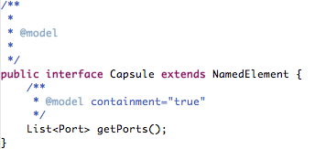
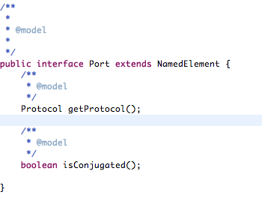
EMF from Java
EMF models can be created from annotated Java
  Typically for EMFizing legacy software
@model annotation indicates parts of the code that correspond to model elements
  interface - creates a class in EMF
  method - creates operation in EMF
  get method - creates attribute in EMF
Supports reloading
  i.e. can update the model by editing Java
Notes:
Version 0.1, Sept. 2008
Toby McClean, Zeligsoft, 2008

Slide 15
More EMF from Java
Create or use existing Java interfaces for data model or metamodel
Create EMF Model
  Right-click on project/folder New → Other...
  Use Annotated Java Model Importer
  Chose the Java package containing the annotated Java
  Creates ecore and genmodel resources for the metamodel
To update
  Open the genmodel resource using the Ecore Generator editor
  Select Generator → Reload... from the main menu
Notes:
Version 0.1, Sept. 2008
Toby McClean, Zeligsoft, 2008

Slide 16
EMF from UML Class Model
EMF models can be created from a UML class model
The classes are assumed to be metaclasses
Supports reloading from the UML model
Some restrictions
Notes:
Version 0.1, Sept. 2008
Toby McClean, Zeligsoft, 2008
In this slide it is assumed that the Class diagram is UML compliant

Slide 17
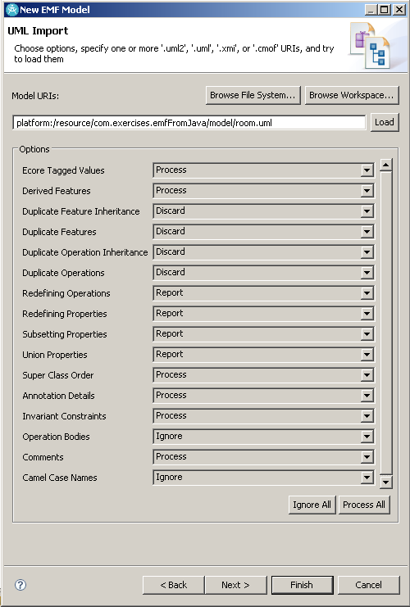
More EMF from UML Class Model
Create UML model
Create EMF model
  New → Other...
  Use UML Model Importer
  Chose the UML model
  Configure import
  Creates ecore and genmodel resources for the metamodel
To update
  Open the genmodel resource using the Ecore Generator Editor
  Select Generator → Reload...
Notes:
Version 0.1, Sept. 2008
Toby McClean, Zeligsoft, 2008
Along the same vane
EMF models can be created from RSx models
EMF can be created from Rose class models

Slide 18
EMF from XML Schema
Many industry standards produce XML schemas to define their data format
EMF model can be created from an XML schema
  Model instances are schema compliant
Supports reloading from XML schema
Schema can be regenerated from EMF model
Notes:
Version 0.1, Sept. 2008
Toby McClean, Zeligsoft, 2008

Slide 19
More EMF from XML Schema
Create/Find XML Schema
Create EMF model
  New → Other...
  Use XML Schema Importer
  Choose the XML Schema
  Creates ecore and genmodel resources for the metamodel
To update
  Open the genmodel resource using the Ecore Generator Editor
  Select Generator → Reload...
Notes:
Version 0.1, Sept. 2008
Toby McClean, Zeligsoft, 2008

Slide 20
EMF with Ecore Diagram Editor
The Ecore Diagram Editor provides a Class diagram like editor for graphically modeling
Built on top of the GMF framework
Editor is canonical
  One diagram per EMF model
Creates model and diagram resources
  File → New → Other...
  Ecore Diagram
Notes:
Version 0.1, Sept. 2008
Toby McClean, Zeligsoft, 2008

Slide 21
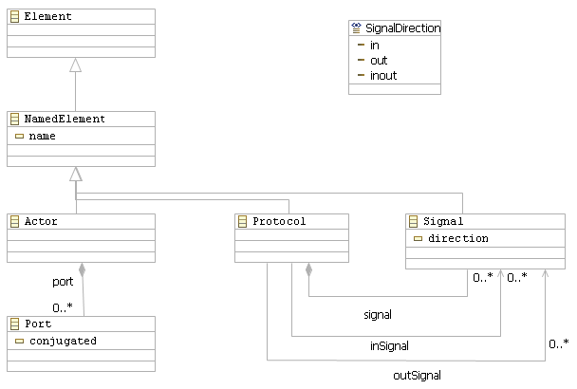
More EMF with Ecore Diagram Editor
Notes:
Version 0.1, Sept. 2008
Toby McClean, Zeligsoft, 2008

Slide 22
How do I Test my Model?
Manually review the model and ensure that it looks like it will work!
  Error prone
Build the generation model now generate the default model editor
  Time consuming when frequently changing
Use the dynamic instance creation capabilities
  Part of the Sample Ecore Model Editor
Use the generated test suite from EMF
  Generates a JUnit test suite, to test the user supplied code in operations and derived features

Slide 23
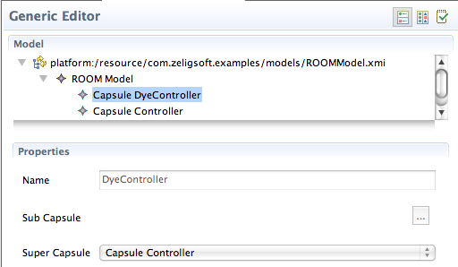
Dynamically Creating Models
While developing a model it can be tested by creating dynamic instance
  Does not require anything to be generated
  Does not require a runtime workbench
  Uses reflective capabilities of EMF
In the Ecore editor
  Right-click on the EClass
  Create Dynamic Instance...
Stored as XMI
Notes:
Version 0.1, Sept. 2008
Toby McClean, Zeligsoft, 2008

Slide 24
Do this with Code?
Register the ecore model as a dynamic package
Use the reflective API of EMF
  Can create instances and persist them

Slide 25
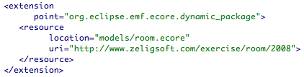
Registering the Model
EMF maintains a registry of models
  Access model through its namespace URI
To register model
  EPackage.Registry - programmatically
  org.eclipse.emf.ecore.generated_package extension point
  org.eclipse.emf.ecore.dynamic_package
To access model
  EPackage.Registry.INSTANCE.getEPackage(nsURI)
Notes:
Version 0.1, Sept. 2008
Toby McClean, Zeligsoft, 2008

Slide 26
Using the Reflective API
Model instances of an Ecore model can be created using the reflective API
Reflective API
  Generic API for working with EMF
  Accessing and manipulating metadata
  Instantiating classes
Usage examples
  EMF tool builders
  Serialization and deserialization
Notes:
Version 0.1, Sept. 2008
Toby McClean, Zeligsoft, 2008

Slide 27
Dynamic example
private static final String MODELS_FOLDER
= "platform:/resource/com.eett.exercises.emf.pluglets/models/";
…
// Retrieved the EPackage for the Room metamodel that we registered
// It is retrieved using the string we specified as the URI when we
// registered it in the dynamic_package extension point
EPackage room
= EPackage.Registry.INSTANCE
.getEPackage("http://www.eett.com/room/2008");
// Create a ResourceSet so that we can create Resources
// to store the model elements we create in
ResourceSet resourceSet = new ResourceSetImpl();
// Create the Resources to store the objects that we create in
Resource controllerResource
= resourceSet.createResource(URI.createURI(
MODELS_FOLDER + "dyeingController.xmi"));
Resource abstractControllerResource
= resourceSet.createResource(URI.createURI(
MODELS_FOLDER + "abstractDyeingController.xmi"));
Implementation details

Slide 28
Dynamic Example (2)
// In order to be able to create an Actor object we need
// have its EClass which we can get from the EPackage
EClass actorEClass = (EClass) room.getEClassifier("Actor");
// Similarly, to set the features of an Actor we
// need the EStructuralFeature objects for them which we
// can get from the EClass
EStructuralFeature actorNameAttribute
= actorEClass.getEStructuralFeature("name");
EStructuralFeature actorSuperclass
= actorEClass.getEStructuralFeature("actorSuperclass");
// Create the AbstractDyeingController Actor and add it
// to the Resource we created for it
EObject abstractController =
EcoreUtil.create(actorEClass);
abstractController
.eSet(actorNameAttribute, "AbstractDyeingController");
abstractControllerResource.getContents().add(abstractController);
Implementation details

Slide 29
Dynamic Example (3)
// Create the DyeingController Actor and add it
// to the Resource we created for it
EObject controller = EcoreUtil.create(actorEClass);
controller
.eSet(actorNameAttribute, "DyeingController");
controllerResource.getContents().add(controller);
// Set the actorSuperclass feature of the dyeingController
// to be the abstractController
controller.eSet(actorSuperclass, abstractController);
Implementation details

Slide 30
Summary
In this module we explored
  What EMF is...
  How to create Ecore models
    Java
    XML Schema
    UML model
    From scratch with Ecore Diagram Editor
  How to test an Ecore model under development
Notes:
Version 0.1, Sept. 2008
Toby McClean, Zeligsoft, 2008

Slide 31
Agenda
EMF models
  Meta-model
  Creating models
  Testing models
Generating code from EMF models
  Model manipulation
  Model Editors
EMF architecture and run-time
Transactions
Queries
Notes:
Version 0.1, Sept. 2008
Toby McClean, Zeligsoft, 2008

Slide 32
Generating Code with EMF
Code can be generated from the Ecore model to work with it
  Model specific API rather than the reflective API
  Support for editing model instances in an editor
Driven by a generator model
  Annotates the Ecore model to control generation
Generated code can be augmented
  Derived attributes
  Volatile attributes
  Operations
Notes:
Version 0.1, Sept. 2008
Toby McClean, Zeligsoft, 2008

Slide 33
More Generating Code with EMF
Full support for regeneration and merge
Code can be customized
  Configuration parameters
  Custom templates
Code can be generated from
  Workbench
  Ant script
  Command line
  NOTE THAT BOTH ANT AND COMMAND LINE STILL REQUIRE ECLIPSE
Notes:
Version 0.1, Sept. 2008
Toby McClean, Zeligsoft, 2008
REGENERATION and MERGE
The generated code can be modified without having to worry about it being trampled when the model is regenerated

Slide 34
The genmodel
genmodel
Wraps the Ecore model and automatically kept in sync
  Only true for Ecore
  Others like Java require explicit reload
Decorates the Ecore model
  Target location for generated code
  Prefix for some of the generated classes
GenClass
GenFeature
GenFeature
ecore
EClass
EReference
EReference
Notes:
Version 0.1, Sept. 2008
Toby McClean, Zeligsoft, 2008
Full support for regeneration and merge
That is it is possible to modify the EMF model and to regenerate the other artifacts without losing any changes that have been made to the generated code
Code generation is customizable
JDT, command-line and Ant capable
What is generated?
Interface and implementation class for each class in the Ecore model
Getter and Setter for each attribute and navigable reference in the Ecore model
Change notification for each class in the Ecore model
Sends notification to listeners whenever an attribute or reference is changed
Observers can perform actions based on change (e.g. updating views)
Observers can also be adatpers
Bidirectional relationship integrity is maintained
Notifications are fired at the end
Type safe enumerations
Factory
To create instances of modeled classes
Package
Access to metadata
Reflective API
All objects implement the EObject interface
Provides an interface for manipulating objects reflectively
Used by frameworks (e.g. persistence framework, copy utility, and editing commands)
Key for integrating EMF based tools and framworks
Provides a common API
Summary
Model
Interfaces and classes
Type-safe enums
Package (metadata)
Factory
Adaptor factory base
Validator
Custom resource
XML processor
Manifests, plug-in classes, properties and default icons…
Edit
UI independent
Item providers
Item provider adapter factory
Editor
Model wizard
Editor
Action bar contributor
Advisor for RCP
Tests
Test cases
Test suite
Stand-alone example
Regeneration
@generated elements are removed and replaced/removed
If removed or replaced with @generator NOT it will preserve changes
Generated methods can be extended through redirection
E.g. getName and getNameGen
Generator Options
Control the code generated with the default templates
Suppress Interfaces
Only applicable when there is no multiple inheritance
Suppress EMF metadata
Helps reduce EMF dependencies in generated API
Root Extends Interface
Selection of the root interface, class and implementation interface
Can be empty helping to reduce EMF dependencies in generated API
Suppress EMF types
Uses corresponding standard Java types in place of EMF types
Object instead of EObject
List instead of EList
…
Generator Templates
Can be
Replaced
Inserted
Insert content into default templates at insertion points (JET @include with fail set to silent)
Overriden
Override content of default templates at override points (JET @include with fail set to alternative)
Suppress EMF Model tags
Removes tags in generated code specific to EMF
Reduces the visibility of EMF in the generated code
Extensions
Code generation is performed by visiting the elements in the model and invoking templates to generate artifacts for each element
Control over this process is delegated to GeneratorAdapters via one or more GeneratorAdapterFactory
Additional adapter factories can be plugged into the generator to create adapters that generate additional artifacts

Slide 35
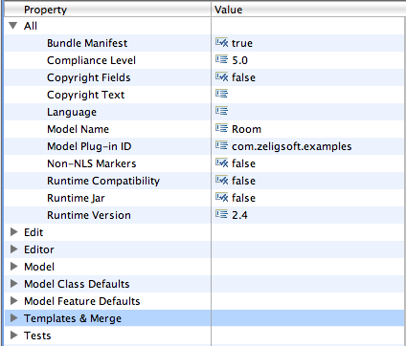
More genmodel
Global generator configuration
To generate
  Context menu in the editor
  Main menu in the editor
Generates for
  GenModel, GenPackage, GenClass and GenEnum
What is generated
  Model
  Edit
  Editor
  Tests
Notes:
Version 0.1, Sept. 2008
Toby McClean, Zeligsoft, 2008
Bundle Manifest
Whether to generate the OSGi bundle manifes
Compliance Level
JDK compliance of the generated code
Copyright Fields
Copyright Text
Language
Model Name
Model Plug-in ID
Non-NLS Markers
Runtime Compatibility
Runtime jar
Runtime Version

Slide 36
Model Code
Java code for working with and manipulating model instances
Interfaces, classes and enumerations
Metadata
  Package
API for creating instances of classes
  Factory
Persistence
  Resource and XML processor
Utilities
  E.g. Switch for visiting model elements
Notes:
Version 0.1, Sept. 2008
Toby McClean, Zeligsoft, 2008
Interfaces and classes
Get and set for attributes of concepts in the model
Type-safe enums
Package (metadata)
Access to the metadata of the concepts in the model
Used by the EMF runtime and utilities
Factory
For creating instances of concepts in the model
Adaptor factory base
Switch utility
Validator
Provides integration with the validation framework for constraints and invariants
Custom resource
XML processor
The latter is a utility class that provides a convenient API for working with XML files that conform to the schema described by the Ecore model.
Manifests, plug-in classes, properties and default icons…

Slide 37
Model Code Detail
Source: EMF Eclipse Modeling Framework, Second Edition, Addison Wesley Professional

Slide 38
More Model Code
Source: EMF Eclipse Modeling Framework, Second Edition, Addison Wesley Professional
Notes:
Version 0.1, Sept. 2008
Toby McClean, Zeligsoft, 2008
Factory
Create instances of model classes
Package
Access to metadata, for working with reflective and dynamic API

Slide 39

More Model Code
Source: EMF Eclipse Modeling Framework, Second Edition, Addison Wesley Professional
Notes:
Version 0.1, Sept. 2008
Toby McClean, Zeligsoft, 2008

Slide 40
Model Edit Code
User interface independent editor code
Interfaces to support viewing and editing of model objects
  Content and label provider functions
  Property descriptors
  Command factory
  Forwarding change notifications
Sample icons are generated
Notes:
Version 0.1, Sept. 2008
Toby McClean, Zeligsoft, 2008
Content and label provider
Eclipse viewers use a content provider (e.g., ITreeContentProvider) and a label provider (e.g., ILabelProvider) to get the information they need from the model. EMF.Edit provides generic content and label provider implementation classes, AdapterFactoryContentProvider and AdapterFactoryLabelProvider, that delegate their implementation to item providers
Property descriptors
a property source for the property sheet
Command factory
EMF.Edit provides all the mechanisms for modifying EMF objects in an undoable way, including a full set of generic commands. The framework makes it easy to tune the command behavior for specific models by delegating their creation to item providers.

Slide 41
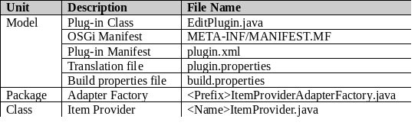
More Model Edit Code
Source: EMF Eclipse Modeling Framework, Second Edition, Addison Wesley Professional
Notes:
Version 0.1, Sept. 2008
Toby McClean, Zeligsoft, 2008

Slide 42
Model Editor Code
User interface specific editor code
  Choice between workbench integration or a rich client
A default tree based editor
  With toolbar, context menu and menu bar actions for creating an instance of the model
  Full undo and redo support
A default model creation wizard
Icons for the editor and wizard
Notes:
Version 0.1, Sept. 2008
Toby McClean, Zeligsoft, 2008
Advisor
Used when targetting a RCP application

Slide 43
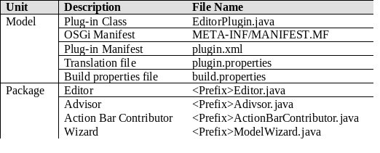
More Model Editor Code
Source: EMF Eclipse Modeling Framework, Second Edition, Addison Wesley Professional
Notes:
Version 0.1, Sept. 2008
Toby McClean, Zeligsoft, 2008

Slide 44
Regeneration and Merge
EMF generator merges with existing code
Generated elements annotated
  @generated
  Will be replaced on regeneration
Preserving changes
  Remove @generated tag
  e.g. @generated NOT
  Changes will be preserved on regeneration
Redirection
  Add Gen to the end of the generated operation
  This is the best practice

Slide 45
Summary
In this module we explored
  The EMF code generation
  What is generated?
    Model
    Edit
    Editor
  How do we generate it?

Slide 46
Agenda
EMF models
  Meta-model
  Creating models
  Testing models
Generating code from EMF models
  Model manipulation
  Model Editors
EMF architecture and run-time
Transactions
Queries
Notes:
Version 0.1, Sept. 2008
Toby McClean, Zeligsoft, 2008

Slide 47
EMF Architecture
Editor
Model
EMF Tools
Codegen
EMF Runtime
Edit
Core
Eclipse Platform
Notes:
Version 0.1, Sept. 2008
Toby McClean, Zeligsoft, 2008

Slide 48
EMF Runtime - Core
Notification framework
Ecore metamodel
Persistence
Validation
Change model
Notes:
Version 0.1, Sept. 2008
Toby McClean, Zeligsoft, 2008

Slide 49
EMF Runtime - Edit
Support for model-based editors and viewers
Notification framework
  Sends out notification whenever attribute or reference is changed
  Observers (also an adapter) receive notification and can act
Default reflective editor

Slide 50
EMF Tools - Codegen
Code generator for application models and editors
  Interface and class for each class in the model
  ItemProviders and AdapterFactory for working with Edit framework
  Default editor
Extensible model import/export framework
  Contribute custom model source import modules
  Contribute custom export modules
Notes:
Version 0.1, Sept. 2008
Toby McClean, Zeligsoft, 2008

Slide 51
Persistence
EMF refers to persisted data as a Resource
Model objects can be spread across resources
  Proxy is an object referenced in a different resource
EMF refers to the collection of resources as a ResourceSet
  Resolve proxies between resources in the set
Registry maintains the resource factory for different types of resources
  For the creation of resources of a specific type
Resources are identified by their their URI
Notes:
Version 0.1, Sept. 2008
Toby McClean, Zeligsoft, 2008
Pesistence data is referred to as a Resource
Objects can be spread out among many resources in a ‘Resource Set’
Proxy
An object referenced in a different Resource
Resource set
Context for mutliple Resources that may have references between them
Usually just an instance of ResourceSetImpl
Provides a factory method for creating new resources in the set
Also provides access to the registries, URI converter and default load operations for the set
Registries
Returns a resource factory for a given type of Resource
Based on URI scheme, filename or content type
Determines the format for save/load
If no registered resource factory found locally, delegates to global registry: Resource.Factory.Registry.INSTANCE
Package Registry
Returns the package identified by a given namespace URI
Used during loading to access factory for instantiating classes
If no registered package found locally, delagates to global registry: EPackage.Registry.INSTANCE
Resource
Container for objects that are to be persisted together
Convert to and from persistent form via save() and load()
Access contents of resource via getContents()
EMF provides generic XMLResource implementation
Other, customized implementations, too (e.g. XMI, EMOF)
Proxy resolution and on demand load
XML Schema-Conformant Serialization
A DocumentRoot class is included in models created from XML Schema
Includes one containment reference per global element
To serialize an instance document
Use an XMLResource with extended metadata enabled (e.g. use the resource factory generated with your m0del)
Use an instance of the DocumentRoot in the resource’s contents
Set the appropriate reference to select the root element

Slide 52
Notification
Every EObject is a notifier
  Whenever it changes it notifies interested parties
In EMF terminology observers are adapters
  A way to extend or change the behavior
    No subclassing is required
AdapterFactory provides the means to add an adapters
  adapterFactory.adapt(object, ITreeItemContentProvider.Class)
Notification is automatically generated
Notes:
Version 0.1, Sept. 2008
Toby McClean, Zeligsoft, 2008
Every EMF object is also a Notifier
Send notification whenever an attribute or reference is changed
EMF objects can be “observed” in order to update views and dependent objects
Observers or listeners in EMF are called adapters
An adapter can also extend class behavior without subclassing
For this reason they are typically added using an AdapterFactory
Efficient notification in “set” methods
Checks for listeners before creating and sending notification
This multi-step procedure is implemented using InternalEObject methods:
eInverseRemove()
eInverseAdd()
Framework list implementations and generated setters directly invoke them on target objects as needed
Notifications are accumulated using a NotificationChain and fired off at the end
They are not used to implement the handshaking

Slide 53
Notification Example
/**
* <!-- begin-user-doc -->
* <!-- end-user-doc -->
* @generated
*/
public void setActorSuperclass(Actor newActorSuperclass) {
Actor oldActorSuperclass = actorSuperclass;
actorSuperclass = newActorSuperclass;
if (eNotificationRequired())
eNotify(new ENotificationImpl(this, Notification.SET,
ROOMPackage.ACTOR__ACTOR_SUPERCLASS,
oldActorSuperclass, actorSuperclass));
}
Implementation details

Slide 54
Notification Example
public void setActor(Actor newActor) {
if (newActor != eInternalContainer()
|| (eContainerFeatureID != ROOMPackage.BINDING__ACTOR && newActor != null)){
if (EcoreUtil.isAncestor(this, newActor))
throw new IllegalArgumentException("Recursive containment not allowed for ”
+ toString());
NotificationChain msgs = null;
if (eInternalContainer() != null)
msgs = eBasicRemoveFromContainer(msgs);
if (newActor != null)
msgs = ((InternalEObject)newActor)
.eInverseAdd(this, ROOMPackage.ACTOR__BINDING, Actor.class, msgs);
msgs = basicSetActor(newActor, msgs);
if (msgs != null) msgs.dispatch();
}
else if (eNotificationRequired())
eNotify(new
ENotificationImpl(this,
Notification.SET, ROOMPackage.BINDING__ACTOR, newActor, newActor));
}
Implementation details

Slide 55
Change Recording
Track the changes made to instances in a model
  Use the notification framework
ChangeRecorder
  Enables transaction capabilities
  Can observe the changes to objects in a Resource or ResourceSet
Notes:
Version 0.1, Sept. 2008
Toby McClean, Zeligsoft, 2008
Adapter that creates change description based on notifications, to describe reverse delta
Provides transaction capability
Can be attached to EObjects, Resources, and ResourceSets
Monitors changes to the objects and their contents trees
Produces a description of the changes needed to return to the original state (a reverse delta)
Result: a change description with one change, setting billTo to “123 Elm St.”
Given a change description, the change can be applied:
ChangeDescription.apply()
consumes the changes, leaving the description empty
ChangeDescription.applyAndReverse()
reverses the changes, leaving a description of the changes originally made (the forward delta)
The model is always left in an appropriate state for applying the resulting change description

Slide 56
Dynamic EMF
We looked at this before in this module
Working with Ecore models with no generated code
  Created at runtime
  Loaded from a ecore resource
Same behavior as generated code
  Reflective EObject API
Model created with dynamic EMF is same as one created with generated code
Supports delegation of reflective API to static API and vice-versa
Notes:
Version 0.1, Sept. 2008
Toby McClean, Zeligsoft, 2008
An Ecore model can be created at runtime using Ecore API or loaded from persistent form
No generated code required
Dynamic implementation of reflective EObject API provides same runtime behavior as generated code
Can create dynamic subclasses of generated classes
The framework treats all model instances the same whether generated or dynamic
Ecore models can be defined dynamically in memory
No generated code required
Dynamic implementation of reflective EObject API provides same runtime behavior as generated code
Also supports dynamic subclasses of generated classes
All EMF model instances, whether generated or dynamic, are treated the same by the framework
A dynamic Ecore model can be defined by
Instantiating model elements with the Ecore API
Loading from a .ecore file

Slide 57
Automatically implemented Constraints
Some constraints are automatically implemented
  Derived directly from the model
Multiplicity constraints
  Enforce the multiplicity modeled in the Ecore model
Data type values
  Ensure that the value of an attribute conforms to the rules of the data type
Notes:
Version 0.1, Sept. 2008
Toby McClean, Zeligsoft, 2008
Multiplicity
Data type values
In XML schema, constraints can be defined as facets on simple types
Full implementation generated in validator

Slide 58
Validation
Infrastructure for providing rich invariants and constraints on the model
  Will invoke the invariants and constraints
  Requires the user to write the invariants and constraints
Invariants
  Defined by operations on a class with signature
    (EDiagnosticChain, EMap) : EBoolean
Constraints
  Defined using a Validator
More on this in a later module

Slide 59
EMF Utilities
Copying
  EcoreUtil.copy
Equality
  EcoreUtil.equal
Cross-referencing, contents/container navigation, annotation, proxy resolution, adapter selection, …
Notes:
Version 0.1, Sept. 2008
Toby McClean, Zeligsoft, 2008

Slide 60
Summary
In this module we explored
  EMF architecture
  EMF runtime aspects
    Notification
    Persistance
    Change recording
    Validation and constraints

Slide 61
Agenda
EMF models
  Meta-model
  Creating models
  Testing models
Generating code from EMF models
  Model manipulation
  Model Editors
EMF architecture and run-time
Transactions
Queries
Notes:
Version 0.1, Sept. 2008
Toby McClean, Zeligsoft, 2008

Slide 62
EMF Transaction
A framework for managing multiple readers and writers to EMF resources or sets of resources
An editing domain object manages access to resources
  Can be shared amongst applications
A transaction object is the unit of work
Support for rolling back changes
  Support for workbench undo/redo infrastructure
Notes:
Version 0.1, Sept. 2008
Toby McClean, Zeligsoft, 2008
manages access to an editing domain by multiple readers and writers
ability to register an editing domain to be shared amongst several clients and listeners
Getting an objects editing domain TransactionUtil.getEditingDomain
Registering editing domain
To share with other applications, so that they may cooperatively edit a common set of resources
TransactionalEditingDomain.Registry.INSTANCE.add(“<unique identifier>”, <editing domain>)
May be problems that clients want to access before creator has created or activated it
org.eclipse.emf.transaction.editingdomains extension point
first access it is created and activated
Transaction
Discrete unit of work in a ResourceSet
Isolate of concurrent threads to prevent corruption
Validation of changes on commit, rolling back (undoing those changes) automatically when data integrity is violated
Automatic execution of triggers on commit, to proactively maintain data integrity
Not a concurrent transactional environment
Transactions on multiple threads execute strictly in serial order
Most clients do not have to interact directly with transactions only with the editing domain
The default code generated by EMF is not thread safe, even for reading
Read-only transaction
Gives a thread exclusive access to the resource set of a trasactional editing domain
Encapsulate the read operation in a Runnable and pass it to the TransactionalEditingDomain.runExclusive
moving objects between ResourceSets that do not share an editing domain requires that it be first disconnected from its original editing domain
Resource resource = getResource(); // a resource to move to another resource set
TransactionalEditingDomain formerDomain = TransactionUtil.getEditingDomain(resource);
ResourceSet newResourceSet = getNewResourceSet(); // resource set to move to
newResourceSet.getResources().add(resource); // first, move the resource
if (domain != null) {
// then disconnect it from the former editing domain
TransactionUtil.disconnectFromEditingDomain(resource);
}
A transactional editing environment
Safe read and write access to EMF resources from multiple concurrent threads
Commit protocol providing mechanisms for ensuring model integrity:
Validation of the changes performed during the transaction (constraints) using the Validation Framework
Pre-commit listeners proactively performing concomitant changes (triggers) to maintain consistency of dependencies
Automatic rollback of changes on failure to validate or complete triggers
Supports transaction nesting

Slide 63
Read/Write Transactions
Gives a thread exclusive access to a ResourceSet to modify its content
  To change the Resources within the ResoureSet
Prevent other threads from observing incomplete changes
  Classic dirty read “phenomenon”

Slide 64
Read Transactions
Reading a ResourceSet sometimes causes initialization to happen
  e.g. proxy resolution
Need to protect against concurrent initialization by simultaneous reads
A read transaction protects the ResourceSet during simultaneous reads

Slide 65
Change Events
When a transaction is committed change notifications are sent to registered listeners
  Includes a summary of changes
Successful commits send notifications as a batch
  Prevents listeners from being overwhelmed
  Has its quirks, too. Most notable is its asynchronous nature: the object that sent a notification may not be in either the old state nor the new state, so processing changes takes some getting used to
Notes:
Version 0.1, Sept. 2008
Toby McClean, Zeligsoft, 2008
Batch
If they weren’t batch then UI refreshes get hairy

Slide 66
Creating Read/Write Transactions
To create a read/write transaction
  Execute a command on the TransactionalCommandStack
  TransactionalCommandStack::execute(Command, Map)
Transaction can be rolled back and it will be undone automatically
Supports undo and redo functionality
  TransactionalCommandStack::undo
  TransactionalCommandStack::redo

Slide 67
RecordingCommands
The RecordingCommand class is a convenient command implementation for read/write transactions
  Uses the change information recorded (for possible rollback) by the transaction to “automagically” provide undo/redo
Notes:
Version 0.1, Sept. 2008
Toby McClean, Zeligsoft, 2008
TransactionalCommandStack stack;
stack

Slide 68

RecordingCommand Example
TransactionalCommandStack ts = ….
ts.execute(new RecordingCommand() {
protected void doExecute() {
Iterator iter = resource.getAllContents();
while (iter.hasNext()) { // changes are determined on-the-fly
Object next = iter.next();
if (next instanceof Library) {
((Library) next).getBooks().add(
LibraryFactory.eINSTANCE.createBook());
}
}
}}, Collections.EMPTY_MAP);
Implementation details
Notes:
Version 0.1, Sept. 2008
Toby McClean, Zeligsoft, 2008

Slide 69
Creating Read-Only Transactions
To read the contents of the resource set safely, use the runExclusive() API:
Implementation details
Notes:
Version 0.1, Sept. 2008
Toby McClean, Zeligsoft, 2008
TransactionalEditingDomain domain;
domain.runExclusive(new Runnable() {
public void run() {
Iterator iter = resource.getAllContents();
while (iter.hasNext()) {
Object next = iter.next();
if (next instanceof Library) {
Library lib = (Library) next;
System.out.println(lib.getName() + " inventory: " +
lib.getBooks().size() + " books");
}
}
}}, Collections.EMPTY_MAP);

Slide 70
Read-only Transaction Example
TransactionalCommandStack ts = ….
ts.runExclusive(new Runnable() {
public void run() {
while (moreToRead()) {
// … do a bunch of reading …
readSomeStuff();
// checking the progress monitor is a good opportunity to
// yield to other readers
if (monitor.isCancelled()) {
forgetIt();
break;
}
}
}});
Implementation details
Notes:
Version 0.1, Sept. 2008
Toby McClean, Zeligsoft, 2008
final TransactionalEditingDomain domain;
final IProgressMonitor monitor;
// acquire read transaction on this thread
domain

Slide 71
Transaction Validation
When a read/write transaction commits, all of the changes that it performed are checked using the Validation Framework’s live validation capability
  If problems of error severity or worse are detected, then the transaction rolls back
Pre-commit listeners
Post-commit listeners

Slide 72
UI Utilities
The Transaction API includes some utilities for building transactional editors
  Use the editing domain to create read-only and/or read-write transactions as necessary
  Substitute for the default EMF.Edit implementations

Slide 73
ResourceSetListener
Avoid reacting to changes before they have been committed
If a transaction rolls back, no event is sent
  Except for changes that are not undoable, such as proxy resolution and resource loading. In general, these are the changes that are compatible with a read-only transaction
Notes:
EMF provides an Adapter mechanism to notify listeners when objects change
In a transactional environment, though, we can end up reacting to changes only to find that they are reverted when a transaction rolls back
Enter the ResourceSetListener
Post-commit event notifies a listener of all of the changes, in a single batch, that were committed by a transaction
If a transaction rolls back, no event is sent because there were no changes
There are exceptions for changes that are not (and need not be) undone, such as resource loading and proxy resolution
Version 0.1, Sept. 2008
Toby McClean, Zeligsoft, 2008

Slide 74
Summary
In this module we have discussed
  EMF transactions and how to respond to their changes

Slide 75
Agenda
EMF models
  Meta-model
  Creating models
  Testing models
Generating code from EMF models
  Model manipulation
  Model Editors
EMF architecture and run-time
Transactions
Queries
Notes:
Version 0.1, Sept. 2008
Toby McClean, Zeligsoft, 2008

Slide 76
EMF Query
Framework for executing queries against any EMF based model
  Java API
  Customizable
EMF model query
  SQL like queries
  SELECT stament = new SELECT(new FROM(queryRoot), new WHERE(condition));
OCL support in query
  Condition expressed in OCL
  self.member.oclTypeOf(uml::Property)
    Get all the Properties of a Classifier

Slide 77
Query Statements
SELECT statements filter the objects provided by a FROM clause according to the conditions specified in the WHERE clause
SELECT(
<FROM>,
<WHERE>);
Implementation details

Slide 78
The FROM Clause
Uses EMF’s tree iterators to walk the objects being queried
  Traverses the hierarchy of the elements
Optionally specifies an EObjectCondition filter
  Filter the source objects
Implementation details

Slide 79
The WHERE Clause
The WHERE clause specifies a single filter condition
Filters can be combined in innumerable ways using the common boolean operators
  Not, ENOT, And, Implies, and Equivalent
Implementation details

Slide 80
Collection & Type Conditions
EObjectInstanceCondition
  Tests whether an object is of a particular EClass
IN
  Tests whether an object is an element of a collection
Implementation details

Slide 81
EAttributes Conditions
The framework includes a variety of conditions for working with primitive-valued EAttributes
  StringLength, StringRegularExpressionValue, StringValue, SubStringValue
  NumberCondition.* with NumberCondition.RelationalOperator
  BooleanCondition
EAttributeValueCondition
Adapters convert inputs to the required data type
Implementation details
Notes:
Adapters
Default implementations simply cast, assuming that the values already conform
Can be customized to convert values by whatever means is appropriate
Version 0.1, Sept. 2008
Toby McClean, Zeligsoft, 2008

Slide 82
EReference Conditions
EObjectContainmentCondition
  Tests for the containing feature to see if it is the same as a specific EReference
EObjectReferencerCondition
  Tests if an EObject references another EObject
EObjectReferenceValueCondition
  Test the value of an EReference
Implementation details

Slide 83
OCL Conditions
OCL can be used to specify WHERE clause conditions
  OCLConstraintCondition
Specifies a boolean-valued expression (i.e., a constraint) that selects those elements for which the expression is satisfied
Requires that the MDT OCL component
Implementation details

Slide 84
The UPDATE Statement
Passes the SELECT objects to the SET clause
The result is the subset of the SELECT objects that were modified by the SET clause
Implementation details

Slide 85
SELECT Query Example
new SELECT(
new FROM(objects),
new WHERE(new EObjectReferenceValueCondition(
ROOMPackage.Literals.ACTOR__ACTORSUPERCLASS,
EObjectInstanceCondition.IS_NULL))).execute();
Implementation details
Notes:
Version 0.1, Sept. 2008
Toby McClean, Zeligsoft, 2008
IQueryResult result = new SELECT(
new FROM(res.getContents()),
new WHERE(new EObjectAttributeValueCondition(
EXTLibraryPackage.Literals.WRITER__NAME,
new StringRegularExpressionValue(".*Da.*")))).execute();
for (EObject next : result.getEObjects()) {
Writer writer = (Writer) next;
System.out.println(“Found “ + writer.getName());
}

Slide 86
SELECT Query with OCL Condition
new SELECT(
new FROM(objects),
new WHERE(new OCLConstraint(
“self.ports->isEmpty()”,
ROOMPackage.Literals.ACTOR))).execute();
Implementation details
Notes:
Version 0.1, Sept. 2008
Toby McClean, Zeligsoft, 2008
IQueryResult result = new SELECT(
new FROM(res.getContents()),
new WHERE(new OCLConstraintCondition(
"self.books->isEmpty()",
null /* no EClass implies context-free */))).execute();
for (EObject next : result.getEObjects()) {
String label = ((IItemLabelProvider) adapterFactory.adapt(
next, IItemLabelProvider.class)).getText(next);
System.out.println("Found " + label);
}

Slide 87
Summary
In this module we explored
  How to query EMF models

Slide 88

Questions

