Slide 1
_x0014_Exploring UML in Eclipse
The what and how of the UML2 project?
Notes:
Version 0.1, Sept. 2008
Toby McClean, Zeligsoft, 2008

Slide 2
Overview
Understand profiles in UML
  How to create and apply them
Understand how RSA-RTE uses profiles

Slide 3
Goals
After these modules you will understand how RSA-RTE extends UML for real-time and embedded modeling
Discuss what type of extensions you could define

Slide 4
Agenda
UML2 models
Extending UML2 models
  Keywords, profiles, stereotypes
RSA-RTE and profiles

Slide 5
What is the UML2 project?
An UML2 project based implementation of the UML 2.x specification
A base for modeling tools to build upon
With support for UML Profiles
Notes:
Version 0.1, Sept. 2008
Toby McClean, Zeligsoft, 2008

Slide 6
EMF Implementation of UML2 Spec
What many consider the reference implementation for the UML 2 specification
Metamodel completely specified as an Eclipse UML2 model
Support for many of the UML techniques
  Redefinition
  Subsetting
Notes:
Version 0.1, Sept. 2008
Toby McClean, Zeligsoft, 2008

Slide 7
Base for Modeling Tools
Tools share a common foundation improving
  Model interchange
  Add-on tools, for example model analysis
  Tool independent transformations
Shared interpretation of the UML 2.x specification
Models serialized to common format
  Can be the OMG XMI format
Notes:
Version 0.1, Sept. 2008
Toby McClean, Zeligsoft, 2008

Slide 8
Support for UML Profiles
Profiles are UML 2.x extensibility and customization mechanism
  Use domain concepts
  Refining semantics
  Customize presentation
  Tagging model elements
  Add domain specific information
Enables the definition of domain specific languages
  For example Rose Real-Time in RSA
Notes:
Version 0.1, Sept. 2008
Toby McClean, Zeligsoft, 2008
A profile is an extension of a metamodel
Stereotypes a kind of class to extend one or more metaclasses
Different mechanisms
MOF
Specialization
Merge
Profiles
Keywords

Slide 9
Creating a UML model
Default editor
  Tree based editor
Rational Modeling Platform
  Visual modeling
Programmatically
  Use the Factory for the UML 2 model
Notes:
Version 0.1, Sept. 2008
Toby McClean, Zeligsoft, 2008
For this slide it is best to demonstrate the creation of a UML model using each of these techniques

Slide 10
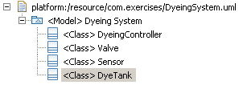
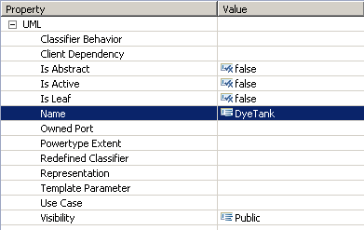
UML Model Editor
File → New... from the main menu
Select UML Model
  Under Example EMF Model Creation Wizards
Provide a name
Set Model Object to Model
Open with UML Model Editor
Use Create Child in the context menu to create model elements

Slide 11
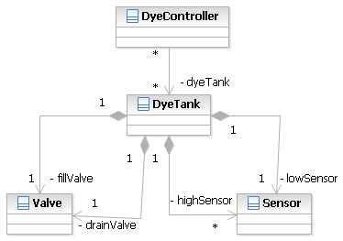
Rational Modeling Platform
Create a UML 2 model graphically
How to
  File → New... from the main menu
  UML Model
    Under Modeling
  Set the model name
Create elements using diagrams and project explorer
Created model can be opened in the UML Model Editor

Slide 12
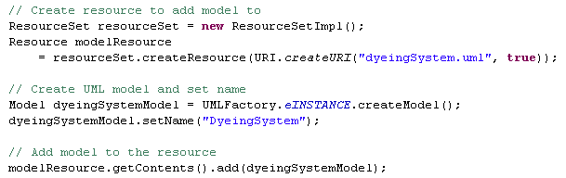
Creating Models in Code
Programmatically create UML models and elements
Use of the standard EMF generated API
EMF reflective capabilities available

Slide 13
More Creating Models in Code
To create UML model elements use
  UMLFactory, or
  For Packages and Models
    createdOwnedClass
    createNestedPackage
    createdOwnedPrimitiveType
    createdOwnedEnumeration
    ...

Slide 14
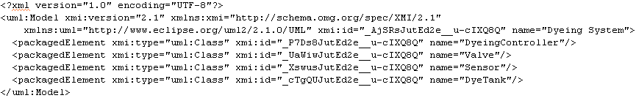
Persistence and Serialization
Models are persisted in an XMI compliant format
Tools built on top of UML2 project should be able to load the model
  Likely won’t maintain diagrams

Slide 15
Summary
In this module we explored
  What the UML2 project is
  How to create UML2 models
    UML Model Editor
    Rational Modeling Platform
    Through code
  Persistence

Slide 16
Extending UML
UML 2 is a general purpose modeling language
  Large and expressive
Often specific domains need to extend it
  Additional concepts
  Restricting metamodel
  Defining domain specific semantics for elements
Different approaches
  Feather weight
    Tagging a model
  Light weight
    UML Profile
  Middle weight
    Extending the metamodel through metaclass specialization

Slide 17
Tagging a model with keywords
Feather weight approach to adding data to a model
  Control code generators
  Categorizing
Create by
  Adding Annotation with source set to UML
  Add details to the Annotation with key being the keyword
Simple API to retrieve keywords
  addKeyword, removeKeyword, and hasKeyword
An Eclipse UML2 project construct
  Not part of the OMG specification
Notes:
Version 0.1, Sept. 2008
Toby McClean, Zeligsoft, 2008

Slide 18
Adding Keywords
Add an EAnnotation to the element
  UML Editor → New Child → EAnnotations → EAnnotation
Set the EAnnotation source attribute
  UML
Add a Details Entry
  UML Editor → New Child → Details Entry
Set the Key attribute
  This is your keyword
Additional keywords are added by create new Details Entry elements

Slide 19
Extending UML with a Profile
UML profiles provide a lightweight approach to extending the UML metamodel
UML profiles can be created in the same way as UML models
  UML Model Editor
  Rational Modeling Platform
  Programmatically
Profiles can be published or registered
  Makes them accessible to others
  Approach used by RSA RTE
Notes:
Version 0.1, Sept. 2008
Toby McClean, Zeligsoft, 2008

Slide 20
UML Profile
Primary construct in a profile is a stereotype
  Extends one or more metaclasses from the UML
  May add information and/or constraints
  May add/or constrain semantics
  May change graphical display
Can be applied to one or more UML models or packages
  Stereotypes applied to model or package and its contents

Slide 21
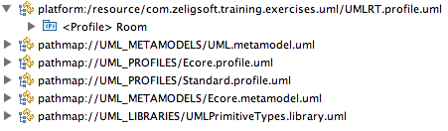
Creating UML Profile
Using UML Model Editor
Select File → New...
Choose UML Model and provide a name
  Under Example EMF Model Creation Wizards
Set Model Object to Profile
Open with UML Model Editor
Select UML Editor → Profile → Reference Metamodel... from the main menu
Choose the UML metamodel

Slide 22
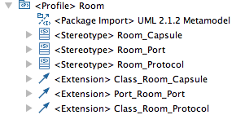
Creating a Stereotype
Open profile in UML Model Editor
Select the profile object and New Child → Owned Stereotype → Stereotype from the context menu
Select the stereotype and UML Editor → Stereotype → Create Extension... from the main menu
Select the UML metaclasses to extend
Creates Extension object in the profile

Slide 23
UML Profile Static vs. Dynamic
Dynamic Profile
  The profile is defined in a model whose model object is a Profile
  No code is generated
  Profile is deployed in a plug-in and registered as a dynamic package
Static Profile
  The profile is defined in a model whose model object is a Profile
  An API for the profile is generated to make it easier to work with the profile in code
  Profile code is deployed in a plug-in and registered as a static package

Slide 24
Deploying a Dynamic Profile
Define the profile
  Converts the profile elements into Ecore representation
  Select the profile element in the model
  Select UML Editor → Profile → Define from main menu
  This stores Ecore representation as an annotation in the profile
Make the project a plug-in project and make sure the profile model is in the build
Register the profile
  org.eclipse.uml2.uml.dynamic_package
Notes:
Version 0.1, Sept. 2008
Toby McClean, Zeligsoft, 2008
Defining the profile
Converts the profile elements into Ecore representation
Stores as annotation in the Profile
In RSx it is done for you
Deploy in a plug-in
Makes distribution easier
Register profile
Different for dynamic and static profiles
RSx has own registration that lets tool find the available profiles

Slide 25
Deploying a Static Profile
Generate the profile code
  Requires creating an EMF representation of the profile
Make the project a plug-in project
  Include the generated code and the profile model
Register the profile
  org.eclipse.uml2.uml.generated_package
Notes:
Version 0.1, Sept. 2008
Toby McClean, Zeligsoft, 2008
Apply the ecore profile
Apply ePackage stereotype to model
Set the following properties
NS URI
NS Prefix
Base Package
Create EMF model from the profile
File --> New --> Other...
Eclipse Modeling Framework --> EMF Model
Next >
Provide name and Next >
Select UML model importer and press next >
Press the Process All button and then change the Operation Bodies option back to Ignore
Load and then Next >
Reference the Ecore and UML models in the bottom pane, select the new package in the top pane
Finish
Tailor Generator Settings
Enable NON-NLS Markers in the All section
Enable Containment Proxies in the Model section
Boolean Flags Field property to eFlags and the Boolean Flags Reserved Bits property to 8 in the Model Feature Defaults
Templates and Merge section
Dynamic Templates property to enabled
Template Directory to /org.eclipse.uml2.tutorial.lw/templates
UML2 section of the properties
Cache Adapter Support enabled
Factory Methods enabled
Pluralized Getters enabled
Invariant Prefix property to check

Slide 26
Generating Profile Code
Apply Ecore profile to the profile object
Apply ePackage stereotype to the profile object
  Set the following ePackage properties
    NS URI
    NS Prefix
    Base Package
Create an EMF model from the profile using the UML model importer
Configure generator settings
Generate Model code for the EMF model
Notes:
Apply the ecore profile
Apply ePackage stereotype to model
Set the following properties
NS URI
NS Prefix
Base Package
Create EMF model from the profile
File --> New --> Other...
Eclipse Modeling Framework --> EMF Model
Next >
Provide name and Next >
Select UML model importer and press next >
Press the Process All button and then change the Operation Bodies option back to Ignore
Load and then Next >
Reference the Ecore and UML models in the bottom pane, select the new package in the top pane
Finish
Tailor Generator Settings
Enable NON-NLS Markers in the All section
Enable Containment Proxies in the Model section
Boolean Flags Field property to eFlags and the Boolean Flags Reserved Bits property to 8 in the Model Feature Defaults
Templates and Merge section
Dynamic Templates property to enabled
Template Directory to /org.eclipse.uml2.tutorial.lw/templates
UML2 section of the properties
Cache Adapter Support enabled
Factory Methods enabled
Pluralized Getters enabled
Invariant Prefix property to check
Version 0.1, Sept. 2008
Toby McClean, Zeligsoft, 2008

Slide 27
Discussion
Examples from your experience?
  Additional information?
  Additional concepts?
Does this impact modeling, validation or generation?

Slide 28
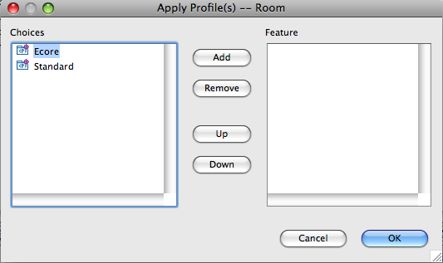
Applying a UML profile
A Profile is applied to a Model, Profile or Package
Open model in UML Model Editor
Select model or package object and UML Editor → Package → Apply Profile... from the main menu
Choose the profiles to apply
Creates a Profile Application object in the package
Notes:
Version 0.1, Sept. 2008
Toby McClean, Zeligsoft, 2008
getStereotypeApplications
getStereotypeApplication(Stereotype)
getRequiredStereotypes
getRequiredStereotype(String)
getAppliedStereotypes
getAppliedStereotype(String)
getAppliedSubstereotype(Stereotype, String)
hasValue(Stereotype, String)
getValue(Stereotype, String)
setValue(Stereotype, String, Object)

Slide 29
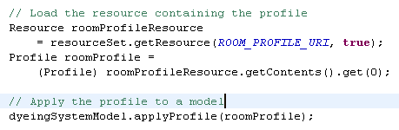
Applying a UML Profile - Code
Implementation details

Slide 30
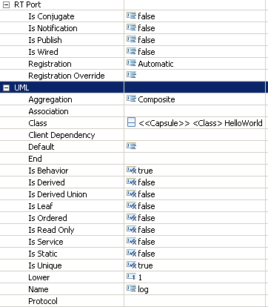
Applying a Stereotype
Stereotypes are applied to elements in a model
  More than one can be applied
  Applicable elements defined by Stereotypes metaclass extensions
  Attributes of Stereotypes can be set in the properties view of the UML Model Editor
Select the element in the editor and UML Editor → Element → Apply Stereotype... from the main menu

Slide 31
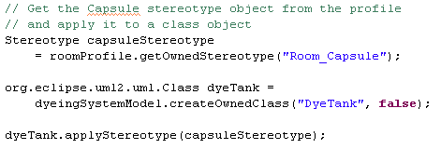
Applying a Stereotype - Code
Implementation details

Slide 32
Working Stereotype Properties
Accessing a stereotype value
Setting a stereotype value
Adding to a stereotype list property
Implementation details

Slide 33
Summary
In this module we explored
  Extending a model with additional information
  Through keywords and profiles
  How to achieve this through model and code

Slide 34
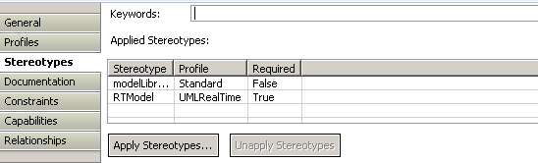
Keywords in RSA-RTE

Slide 35
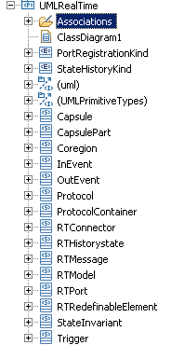
Profiles in RSA-RTE
Profiles are used extensively in RSA-RTE
  Extending/constraining the UML to UML-RT semantics and notation
    UMLRealTime profile
    UMLRealTime model libraries for things like Frame, and Log
  Adding information to model elements to generate code
    C++ support through CPPPropertySets profile
    C++ model libraries for
When a RSA-RTE model is created
  UMLRealTime profile is applied
  CPPPropertySets profile is applied
  RTClasses, RTComponents and CPPPrimitiveDatatypes libraries
Notes:
Version 0.1, Sept. 2008
Toby McClean, Zeligsoft, 2008
UMLRealTime profile - com.ibm.xtools.uml.rt.core
CPPPropertySets - com.ibm.xtools.umldt.rt.cpp.core

Slide 36
Creating Profiles in RSA-RTE
Model the domain
  Concepts, attributes and relationships in a Profile
  Complimentary model libraries
  Constraints - OCL or Java
Publish the Profile
  Helps RSA-RTE with versioning and migration
Register the Profile in a plug-in
  Make it available for RSA-RTE to apply it
Can export to open source UML 2
Notes:
Version 0.1, Sept. 2008
Toby McClean, Zeligsoft, 2008
<extension point="com.ibm.xtools.uml.msl.UMLProfiles">
<UMLProfile id="com.ibm.xtools.umldt.rt.cpp.propertySets" name="CppPropertySets" path="pathmap://CPP_LANGUAGE_PROFILE/CppPropertySets.epx" required="false" visible="true" />
</extension>

Slide 37
Creating Profiles in RSA-RTE
File → New → Other…
Select UML Profile or UML Profile Project…
  Under Modeling → UML Extensibility
Set name and import the UML Primitive Types library
Creates a Profile object that already imports the UML metamodel
Add stereotypes, classes and relationships
Notes:
Version 0.1, Sept. 2008
Toby McClean, Zeligsoft, 2008

Slide 38
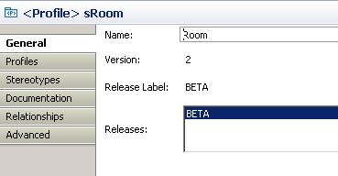
Releasing a Profile
RSA-RTE provides a release capability for profiles
  A released profile is to be additive otherwise backwards compatibility may not work
To release a profile
  Select Release in the context menu of the profile object
  Associate a label with the release
  Be careful how often a profile is released

Slide 39

Publishing a Profile
Publishing a profile makes it available for others to install and use in their RSA-RTE models
To publish
  Make the project a plug-in project
  Add the profile file to the build
  Extend “com.ibm.xtools.uml.msl.UMLProfiles”
    Enables RSM to find the profile
  Publish the plug-in
Notes:
Version 0.1, Sept. 2008
Toby McClean, Zeligsoft, 2008

Slide 40
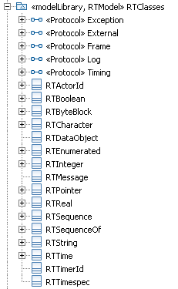
Model Libraries
Model libraries provide a mechanism for publishing a set of model elements for reuse
  e.g. Data types, reusable components
It is a model with the modelLibrary stereotype applied
  modelLibrary is part of the Standard profile
The elements will be read-only in the model that imports the library
Notes:
Version 0.1, Sept. 2008
Toby McClean, Zeligsoft, 2008
<extension name="C++ Libraries" point="com.ibm.xtools.uml.msl.UMLLibraries">
<UMLLibrary id="CppTargetRTSLibrary" name="C++ TargetRTS Library" path="platform:/plugin/com.ibm.xtools.umldt.rt.cpp.core/libraries/RTClasses.emx" required="false" visible="true" />
<UMLLibrary id="CppPrimitiveDataTypesLibrary" name="C++ Primitive Data Types Library" path="platform:/plugin/com.ibm.xtools.umldt.rt.cpp.core/libraries/CppPrimitiveDatatypes.emx" required="false" visible="true" />
<UMLLibrary id="CppRTComponentsLibrary" name="C++ RTComponents Library" path="platform:/plugin/com.ibm.xtools.umldt.rt.cpp.core/libraries/RTComponents.emx" required="false" visible="true" />
</extension>

Slide 41
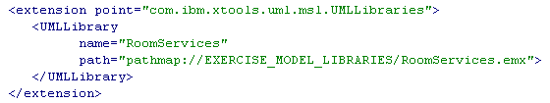
Publishing a Model Library
Publishing a model library makes it available for others to import and use in their RSA-RTE models
To publish
  Make the project a plug-in project
  Add the model file to the build
  Extends com.ibm.xtools.uml.msl.UMLLibraries
    Enables RSM to find the profile
  Publish the plug-in
Notes:
<extension name="C++ Libraries" point="com.ibm.xtools.uml.msl.UMLLibraries">
<UMLLibrary id="CppTargetRTSLibrary" name="C++ TargetRTS Library" path="platform:/plugin/com.ibm.xtools.umldt.rt.cpp.core/libraries/RTClasses.emx" required="false" visible="true" />
<UMLLibrary id="CppPrimitiveDataTypesLibrary" name="C++ Primitive Data Types Library" path="platform:/plugin/com.ibm.xtools.umldt.rt.cpp.core/libraries/CppPrimitiveDatatypes.emx" required="false" visible="true" />
<UMLLibrary id="CppRTComponentsLibrary" name="C++ RTComponents Library" path="platform:/plugin/com.ibm.xtools.umldt.rt.cpp.core/libraries/RTComponents.emx" required="false" visible="true" />
</extension>
Version 0.1, Sept. 2008
Toby McClean, Zeligsoft, 2008

Slide 42
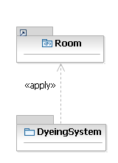
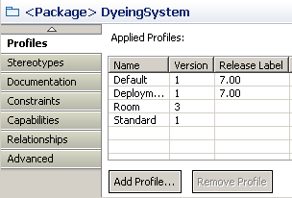
Applying Profiles in RSA-RTE
On a Model or Package “Add Profile…”
Apply Stereotype to Elements in the model
Set attributes of the Stereotype
  Advanced tab
  Stereotype tab
Notes:
Version 0.1, Sept. 2008
Toby McClean, Zeligsoft, 2008

Slide 43
Summary
In this module we explored
  Profiles and RSA-RTE
  How to create, release and publish
  Model Libraries
Notes:
Version 0.1, Sept. 2008
Toby McClean, Zeligsoft, 2008

Slide 44
Discussion
Any RSA-RTE concepts you would add/remove?

Slide 45

Questions

