Slide 1
Eclipse Transformation Technologies
Exploring your model transformation options in Eclipse?
Notes:
Version 0.1, Sept. 2008
Toby McClean, Zeligsoft, 2008

Slide 2
Overview
Introduction to the eclipse transformation techniques
Exercises to get you started
Notes:
Version 0.1, Sept. 2008
Toby McClean, Zeligsoft, 2008

Slide 3
Goals
After this module you will have
  An understanding of the main transformation technologies
  Understand their applicability
  Be able to put simple transformations together

Slide 4
Agenda
Model transformation introduction
Model to model
  Java
  QVT
Model to text
  xPand
  xTend
  JET
oAW
Notes:
Version 0.1, Sept. 2008
Toby McClean, Zeligsoft, 2008

Slide 5
Model Transformation
Model transformation is the creation of one or more target artifacts from one or more source models
Model transformations are used for
  Tool integrations (model interchange through transformation)
  Model refinement, abstraction and refactoring
  Code generation
  Documentation generation and reporting
Notes:
Version 0.1, Sept. 2008
Toby McClean, Zeligsoft, 2008

Slide 6
Model Transformation
Typically we talk about two forms
  Model to model transformations (M2M)
  Model to text transformations (M2T)
Notes:
Version 0.1, Sept. 2008
Toby McClean, Zeligsoft, 2008

Slide 7
M2M Transformations
An M2M transformation creates one or more target models from one or more source models
Classifying M2M transformations
  Horizontal
  Vertical
  Bi-directional
  In place
Notes:
Version 0.1, Sept. 2008
Toby McClean, Zeligsoft, 2008

Slide 8
Eclipse Transformation Technology
Eclipse Technologies
  Java
  M2M Project - QVT, xTend and ATL
RSA-RTE Technologies
  Rational Transformation Engine
Notes:
Version 0.1, Sept. 2008
Toby McClean, Zeligsoft, 2008

Slide 9
Model to Text Transformations
A M2T transformation creates one or more text based artifacts from one or more source model
Typically template based
  Create a template from an example of the desired artifact
M2T consideration
  Often it is best to use M2T with a source model that is dedicated to the transformation
Eclipse technologies
  M2T Project - JET2 and xPand

Slide 10
RSA RTE Transformation Workflow
Lets put this into context, RSA-RTE uses a M2M then M2T to generate code
UML
Model
.cpp
AST
Model
Java
JET
Notes:
Version 0.1, Sept. 2008
Toby McClean, Zeligsoft, 2008

Slide 11
Summary
Introduction to main transformation technologies
Model-to-model
Model-to-text
Usually first do model-to-model, then model-to-text

Slide 12
Discussion
What type of transformations could you imagine?
  Some examples
    Structural, in place
      Capsule-to-class
      Proxies
    Bi-directional
      Linking between system and design
    Analysis
      Walk the model and generate reports
        Dependency, packaging violations

Slide 13
Agenda
Model transformation introduction
Model to model
  Java
  QVT
Model to text
  xPand
  xTend
  JET
oAW
Notes:
Version 0.1, Sept. 2008
Toby McClean, Zeligsoft, 2008

Slide 14
Eclipse Transformation Technologies
Model to Model Transformations

Slide 15
Overview
In this section we will explore the M2M technologies available in Eclipse
The specific technologies are
  Java
  QVT

Slide 16
M2M with Java
The most basic approach to M2M is to use straight Java with the EMF generated API
Transformation writer has full power or a 3GL
  Development tools
  Debugging facilities
MMa
Java
MMb
Transformation written against meta-model
  Executed against instance model
Ma
Mb

Slide 17
Developing a Transformation
Develop the transformation as if you were writing a Java application
Model navigation
  EMF Reflective API
  Metamodel specific API generated by EMF
Transformation rules
  Rule constraints
  Target element construction

Slide 18
Testing Transformations
Traditional Java test techniques
  Hand crafted test framework
  JUnit
Using JUnit
  Automatable
  Repeatable
Source
Transform/Rule
Expected
Input
Load/Create Source
Execute
Compare with expected
Test
Case
Notes:
Source model
Create in code
The source model can be created during the load/create (setup) of the test case
Create source resource
The specific element is loaded from a resource
Loaded element can be manipulated for specific test case
Transform/Rule
The use of JUnit does perscribe the granularity of testing the transformation can be an entire transformat, part of a transformation or a leaf rule
May require configuration of the transformation or rule
Expected element
Created as part of test case
The expected element is encoded in the assertion that the expected element was in fact created
Can be loaded from a resource
Use the compare facilities of EMF or RSA-RTE to ensure that the expected result was produced
Version 0.1, Sept. 2008
Toby McClean, Zeligsoft, 2008

Slide 19
Executing the Transformation
Use workbench Java execution capabilities
  We can use the Run As → Java Application
  We can debug using Debug As → Java Application
  To pass transformation parameter values
    Use command line
    Build a user interface
Integrate with workbench
  Provide an action to invoke from editor and/or view
  Provide a transformation resource with action to execute
Notes:
Java Application execution
The Run As → Java Application works well during development of a transformation or for transformations used as scripts
Difficult to pass information from the workbench to the transformation, often the transformation parameters a hard coded into individual Java Applications
Workbench integration
This is a heavier weight approach that is a tooling approach
Integrates nicely with modeling tools like RSA-RTE
Action
Works well for transformations that only require an element as input and little configuration
Resource with action
This is the approach taken by RSA-RTE, where the configuration of the transformation is stored in a Resource so that it can be edited and re-executed
Very useful when the transformation is extremely configurable
Version 0.1, Sept. 2008
Toby McClean, Zeligsoft, 2008

Slide 20
Integrating with the Workbench
Lets look at adding an action to the UML Model Editor to transform a UML element into a Java abstract syntax model
Contribute an action to the editor’s menu
Implement behavior for the action
Test
  In runtime workbench
Deploy
  Publish the plug-in

Slide 21
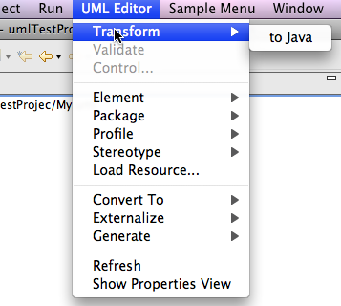
Contribute Action to the Editor
UML Model Editor ID
  org.eclipse.uml2.uml.editor.presentation.UMLEditorID
Menu bar path
  org.eclipse.uml2.umlMenuID
    settings
    actions
    additions
    additions-end
Notes:
Version 0.1, Sept. 2008
Toby McClean, Zeligsoft, 2008

Slide 22
Integrating with RSA-RTE
Contribute an action
  to the Project Explorer context menu
  to the Diagram Editor context menu
Implement action handler
  Implement IEditorActionDelegate
Test
  In runtime workbench
Deploy
  Publish the plug-in
Notes:
Context menu id
org.eclipse.ui.navigator.ProjectExplorer#PopupMenu
org.eclipse.gmf.runtime.diagram.ui.DiagramEditorContextMenu
<visibility>
<and>
<objectState name="isSingleSelection" value="visibility" />
<objectState name="umlType" value="Namespace" />
</and>
</visibility>
<enablement>
Version 0.1, Sept. 2008
Toby McClean, Zeligsoft, 2008

Slide 23
Java Transformation Considerations
Transformation Architecture
  How flexible is it
  Rules – classes vs. methods
  Extensibility
Model merge
Transactions
Traceability must be managed by transformation developer

Slide 24
Summary
In this module we explored
  M2M transformations with Java
  Integrating Java M2M transformations with
    UML Model Editor
    RSA-RTE
  Considerations when implementing M2M with Java

Slide 25
Agenda
Model transformation introduction
Model to model
  Java
  QVT
Model to text
  xPand
  xTend
  JET
oAW
Notes:
Version 0.1, Sept. 2008
Toby McClean, Zeligsoft, 2008

Slide 26
Query/View/Transformation (QVT)
An OMG specification for transforming querying and transforming models
Two languages
  Operational Mapping Language (OML)
    Procedural/Imperative language to mapping and query definition
    Supported in M2M project
  Relational Language
    Declarative language for mapping definition
    Being developed as part of the M2M project

Slide 27
Operational QVT Project (QVTO)
The QVT OML is a sub-project of the M2M project
  http://www.eclipse.org/m2m/
Its goal is to provide an implementation of the MOF 2.0 Query/View/Transformation Specification
  http://www.omg.org/cgi-bin/doc?ptc/2007-07-07
Works out of the box for transforming EMF based models
Notes:
Version 0.1, Sept. 2008
Toby McClean, Zeligsoft, 2008

Slide 28
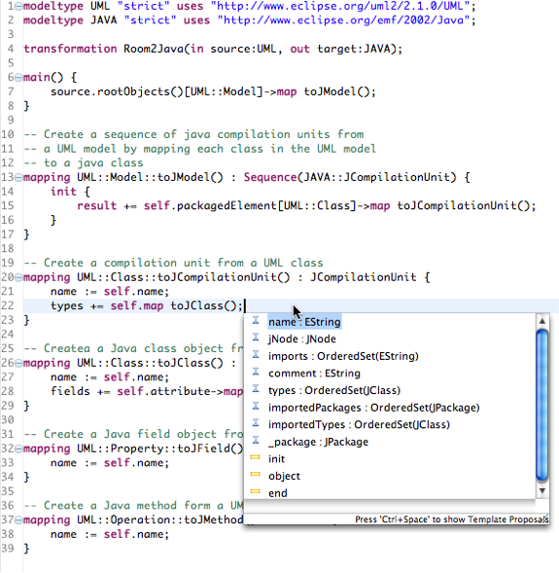
Developing QVTO Transformations
Editor
  Syntax highlighting
  Code completion
Model navigation
  Superset of EssentialOcl (OCL adaptation for EMOF)
  Support for OCL collection operators
Focus on transformation logic
  Execution infrastructure left to the QVTO runtime

Slide 29
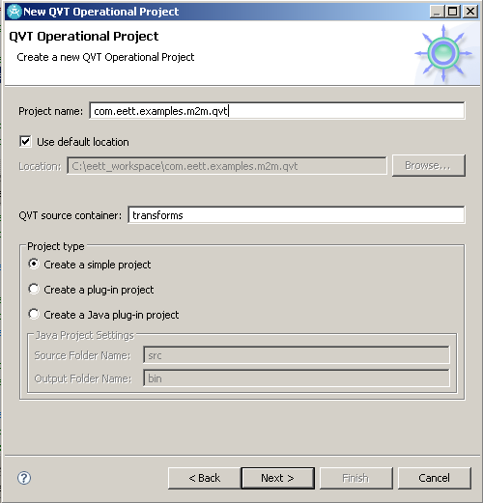
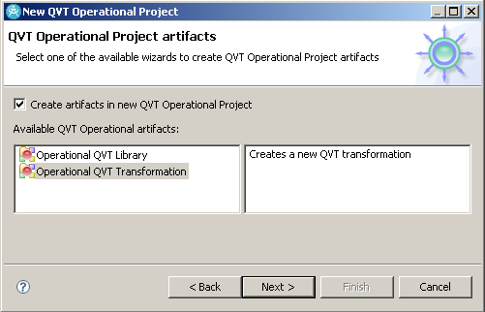
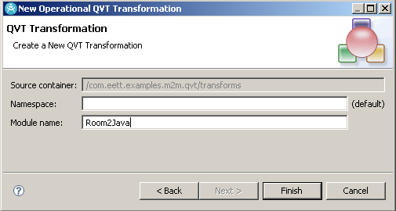
Developing QVTO Transformations

Slide 30
Testing QVTO Transformations
Same approach as Java transforamtions
Traditional Java test techniques
  Hand crafted test framework
  JUnit
Using JUnit
  Automatable
  Repeatable
Notes:
QvtInterpretedTransformation trans = new QvtInterpretedTransformation(transformation);
where transformation is an IFile pointing to the transformation
List<EObject> inputs = new ArrayList<EObject>(inUris.size());
for (URI uri : inUris) {
EObject in = EmfUtil.loadModel(uri);
inputs.add(in);
}
TransformationRunner.In input = new TransformationRunner.In(inputs.toArray(new EObject[inputs.size()]), qvtContext);
TransformationRunner.Out output = null;
try {
output = trans.run(input);
} catch (QvtRuntimeException e) {
TestUtil.logQVTStackTrace(e);
throw e;
}
Version 0.1, Sept. 2008
Toby McClean, Zeligsoft, 2008

Slide 31
Executing QVTO Transformations
The QVTO project integrates with the workbench Run framework
Select the transformation resource in the project explorer
Choose Run As → Run Configurations… from the context menu
Create a new configuration under Operational QVT Interpreter
  The transformation parameters is populated from the transformation module that is specified
  The option to generate a trace file for debugging
  The option to save the configuration for sharing

Slide 32
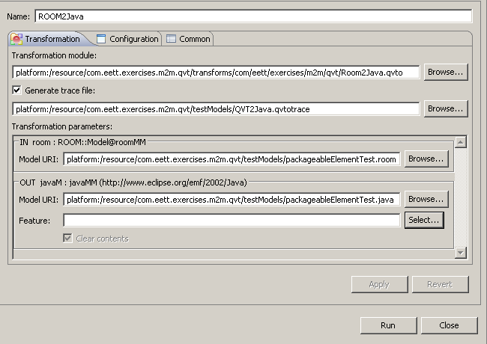

Executing QVTO Transformations

Slide 33
Integrating with the Workbench
Add an action to the workbench
Create a context
Use an interpreted QVT transformation
Grab the input model element from a Resource or editor
Execute the transformation
Display or persist results and trace

Slide 34
QVTO - Transformation
Referring to metamodels
  modeltype keyword
  Use namespace URI used to register metamodel
  modeltype UML uses ‘http://www.eclipse.org/uml2/2.1.0/UML’
Transformation defines source and target metamodels
  in keyword indicates source
  out keyword indicates target
  transformation Design2Implementation(in uml : UML, out UML);
Notes:
Version 0.1, Sept. 2008
Toby McClean, Zeligsoft, 2008

Slide 35
QVTO - Transformation
Source model Ma that conforms to metamodel MMa
Target model Mb that conforms to metamodel MMb
Possible to have multiple sources and targets
MMa
transformation
MMb
conforms to
conforms to
Ma
Mb
transformation mMa2MMb(in ma : Mma, out mb : MMb);

Slide 36
QVTO - Metamodels
Define the parameter types for transformations
Can be explictly referenced by their namespace URI
  UML - http://www.eclipse.org/uml2/2.1.0/UML
  Ecore - http://www.eclipse.org/emf/2002/Ecore
Use Metamodel Explorer view to find URI’s
  Window → Show View → Metamodel Explorer
Syntax
  modeltype <local name> uses ‘<ns uri>’;
  modeltype UML uses ‘http://www.eclipse.org/uml2/2.1.0/UML’;
Notes:
Version 0.1, Sept. 2008
Toby McClean, Zeligsoft, 2008
Metamodel conformance kind can be specified
Effective
(default) structural match based;
indicates a declaration time metamodel, the actual metamodel involved at runtime, typically different versions of logically the same metamodel with compatible changes -> flexibility, high applicability
Strict
model objects must be instance of the exact classes from the referred metamodels, required for XMI serialization
• Restricting conditions on metamodelsa ccepted by transformations
modeltype MMa uses“http://qvtexample/mm/MMa”
where{ self.objectsfOfType(A)->notEmpty() };
• Allows for validation check on input models without executing the transformation, using selfvariable of model type instance (a model)

Slide 37
QVTO - Entry Point
Entry point is explicit and identified by a possibly parameterless mapping with the name main
  One entry point per transformation
  main() {<body>}
Invoked when the transformation is invoked
Abstract transformations do not have an entry point
Example
  mapping main(in rModel:Model, out jModel:JModel)
Implementation details

Slide 38
QVTO - Mapping Rules
A mapping rule
  Applies to specific metaclass
  Has a name that it is referred to by
  May have additional in/out/inout parameters
  Creates/modifies/returns one or more specific metaclasses
    Maybe a collection
Syntax
  mapping (<context type>::)?<name>(<parameters>?)(:<result parameters>)? {<body>}
Example
  mapping UML::Class::capsuleToClass() : UML::Class { ... }
Implementation details
Notes:
Version 0.1, Sept. 2008
Toby McClean, Zeligsoft, 2008

Slide 39
QVTO - Mapping Parameters
Mapping parameters allow additional data/elements to passed into and out of the mapping
Implicit parameters
  self - context of mapping
  result - target of mapping
Direction
  in - object passed in with read-only access
  out - value set by mapping
  inout - object passed in with readwrite access
Syntax
  <direction> <name> : <type>
Example
  in prefix : String
  out elements : Sequence(ModelElement)
Implementation details
Notes:
Version 0.1, Sept. 2008
Toby McClean, Zeligsoft, 2008
the implicit contextual parameter can have a direction of in (default) or inout (needs to be explicitly indicated)
the output parameters always have a direction of out

Slide 40
QVTO - Invoking Mapping
A mapping is invoked on an object whose type complies with the context type of the mapping
Special operation on object whose parameter is a mapping
  <object>.map <mapping with context type>()
  capsule.map capsuleToClass();
    Assuming that capsule is UML::Class
Values can be passed into the mapping
  capsule.map capsuleToClass(true);
Implementation details
Notes:
Version 0.1, Sept. 2008
Toby McClean, Zeligsoft, 2008
* the trace semantics make sure that an object is only transformed once for a given mapping, that is the trace is checked before a mapping is invoked

Slide 41
QVTO - Constraining Mappings
It is possible to restrict when a mapping will execute
  when clause constrains the input parameters that are accepted for the mapping to execute
  ... (:<result parameters>)?(when { <constraint> })?
Example
  mapping uml::Class::class2JClass() : JClass
  when { self.isStereotypedBy(‘Capsule’) }
Two modes of invocation
  Standard .map if the context doesn’t satisfy the when clause then the mapping is not executed and control is returned to the caller
    when clause acts like a guard
  Strict .xmap if the context doesn’t satisfy the when clause then an exception is thrown
    when clause acts like a pre-condition
Implementation details

Slide 42
QVTO - Implementing Mappings
Four sections to the body of a mapping
  init
    variable assignments
    out parameter assignments
  instantiation
    implicitly instantiates out parameters that are null
  population
    updating result parameters
  end
    mapping invocations
    logging, assertions, etc.
Implementation details
Notes:
Version 0.1, Sept. 2008
Toby McClean, Zeligsoft, 2008
init
code to be executed before the instantiation of the declared outputs
section must be explicitly identified with init{}
instantiation
creates all outputs that have a null value following the intialization section
therefore to return an existing object rather than a new, it must be set in the init section
population
code to populate the result parameters
can be explicitly captured population {} or implicit if population keyword left out
end
code to be executed before exiting the mapping
must be explicitly captured with the end {} keyword
example of a mapping invocation would be to update one of the features of an out parameter based on the values of other features

Slide 43
QVTO - Object Construction
To explicitly create an object of a specific type
object keyword
  object <identifier> : <type> { <update slots> }
If the variable (referred to by identifier) is null
  Creates the object
If the variable is not null
  Slots are updated
Trace is created immediately upon object construction
Can be part of an assignment statement
Implementation details
Notes:
Version 0.1, Sept. 2008
Toby McClean, Zeligsoft, 2008
object keyword
object s : Class { name:= ‘Decryptor’; }
in this case s is an existing variable
if s is null than a Class is constructed otherwise it simply updates the slots of s
not necessary in the population section for the implicit result object
object result : Class { name := ‘Decryptor’; }
name := ‘Decryptor’;
the trace associated with the execution of a mapping is created immediately upon object construction and thus can be used in the inner mappings of the population section
it is possible to construct an object as part of an assignment statement
features += object Operation { name := ‘decrypt’; params := <call a mapping to create>; }

Slide 44
QVTO – Object Construction
No population
  object jClass : JClass{}
With population
  object jClass : JClass{ name:= uClass.name; }
As part of an assignment
  features += object JOperation{ name:= ‘log’; }
Implementation details

Slide 45
QVTO - Constructors
Special type of operation that creates instances of a specific type
  Parameters used to populate the object
Useful for simplifying transformation logic
Invoked with the new keyword
Syntax
constructor <type>::<name>(<parameters>){<body>}
Implementation details
Notes:
Version 0.1, Sept. 2008
Toby McClean, Zeligsoft, 2008
an operation that creates instances of a specific type
constructor UML::Class::Class(name : String, attNames : Sequence(String), opNames : Sequence(String) { body }
use with the new keyword
self.classes->new(c) Class(c.name, ..., ...) ;
use c in this case to refer to the current element in the collection
new Class(‘Foo’, ..., ...);

Slide 46
QVTO - Constructors
Constructor example
  constructor JavaMM::JClass::JClass(uName:String, attributes :
  Sequence(UML::Property)) {
  name := uName;
  fields += attNames.new(an) JField(an.name);
  }
Using a constructor
  types +=
  packagedElement[UML::Class].new(uClass)
  JClass(uClass.name, uClass.attribute);
Implementation details

Slide 47
QVTO - Helpers
A special type of operation that calculates a result from one or more source objects
  Similar to an operation in Java
  May have side effects on parameters
  Requires explicit return
Use for simplifying transformations
  Encapsulate complex navigations
Query helper
  A helper that has no side effects on the parameters
  Can be defined on primitive types to extend their capabilities
Implementation details
Notes:
Version 0.1, Sept. 2008
Toby McClean, Zeligsoft, 2008
helper is
operation that performs a computation on one or more source objects and provides a result
a ordered list of expressions that are executed in sequence
may have side effects on the parameters
return is used to exit immediately
query
helper that has no side effects on the parameters
can be defined on primitive types
query String::addUnderscores() : String = “_”.concat(self).concat(“_”);
Simplify
complex navigations can be performed without the restriction of a unique expression

Slide 48
QVTO - Helpers
Helper example
  helper umlPrimitiveToJava(UML::PrimitiveType uType) : String {
  return if uType.name = ‘String’ then ‘String’ else
  if uType.name = ‘Boolean’ then ‘boolean’ else
  if uType.name = ‘Integer’ then ‘int’ else
  uType.name
  endif
  endif
  endif
  }
Query example
  query UML::Element::isTaggedWith(in tag: String) : Boolean {
  return self.hasKeyword(tag);
  }
Implementation details

Slide 49
QVTO - Intermediate Data
Able to define classes and properties within a transformation
Intermediate class
  Local to the transformation it is defined in
  Helps defined data to be stored during a transformation
  Currently not supported
Intermediate property
  Local to the transformation it is defined in
  Instance of metaclass or intermediate class
  Use to extend metamodel
    Can be attached to a specific type, appears as though it is a property of that type
Implementation details
Notes:
Version 0.1, Sept. 2008
Toby McClean, Zeligsoft, 2008
intermediate classes
a class that is defined within the transformation and can be used to store data used throughout the transformation
intermediate class LeafAttribute { name : String; kind:String; attr:Attribute}
intermediate properties
an instance to store intermediate objects
can be attached to a specific type and acts as though it is a property of that type
intermediate property Class::leafAttributes : Sequence(LeafAttribute);
manipulated as ordinary properties in the context of the metaclass
do not exist outside the scope of the transformation that defines it

Slide 50
QVTO – Intermediate Data
Intermediate class syntax
  intermediate class <name> {<attributes>}
Intermediate class example
  intermediate class LeafAttribute
  { name : String; kind:String; attr:Attribute}
Intermediate property syntax
  intermediate property <name> : <type>;
Intermediate property example
  intermediate property UMLClass::allAttributes :
  Sequence(UML::Property);
Implementation details

Slide 51
QVTO - Resolving Objects
Transformations often perform multiple passes in order to resolve cross references
  Referenced objects may not exist yet
Facilities are provided to reduce the number of passes, by using the trace records that QVT creates
  Resolve target from source and source from target
  Resolve using a specific mapping rule
  Specify number of objects to resolve
  Defer resolution to end of the transformation
  Filter the scope of objects to resolve
Implementation details
Notes:
Version 0.1, Sept. 2008
Toby McClean, Zeligsoft, 2008
Model transformations often involve multiple passes in order to be able to resolve a cross referencing
QVT implicitly uses the trace records to be able to do the resolution
Direction
resolve
invresolve - performs the inverse, looks for objects that were responsible for generating the context object
Specific mapping
resolveIn - looks for objects that were created by a specific mapping
Multiplicity
resolveone - single Object
resolve - sequence of Objects
Time
resolve... - resolve now
.late resolve... - deferred resolve to the end of the entry operation
Filters and conditions
resolve...(name=‘Joe’)
resolve...(<type>)
resolve...(<constraint>)
Late resolution
assignment is not executed
stores data to perform assignment at a latter time
executed at the end of the transformation in the order that they were come across in the transformations execution

Slide 52
QVTO – Resolving Objects
Deferred resolution example
  protocol.late resolveoneIn(JClass);
Specific mapping
  protocol.resolveoneIn(
  Protocol::protocol2JClass, JClass);
Filtered resolution example
  protocol.resolveone (name = ‘Control’);
  protocol.resolveone (p : JClass |
  p.name = ‘Control’);
Resolve multiple objects example
    protocol.resolve (JClass);
Implementation details

Slide 53
QVTO – Transformation reuse
Composition
  Explicit instantiation and invocation
  transformation ROOM2JavaExt(in room : ROOM, out java : JAVA)
  access transformation ROOM2Java(in ROOM, out JAVA)
  main() {
  var base := new ROOM2Java(room, java);
  base.transform();
  }
Extension
  Implicit instantiation
  Ability to override a mapping in the extended transformation, which will be used in place of the mapping int he extended transformation
  transformation ROOM2JavaExt(in room : ROOM, out java : JAVA)
  extends transformation ROOM2Java(in ROOM, out JAVA)
Implementation details
Notes:
Version 0.1, Sept. 2008
Toby McClean, Zeligsoft, 2008
access
behaves as a traditional package import
extends
behaves as a combination of package import and inheritance
possible to override the mappings imported
execution of in place transformation
<transformation instance>->transform();
instantiating transformations
new <transformation>(<parameters);

Slide 54
QVTO – Mapping Reuse
Inheritance
  Inherited mapping is executed after the init section
  mapping A::AtoSubB() : SubTypeofB inherits A::AtoB {…}
    Executes init of AtoSubB then AtoB then the rest of AtoSubB
Merge
  List of mappings executed in sequence after end section
  mapping A::AtoB() : B
  merges A::toSuperB1, A::toSuperB2 {}
    Executes AtoB then toSuperB1, then toSuperB2
Parameters of inherited/merged mappings must match
Implementation details
Notes:
Version 0.1, Sept. 2008
Toby McClean, Zeligsoft, 2008
mapping reuse
inheritance
the inherited mapping is executed after the intialization section of the inheriting mapping
merge
the ordered list of mappings is executed in sequence after the end section
it will not be executed if the when condition is not satisfied
the complimentary mappings parameters must comply with the base (inheriting or base of merge)

Slide 55
QVTO - Disjuncts
An ordered list of mappings
  First mapping in the list whose guard (type and when clause) is satisfied is executed
  Null is returned if no mapping in the list is executed
Example
mapping PackageableElement::roomElement2JCompilationUnit()
: JCompilationUnit
disjuncts Actor::actor2JCompilationUnit,
Protocol::protocol2JCompilationUnit {
}
Implementation details
Notes:
Version 0.1, Sept. 2008
Toby McClean, Zeligsoft, 2008
an ordered list of mappings where the first mapping in the list whose guard (type and when clause) is satisfied
null is returned if no mapping in the list is executed

Slide 56
QVTO - Control
while loop
  execute a block until a condition is false
foreach
  iterate over a block
  can add filter to the iterator
while and foreach support
  break
  continue
if-then-else
  if(<cond>){<block>}
  elif(<cond>){<block>}
  else{<block>}
Implementation details
Notes:
Version 0.1, Sept. 2008
Toby McClean, Zeligsoft, 2008
compute
a block of expressions that returns variables listed in the compute
compute(v:T := initExp) body;
variables defined in outer scope are freely accessed and changed
while(v; cond) body is shorthand for compute(v) while(cond) body;
if-then-else construct
if(cond) {} elif(cond) {} else{}

Slide 57
QVTO – IF Example
init {
result := object JClass{};
if(self.isStereotypedBy(‘Capsule’) then {
result.name := self.name + ‘C’;
} else {
result.name := self.name + ‘P’;
}endif;
}

Slide 58
QVTO – FOREACH Example
init {
…
self.property->foreach(p | p.isStereotypedBy(‘Port’)) {
result.member += object JField{ name:= p.name; };
}
range(1,5)->forEach(i){…}
}
Notes:
foreach - iterate over a block expression and make an optional filter on elements
self.ownedElement->forEach(i | i.isKindOf(Actor)) {...}
range(2, 8)->forEach(i){}
break and continue are available in foreach and while loops
Version 0.1, Sept. 2008
Toby McClean, Zeligsoft, 2008

Slide 59
QVTO - More than 1 Target Model
When multiple target models are specified, need to be able to indicate which one a model is instantiated in
  object <type>@<target model>{}
  mapping <type>::<name> : <type>@<target model> {}
Implementation details
Notes:
Version 0.1, Sept. 2008
Toby McClean, Zeligsoft, 2008
the target models can be referred to by indicating them when objects are created (explicitly indicating model in which it is instantiated)
object B@<target model> {};
mapping A::AtoB() : B@<target model> {}
may move because of containment relationships

Slide 60
QVTO - Libraries
A QVTO library
  contains definitions of specific types
  contains queries, constructors, and mappings
A library must explicitly included
  By extending
  By accessing
Blackboxing
  Defining a library in a language other than QVT
Implementation details
Notes:
Version 0.1, Sept. 2008
Toby McClean, Zeligsoft, 2008
contains definitions that can be reused by transformations
specific types
operations - queries and mappings
libraries have to be explicitly included
extends
libraries can be external, that is implemented in a language other than QVT
access

Slide 61
QVTO - Configuration Properties
Provided the ability to pass additional information into the transformation
Accessed in the transformation logic as if they are variables
Syntax
  configuration property <name> : <type>;
Example
  configuration property useGenerics : Boolean;
Implementation details
Notes:
Version 0.1, Sept. 2008
Toby McClean, Zeligsoft, 2008
configuration property <name> : <type>;

Slide 62
QVTO - Logging
Transformations can log messages to the execution environment
log(<message>, <data>, <log level>);
  Message - the message to the users
  Data - an optional parameter that is the model element to be associated with the message
  Log level - an integer indicating logging level that can be be used to filter message significance
Implementation details
Notes:
Version 0.1, Sept. 2008
Toby McClean, Zeligsoft, 2008

Slide 63
QVTO - Working with Profiles
QVTO provides no special operators for working with UML2 profiles
Transformations and mappings use the API defined in the UML2 metamodel
A library can be built to simplify the UML2 stereotype API
Example
  query UML::Element::isStereotypedBy(in qualifiedName : String) : Boolean {
  return self.getAppliedStereotype(qualifiedName) <> null;
  }
Implementation details
Notes:
Version 0.1, Sept. 2008
Toby McClean, Zeligsoft, 2008
QVT doesn't understand profiles because it is EMOF-based, not MOF-based. Why oh why did they do that?

Slide 64
QVTO - Extensions
Blackbox libraries are defined through the org.eclipse.m2m.qvt.oml.ocl.libraries extension point
Must have a static class Metainfo
  specifies the parameters of the transformation
Enables QVTO to leverage the power of a 3GL like Java
Implementation details
Notes:
Version 0.1, Sept. 2008
Toby McClean, Zeligsoft, 2008
<extension point="org.eclipse.m2m.qvt.oml.ocl.libraries">
<library class="org.eclipse.m2m.tests.qvt.oml.TestBlackboxLibrary" id="TestBlackboxLibrary">
<inMetamodel uri="http://www.eclipse.org/emf/2002/Ecore"/>
<outMetamodel uri="http://www.eclipse.org/emf/2002/Ecore"/>
</library>
</extension>
package org.eclipse.m2m.tests.qvt.oml;
import java.util.Collections;
import java.util.Set;
import org.eclipse.emf.ecore.ENamedElement;
public class TestBlackboxLibrary {
public Set<ENamedElement> asRenamedSetSingleton(Object arg, String newName) {
if(arg instanceof ENamedElement) {
ENamedElement namedElement = (ENamedElement) arg;
namedElement.setName(newName);
return Collections.singleton(namedElement);
}
return Collections.emptySet();
}
/**
* Metainfo for the native methods should be accessible throu the static
* methods of inner class <code>Metainfo</code> with the same signature
* ant <code>String[]</code> return type. Returned array should contains
* string representation of OCL classifiers:
*
* array[0] - Context classifier
* array[n] - Classifier corresponds to the n-th operation parameter
* array[n+1] - Return type classifier
*/
public static class Metainfo {
/**
* array[0] - Context classifier
* array[n] - Classifier corresponds to the n-th operation parameter
* array[n+1] - Return type classifier
*/
private static final String[] RENAMED_SET_SINGLETON = new String[] {
"oclstdlib::OclVoid", // Void context -> module owned (context-less) operation
// imported library module is the implicit source object of the call
"oclstdlib::OclAny", // your argument1
"oclstdlib::String", // your argument2
"Set(ecore::ENamedElement)" // return type
};
public static final String[] asRenamedSetSingleton(Object arg, String newName) {
return RENAMED_SET_SINGLETON;
}
}
}

Slide 65
QVTO - Programatically Invoking
URI transformation =
URI.createURI("platform:/resource/com.eett.exercises.m2m.qvt/transforms/Room2Java.qvto");
IFile qvtFile = getIFile(transformation);
IContext qvtContext = new Context();
QvtInterpretedTransformation trans =
new QvtInterpretedTransformation(qvtFile);
EObject inputModel =
getInput(
URI.createURI("platform:/resource/com.eett.exercises.m2m.qvt/testModels/packageableElementTest.room"));
EObject[] inputs = {inputModel};
TransformationRunner.In input =
new TransformationRunner.In(inputs, qvtContext);
TransformationRunner.Out output = null;
try {
output = trans.run(input);
} catch (MdaException e) {
out.println("Error running transformation!");
out.println(e.getMessage());
}
Notes:
Version 0.1, Sept. 2008
Toby McClean, Zeligsoft, 2008
QvtInterpretedTransformation
QvtoTransformationHelper

Slide 66
Summary
In this module we explored
  QVT mappings
  Invoking QVT
  Details on QVT usage

Slide 67
Agenda
Model transformation introduction
Model to model
  Java
  QVT
Model to text
  xPand
  xTend
  JET
oAW
Notes:
Version 0.1, Sept. 2008
Toby McClean, Zeligsoft, 2008

Slide 68
Eclipse Transformation Technologies
M2T with xPand

Slide 69
xPand Overview
The M2T language from the openArchitectureWare toolkit
xPand has been adapted and used by the GMF project for its generators
Graduated to become a sub-project of the M2T project with MDT
  Integrating some of changes made by GMF
It is a non-standardized declarative template based language
Notes:
Version 0.1, Sept. 2008
Toby McClean, Zeligsoft, 2008
template language for specifying textual output
Templates are stored in files with the extension .xpt. Template files must reside on the Java classpath of the generator process.
Names of properties, templates, namespaces etc. must only contain letters, numbers and underscores.
A template file consists of any number of IMPORT statements, followed by any number of EXTENSION statements, followed by one or more DEFINE blocks (called definitions)

Slide 70
xPand Highlights
Supports template polymorphism
Extensible with the xTend language
Support for aspect oriented techniques
Editor with syntax highlighting and code completion support
  Metamodel aware
  Extension aware
Debugger
Notes:
Version 0.1, Sept. 2008
Toby McClean, Zeligsoft, 2008

Slide 71
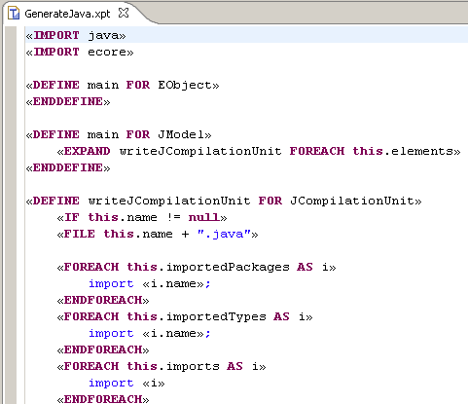
Developing xPand Transformations
Editor
  Syntax highlighting
  Code completion
Model navigation
  Java based syntax for model navigation
  Has operators for working with collections
Focus on transformation logic
  Execution infrastructure left to the xPand runtime

Slide 72
Executing an xPand Transformation
Using an oAW workflow
  More about workflows later
  Can use integration with the Run as... or Debug as... oAW workflow
Write a Java application
  Call the transformation explicitly in code
    Use the XPandFacade class
  Use the Run as... or Debug as... Java Application

Slide 73
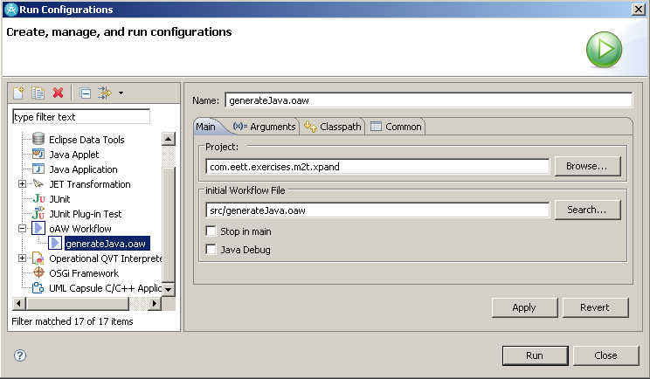
Executing an xPand Transformation

Slide 74
Integrating with Workbench
Contribute an action to the editor's menu
  Implement the action handler
    Call the workflow passing in the selected element as the source
Alternative is append to an existing action
  e.g. the ROOM to Java transformation
Test
  In runtime workbench
Deploy
  Publish the plug-in

Slide 75
Integrating with RSA-RTE
Contribute an action
  to the Project Explorer context menu
  to the Diagram Editor context menu
Implement action handler
  Class that implements IEditorActionDelegate
Test
  In runtime workbench
Deploy
  Publish the plug-in

Slide 76
xPand - Metamodels
Define the types used in transformation
  Use fully qualified names
  Use unqualified names for imported metamodels
Referenced through
  namespace
Syntax
  «IMPORT <namespace of metamodel>»
Example
  «DEFINE write FOR java::JClass»
  «IMPORT java»
  …
  «DEFINE write FOR JClass»
Notes:
Version 0.1, Sept. 2008
Toby McClean, Zeligsoft, 2008
If you are tired of always typing the fully qualified names of your types and definitions, you can import a namespace using the IMPORT statement.
«IMPORT meta::model»
This one imports the namespace meta::model. If your template contains such a statement, you can use the unqualified names of all types and template files contained in that namespace. This is similar to a Java import statement import meta.model.*.

Slide 77
xPand - Extensions
xPand has a supporting language xTend for specifying extensions
  Additional features for metamodel types
  Additional helper functionality
Extensions with xTend
  xTend language which can define blackbox functions that are implemented in Java
Found on the classpath of the xPand template
  Imported by «EXTENSION com::zeligsoft::exercises::room::xpand::RoomUtils»
Appear as though they are part of the meta type
Notes:
Version 0.1, Sept. 2008
Toby McClean, Zeligsoft, 2008
Metamodels are typically described in a structural way (graphical, or hierarchical, etc.) . A shortcoming of this is that it is difficult to specify additional behaviour (query operations, derived properties, etc.). Also, it is a good idea not to pollute the metamodel with target platform specific information (e.g. Java type names, packages, getter and setter names, etc.).
Extensions provide a flexible and convenient way of defining additional features of metaclasses. You do this by using the Extend language. (See the corresponding reference documentation for details)
An EXTENSION import points to the Xtend file containing the required extensions:
«EXTENSION my::ExtensionFile»
Note that extension files have to reside on the Java classpath, too. Therefore, they use the same namespace mechanism (and syntax) as types and template files.

Slide 78
xPand - Templates
An xPand template consists of
  Referenced metamodels
  Imported extensions
  Set of DEFINE blocks
DEFINE block
  name
  metamodel class for which template is defined
  comma separated parameter list
Syntax
  «DEFINE templateName(formalParameterList) FOR MetaClass»
  a sequence of statements
  «ENDDEFINE»
Notes:
Version 0.1, Sept. 2008
Toby McClean, Zeligsoft, 2008
The central concept of Xpand is the DEFINE block, also called a template. This is the smallest identifiable unit in a template file. The tag consists of a name, an optional comma-separated parameter list, as well as the name of the metamodel class for which the template is defined.
«DEFINE templateName(formalParameterList) FOR MetaClass»
a sequence of statements
«ENDDEFINE»
To some extent, templates can be seen as special methods of the metaclass – there is always an implicit this parameter which can be used to address the "underlying" model element; in our example above, this model element is "MetaClass".
As in Java, a formal parameter list entry consists of the type followed by the name of that parameter.
The body of a template can contain a sequence of other statements including any text.
A full parametric polymorphism is available for templates. If there are two templates with the same name that are defined for two metaclasses which inherit from the same superclass, Xpand will use the corresponding subclass template, in case the template is called for the superclass. Vice versa, the template of the superclass would be used in case a subclass template is not available. Note that this not only works for the target type, but for all parameters. Technically, the target type is handled as the first parameter.

Slide 79
xPand – Templates Example
«DEFINE writeJCompilationUnit FOR JCompilationUnit»
«IF this.name != null»
«FILE this.name + ".java"»
«REM»
The imports required by this compilation unit that
may be packages, types or freeform
«ENDREM»
«FOREACH this.importedPackages AS i»
import «i.name».*;
«ENDFOREACH»
«FOREACH this.importedTypes AS i»
import «i.name»;
«ENDFOREACH»
«FOREACH this.imports AS i»
import «i»;
«ENDFOREACH»
Implementation details

Slide 80
xPand – Template Example (2)
«REM»
Write out the source for each of the classes in the
compilation uni
«ENDREM»
«EXPAND writeJClass FOREACH this.types»
«ENDFILE»
«ENDIF»
«ENDDEFINE»
Implementation details

Slide 81
xPand - Output
The output control structure in xPand is FILE which defines a target file to write the contents of the block to
Outlets can be defined a workflow and referenced
  Workflow
    <outlet path='main/src-gen'/> -- default
    <outlet name='TO_SRC' path='main/src' overwrite='false'/>
  «FILE 'test/note.txt’»# this goes to the default outlet«ENDFILE»
  «FILE 'test/note.txt' TO_SRC»# this goes to the TO_SRC outlet«ENDFILE»
Implementation details
Notes:
Version 0.1, Sept. 2008
Toby McClean, Zeligsoft, 2008
The FILE statement redirects the output generated from its body statements to the specified target.
«FILE expression [outletName]»
a sequence of statements
«ENDFILE»
The target is a file in the file system whose name is specified by the expression (relative to the specified target directory for that generator run). The expression for the target specification can be a concatenation (using the + operator). Additionally, you can specify an identifier (a legal Java identifier) for the name of the outlet. (See the configuration section for a description of outlets).
The body of a FILE statement can contain any other statements.
Output configuration
The second mandatory configuration is the specification of so called outlets (a concept borrowed from AndroMDA). Outlets are responsible for writing the generated files to disk . Example:
<component class="oaw.xpand2.Generator2">
...
<outlet path='main/src-gen'/>
<outlet name='TO_SRC' path='main/src' overwrite='false'/>
...
</component>
In the example there are two outlets configured. The first one has no name and is therefore handled as the default outlet. Default outlets are triggered by omitting an outlet name:
«FILE 'test/note.txt'»
# this goes to the default outlet
«ENDFILE»
The configured base path is 'main/src-gen', so the file from above would go to 'main/src-gen/test/note.txt'.
The second outlet has a name ('TO_SRC') specified. Additionally the flag overwrite is set to false (defaults to true). The following Xpand fragment
«FILE 'test/note.txt' TO_SRC»
# this goes to the TO_SRC outlet
«ENDFILE»
would cause the generator to write the contents to 'main/src/test/note.txt' if the file does not already exist (the overwrite flag).
Another option called append (defaults to false) causes the generator to append the generated text to an existing file. If overwrite is set to false this flag has no effect.

Slide 82
xPand - Invoking a Template
The xPand language uses EXPAND to invoke a template
  «EXPAND definitionName [(parameterList)]
  [FOR expression | FOREACH expression [SEPARATOR expression] ]»
FOR
  Invokes the template on the specified element
FOREACH
  Invokes the template on each element in the collection
SEPERATOR
  Specifies an optional delimiter output between each invocation
Omitting FOR\FOREACH invokes with FOR this
Implementation details
Notes:
Version 0.1, Sept. 2008
Toby McClean, Zeligsoft, 2008
The EXPAND statement "expands" another DEFINE block (in a separate variable context), inserts its output at the current location and continues with the next statement. This is similar in concept to a subroutine call.
«EXPAND definitionName [(parameterList)]
[FOR expression | FOREACH expression [SEPARATOR expression] ]»
The various alternative syntaxes are explained below.
If FOR or FOREACH is omitted the other template is called FOR this.
«EXPAND TemplateFile::definitionName»
equals
«EXPAND TemplateFile::definitionName FOR this»
If FOR is specified, the definition is executed for the result of the target expression.
«EXPAND myDef FOR entity»
If FOREACH is specified, the target expression must evaluate to a collection type. In this case, the specified definition is executed for each element of that collection.
«EXPAND myDef FOREACH entity.allAttributes»
Specifying a Separator
If a definition is to be expanded FOREACH element of the target expression it is possible to specify a SEPARATOR expression:
«EXPAND paramTypeAndName FOREACH params SEPARATOR ','»
The result of the separator expression will be written to the output between each evaluation of the target definition (not after each one, but rather only in between two elements. This comes in handy for things such as comma-separated parameter lists).
An EvaluationException will be thrown if the specified target expression cannot be evaluated to an existing element of the instantiated model or no suitable DEFINE block can be found.

Slide 83
xPand – Invoking a Template
Invocation finds a template than matches the name specified and picks the most specific type match
  Polymorphic behaviour
Implementation details

Slide 84
xPand – Invoking Example
Implicit element
Iterate over elements
Iterate over elements
«DEFINE writeJCompilationUnit FOR JCompilationUnit»
«EXPAND writePackage»
«ENDDEFINE»
«DEFINE writeJField FOR JField»
«EXPAND writeFieldType FOR this.type»
«ENDDEFINE»
«DEFINE main FOR JModel»
«EXPAND writeJCompilationUnit FOREACH this.elements»
«ENDDEFINE»
Implementation details

Slide 85
xPand - Control
LET block
  the value of the expression is bound to the specified variable
  only available inside the block
IF, ELSEIF, ELSE block
  traditional if construct from programming languages
FOREACH
  execute the contents for each element in a collection
ERROR
  aborts evaluation with the specified message
Implementation details
Notes:
Version 0.1, Sept. 2008
Toby McClean, Zeligsoft, 2008
ERROR
The ERROR statement aborts the evaluation of the templates by throwing an XpandException with the specified message.
«ERROR expression»
Note that you should use this facility very sparingly, since it is better practice to check for invalid models using constraints on the metamodel, and not in the templates.

Slide 86
xPand - LET
«LET jClass.package.name + ‘.’ + jClass.name AS qualifiedName»
/**
* The fully qualified name of the class is «qualifiedName»
**/
«ENDLET»
Implementation details
Notes:
LET
LET lets you specify local variables:
«LET expression AS variableName»
a sequence of statements
«ENDLET»
During the expansion of the body of the LET block, the value of the expression is bound to the specified variable. Note that the expression will only be evaluated once, independent from the number of usages of the variable within the LET block. Example:
«LET packageName + "." + className AS fqn»
the fully qualified name is: «fqn»;
«ENDLET»
Version 0.1, Sept. 2008
Toby McClean, Zeligsoft, 2008

Slide 87
xPand – IF, ELSEIF, ELSE
«REM»Output the return type for the operation
«ENDREM»
«IF jOperation.type != null»
«jOperation.type.name»
«ELSE»
void
«ENDIF»
Implementation details
Notes:
IF
The IF statement supports conditional expansion. Any number of ELSEIF statements are allowed. The ELSE block is optional. Every IF statement must be closed with an ENDIF. The body of an IF block can contain any other statement, specifically, IF statements may be nested.
«IF expression»
a sequence of statements
[ «ELSEIF expression» ]
a sequence of statements ]
[ «ELSE»
a sequence of statements ]
«ENDIF»
Version 0.1, Sept. 2008
Toby McClean, Zeligsoft, 2008

Slide 88
xPand - FOREACH
«FOREACH jClass.member AS jMember»
«IF jMember.metatype == JField»
//Output for a Java field
«ELSEIF jMember.metatype == JOperation»
//Output for a Java operation
«ENDIF»
«ENDFOREACH»
Implementation details
Notes:
This statement expands the body of the FOREACH block for each element of the target collection that results from the expression. The current element is bound to a variable with the specified name in the current context.
«FOREACH expression AS variableName [ITERATOR iterName] [SEPARATOR expression]»
a sequence of statements using variableName to access the
current element of the iteration
«ENDFOREACH»
The body of a FOREACH block can contain any other statements; specifically FOREACH statements may be nested. If ITERATOR name is specified, an object of the type xpand2::Iterator (see API doc for details) is accessible using the specified name. The SEPARATOR expression works in the same way as the one for EXPAND.
Version 0.1, Sept. 2008
Toby McClean, Zeligsoft, 2008

Slide 89
Summary
In this module we explored
  xPand transformations
  Invoking xPand
  xPandsyntax

Slide 90
Agenda
Model transformation introduction
Model to model
  Java
  QVT
Model to text
  xPand
  xTend
  JET
oAW
Notes:
Version 0.1, Sept. 2008
Toby McClean, Zeligsoft, 2008

Slide 91
xTend Overview
A language to
  Define libraries of independent operations
  Define non-invasive metamodel extensions
Operations and extensions can be defined
  Using xTend expressions
  Using Java (blackboxing)
Can be called
  Directly from a workflow
  From within an xPand transformation
Notes:
Version 0.1, Sept. 2008
Toby McClean, Zeligsoft, 2008
This language provides the possibility to define rich libraries of independent operations and no-invasive metamodel extensions based on either Java methods or oAW expressions. Those libraries can be referenced from all other textual languages, that are based on the expressions framework.
An extend file must reside in the Java class path of the used execution context. Additionally it is file extension must be *.ext.

Slide 92
xTend Example
import java;
import org::eclipse::emf::java;
String qualifiedName(JClass jClass) :
jClass.package.name + "." + jClass.name;
String javaFileName(JCompilationUnit unit) :
JAVA com.eett.exercises.m2t.GenerateJava.javaFileName
(org.eclipse.emf.java.JCompilationUnit);
Implementation details

Slide 93
Summary
In this module we have covered
  A short introduction to xTend

Slide 94
Agenda
Model transformation introduction
Model to model
  Java
  QVT
Model to text
  xPand
  xTend
  JET
oAW
Notes:
Version 0.1, Sept. 2008
Toby McClean, Zeligsoft, 2008

Slide 95
JET Overview
Original Eclipse M2T technology
  Language for specifying templates to output text based artifacts
Works with XML content and EMF based models
  Including UML2 models
A declarative language
  JSP based syntax
  Extensive use of XPath for model nagivation
JET templates are automatically compiled to Java
Used by
  Eclipse EMF code generation
  RSA-RTE intermediate language model to text transformation
Notes:
Version 0.1, Sept. 2008
Toby McClean, Zeligsoft, 2008

Slide 96
Developing a JET Transformation
JET transformations can be created by
  Adding a JET transformation to an existing project
  Creating a JET transformation project
Editor
  Syntax highlighting
Model navigation
  XPath
Focus on transformation logic
  Execution infrastructure left to the compiled JET code

Slide 97
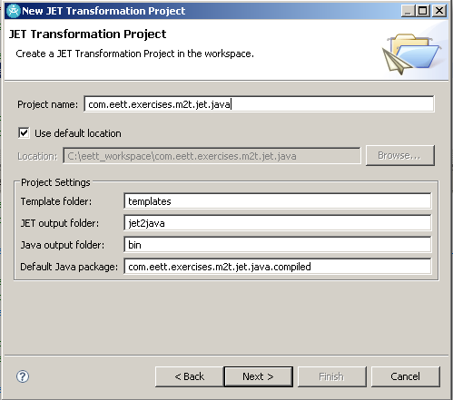
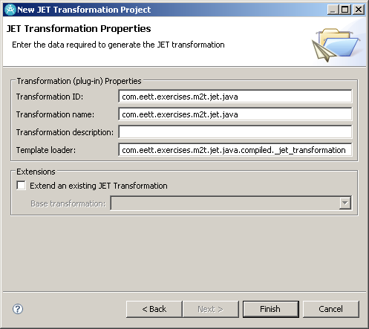
Developing a JET Transformation

Slide 98
Executing a JET Transformation
The JET project integrates with the workbench Run framework
Select the transformation resource in the project explorer
Choose Run As → Run Configurations… from the context menu
Create a new configuration under JET transformation
  The input model is specified
  The option to save the configuration for sharing

Slide 99
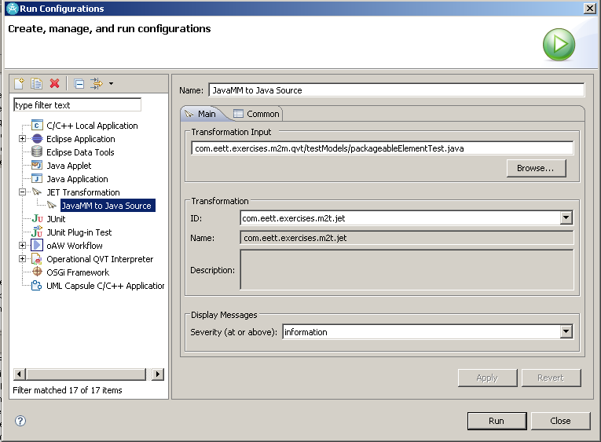
Executing a JET Transformation

Slide 100
Integrating with Workbench
Contribute an action to the editor's menu
  Implement the action handler
    Call the workflow passing in the selected element as the source
Alternative is append to an existing action
  e.g. the ROOM to Java transformation
Test
  In runtime workbench
Deploy
  Publish the plug-in
Notes:
Version 0.1, Sept. 2008
Toby McClean, Zeligsoft, 2008

Slide 101
Integrating with RSA-RTE
Contribute an action
  to the Project Explorer context menu
  to the Diagram Editor context menu
Implement action handler
  Class that implements IEditorActionDelegate
Test
  In runtime workbench
Deploy
  Publish the plug-in

Slide 102
JET Concepts Overview
Comments
  <%-- … --%>
Directives
  Provide guidance to JET
  <%@ … %>
Declarations
  Declare Java methods or fields
  <%! … %>
Expressions
  Valid Java expression, no semicolon
  <%= … %>
Scriptlets
  Valid Java statements or blocks (complete or partial)
  <% … %>
Implementation details
Notes:
Version 0.1, Sept. 2008
Toby McClean, Zeligsoft, 2008
Expressions
Expressions contain valid Java expressions. Java expressions are not complete statements, and in particular, they do not include a semi-colon (;). Expressions may access any Java element inscope Java elemement, including fields and methods declared in Java declarations, or in Java scriptlets, or Implicit Java Objects.
Scriptlets
Scripts may contain one more more valid Java statements or blocks. A scriptlet may also include a partial Java block, so long as a subsequent scriptlet completes it. Scriplets may reference any Java elements in scope, including variables declared in other scriptlets, and methods and fields declared in Java declarations or Implicit Java Objects. Some examples of valid scriplets:

Slide 103
JET – Directives
@jet
  Control or affect the Java code that is created by the JET compiler
  <%@jet package=“” class=“” imports=“” startTag=“” endTag=“” />
@taglib
  Import a tag library that is used in the template and assign it to a namespace
  Control tags – org.eclipse.jet.controlTags
  Workspace tags – org.eclipse.jet.workspaceTags
  Java tags – org.eclipse.jet.javaTags
  Format tags – org.eclipse.jet.java.formatTags
Implementation details
Notes:
@jet
package – the name of the package to compile the template into
class – the name of the class to compile the template into
imports – a space delimited list of package and class imports used in the template
startTag - the element that indicates the start of a JET tag
endTag – the element that indicates the end of a JET tag
Version 0.1, Sept. 2008
Toby McClean, Zeligsoft, 2008

Slide 104
JET - Declarations
Used to declare Java methods and fields that are part of the class generated by the template
Any syntactically correct method or field declaration is valid
<%! declaration %>
Example
  <%! private String qualifiedName; %>
Implementation details

Slide 105
JET – Expressions
A valid Java expression which will be evaluated and emitted
  They do not include a “;” at the end
Has access to any Java element in scope
  Including implicit objects context and out
<%= expression %>
Example
  <%= 3 + 4 %>
Implementation details
Notes:
context – access to template invocation information
logs
variables
Version 0.1, Sept. 2008
Toby McClean, Zeligsoft, 2008

Slide 106
JET – Scriptlets
One or more Java statements
  <% statement+ %>
Has access to any Java element in scope
  Including implicit objects context and out
A block can be split between Scriptlets
  <% if(jCompilationUnit.getName() != null) { %>
  …
  <% } // end if %>
Implementation details

Slide 107
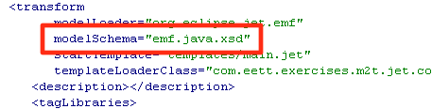
JET - Metamodels
By default JET is setup to work with XML files
To work with EMF models
  In the transform extension specify model loader as org.eclipse.jet.emf.modelLoader
To work with a specific metamodel
  Add its Java package to the imports list of the template
    <%@jet imports=“org.eclipse.emf.java.*” %>
  Can use the schema for an EMF model to control inputs
Implementation details
Notes:
Version 0.1, Sept. 2008
Toby McClean, Zeligsoft, 2008
use the org.eclipse.jet.emf modelLoader
set in the transform extension
part of the <%@jet imports=“” %> directive
e.g. for UML <%@jet imports=“org.eclipse.uml2.uml.*” %>
the imports is a list of space separated entries

Slide 108
JET – Loading Models
Tags in JET used to load content
  Load the content into a variable so it can be referenced
c:load
  Loads the referenced model into a specified variable
  Can be referenced through the variable after that
c:loadContent
  Load the content of the tag into the specified variable as XML
Implementation details
Notes:
c:load
load the referenced model, and set the passed variable to the loaded document root
url - the url of the model to load, usually relative, interpretation controlled by urlContext
var - the variable name to assign the loaded model to
urlContext (optional) - how relative URL in the url attribute will be resolved, ‘transform’, ‘workspace’
loader (optional) - a constant defining the loader to use, default is ‘emf’ (other values are dependent on the loaders that have been contributed)
type (optional) - type of the model
c:loadContent
loads the contents into a variable as XML

Slide 109
JET - Extensions
JET is extremely extensible and since it is much like JSP you are able to insert Java almost anywhere in a template
  Declarations, expressions and scriplets
The other means of extension are
  Custom model loaders
  New tag libraries
  New XPath functions
  Custom model inspectors
Implementation details
Notes:
Version 0.1, Sept. 2008
Toby McClean, Zeligsoft, 2008
Java Declarations
Java Expressions
Java Scriptlets
Implicit Java Objects
context - template invocation information
out - the write to which the template output is being written
Model loaders
an extension to load models of different formats
Tag libraries
new libraries of tags that can be used
XPath functions
adding functions that can be used in XPath expressions
Model inspectors
enable JET to interpret loaded Java objects as XPath nodes

Slide 110
JET - Templates
A template in JET is defined in a file
  There is a 1 to 1 mapping between file and template
Directives configure the template
  @jet
    affects the code created by the JET compiler
      package
      class
      imports
      startTag
      endTag
  @taglib
    imports a tag library for use in the template and assigns it a namespace prefix
Implementation details
Notes:
Version 0.1, Sept. 2008
Toby McClean, Zeligsoft, 2008
A transformation is defined in a file
A file equates to a templates
Directives
@jet
affects the code created by the JET compiler
attributes
package
name of the package into which the template will be compiled
one per template
class
name of Java class to be generated, may be used only once per template
imports
space separated list of Java import locations
startTag
two character replacement for <% in subsequent JET elements
endTag
two character replacement for %> in subsequent JET elements
@taglib
imports a tag library into the template for use, and assigns it a unique namespace prefix
standard tag libraries
org.eclipse.jet.controlTags
org.eclipse.jet.workspaceTags
org.eclipse.jet.javaTags
org.eclipse.jet.formatTags

Slide 111
JET – A template of a Template
Template directives
  Configure the output of the JET compiler
  Reference the tag libraries to be used
Compute derived attributes by traversing model
  Consider this the annotated model
Perform transformations on annotated model
  Creating projects, folders and files
Post transformation actions
  Template specific actions outside transformation logic
Implementation details

Slide 112
JET - Output
The output control in M2T is critical
  Out of the box JET provides several tags that help with output produced by the transformation
  Found in the formatting tag library
f:ident
  Indent the contents the specified number of times
f:lc, f:uc
  Convert the contents to lowercase/uppercase
f:replaceAll
  Replace all instances of a value within the contents to a new value
f:xpath
  Evaluate an XPath expression and writes it result
Implementation details
Notes:
Version 0.1, Sept. 2008
Toby McClean, Zeligsoft, 2008
f:ident
indent the tag contents the specified number of times
<f:indent text=“ “ depth=“2”>/*<f:indent text=“ * “><c:get select=“$myMode/@description” /></f:indent>*/> <f:/indent>
f:lc
convert the contents to lower case
offset (optional) - start conversion from the specified character
length (optional) - convert only the specified number of characters
f:replaceAll
replace all instances of a value in the tag’s content to a new value
can use a regular expression
f:uc
convert the tag contents to upper case
offset (optional) - start conversion from the specified character
length (optional) - convert only the specified number of characters
f:unique
write out a unique integer value
f:uuid
generate a universally unique identifier
f:xpath
evaluate the specified XPath function on the tag content and write the result in place of the tag content
tags for writing Java source
class
impliedImport
import
imports location
merge
package
resource - a non java file in a Java package
tags for working with the workspace
copyFile
file
folder
project
rebuildWorkspace

Slide 113
JET - Control
The control tag library provides capabilities for putting control logic into your template
c:choose
  A group of mutually exclusive choices
c:if
  Only process the contents if a test condition is satisfied
c:iterate
  Process the contents for each element specified by an XPath expression
  If the XPath expression evaluates to a number that it iterates that number of times
Implementation details
Notes:
Version 0.1, Sept. 2008
Toby McClean, Zeligsoft, 2008
c:choose
a group of mutually exclusive choices
contents are c:when and c:otherwise
optional ‘select’ attribute to select the element to use in the c:when tags test attribute
c:if
process the contents if a test condition is satisfied
test attribute specifies the condition
var is an optional attribute that will store the value of evaluating the test condition before converting it to a boolean
c:iterate
write the tag contents for each in the template input model identified by an XPath expression
if select returns a number then the body of the loop is processed that number of times, and the variable named by var is set to 1 for the first iteration and incremented by one for each successive iteration
select - the expression that returns wither a node set or a number
var - variable name, during each iteration, the value of the variable is an object from the set of objects selected by the ‘select’
delimiter (optional) - string that is written to the tag’s output between iteration of the tag
not written after the last iteration
c:replaceStrings
replaces one set of strings in its content with another set of strings and writes out the result
similar to printf
<c:replaceStrings replace=“%name, %age” with=“Jim, 47”>My name is %name. My age is %age.</c:replaceStrings>

Slide 114
JET – Control (c:choose)
Syntax
  <c:choose select=“[xpath]”>[content]</c:choose>
  Select when used specifies the value to be used in the when tags test attribute
Example
<c:choose>
<c:when test=“$jCompilationUnit/@name != ‘’”>
<ws:file path=“{concat($jCompilationUnit/@name, '.java')}”
template="templates/JCompilationUnit.java.jet"/>
</c:when>
<c:otherwise></c:otherwise>
</c:choose>
Implementation details

Slide 115
JET – Control (c:if)
Syntax
  <c:if test=“[condition]” var=“[var name]”></c:if>
  var is optional and if specifies stores the result of evaluating the condition before it is converted to a boolean
Example
<c:if test=“$jCompilationUnit/@name != ‘’”>
<ws:file path=“{concat($jCompilationUnit/@name, '.java')}”
template="templates/JCompilationUnit.java.jet"/>
</c:if>
Implementation details

Slide 116
JET – Control (c:iterate)
Syntax
  <c:iterate select=“” var=“” delimiter=“”></c:iterate>
  select – xpath that returns node set or number
  var – the variable referencing the current iterator object
  delimiter – string written to output between iterations but not the last
Example
<c:iterate select=“$jCompilationUnit/types” var=“type”>
class <c:get select=“$type/@name /> {
}
</c:iterate>
Implementation details

Slide 117
JET - Expressions
JET has several tags for working model elements and variables in the logic of the template
c:get
  Evaluate an XPath expression and write the result
c:set
  Select an object with a XPath expression and set an attribute on it to the specified value
  Can be used to dynamically add to an object at runtime
c:setVariable
  Create a variable and sets it value by specifying an XPath expression
Implementation details
Notes:
Version 0.1, Sept. 2008
Toby McClean, Zeligsoft, 2008
c:get
write the result of an XPath expression
expression is in the select attribute of the tag
c:set
set an attribute on an object selected by an XPath expression, value is determined by contents
if the attribute doesn’t exist than one is created dynamically (not permanent or persisted)
<c:set select=“$var” name=“name-length”>10</c:set>
c:setVariable
create a variable whose value is set to the result of the provided XPath expression
<c:setVariable select=“/*” var=“root” />

Slide 118
JET – Expressions (c:get)
Syntax
  <c:get select=“[xpath]” default=“[value]” />
  select is the xpath to evaluate, if it selects nothing than an error may occur
  default (optional) is the value to use if the XPath expression returns nothing, prevents error
Example
<c:get select=“$jClass/@name” default=“ ’’ ” />
Implementation details

Slide 119
JET – Expressions (c:set)
Syntax
  <c:set select=“[XPath]” name=“[name]”>[value]</c:set>
  select is XPath expression selecting the element to add or set the attribute specified by the value of name on
  creates attribute if none exists
Example
<c:set select=“$jCompilationUnit” name=“fileName”>
<c:get select=“concat($jCompilationUnit/@name, ‘.java’)” />
</c:set>
Implementation details
Notes:
DOESN’T MODIFY THE ACTUAL MODEL ONLY LASTS for the lifetime of the current context
Version 0.1, Sept. 2008
Toby McClean, Zeligsoft, 2008

Slide 120
JET – Expressions (c:setVariable)
Syntax
  <c:setVariable select=“[xpath]” var=“[name]” />
  Assign the result of evaluating select to the variable specified by var
Example
<c:setVariable select="/*" var="jModel"/>
Implementation details

Slide 121
JET - Reuse
There are two forms of reuse in JET
  c:inlcude tag which processes the referenced template and includes its output
    Variables from the including template are passed to the included template (can specify which ones)
    Example
      <c:include template=“templates/header.jet.inc” />
  Overriding a transformation
    In the transform extension point declare that the transformation overrides templates in the overriden transformation
Implementation details
Notes:
Version 0.1, Sept. 2008
Toby McClean, Zeligsoft, 2008
c:include
process the referenced template, and include its results in the output of the current template
can select which variables are passed onto the included template (passVariables attribute), by default all are available
changes made in the invoked template are not reflected in the invoking
override attribute in the transform extension point
declares that the transformation overrides templates in the identified transformation

Slide 122
JET - Invoking a Transform
To invoke another template from the current template use the c:invokeTransform
  passes the current transformation’s source and context variables
Syntax
  <c:invokeTransform transformId=“<id>” passVariables=“<variable list>” />
  passVariables is optional
Example
  <c:invokeTransform transformId=“com.eett.exercises.m2t.jet.writejava” />
Implementation details
Notes:
Version 0.1, Sept. 2008
Toby McClean, Zeligsoft, 2008
c:invokeTransform
invoke another transformation, passing it the current transformation’s source model and context variables
Transformation’s actions will be accumulated, and commit when the invoking transformation commits
passVariables (optional) allows explicit declaration of the variables that are passed to the transformation. By default, all context variables are available. With this parameter, only those variables specified are available. In addition, any changes to passed variables are not reflected in the invoking context.

Slide 123
JET - Working with Profiles
Since JET is a generic solution there is no special support for UML Profiles
Use the UML API to access stereotype information
  Make use of declarations, expressions and scriptlets
Create templates that encapsulate the handling of specific stereotypes
  Use the c:include to execute the template in place
Implementation details
Notes:
Version 0.1, Sept. 2008
Toby McClean, Zeligsoft, 2008

Slide 124
JET - Logging
JET has several tags to support logging in the transformation
c:log
  write a message to the transformation log
  optional severity attribute
c:dump
  dump the contents of the node passed
c:marker
  create an Eclipse task marker to the text in the tag
  optional description for the marker
Implementation details
Notes:
Version 0.1, Sept. 2008
Toby McClean, Zeligsoft, 2008
c:log
write a message to the transformation log
optional severity attribute
info, warning or error
default info
c:dump
dump the contents of the specified node
c:marker
create a Eclipse task marker to the text in the tag
optional description to be used for the marker

Slide 125
JET – Logging (c:log)
Examples
<c:if test=“$jClass/@name = ‘’”>
<c:log severity=“error”>
Can not write a class that has no name
</c:log>
</c:if>
<c:log>
Writing <c:get select=“$jClass/@name” />
</c:log>
Implementation details

Slide 126
JET – Logging (c:dump)
Examples
<c:if test=“$jClass/@name = ‘’”>
<c:log severity=“error”>
Can not write a class that has no name
</c:log>
<c:dump select=“$jClass” />
</c:if>
Implementation details

Slide 127
JET – Logging (c:marker)
Example
<c:marker description=“concat($op/@name, ‘ needs an implementation’)>
throw UnsupportedOperationException();
</c:marker>
A task marker will be created in the Eclipse task view identifying to the user that something needs to be done
Implementation details

Slide 128
Summary
We have explored JET
  What is JET
  How I develop a model to text transformation with JET
  How is my transformation integrated with Eclipse
  The features and syntax of JET
You should now be able to
  Do the JET exercises
  Navigate around the JET documentation and other resources
Notes:
Version 0.1, Sept. 2008
Toby McClean, Zeligsoft, 2008
userRegion
a region in the generated text where users may write customized content
must contain a single initialCode tag
content before is considered a begin marker
content after is considered an end marker
visitor
iterate over an object and all its contained objects
for each identified object, the tag evaluates the ‘test’ condition on its contained ‘visit’ tags, only those tags whose test condition is true have their contents processed

Slide 129
Agenda
Model transformation introduction
Model to model
  Java
  QVT
Model to text
  xPand
  xTend
  JET
oAW
Notes:
Version 0.1, Sept. 2008
Toby McClean, Zeligsoft, 2008

Slide 130
oAW Workflow
An XML based language for describing the sequence of steps in a transformation
  For example
    load UML model,
    transform to Java mode,
    manipulate Java model,
    write Java model to source, and
    format generated Java code
In the process of becoming an Eclipse project called Model Workflow Engine (MWE)
Notes:
Version 0.1, Sept. 2008
Toby McClean, Zeligsoft, 2008
a mechanism for specifying the workflow of the transformations M2M2T
a sequential or parallel list of steps in the transformation of one or more source models into one or more target artifacts
MWE
workflow is a sequence of steps
step is a called a component
component examples
model parsers
model validators
M2M transformations
M2T transformations
XML syntax
control the workflow
do no execute components if an error occured in a previous component
specify configuration properties
can be declared anywhere in the workflow
available only after declaration
can be declared in line or in a file
previously declared properties can be included in the file
components can have configuration parameters/properties that are defined on the component with property accessors
setter for individual property
add for collection
put key value pairs
slots allow for sharing of values between components
composition
workflow files can be included in other workflow files
<comp class=‘MyBean’><bean file=“mybean.oaw” /></comp>
Starting a Workflow
use the WorkflowRunner class
can be run from Eclipse workbench

Slide 131
oAW Workflow Project?
Out of the box the oaW Workflow Project consists of
  A workflow execution engine
  Workflow components for reading and writing EMF models
  API for integration with oAW Workflow
  Workbench integration
    Editor, Run as…, Debug as…, and ANT

Slide 132
More oAW Workflow Project?
API allows for custom workflow components
  e.g. QVT transformation execution
Configuration properties
  Properties passed into the workflow
  <property name='targetDir' value='src-gen/'/>
Slots or variables
  Simple syntax, variables are referred to by name
  No declaration
  <component id="generator" class="oaw.xtend.XtendComponent">
  …
  <outputSlot value=“javaModel” />
  </component>

Slide 133
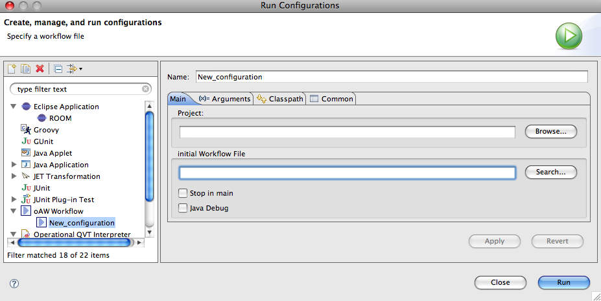
Executing an oAW Workflow
The oAW Workflow Engine is integrated with Run as…

Slide 134
Discussion
We can combine the previous module and this module
  Extend the model with additional information
  Extend generation to use this information
  May require RTS customization
Examples?
  Deadlines in messages
  Port patterns

Slide 135

Questions

