Slide 1
Validating Eclipse Models
How can I ensure valid models?
Notes:
Version 0.1, Sept. 2008
Toby McClean, Zeligsoft, 2008

Slide 2
Overview
Explore the validation service
Explore the different types of constraints
Notes:
Version 0.1, Sept. 2008
Toby McClean, Zeligsoft, 2008
Model objects validated by external EValidator
Detailed results accumulated as Diagnostics
Essentially a non-Eclipse equivalent to IStatus
Records severity, source plug-in ID, status code, message, other arbitrary data, and nested children
Invariant
Defined directly on the class, as an operation with <<inv>> stereotype
Stronger statement about validity than a constraint
Constraint
Externally defined for the class via a method on the validator
Generated EValidator Implementations
Generated for each package that defines invariants or constraints
Dispatches validation to type-specific methods
For classes, a validate method is called for each invariant and constraint
Method body must be hand coded for invariants and named constraints
Schema-Based Constraints
In XML Schema, named constraints are defined via annotations
Also, constraints can be defined as facets on simple types, and no additional coding is required
Constraint method implementation generated
Framework EValidator Implementations
EObjectValidator validates basic EObject constraints:
Multiplicities are respected
Proxies resolve
All referenced objects are contained in a resource
Data type values are valid
Used as base of generated validators and directly for packages without additional constraints defined

Slide 3
Goals
After this module you understand how validation is performed in the Eclipse environment
You will be able to add your own constraints
Notes:
Version 0.1, Sept. 2008
Toby McClean, Zeligsoft, 2008
Framework Evalidator Implementations
Diagnostician walks a containment tree of model objects, dispatching to package-specific validators
Diagnostician.validate() is the usual entry point
Obtains validators from its EValidator.Registry

Slide 4
Agenda
Overview
Static and dynamic constraint providers
Constraints
Validation service
Creating constraints

Slide 5
What can I Validate?
The validation framework provides a way to describe constraints to go with models
  To protect model sanity
  To validate domain rules
  To validate your specific rules

Slide 6
Validation Framework Overview
Constraints are organized through categories and bindings
Constraint providers contribute constraints
Constraint parsers implement implementation languages
Traversal strategies walk the model
Validation listeners are notified when validation occurs
Notification generators for custom (esp. higher-order) notifications for processing in live validation
Notes:
Old slide content:
Constraint providers contribute constraints from any source they deem fit, including the plugin.xml, constraints embedded in models, or external models
Constraint parsers contribute support for constraint specification languages. Out of the box, the framework implements Java and OCL support.
Traversal strategies contribute knowledge of the model structure and how to discover its extent to validate it
Constraint categories and bindings help to organize constraints and activate them in specific applications
Validation listeners are notified whenever validation occurs, to provide an appropriate response from the application
Version 0.1, Sept. 2008
Toby McClean, Zeligsoft, 2008

Slide 7
What does the Validation Framework Provide?
Invocation (Triggers)
  “Batch” validation: initiated by the user or by the system on some important event, validates all or a selected subset of a model
  “Live” validation: initiated automatically by the system to validate a set of changes performed during some transaction. The semantics of “transaction” are defined by the client
    Constraints can specify which particular changes trigger them (by feature and event type)
Support for OCL constraints
  EMFT Validation uses the OCL component of the MDT project to provide out-of-box support for specifying constraints using OCL
  API supports UML binding and more flexibility in working with OCL constraints embedded in metamodels

Slide 8
Constraint Providers
Constraint providers are of two flavours: static and dynamic
  Static providers declare their constraints in the plugin.xml of a client plug-in of the constrained model
  Dynamic providers obtain constraints from an arbitrary source at run-time
Both kinds of providers can declare constraint categories and include their constraints in categories defined by any provider
  Categories are hierarchical namespaces for constraints
  Constraints are grouped by category in the preference page

Slide 9
Static Constraint Provider
<extension point="org.eclipse.emf.validation.constraintProviders">
<category name="Library Constraints" id="com.example.library">
<constraintProvider>
<package namespaceUri="http:///www.eclipse.org/Library/1.0.0"/>
<constraints categories="com.example.library">
<constraint
lang="Java"
class="com.example.constraints.UniqueLibraryName"
severity="WARNING"
mode="Batch"
name="Library Must have a Unique Name"
id="com.example.library.LibraryNameIsUnique"
statusCode="1">
<description>Libraries have unique names.</description>
<message>{0} has the same name as another library.</message>
<target class="Library"/>
</constraint>
</constraints>
</constraintProvider>
</extension>

Slide 10
Dynamic Constraint Provider
Registered by name of a class implementing the IModelConstraintProvider interface
Indicate the packages for which they supply constraints
  Biggest difference is the absence of a <constraints> element
System can optionally cache the provided constraints
<extension point="org.eclipse.emf.validation.constraintProviders">
<category name="Library Constraints" id="com.example.library">
<constraintProvider
class="com.example.MyConstraintProvider"
cache="false">
<package namespaceUri="http:///www.eclipse.org/Library/1.0.0"/>
</constraintProvider>
</extension>

Slide 11
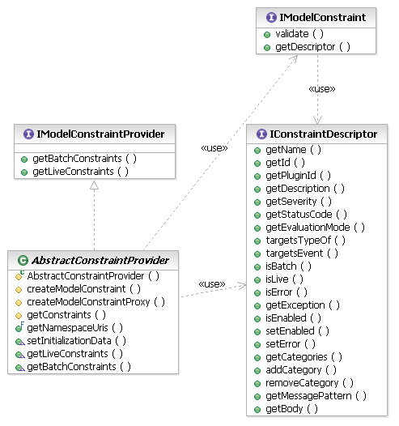
Dynamic Constraint Provider
A dynamic constraint provider implements the IModelConstraintProvider interface
A descriptor supplies
meta-data about a
constraint
The validation algorithm
is supplied by the
constraint object in
the validate() method

Slide 12
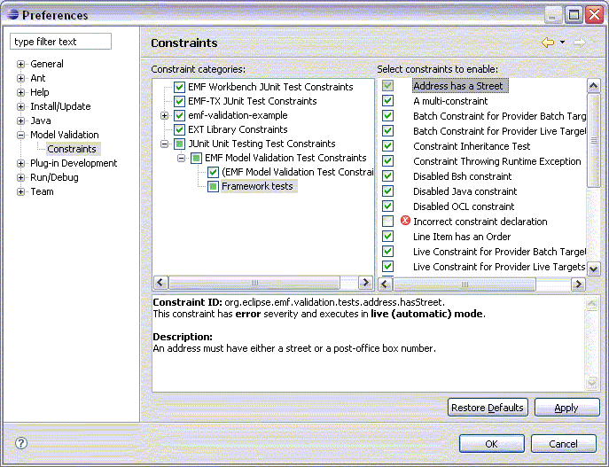
Constraints
Descriptor provides:
  ID and localizable name
  Evaluation mode
  Target EClasses
  Triggering events (live)
  Severity, error message
  Categorization
  Enabled state
Much of this information
appears in the preference page
Users can choose which constraints to activate

Slide 13
Evaluation Modes
Batch validation is usually explicitly requested by the user, via a menu action or toolbar button
Live validation is performed automatically as changes are made to EMF resources
  Live constraints indicate which specific changes trigger them
<constraint
mode="Live"
… >
<description>Libraries have unique names.</description>
<message>{0} has the same name as: {1}.</message>
<target class="Library">
<event name="Set">
<feature name="name"/>
</event>
</target>
</constraint>

Slide 14
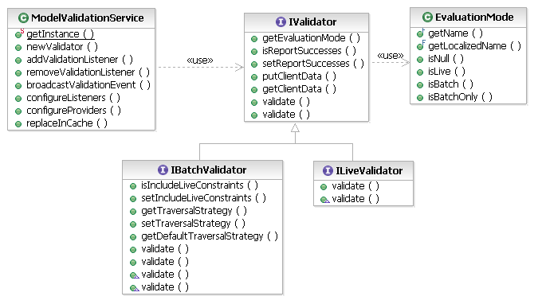
Validation Service
Evaluation of constraints is performed via the Validation Service
The service provides validators corresponding to the available evaluation
modes
By default, batch
validation includes
live constraints, also,
for completeness

Slide 15
Validation Service
To validate one or more elements, in batch mode, simply create a new validator and ask it to validate:
List objects = myResource.getContents(); // objects to validate
// create a validator
IValidator validator = ModelValidationService.getInstance()
.newValidator(EvaluationMode.BATCH);
// use it!
IStatus results = validator.validate(objects);
if (!results.isOK()) {
ErrorDialog.openError(null, "Validation", "Validation Failed",
results);
}

Slide 16
Validation Service
Live validation does not validate objects, but rather Notifications indicating changes to objects
List<Notification> notifications = … ; // some changes that we observed
// create a validator
IValidator validator = ModelValidationService.getInstance()
.newValidator(EvaluationMode.LIVE);
// use it!
IStatus results = validator.validate(notifications);
if (!results.isOK()) {
ErrorDialog.openError(null, "Validation", "Validation Failed",
results);
}

Slide 17
Creating Constraints
Specifying a constraint doesn’t necessarily require any code
Requires the OCL component of the MDT project
<constraint
lang="OCL"
mode="Batch"
… >
<description>Libraries have unique names.</description>
<message>{0} has the same name as: {1}.</message>
<target class="Library"/>
<![CDATA[
Library.allInstances()->forAll(l |
l <> self implies l.name <> self.name)
]]>
</constraint>

Slide 18
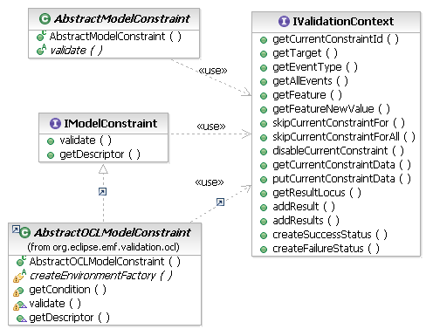
Creating Constraints
Sometimes the easiest or best way to formulate a constraint is in Java
Java constraints extend the
AbstractModelConstraint
class
The validation context
provides the validate()
method with information
about the validation
operation

Slide 19
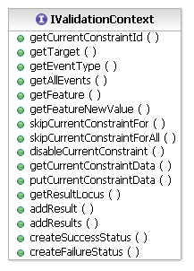
Validation Context
Provides the element being validated
(the target)
Indicates the current evaluation mode
(live or batch)
  In case of live invocation, provides the
  changed feature and the event type
Allows constraints to cache arbitrary
data for the duration of the current validation
operation
Provides convenient methods for reporting results
Provides the ID of the constraint that is being invoked

Slide 20
Creating Constraints
public class LibraryNameIsUnique extends AbstractConstraint {
public IStatus validate(IValidationContext ctx) {
Library target = (Library) ctx.getTarget(); // object to validate
// does this library have a unique name?
Set<Library> libs = findLibrariesWithName(target.getName());
if (libs.size() > 1) {
// report this problem against all like-named libraries
ctx.addResults(libs);
// don’t need to validate these other libraries
libs.remove(target);
ctx.skipCurrentConstraintFor(libs);
return ctx.createFailureStatus(new Object[] {
target, libs});
}
return ctx.createSuccessStatus();
}
}

Slide 21
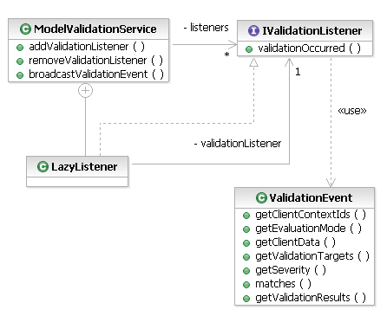
Listening for Validation Events
Every validation operation
executed by the Validation
Service generates an event
The event indicates the kind
of validation performed, on what
objects, and what were the results (incl. severity)
Listeners registered on the extension point
are lazily initialized when their selection criteria
are met
<extension point="org.eclipse.emf.validation.validationListeners">
<listener class="com.example.validation.ProblemsReporter">
<clientContext id="com.example.MyClientContext"/>
</listener>
</extension>

Slide 22
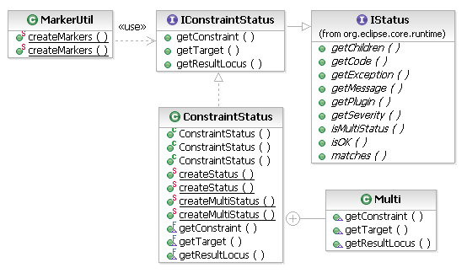
Reporting Problems
Problems are
reported as
IConstraintStatus
objects. A status knows:
  The constraint that was violated
  The objects that violated it
  The severity and error message,
  as usual for an IStatus
The marker utility encodes all
of this information in a problem
marker on the appropriate resource,
to show in the Problems view

Slide 23
Summary
We have discussed validation in Eclipse
Static, dynamic, live and batch
You have learned how to create a constraint

Slide 24
RSA-RTE Validation
Validating models in RSA-RTE

Slide 25
Overview
Adding constraints to models in RSA-RTE
  Authoring
  Executing
Adding constraints to profiles in RSA-RTE
  Authoring
  Executing

Slide 26
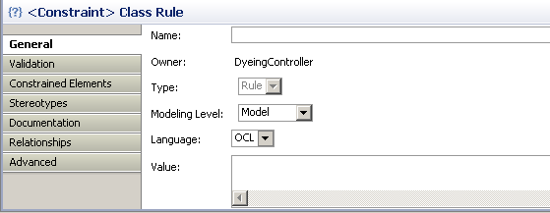
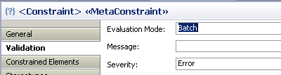
Authoring Model Constraint
Contraints can be added to model elements
  Add UML → Constraint from the elements context menu
  Defined by
    Name
    Constrained elements
    Modeling level
    Language
    Mode
    Message_x0018_

Slide 27
Executing Model Constraint
Batch constraints are evaluated by
  Validate in the context menu of the element
Live constraints are evaluated by
  Validate in the context menu
  i.e. they are all Batch
You will see the results if any
  In the problems view

Slide 28
Authoring Profile Constraint
Profile authored in the same way as model constraints
They apply to elements that the stereotype is applied to
Nothing special is needed to have them work in a deployed profile
This is specific to RSx you would have to create your own with Eclipse UML2

Slide 29
Executing Profile Constraint
Batch mode constraints evaluate
  When the model or model element is validated
  They are reported in the Problems view
Live mode constraints evaluate
  When the model change is made
  They are reported in a dialog and in the Problem view

Slide 30
Summary
We have discussed validation specific to RSx
How to author model specific constraints
How to author constraints in profiles

Slide 31

Questions

