Slide 1


Stochastic Block Jacobi PageRank Acceleration
UCS645- Project Presentation
Presented by : Nikhil Krishna KN(102303512)
Lavisha(102303423)
Mannat Bhardwaj(102303148)
Shrestha Bhowmchik(102303878)

Slide 2
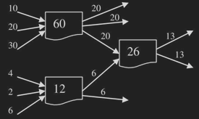
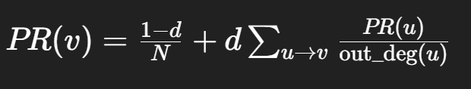
PROBLEM STATEMENT
Large-scale graphs are common (web, social networks)
Need to compute node importance efficiently
Existing methods struggle with scalability
02
d= damping factor (≈ 0.85)
N= total number of nodes
out_deg(u) = number of outgoing links from u
Σ (u → v) → all nodes pointing to v

Slide 3
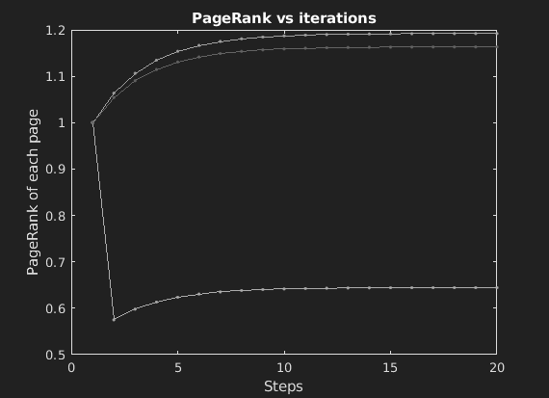
Challenges in PageRank Computation
Iterative Computation
Requires many iterations to converge
Recomputes all nodes each time
Irregular Graph Structure
Power-law graphs → few high-degree nodes
Most nodes have very few connections
GPU Inefficiency
High-degree nodes cause warp divergence
Uneven workload → poor utilization
03

Slide 4
04
Proposed Approach
PROBLEM
SOLUTION
Full updates every iteration | Stochastic Sampling
Unstructured iterative updates | Block-Jacobi Method
Load imbalance in parallel systems | Hybrid CPU-GPU

Slide 5
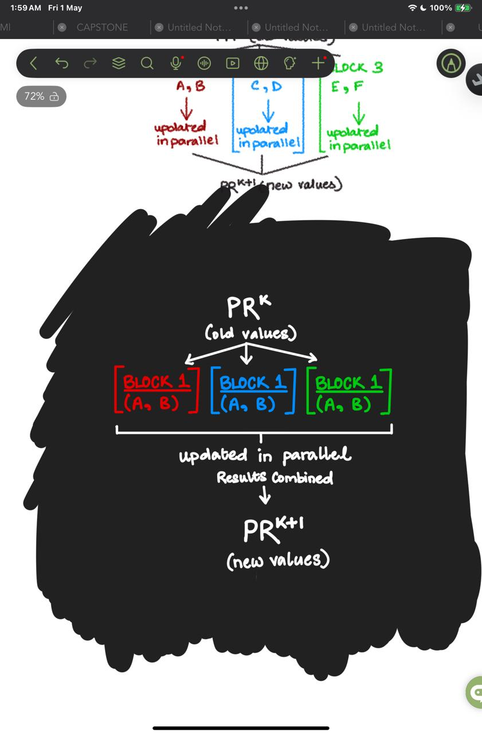
Block-Jacobi Method
CORE IDEA
Partition graph into independent blocks
Update blocks in parallel
HOW IT WORKS
Uses values from previous iteration
All nodes update simultaneously
No dependency conflicts
WHY IT WORKS
Enables safe parallel computation
Eliminates need for locks/atomics
Improves scalability
05

Slide 6
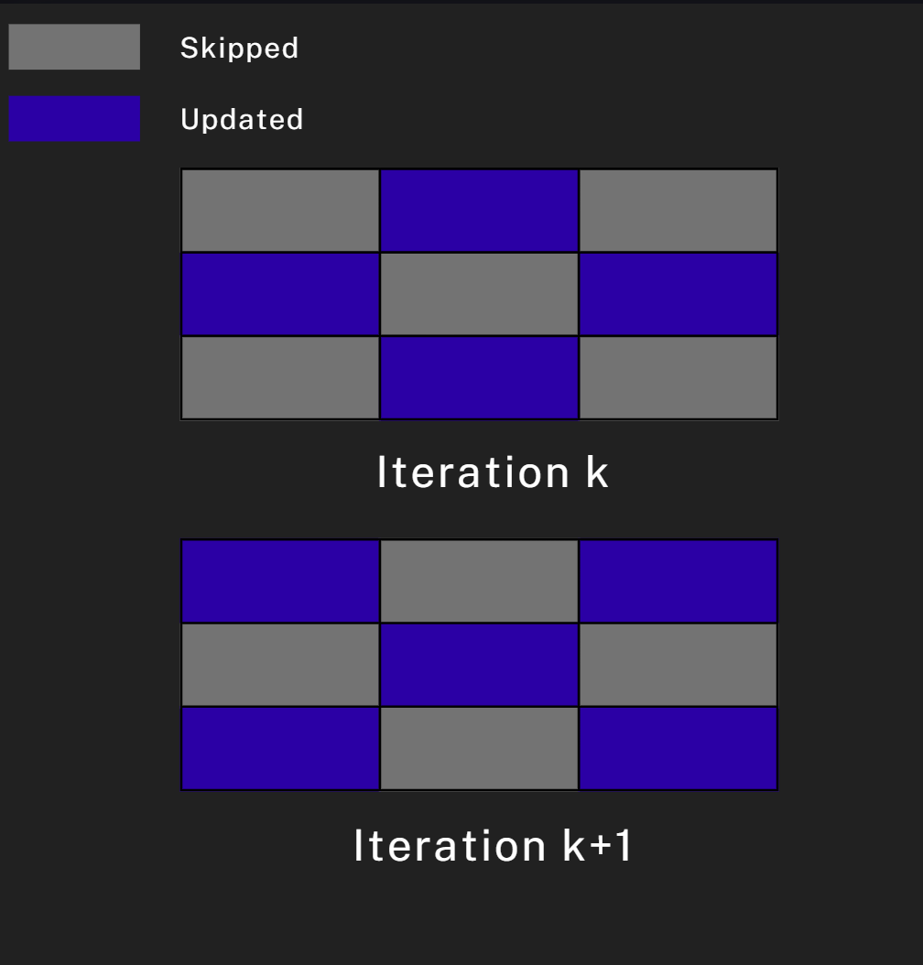
Stochastic Sampling
CORE IDEA
Update only a subset of blocks each iteration
Selected randomly
HOW IT WORKS
Block-Jacobi still updates ALL blocks
Many updates contribute very little
WHY IT WORKS
Sample fraction r of blocks (e.g., 80%)
Skip remaining blocks temporarily
Rotate selection across iterations
06

Slide 7

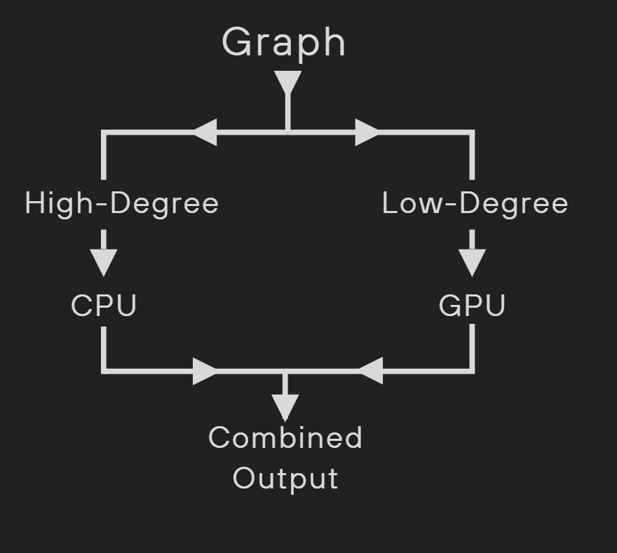
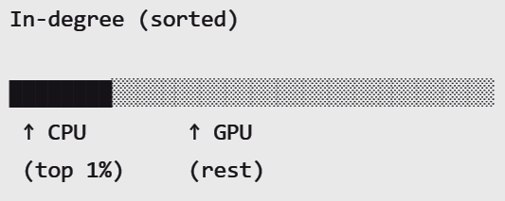
Hybrid CPU–GPU
CORE IDEA
handles irregular, complex workloads
handles large-scale parallel tasks efficiently
Split nodes based on degree
Assign work to best-suited hardware
High-degree nodes → CPU
Low-degree nodes → GPU
07

Slide 8
IMPLEMENTATION
Data (Graph + CSR)
CPU Logic (OpenMP)
GPU Compute (CUDA)
Graph Input
CSR Transformation
Degree Partitioning
Build Transposed CSR layout to map in-neighbors.
Enables pull-based, lock-free rank updates (no atomics).
Partition nodes into fixed-size blocks
Assign top P% to CPU pool; remainder to GPU pool.
Edge list / SNAP dataset
Synthetic graph generation
Overlapped Compute
Asynchronous Dispatch
Stochastic Sampling
CPU: OpenMP threads process warp-breaking hubs.
GPU: CSR kernel concurrently computes the uniform tail.
Queue data transfers using Pinned Host Memory
Initiate non-blocking PCIe transfers via CUDA Streams.
Randomly shuffle and select active vertices per iteration.
Amortizes compute cost on the slow-moving long tail.
08

Slide 9
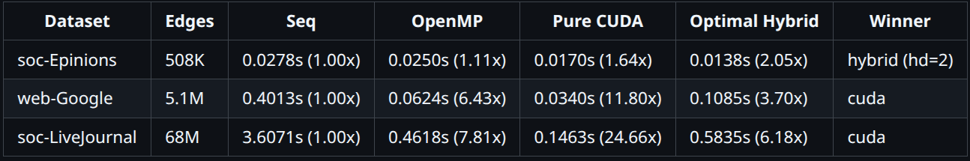
09
RESULTS
CPU-Only Performance
Tested on real-world SNAP datasets (social and web graphs with up to 68M edges).
Full Hardware Acceleration: Hybrid engine uses true asynchronous overlap via CUDA streams and pinned memory.
Compared 4 Engines: Sequential, OpenMP, Pure CUDA, and an Optimal Hybrid configuration.
Hybrid wins on skewed, smaller graphs: Achieved a 2.05× peak speedup on soc-Epinions (hd=2) by successfully masking GPU warp divergence.
Pure CUDA dominates massive graphs: Achieved up to 24.6× speedup on LiveJournal, proving that avoiding PCIe transfers is critical at scale.
The PCIe Floor: Hybrid scaling on large graphs is physically capped by the motherboard's PCIe bandwidth (~0.5s per 50 round trips), exposing a fundamental hardware limitation.

Slide 10
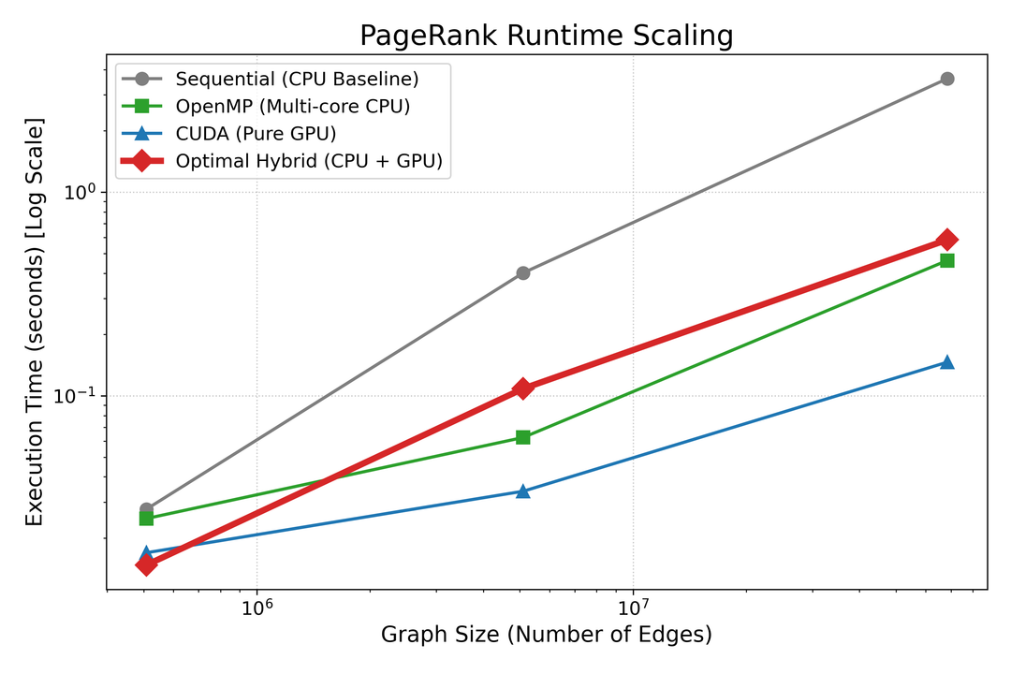
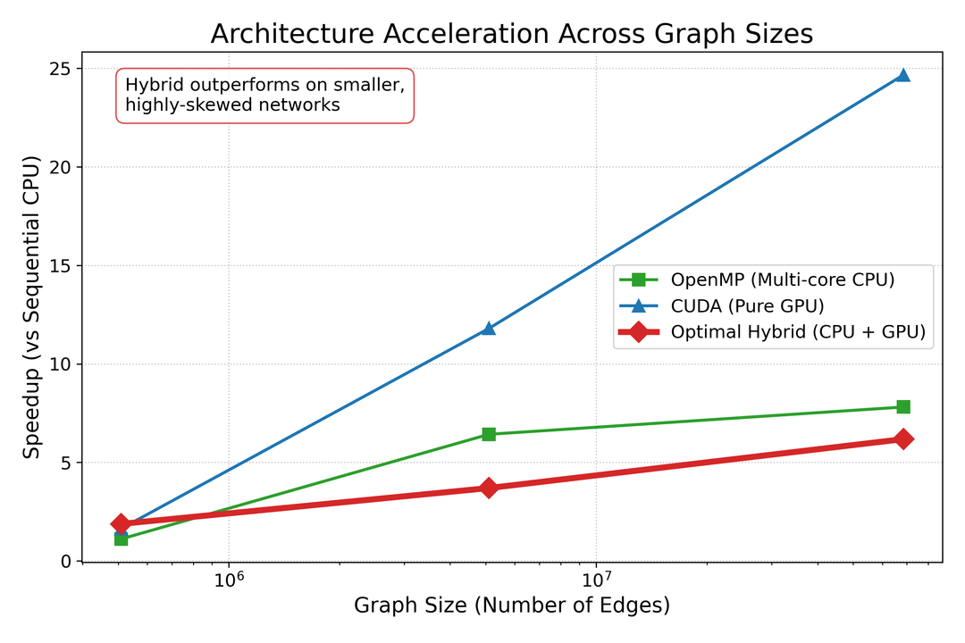
RESULTS
Analysis
All methods exhibit stable log-linear scaling, confirming optimal O(|E|) algorithmic efficiency across engines.
The PCIe Floor is visually confirmed at scale: the Hybrid engine's execution time flattens out because PCIe transfer latency eventually dwarfs the actual GPU computation time.
OpenMP provides a stable, moderate acceleration baseline (~6–8×) regardless of graph size.
Hybrid peaks early, achieving optimal efficiency on smaller networks where it successfully masks warp divergence without triggering PCIe bottlenecks.
Pure CUDA acceleration scales exponentially with graph size (reaching ~25×), proving that massive VRAM bandwidth completely overwhelms divergence penalties at scale.
10

Slide 11
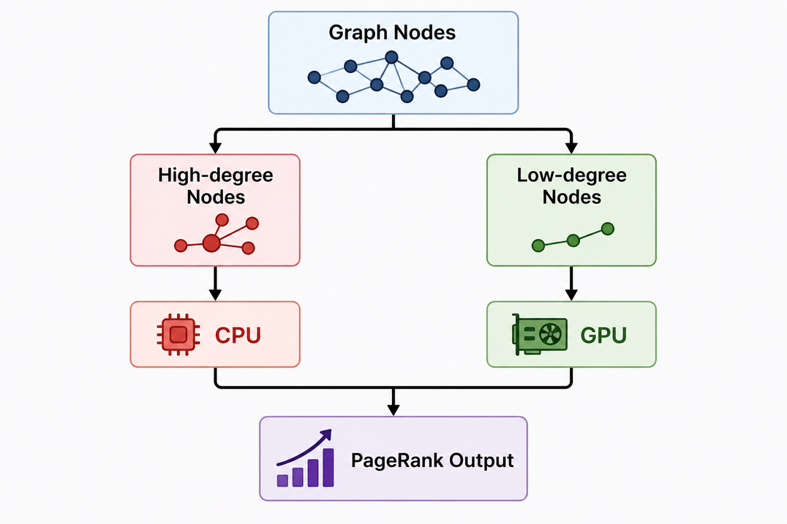
Conclusion
12
Achieved full async CPU-GPU overlap using CUDA streams and pinned memory.
Offloading hubs to the CPU maximizes efficiency on skewed graphs (e.g., soc-Epinions).
Transfer latency caps Hybrid scaling. Pure GPU wins on massive graphs by keeping data in VRAM.
Bypassing PCIe limits requires NVLink (unified memory) or NCCL (multi-GPU architectures).

Slide 12
12
Thank You

