Slide 1
AzureML Walkthrough A Data Journey
October 16th, 2017

Slide 2

Gold Application Development
Gold Cloud Platform
Gold Cloud Productivity
Gold Data Analytics
Gold Data Platform
Gold Datacenter
Gold Enterprise Mobility Management
Gold Hosting
Silver Cloud Customer Relationship Management
Silver Collaboration and Content
Silver Digital Advertising
Silver Intelligent Systems
Silver Messaging
Silver MidMarket Solutions Provider
Silver Small and MidMarket Cloud Solutions
Silver Windows and Devices

Slide 3
WHO WE ARE
Global Services
Valorem helps clients realize value through business technology solutions. Collectively our people have worked with thousands of enterprises around the world delivering innovative, insightful and technical services.
Recent Awards
CRN: 2017 Fast Growth 150
CRN: 2017 Solution Provider 500
KC Business Journal: 2017 Info Systems Firm (#4)
KC Business Journal: 2016 Fastest Growing
Redmond Channel Partner: 2016 Top 200 US MS Partners
Microsoft DX EIP Elite Partner

Slide 4

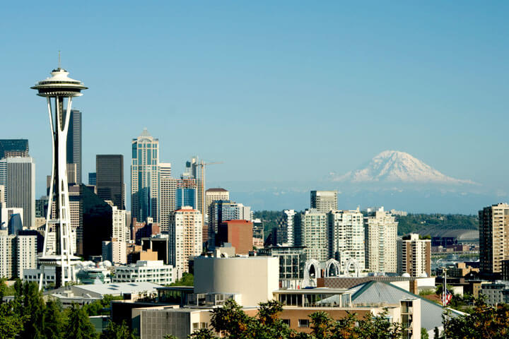



KANSAS CITY
2101 Broadway, Ste 31 Kansas City, MO 64108
SEATTLE
1201 Western Ave. #350 Seattle, WA 98101
(816) 398-8949
(855) 864-9929
ST. LOUIS
111 Westport Plaza Dr., Ste 600 St. Louis, MO 63146
KOCHI
33/2361 B5 Jacob Towers Kochi, India 682019
HERRLIBERG
Ackerstrasse 13 8704 Herrliberg, Switzerland
(314) 696-0030
+91 484-280-3193
+41 435-004-265

Slide 5






CAPABILITIES
Cloud
Digital Strategy
Business Solutions
Digital Insights
App Development
User Experience (UX)
Immersive Experiences
Security

Slide 6
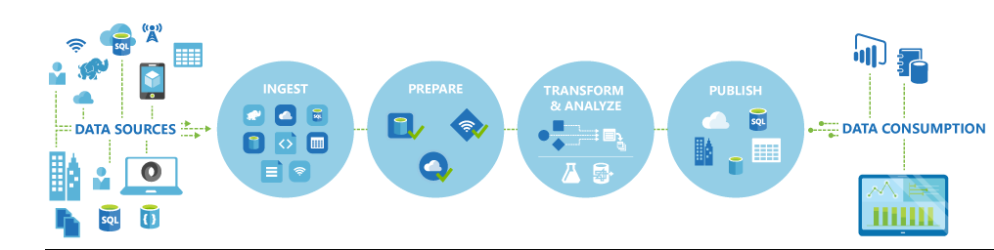
AGENDA SLIDE
We will use:
Azure Data Factory to retrieve on-premises data
Store the data on Azure Storage Blob
Ingest data from Azure Blob into AzureML
Create a predictive model and operationalize it through an API
Consume the API in Excel and Power BI

Slide 7
Setup/Prep Requirements
Start DSVM on Azure DI Subscription
Check to see if Integration Runtime is working (shortcut on desktop)
Public IP: 40.76.18.186
Using the Azure Portal, ensure czwADF1 Pipeline is working

Slide 8
DEMO
Summary
This is a buyer propensity model that predicts which customers are most likely to buy bikes. This is a good example of a customer targeting model that is widely used in Marketing. It uses 2 binary classification algorithms namely Logistic Regression and Boosted Decision Trees.
**Inputs:**
The input data is the BikeBuyer dataset that has historical sales data on a set of fictitious customers. This data includes demographic variables such as marital status, gender, yearly income, number of children, occupation, age, etc. Other input variables include home ownership status, number of cars, and commute distance.
**Outputs:**
The training data has one output - a single binary variable showing whether the customer bought a bike or not. The output of the model is the probability of purchase. So for a given customer the model shows the probability that the given customer will buy a bike.

Slide 9
Demo – Detailed Steps
Search for interesting data in data catalog
Open Azure Data catalog app on laptop and search for bike
Show the columns in the CSV
Note that cweaver@valorem is the person to contact for access
Go to Azure portal and open Blob storage
Note that the data could be downloaded by the Download link or the URL
Introduce Data Factory to show how the data gets into Blob (recall the data comes from the DSVM VM, not the laptop!)
Recall the VM must be running (verify the Integration Runtime is enabled)
Data is in the czwdemo container
DSVM should be running. Make sure Integration Runtime is status green

Slide 10
Demo – Detailed Steps, Cont’d
Open AzureML Studio
Open Buyer Propensity Model-US
Note that the data is retrieved directly from the Azure Blob storage
Briefly review the AzureML Model – visualize the performance
Show Predictive Experiment tab
Mention it is created automatically. Only mod was the selection of output variables
Go to Web Services and select Buyer Propensity Model – US [predictive exp]
Show the Test Button but do not execute (just to save time)
Open the Excel 2013 or Later link (enable editing when prompted)
Use Sample Data. Select N1 as Output (ensure Include headers is selected)
Go to Azure Blob czwdemo and download BikeBuyerRandomTestData.csv.
Copy the random data into the Excel Algorithm file and run the prediction (note, Excel seems to hang – give it a minute – it’ll free up!) Move to PBI

Slide 11
Demo – Detailed Steps, Cont’d
Open BikeBuyer PBI File
Highlight the data on the dashboard where the scored probabilities from the Excel file are illustrated
Note the fields are the same that we saw throughout the demo
Started at Data Catalog, through Data Factory, Azure Blob, AzureML, Excel and finally into Power BI

Slide 12


What we learned
Azure Data Factory used to collect local data
Store data on Azure Storage
Use cloud data to build a predictive model
Deploy predictive model and an API
Consume the API in Excel
Leverage Power BI to democratize the results from machine learning investments
©Valorem

Slide 13
THANK YOU
Cliff Weaver
Data Scientist
cweaver@valorem.com
(816) 406-1501

