Slide 1



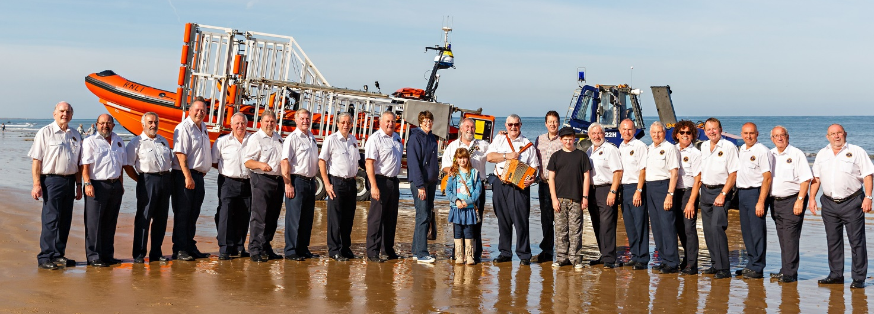
SHERINGHAM SHANTYMEN
UKRAINE CHARITY CONCERT
St. Peter’s Church Sheringham
Sat 26th March 2022 Doors Open @ 7.00 pm
Performance starts @ 7.30 pm
FREE ENTRY
With retiring collection for the
people of Ukraine
Introduced by Duncan Baker MP

