Slide 1
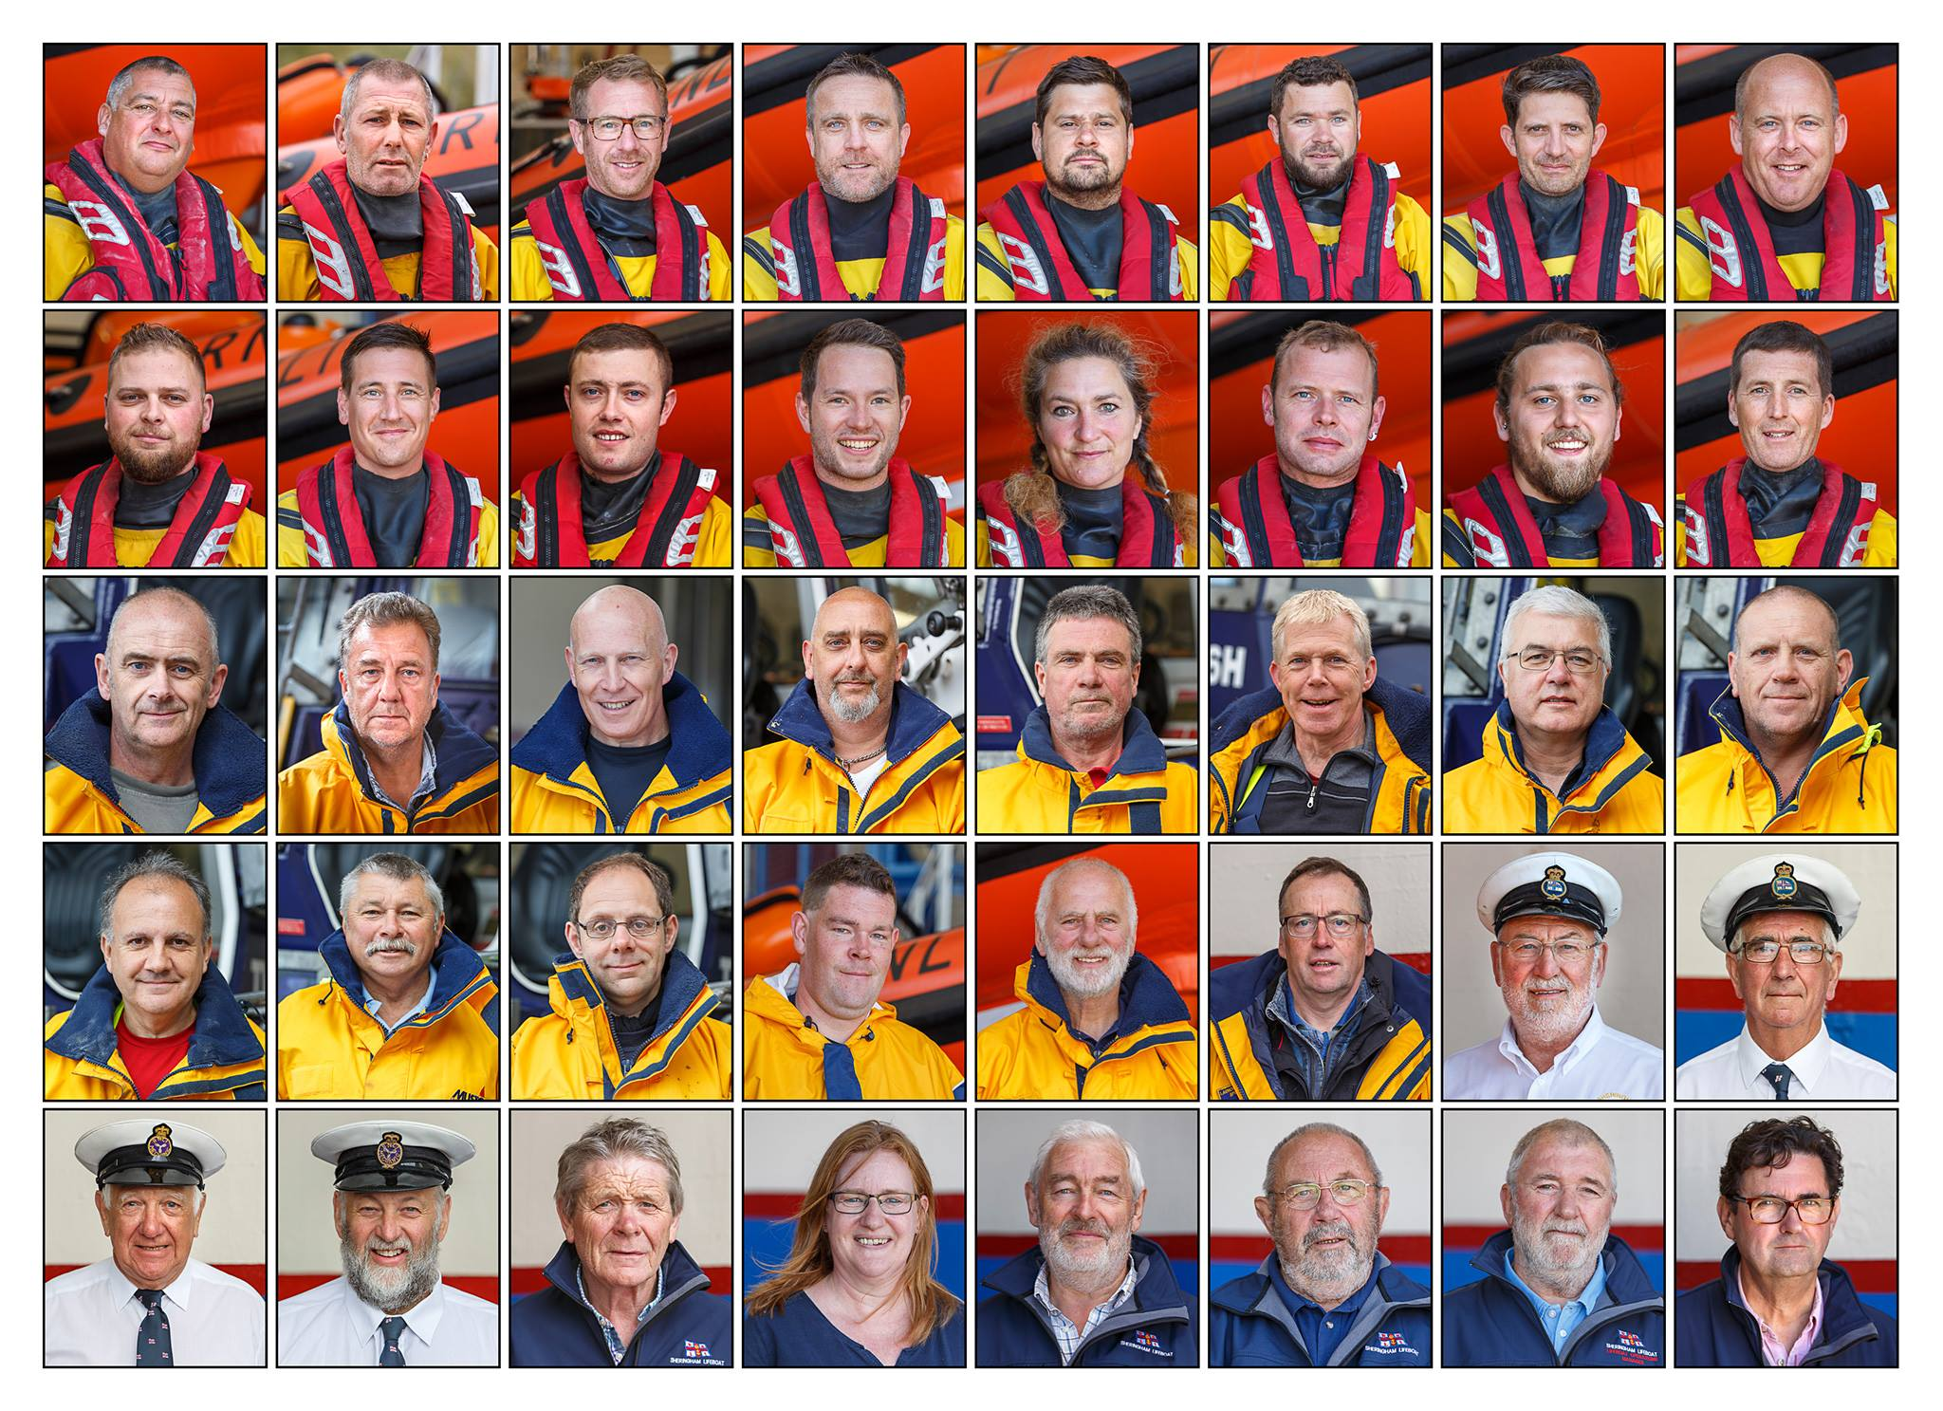
David Hagan
Senior Helm
Tony Webster
Helmsman
Chris Taylor
Helmsman
Steve Banks
Helmsman
Steve Wright
Helmsman
Liam Cooper
Crew
Paul Pretty
Crew
Andy Trend
Crew
Jamie Crisp
Crew
Paul Harding
Crew
Kieren Spurling
Crew
Steve Price
Crew
Kate Munro
Crew
Jim Mack
Crew
Lewis Gray
Crew
Paul Brennan
Crew
Steve Roberts
Team Leader
Mark Herring
Tractor Driver
Steve Howes
Tractor Driver
Paul Wheatland
Tractor Driver
Graham Brennan
Tractor Driver
Denis Coogans
Shorehelper
Paul Wadsworth
Tractor Driver
Kevin Mann
Shorehelper
Ian Roper
Shorehelper
Roderick Cowen
Shorehelper
Joseph Jarvis
Shorehelper
Tom Harbord
Shorehelper
Ian Dent
Head Launcher
Ben Middleton
Ass't Launcher
Clive Rayment
DLA
Trevor Holsey
DLA
Chris Ayers
Boathouse H&S
David Mann
DLA
Martyn Jackson
L/B Trainer
Gail Barker
L/B Visits Officer
Dick Grieve
Publicity Officer
Tony Randall
RNLI Treasurer
Brian J Farrow
L/B Ops Manager
Phil Hawes
Branch Chairman

