Slide 1


EFREI / LMG
HACKATON
BUILD A NLP MODEL FROM SCRATCH

Slide 2

DEMO

Slide 3
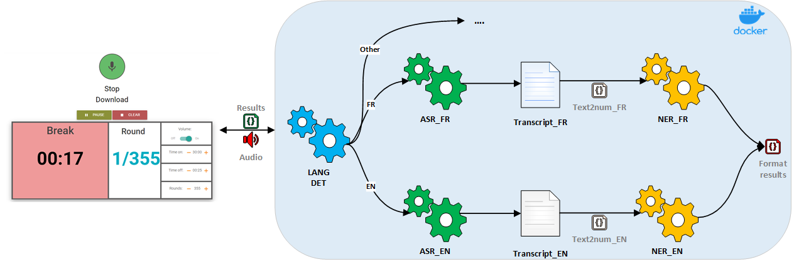
SpeechTimer : Use your voice to setup a sport interval timer
The camp consists on building from scratch NLP/NER model in French
Goal: a more complex dataset and a better model

Slide 4


Slide 5
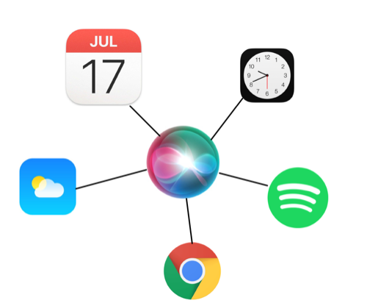
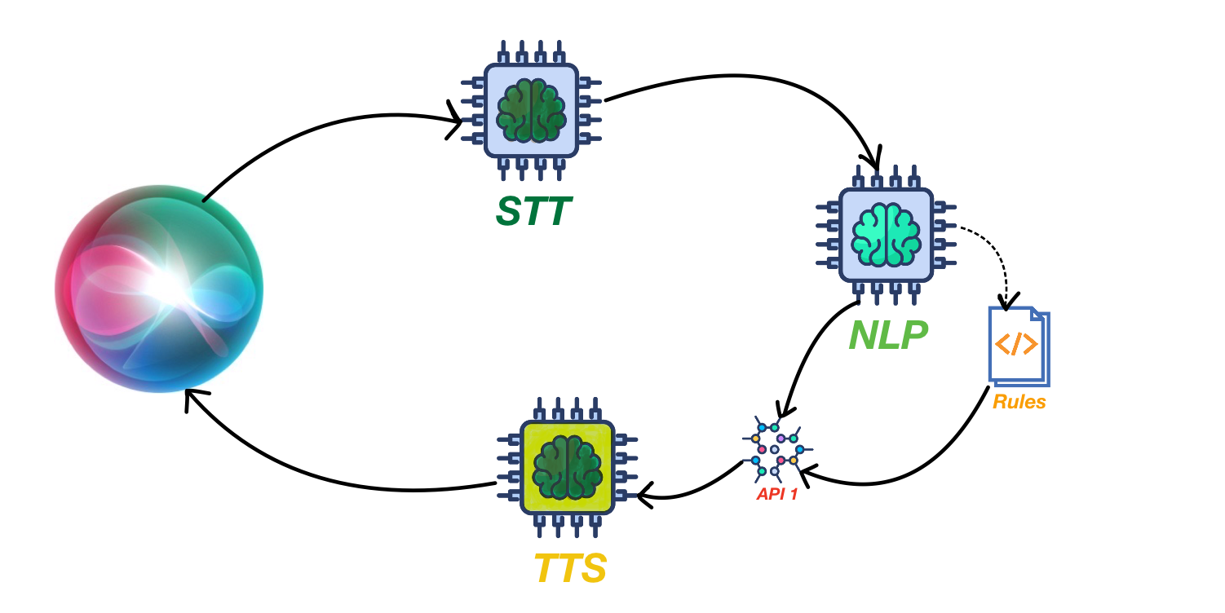

Slide 6

NLP : Natural Language Processing
Set of techniques for understanding, analyzing and extracting text
Technological advancements timeline :
ML (BOW / TF-IDF) > RNN > LSTM > BERT (2019)
Some types on NLP models :
Classification
Named Entity Recognition
Translation
Sentiment Analysis
Q/A
…

Slide 7



Slide 8

ASR : Automatic Speech Recognition
Technological advancements timeline :
Standard: Kaldi (acoustic model to train phonemes - langage model to convert phonemes to readable text)
End-to-End : Deepspeech (2014)
Self-supervised : Wav2vec2.0 (2020)

Slide 9
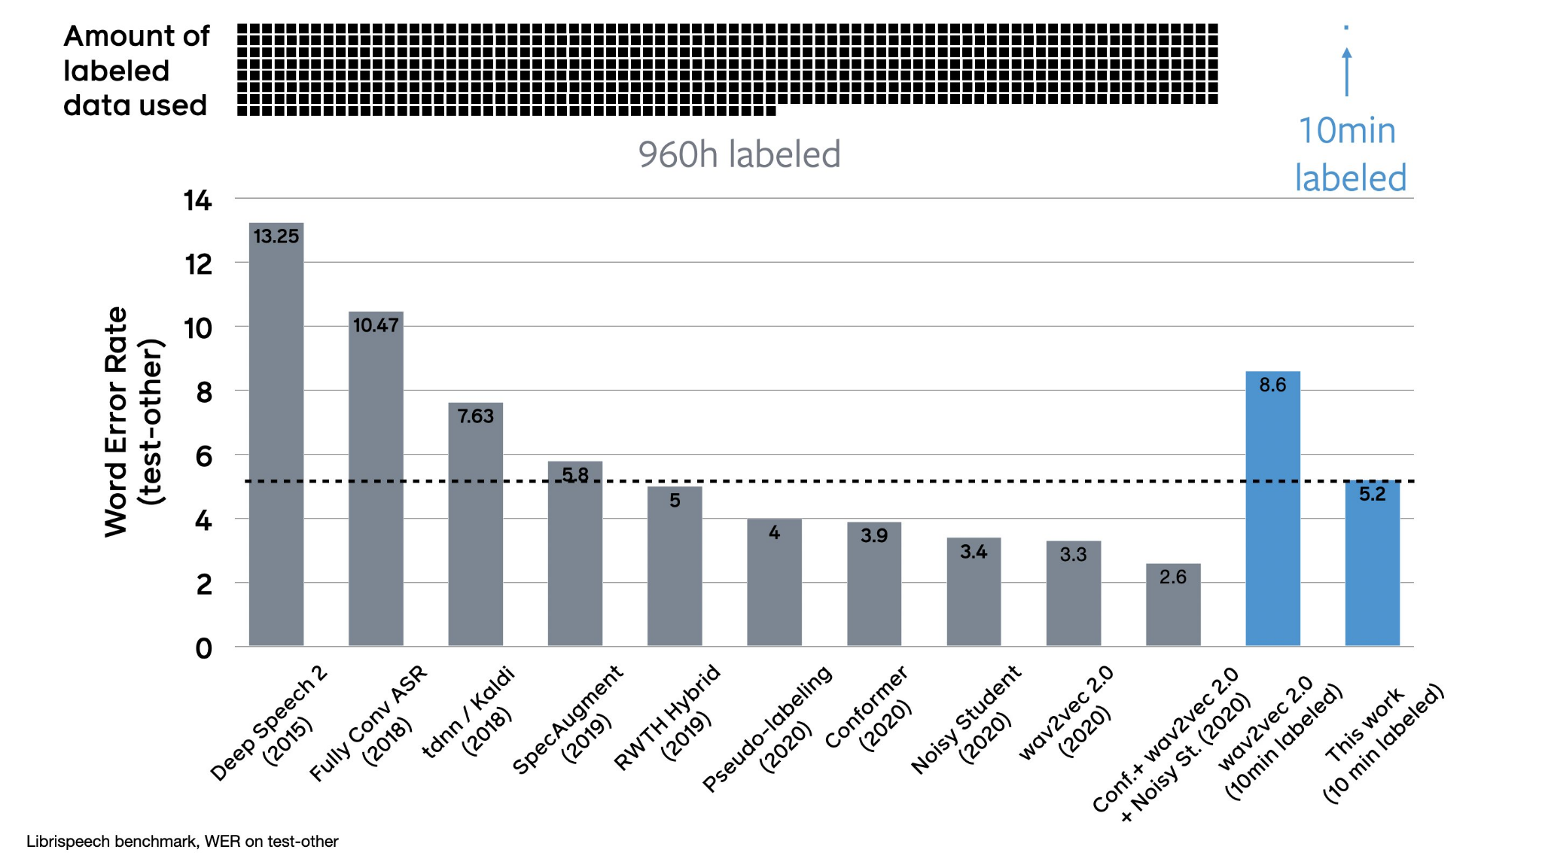

Slide 10
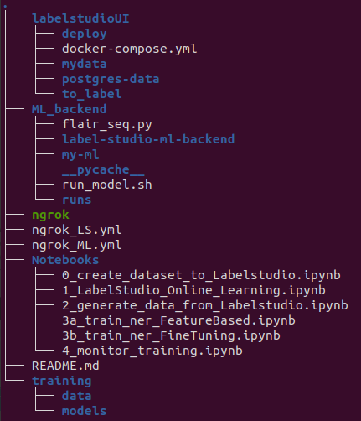
Project folders

Slide 11



Opensource Toolset
Work environment

Slide 12
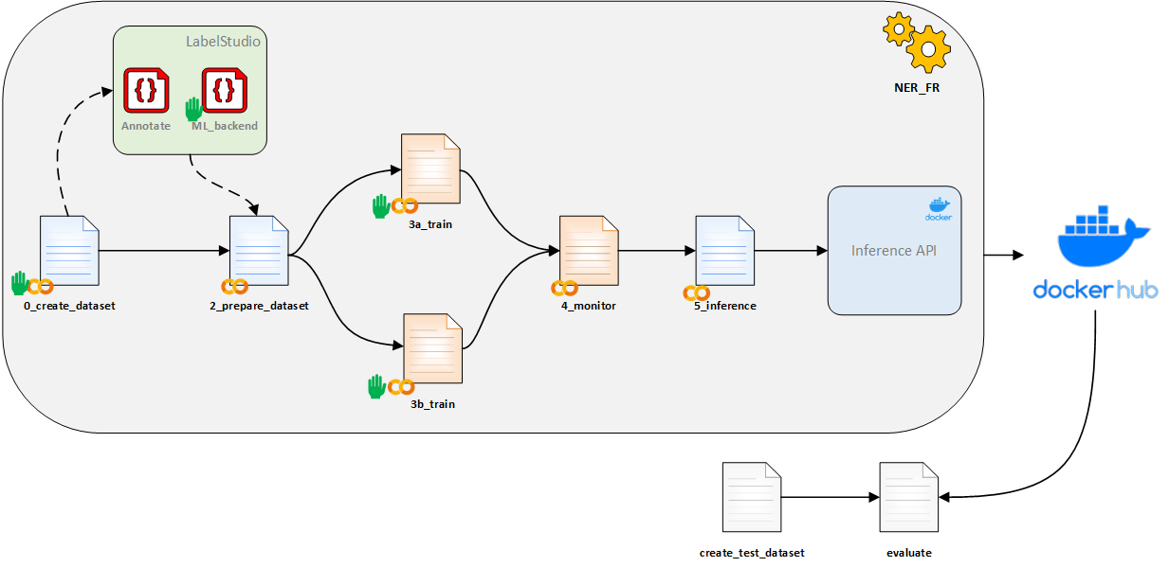
Application / NER French
EVALUATOR

Slide 13
Day main stages
STAFF
DEADLINE
Send project link 9h45
Upload project to Google Drive
Setup Labelstudio in PC
Build Dataset & extract labeled data - Notebook 0 & 2
Start labelling
Send Evaluator link 11h30
Setup Labelstudio Model backend in PC
Submit a basic model to Evaluator before 13h30
API
Model
(Pre-)Labelling + correction and monitoring
Training and optimization (model architecture, hyperparams) - Notebook 3a & 3b
Test final model before submission - Notebook 5
Submit final model & Api (dernier 17h15)
Display winners by 18h30
NOTES:
Pay attention to the download time, the Model can be large, up to 2Gb (it can take up to 20 min to upload)

Slide 14
Sourcing / setup labelling tool
Dataset is built with code (Notebook 0)
You can edit code parts:
Dataset volume
Get representative dataset
The dataset template contains already all the type of sentences needed for this use case
NOTES:
This step should be done once, choose carefully the dataset size you will be using during all the day

Slide 15
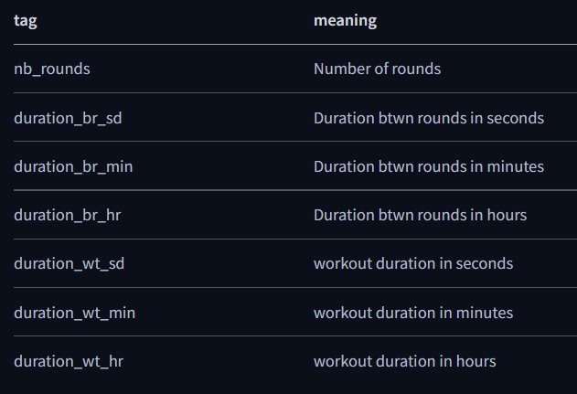
Dataset / Labelling
Goal is to add more complexity to the Dataset:
1 er ajout
19 séries de 3 minutes 30duration_wt_sd 21 minutes 25duration_br_sd entre chaque série
2ème ajout
3 sets de 20 heures et quartduration_wt_min
3 sets de 20 heures moins quartduration_wt_min
3 sets de 3 minutes, 3 heures et demiduration_br_min entre chaque série
NOTES:
Highlight only numeric characters (except “et quart” “moins quart”...)
Avoid making mistakes, 10 sentences labelled correctly better than 50 with 20% errors
Check instructions carefully before starting to label
You have all admin rights in the UI, be careful what you’re doing (Ex. remove labeled data !)

Slide 16
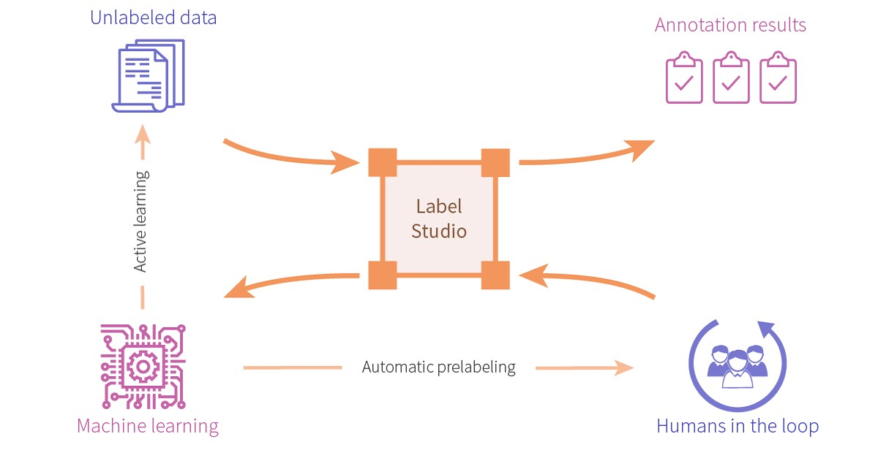
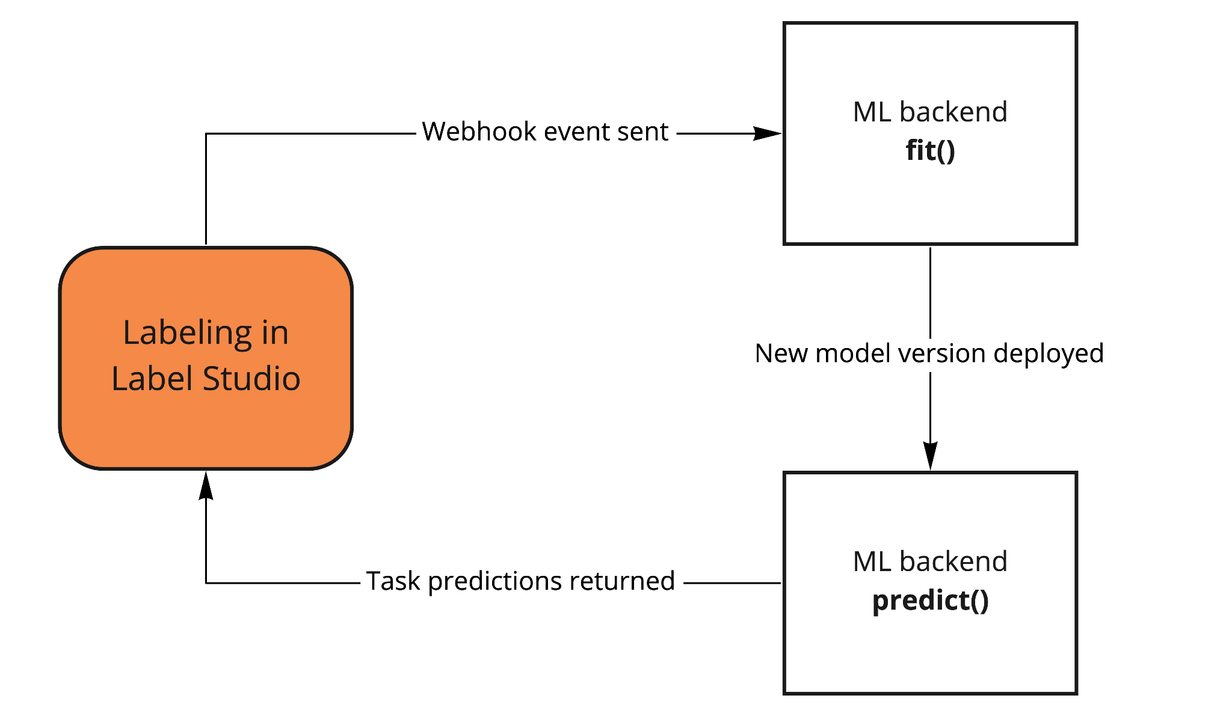
Model pre-labelling setup
Model pre-labelling is a manually intensive Task !
Automatic pre-labelling / Active learning can help!
Model templates:
Flair seq2seq (LSTM + CRF)
Flair Transformers (fine-tuning Transformer pretrained models)
NOTES:
At least 50 annotated sentences before running the first training
Take into account the training time before re-launching a model
The more data there is, the longer the model takes to train
One person per Team is charged to Train the model - Communicate with your teammates

Slide 17
Training / optimization
2 Notebooks templates for training use 2 different approaches
Lstm + CRF
Transformers
Included Hyper-parameter optimization / real time monitoring on Tensorboard
Check links and tags in training notebooks for more detail
#FINETUNE #TIPS #PAPER
NOTES:
Start this step only when you decide to stop the annotation (except for the basic model)
Model evaluation is not based only on performance ! (check Final Evaluation slide)

Slide 18
Model uploading to Evaluator
Notebook 5 to test and evaluate your model and Api before uploading
To submit your model:
if <= 500 Mo:
submit to EVALUATOR App
if > 500 Mo:
Share downloadable link by email (respond to TOKEN EMAIL)
Google drive
Wetransfer
To submit your API:
Submit to EVALUATOR App
NOTES:
Start this step only when you decide to stop the annotation (except for the quick & dirty model)

Slide 19
Final evaluation
Deliverables
Api (Https link) to submit to Evaluator
a model named model.pt
Metrics used for evaluation:
Performance (F1-micro)
Model size (Mb)
Inference speed (seconds)
Penalties :
Teams submit similar model (may infringe School regulations)
Api URL not submitted
Late submission

Slide 20
GOOD LUCK !

