Slide 1

Note: The data and information in this document is reflective of a hypothetical situation and client. This document is to be used for KPMG Virtual Internship purposes only.
Sprocket Central Pty Ltd
Data analytics approach
[Zelong Chen]

Slide 2
Note: The data and information in this document is reflective of a hypothetical situation and client. This document is to be used for KPMG Virtual Internship purposes only.
Agenda
Introduction
Data Quality Assessment
Data Analytics Approach
Data Insights & Assumptions

Slide 3
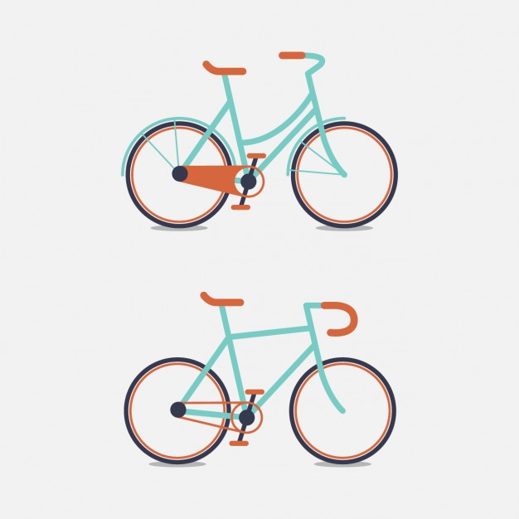

Note: The data and information in this document is reflective of a hypothetical situation and client. This document is to be used for KPMG Virtual Internship purposes only.
Introduction
The analysis below aims to boost Sprocket Central’s bike sales by analyzing their existing customer dataset to determine customer trends and behavior. In addition, identify high value customers for targeted marketing.

Slide 4
Note: The data and information in this document is reflective of a hypothetical situation and client. This document is to be used for KPMG Virtual Internship purposes only.
Data Quality Assessment
Sprocket Central provided three datasets: “Transactions”, “Customer Address”, and “Customer Demographic”. Below outlines some data issues and ways to mitigate them.
Validity: Inconsistent values for same attribute
(i.e. Victoria = “V”, “Vic”, “Victoria” , Female = “F”, “Femal”, “Female”)
Mitigation: Use regular expressions to replace extended values to ensure consistency
Completeness: Missing values in certain records
Mitigation: Remove records as number of empty rows are small w.r.t. size of dataset
Relevancy: Some customers from “Transactions table” are not in “Customer Demographic table”
Mitigation: Remove these transaction records w/o complete customer demographic data
(32 / 20,000 records)

Slide 5
Note: The data and information in this document is reflective of a hypothetical situation and client. This document is to be used for KPMG Virtual Internship purposes only.
Data Analytics Approach
Data Cleaning:
- Refer to Data Quality Assessment Slide
Data Processing:
- Categorical Variables Encoding using One Hot Encoding / Label Encoding
- Converting Date of Birth into Age Brackets
- Split data into Training and Validation sets
Model Training and Validation:
- Generate all permutation of features to train multiple Linear Regression models
- In addition, train multiple Decision Tree Regressor models with different depth
- Then using 5-fold cross validation to select the best performing model
Prediction and Interpretation
- Using best performing model, retrain using the full set of training data and
predict “High Value Customers” using the New Customer Demographic Data

Slide 6
Note: The data and information in this document is reflective of a hypothetical situation and client. This document is to be used for KPMG Virtual Internship purposes only.
Data Insights & Assumptions
Best performing model: Decision Tree Regressor (Depth = 3)
Feature Importance
Past 3 Years Bike Related Purchases | 0.28
Owns Car | 0.22
Age Bracket | 0.18
Property Valuation | 0.14
Tenure | 0.09
Job Industry Category: Financial Services | 0.08
Key Insights:
- Past 3 Years Bike Related Purchases > 65
- Owns Car: Yes

Slide 7
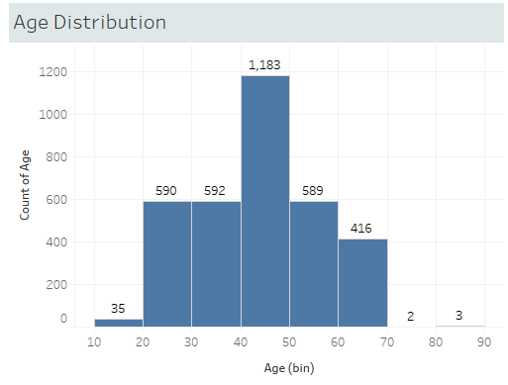
Note: The data and information in this document is reflective of a hypothetical situation and client. This document is to be used for KPMG Virtual Internship purposes only.
Data Insights & Assumptions
Assumption: “High Value Customers”
- “Value” in this analysis is defined as total profit generated
- It can also be defined as the number of purchases, number of
high margin products purchased, or etc.
Assumption: Data Skew
- The age distribution of the data is skewed towards the 40-50s
range. It might not represent the actual customer
demographics.

Slide 8
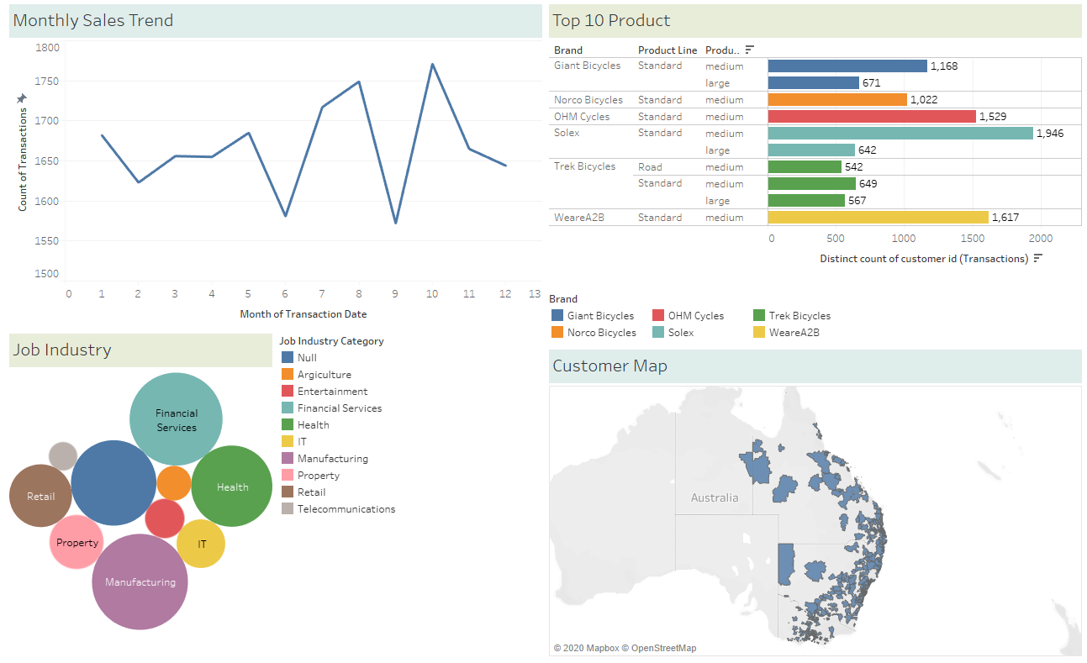
Note: The data and information in this document is reflective of a hypothetical situation and client. This document is to be used for KPMG Virtual Internship purposes only.
Tableau Analysis

