Slide 1
APPENDIX · TECHNICAL DEPTH
Knowhow
Twelve slides of the math, the tests, and the code patterns that back the headline numbers.
INDEX
A1 Walk-forward CV A2 Log-loss vs accuracy A3 Brier decomposition A4 Dixon-Coles math A5 Time-decay weighting A6 ClubElo update A7 Vig removal + Kelly A8 NLP attribution A9 PCA + K-means clusters A10 Team-name harmonisation A11 Anti-leakage unit test A12 Posit Cloud deploy
Notes:
Speaker notes — Knowhow A0 (cover). This is the appendix deck. Twelve slides of technical depth I'd reach for if a question goes beyond the headline ten-minute talk. The index is on the cover so I can jump directly to a slide by number when prompted. Routing rule: if the question is about methodology, anti-leakage, or a specific math choice (Dixon-Coles, Kelly, Brier), I have a slide for it. Otherwise I'll stay verbal.

Slide 2
A1 · VALIDATION
Walk-forward CV — never k-fold
Random k-fold leaks the future. Folds drawn uniformly mix matches from 2020 with matches from 2010 — the model can use a 2020 home-form average to predict a 2010 outcome. Walk-forward expanding window. At fold k, train on seasons 1..k, validate on season k+1. Mirrors how the model would actually be used in production: every prediction uses only data available before kickoff.
Reported metric is the mean over folds; we also report per-season log-loss to show stability across the test windows.
Season 1
Season 2
Season 3
Season 4
Season 5
Fold 1
Fold 2
Fold 3
Fold 4
train
validate
unseen (future)
STAT 5243 Project 4 — Knowhow Appendix · Liang · Chen · Collaborator
A1 / A12
Notes:
A1 — Walk-forward CV. The picture on the right shows the expanding-window pattern: at fold k we train on the first k seasons, validate on season k+1, never let the future look back. Mean-over-folds is what we report. Per-season log-loss is in the appendix-of-the-appendix.

Slide 3
A2 · SCORING RULES
Why log-loss is the headline metric
Accuracy is too coarse for 3-class probabilistic forecasting. It throws away the model's confidence. A model that says (0.50, 0.20, 0.30) and one that says (0.95, 0.02, 0.03) are scored identically when the home team wins. Log-loss is a proper scoring rule. It is uniquely minimised when the predicted distribution equals the true distribution. Confidently wrong predictions are penalised asymptotically — that's why Always-Home gets log-loss 22.4.
We also report Brier (alternative proper rule) and AUC OvR (rank-based).
Multiclass log-loss
L(y, p̂) = − (1/N) Σᵢ Σ_c 1{yᵢ = c} · log p̂ᵢ,c
Predicted p̂(true class) | Per-row log-loss
0.95 | 0.05
0.50 | 0.69
0.20 | 1.61
0.05 | 3.00
0.001 | 6.91
STAT 5243 Project 4 — Knowhow Appendix · Liang · Chen · Collaborator
A2 / A12
Notes:
A2 — Why log-loss. Accuracy collapses confidence into 0/1, so it cannot tell a model that's barely correct from one that's screamingly correct. Log-loss is a proper scoring rule, the cost of being confidently wrong grows asymptotically, and that is exactly why Always-Home posts a catastrophic 22.4 on the leaderboard.

Slide 4
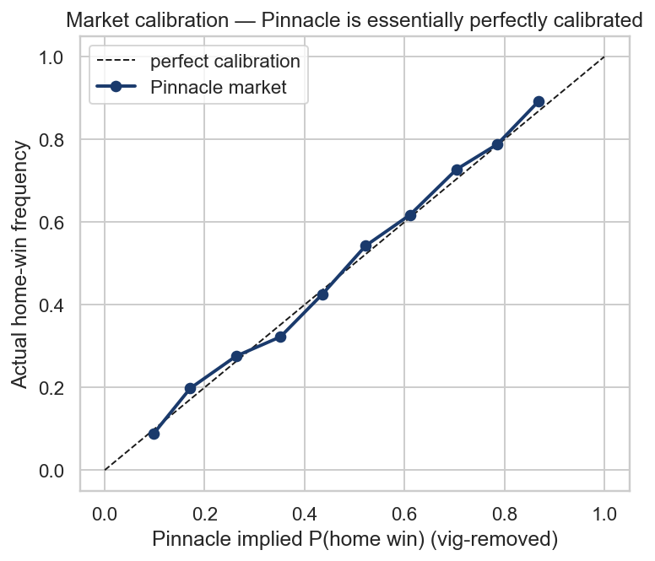
A3 · CALIBRATION
Brier-score decomposition
Brier complements log-loss with a finite penalty for any error. Murphy (1973) decomposes a Brier score into three interpretable parts:
Murphy decomposition
Brier = Reliability − Resolution + Uncertainty
Reliability
Lower is better. Distance between predicted probability bins and observed frequencies. Calibration error in disguise.
Resolution
Higher is better. How much sharper the conditional distributions are than the marginal — i.e. is the model differentiating?
Uncertainty
Irreducible. Variance of the marginal class distribution. Football's intrinsic noise floor.
Pinnacle close: essentially on the diagonal — pure calibration.
STAT 5243 Project 4 — Knowhow Appendix · Liang · Chen · Collaborator
A3 / A12
Notes:
A3 — Brier decomposition. Reliability is calibration error in another guise. Resolution measures how much the model differentiates. Uncertainty is the irreducible noise floor of football. We compare reliability and resolution across models — a model can lose to the market on log-loss but still be better-calibrated on a particular outcome.

Slide 5
A4 · SCORE MODEL
Dixon-Coles bivariate Poisson
Per-team latent attack and defence. α_t = attack strength of team t β_t = defensive frailty (positive → leaks goals) γ = global home-advantage offset ρ = low-score correlation correction Identifiability constraint: Σ_t α_t = 0. Fitted by SLSQP-constrained MLE on a 0.0065/day exponentially decayed sample.
Marginalise the joint to recover H/D/A:
p_H = Σ_{x>y} P(x,y) · p_D = Σ_x P(x,x) · p_A = Σ_{x<y} P(x,y)
Match-level scoring rates
λ = exp(α_h + β_a + γ)
μ = exp(α_a + β_h)
Joint pmf with low-score correction
P(X=x, Y=y) = τ(x,y; λ,μ,ρ) · Pois(x;λ) · Pois(y;μ)
tau τ — fixes 0-0 / 1-1 underprediction
τ(0,0)=1−λμρ τ(0,1)=1+λρ
τ(1,0)=1+μρ τ(1,1)=1−ρ
STAT 5243 Project 4 — Knowhow Appendix · Liang · Chen · Collaborator
A4 / A12
Notes:
A4 — Dixon-Coles. Each team has an attack rating α and a defence frailty β. The home team's expected goal rate is exp of attack + opponent defence + γ home advantage. The tau correction multiplies the joint pmf for the four low-low scorelines so the model doesn't under-predict 0-0 / 1-0 / 0-1 / 1-1 — the well-known Maher-1982 weakness. We marginalise the joint to get H/D/A — the same model gives us both the exact-score prediction and the outcome prediction.

Slide 6
A5 · WEIGHTING
Time-decay weighting
Football is non-stationary. Manager turnover, transfers, tactical evolution — a match from 2002 should not be weighted equally to one from last week. Exponential decay weight in the likelihood:
WEIGHT-VS-AGE CURVE (placeholder)
figures/decay_weight_curve.png
Weight of a historical match i
w_i = exp(−λ · days_old_i)
Match age | Weight
30 days | 0.82
107 days (half-life) | 0.50
1 year | 0.094
3 years | 0.001
λ = 0.0065 / day gives a half-life of about 107 days — roughly 14 matches. Tuned by walk-forward log-loss; flat (λ=0) loses to decayed by ~0.01.
STAT 5243 Project 4 — Knowhow Appendix · Liang · Chen · Collaborator
A5 / A12
Notes:
A5 — Decay. The exp-minus-lambda-times-days kernel down-weights old matches. Lambda equals 0.0065 per day was chosen by walk-forward log-loss; it gives a half-life around 107 days — roughly fourteen matches, which is a meaningful window of "current form".

Slide 7
A6 · STRENGTH RATING
ClubElo update mechanics
Two strength signals. 1. ClubElo (clubelo.com) — third-party, daily, since 2000. 2. Our own Elo, recomputed from football-data.co.uk results. Update rule (Elo / FIFA-Maher style):
WORKED EXAMPLE
Liverpool 1 − 1 Tottenham
Pre-match: R_h = 1920 R_a = 1820 HFA-adj diff: (1820 − 1920 − 65) / 400 = −0.4125 E_h = 1 / (1 + 10^−0.4125) = 0.721 S_h = 0.5 (a draw) Update: R_h ← 1920 + 20·(0.5 − 0.721) = 1915.6 (drops 4.4) R_a ← 1820 + 4.4 = 1824.4
Expected score & rating update
E_h = 1 / (1 + 10^((R_a − R_h − HFA)/400))
R_h ← R_h + K · (S_h − E_h)
K = 20 (typical), HFA = 65 home-advantage points (pre-Covid).
STAT 5243 Project 4 — Knowhow Appendix · Liang · Chen · Collaborator
A6 / A12
Notes:
A6 — Elo. Two strength signals. We use third-party ClubElo as the canonical rating and we re-derive our own Elo from results so we can audit the rating dynamics. The worked example on the right walks through Liverpool drawing 1-1 with Tottenham at home: Liverpool was the favourite, expected score 0.72, actual 0.5, so they drop 4.4 rating points and Tottenham gain the same amount.

Slide 8
A7 · MARKET & BETTING
Vig removal and Kelly-fractional sizing
Vig removal — Pinnacle close
Kelly — fraction of bankroll to stake
p_raw,c = 1 / odds_c
overround = Σ_c p_raw,c (≈ 1.05)
p_novig,c = p_raw,c / overround
f* = (b · p − q) / b
where b = decimal_odds − 1, q = 1 − p
Pinnacle's overround is ~5%. Renormalising p_H + p_D + p_A → 1 strips the bookmaker margin and gives a usable probability estimate. Pinnacle is the closest-to-fair book; other books need their bigger overround removed before comparison.
f* maximises expected log-bankroll. We cap f* at 5% of bankroll per bet ("fractional Kelly"). Full Kelly's variance is brutal — the cap halves drawdown for ~80% of expected growth. Place only when edge = p · odds − 1 > 0. Size by the formula above; track bankroll trajectory.
STAT 5243 Project 4 — Knowhow Appendix · Liang · Chen · Collaborator
A7 / A12
Notes:
A7 — Vig + Kelly. Vig removal: bookmakers' implied probabilities don't sum to 1; you renormalise to recover a usable probability. Kelly sizing: the fraction that maximises expected log-bankroll. Full Kelly is too volatile so we cap at 5% — that's "fractional Kelly". We only place a bet when the edge is strictly positive.

Slide 9
A8 · NLP PIPELINE
spaCy + VADER per-team sentence attribution
Algorithm sketch. 1. Strip BBC/Guardian boilerplate via BeautifulSoup; concat <article> text. 2. Sentence-split on the standard regex (?<=[.!?])\s+. 3. For each sentence, attribute to the team whose canonical name appears uniquely in that sentence (skip mixed-mention sentences). 4. Score each per-team sentence with VADER; aggregate by mean. 5. Run spaCy en_core_web_sm NER once on the full doc; count PERSON entities. 6. Apply regex keyword classifier (red card / penalty / VAR / injury / controversy). Output ~12 derived columns per match.
src/nlp/parse_match_report.py
def per_team_sentiment(text, h_t, a_t):
sia = _sentiment()
sents = re.split(
r"(?<=[.!?])\s+", text)
hl, al = h_t.lower(), a_t.lower()
h, a = [], []
for s in sents:
sl = s.lower()
c = sia.polarity_scores(s)[
"compound"]
if hl in sl and al not in sl:
h.append(c)
elif al in sl and hl not in sl:
a.append(c)
return mean(h), mean(a)
STAT 5243 Project 4 — Knowhow Appendix · Liang · Chen · Collaborator
A8 / A12
Notes:
A8 — NLP attribution. Sentence-split, attribute each sentence to whichever team is mentioned uniquely in it, score with VADER, mean-aggregate. The mixed-mention sentences are deliberately dropped — they're noise. SpaCy NER runs once on the full doc for entity counts, and a small regex classifier flags red cards, penalties, VAR, injuries, and a generic controversy flag.

Slide 10
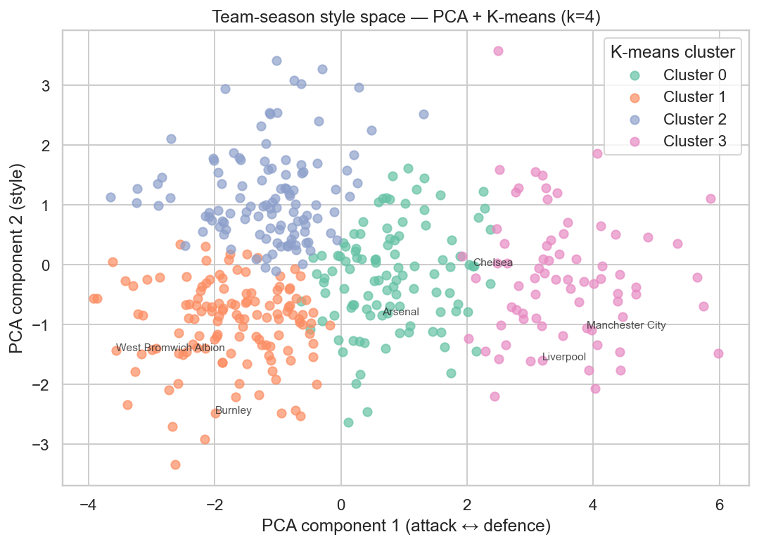
A9 · UNSUPERVISED
PCA + K-means team-style clusters
Inputs. Per-team-per-season aggregate stats: shots/match, possession, passes-completed, xG-for, xG-against, set-piece share, fouls. Pipeline. StandardScaler → PCA(n=2) → KMeans(k=4, random_state=20260426). Why k=4. Elbow at k=4 on the within-cluster sum of squares; silhouette also peaks around k=4. The clusters correspond to interpretable archetypes:
k | Archetype | Typical clubs
0 | Possession-dominant | Man City, Liverpool, Chelsea
1 | Counter-attacking | Leicester '15-16, Spurs '21
2 | Defensive low-block | Burnley, Stoke '12-15
3 | Mid-table mix | West Ham, Everton, Newcastle
PCA-2 with K-means (k=4) — see clusters identified on facing page.
STAT 5243 Project 4 — Knowhow Appendix · Liang · Chen · Collaborator
A9 / A12
Notes:
A9 — PCA + K-means. PC1 is roughly possession-vs-counter, PC2 is roughly defensive-discipline. K=4 hits the elbow on inertia and the local max on silhouette. The archetypes drift across seasons — Leicester's title-winning team sits in cluster 1, but the same club sits in cluster 3 a year later. We feed the cluster ID and the two PCs to the supervised model.

Slide 11
A10 · JOINS
Team-name harmonisation — fail fast on unknowns
The silent-mis-join trap. football-data.co.uk uses "Man United", FBref uses "Manchester Utd", BBC uses "Manchester United", Wikipedia uses "Manchester United F.C.". A naive merge silently drops ~40% of rows and corrupts every feature downstream. Our pattern. 1. Define a canonical name dict (Wikipedia article title minus F.C.). 2. Every variant is normalised case + suffix-stripped. 3. canonical() raises UnknownTeamError on miss — caller fails loudly. 4. CI runs the canonicaliser over every scraped row on every push.
src/team_harmonize.py
class UnknownTeamError(KeyError):
pass
_TEAM_VARIANTS = {
"Manchester United": (
"Man United", "Man Utd",
"Manchester Utd",
),
"Tottenham Hotspur": (
"Tottenham", "Spurs",
),
...
}
def canonical(name: str) -> str:
key = _normalize(name)
if key not in _MAP:
raise UnknownTeamError(name)
return _MAP[key]
STAT 5243 Project 4 — Knowhow Appendix · Liang · Chen · Collaborator
A10 / A12
Notes:
A10 — Harmonisation. The classic football-data trap is silent mis-joins. We have a canonical dictionary, every variant is normalised before lookup, and unknown variants raise UnknownTeamError so the caller fails loudly instead of dropping rows quietly. CI runs this over every scraped row on every push, which catches new variants the moment a scraper picks them up.

Slide 12
A11 · CI SAFETY NET
Anti-leakage invariant — what the test checks
The invariant. For every row m in the processed feature matrix and every rolling feature column f, the value of f[m] depends only on rows whose match_date is strictly less than m.match_date. What would break. Forgetting a .shift(1) on a rolling-window aggregate would let the current match's own goals leak into its own form-feature. What the test does. Build features twice — once with the full dataset, once with the dataset truncated to seasons ≤ 2018-19. For every match in 2018-19, the feature values must match exactly across the two builds. If they differ, future data leaked.
tests.test_no_temporal_leakage
def test_no_temporal_leakage():
raw = load_interim_matches()
full = build_processed_matches(raw)
cutoff = pd.Timestamp("2019-08-01")
early = raw[raw.match_date < cutoff]
truncd = build_processed_matches(early)
cols = [c for c in full.columns
if c.startswith(("home_form",
"away_form"))]
full_pre = full[full.match_date < cutoff]
pdt.assert_frame_equal(
full_pre[cols].reset_index(drop=True),
truncd[cols].reset_index(drop=True),
)
STAT 5243 Project 4 — Knowhow Appendix · Liang · Chen · Collaborator
A11 / A12
Notes:
A11 — Anti-leakage. The invariant is that any rolling feature for match m depends only on matches strictly older than m. The test builds the feature matrix twice — once with the whole dataset, once truncated to before our cutoff — and asserts the rolling features for the pre-cutoff matches are identical between the two runs. If they differ, future data must have leaked.

Slide 13
A12 · DEPLOY
Posit Connect Cloud deployment workflow
1
Pre-bake artefacts
Run scrape → train → evaluate locally; commit results/leaderboard.csv plus the .joblib model files into the repo.
2
Pin the environment
requirements.txt with exact versions; rsconnect-python verifies and replays the env in the cloud build.
3
rsconnect deploy
rsconnect deploy shiny app.py --server connect.posit.cloud --api-key $RSC_API_KEY
4
Smoke-test in cloud
First request loads models; warm-time ~6s; subsequent requests <300ms because Shiny keeps state.
5
Pin the URL
Paste the deployed URL into the oral deck slide 11 and the README before submission.
STAT 5243 Project 4 — Knowhow Appendix · Liang · Chen · Collaborator
A12 / A12
Notes:
A12 — Deploy. Pre-bake every heavy artefact locally, commit the leaderboard CSV and model joblibs, pin the environment with requirements.txt, deploy via rsconnect-python, smoke-test once warm, paste the URL into slide 11 of the oral deck and the README. The deploy URL is a TODO until the night before — Posit Connect Cloud regenerates the URL on every push.

