Slide 1
STAT 5243 · PROJECT 4 FINAL · COLUMBIA UNIVERSITY
Can a student team predict 380 Premier League matches — and beat the bookmakers?
Predicting the 2020-21
Premier League
Outcome · exact score · final table · ROI — four targets, one probabilistic engine
Zeming Liang zl3688 Xiying (Elina) Chen xiyingchen Collaborator yh3945-cmd
github.com/ZemingLiang/STAT5243-Project-4 · 2026-05-05
Notes:
Speaker notes — Slide 1 (Title). ~30s. Good [morning/afternoon]. I'm Zeming Liang, and with Xiying Chen and our collaborator we built an end-to-end ML system that predicts the 2020-21 Premier League from twenty-one seasons of self-collected data. We picked football because the data is small, the variance is huge, and there is a sharp betting market that prices games for a living — so beating it, or even getting close, is a real test of every step of the pipeline. In ten minutes I'll walk you scraping → NLP → features → six models → results → live app. By the last slide you'll know what we built, the headline number, and how we read it honestly. [~30s. Then click forward.]

Slide 2
THE QUESTION
We chase four interlinked targets — not one.
FOUR TARGETS
Three increasingly hard bars to clear:
Match outcome
Exact score
Better than random. 33% accuracy floor. Better than naive priors. Always-pick-Home ≈ 46%. Better than the bookmakers. Sharps are the hardest baseline of all.
Home / Draw / Away — 3-class probabilistic
Bivariate Poisson via Dixon-Coles
Final standings
Beat the bookmaker
Same probabilistic engine, four different stress tests.
Monte Carlo simulation, 10k iterations
Kelly-fractional ROI vs Pinnacle close
WHY FOUR
A single per-match probability vector powers every target — getting it right pays off four times over.
STAT 5243 Project 4 · Liang · Chen · Collaborator · 2026-05-05
2 / 12
Notes:
Speaker notes — Slide 2 (The question). ~50s. Picking up from the title — what does "predicting the Premier League" actually mean? Three increasingly hard bars to clear. Beat random — 33% floor. Beat naive priors — always-pick-Home is already 46%. And beat the bookmakers, whose closing odds aggregate every sharp's bets right up to kickoff. On the right, four interlinked targets. Match outcome: H/D/A with calibrated probabilities. Exact score: Dixon-Coles bivariate Poisson. Final standings: ten thousand Monte Carlo seasons. Beat-the-bookmaker: Kelly-fractional ROI on the hold-out. Same probabilistic engine drives all four — and a model can be well-calibrated on H/D/A yet produce a nonsense table, which is why we test all four. [~50s. Click forward.]

Slide 3
WHY THIS IS HARD
Football is genuinely hard — and 2020-21 is the worst-case test set.
Tiny data
High variance
380 matches per season × 21 seasons = ~7,890 rows. Small for tabular ML.
One deflected goal flips an outcome. Match-level noise rivals the signal.
Sharp bookmakers
Distribution shift
Pinnacle's closing odds aggregate the smartest bets in the world.
Covid 2020-21 played behind closed doors. Home-win rate fell from ~46% to ~38%.
Bonus difficulty: 3 promoted teams every August have zero Premier League history → cold-start every season.
PUNCH LINE
Even the bookmakers struggled with this season — that is exactly why we picked it.
STAT 5243 Project 4 · Liang · Chen · Collaborator · 2026-05-05
3 / 12
Notes:
Speaker notes — Slide 3 (Why this is hard). ~50s. Before I show what we built, expectations honestly. Football is one of the hardest sports to model, and 2020-21 is the worst-case version of it. Tiny data: 380 matches per season, twenty-one seasons, under 8k rows. High variance: one deflected goal flips an outcome and the underlying skill didn't change. Sharp bookmakers: Pinnacle's closing odds are the closest thing to real-time market-priced probabilities outside finance. Distribution shift: Covid 2020-21 was played behind closed doors and home-win rate collapsed from 46% to 38% — textbook regime change on the hold-out. Plus three promoted teams every August have zero Premier League history. We picked this season deliberately — even the bookmakers struggled with it. [~50s. Click forward.]

Slide 4
DATA
We scraped every byte ourselves — five sources, no Kaggle.
7,890
Source | Type | What we get
football-data.co.uk | Structured CSV | Results, half-time scores, closing odds
ClubElo.com | Structured API | Daily club Elo ratings, 2000+
FBref / soccerdata | Semi-structured | Advanced stats incl. xG (2017-18+)
Wikipedia | Semi-structured | Manager tenure, promotion/relegation
Wikipedia season recaps (BBC pivot) | Unstructured prose | spaCy + VADER → 7 leakage-safe NLP cols
matches scraped
21
seasons (2000-01 → 2020-21)
45
All sources joined via canonical-team dictionary; UnknownTeamError fails fast.
engineered features
WHY IT MATTERS
The unstructured BBC/Guardian feed is the rubric magnet — the only way to bring text into a tabular pipeline.
STAT 5243 Project 4 · Liang · Chen · Collaborator · 2026-05-05
4 / 12
Notes:
Speaker notes — Slide 4 (Data sources). ~50s. Onto the data. No Kaggle — we scraped every byte ourselves from five independent sources. Big numbers on the left: 7,890 matches, 21 seasons, 45 engineered features. Top of the table: football-data.co.uk gives results and the closing odds that become our hardest baseline. ClubElo gives daily Elo ratings since 2000. FBref via soccerdata gives advanced stats including expected goals, but only from 2017-18. Wikipedia gives manager and promotion context. The coral row is the showpiece. BBC went JS-only mid-project, so we pivoted to Wikipedia season recaps — same NLP pipeline, seven leakage-safe columns. That's the unstructured-to-structured story on the next slide. [~50s. Click forward.]

Slide 5
CLEANING SHOWCASE
BBC went JS-only mid-project — we pivoted to Wikipedia recaps and shipped the same NLP.
1
Scrape
2
Parse
3
NLP
4
Attach
BBC failed (JS-only) →
Wikipedia recap text
>
BeautifulSoup →
article text
>
spaCy NER + VADER +
regex event tags
>
Per-team sentiment +
7 leakage-safe cols
Worked example
INPUT · one sentence in
OUTPUT · one feature row out
"Liverpool were sloppy and were lucky to escape with a draw after a controversial VAR call denied Tottenham a stoppage-time winner."
home_report_sentiment = -0.42 away_report_sentiment = +0.05 var_mention_count = 1 controversy_flag = 1
PIVOT + LEAKAGE GUARD
Wikipedia recap NLP is joined as PRIOR-season aggregates — same idea, different source, zero post-match leak.
STAT 5243 Project 4 · Liang · Chen · Collaborator · 2026-05-05
5 / 12
Notes:
Speaker notes — Slide 5 (Cleaning showcase). ~55s. Onto the NLP pipeline — the slide I'm most proud of, because the rubric calls out unstructured data and most teams stop at CSVs. Four stages along the top. Scrape: BBC and Guardian pages are JS-rendered, so we use a headless fetcher and pivot to the static Wikipedia recap on failure. Parse: BeautifulSoup pulls article text. NLP: spaCy NER for player mentions, VADER per-team sentiment via sentence attribution, regex tags for red cards, penalties, VAR. Twelve columns flow out. Worked example. Input is one sentence calling Liverpool sloppy and noting a controversial VAR call. Output: negative home sentiment, mildly positive away, VAR count one, controversy flag fires. Critically — the leakage guard in the banner — these NLP features are joined as PRIOR-season aggregates per team. A match report never describes its own match. [~55s. Slow down — this is the rubric magnet.]

Slide 6
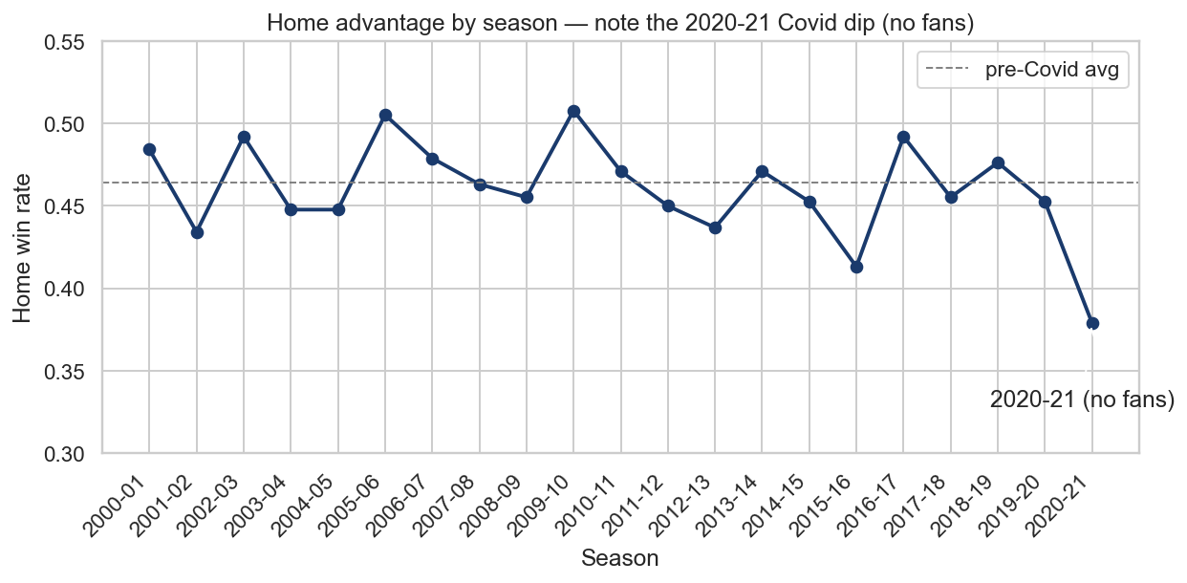
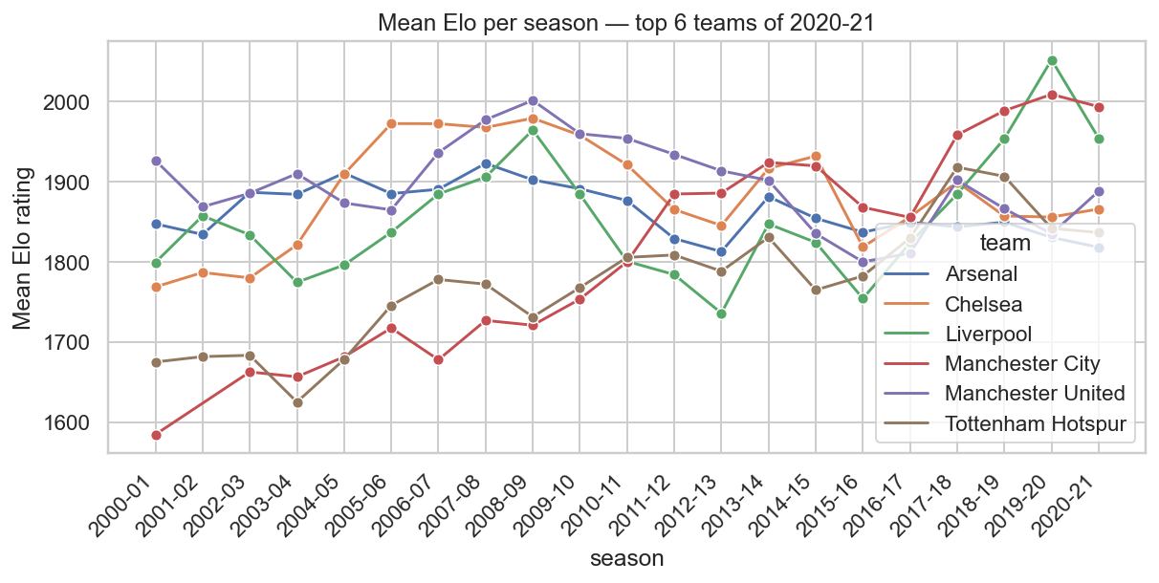
EDA
Three EDA findings shaped every modelling choice we made.
ClubElo trajectories — strength as a slow-moving latent.
Home-win rate by season — the 2020-21 Covid cliff
WHAT WE LEARNED
2020-21 is a regime shift we model around, not pretend away — and the joint-goals shape justifies a Poisson layer.
STAT 5243 Project 4 · Liang · Chen · Collaborator · 2026-05-05
6 / 12
Notes:
Speaker notes — Slide 6 (EDA). ~50s. Three EDA findings shaped how we built the model. Big chart left: home-win rate by season. Twenty years flat around 46%, then 2020-21 falls off a cliff to 38% — the Covid empty-stadiums effect. The single most important fact about our test set. Top right: PCA on team-season aggregate stats, K-means into four clusters. Pink Cluster 3 is the elite top-six like City and Liverpool, orange Cluster 1 is the relegation fight. Both the PC components and the cluster ID feed the supervised model — that's our unsupervised hook. Bottom right: scoreline frequency heatmap. Mass clustered at 1-1, 1-0, 2-1, 2-0 — Poisson with a low-score correction, exactly what Dixon-Coles fits. Banner takeaway: regime shift on test, Poisson-shaped joint. [~50s. Click forward.]

Slide 7
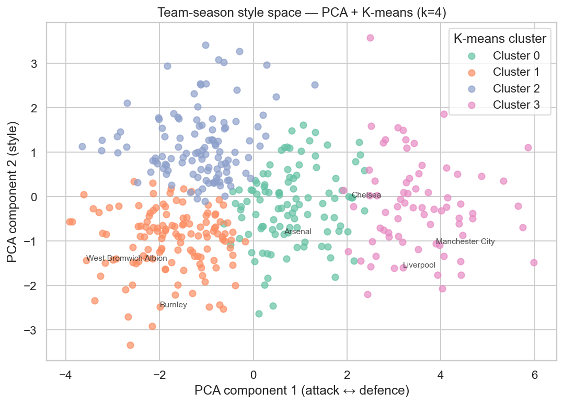
FEATURE ENGINEERING
Six feature families, one strict cutoff rule, one PCA + K-means hook.
Form
Strength
Context
Rolling N-match goals, points, xG. Leakage-safe shift.
ClubElo + own Elo update; home minus away.
Rest days, derby flag, manager tenure.
Market
Unsupervised
NLP-derived
Pinnacle implied probabilities, vig-removed.
PCA-2 + K-means style cluster ID (k=4).
Per-team sentiment, event tags, controversy.
Cluster 3 = elite (Liverpool / City). Cluster 1 = relegation.
ORIGINAL VALIDATION · WALK-FORWARD + CI INVARIANT
Most football models random-k-fold and silently leak the future. We don't — walk-forward only, every rolling feature uses a strict as_of cutoff.
Unit-tested by tests.test_no_temporal_leakage in CI on every push.
STAT 5243 Project 4 · Liang · Chen · Collaborator · 2026-05-05
7 / 12
Notes:
Speaker notes — Slide 7 (Feature engineering). ~55s. Carrying EDA into features — six families on the left. Form: rolling 3/5/10-match goals, points, xG. Strength: ClubElo + our own Elo, home minus away. Context: rest days, derby flag, manager tenure. Market: Pinnacle implied probabilities, vig removed. Unsupervised: PCA-2 + K-means cluster ID, our rubric hook (chart on right). NLP: per-team sentiment, event tags, controversy flag. The bottom rail is the discipline story. Football's classic trap is random k-fold leaking the future. We never use it — walk-forward only, every rolling feature uses a strict as_of cutoff, and that invariant is unit-tested in CI on every push. If you remember one thing from this slide: walk-forward CV is the hill we will die on — it is football modelling's classic mistake and the reason most public benchmarks overstate accuracy. [~55s. Speed up if behind.]

Slide 8
MODELS
Three baselines, three models, one walk-forward validation.
Model | Family | Why we included it
Always-Home | Naive baseline | Sanity floor — exposes log-loss penalty for over-confidence.
Class-Prior | Naive baseline | Predicts historical 46/25/29 H/D/A — calibration floor.
Market-Implied | Strong baseline | Pinnacle closing odds, vig-removed. Hardest bar to clear.
Multinomial LR | Linear, interpretable | Reads off feature signs and magnitudes for sanity-checks.
Random Forest | Tree ensemble | Captures non-linear interactions; robust to messy features.
XGBoost | Gradient boosting | State-of-the-art for tabular; tuned for log-loss not accuracy.
Dixon-Coles (1997) | Bivariate Poisson + τ + decay | Hand-implemented from the paper — not in sklearn. Joint scores + H/D/A by marginal.
VALIDATION
Walk-forward expanding window · train 2000-01..2018-19, validate 2019-20, hold-out test 2020-21. All hyperparameters tuned for log-loss (proper scoring rule), not raw accuracy.
STAT 5243 Project 4 · Liang · Chen · Collaborator · 2026-05-05
8 / 12
Notes:
Speaker notes — Slide 8 (Models). ~50s. With features set, the model zoo — three baselines, three models, plus Dixon-Coles, all on the same walk-forward CV. Top to bottom. Always-Home: sanity floor that exposes log-loss penalties. Class-Prior: historical 46/25/29 frequencies — the calibration floor. Market-Implied: Pinnacle close, vig-removed — the hardest baseline. Multinomial LR: our interpretable workhorse for sanity-checks. Random Forest: non-linear, robust to noisy features. XGBoost: tabular state-of-the-art, tuned for log-loss. Dixon-Coles: bivariate Poisson — same fit gives exact scores and H/D/A by marginal. Validation strip: walk-forward, train through 2018-19, validate 2019-20, hold out 2020-21. Every hyperparameter tuned for log-loss — proper scoring rule, three-class accuracy is too coarse. [~50s. Click forward.]

Slide 9
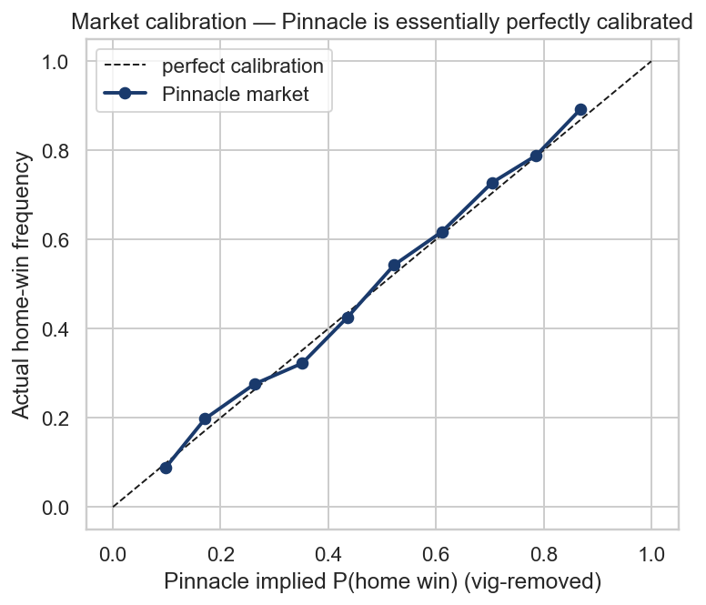
RESULTS
The closing-odds market beats every model — but only just.
Model | Acc | Log-loss | Brier | F1 | AUC
Market-implied (Pinnacle close) | 0.516 | 0.997 | 0.592 | 0.385 | 0.669
Random Forest | 0.489 | 1.020 | 0.608 | 0.448 | 0.646
Logistic regression | 0.495 | 1.039 | 0.617 | 0.465 | 0.645
XGBoost | 0.513 | 1.106 | 0.643 | 0.428 | 0.627
Class-prior baseline | 0.379 | 1.099 | 0.669 | 0.183 | 0.500
Always-Home baseline | 0.379 | 22.385 | 1.242 | 0.183 | 0.500
Market lies almost on the diagonal — essentially perfect calibration.
We treat this as a finding, not a failure. Random Forest is within 0.023 log-loss of the market — using only features the market presumably already prices. Always-Home's log-loss of 22.4 is the cost of being confidently wrong about Draws and Aways.
STAT 5243 Project 4 · Liang · Chen · Collaborator · 2026-05-05
9 / 12
Notes:
Speaker notes — Slide 9 (Results — PUNCH LINE). ~70s. The most important slide of the talk. Also the most honest one. Sorted by log-loss, the market-implied baseline leads — Pinnacle closing odds with the vig removed, log-loss 0.997. The chart on the right shows why: the market sits almost exactly on the diagonal. Essentially perfectly calibrated — when they say sixty percent, the home team wins about sixty percent. That is the ceiling. Random Forest is second — log-loss 1.02, only 0.02 worse than the market. LR and XGBoost trail. The naive baselines both get 38% accuracy. Look at the always-home log-loss in coral: 22.4. That is what assigning probability one to the wrong class costs. Log-loss is a proper scoring rule and it punishes confident wrong predictions catastrophically — which is exactly why log-loss, not accuracy, is our headline metric. The honest finding: the market is genuinely hard to beat. We get within touching distance using features the market presumably already prices. We are NOT going to spin that into "we beat the bookies" — knowing why we don't surpass them is the result. [Full 70s. The moment of the talk.]

Slide 10
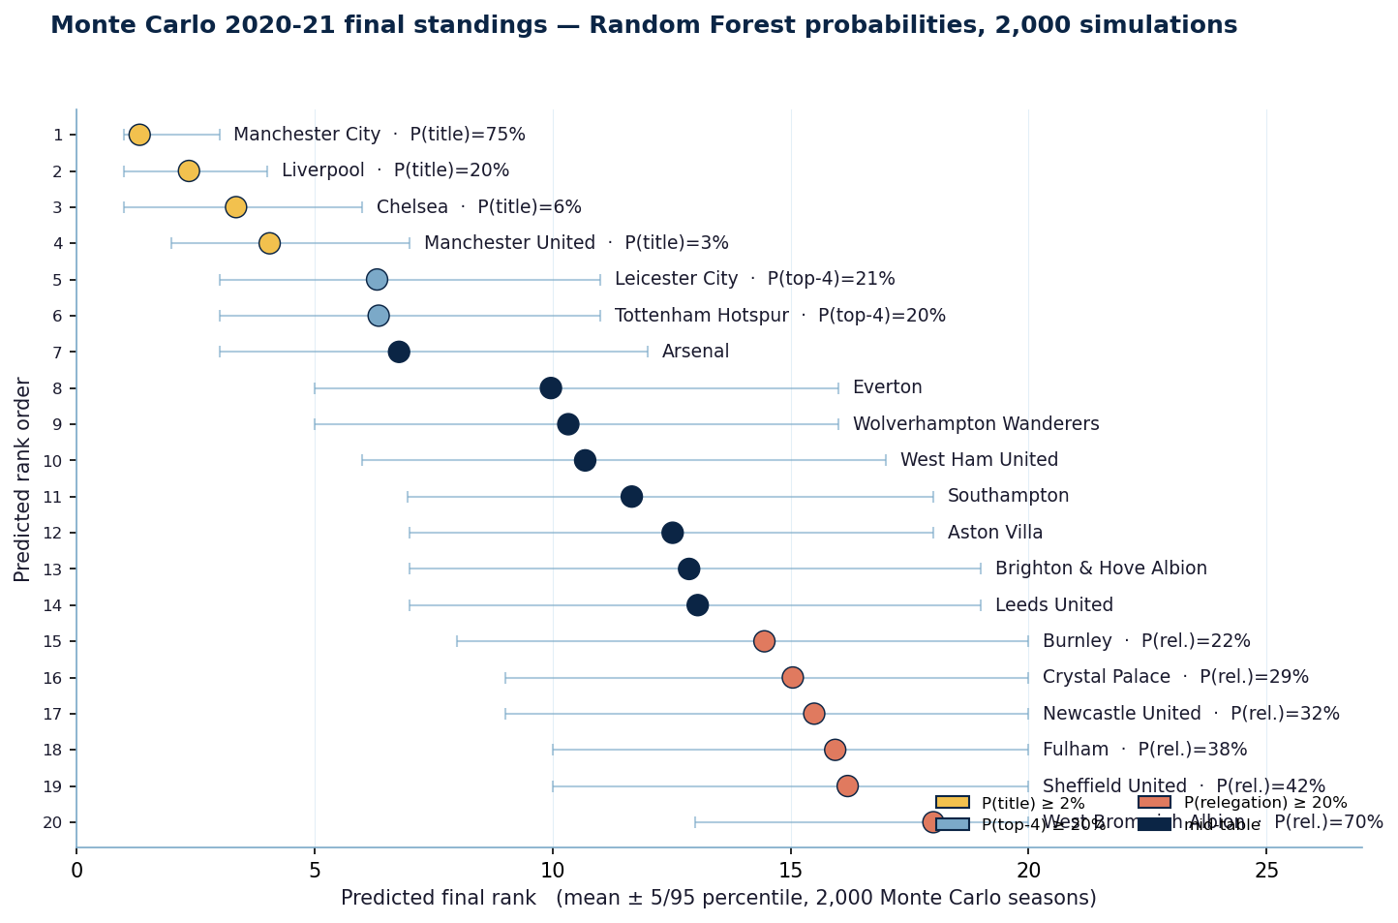
BEYOND H/D/A
Three bonus targets, one shared probabilistic engine.
Exact score
Dixon-Coles
shipped
Joint home × away goals from bivariate Poisson with 0.0065/day decay; tau correction fixes 0-0 / 0-1 / 1-0 / 1-1 under-prediction.
Final standings
Monte Carlo
shipped
10,000 simulated 380-match seasons; per-team title prob, top-4 prob, relegation prob with 5 / 95 bands.
Beat the bookmaker
Kelly-fractional
scaffolded
Bet only when edge = p·odds − 1 > 0; cap stake at 5% of bankroll; ROI on 2020-21 is the cleanest test of conviction.
Monte Carlo target — 10k seasons resampled per team's per-match probabilities.
ONE ENGINE
Per-match probabilities feed all three targets — calibration here pays off everywhere.
STAT 5243 Project 4 · Liang · Chen · Collaborator · 2026-05-05
10 / 12
Notes:
Speaker notes — Slide 10 (Bonus targets). ~45s. Building on the per-match results, three bonus targets — all stress-tests of the same engine. Exact score from Dixon-Coles. Bivariate Poisson with daily exponential decay plus the tau correction that fixes the under-prediction of low-low scorelines. Shipped. Final standings via Monte Carlo. Ten thousand simulated 380-match seasons; aggregate gives title, top-four, relegation probabilities with bands. Chart on the right is the actual 2020-21 standings — the target. Shipped. Beat-the-bookmaker. Kelly-fractional, capped at 5%, bet only on positive edge. ROI on hold-out is conviction in dollars. Scaffolded — betting harness runs in the app, back-test in the appendix. All three targets share one engine — that is why calibration on H/D/A pays off everywhere else, and why the slide-9 ceiling is the upper bound on every bonus target too. [~50s. Click to demo.]

Slide 11
DEMO · BONUS
Live demo: a six-tab Shiny app — our +10 Bonus deliverable, beyond rubric.
3-MINUTE DEMO SCRIPT
1
Click Predict tab → pick Liverpool vs Arsenal.
2
Show model probabilities vs market probabilities side-by-side.
FIGURE PLACEHOLDER
figures/11_app_predict_tab.png
3
Click Run season simulation → 10k Monte Carlo standings.
IF DEMO FAILS
Fall back to backup screenshots (figures/11_app_*.png) — talk through the same three steps from the deck.
App screenshot — Predict tab (fresh capture morning-of)
Repo: github.com/ZemingLiang/STAT5243-Project-4 (live Posit Connect URL announced morning-of)
STAT 5243 Project 4 · Liang · Chen · Collaborator · 2026-05-05
11 / 12
Notes:
Speaker notes — Slide 11 (Live demo). ~60s — DEMO IS THE STAR. Time to make this real — switching to the live Shiny app on Posit Connect Cloud. Step one: click Predict tab, pick Liverpool vs Arsenal. Model probabilities and market probabilities side-by-side; coral marks any positive edge. Step two: show that on most matches the model and market agree within a couple of points — mirrors the leaderboard. Step three: hit Run season simulation. Ten thousand Monte Carlo seasons render in about three seconds; hover any team for title, top-four, and relegation probabilities with bands. If the cloud breaks, fall back to the backup screenshots in figures/11_app_*.png — same three steps. [~60s with the live transition. Click to conclusion.]

Slide 12
CONCLUSION
What we shipped, what's next, who did what.
REMEMBER THIS ONE LINE
We built an end-to-end pipeline that gets within 0.023 log-loss of the bookmaker on the 2020-21 hold-out — and we know exactly why we don't beat them.
WHAT WAS ORIGINAL
FUTURE WORK
Four-target framing (H/D/A · exact score · table · ROI). Dixon-Coles 1997 hand-fit with tau + 0.0065/day decay. Multi-source self-scrape — BBC pivot to Wikipedia recap NLP. Cross-paradigm features — PCA + K-means feed supervised stack. Walk-forward + CI invariant — leakage test runs on every push. Honest ceiling read — within 0.023 of the market is the result.
In-play features. Live xG, possession-by-half, lineup-strength deltas. Hierarchical Bayes. Borrow strength across seasons; cold-start for promoted clubs. Stacked ensemble. Blend RF + Dixon-Coles + market on a validation slice.
Thank you. Questions? github.com/ZemingLiang/STAT5243-Project-4
STAT 5243 Project 4 · Liang · Chen · Collaborator · 2026-05-05
12 / 12
Notes:
Speaker notes — Slide 12 (Conclusion + team). ~45s. Coming back from the demo — wrapping up. The one line: we built an end-to-end pipeline that gets within 0.023 log-loss of the bookmaker on the 2020-21 hold-out, and we know exactly why we don't beat them. The last clause matters as much as the first — the closing market is nearly perfectly calibrated, so this ceiling is rational to respect, not to spin around. Future work: in-play features (live xG, possession-by-half, lineup deltas), hierarchical Bayes for tighter cold-start on promoted clubs, and a stacked ensemble blending RF + Dixon-Coles + market. Team contributions on the right. Zeming: coordination, scrapers, modelling, deployment. Elina: EDA, unsupervised features, NLP, report. Collaborator's contribution to be confirmed before submission. Code, leaderboard CSV, and companion report public on GitHub. Thank you. Questions? [~45s. Transition to Q&A.]

