Slide 1
Using Kivy and Flask
For cross platform, mobile webservers
www.kivy.org
www.github.com/kivy

Slide 2
Scenario
Deploying an Educational app to schools home users
Core app:
  17mb on Android
  28mb on Windows
  60+mb on iOS (4x arch – x86/x64/ARM32/64)
Content:
  Declarative (XML) - 800mb+

Slide 3
Conventional Solutions
Android
  APK size max 50mb!
  Each signed, linked, priced, controlled by Google.
  Unique in-app billing/licensing API
iOS
  Unique in-app billing/licensing API
Windows App Store
  Unique in-app billing/licensing API
Win32? Linux? MacOS?

Slide 4
Our Solution
Free app with a basic Speedtest exercise
Content purchased independently of stores
Content downloaded into app via simple HTTP (HTTPS for caching) on license acquisition
Benefits
Single solution for all platforms
Retain control of content distribution

Slide 5
Challenges
Poorly maintained School infrastructures
Overloaded School wifi-networks
Limited/No connectivity in poor rural areas
Long install times
Remote Schools require long travel times

Slide 6
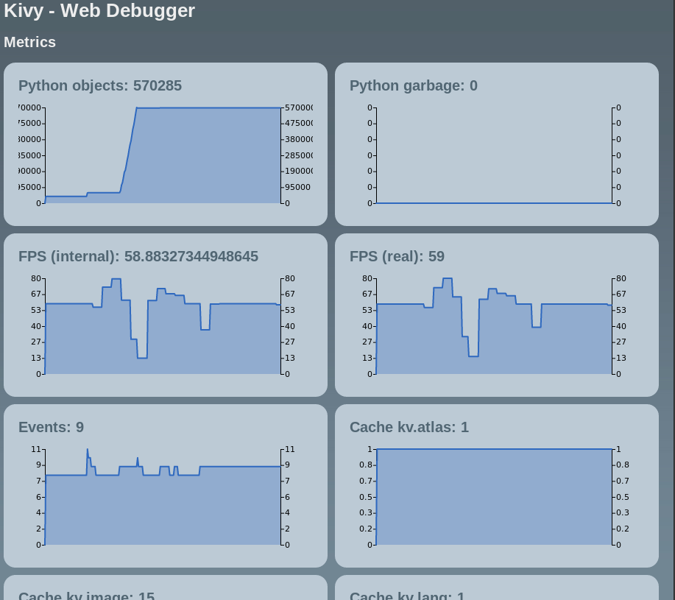
Inspiration!
The Kivy webdebugger! Debug info webserver.
  $ python -m webdugger main.py

Slide 7
The CODE
Switch to CODE!

Slide 8
What is Flask?
A Python-based micro web-framework
Self-contained
Extensible
Fast, no dependencies
BSD licensed

Slide 9
The Content Server
Switch to app

