Slide 1
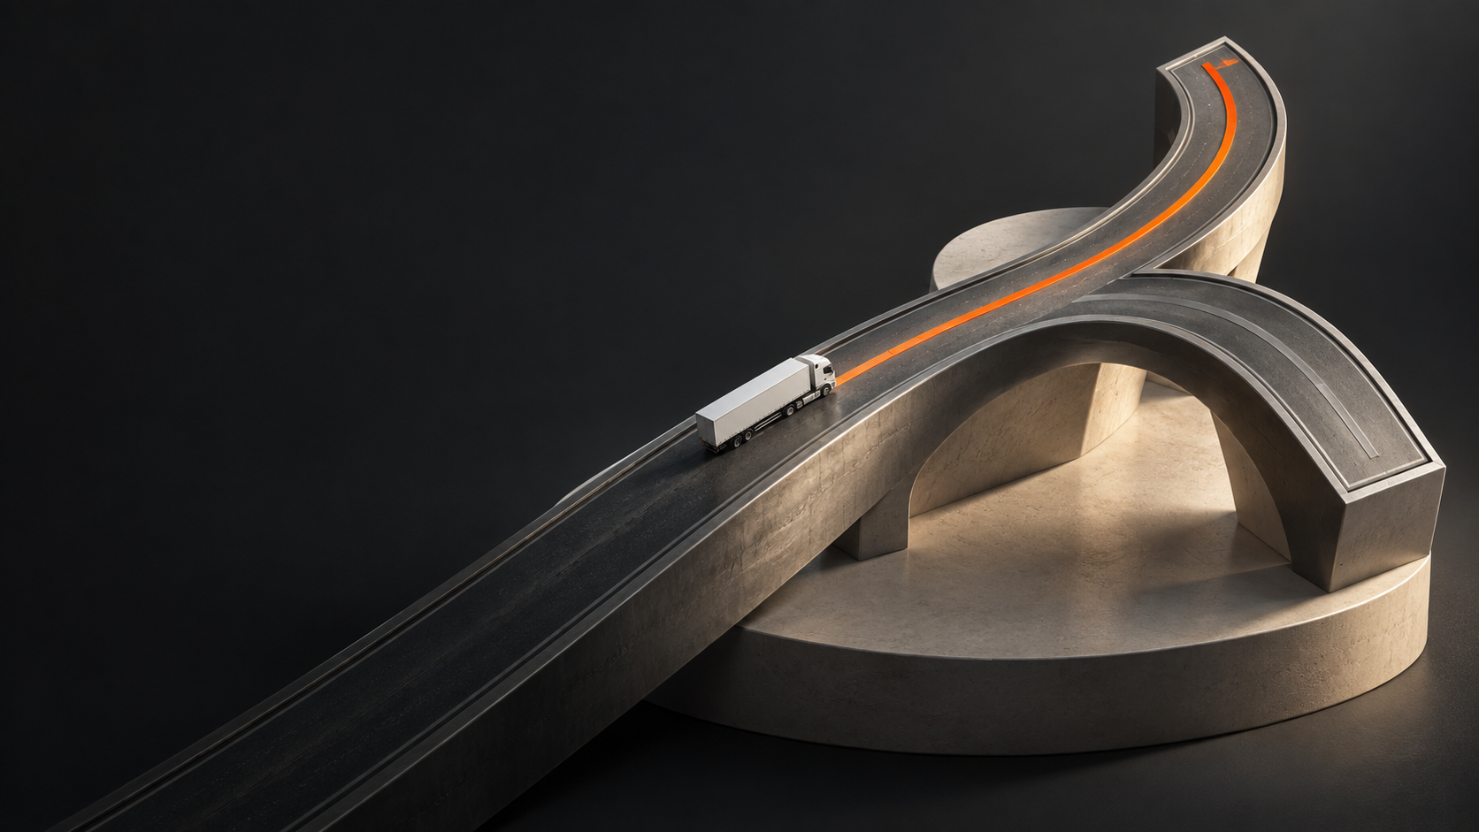
RoadStar
Dispatch recovery
Carrier decisions. Driver execution.
RoadStar Hackathon 2026
01
Notes:
35 seconds. Introduce carrier dispatch recovery. Demonstration records are synthetic. Show actual app immediately after this opening. No customer records are published.
Visual source: actual RoadStar application captures where shown. Generated road sculpture is illustrative brand artwork, not geographic or route evidence. Design system: docs/design/precision-transport.md. Current check counts: 22 backend, 23 native mobile. Core slides 1–11 total 10 minutes. Appendix slides 12–13 total 5 minutes.

Slide 2
A dock delay
reaches the
next pickup
Dock delay
Current truck is still committed
Next pickup
Driver
Truck
Trailer
A dispatcher must reconnect the next assignment with available resources.
Illustrative dispatch scenario
02
Notes:
45 seconds. Explain a dispatcher coordinating resource commitments. This is a scenario, not an estimate of industry-wide cost or frequency.
Visual source: actual RoadStar application captures where shown. Generated road sculpture is illustrative brand artwork, not geographic or route evidence. Design system: docs/design/precision-transport.md. Current check counts: 22 backend, 23 native mobile. Core slides 1–11 total 10 minutes. Appendix slides 12–13 total 5 minutes.

Slide 3
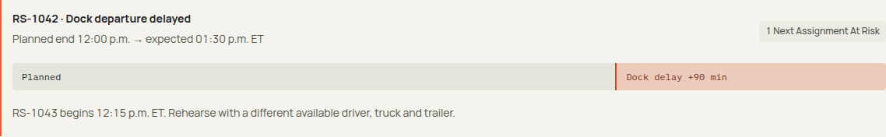
Recovery rehearsal
A delayed departure makes the next assignment visible
12:00
13:30
12:15
Planned departure
Expected departure
Next pickup
Synthetic scenario. Times in ET. Actual Ontario truck routing supports the recovery.
03
Notes:
80 seconds. Switch to live cloud film-demo or downloaded recording. Record expected departure and inspect the affected next load. Sources: actual RoadStar cloud browser capture, docs/evidence/cloud-auth-smoke.json. Visual: September 10 design-film cloud recording, 01-dock-delay-end.png, exact disruption strip. 12:00 planned departure, 13:30 expected departure, 12:15 next pickup, ET. Final frozen web source: capture-final/delay-impact.png, expanded real delay record in design-final synthetic carrier, September 10 2026. Final v9 source: /tmp/roadstar-polish/final-capture/delay-impact.png, deployment 00017-bj6, design-polish-final carrier. Actual recorded delay; same 12:00 / 13:30 / 12:15 ET scenario.
Visual source: actual RoadStar application captures where shown. Generated road sculpture is illustrative brand artwork, not geographic or route evidence. Design system: docs/design/precision-transport.md. Current check counts: 22 backend, 23 native mobile. Core slides 1–11 total 10 minutes. Appendix slides 12–13 total 5 minutes.

Slide 4
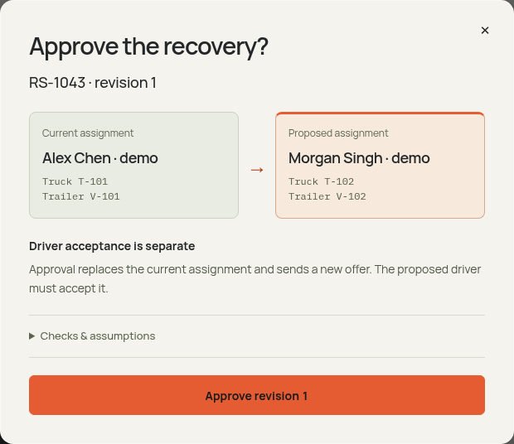
Approval
against current
evidence
The server rechecks the proposal at the moment of approval.
Versions
Availability
Atomic reservations
04
Notes:
65 seconds. Show current assignment and proposed D02/T102/V102. Approval rechecks versions and availability, then commits reservations and driver offer atomically. Source: tests/postgres.test.ts and actual cloud recovery verification. Visual: exact modal frame at 16 seconds from the new design-film 02-recovery-approval recording. Actual proposal and approval API responses succeeded. Final frozen web source: capture-final/approval-review.png, exact displayed consequential approval dialog in design-final carrier. The capture precedes the explicit confirmation. Final v9 capture: /tmp/roadstar-polish/capture/approval-review.png. Current and proposed drivers and equipment are shown before confirmation. Driver acceptance is separate. Checks and assumptions remain available in the disclosure. Final v9 source supersedes previous frame: /tmp/roadstar-polish/final-capture/approval-review.png, deployment 00017-bj6. Same explicit current-to-proposed dialog before confirmation.
Visual source: actual RoadStar application captures where shown. Generated road sculpture is illustrative brand artwork, not geographic or route evidence. Design system: docs/design/precision-transport.md. Current check counts: 22 backend, 23 native mobile. Core slides 1–11 total 10 minutes. Appendix slides 12–13 total 5 minutes.

Slide 5
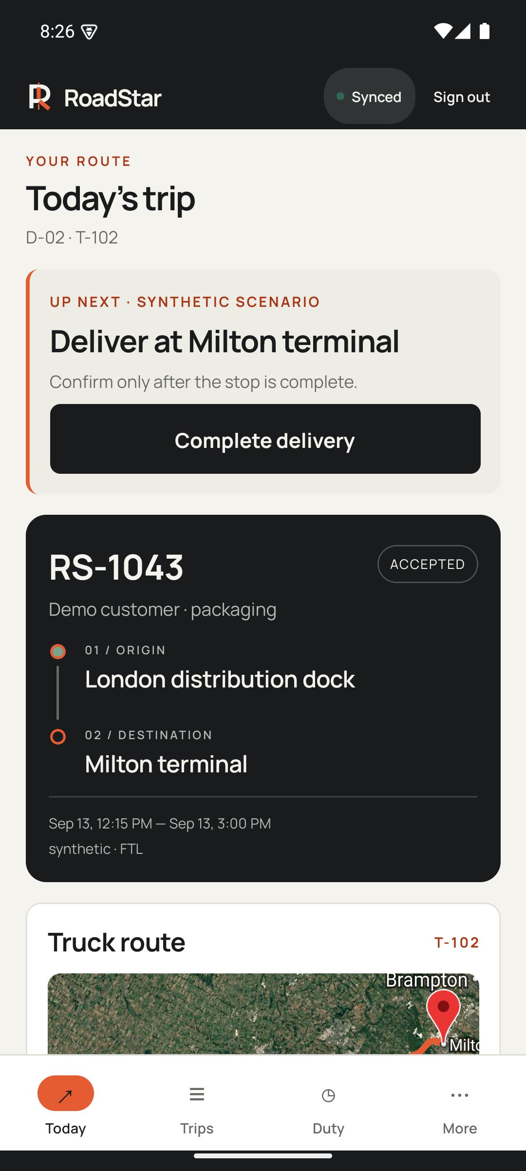
The driver
keeps the work
Acceptance stays visible through an offline interruption.
01
Pending while offline
02
Trip and draft survive termination
03
Server confirms the command
Android emulator verified. Physical phone and native iOS remain unverified.
05
Notes:
65 seconds. Native API35 Android emulator testing: Firebase login, offline acceptance, force-stop, restored session/downloaded trip/note/pending key, reconnect to accepted version2. Physical device background location and native iOS remain unverified. Current visual: actual September 10 Android API35 emulator Today screen. RS1043 accepted, pickup already completed, delivery is next. The screenshot does not claim a newly completed delivery or a new offline acceptance test. Density refresh: final native screenshot mobile/34-today-frozen.png, consistent RoadStar case and compact header. State remains accepted with delivery next. Final source freeze uses mobile/41-today-final.png. Compact one-row identity header and explicit synthetic scenario label. Original facility values remain unchanged underneath their shortened display labels. Final review-pass capture: mobile/56-today-frozen-review-pass.png. Same accepted trip state, pickup completed and delivery next; this capture is not new offline-acceptance verification. Final v9 capture supersedes the prior frame: mobile/60-today-density-final.png. Compact single-row header; accepted trip and delivery-next state unchanged.
Visual source: actual RoadStar application captures where shown. Generated road sculpture is illustrative brand artwork, not geographic or route evidence. Design system: docs/design/precision-transport.md. Current check counts: 22 backend, 23 native mobile. Core slides 1–11 total 10 minutes. Appendix slides 12–13 total 5 minutes.

Slide 6
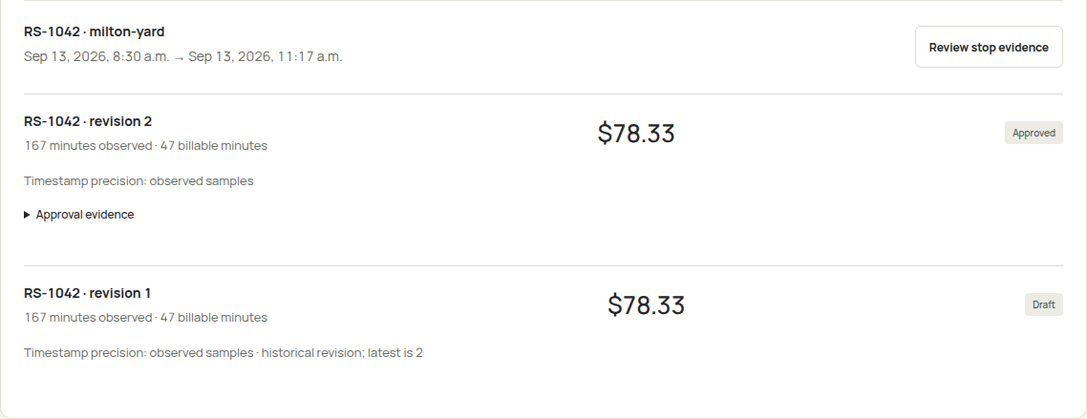
Documents and detention
A reviewed revision keeps the original draft in view
Observed samples require review. Billing approval does not initiate payment.
06
Notes:
60 seconds. Show original synthetic PDF and reviewed fields. Source hash/model output retained. Same-stop arrival/departure samples and configured terms produce draft. Human approval retains draft and creates new revision; no payment. Source: docs/evidence/cloud-document-extraction.json and actual cloud billing capture. Visual: retained actual synthetic cloud billing panel, cropped to the stop record and draft/approved revisions without changing content. Density refresh source: cloud-current/web-billing-panel.png. Same approved revision and original draft, original amounts and observed precision preserved.
Visual source: actual RoadStar application captures where shown. Generated road sculpture is illustrative brand artwork, not geographic or route evidence. Design system: docs/design/precision-transport.md. Current check counts: 22 backend, 23 native mobile. Core slides 1–11 total 10 minutes. Appendix slides 12–13 total 5 minutes.

Slide 7
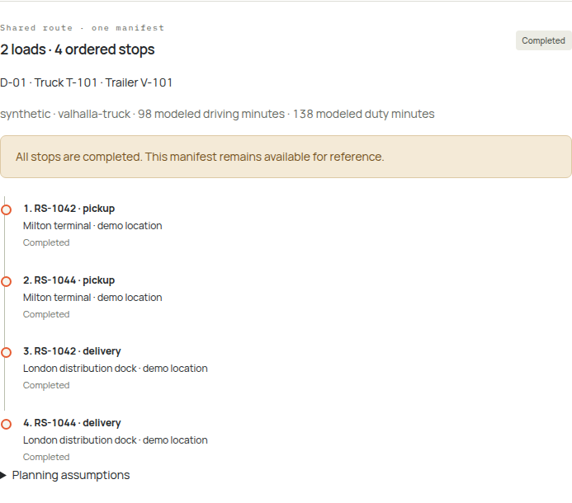
2 loads
4 ordered stops
One vehicle pairing
One approval
Reservations stay active until every load completes.
Synthetic pallet capacity disclosed
07
Notes:
55 seconds. Real OR-Tools with Valhalla truck matrix produced two LTL pickups and two deliveries. Cloud planning-demo approved, accepted and completed global order. Three vehicle-resource reservations stay active until every load completes. Synthetic26-pallet allowance disclosed. Source: docs/evidence/cloud-planning-verification.json and tests/group-road.test.ts. Visual: retained actual planning-demo completed two-load, four-stop manifest in the redesigned UI. Density refresh source: cloud-current/web-completed-manifest.png. Same actual completed two-load/four-stop fixture.
Visual source: actual RoadStar application captures where shown. Generated road sculpture is illustrative brand artwork, not geographic or route evidence. Design system: docs/design/precision-transport.md. Current check counts: 22 backend, 23 native mobile. Core slides 1–11 total 10 minutes. Appendix slides 12–13 total 5 minutes.

Slide 8
All five sheets retain lineage
Sheet | Rows
Tlorder | 4,031
Dispatch | 10,479
Driver | 131
Trucks | 131
Trailers | 425
15,197
source rows
82
exact Dispatch duplicates
Historical provenance preserved
Private source data stays local
Public preview uses labeled synthetic operational scenarios.
08
Notes:
50 seconds. Imported15197 rows locally only.82 exact duplicates in Dispatch. Source originals, missing fields and historical dates retained. No customer rows shown or uploaded. Source: docs/evidence/workbook-import.json.
Visual source: actual RoadStar application captures where shown. Generated road sculpture is illustrative brand artwork, not geographic or route evidence. Design system: docs/design/precision-transport.md. Current check counts: 22 backend, 23 native mobile. Core slides 1–11 total 10 minutes. Appendix slides 12–13 total 5 minutes.

Slide 9
One operational database
CLIENTS
COMMANDS
STORAGE
Web + mobile
Fastify API
PostgreSQL
React dispatcher UI
Expo driver execution
Firebase identity
Carrier membership
Validated commands
Versions
Reservations
Evidence
PROPOSALS
DOCUMENT FIELDS
OR-Tools + Valhalla
Gemini extraction
Independent replay clock · Approval remains an explicit command.
09
Notes:
50 seconds. Cloud Run Fastify owns state changes. Dedicated PG16/PostGIS owns truth; ORTools/Valhalla compute; Vertex extracts; independent simulator posts synthetic events. API accepts no AI approval. See infra/gcp/README.md and services/api/src/store.ts.
Visual source: actual RoadStar application captures where shown. Generated road sculpture is illustrative brand artwork, not geographic or route evidence. Design system: docs/design/precision-transport.md. Current check counts: 22 backend, 23 native mobile. Core slides 1–11 total 10 minutes. Appendix slides 12–13 total 5 minutes.

Slide 10
Measured proof
5.4 s
524
telemetry + synchronization pairs
Zero failed commands
p95 acknowledgement-to-snapshot lag
in the 131-driver cloud burst
Physical background location and native iOS still need testing.
Declared duty budgets are not a certified ELD.
22 backend checks
23 mobile checks
Real-road integration verified separately
10
Notes:
55 seconds. Do not claim complete legal HOS, guaranteed2s latency, realdevice/iOS or productioncapacity. Cloud benchmark524 telemetry+524syncpairs, no failures, ownacktosnapshotp955448ms. Real-road group integration separate enabled test. Source artifacts under docs/evidence.
Visual source: actual RoadStar application captures where shown. Generated road sculpture is illustrative brand artwork, not geographic or route evidence. Design system: docs/design/precision-transport.md. Current check counts: 22 backend, 23 native mobile. Core slides 1–11 total 10 minutes. Appendix slides 12–13 total 5 minutes.

Slide 11
Next carrier
evaluation
Physical device validation
Carrier inputs and facility review
Measured dispatcher and driver use
roadstar-web-739889188415.us-central1.run.app
11
Notes:
40 seconds. Ask carrier to evaluate complete recovery workflow with permissioned operational input. Physicalhardwarecurrentlyunavailable. No invented customer adoption, measuredsavings or revenue. Full testinginstructions in local submission handoff.
Visual source: actual RoadStar application captures where shown. Generated road sculpture is illustrative brand artwork, not geographic or route evidence. Design system: docs/design/precision-transport.md. Current check counts: 22 backend, 23 native mobile. Core slides 1–11 total 10 minutes. Appendix slides 12–13 total 5 minutes.

Slide 12
Concurrent approval
A stable command key and expected version protect the same intent
Command
Recheck
Commit
Identity and version
Stable idempotency key
Current availability
Resource exclusion constraints
Atomic reservations
Commit-ordered events
A stale proposal conflicts before mutation. A repeated key returns its original result.
12
Notes:
120 seconds. Optional2 minutes. PostgreSQL btree_gist exclusion onresourceperiods. Commands have stableidempotencykey+expectedversion; staleproposal yields conflictbeforemutation. Per-carrier exclusivecommands sharedtelemetrytriplocks; eventinsertionlock ensurescommitordercursor. Explain rollback boundaries and carrier membership.
Visual source: actual RoadStar application captures where shown. Generated road sculpture is illustrative brand artwork, not geographic or route evidence. Design system: docs/design/precision-transport.md. Current check counts: 22 backend, 23 native mobile. Core slides 1–11 total 10 minutes. Appendix slides 12–13 total 5 minutes.

Slide 13
Replay and telemetry evidence
Replay conditions
Telemetry interpretation
Recorded starting conditions
Disclosed dock wait and road assumptions
An independent scenario clock
Duplicate samples do not double-count
Out-of-order samples retain history
Uncertain boundaries stay uncertain
Operational outcomes remain separate from modeled savings.
13
Notes:
180 seconds. Optional3 minutes. Simulator actualroadroute, constantspeed/dockwaitassumptions. Identicalstartingconditionshash; scenario clocks neveroverwriteoperationtime. Duplicate/outoforder retained withoutdoublecount; entireaccuracydisc determinesinside/outside; uncertainboundarynotarrival. Benchmark burstbarrier/warmdataqualifiers.
Visual source: actual RoadStar application captures where shown. Generated road sculpture is illustrative brand artwork, not geographic or route evidence. Design system: docs/design/precision-transport.md. Current check counts: 22 backend, 23 native mobile. Core slides 1–11 total 10 minutes. Appendix slides 12–13 total 5 minutes.

