Slide 1
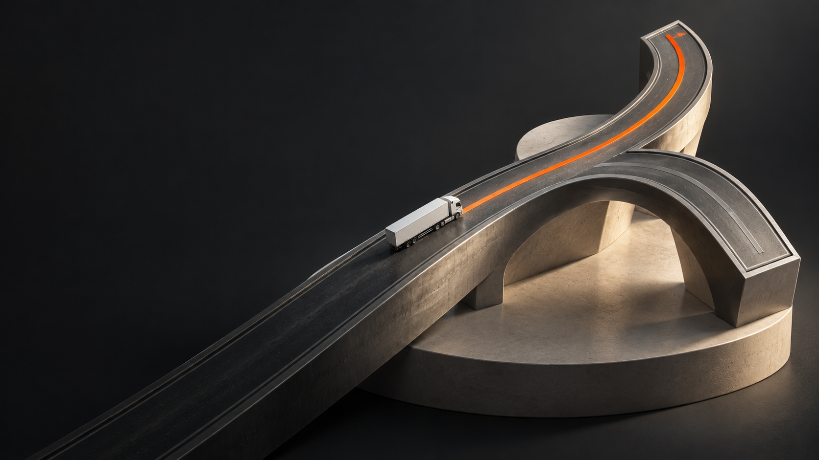
Rhode
Dispatch recovery
Carrier decisions. Driver execution.
RoadStar Hackathon 2026
01
Notes:
35 seconds. Introduce carrier dispatch recovery. Demonstration records are synthetic. Show actual app immediately after this opening. No customer records are published.
Visual source: actual Rhode application captures where shown. Generated road sculpture is illustrative brand artwork, not geographic or route evidence. Design system: docs/design/precision-transport.md. Current accepted check counts: 106 backend, 50 native mobile. Core slides 1–11 total 10 minutes. Appendix slides 12–13 total 5 minutes.

Slide 2
A dock delay
reaches the
next pickup
Dock delay
Current truck is still committed
Next pickup
Driver
Truck
Trailer
A dispatcher must reconnect the next assignment with available resources.
Illustrative dispatch scenario
02
Notes:
45 seconds. Explain a dispatcher coordinating resource commitments. This is a scenario, not an estimate of industry-wide cost or frequency.
Visual source: actual Rhode application captures where shown. Generated road sculpture is illustrative brand artwork, not geographic or route evidence. Design system: docs/design/precision-transport.md. Current accepted check counts: 106 backend, 50 native mobile. Core slides 1–11 total 10 minutes. Appendix slides 12–13 total 5 minutes.

Slide 3
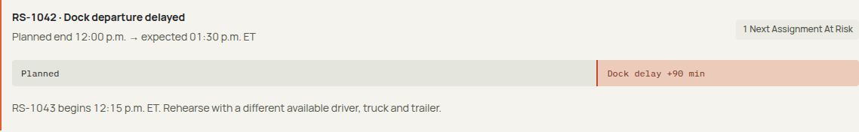
Recovery rehearsal
A delayed departure makes the next assignment visible
12:00
13:30
12:15
Planned departure
Expected departure
Next pickup
Synthetic scenario. Times in ET. Actual Ontario truck routing supports the recovery.
03
Notes:
80 seconds. Switch to live cloud film-demo or downloaded recording. Record expected departure and inspect the affected next load. Sources: actual Rhode cloud browser capture, docs/evidence/cloud-auth-smoke.json. Visual: September 10 design-film cloud recording, 01-dock-delay-end.png, exact disruption strip. 12:00 planned departure, 13:30 expected departure, 12:15 next pickup, ET. Final frozen web source: capture-final/delay-impact.png, expanded real delay record in design-final synthetic carrier, September 10 2026. Final v9 source: /tmp/roadstar-polish/final-capture/delay-impact.png, deployment 00017-bj6, design-polish-final carrier. Actual recorded delay; same 12:00 / 13:30 / 12:15 ET scenario. Third-pass image: actual expanded delay-impact capture from frozen cloud 00020-8l2, cropped to the delay evidence strip; synthetic rehearsal.
Visual source: actual Rhode application captures where shown. Generated road sculpture is illustrative brand artwork, not geographic or route evidence. Design system: docs/design/precision-transport.md. Current accepted check counts: 106 backend, 50 native mobile. Core slides 1–11 total 10 minutes. Appendix slides 12–13 total 5 minutes.

Slide 4
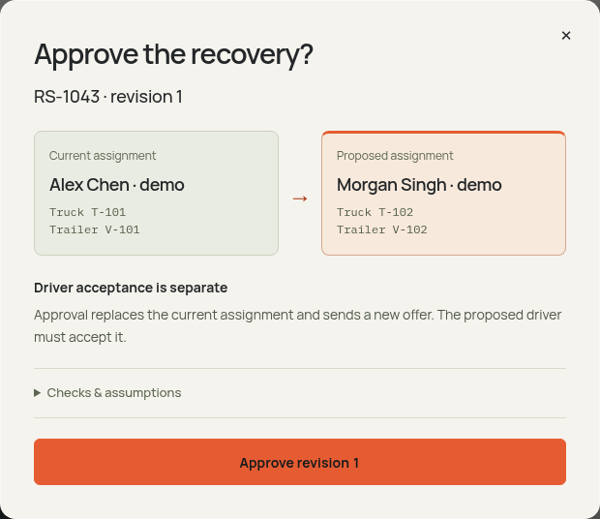
Approval
against current
evidence
The server rechecks the proposal at the moment of approval.
Versions
Availability
Atomic reservations
04
Notes:
65 seconds. Show current assignment and proposed D02/T102/V102. Approval rechecks versions and availability, then commits reservations and driver offer atomically. Source: tests/postgres.test.ts and actual cloud recovery verification. Visual: exact modal frame at 16 seconds from the new design-film 02-recovery-approval recording. Actual proposal and approval API responses succeeded. Final frozen web source: capture-final/approval-review.png, exact displayed consequential approval dialog in design-final carrier. The capture precedes the explicit confirmation. Final v9 capture: /tmp/roadstar-polish/capture/approval-review.png. Current and proposed drivers and equipment are shown before confirmation. Driver acceptance is separate. Checks and assumptions remain available in the disclosure. Final v9 source supersedes previous frame: /tmp/roadstar-polish/final-capture/approval-review.png, deployment 00017-bj6. Same explicit current-to-proposed dialog before confirmation. Third-pass image: actual approval-review capture from frozen cloud 00020-8l2, cropped to the dialog. Driver acceptance remains a separate command.
Visual source: actual Rhode application captures where shown. Generated road sculpture is illustrative brand artwork, not geographic or route evidence. Design system: docs/design/precision-transport.md. Current accepted check counts: 106 backend, 50 native mobile. Core slides 1–11 total 10 minutes. Appendix slides 12–13 total 5 minutes.

Slide 5
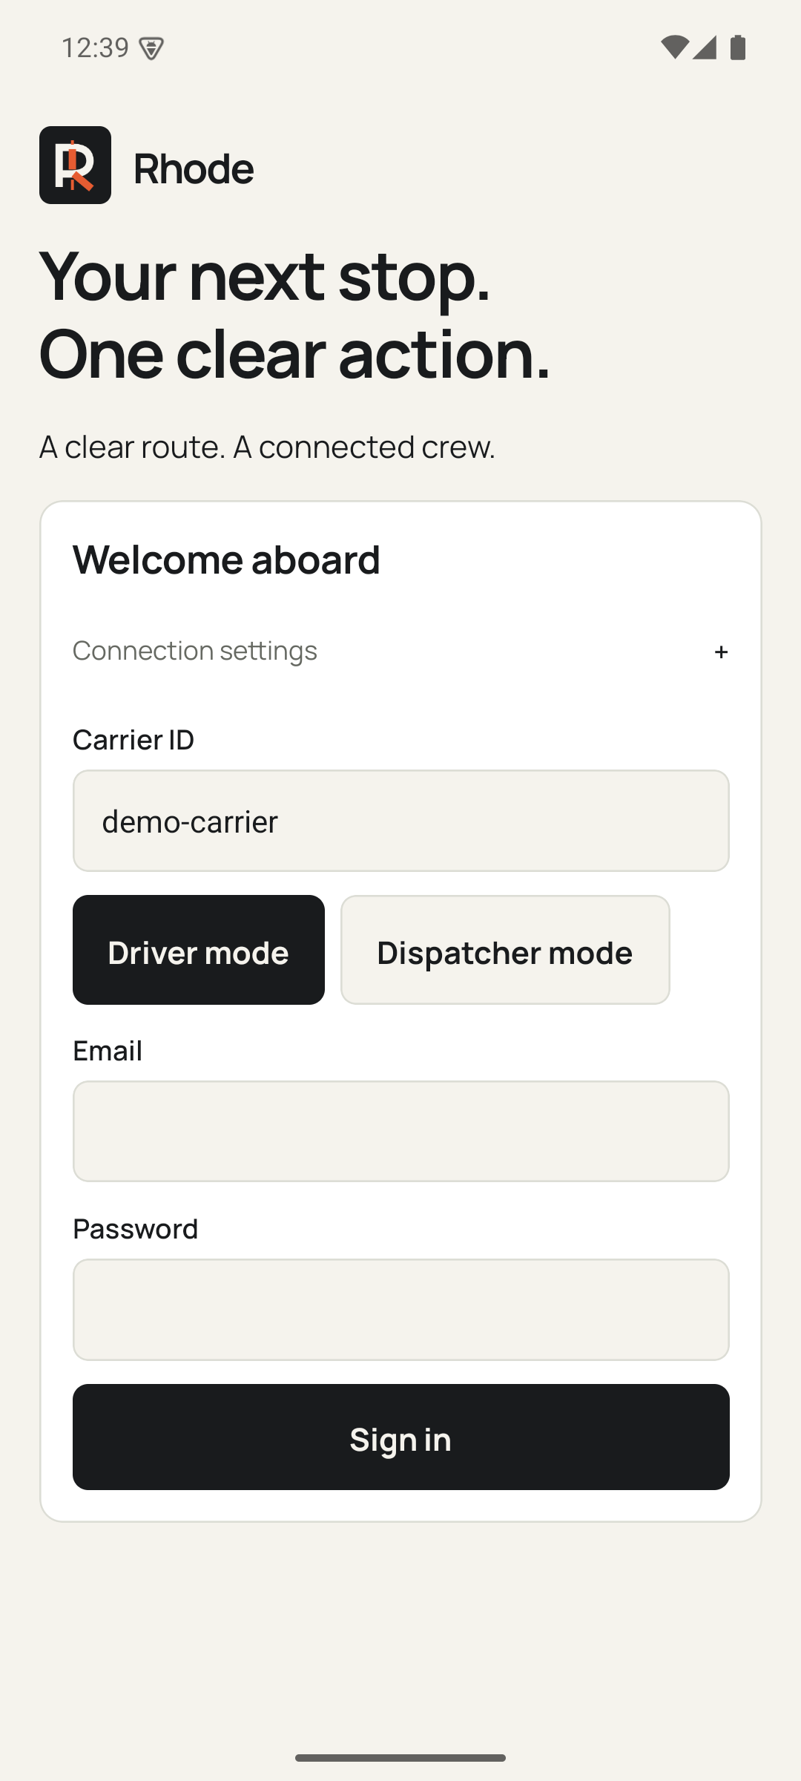
The driver
gets one clear action
The same dispatch reaches a focused native workflow.
01
Manifest first
02
Acceptance survives interruption
03
Dispatch sees confirmation
Android emulator verified. Physical phone and native iOS remain unverified.
05
Notes:
65 seconds. Native API35 Android emulator testing: Firebase login, offline acceptance, force-stop, restored session/downloaded trip/note/pending key, reconnect to accepted version2. Physical device background location and native iOS remain unverified. Current visual: actual September 10 Android API35 emulator Today screen. RS1043 accepted, pickup already completed, delivery is next. The screenshot does not claim a newly completed delivery or a new offline acceptance test. Density refresh: final native screenshot mobile/34-today-frozen.png, consistent Rhode case and compact header. State remains accepted with delivery next. Final source freeze uses mobile/41-today-final.png. Compact one-row identity header and explicit synthetic scenario label. Original facility values remain unchanged underneath their shortened display labels. Final review-pass capture: mobile/56-today-frozen-review-pass.png. Same accepted trip state, pickup completed and delivery next; this capture is not new offline-acceptance verification. Final v9 capture supersedes the prior frame: mobile/60-today-density-final.png. Compact single-row header; accepted trip and delivery-next state unchanged.
Visual source: actual Rhode application captures where shown. Generated road sculpture is illustrative brand artwork, not geographic or route evidence. Design system: docs/design/precision-transport.md. Current accepted check counts: 106 backend, 50 native mobile. Core slides 1–11 total 10 minutes. Appendix slides 12–13 total 5 minutes.

Slide 6
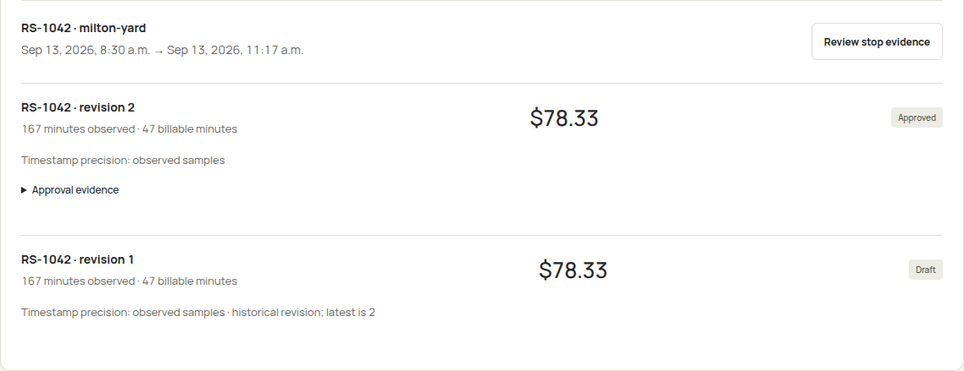
Documents and detention
A reviewed revision keeps the original draft in view
Observed samples require review. Billing approval does not initiate payment.
06
Notes:
60 seconds. Show original synthetic PDF and reviewed fields. Source hash/model output retained. Same-stop arrival/departure samples and configured terms produce draft. Human approval retains draft and creates new revision; no payment. Source: docs/evidence/cloud-document-extraction.json and actual cloud billing capture. Visual: retained actual synthetic cloud billing panel, cropped to the stop record and draft/approved revisions without changing content. Density refresh source: cloud-current/web-billing-panel.png. Same approved revision and original draft, original amounts and observed precision preserved.
Visual source: actual Rhode application captures where shown. Generated road sculpture is illustrative brand artwork, not geographic or route evidence. Design system: docs/design/precision-transport.md. Current accepted check counts: 106 backend, 50 native mobile. Core slides 1–11 total 10 minutes. Appendix slides 12–13 total 5 minutes.

Slide 7
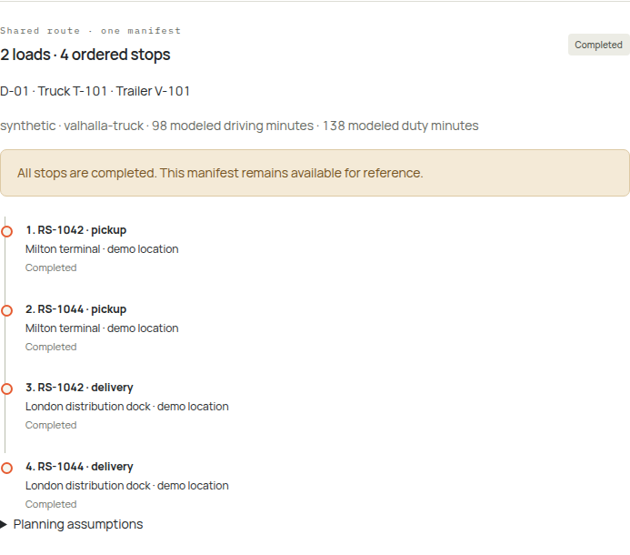
2 loads
4 ordered stops
One vehicle pairing
One approval
Reservations stay active until every load completes.
Synthetic pallet capacity disclosed
07
Notes:
55 seconds. Real OR-Tools with Valhalla truck matrix produced two LTL pickups and two deliveries. Cloud planning-demo approved, accepted and completed global order. Three vehicle-resource reservations stay active until every load completes. Synthetic26-pallet allowance disclosed. Source: docs/evidence/cloud-planning-verification.json and tests/group-road.test.ts. Visual: retained actual planning-demo completed two-load, four-stop manifest in the redesigned UI. Density refresh source: cloud-current/web-completed-manifest.png. Same actual completed two-load/four-stop fixture.
Visual source: actual Rhode application captures where shown. Generated road sculpture is illustrative brand artwork, not geographic or route evidence. Design system: docs/design/precision-transport.md. Current accepted check counts: 106 backend, 50 native mobile. Core slides 1–11 total 10 minutes. Appendix slides 12–13 total 5 minutes.

Slide 8
All five sheets retain lineage
Sheet | Rows
Tlorder | 4,031
Dispatch | 10,479
Driver | 131
Trucks | 131
Trailers | 425
15,197
source rows
82
exact Dispatch duplicates
Historical provenance preserved
Private source data stays local
Public preview uses labeled synthetic operational scenarios.
08
Notes:
50 seconds. Imported15197 rows locally only.82 exact duplicates in Dispatch. Source originals, missing fields and historical dates retained. No customer rows shown or uploaded. Source: docs/evidence/workbook-import.json.
Visual source: actual Rhode application captures where shown. Generated road sculpture is illustrative brand artwork, not geographic or route evidence. Design system: docs/design/precision-transport.md. Current accepted check counts: 106 backend, 50 native mobile. Core slides 1–11 total 10 minutes. Appendix slides 12–13 total 5 minutes.

Slide 9
One operational database
CLIENTS
COMMANDS
STORAGE
Web + mobile
Fastify API
PostgreSQL
React dispatcher UI
Expo driver execution
Firebase identity
Carrier membership
Validated commands
Versions
Reservations
Evidence
Supporting capabilities used by the API
Proposals: OR-Tools + Valhalla
Documents: Gemini extraction
Independent replay clock · Approval remains an explicit command.
09
Notes:
50 seconds. Cloud Run Fastify owns state changes. Dedicated PG16/PostGIS owns truth; ORTools/Valhalla compute; Vertex extracts; independent simulator posts synthetic events. API accepts no AI approval. See infra/gcp/README.md and services/api/src/store.ts. Third-pass architecture clarifies that OR-Tools/Valhalla proposals and Gemini document extraction are supporting capabilities used by the API. The lower section expresses those capabilities without depicting a new transaction flow.
Visual source: actual Rhode application captures where shown. Generated road sculpture is illustrative brand artwork, not geographic or route evidence. Design system: docs/design/precision-transport.md. Current accepted check counts: 106 backend, 50 native mobile. Core slides 1–11 total 10 minutes. Appendix slides 12–13 total 5 minutes.

Slide 10
Measured proof
5.4 s
524
telemetry + synchronization pairs
Zero failed commands
p95 acknowledgement-to-snapshot lag
in the 131-driver cloud burst
Manual 8 / ranked 2 activations
Manual 2 / ranked 1 recovery requests
Five matched synthetic browser pairs
Physical background location and native iOS still need testing.
Declared duty budgets are not a certified ELD.
After login. Scripted counts, not human task time.
10
Notes:
55 seconds. Cloud benchmark: 524 telemetry and synchronization pairs, no failures, acknowledged-write-to-snapshot p95 5,448 ms. A separate five-pair local browser comparison observed eight scripted activations and two requests for manual resource assembly versus two activations and one request for ranked recovery. Both selected the same feasible resources; ranked recovery retained the rejected HOS reason. These are after-login automation counts and local execution timings, not dispatcher task time, carrier savings or production latency. Sources: docs/evidence/cloud-load-test-131-after-concurrency.json and docs/evidence/workflow-comparison-2026-09-12/verification.json. HOS remains a planning aid rather than a certified ELD; physical Android and native iOS remain unverified.
Visual source: actual Rhode application captures where shown. Generated road sculpture is illustrative brand artwork, not geographic or route evidence. Design system: docs/design/precision-transport.md. Current accepted check counts: 106 backend, 50 native mobile. Core slides 1–11 total 10 minutes. Appendix slides 12–13 total 5 minutes.

Slide 11
Next carrier
evaluation
Physical device validation
Carrier inputs and facility review
Measured dispatcher and driver use
roadstar-web-739889188415.us-central1.run.app
11
Notes:
40 seconds. Ask carrier to evaluate complete recovery workflow with permissioned operational input. Physicalhardwarecurrentlyunavailable. No invented customer adoption, measuredsavings or revenue. Full testinginstructions in local submission handoff.
Visual source: actual Rhode application captures where shown. Generated road sculpture is illustrative brand artwork, not geographic or route evidence. Design system: docs/design/precision-transport.md. Current accepted check counts: 106 backend, 50 native mobile. Core slides 1–11 total 10 minutes. Appendix slides 12–13 total 5 minutes.

Slide 12
Concurrent approval
A stable command key and expected version protect the same intent
Command
Recheck
Commit
Identity and version
Stable idempotency key
Current availability
Resource exclusion constraints
Atomic reservations
Commit-ordered events
A stale proposal conflicts before mutation. A repeated key returns its original result.
12
Notes:
120 seconds. Optional2 minutes. PostgreSQL btree_gist exclusion onresourceperiods. Commands have stableidempotencykey+expectedversion; staleproposal yields conflictbeforemutation. Per-carrier exclusivecommands sharedtelemetrytriplocks; eventinsertionlock ensurescommitordercursor. Explain rollback boundaries and carrier membership.
Visual source: actual Rhode application captures where shown. Generated road sculpture is illustrative brand artwork, not geographic or route evidence. Design system: docs/design/precision-transport.md. Current accepted check counts: 106 backend, 50 native mobile. Core slides 1–11 total 10 minutes. Appendix slides 12–13 total 5 minutes.

Slide 13
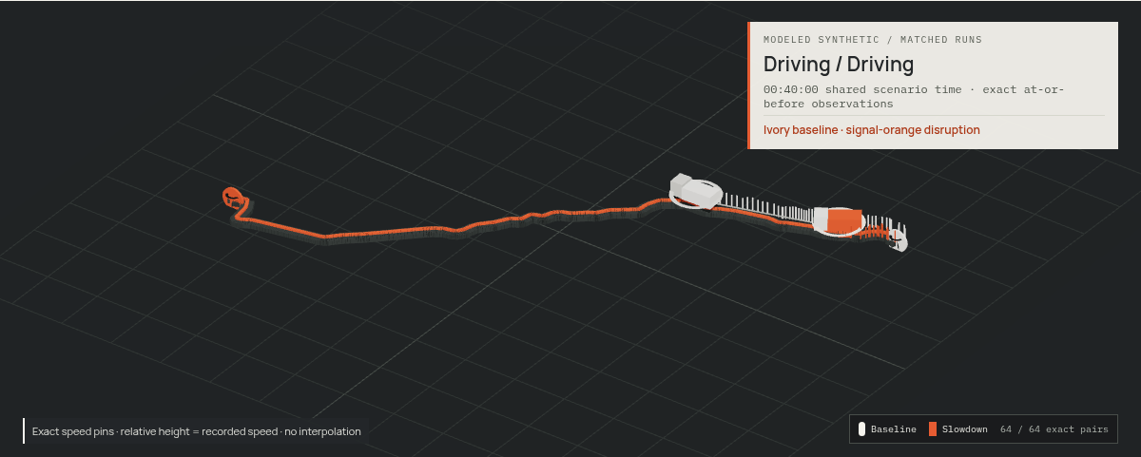
Matched Highway 401 slowdown
Same route, seed, clock, dwell and source · only the road intervention changes
2,401 × 2
acknowledged observations
+27.657 km
progress gap at T+40:00
+26m46s
modeled finish delta
Exact at-or-before samples · no interpolation
Synthetic route and slowdown; no live-traffic claim.
13
Notes:
180 seconds. Optional3 minutes. Show the actual matched Rhode comparison at shared T+40:00: baseline and 10%-speed Highway401 slowdown branches each retain2,401 acknowledged observations; the displayed progress gap is27.657km and deterministic modeled finish delta is26m46s. Matching binds route, source, clock, seed, speed, dwell and stops while excluding the declared intervention. Exact at-or-before observations are used without interpolation. Synthetic Valhalla route and modeled slowdown; no live-traffic, measured-savings or certified-GPS claim. Sources: docs/3d-slowdown-comparison.md and docs/evidence/3d-slowdown-comparison-2026-09-12/verification.json.
Visual source: actual Rhode application captures where shown. Generated road sculpture is illustrative brand artwork, not geographic or route evidence. Design system: docs/design/precision-transport.md. Current accepted check counts: 106 backend, 50 native mobile. Core slides 1–11 total 10 minutes. Appendix slides 12–13 total 5 minutes.

