Slide 1

BloxFloat
A1095537黃印建
A1095545吳家號
A1095543張保安

Slide 2

Introduction
Difficulities
01
03
Function
Demo
02
04

Slide 3
INTRODUCTION
01

Slide 4

Introduction
For our project we decided to make a game inspired by flappy bird called BloxFloat.
in the game we control a box called rex,the objective of the game is to try and avoid the obstacle as far as possible.

Slide 5


TOOLS WE USED
Java
Ecplise

Slide 6
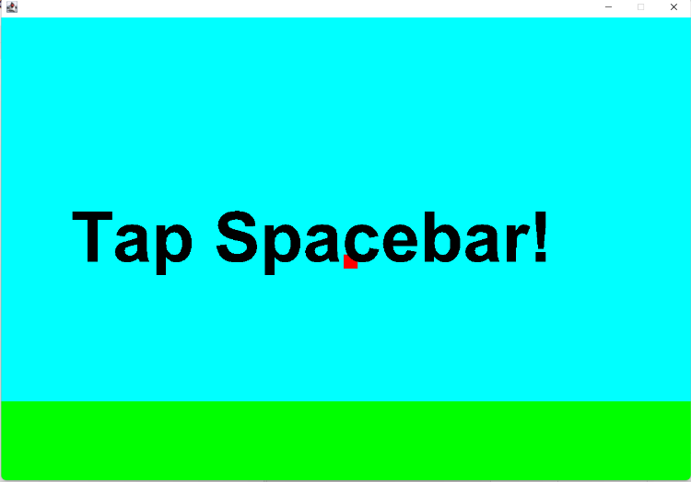
遊戲開始前

Slide 7
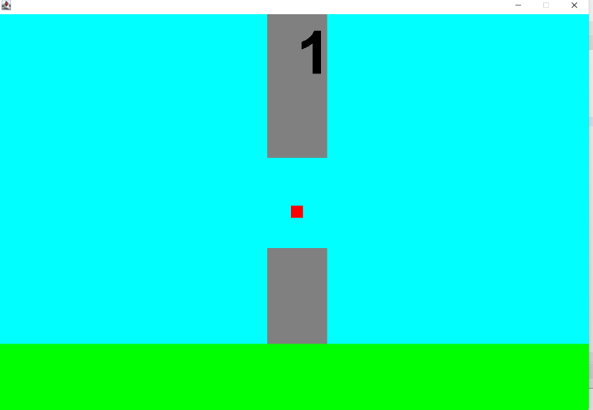
在遊戲中

Slide 8
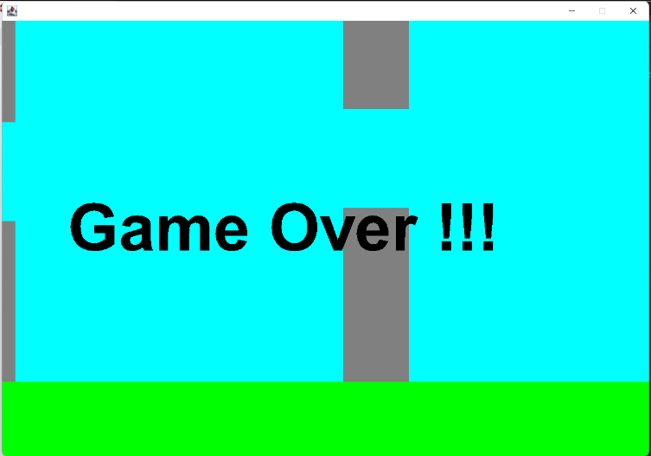
GAME OVER

Slide 9
Function in details
02

Slide 10
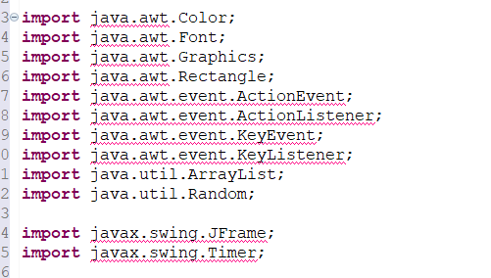

Slide 11
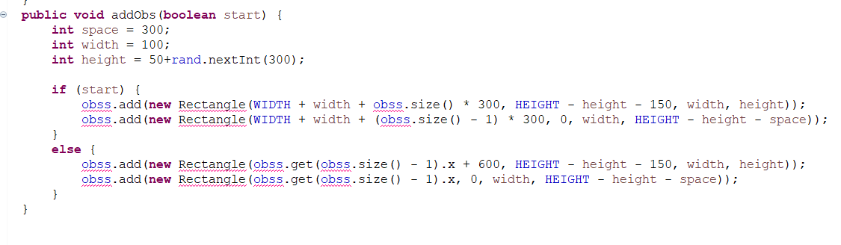
we use this function to set the information of our obstacles

Slide 12
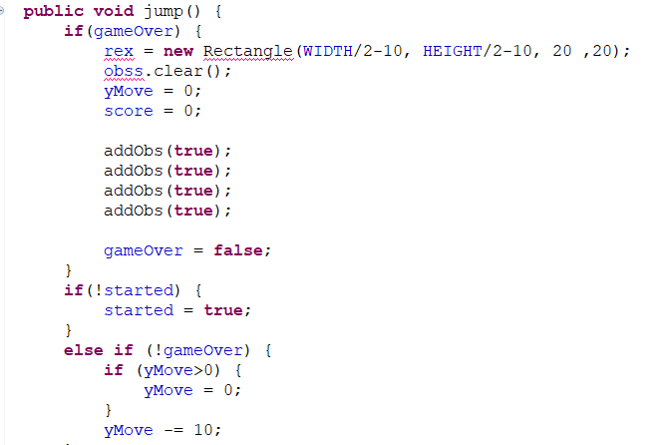
we use yMove=0 to set the gravity so that our box get pushed down by the gravity.

Slide 13
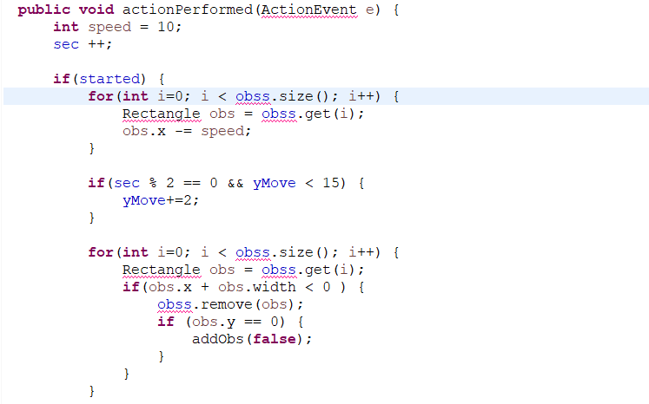
we use this fuction to make the obstacle keep moving along the screen.
we use this function to make the obstacle keep spawning infinitely

Slide 14
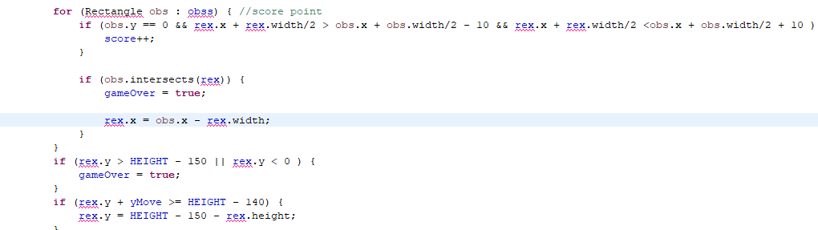
we use the function so that when our box passes the middle of the obstacle the score will go up by 1.

Slide 15
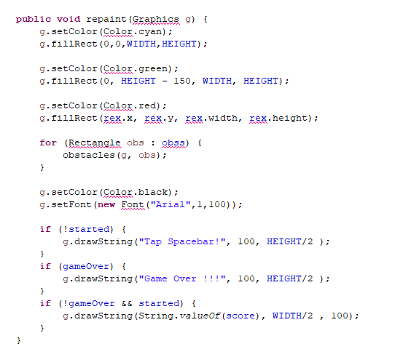
we use the void repaint to display the game.obstacle,our box,the instruction all are displayed from here.

Slide 16
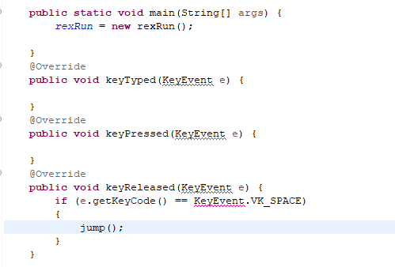
we use the function so that our input will be set to space.when we press space the box will go up.

Slide 17
Difficulities
03

Slide 18
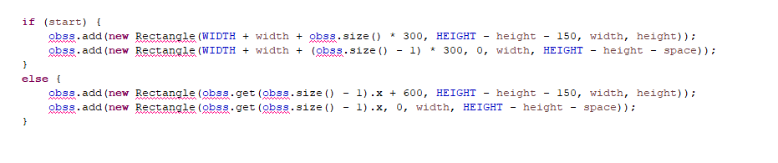
Difficulities
our hardest difficulities in making this program is finding out the right formula. for example the function here.finding the right combination so that our game can run smoothly and not have stutters or choppy frames.

Slide 19
Demo
04

