Slide 1

































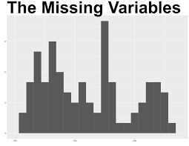




Team εpsilon
Syed Faizanul Haque
Hahnara Hyun
Anass Malabeh
Hugo Tran
Tina Tran

Slide 2

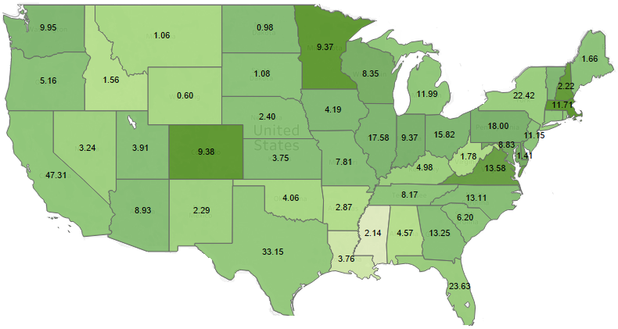
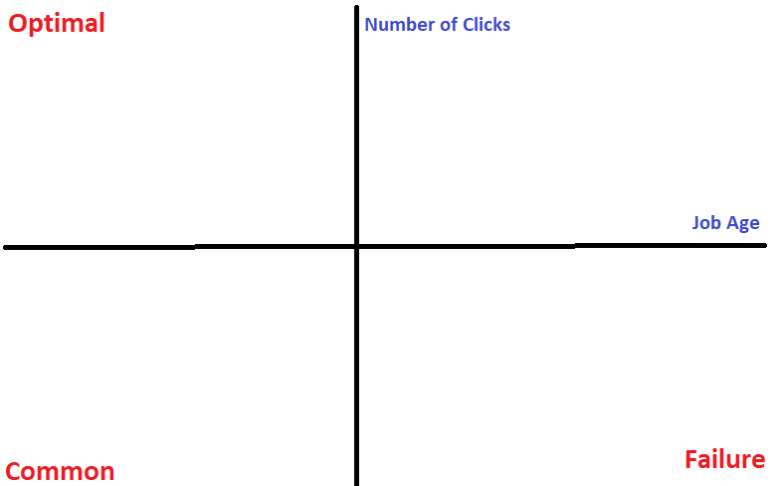


Ratio of Jobs Posted on Indeed to State Population
CA and TX have highest # of job postings whereas VA and MA have the highest ratio

Slide 3

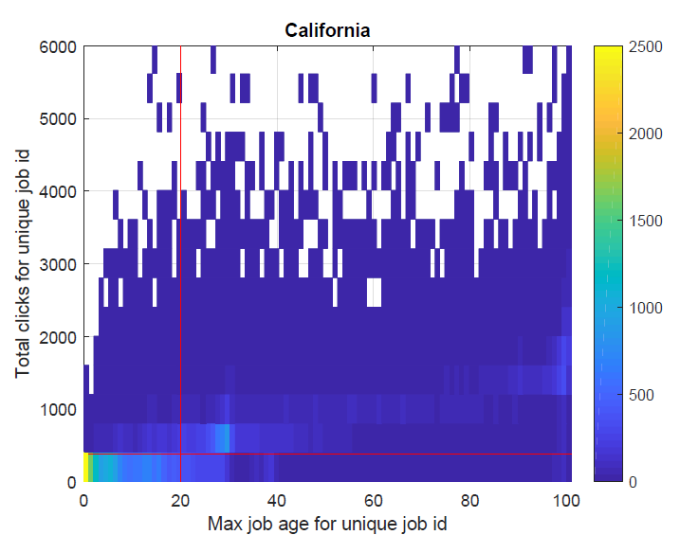
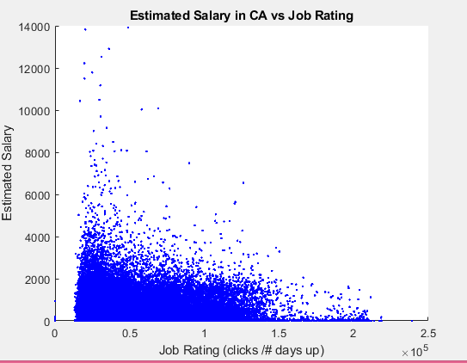
Most and least successful job postings based job postings to job age
Insert california graph
Recommendation: Optimization of numbers click to job age
Low job days, low clicks: Median salary of $43,000; Mode job is mednurse
Low job days, high clicks: Median salary of $34,050; Mode job is admin

