Slide 1
Three Recommendations for Making Profitable Movies
Presenters:
Colin Pelzer
Daniel Burdeno
Emiko Naomasa
Piotr Czolpik

Slide 2
Summary
Provide three recommendations to make the most profitable movies for Microsoft’s new original studio.
Notes:
I don’t know if we need this summary slide.

Slide 3
Outline
Business Problems
Data & Methodology
Recommendations #1
Recommendations #2
Recommendations #3
Conclusion

Slide 4
Business Problem
Business Questions
Microsoft has expressed interest in creating a new original content studio.
Which genre of movies promises a high rate of return on investment?
Which months of year are the best time to release movies?
Which directors promise high global grossing?

Slide 5
Data & Methodology
Data Source: IMDb , The Numbers
Years: 2010 – 2019
Sample Size: 1609 films
Return on Investment (ROI)
= ( Worldwide Gross – Production Budgets ) / Production Budgets

Slide 6
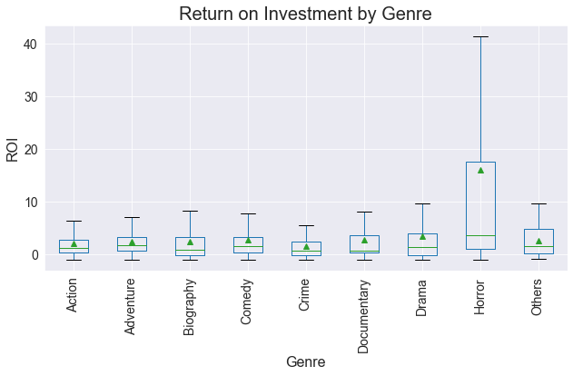
Recommendation 1 - Invest in horror movies for a high ROI
Horror movies have a higher ROI.

Slide 7
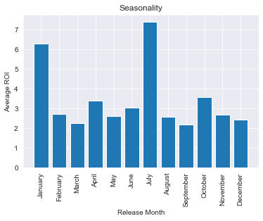
Recommendation 2 - Release in July and January
It’s no myth that the seasons influence consumer habits.

Slide 8
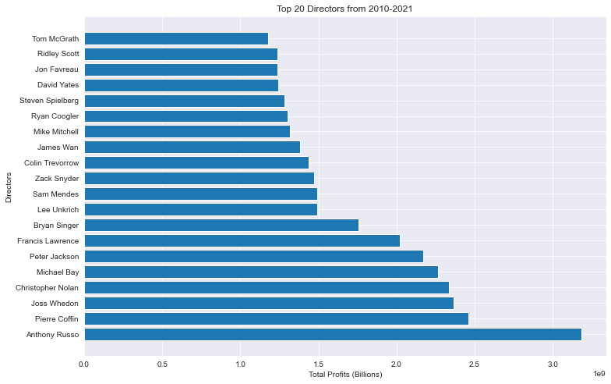
Recommendation 3 - Opt for famous directors when possible
Some of the most popular directors are on the list.

Slide 9
Recap
To make a high rate of return, (1) make a horror film, (2) ask for a famous director, (3) and release the film in July or January.
Next Step
Expand the analysis, including movie-streaming services

Slide 10
THANK YOU
ADD Horror Movie GIF in HERE
Email: pelzercolin@gmail.com,
GitHub(s): @ZenBurrito

