Slide 1
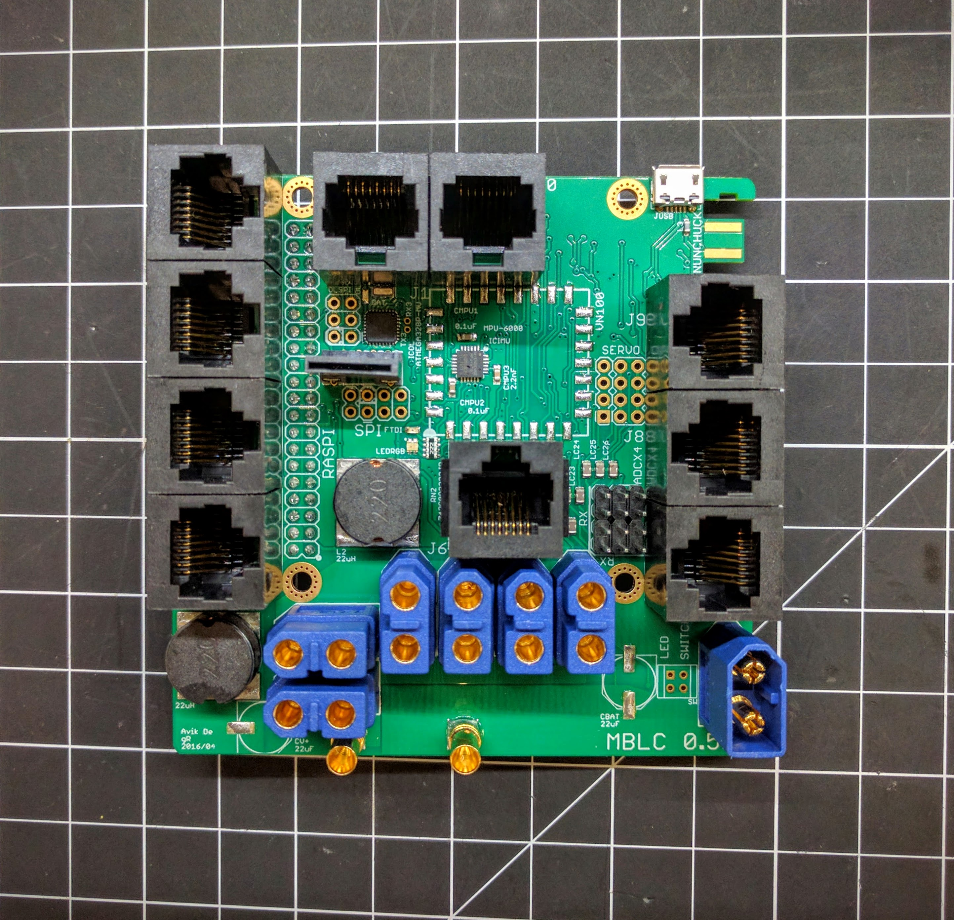
Motor signal
connectors
J2
J1
J0
J3
J9
J4
J8
J6
J5
J7

