Slide 1
Software Measurement
SOEN 6611
Metric Calculation and Correlation
Submitted by
Venkat Mani Deep Chandana - 40080924
Hetvi Shah - 40089272
Satish Chanda - 40091187
Khyatibahen Chaudhary - 40071098
Sarvesh Vora - 40081458
Presented By: Team E
Presented To: Dr. Jinqiu Yang

Slide 2
Metric 1, Metric 2, Metric 4
Statement coverage, Branch coverage, Cyclomatic complexity
Statement Coverage :
Statement coverage is a white-box testing approach. It is also known as Line coverage. It is used to measure and calculate the number of executable statements in a program.
Branch Coverage :
Branch coverage is also known as decision coverage. It covers all the edges and measures every branch in the program and fraction of independent code segments
Cyclomatic Complexity:
It is used to indicate the complexity of the given software by calculating the independent paths through your source code structure.

Slide 3
JaCoCo
JaCoCo is a free code coverage tool for java.
It Gives the code coverage analysis of line , methods, branches and cyclomatic complexity.
Various format of report can be generated like HTML , CSV , XML , EXEC
Integrated JaCoCo with Maven-plugin for our project.

Slide 4
Process
Import project using maven
Add the jacoco plugin into the pom file of java project.
Run the test cases
Execute mvn clean install and make sure it successfully build.
Execute mvn test
Execute mvn report
In the target folder , different jacoco file is generated with .html , .xml , and we are using .csv extension shows the class wise Statement , Branch and Code Complexity coverage for the project.

Slide 5
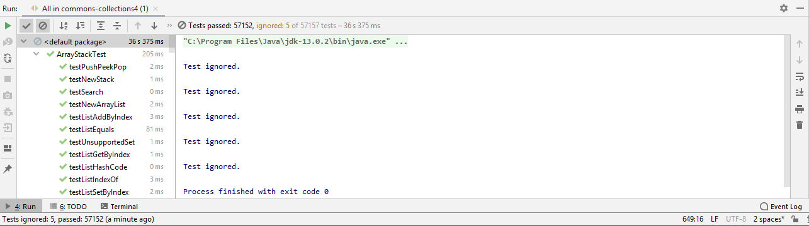
Challenges faced
Build the multiple version of same project for the analysis of the result.
Ignore the test cases(@Ignore) which shows no coverage.
Resolved the dependency errors to run the project.

Slide 6
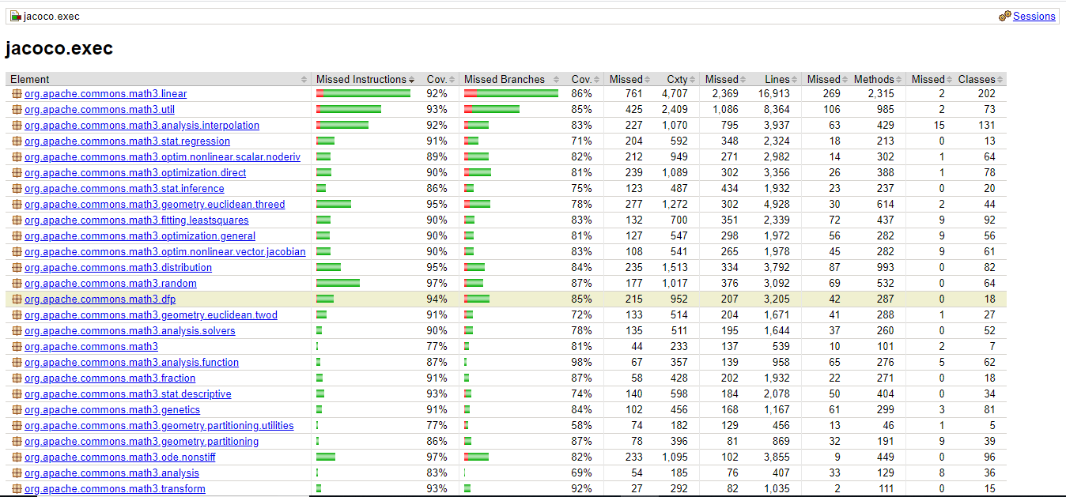
JaCoCo report

Slide 7
Metric 3
Mutation Testing
Mutation testing is conceptually quite simple. Faults (or mutations) are automatically seeded into your code, then your tests are run.
If your tests fail then the mutation is killed.
if your tests pass then the mutation lived.
The quality of your tests can be gauged from the percentage of mutations killed.

Slide 8
Various Types of Mutants
Operand replacement operators Replace the operand with another operand (x with y or y with x) or with the constant value. Example:- If(x>y) replace x and y values If(5>y) replace x by constant 5 Expression Modification Operators Replace an operator or insertion of new operators in a program statement. Example:- If(x==y) If(x==++y) Statement modification Operators Programmatic statements are modified to create mutant programs. Example:- Removing of else part in the if-else statement

Slide 9
Process of running pit
PIT runs your unit tests against automatically modified versions of your application code.
When the application code changes, it should produce different results and cause the unit tests to fail.
If a unit test does not fail in this situation, it may indicate an issue with the test suite.

Slide 10
Process
Copy the plugin into the pom file of your java project.
Execute mvn clean install.
Execute mvn org.pitest:pitest-maven:mutationCoverage -X.
A .csv file is create showing various mutation score of every mutation test that has been applied to the project.
Execute the ClassMutationScore.py generator to generate class wise mutation score.
Mutation Score = (Killed Mutants / Total number of Mutants) * 100.

Slide 11
Plugin used to run pit test
<plugin>
<groupId> org.pitest </groupId>
<artifactId> pitest-maven </artifactId>
<version> LATEST </version>
<configuration>
<outputFormats>
<param> HTML </param>
<param> CSV </param>
</outputFormats>
</configuration>
</plugin>

Slide 12
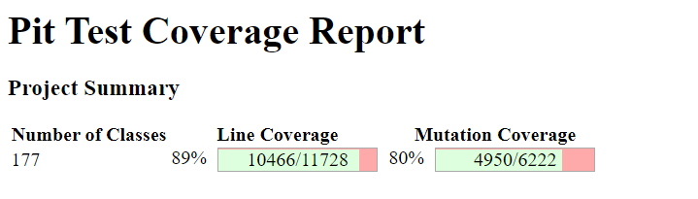
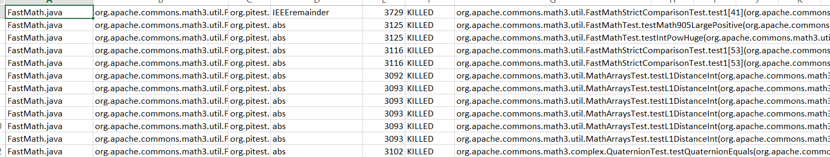
Output of Pit plugin
The .csv is created by pit tool representing
Col1 - java class (on which mutation has been tested)
Col2 - respective package
Col5 - Status of the mutation

Slide 13
Output produced by Python
ClassMutationScore.py takes .csv and produces class wise mutation as well as total mutation which can than be correlated with 1 & 2 metrics.

Slide 14
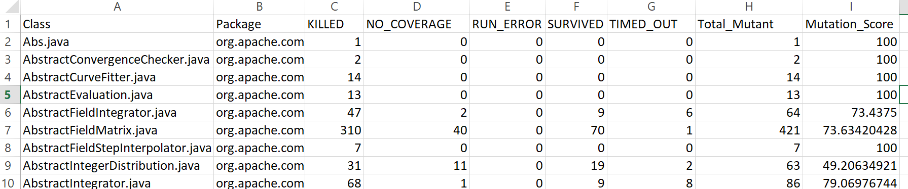
Output after running Python
Class wise attributes(Coverage, Status for each class and Mutation score) are generated usingClassMutationScore.py

Slide 15
Metric 5
Software Science Efforts
It’s an estimation of programming effort based on the number of operators and operands.
It is a combination of other Software Science metrics.
Hypothesis: Maintainability should decrease as the effort increases.
Algorithm: Scan the whole module code to compute parameters and perform calculations.

Slide 16
How to calculate Software Science Efforts (E)
To calculate the Software Science Effort, we need various parameters,
Number of distinct operators(D) like if, while, <, <=, etc.
Number of distinct operands(O) like variables, constants, etc.
Total occurrence of operators(F).
Total occurrence of operands(G).
Vocabulary, 𝐾=𝐷 + O
Observed length, 𝐿 = 𝐹 + 𝐺
The complete volume(V), V = 𝐿.log₂𝐾
The Difficulty, 𝐷′=𝐷.𝐺/2O
Software Science Effort, 𝐸=𝑉.𝐷’

Slide 17
Metric 5
Knots
It’s the number of crossing lines in a control flow graph.
Hypothesis: It's used to evaluate the structure of the module. The high number of knots, the less maintainable and understandable the project is.
Algorithm: Scan the whole module code to compute CFG and find knots

Slide 18
How to calculate Knots (K)
We need to label each line with line number in a module and generate a CFG.
A jump from line number x to line number y is represented by (𝑥,𝑦).
Let’s assume there exist two jumps in the module, (𝑖,𝑘) and (𝑗,𝑙), Without loss of generality, there exist a knot if and only if,
min(𝑖,𝑘) ≤ min(𝑗,𝑙) ≤ max(𝑖,𝑘) ≤ max⁡(𝑗,𝑙)
In our implementation we have used SciTools Understand to evaluate knots. For a particular version of a particular project we have calculated the total number of knots for simplicity.

Slide 19
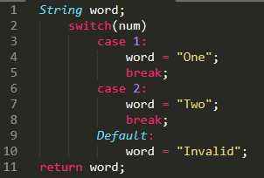
Example - Knots
1
2
3
6
9
4-5
7-8
10
11

Slide 20
Example - Knots
Jumps = {(2,3), (2,6), (2,9), (5,11), (8,11)}
Knots = {[(2,3), (2,6)],
[(2,3), (2,9)],
[(2,9), (2,6)],
[(5,11), (2,6)],
[(2,9), (5,11)],
[(5,11), (8,11)]}
Number of knots = 6
1
2
3
6
9
4-5
7-8
10
11

Slide 21
Metric 6
Post Release Defect Density
Post-release Defect Density is a quality indicator of a project and considers the number of bugs after a release.
Defect Density = Number of known defects (bugs) / SLOC
Defect(fault) is a flaw in any aspect of the system that contributes, or may potentially contribute,to the occurrence of one or more failures.
How to calculate ?
Extract the number of defects(bugs) from JIRA reports.
Run CLOC tool on project source and get Source lines of Code
Compute Defect Density from 1 & 2.

Slide 22
Post-release Defect Density Results
Project | Version | Number of Defects | SLOC | Post-release Defect Density
Apache Commons Collections | 4.4.0 | 37 | 51622 | 0.000716749
Apache Commons Configuration | 2.7 | 1 | 67632 | 0.000014785
Apache Commons Lang | 3.9 | 18 | 75643 | 0.000237960
Apache Commons Math | 3.6.1 | 48 | 208891 | 0.000229785
 | 3.6 | 16 | 208840 | 0.000076613
 | 3.5 | 40 | 196550 | 0.000203511
 | 3.4 | 12 | 195595 | 0.000061351
 | 3.3 | 37 | 187519 | 0.000197313

Slide 23
Metric Correlation

Slide 24
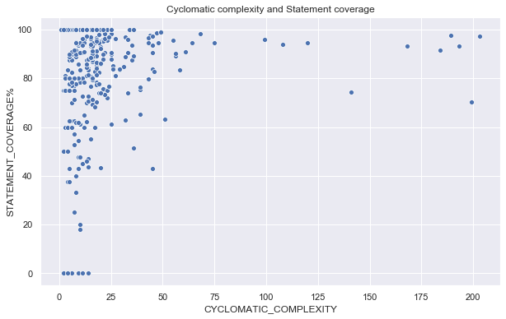
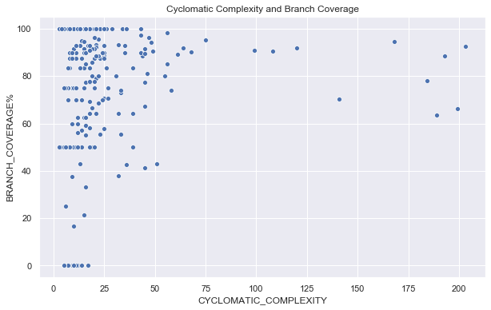
Metric 1 & 2 with 4
Commons.Collections
Metric 1 & Metric 4
 | CC | Statement Coverage
CC | 1.0 | -0.408
Statement Coverage | -0.408 | 1.0
Metric 2 & Metric 4
 | CC | Branch Coverage
CC | 1.0 | -0.276
Branch Coverage | -0.276 | 1.0

Slide 25
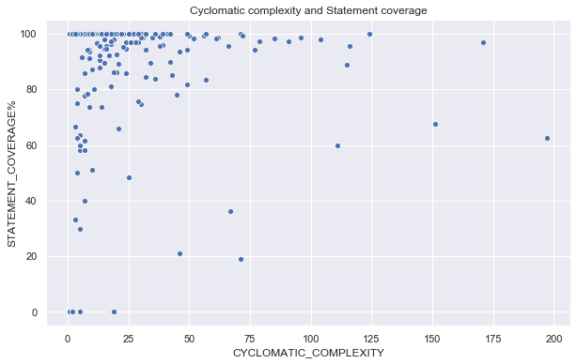
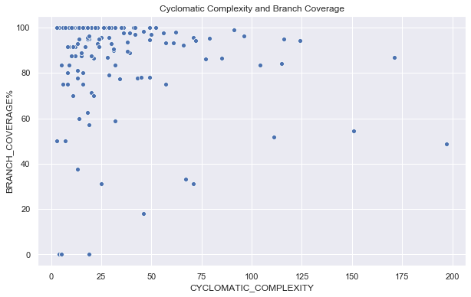
Metric 1 & 2 with 4
Commons.Configuration
Metric 1 & Metric 4
 | CC | Statement Coverage
CC | 1.0 | -0.383
Statement Coverage | -0.383 | 1.0
Metric 2 & Metric 4
 | CC | Branch Coverage
CC | 1.0 | -0.379
Branch Coverage | -0.379 | 1.0

Slide 26
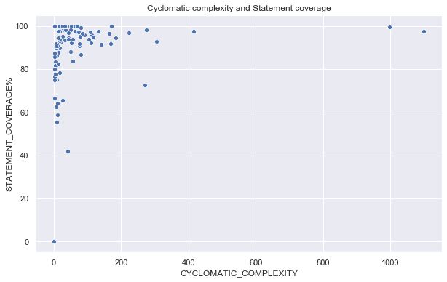
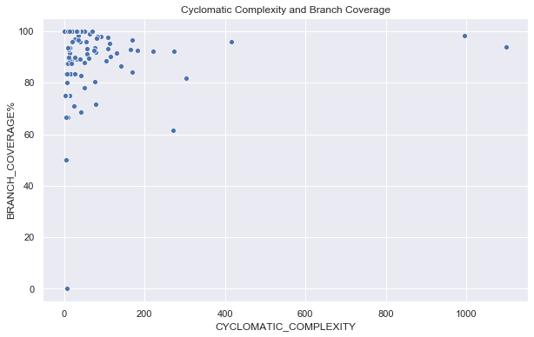
Metric 1 & 2 with 4
Commons.Lang
Metric 1 & Metric 4
 | CC | Statement Coverage
CC | 1.0 | -0.296
Statement Coverage | -0.296 | 1.0
Metric 2 & Metric 4
 | CC | Branch Coverage
CC | 1.0 | -0.303
Branch Coverage | -0.303 | 1.0

Slide 27
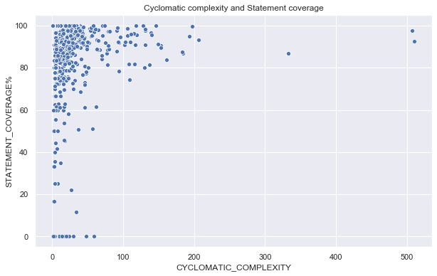
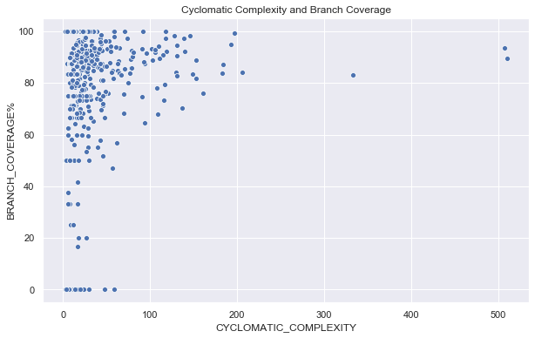
Metric 1 & 2 with 4
Commons.Math
Metric 1 & Metric 4
 | CC | Statement Coverage
CC | 1.0 | -0.382
Statement Coverage | -0.382 | 1.0
Metric 2 & Metric 4
 | CC | Branch Coverage
CC | 1.0 | -0.128
Branch Coverage | -0.128 | 1.0

Slide 28
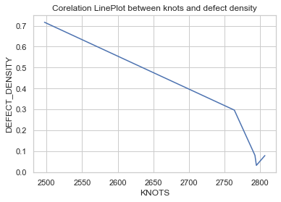
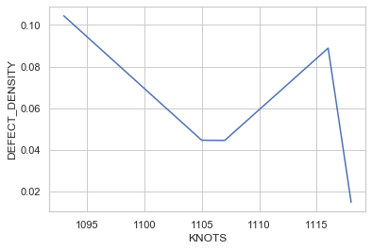
Metric 5 with 6
Commons.Collections
 | Knots | Defect Density
Knots | 1.0 | -0.9
Defect Density | -0.9 | 1.0
Commons.Collections
Commons.Configuration
Commons.Configuration
 | Knots | Defect Density
Knots | 1.0 | -0.7
Defect Density | -0.7 | 1.0

Slide 29
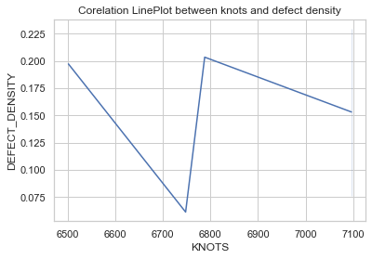
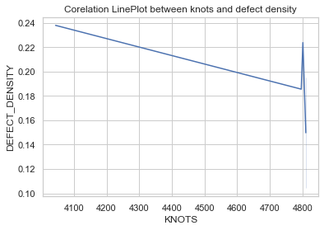
Metric 5 with 6
Commons.Math
 | Knots | Defect Density
Knots | 1.0 | 0.359092
Defect Density | 0.359092 | 1.0
Commons.Math
Commons.Lang
Commons.Lang
 | Knots | Defect Density
Knots | 1.0 | -0.615587
Defect Density | -0.615587 | 1.0

Slide 30


