Slide 1
Software Engineering
Northeastern University
Software College
Wei Zhang
zhangwei@swc.neu.edu.cn

Slide 2
CHAPTER 16
POSTDELIVERY MAINTENANCE

Slide 3
Overview
Why postdelivery maintenance is necessary
What is required of postdelivery maintenance programmers?
Postdelivery maintenance mini case study
Reverse engineering
Testing during postdelivery maintenance
Challenges of postdelivery maintenance

Slide 4
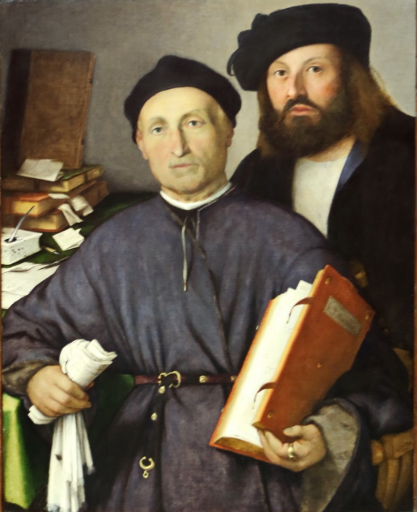
Postdelivery Maintenance
Postdelivery maintenance
  Any change to any component of the product (including documentation) after it has passed the acceptance test
Lorenzo Lotto
1480-1556

Slide 5
16.1 Why Postdelivery Maintenance Is Necessary
Corrective maintenance
  To correct residual faults
    Analysis, design, implementation, documentation, or any other type of faults
Perfective maintenance
  Client requests changes to improve product effectiveness
    Add additional functionality
    Make product run faster

Slide 6
Why Postdelivery Maint. Is Necessary
Adaptive maintenance
  changes in the environment in which the product operates
    The product is ported to a new compiler, operating system, and/or hardware
    A change to the tax code
    9-digit ZIP codes

Slide 7
16.2 What Is Required of Postdelivery Maintenance Programmers?
Maintenance Programmers
At least 67% of the total cost of a product accrues during postdelivery maintenance
Maintenance is a major income source
Nevertheless, even today many organizations assign maintenance to
  Unsupervised beginners, and
  Less competent programmers

Slide 8
What is Required of Postd. Maint. Prog.
Maintenance Programmers
Postdelivery maintenance is the most difficult aspects of software production because
  Postdelivery maintenance incorporates aspects of
  all other workflows
  Locate the bugs in all kinds of artifacts.

Slide 9
What is Required of Postd. Maint. Prog.
Maintenance Programmers
Suppose a defect report is handed to a maintenance programmer
  Recall that a “defect” is a generic term for a fault, failure, or error
What is the cause?
  Nothing may be wrong
  The user manual may be wrong, not the code
  Usually, however, there is a fault in the code

Slide 10
Corrective Maintenance
What tools does the maintenance programmer have to find the fault?
  The defect report by user
  The source code
  And often nothing else
维护人员的困境

Slide 11
Corrective Maintenance (contd)?
A maintenance programmer must therefore have superb debugging skills
  The fault could lie anywhere within the product
  The original cause of the fault might lie in the by now non-existent specifications or design documents
维护人员的困境

Slide 12
Corrective Maintenance
Suppose that the maintenance programmer has located the fault
Problem:
  How to fix it without introducing a regression fault
维护人员的困境

Slide 13
Corrective Maintenance (contd)
How to minimize regression faults
  detailed documentation for the product as a whole
  detailed documentation for each individual module
What usually happens
  There is no documentation at all, or
  The documentation is incomplete, or
  The documentation is faulty
The programmer must deduce from the source code itself all the information needed to avoid introducing a regression fault
The programmer now changes the source code
维护人员的困境

Slide 14
The Programmer Now Must
Test that the modification works correctly
  Using specially constructed test cases
Check for regression faults
  Using stored test data
Add the specially constructed test cases to the stored test data for future regression testing
Document all changes
维护人员的困境

Slide 15
Corrective Maintenance (contd)
Major skills are required for corrective maintenance
  Superb diagnostic skills
  Superb testing skills
  Superb documentation skills
维护人员的困境

Slide 16
Adaptive and Perfective Maintenance
The maintenance programmer must go through the
  Requirements
  Specifications
  Design
  Implementation and integration
workflows, using the existing product as a starting point
维护人员的困境

Slide 17
Adaptive and Perfective Maintenance
在原始的开发过程中
When programs are developed
  Specifications are produced by analysis experts
  Designs are produced by design experts
  Code is produced by programming experts
But a maintenance programmer must be expert in all three areas, and also in
  Testing, and
  Documentation
维护人员的困境

Slide 18
Conclusion
No form of maintenance
  Is a task for an unsupervised beginner, or
  Should be done by a less skilled computer professional

Slide 19
The Rewards of Maintenance
Maintenance is a thankless task in every way
  Maintainers deal with dissatisfied users
  If the user were happy, the product would not need maintenance
  The user’s problems are often caused by the individuals who developed the product, not the maintainer
  The code itself may be badly written
  Postdelivery maintenance is despised by many software developers
  Unless good maintenance service is provided, the client will take future development business elsewhere
  Postdelivery maintenance is the most challenging aspect of software production — and the most thankless

Slide 20
The Rewards of Maintenance (contd)
How can this situation be changed?
Managers must assign maintenance to their best programmers, and
Pay them accordingly

Slide 21
Case-study
Postdelivery Maintenance Mini Case Study
这类维护工作属于哪一类维护？
试分析维护的困难是什么？
如果你是维护人员，你会如何做？

Slide 22
16.3 Postdelivery Maintenance Mini Case Study
The Temperate Fruit Committee orders software to be developed for exactly 7 temperate fruits
  Apples, apricots, cherries, nectarines, peaches, pears, and plums
It is extended to include kiwi fruit, with difficulty
The product now needs to handle 26 additional fruits
“Just to the same thing 26 times”

Slide 23
Postdelivery Maintenance Case Study
Lessons to be learnt from this
  The problem was caused by the developer, not the maintainer
  A maintainer is often responsible for fixing other people’s mistakes
  The client does not understand that postdelivery maintenance can be difficult, or all but impossible
  All software development activities must be performed with an eye on future postdelivery maintenance

Slide 24
Reverse Engineering
When the only documentation for postdelivery maintenance is the code itself
  Start with the code
  Recreate the design
  Recreate the specifications (extremely hard)
  CASE tools can help (flowcharters, other visual aids)

Slide 25
Reverse Engineering (contd)
Reengineering
  Reverse engineering, followed by forward engineering
  Lower to higher to lower levels of abstraction
Restructuring- refactor
  Improving the product without changing its functionality
  Examples:
    Structuring code
    Improving maintainability
    Restructuring (XP, agile processes)

Slide 26
Reverse Engineering (contd)
What if we have only the executable code?
  Treat the product as a black box
  Deduce the specifications from the behavior of the current product

Slide 27
16.8 Testing during Postdelivery Maintenance
Maintainers tend to view a product as a set of loosely related components
  They were not involved in the development of the product
Regression testing is essential
  Store test cases and their outcomes, modify as needed

Slide 28
Challenges of Postdelivery Maintenance
The chapter describes numerous challenges
The hardest challenge to solve
  Maintenance is harder than development, but
  Developers tend to look down maintainers, and
  Are frequently paid more

Slide 29
The end of this section

