Slide 1
Software Engineering
Northeastern University
Software College
Wei Zhang
zhangwei@swc.neu.edu.cn

Slide 2
CHAPTER 6
TESTING

Slide 3
Overview
Quality issues
Non-execution-based testing
Execution-based testing
What should be tested?
Testing versus correctness proofs
Who should perform execution-based testing?
When testing stops

Slide 4
Testing
There are two basic types of testing
  Execution-based testing
  Non-execution-based testing

Slide 5
Testing (contd)
“V & V”
  Verification 验证
    Determine if the workflow was completed correctly
  Validation 确认
    Determine if the product as a whole satisfies its requirements
Warning
  The term “verify” is also used for all non-execution-based testing

Slide 6
6.1 Software Quality
Not “excellence”
The extent to which software satisfies its specifications
Every programmer is responsible for ensuring that his or her work is correct
  Quality must be built in from the beginning
质量不是由SQA小组来保证的，而是由每一位软件工程师和SQA共同保证的。

Slide 7
6.1.1 Software Quality Assurance
The members of the SQA group must ensure that the developers are doing high-quality work
  At the end of each workflow
  When the product is complete
In addition, quality assurance must be applied to
  The process itself
    Example: Standards
    Monitor

Slide 8
6.1.2 Managerial Independence
There must be managerial independence between
  The development group
  The SQA group
Neither group should have power over the other

Slide 9
Managerial Independence (contd)
One scenario before delivery deadline:
  Too many bugs or serious defects
More senior management must decide whether to
  Deliver the product on time but with faults, or
  Test further and deliver the product late
The decision must take a good balance between the interests of the client and the development organization
The cost of the SQA group
  Small size company
  Big size company

Slide 10
6.2 Non-Execution-Based Testing
Underlying principles
  Only review our own work is not a good choice
    Joint self checking and group checking
  Group synergy 小组协同
Walkthrough 走查
Review 评审
Inspection 审查

Slide 11
6.2.1 Walkthroughs
A walkthrough team consists of from 4 to 6 members
It includes representatives of
  The team responsible for the current workflow
  The team responsible for the next workflow
  The SQA group
  Client (for some workflows)
The walkthrough is preceded by preparation
  Lists of items
    Items not understood
    Items that appear to be incorrect

Slide 12
A case study for analysis workflow
An analysis walkthrough team should include at least one representative from the team responsible for drawing up the specifications, the manager responsible for the analysis workflow, a client representative, a representative of the team that will perform the next workflow of the development (in this instance the design team), and a representative of the software quality assurance group.
the SQA group member should chair the walkthrough.

Slide 13
6.2.2 Managing Walkthroughs
The walkthrough team is chaired by the SQA representative
In a walkthrough we detect faults, not correct them
  A correction produced by a committee is likely to be of low quality
  The cost of a committee correction is too high
  Not all items flagged are actually incorrect
  A walkthrough should not last longer than 2 hours
  There is no time to correct faults as well

Slide 14
Managing Walkthroughs (contd)
participant-driven 参与人驱动
document-driven 文档驱动
A walkthrough must be document-driven, rather than participant-driven
Verbalization leads to fault finding
A walkthrough should never be used for performance appraisal

Slide 15
6.2.3 Inspections
An inspection has five formal steps
  Overview - Abstraction
  Preparation, aided by statistics of fault types
  Inspection
  Rework
  Follow-up
审查比走查更加深入

Slide 16
Inspections (contd)
An inspection team has four members
  Moderator 审查主持人
  A member of the team performing the current workflow
  A member of the team performing the next workflow
  A member of the SQA group
  checklist of potential faults（see next slide）
Special roles are played by the
  Moderator
  Reader
  Recorder 记录员

Slide 17
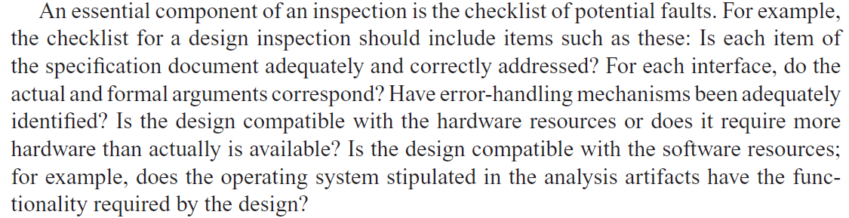
checklist of potential faults

Slide 18
Fault Statistics
Faults are recorded by severity （严重程度）
  Example:
    Major or minor
Faults are recorded by fault type
  Examples of design faults:
    Not all specification items have been addressed
    Actual and formal arguments do not correspond

Slide 19
Fault Statistics (contd)
We compare current fault rates with those of previous products
If inspecting two or three code artifacts results in the discovery of a disproportionate number of faults of a particular type
We take action if there are more faults in an artifact
  Redesigning from scratch is a good alternative
We carry forward fault statistics to the next workflow

Slide 20
Statistics on Inspections
IBM inspections showed up
  82% of all detected faults (1976)
  70% of all detected faults (1978)
  93% of all detected faults (1986)
  85% operating system
Switching system 交换系统
  90% decrease in the cost of detecting faults (1986)
JPL-美国喷气推进实验室
  Four major faults, 14 faults per 2 hours (1990)
  Savings of $25,000 per inspection
  The number of faults decreased exponentially by phase (1992) 更早的发现错误

Slide 21
Statistics on Inspections (contd)
Warning
Fault statistics should never be used for performance appraisal
  “Killing the goose that lays the golden eggs”
过去的时间里，IBM没有一个管理者应用审查的错误数量来评价程序员，这也是他走向成功的依据之一。

Slide 22
6.2.4 Comparison of Inspections and Walkthroughs
Walkthrough
  Two-step, informal process
    Preparation
    Analysis
Inspection
  Five-step, formal process
    Overview
    Preparation
    Inspection
    Rework
    Follow-up

Slide 23
6.2.5 Strengths and Weaknesses of Reviews
Reviews can be effective
  Faults are detected early in the process
Reviews are less effective if the process is inadequate
  Large-scale software should consist of smaller, largely independent pieces
  The documentation of the previous workflows has to be complete and available online

Slide 24
6.2.6 Metrics for Inspections
对于审查本身，如何去测试它的效果？
Inspection rate (e.g., design pages inspected per hour)
Fault density (e.g., faults per KLOC inspected)
Fault detection rate (e.g., faults detected per hour)
Fault detection efficiency (e.g., number of major, minor faults detected per hour)

Slide 25
Metrics for Inspections (contd)
Think about the question
Does a 50% increase in the fault detection rate mean that
  Quality has decreased? Or
  The inspection process is more efficient?

Slide 26
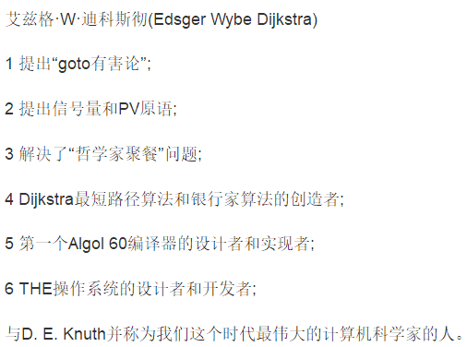

6.3 Execution-Based Testing
Organizations spend up to 50% of their software budget on testing
  But delivered software is unreliable
Dijkstra (1972)
  “Program testing can be a very effective way to show the presence of bugs, but it is hopelessly inadequate for showing their absence”
Dijkstra 1930-2002

Slide 27
6.4 What Should Be Tested?
Definition of execution-based testing
  “The process of inferring certain behavioral properties of the product based, in part, on the results of executing the product in a known environment with selected inputs”
  1979，Goodenough
This definition has troubling implications

Slide 28
6.4 What Should Be Tested? (contd)
“Inference” 推断
  The tester takes the product, runs it with known input data, and examines the output.
“Known environment”
“Selected inputs”
  Sometimes we cannot provide the inputs we want
  Simulation is needed

Slide 29
6.4 What Should Be Tested? (contd)
We need to test correctness (of course), and also
  Utility 实用性
  Reliability
  Robustness, and
  Performance
  Correctness

Slide 30
6.4.1 Utility 实用性
The extent to which the product meets the user’s needs
  Examples:
    Ease of use
    Useful functions
    Cost effectiveness 与竞争对手相比

Slide 31
6.4.2 Reliability 可靠性
A measure of the frequency and criticality of failure
  Mean time between failures
  Mean time to repair
  Cost to repair the results of a failure

Slide 32
6.4.3 Robustness健壮性
A function of
  The range of operating conditions
  The possibility of unacceptable results with valid input
  The effect of invalid input

Slide 33
6.4.4 Performance 性能
The extent to which space and time constraints are met
If data are lost because the system is too slow
  There is no way to recover those data
Real-time software is characterized by hard real-time constraints

Slide 34
6.4.5 Correctness
A product is correct if it satisfies its specifications
前提是specification是正确的，如果specification是错误的呢？

Slide 35
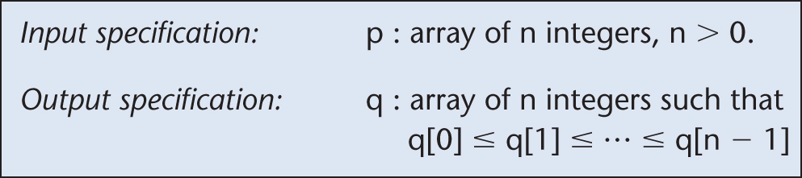
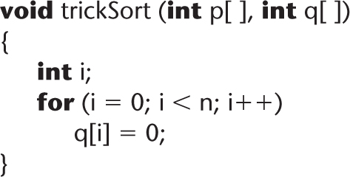
Correctness of specifications
Incorrect specification for a sort:
Function trickSort which satisfies this specification:
Figure 6.1
Figure 6.2

Slide 36
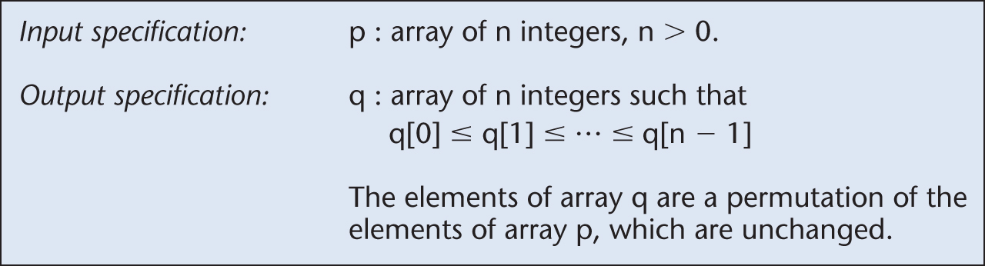
Correctness of specifications (contd)
Incorrect specification for a sort:
Corrected specification for the sort:
Figure 6.1 (again)
Figure 6.3

Slide 37
6.5 Testing versus Correctness Proofs
A correctness proof is an alternative to execution-based testing

Slide 38
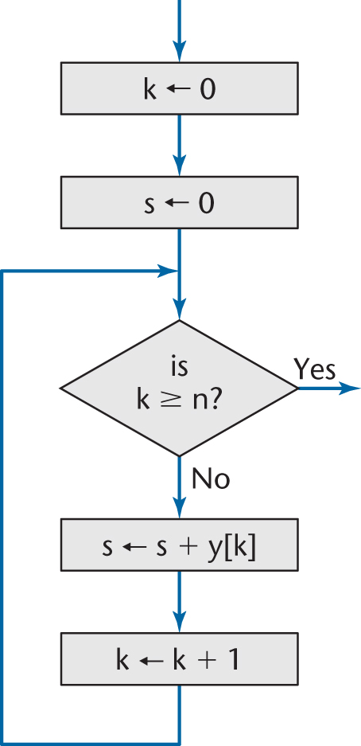
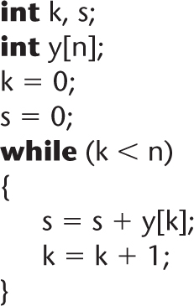
6.5.1 Example of a Correctness Proof
The code segment to be proven correct

Slide 39
Example of a Correctness Proof (contd)
Add
  Input specification
  Output specification
  Loop invariant
  Assertions
(See next slide)

Slide 40
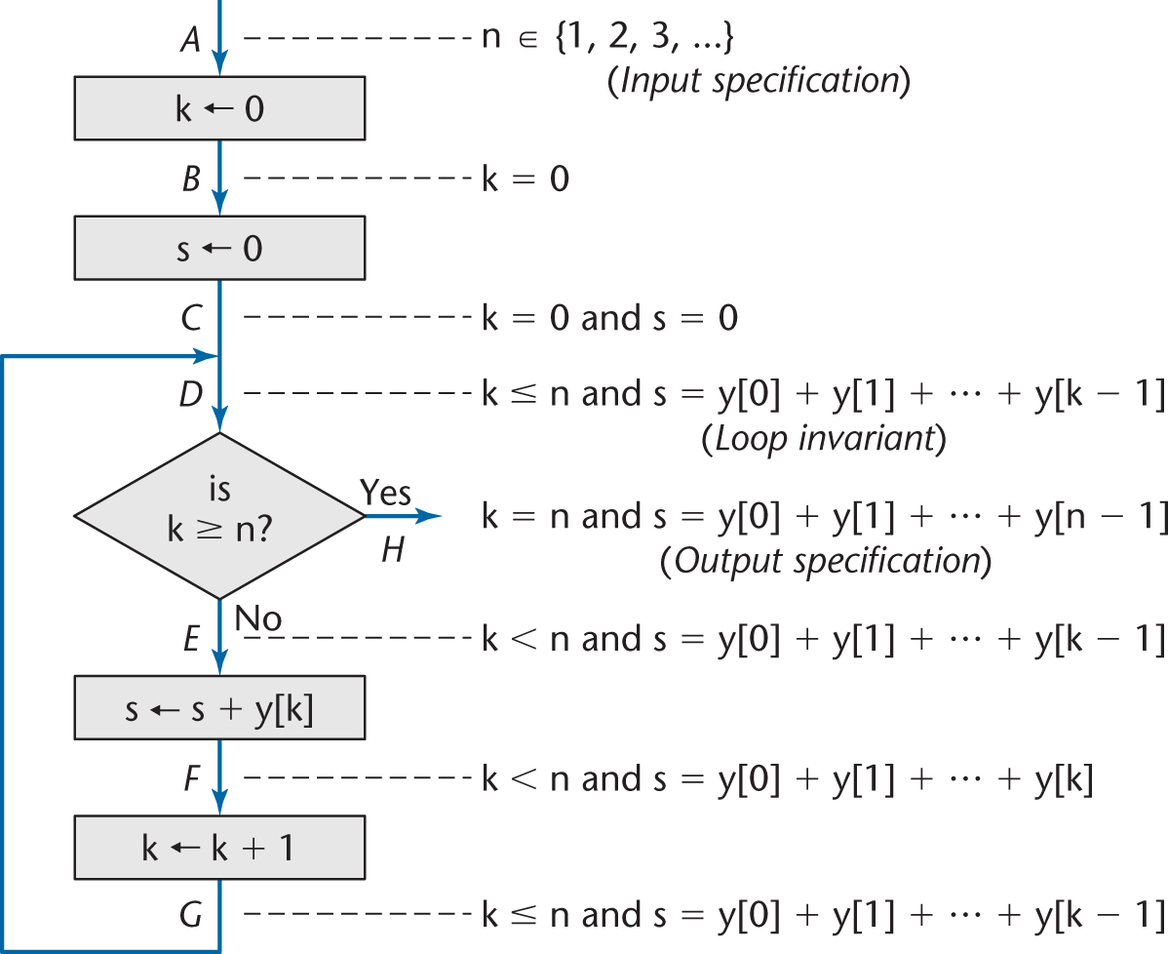
Example of a Correctness Proof (contd)
Figure 6.6

Slide 41
Difficulties with Correctness Proving (contd)
How do we find input–output specifications, loop invariants?
What if the specifications are wrong?
We can never be sure that specifications or a verification system are correct

Slide 42
6.6 Who Should Perform Execution-Based Testing?
Programming is constructive
Testing is destructive破坏性的
  A successful test finds a fault
So, programmers should not test their own code artifacts

Slide 43
Who Should Perform Execution-Based Testing? (contd)
Solution:
  The programmer does informal testing
  The SQA group then does systematic testing
  The programmer debugs the module
All test cases must be
  Planned beforehand, including the expected output, and
  Retained afterwards

Slide 44
6.7 When Testing Stops
Only when the product has been irrevocably discarded

