Slide 1
Test Automation and Quality Assurance
Chapter 10

Slide 2
Overview
Motivations for Automated Testing
Examples of
Continuous Integration
Acceptance Test Tools

Slide 3
Learning Objectives
Describe the motivation for different types of automated testing
Discuss the capabilities for some of the example tools

Slide 4
Automated Testing
For testing to be effective, it is good to automate it as much as possible.
Benefits:
Speed – ideally, issue one command to start a full run of tests. Quicker than a human following a test list.
Frequency – regular execution of the tests.
Repeatability – run the same tests multiple times.
Accuracy – less mistakes made during testing
Documentation – such tests are also a form of documentation, listing what needs to be tested
Feedback on progress – information to share with the team and managers

Slide 5
Getting ready to run automated tests
Manual Tests
Cost of
Running
Tests
Automated
Tests
Time to run tests
Notes:
There will be higher initial costs to setup and get ready to run automated tests, but over time it will be more cost effective to run, and re-run, the tests to confirm that new changes to the software have not broken earlier working functions.

Slide 6
Key Steps
Run a set of tests
Run based on time, or related test sets
Gather the results and process information
Record all outcomes
Generate statistics about testing
Number of faults per-build
Code coverage analysis
Share the results with the developers and managers

Slide 7
Automated Testing
Is this suitable for all testing scenarios?
Ad-hoc/exploratory Testing – difficult to build ‘experimentation’ into an automated test suite
Dynamic Applications – applications that require dynamic input or the system adapts its behaviour based on the current situation
Hardware setup – complicated if hardware needs to be setup to run the tests.

Slide 8
Automated Testing Tools Introduction

Slide 9
Test Automation
Range of tools, covering different issues
Commercial Tools
e.g. GUI Test, Microsoft’s Web Capacity Analysis Tool
Open Source Tools
e.g. Jenkins (https://www.jenkins-ci.org)
Project specific Tools
Developed by the testers / project team
Reusable across different products

Slide 10
Version Control Systems
Core tool for team work
CVS – Concurrent Versions System
http://cvs.nongnu.org - Website
Subversion (svn)
http://svnbook.red-bean.com - Version Control with Subversion.
Git
http://git-scm.com/book - Pro Git
Mecurial
http://mercurial.selenic.com - Website

Slide 11
Continuous Integration (CI)
Automating the Build Process, e.g. Jenkins (Hudson), Cruise Control
Checkout
Code & Build Scripts
Email
Code &
Project Details
notify
Developer
Version Control
CI Server
SMS
deploy
Instant Messaging
Deploy to Test Server

Slide 12
Build Scripts
We need a way to build software projects so that they can be tested
The build scripts describe how to create executable from source code
With C and C++, we would probably use make files, which describe how to build (compile and link) a C or C++ project.
With Java, we would probably use Ant, Maven or Gradle to describe how to build
Ant and Maven are XML descriptions of the build process, Gradle uses a different format
Other platforms have scripts to build software
MSBuild for Visual Studio, Xcode also has build tools

Slide 13
Example Maven script (1)
<?xml version="1.0" encoding="UTF-8"?>
<project xmlns="http://maven.apache.org/POM/4.0.0"
xmlns:xsi="http://www.w3.org/2001/XMLSchema-instance"
xsi:schemaLocation="http://maven.apache.org/POM/4.0.0 http://maven.apache.org/xsd/maven-4.0.0.xsd">
<modelVersion>4.0.0</modelVersion>
<groupId>java-sqat</groupId>
<artifactId>junit-test</artifactId>
<version>1.0-SNAPSHOT</version>
<dependencies>
<dependency>
<groupId>org.junit.jupiter</groupId>
<artifactId>junit-jupiter-api</artifactId>
<version>5.3.1</version>
<scope>test</scope>
</dependency>
Full example at: https://github.com/digidol/Example-JUnit-with-JaCoCo/blob/master/pom.xml
Notes:
This is an example Ant Script, taken from the Ant user documentation, which can be download and viewed at docs/manual/index.html in the download directory.

Slide 14
Plugins are used to control what happens when building the project
<plugin>
<groupId>org.jacoco</groupId>
<artifactId>jacoco-maven-plugin</artifactId>
<version>0.8.2</version>
<executions>
<execution>
<id>prepare-agent</id>
<goals>
<goal>prepare-agent</goal>
</goals>
</execution>
<!-– see other execution stages in the build file -->
</executions>
</plugin>
Notes:
The second part of the Ant Script

Slide 15
A Maven Build Script
Maven has a number of build phases, including:
validate, initialize, generate-sources, process-sources, generate-resources, process-resources, compile, process-classes, generate-test-sources, process-test-sources, generate-test-resources, process-test-resources, test-compile, process-test-classes, test, prepare-package, package, pre-integration-test, integration-test, post-integration-test, verify, install, deploy, pre-clean, clean, post-clean, pre-site, site, post-site, site-deploy
There are standard plugins for these phases. There are also additional plugins where you can add extra functions.

Slide 16
Example Maven Build Script
In the build script for this project, we have:
Use of JUnit 5
Build stage to launch code coverage using JaCoCo
Attach this to the prepare-agent so that it is ready to monitor the code as it runs.
We also activate this tool during the prepare-package phase, which is after the tests have run. This generates code coverage reports.
There is another stage we can run, which is to check if we meet code coverage targets, e.g. check how much of the code is covered by the tests.
Build stage to run a check on the number of lines of code, using sloccount.
Maven build stage – running this command line program as an executable file
A separate stage in the Jenkins build steps to access the report

Slide 17
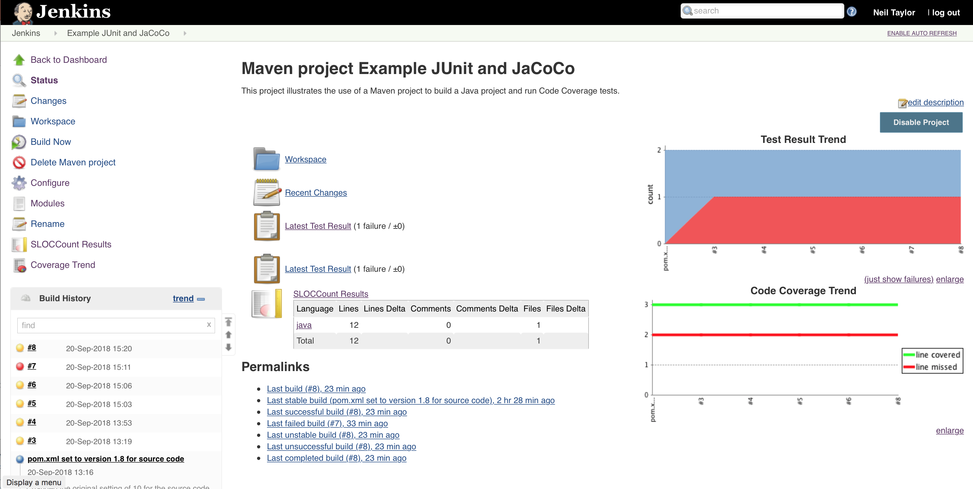

Slide 18
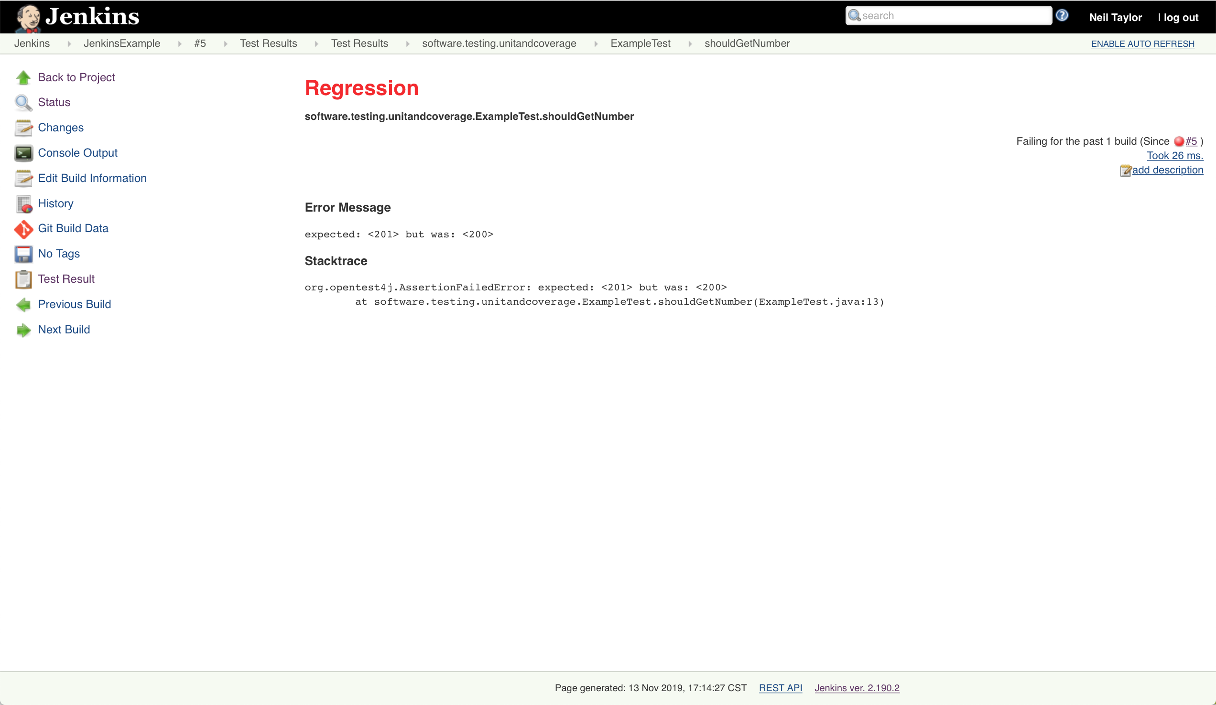

Slide 19
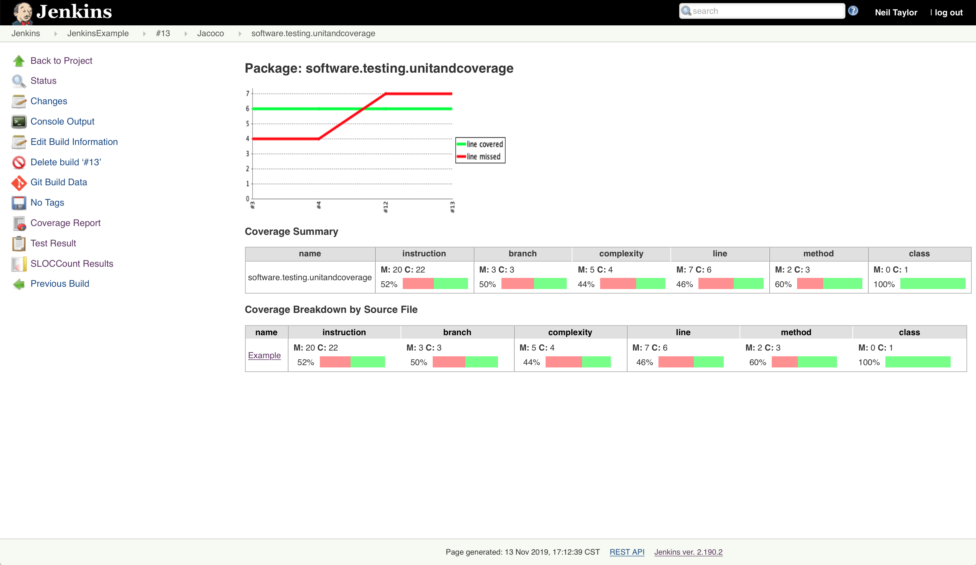

Slide 20
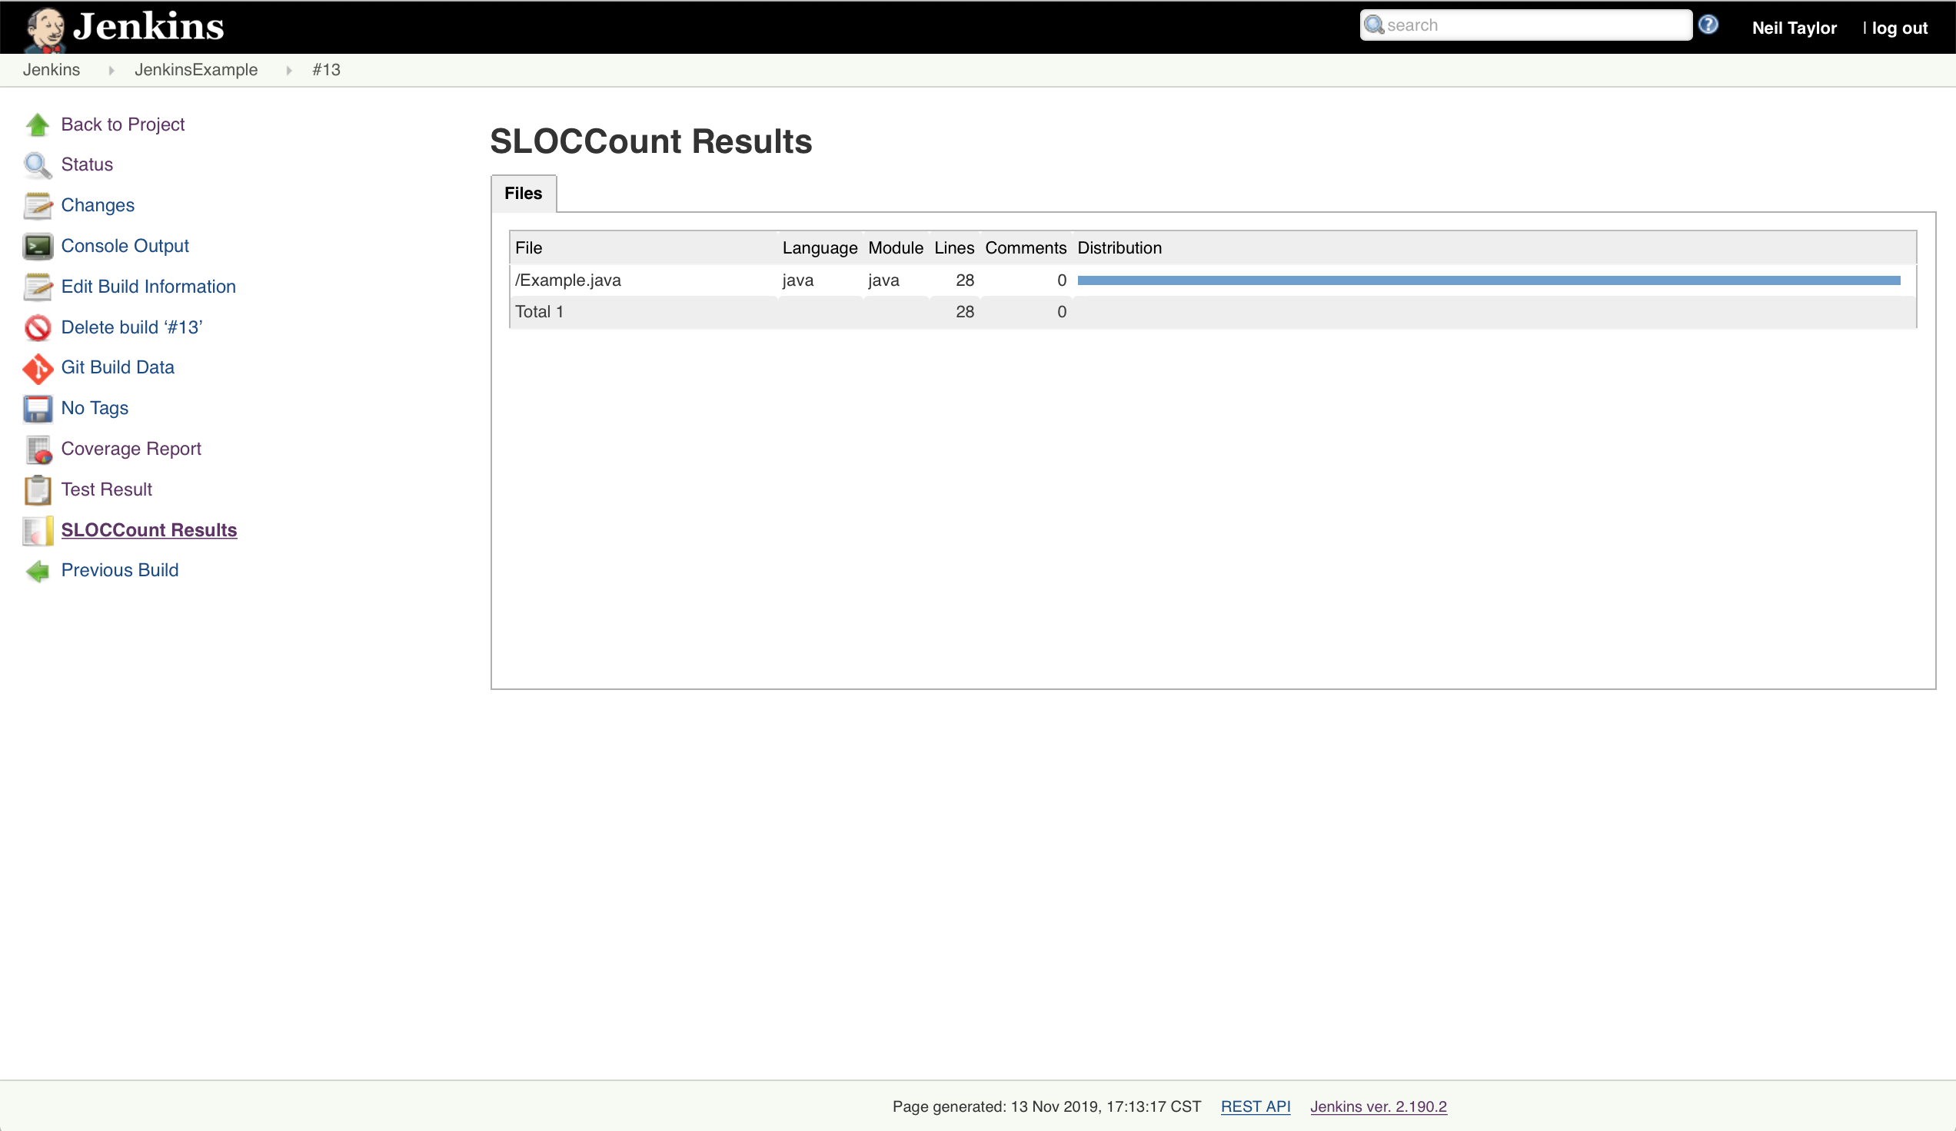

Slide 21
Demo

Slide 22
CI and example tools
JaCoCo – one tool to measure code coverage
Active whilst the tests are running
Gathers data from the JVM
Generates the report
Coverage counters explained at: https://www.jacoco.org/jacoco/trunk/doc/counters.html
sloccount – tool that will count lines of code in different programming languages. Written in C. Need to get a compiled version of download and build yourself.

Slide 23
Jenkins and more complex tools
We have looked at the classic way to configure Jenkins
Using the Jenkins UI to specify the setup
It also has the ability to run Pipelines
A set of stages to build the software
Described in a Jenkinsfile (in a Groovy DSL format)
File can be stored in a version control system
Pipelines can describe more complex setup on larger projects
Continuous Integration -> Continuous Delivery

Slide 24
Benefits of Continuous Integration
Benefits:
It can be set to automatically check for changes to the source code
Runs the full set of tests
Can be configured to run in different ways, e.g. some tests in parallel, some at scheduled times
Build documentation, e.g. javadoc
Build and deploy test versions
Send notifications of build problems
Gather metrics (information) about the build process over time

Slide 25
GUI Tools
Examples include:
TestFX – use JUnit to build tests for GUI testing
Jubula - An Eclipse tool for building and running GUI tests.
Xcode – includes tools for automated UI testing of apps, e.g. iOS
Notes:
We looked at an example of this in the session System tests.

Slide 26
Large Range of Tools
Tools for unit testing
e.g. JUnit, NUnit, test frameworks in Visual Studio and Xcode, …
For Mock Objects: Mockito, JMock, PowerMock, …
For Behaviour-Driven Development
e.g. Cucumber
Web Testing:
e.g. Selenium, Jmeter, Postman
… and many more examples …
When starting a project, it is worth spending time to investigate tools that could help to automate the process.
If the tools are Open Source, find ones with active communities

Slide 27
Building & Extending Test Automation Tools
The main tasks of test automation are the same as unit testing:
Setup
Exercise
Verify (Analyse)
Teardown
Want to build your own automation? Keep in mind the key steps above.
Some test automation tools can be extended to add new functions
New Report Types
New ways to notify you of errors
Other features specific to your project

Slide 28
Functional Testing Tools

Slide 29
FIT, FITNesse, SLiM
FIT (Framework for Integrated Tests) - Ward Cunningham
FitNesse (WIKI tool to create the tests)
Customers specify the top level tests and developers link those tests through to the ‘System Under Test’
Exercise the business logic, not the user interface
Test data is arranged as tables.

Slide 31
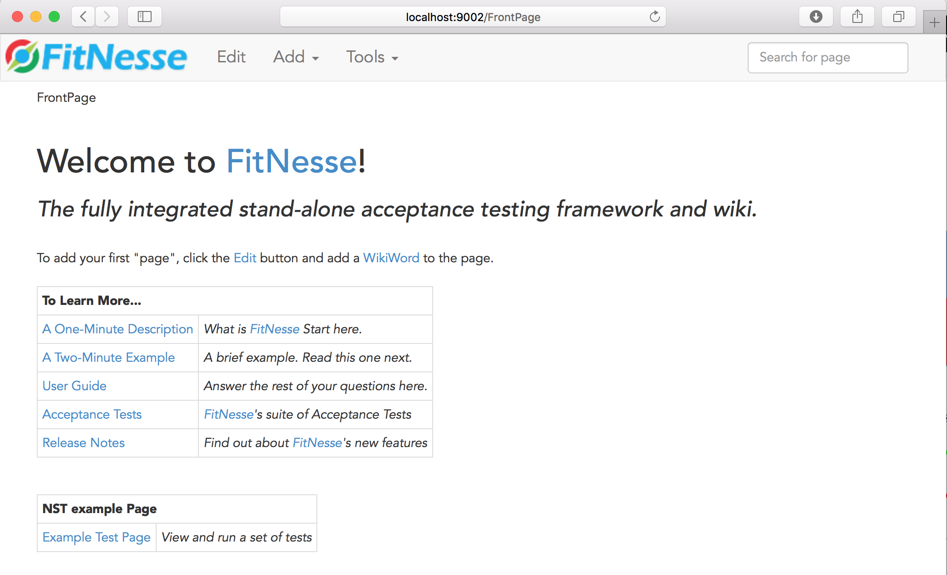

Slide 32
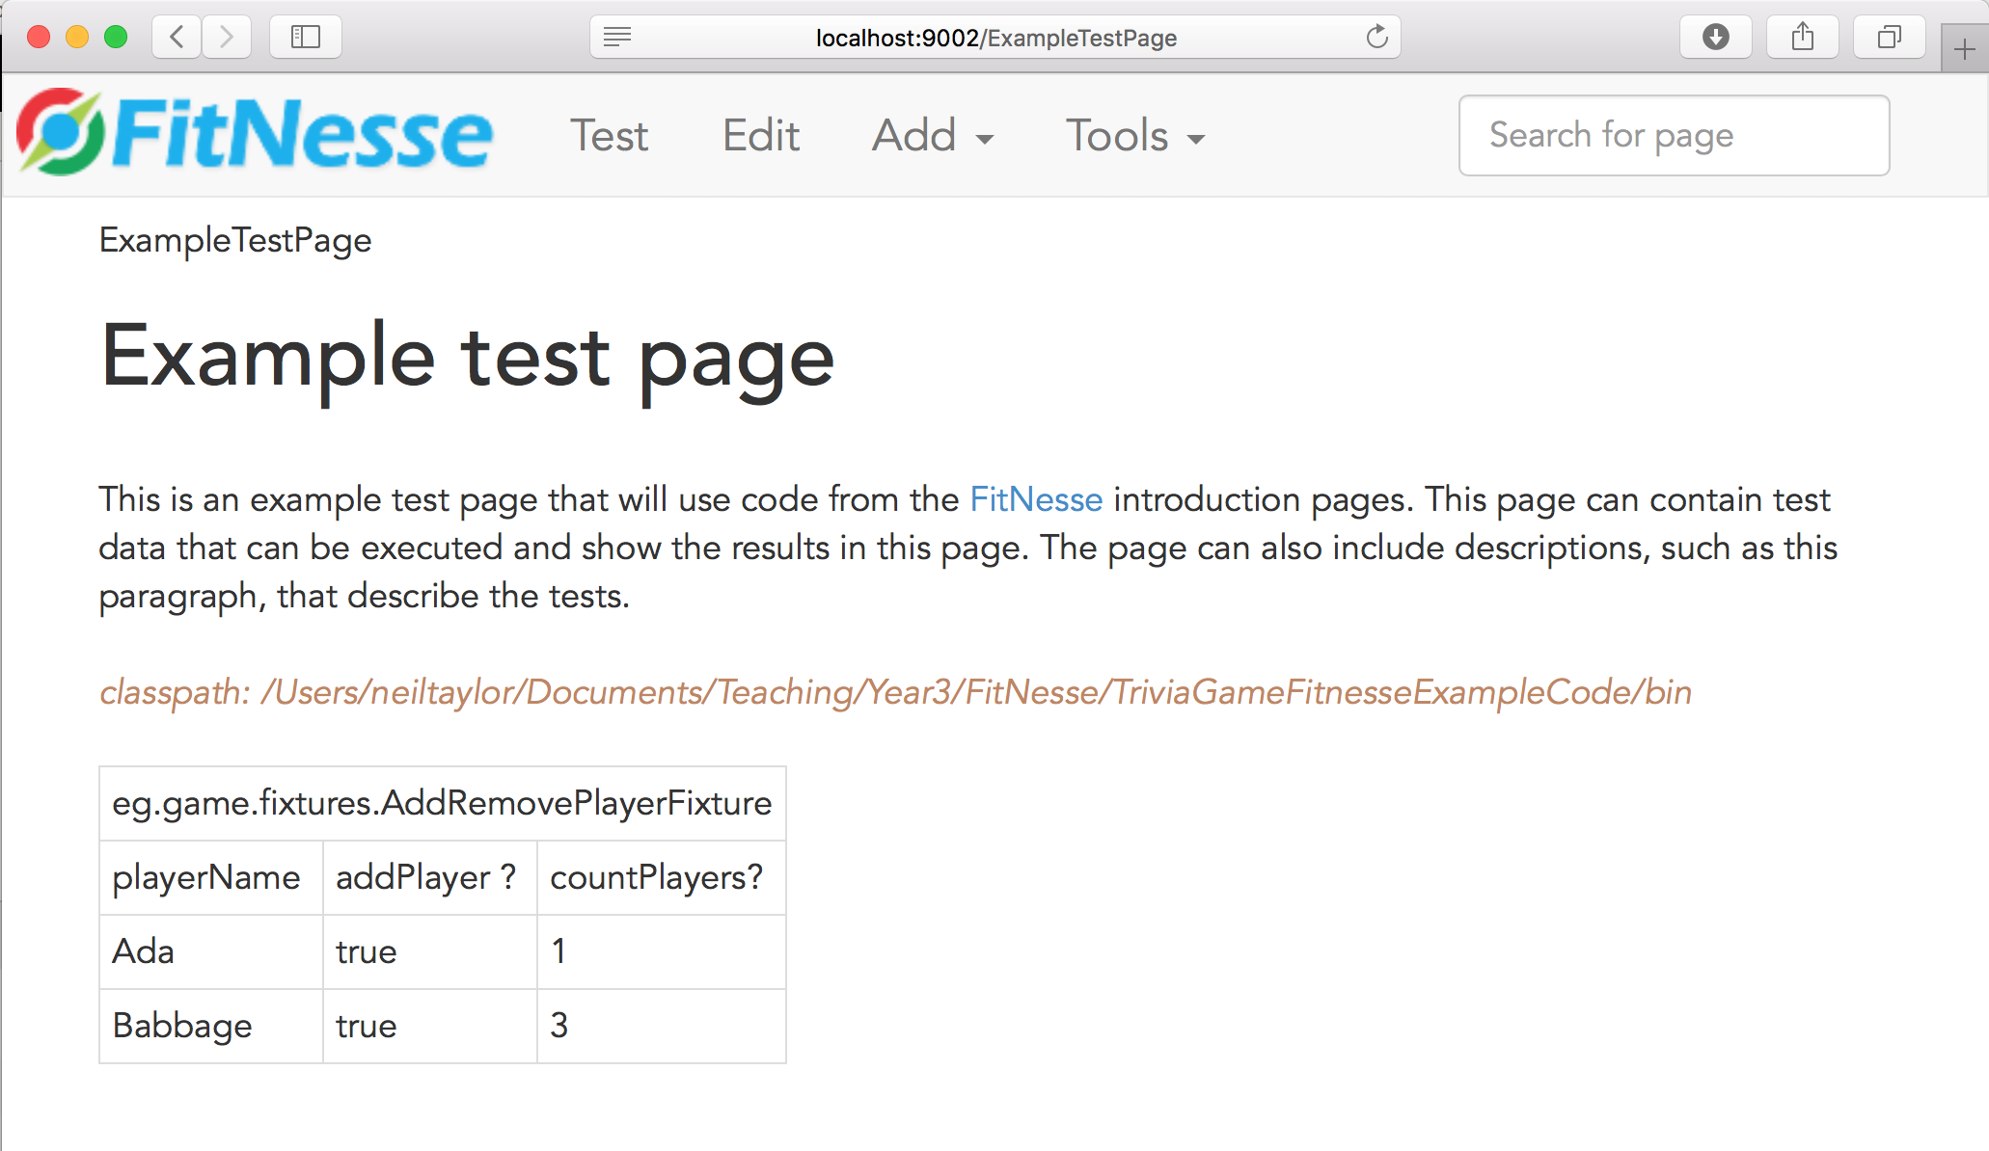
Notes:
Specify test tables.

Slide 33
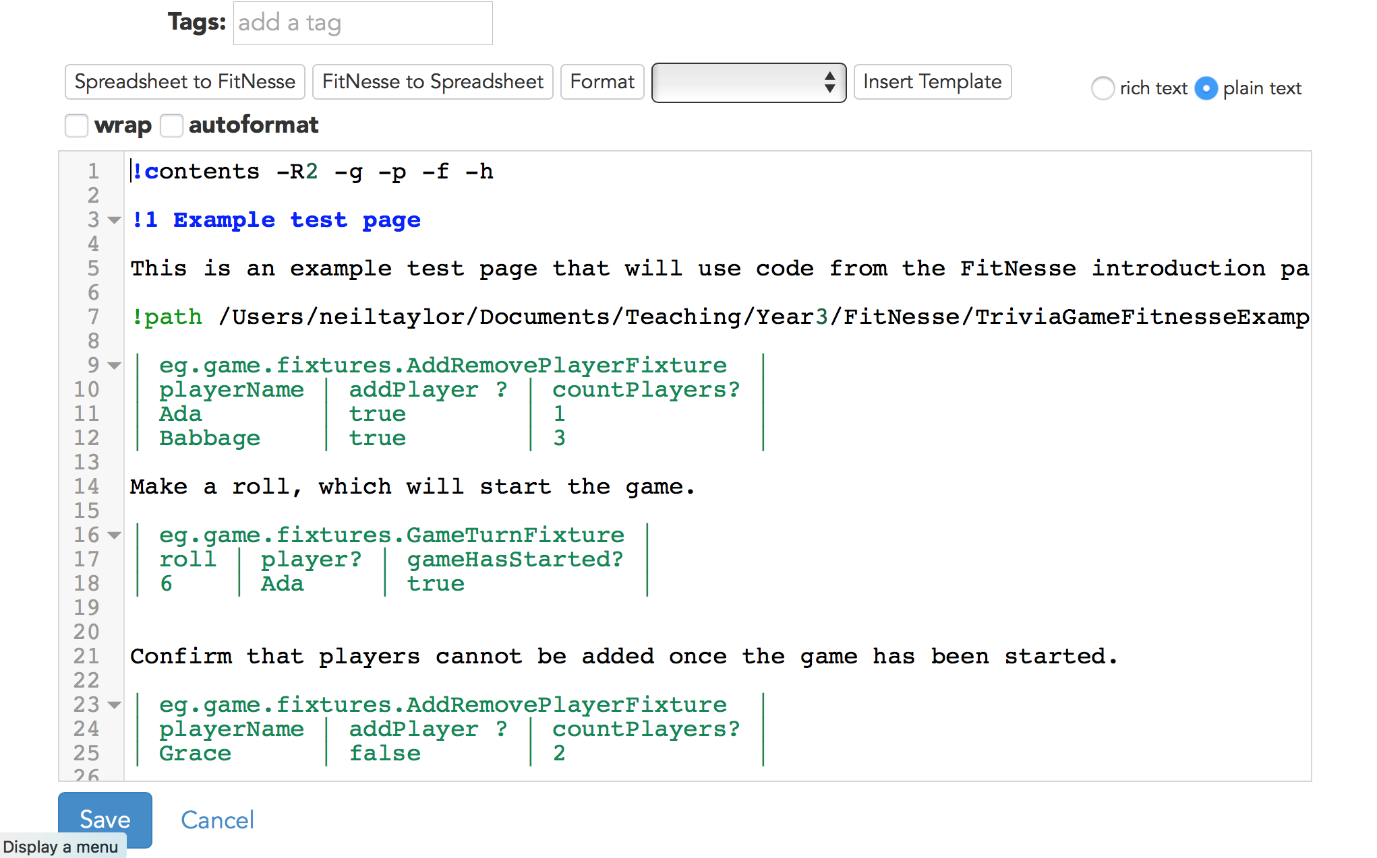
Notes:
Simplified markup, which should be easier for people to define.

Slide 34
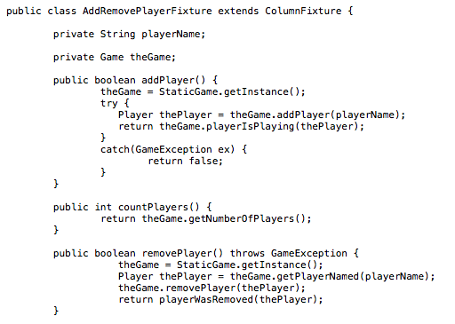
Notes:
Extract from an example fixture.

Slide 35
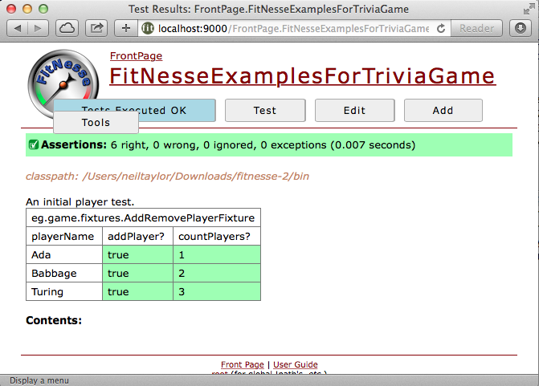
Notes:
A runnable document – run the tests and check that it is ok.

Slide 36
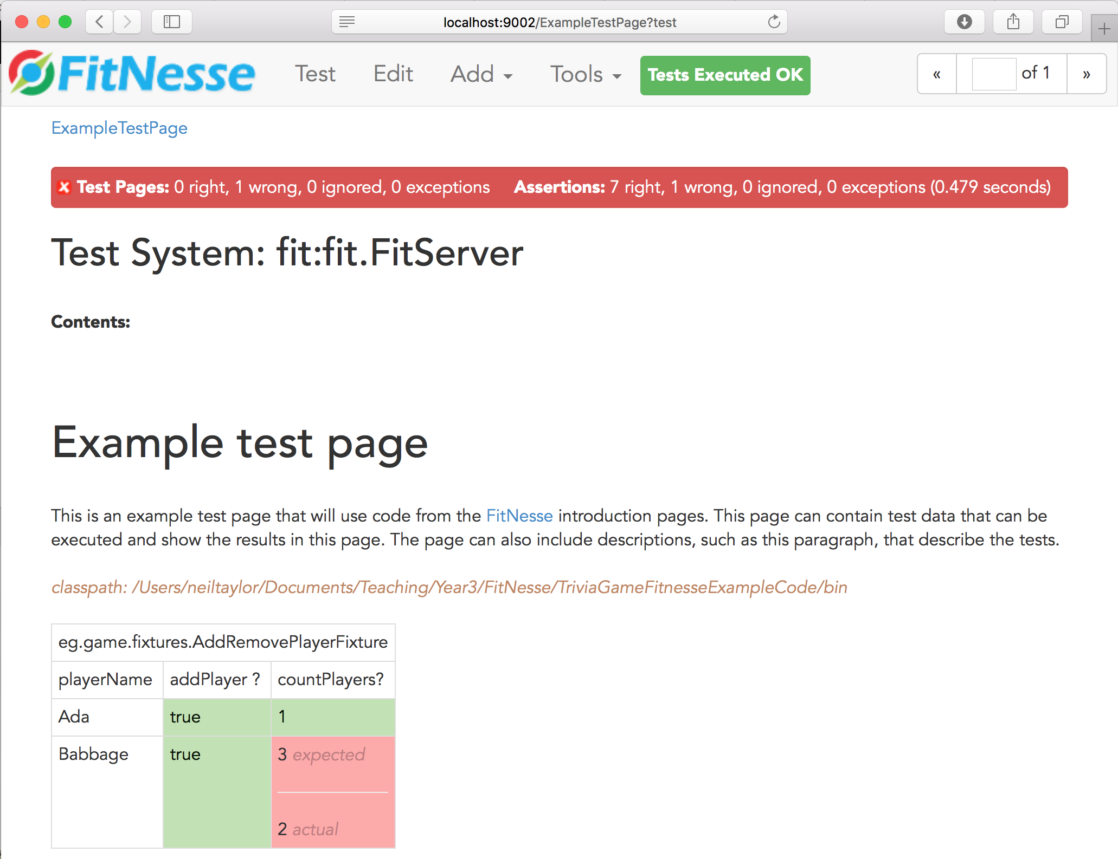
Notes:
A runnable document – run the tests and highlight the errors.

Slide 37
Demo

Slide 38
Summary
Automation can help make it easier for a team to run a consistent process
Regular checks and reports
Gather information that can help in quality control and quality assurance
Feedback to the team and to management
Examples of
Continuous Integration
Acceptance Test Tools

Slide 39
Any Questions?

