Slide 1
White Box Testing (Part 1)
Chapter 3

Slide 2
Introduction
How do we identify test cases? (same question that we had for black-box)
One general approach: White-box testing – testing based on the logic in a program
In this part, we will look at code coverage

Slide 3
Learning Objectives
Describe the purpose of white-box testing
What are the advantages?
What are the disadvantages?
Consider techniques to test the structure of the code
Statements
Decisions
Conditions

Slide 4
Software as a white box
Software
Inputs
Outputs

Slide 5
Tests & Implementation
White-box is based on the implementation
Tests are written when we have code that we can run
Black-box testing works well to generate for high-level test cases that check the general logic of the application
Reasonable confidence that testing will find problems
For high confidence, e.g. in safety critical software, need to look at the code and make sure every possibility is covered
Still worth doing black-box testing then look at EXTRA tests based on white-box approaches

Slide 6
Tests & Implementation
White-box is based on the implementation
Tests are written when we have code that we can run
Black-box testing works well to generate for high-level test cases that check the general logic of the application
Reasonable confidence that testing will find problems
For high confidence, e.g. in safety critical software, need to look at the code and make sure every possibility is covered
Still worth doing black-box testing then look at EXTRA tests based on white-box approaches
What does “every possibility is covered” mean?

Slide 7
Every Possibility?
Does this mean…?
Every possible path through a program
OK for simple programs, but what about tests for programs with loops and complex logic?
Every statement in a program
Every decision in a program
Every condition in a program
Every combination of decisions/conditions
Notes:
A decision is part of the code that is used to decide between one path or another path through a set of statements. A decision contains one or more condition expressions.

Slide 8
White box testing types
Static Analysis
Dynamic Testing with path coverage of code

Slide 9
Static Analysis
Discussed during the Software Lifecycle course
Code Inspection
Engineers arrange meetings to review sections of code
Ask questions about how the code works with specific (test) cases
The analysis cannot be automated
Difficult to repeat the same analysis each time
BUT, code inspections are an effective way to detect potential problems
Notes:
The (test) is included in brackets indicates that the engineers are informally thinking about tests cases. However, this is different to the formal type of test cases that we are talking about in different areas of the course. The cases are discussed during a meeting and not necessarily written up as formal tests.

Slide 10
Dynamic Testing: Path Coverage
Analyse the different ways that the code can be executed
Write tests so that every path through the program is tested
Remember earlier, statements, decisions, conditions
The tests can be automated and repeated
Tool support to check coverage
BUT, we need to update tests when the code changes

Slide 11
Path Coverage
Basic principles of path coverage:
All independent paths in a module must be traversed at least once;
All conditions (e.g. if statements) are tested for the true and false outcomes ;
Review whether the tests cover the internal data structures used;
Test that loops work for their operational range (difficult to try ALL possible values for loops for the same reason that you cannot try ALL values for parameters).

Slide 12
Decision / Branch Coverage (1)
if(x > 400) {
print "a";
} else {
print "b";
}
Example test cases for coverage of this code: (i) x = 401 and (ii) x = 400
Still worth thinking about boundary conditions
Need to decide what the correct answer is for each case, not what answer the code will give you

Slide 13
Ideally, your tools help you with this;
You can use coverage tools to monitor the tests that run and find out which paths in the code are NOT covered;
Then, you can write the tests to cover those paths
However, there are still problems – see the following example

Slide 14
Branch Coverage (2)
MyClass pointer = null;
if(x > 400) {
pointer = new MyClass();
}
if(y > 20){
pointer.myMethod();
}
This works OK if you test decision coverage with two cases (x = 10 and y = 10; x = 401 and y = 21). It fails if you give values (x = 10 and y = 21). So, you need to test all four possibilities.
This gets harder with more combinations.

Slide 15
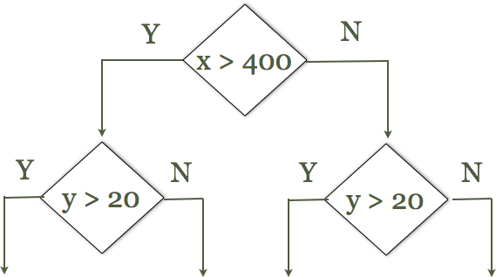
How do you work out the combinations?
Draw a decision tree
Consider tests for all possible combinations
What happens when you have a lot of combinations?
Condition T1 T2 T3 T4
X>400 Y Y N N
Y>20 Y N Y N
Notes:
When you have a lot of combinations, the decision tree (table) becomes difficult to manage. Also, not all combinations will be possible.

Slide 16
Example based on table 7.5 in Jorgensen book, 4th Edition, page 120 Use the decision table to build up a list of test cases. Note that some of them are not logically possible.
C1: a < b + c | F | T | T | T | T | T | T | T | T | T | T
C2: b < a + c |  | F | T | T | T | T | T | T | T | T | T
C3: c < a + b |  |  | F | T | T | T | T | T | T | T | T
C4: a == b |  |  |  | T | T | T | T | F | F | F | F
C5: a == c |  |  |  | T | T | F | F | T | T | F | F
C6: b == c |  |  |  | T | F | T | F | T | F | T | F
A1: Not a triangle | X | X | X
A2: Scalene |  |  |  |  |  |  |  |  |  |  | X
A3: Isosceles |  |  |  |  |  |  | X |  | X | X
A4: Equilateral |  |  |  | X
A5: Impossible |  |  |  |  | X | X |  | X

Slide 17
Summary
What is white-box testing?
Techniques to help specify test cases based on the code
Static Analysis
Dynamic Analysis
In this part – looking at decisions in the code

Slide 18
Any Questions?

