Slide 1
Unit Testing (Part 1)
Chapter 4

Slide 2
Overview
What is Unit Testing
Aspects of unit tests
Using JUnit – Unit Testing with a Framework

Slide 3
Learning Objectives
Discuss what a unit is with respect to testing
Discuss what can be tested in a typical Java program
Write tests with JUnit – build on your existing knowledge
Discuss what is good practice for writing a set of tests
Discuss the role of Stubs and Drivers for unit testing

Slide 4
What is Unit Testing?

Slide 5
Unit Testing
“Unit-testing is a way to ensure that the code you write adheres to design specifications and that it keeps adhering to those specifications as you modify it.
Unit-testing helps you write robust and secure apps. The essential component of unit-testing is a test case, which tests your code at the lowest testable level, or unit.”
Source: Xcode Unit Testing,
Apple Inc. 2012
Notes:
Quote take from Xcode Unit Testing from Apple, Inc.

Slide 6
Unit Testing
Software Units: A unit is the smallest unit of the design in a software project
In Java, a unit is a class or a method
In C, a unit is a function or .h/.c files
Unit Testing: A process to check that each unit is working correctly, according to the requirements and design
Test each unit independently of other units
We can use tools to help us, e.g. JUnit, but the tools aren’t required.

Slide 7
System Under Test
Test one unit at a time
Test the unit in isolation
Check that all units pass all tests
Modern Unit testing frameworks use Red/Green to indicate success
Focus on the interface definition of the unit
What Units are testable in the diagram on the next slide?
Notes:
7

Slide 8
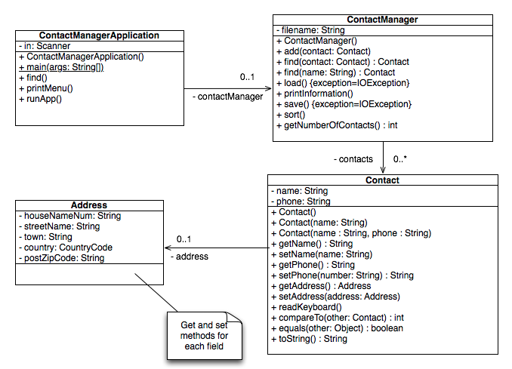

Slide 9
System Under Test
Why do we use the term System Under Test? Aren’t we testing Units?
Notes:
9

Slide 10
Focus on single SUT at a time
Test
SUT
Test
SUT
Test
Test
Notes:
One-to-one or many-to-one are shown in this slide.

Slide 11
Don’t test multiple units at once
Test
SUT
SUT
SUT

Slide 12
Purpose of Unit Testing
Validate whether code is consistent with the design and requirements.
Discover the errors between requirements, the design and implementation.
Errors of omission (what was required, but not implemented)
Errors of commission (an incorrect implementation)
Notes:
12

Slide 13
Aims of Unit Tests
Aim: ensure that module was implemented correctly
Input: detailed specification*
Process: design and implement tests and analyse results (see next slide)
Personnel: Developers and Testers
Test approaches: you can use black-box and white-box methods*
Evaluation: determine if the tests reveal errors.
* We will think about this again when we discuss Agile Testing

Slide 14
Unit Test Plan
Design Tests
Execute Tests
Test Results
Fail
Analysis
Track Defects
Pass
No
Complete?
Yes
Test Summary

Slide 15
Some benefits of unit testing
Benefits ( Why do we need Unit Testing? )

Slide 16
Some benefits of unit testing
Benefits ( Why do we need Unit Testing? )
The goal of unit testing is to isolate each part of the program and show that the individual parts are correct.
Help to improve confidence in the software’s quality
A unit test provides a strict, written contract that the piece of code must satisfy.
Track when the code isn’t satisfying the requirements / design
Easier to find issues when a test fails
Unit tests find problems early in the development cycle. Reduce the costs.
Run the tests many times during development – easier to help with regression issues

Slide 17
Aspects of unit tests
Unit interface
State after unit has been created
Setting and Getting data (do we need to do this? Discuss…)
Calling operations (e.g. methods in Java)
Functional tests – black box
Structural tests – white box
Error handling
Incorrect input

Slide 18
Unit Testing with a Framework

Slide 19

xUnit: Unit Testing Frameworks
xUnit: help to write unit tests
SUnit (original)
JUnit (perhaps the best known)
NUnit
cppUnit
OCUnit
Check
…
Picture of Kent Beck from Twitter

Slide 20
Facilities in a xUnit framework
Ability to create test cases
Assertions on the state of the SUT
Fixtures to share common test data
Expected errors
Facility to run the tests
Tests on a single unit
Groups of tests on different units
Automate…
Collect and display the results
Graphical and textual results

Slide 21
Desirable features of a unit test framework
Easy to write
Easy to learn to write
Quick to execute
Easy to execute
Isolated
Composable
Source: JUnit Pocket Guide, Kent Beck
Notes:
Isolated – tests should not affect one another. If the order of the tests changes, it should not affect the results.
Composable – Should be able to run any number of tests together. This is possible if the tests are isolated.

Slide 22
Demo
Demo of Contact Manager
Look at the UML Class description for a Contact Manager application

Slide 24
Some example assert statements in JUnit
assertEquals(expected, actual)
assertNotEquals(unexpected, actual)
assertTrue(condition)
assertFalse(condition)
assertNull(object)
assertNotNull(object)
assertArrayEquals(expected, actual)
assertSame(expected, actual)
assertNotSame(expected, actual)
fail(message)

Slide 25
Testing other features
JUnit focused on public methods
Is this a problem?
Not suitable
for multi-threaded / concurrent code
for GUI code..?
Web-based code…?

Slide 26
Comments on testing practice
Test Fixtures: Setup-Teardown
How many assertions per test method?
Access to private methods?
Choosing Data Values
Using Test Suites
Print Statements
Handling Exceptions

Slide 27
Test Fixtures: Setup - Teardown
Test Fixture: The starting point for the test
There is a common set of setup for tests:
Setup (might use common setup, e.g. @Before)
Might create some common data to be used by several tests
Or… might just be local setup in each test method
Exercise – call methods on the SUT
Verify (Assertions…)
Teardown (optional, e.g. @AfterEach, @AfterAll)

Slide 28
How many assertions in a test method?
Is it OK to put multiple assert statements in one test statement?
It depends ☺
If a test runs the exercise phase and then needs to check several items about the SUT, then it is OK to use several assert statements
Is a method trying to test too many things? e.g. one test checks if setup is successful and then checks if sending emails is successful.
If it is, then avoid doing this – split into separate methods.

Slide 29
Access to Private Methods?
Tools like JUnit are designed to access the public interface
In a good design, the protected and private methods are there to support the operations of the public interface
Testing the public interface should also exercise the protected/private elements
If you really need to test a protected and private method directly, there are tools that can be used to get access to the private method
For protected, you can subclass the SUT and call the protected methods
For the private methods, you can use some tricks to change the access modifier
Notes:
We have already talked a bit about this. The slide is really a reminder.

Slide 30
Choosing/Generating Data Values
Test typically used values
You don’t always need to type in directly
Can create a function that generates predictable test values:
E.g. I need a set of unique names, create a method to generate names ‘Name1’, ‘Name2’, ‘Name3’, etc.
Should you use randomly generated values?
Maybe
BUT – how repeatable will your tests be?

Slide 31
Print Statements
You may choose to use System.out.println() to help debug some tests.
BUT – they are not the test.
We don’t want to generate a lot of tests output on the console and have to manually check it. We want the unit tests to check for us!

Slide 32
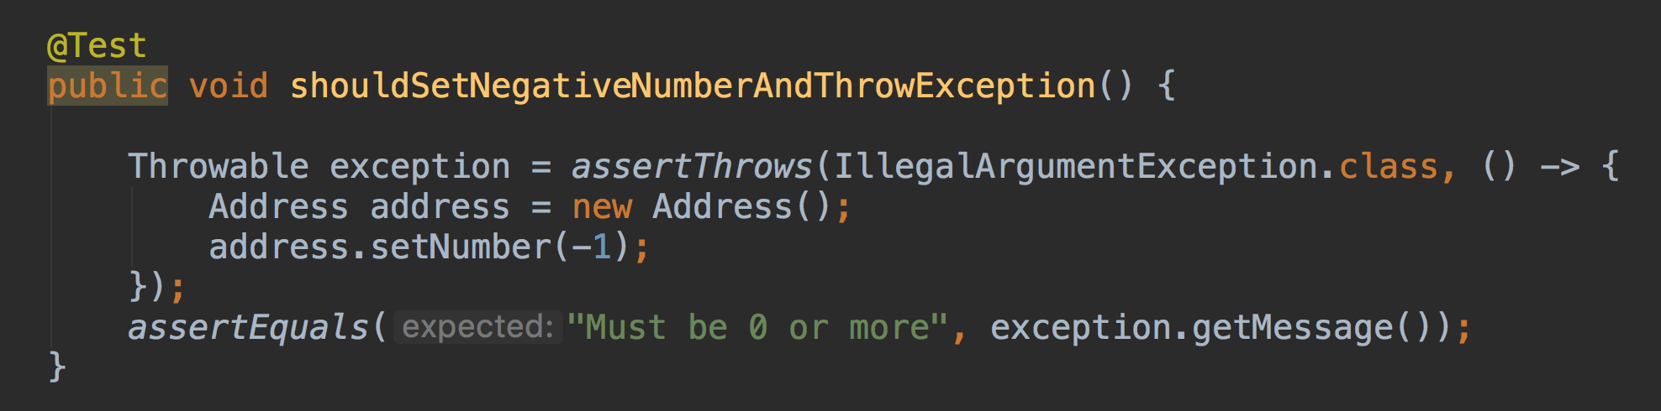
Handling Exceptions
We could run the code. If we get to the line following one that should have generated an exception, then we could use the fail() statement to indicate an error
In JUnit 5, we can use:

Slide 33
Summary
What is Unit Testing?
Aspects of unit tests
Using JUnit

Slide 34
Any Questions?
Notes:
I am very happy to be asked questions during the course, in the lecture and laboratory sessions.

