Slide 1
Integration Testing
Chapter 5

Slide 2
Overview
What is Integration Testing?
Some example projects；
Big-bang, Top-down and Bottom-Up；
How often should you do integration testing?
Integration Testing Implementation

Slide 3
What is Integration Testing?
Integration testing is the phase of software testing in which individual software modules are combined and tested as a group.
When should this happen?
Integration testing follows unit testing and precedes system testing.

Slide 4
The V-model highlights testing
Requirements
Specification
Acceptance Testing
The dashed lines represent planning
Functional
Specification
System
Testing
Architecture
Specification
Integration
Testing
Module
Specification
Unit
Testing
Coding
Notes:
There are different drawings of the V-lifecycle model. It shares a similar flow of tests as the waterfall model, but it tries to emphasise the link between earlier activities and the need for different parts of testing. Some of the aspects of the requirements and design are broken into a couple of different elements, e.g. we might normally talk about requirements and functional specification as one general task, but here it is split into two so that it is easier to see how that relates to the final stages of testing. The same is done for the general design, which is shown as two boxes in this diagram: Architecture and Module.
The solid lines in the diagram represent a flow from one task to another. The dashed lines represent a planning stage, where a plan for one type of testing on the right is made from the linked box on the left.

Slide 5
Definition
“Integration testing is testing a unit of work without having full control over all of it and using one or more of its real dependencies, such as time, network, database, threads, random number generators, and so on.”
A definition taken from The Art of Unit Testing, Second Edition: with examples in C#, Osherove, R., (2013), Manning Publications.

Slide 6

Example: Mars Climate Orbiter
NASA Probe to study the Martian climate
Communication lost on September 23, 1999
Difference in units between ground station and the probe
https://en.wikipedia.org/wiki/Mars_Climate_Orbiter
Image source: http://commons.wikimedia.org/wiki/File:Mars_Climate_Orbiter_2.jpg, public domain

Slide 7
Example Architectures and Integration Testing

Slide 8
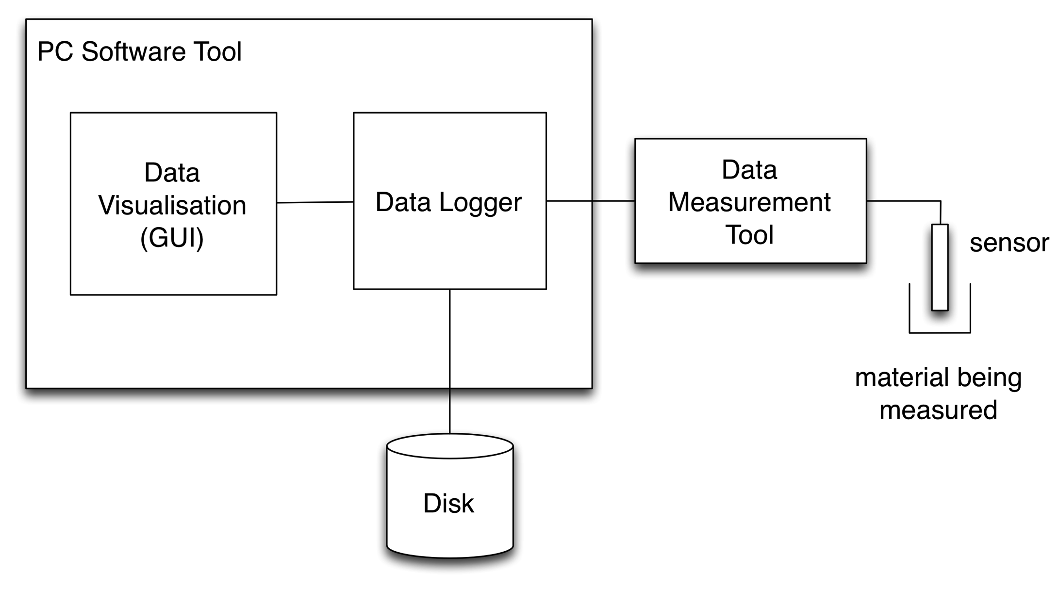
Example
3
2
1
Example: Data gathering software
Notes:
I have already mentioned this example in the section on unit testing. That was to illustrate the idea of integration testing. In this section, the reason for talking about it is to talk about the integration of the different modules (units).
The system has three main areas for integration:
1/ The link between the hardware sensor developed by our customer and the new box with the PIC controller that would read the values (the Data Measurement Tool).
2/ The link between the data logger and the Data Measurement Tool, checking if the communication protocol works between the two units.
3/ The link between the GUI code and the data logger. Does the GUI correctly show data.

Slide 9
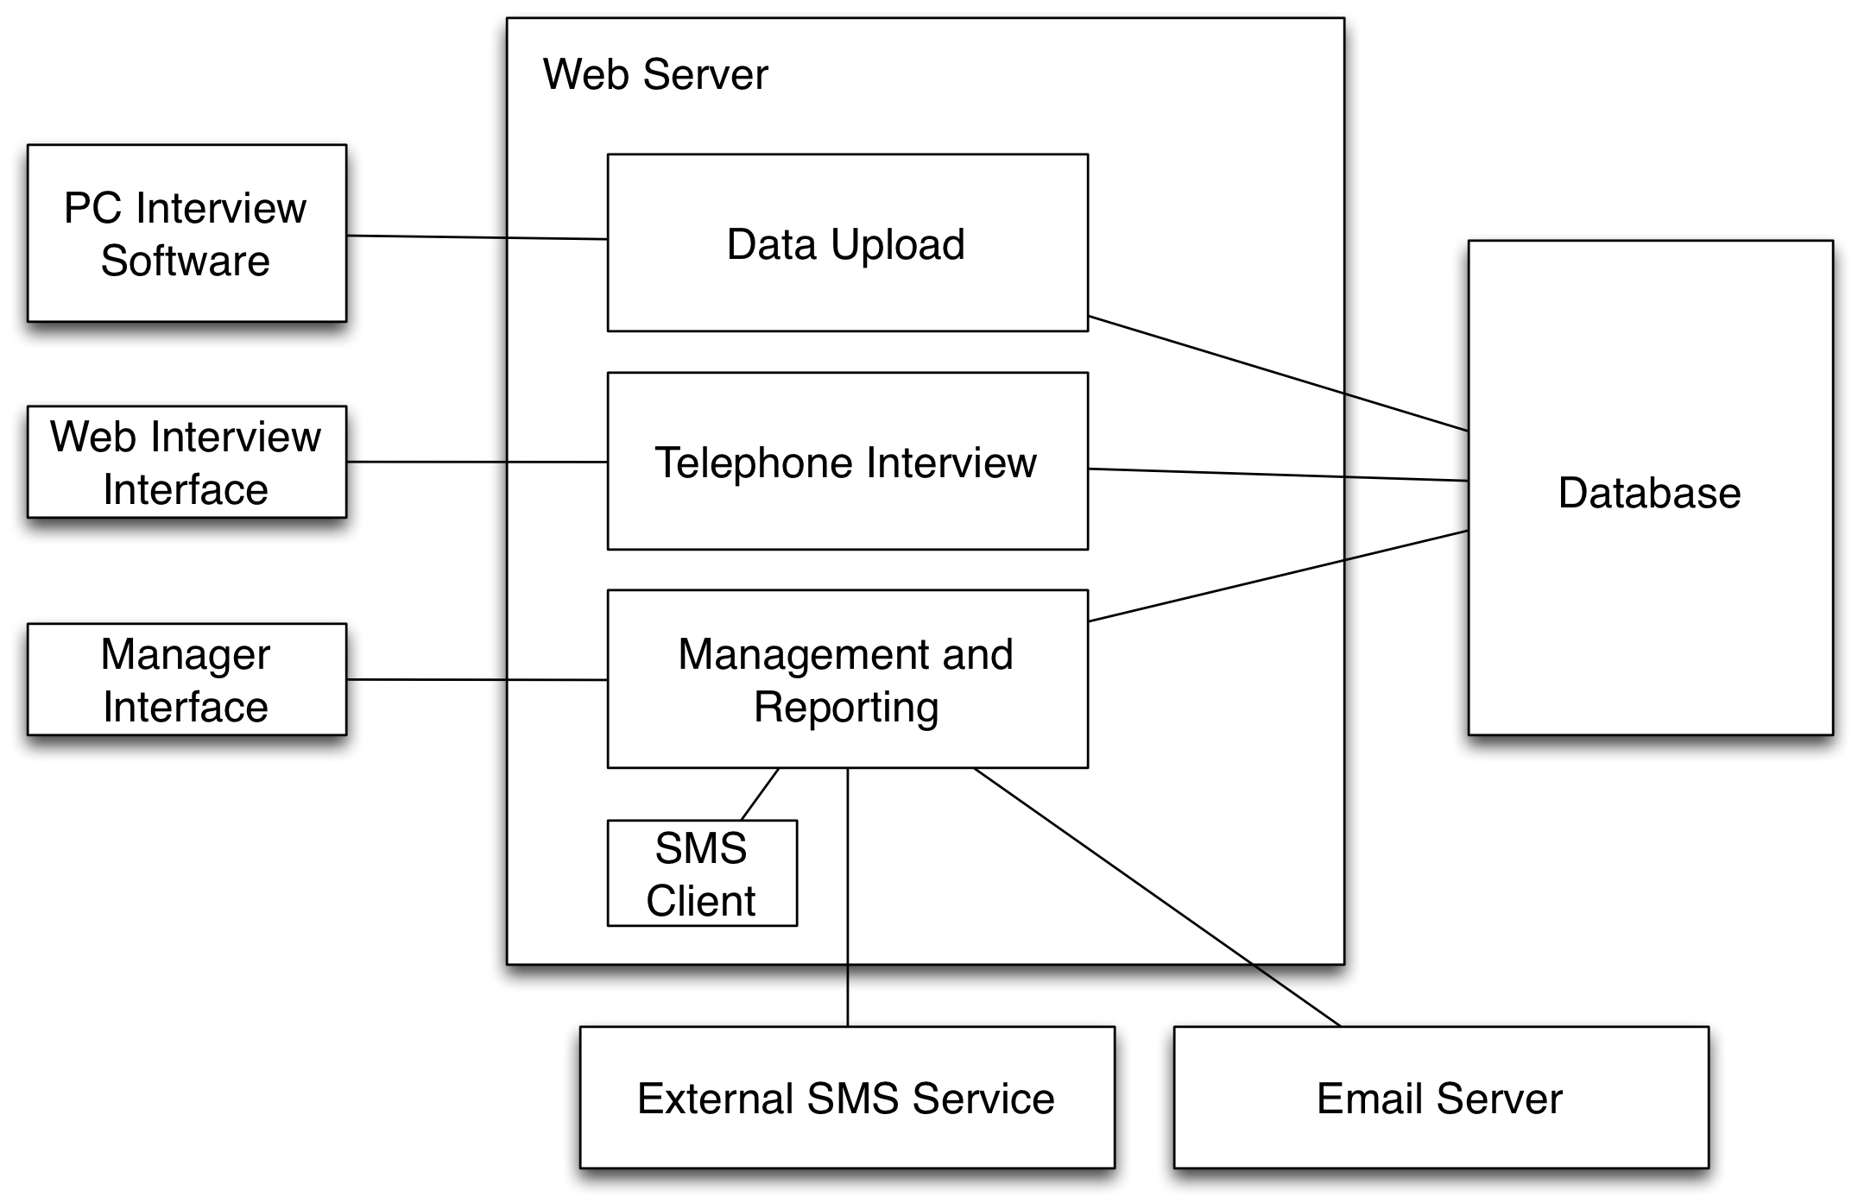
Example: Interview software
Notes:
This example is for a web-based application, which is used to gather interview data. It has a number of components.

Slide 10
Example: Interview software
Notes:
The blue box highlights an areas where unit tests could take place, checking the combined process of handling the telephone interview, the over management and the output to the database. In reality, the unit testing should take place within different aspects of these higher-level modules. It would be possible to substitute the Database for a Fake Object, such as an in memory test database, to make it easier to run the tests.
The purple area represents the modules that would be tested under integration testing, checking the parts of the system for managing interviews and performing web interviews. These represent a related set of modules, where there is related functionality that should be tested to check if the data is correctly flowing through to the database.

Slide 11
Example: Interview software
Notes:
The SMS client software is a small command line application. It is set to run several times a day and its sole function is to call a feature of the management and reporting section to activate a process. The process looks up a list of people who should receive SMS messages to notify them of an interview in the next 2 days. The basis notification list has been tested as a unit. This is checking the integration level.
Another level of integration testing is to check the link between the management and reporting unit and the external SMS service. That is shown in the second area in red.

Slide 12
Integration Testing Cycle
Integration is conducted incrementally as a series of test cycles
Additional modules are integrated in each cycle
Tests are performed and defects noted and fixed
Continues until all of the modules are integrated.

Slide 13
Integration Testing Strategy
Big Bang
Top-Down
Bottom-Up

Slide 14
Big-bang integration
Link all of the modules together as a system.
Limited need for test doubles and drivers
Difficult to isolate errors and identify where the problem occurs
Does not verify the interfaces across module boundaries
Risk of late identification of problems

Slide 15
Top-down Integration
As the system is constructed, test the interactions of modules from the ‘top’ down to the lower level modules.
‘top’ is the module that calls other modules
Breadth-first and Depth-first approaches
Test doubles can be used for some tests

Slide 16
Breadth-first approach

Slide 17
1
TD 2
TD 3
Notes:
The first stage of top-down testing would be to start work on the top-level element. The top-level of most applications would have some depended-on components (DOCs). At a unit level, it is likely that we would use stubs for any DOCs, as shown in the diagram. Then, we can continue to develop the units Stub 1 and Stub 2 and test those two units with unit tests.

Slide 18
Integration Test Driver
1
2
3
TD 4
TD 5
TD 6
TD 7
TD 8
Notes:
Once we have 1, 2 and 3 we could start to run the integration tests to check the links between 1 and 2, then 1 and 3. We might still have stubs representing the lower level units.

Slide 19
Integration Test Driver
1
Integration Test Driver
2
3
4
5
6
TD 7
TD 8
TD 9
TD 10
TD 11
Notes:
Then we can test 2 and 4, 2 and 5 and 2 and 6.
We can then repeat.

Slide 20
Depth-first approach

Slide 21
Integration Test Driver
1
Integration Test Driver
2
9
The elements below 9 are still in the system, but they are not shown for space reasons.
Integration Test Driver
3
TD 5
TD 7
4
TD 6
TD 8
Notes:
Then we can test 2 and 3, 3 and 4
We can then repeat.

Slide 22
Bottom-up integration
Start with bottom-level components, which have no, or minimal, dependencies
Move up through connections, verifying the interactions of modules
Driver modules used to test the integrated modules
It is likely that there is less need for Test Doubles because the lower levels will already exist
BUT – remember that we might use Test Doubles for other reasons

Slide 23
Integration Test Driver
Not all integration test drivers are shown.
15
Integration Test Driver
14
13
2
4
6
12
11
7
1
3
5
8
9
Integration Test Driver
Integration Test Driver
10
Notes:
Not all integration test drivers are shown.

Slide 24
A mixed approach
Is it always possible, and necessary, to develop code in a top-down or bottom-up approach?
Sometimes there is a mixture of top-down and bottom-up
A plan should specify the motivation and order for this mixed approach

Slide 25
How often should we run integration tests?
Regular integration
Daily
In an iteration (e.g. two weeks)
Automated tests
A popular modern approach is to run a set of tests regularly as code is checked in – idea of Continuous Integration (CI)
We will come back to this in a future session

Slide 26
Integration Testing Implementation
Designing Test Cases
Similar issues to unit testing
Good data
Data to test errors
Undefined situations
Focus is on data that will be passed through the interface to other module
We start from the view that the connected modules are working (tested at unit level)

Slide 27
Summary
Integration Testing follows Unit Testing
Focus is on the connections between modules
Plan the approach for the integration testing
Regular integration, started early

Slide 28
Any Questions?

