Slide 1
System Testing
Chapter 6

Slide 2
Overview
Reason for System Testing
Example of some issues
Discussion of problems with system testing
Reviewing some different types of system testing

Slide 3
Concepts
System testing is testing conducted on a complete, integrated system to evaluate the system's compliance with its requirements specifications.
System testing falls within the scope of black box testing, and as such, should require no knowledge of the inner design of the code or logic.

Slide 4
The V-model highlights testing
Requirements
Specification
Acceptance Testing
Functional
Specification
System
Testing
Architecture
Specification
Integration
Testing
Module
Specification
Unit
Testing
Coding
Notes:
There are different drawings of the V-lifecycle model. It shares a similar flow of tests as the waterfall model, but it tries to emphasise the link between earlier activities and the need for different parts of testing. Some of the aspects of the requirements and design are broken into a couple of different elements, e.g. we might normally talk about requirements and functional specification as one general task, but here it is split into two so that it is easier to see how that relates to the final stages of testing. The same is done for the general design, which is shown as two boxes in this diagram: Architecture and Module.
The solid lines in the diagram represent a flow from one task to another. The dashed lines represent a planning stage, where a plan for one type of testing on the right is made from the linked box on the left.

Slide 5
System Testing Concepts
Why is system testing necessary?
Some properties only verifiable at system level
Installation , usability, compatibility, etc.
We may involve users at this level
Use cases may not map to any specific integration unit
Use of alpha and beta tests
The environment of the system is taken into account

Slide 6
System Testing Concepts
System functional requirements
Other
software requirements
Customer requirements
specification
User
environment
Integrated
Modules
Function Test
Non-functional Test
Acceptance Test
Installation Test
System in
use
Functioning system
Verified
validated
software
Accepted system

Slide 7
System Testing Methods
Some example system testing methods:
System functionality Testing
GUI Testing
Usability Testing and Accessibility Testing
Performance Testing
Recovery Testing
Installation Testing

Slide 8
System Functionality Testing
Automate tests where possible
Create test scripts for other areas where a user will perform manual testing
Detailed script that specifies what is to be done for each test case
A general script that talks about things to test, but does not specify every item in the test
Exploratory Testing

Slide 9
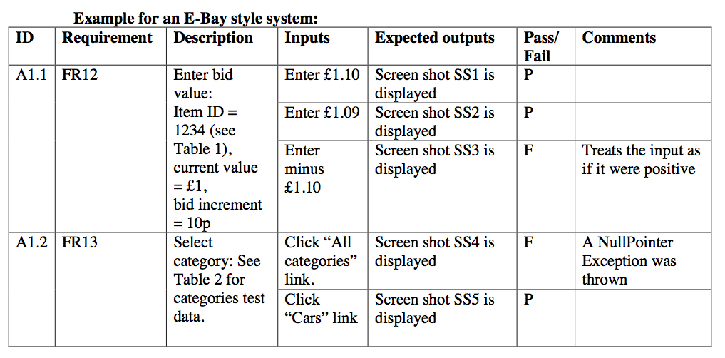
Example Test System: More formal

Slide 10
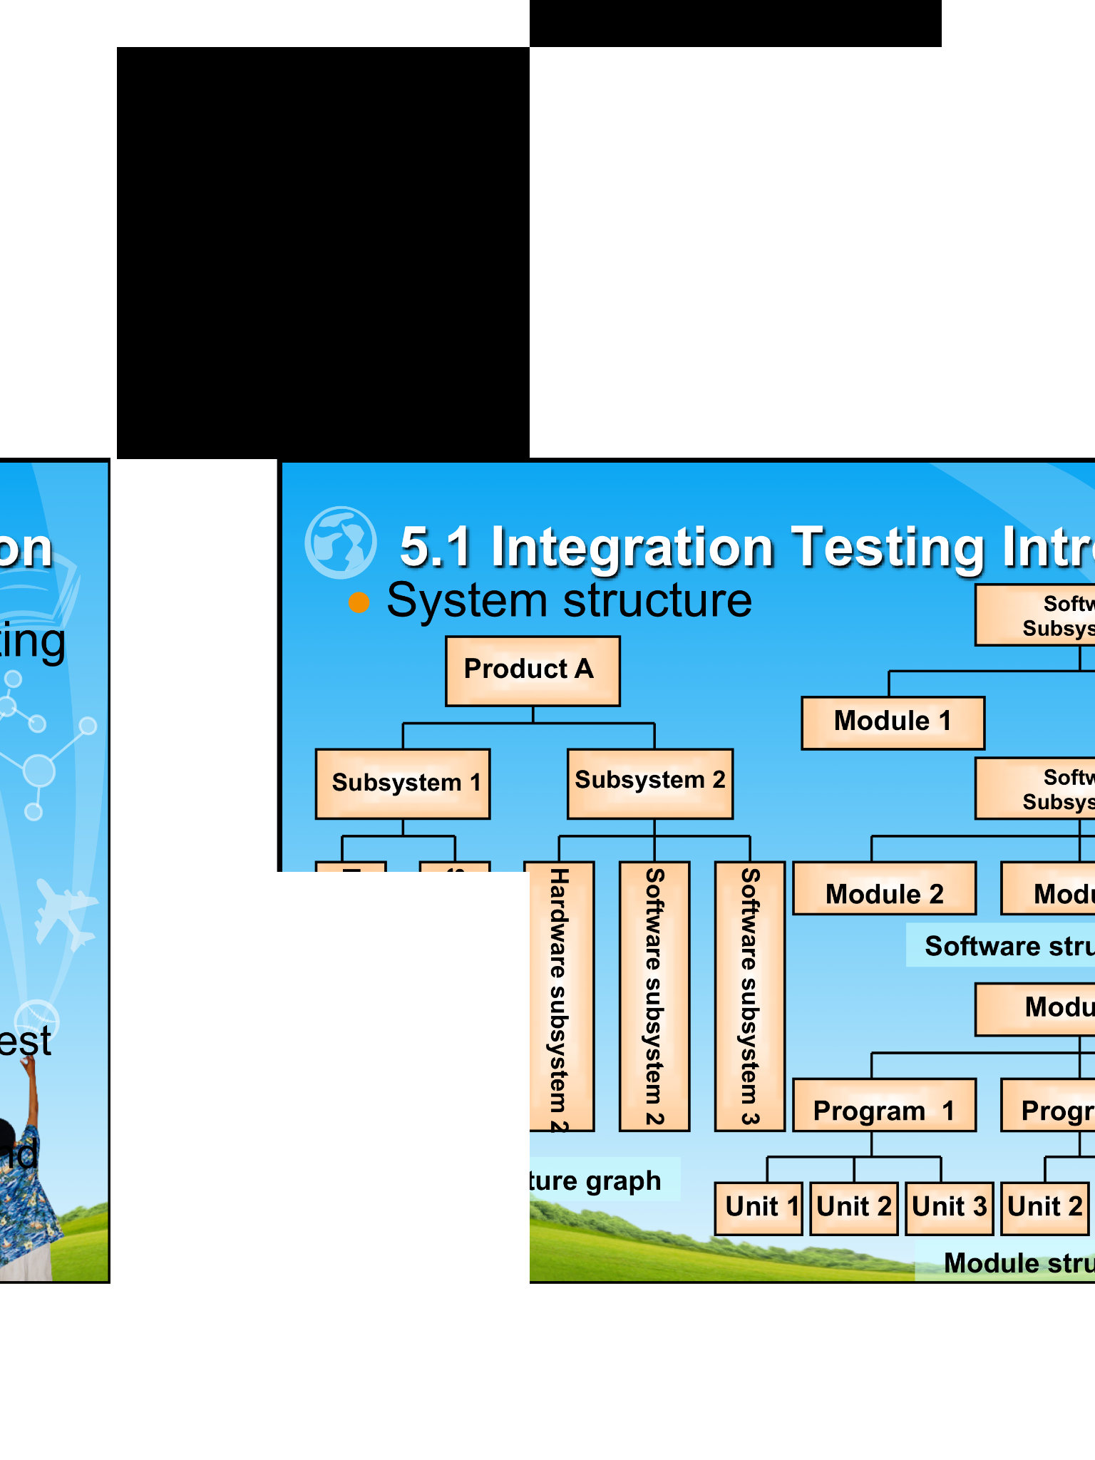
Example: Exploratory Testing Less Formal
Test Case | Description | Expected
TC1 | Open PDF <filename> in iBooks. Swipe through the document and pan and zoom. | The document should scale and move appropriately, showing no visible failures.
Useful to just explore the program and see if there are ways to reveal problems, as a user would approach the system.
Difficulty: If you find a problem, you then need to think carefully about the things that you did before the failure occurred. Capture as much information as you can.
Notes:
The example on the right is taken from an iPad preview of a PDF document of an earlier version of the slides. Whilst zooming in and out, visual defects became apparent , with black areas and white areas on the content.

Slide 11
GUI Testing
The difficulties of GUI software testing
Possible interface test space is massive.
Event-driven characteristics
GUI test coverage is different from traditional structured coverage
Test automation software
Bad design mixes the interface with the ‘logic’ of the application. This can be harder to test.
Design issue: create a separate module for the logic of the application

Slide 12
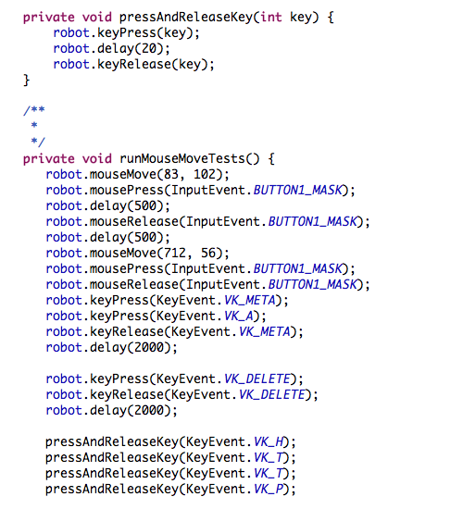
Example: ‘Robot’ facility in Java
Not about Robotics
Java includes a facility to script a set of tests for driving a UI, e.g.
Key Presses
Key Input
Mouse Selection
Look at example of using this
Low level – would need to do more work to create a Test Driver or Test Case

Slide 13
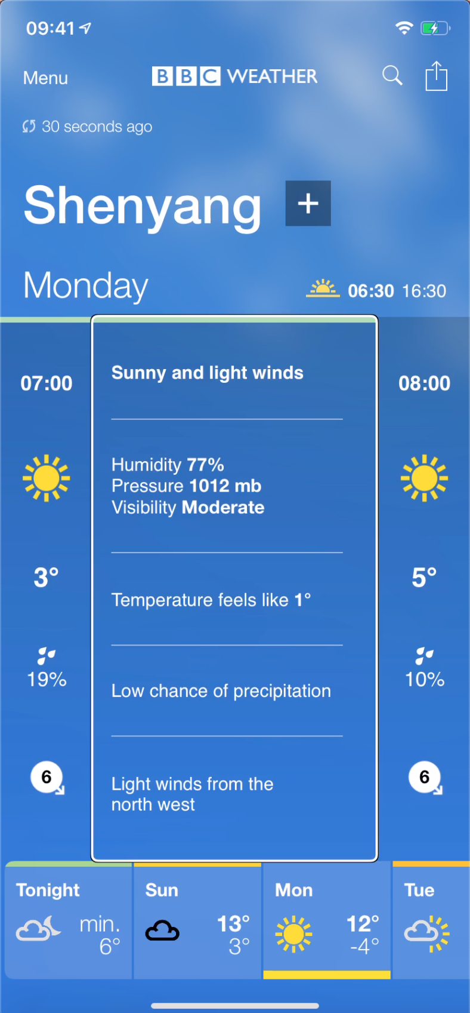
Accessibility
Is there support for accessibility technologies?
Some of the vocal statements are provided by the operating system, but others are controlled by the development team
Probably need a human to run through tests

Slide 14
Performance Testing
Performance testing is used to determine the speed or effectiveness of a computer, network, software program or device.
can involve quantitative tests done in a lab
Qualitative attributes such as reliability, scalability and interoperability(互操作性) may also be evaluated
Goals: eliminate bottlenecks and improve system reliability

Slide 15
Compatibility(兼容性) Testing (1)
Compatibility testing is part of software non-functional tests
Conducted on the application to evaluate the application's compatibility with the computing environment.
E.g.
Computer Platforms (IBM, HP, Apple, Cloud, …)
Network hardware
Peripherals(外围设备) (Printers, CD/DVD, …)
… see next slide …

Slide 16
Compatibility Testing (2)
Operating systems (Windows, UNIX, macOS, Emulators, …)
Database (Oracle, DB2, SQL Server, PostgreSQL, MySQL…)
Other System Software (Apache, IIS, Message Queues, …)
Browser compatibility (Internet Explorer, Firefox, Safari, Chrome, etc.)
Backwards compatibility
Different Compilers (compile the code correctly)

Slide 17
Recovery Testing
Is the application able to recover from crashes, hardware failures and other similar problems.
Force problems with the system and determine how the system responds
Does the system detect issues and restart if there was system crash?
If manual restart is required, are there mechanisms in place so that it can be started within any specified time limits

Slide 18
Examples of Recovery Testing
Examples of recovery testing:
While the application is running, suddenly restart the computer and after that check the validity of the application's data integrity;
While the application receives data from the network, unplug and then in some time plug-in the cable, and analyze the application ability to continue receiving of data from the point, when network connection disappeared;
To restart the system while the browser will have definite number of sessions and after rebooting check, that it is able to recover all of them.

Slide 19
Installation Testing
Test installation instructions
How much of this can be automated?
Example of the interview software.
Test on different computer platforms, if appropriate

Slide 20
Summary
Reason for System Testing
Example of some issues
Discussion of problems with system testing
Reviewing some different types of system testing, e.g.
GUI Testing
Exploratory Testing
Usability Testing

Slide 21
Any Questions?

