Slide 1
Design, Testing and Agile
Chapter 9 (Part 1)

Slide 2
If it’s important, do it often
What is important when developing software?
Notes:
This idea comes from the eXtreme Programming method of developing software.

Slide 3
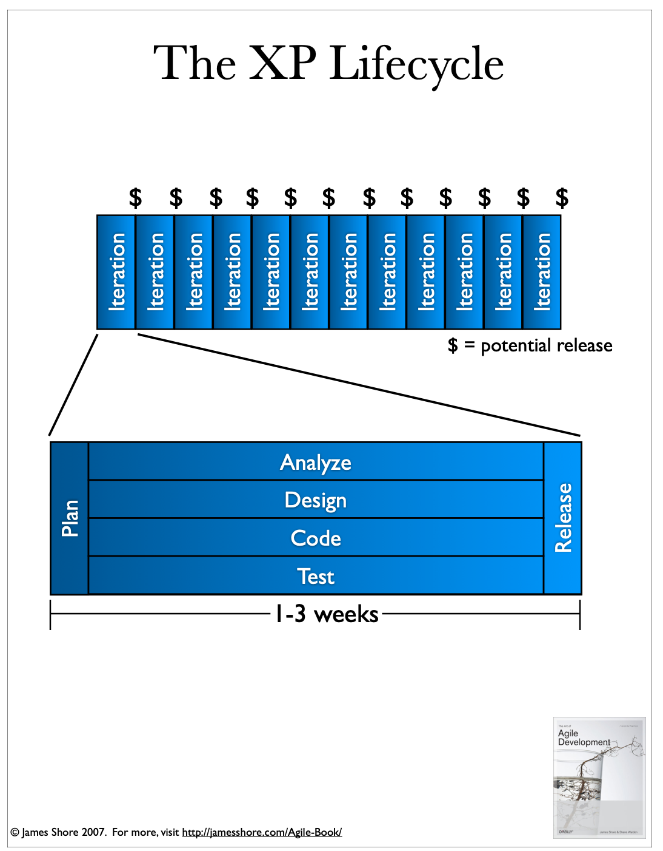
An agile lifecycle
In the book “The Art of Agile Development”, Shore and Warden have a diagram to illustrate the lifecycle for Extreme Programming (XP)
Works for other agile approaches
Source:
https://www.jamesshore.com/Agile-Book/the_xp_lifecycle.html

Slide 4
How does this relate to Testing?
If it is important… do it to the ‘extreme’!
Or, do it regularly as part of your work
Testing is one of 14 practices that eXtreme Programming (XP) uses
It is the combination of those practices that are important
Each practice is designed to work with the weaknesses of the other
If we only do some of these, are we are just pretending to be extreme?

Slide 5
Overview
Test-Driven Development (TDD)
Pair Programming
Try these out
Think about Test-First and Test-Last approaches to testing

Slide 6
Test-Driven Development
Write a test, before writing the code to pass that test
Write the minimum code to pass the test
User your tests as a safety net to catch errors as you add more code
An older idea, but Kent Beck and his team used it in Extreme Programming (XP)

Slide 7
Red
Green
Refactor

Slide 8
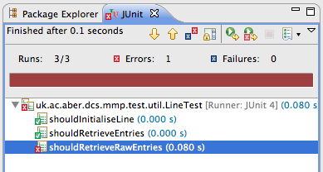
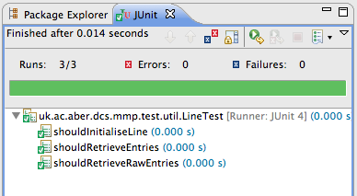
Write a failing test.
It should compile, but the assertions should fail
1
Write enough code to pass the test.
2
3
Refactor
Refactor to improve design. You may not do this step after each test.
Notes:
Red – write a failing test.

Slide 9
Pair Programming
Two people work together to develop new features.
Two people work with one computer
Two roles: Driver and Navigator
Share who controls the keyboard and mouse – swapping regularly
Add tests, then code
🙂
🤔

Slide 10
Pair Programming: Roles
Driver
Decides what to do and type
Listens to the navigator for advice
Makes sure the navigator understands what you are doing
Navigator
Asks questions to clarify
Suggests alternative approaches
Needs to understand fully what is being done
Prepared to take over if the driver gets stuck
🙂
🤔

Slide 11

A simple game to introduce TDD
Test-Driven Development (TDD)

Slide 12
TDD – Fizz Buzz example
Fizz Buzz is a simple game where players count from 1 to 100 – either saying the number or saying a word in place of a number.
If the number is a multiple of 3, e.g. 3, 6, 9, then the player should say Fizz instead of the number.
If the number is a multiple of 5, e.g. 5, 10, 15, then the player should say Buzz instead of the number.
If the number is a multiple of both 3 and 5, e.g. 15, then the player should say Fizz Buzz.
Otherwise, the number is repeated, e.g. 1, 2, 8.

Slide 13
TDD – Fizz Buzz – step 1
Let’s use Test-Driven Development to create a function that:
Takes a number as a parameter
Returns a string, following the rules of Fizz Buzz from the previous slide.
For example:
if passed 1, it returns “1”
If passed 3, it returns “Fizz”
Let’s start this together, but then you can continue in pairs

Slide 14
TDD – Fizz Buzz – step 2
Let’s add a new rule
The function should only allow numbers 1 or higher
How should we handle this?
Exception in Java
Returning an error value, e.g. null or “Error”

Slide 15
TDD – Fizz Buzz – step 3
Let’s add another function
It takes a starting number and an ending number, e.g. 1 and 100.
The function should produce a string that shows the Fizz Buzz output for that range of numbers.
For example, if the numbers are between 1 and 10, the output would be:
“1, 2 Fizz, 4, Buzz, Fizz, 7, 8, Fizz, Buzz”
Notes:
Before you do that, let’s just talk about Pair Programming.

Slide 16
Pair Programming Advantages
😃
To increase code/design quality
Pairing allows for continual review
The reviewer is fully involved
Pair reviewing is less intimidating than formal reviews
Formal reviews still have their place…
Improved communication
More team members are familiar with the code
A way to train new team members

Slide 17
Pair Programming Disadvantages
☹️
Risk of shared assumptions
Experience
Personalities
Expert, extrovert, novice, average, introvert
Workstation layout
Need for concentration
May not be a good idea to pair during exploration / spike work

Slide 18
A programming Kata to try out TDD
This page on GitHub describes a Kata (exercise) that let’s you try a TDD approach to another problem.
Try it in your own time.
https://github.com/testdouble/contributing-tests/wiki/Greeting-Kata

Slide 19
Testing Approaches
Test Last- Writing the tests after the implementation
An established way to build and test software.
Produce something that seems to meet the requirements and then develop tests to try and find errors
Test First – Writing the tests early and use the tests to guide the development
Example of Test-Driven Development
Write a test, and then write code to pass that test
Write
Code
Test
Test
Write
Code
Notes:
We will consider the issue of testing based on the sequence of when testing is performed. The traditional approach is to spend time writing the code and, when it is finished, write tests to check the code. Remember from yesterday, we said that the aim is to write tests that are trying to find out when the code doesn’t work. We will call that Test-Last.
The arrow from Test to ‘Write Code’ indicates that there can be the need to return to change the code in light of what is found in the tests.
For Test-First, we are thinking about Test-Driven Development where a test is written before the code to pass that test is written. This idea was used in XP – it wasn’t a new idea for XP, but it was selected as a way for the team to keep focus whilst writing the software.
So, it becomes interesting about whether there is an advantage to a Test-First approach. As noted in the workshops, it is used as an approach, but there are also teams that keep to the Test-Last approach.

Slide 20
Paper exploring testing early or later
Paper: An External Replication on the Effects of Test-driven Development Using a Multi-site Blind Analysis Approach
from ACM/IEEE International Symposium on Empirical Software Engineering and Measurement (ESEM) 2016. Authors: Fucci, D. et. al.
Looking at a Test-First approach compared with a Test-Last approach
Section 2 describes previous studies
Concerned with issues of external quality of code and productivity of approach
21 participants, with results compared to an earlier study with 36 participants
Notes:
Research papers have been produced that explore the use of Test-Driven Development. Amongst them, there are some studies that try to compare TDD and the more traditional Test-Last approach, one of which is a study reported in 2016.
This study, by Fucci, had looked at existing work. It was trying to replicate results of the earlier research. It was also trying to reduce possible bias by involving different groups in the study to process the results. One example bias is that the researchers who conducted the experiment may also have view of their expectation of what the results might say – so could that bias the interpretation of the results.
Section 2 mentions some ideas from the previous studies.
Within the paper, there is discussion of code quality and productivity, which are two of the measures that are used to assesses the possible differences between writing tests first or later-on.
It is worth noting that is a study with a small number of participants, as was one of the earlier studies (21 this time compared with 36 in one earlier study reported).

Slide 21
Baseline Study
Research Questions from the baseline study (University of Oulu, Finland)
Do test-first developers write more tests than test-last developers?
Measured by the number of assert statements written in the tests
Do test-first developers produce solutions with higher external quality than test-last developers?
Measured as how well, on average, the implementation for a story matches the story’s requirements – according to acceptance tests
Are test-first developers more productive than test-last developers?
Measured as the portion of the task completed successfully – a percentage of the number of acceptance tests that passed
Notes:
The paper does highlight one earlier study, carried out by researchers at the University of Oulu in Finland. The work in this paper is trying to replicate and extend the earlier work at the University of Oulu.
The earlier study had three research questions – with the measurements listed on the slide; these measurements were made after an exercise where some people wrote code using a Test-First approach and others wrote code using a Test-Last approach.
The first measurement of how many tests were developed is easy to assess because it is a simple count of the assert statements.
The other two are a bit harder to measure because there is a judgement about how well the code produced matched the requirements. To address that, some acceptance tests were specified in advance; these were used to judge how much had been achieved when compared against these acceptance tests.
We will say more about acceptance tests later in this module – but for now, a simple reminder is a set of customer focused tests that are checking the expected functionality, based on the customers requirements and not any lower level developer focused information.
For the UOULU study:
External Quality: an average of the proportion of assertions for a given user story, where at least one acceptance test passes for the user story. So, this is only based on the subset of the user stories where it is at least partially complete.
Productivity: The percentage of the number of assertions that passed across the whole acceptance test suite.
So, External Quality is only concerned with the subset of stories that were tackled, at least in part. Whereas the Productivity is a measure of how much they achieved compared to what was deemed to be a full implementation of all user stories.

Slide 22
Study in the paper
Research Questions from the University of Basilicata, Italy
Is there a difference between the number of tests written by TDD developers and TLD developers?
Is there a difference between the external code quality of TDD developers and TLD developers?
Is there a difference between the productivity of TDD developers and TLD developers?
Subtle difference in questions – checking for equality or difference rather than whether Test-First is better than Test-Last.
Took place over two days, with day 1 on Mars Rover API problem and day 2 on Bowling Scorekeeper – 3 hours each day
One part of the group using TDD and one part using TLD
Notes:
As noted, this paper was trying to explore the same issues as that described on the previous slide. The research involving the University of Basilicata, Brunel University and the Polytechnic University of Madrid had similar questions.
There is one subtle difference in the formulation of the research questions – this study was asking if Test-Last and Test-Frist were different, giving the assumptions that for each question either Test-Last and Test-First are equal or just different. That is slightly different from OULU, where they were considering if these were equal or whether Test-First is better than Test-Last.
This difference is subtle, but does highlight the difficulty is specifying research questions to be objective about what is being considered.
There was also another change. The original study used a problem called ‘Bowling Scorekeeper’. This study used the ‘Bowling Scorekeeper’ as well as a ‘Mars Rover API’. Notice also that the study was taken over two 3-hour sessions, which is quite a short period of time.
[The paper does mention two other differences, but this doesn’t need to be mentioned in the lecture. The original study did allow some pair programming, which introduces an extra dimension. This study did not use pair programming, so was trying to isolate the study to focus on the testing aspects. Another change was that participants were randomly allocated to the TDD or TLD groups for the experiment, specifically, TDD+TLD or TLD+TDD for the two stages of the experiment – trying to remove the in-group variance]

Slide 23
Findings
The research didn’t find any evidence to suggest a notable difference between a Test-First or Test-Last approach
Which is consistent with the earlier study
The researchers observed that the experiment focused on the sequence of the testing (first or last). They question whether there is some other aspect to measure (e.g. is there a benefit in the small steps to build the system?)
Is it hard to create experiments to investigate this issue?
There are other studies, which Bb as extra reading.
Notes:
Two notable conclusions to mention. One is that the results don’t suggest a difference. The researchers do wonder if they are measuring the correct issues – is it really about whether the tests are done first or last or whether there are issues such as the iterative nature of building up the tests.
Is it hard to create experiments to investigate this issue? Issues about what tasks to ask developers to work on, how long should the experiment be (is 3 hours enough time?), how many participants would be useful (is 21 a good size?), etc.
From the paper, you can see the detailed thinking that went in to designing the experiment. You don’t need to know the detail (and for your reassurance, you won’t be examined on the detail). The purpose of mentioning such research as this is to highlight a challenge for a team who might be interested in TDD, but wondering if it will make a notable difference to the way that they work.
A couple of other papers will be listed on Bb as extra reading.

Slide 24
Testing – A risk with a Test-Last approach?
Write
Code
Test
A common criticism of TDD is that it is slower to develop code than a traditional approach. Let’s think of a possible issue.
Notes:
A common view about a Test-First approach is that it is slower to develop the necessary functionality. There is a sense that you would be more productive. Perhaps the study talked about earlier in this session might suggest otherwise.
However, let’s briefly explore the issue of what could happen with a Test-Last approach.

Slide 25
Testing – A risk with a Test-Last approach?
Write
Code
Test
Notes:
A common view about a Test-First approach is that it is slower to develop the necessary functionality. There is a sense that you would be more productive. Perhaps the study talked about earlier in this session might suggest otherwise.
However, let’s briefly explore the issue of what could happen with a Test-Last approach.
Please note that this diagram and the diagrams on the following pages assume that there is appropriate analysis and design to be able to write the code. [Unlike the earlier diagram, there is no loop returning from Test to Write Code – this is really to focus on the available time].
This and the next three slides are quick steps, with an animation, showing one possible issue that can come up when tests come after the code is written. It takes a situation where more time is spent on the code, but the intended deadline doesn’t change – more notes in the final slide of this series.
Let’s say that we plan for time to write the code and then do the testing. The width of the boxes represent time on each task. We start out with the intention that there is a similar amount of time.

Slide 26
Testing – A risk with a Test-Last approach?
Write
Code
Test
Notes:
As time goes on, writing the code turns out to be more complex, so takes a bit longer. OK, perhaps we can take a bit of time from what we planned for testing.

Slide 27
Testing – A risk with a Test-Last approach?
Write
Code
Test
Notes:
Perhaps the complexity means further delay, or there are changes to the requirements that need to be done. A further risk of reducing the time for testing.

Slide 28
Testing – A risk with a Test-Last approach?
Write
Code
Test
Notes:
And so it can continue. The risk is that testing becomes squeezed. There is a temptation to complete the functionality that was planned and agreed to, but if the deadline to ship doesn’t change too then the time available for testing can be reduced significantly. If not managed, there is the risk that testing is squeezed so much that it is rushed and not as thorough as the team might really want to achieve.
Is that different to writing tests earlier?
If we are writing tests sooner, does that mean that what is squeezed is actually the expected functionality and not the tests. Thinking about comments on scope from earlier weeks, is it better to have less functionality that is better tested? So reducing the scope to fit the available time rather than just keeping developing without sufficient testing to assess the quality.

Slide 29
Summary
Introduced TDD and Pair Programming
Test-First and Test-Last approaches to testing
Next session, we will think about Refactoring and the role of TDD and design.

Slide 30
Any Questions?

