Slide 1

Introduction
Neil Taylor • nst@aber.ac.uk
Aberystwyth University

Slide 2
Test your software, or your users will.
Test ruthlessly. Don’t make your users find bugs for you.
http://pragprog.com/the-pragmatic-programmer/extracts/tips
Notes:
The Pragmatic Programmer is

Slide 3
Know the bugs you ship
Evan Doll, co-founder of Flipboard
Notes:
Evan Doll is a former developer from Apple, who left to co-found Flipboard, a social news application for mobile devices. In 2013, he spoke at iOSDevUK, a conference held in Aberystwyth for iOS Developers. He said that it is important for companies to understand the software that it releases (ships) and part of that is to understand what bugs that remain in the software. To know what problems exist in your software, you need to take time to test the software and find them. You can then decide which ones you fix before you release the software.

Slide 4
A bit about me…
Neil Taylor (nst@aber.ac.uk)
Lecturer in Computer Science at Aberystwyth University
I teach topics including:
Agile Development and Testing, eCommerce, Advanced Internet-based Applications, Mobile System Development
I manage the final year projects (dissertations), including for students on the 3.5+1.5 programme.
I have commercial and academic experience

Slide 5
Commercial Experience
Industrial Year at Ordnance Survey
Software SME
Bespoke Software Development
Monitoring Tool for a Steel Rolling Mill
Spin-out Company
Electrical Failure Mode Effects Analysis (FMEA) for companies including Ford, Jaguar, VW, Honda
Within University – 3rd Mission Work
Data logger for custom built machine
Digitisation management software
Web-based data gathering system

Slide 6
Academic Experience
Projects on:
Expert Systems
Failure Mode and Effects Analysis
GUI & Analysis areas
Multiple-Failure Analysis
Extension to previous work, but with aerospace
GUI and Integration with Analysis work

Slide 7
Previously on the Software Engineering Module
You had a group project. On that module, you were given an overview of testing, including:
Purpose of testing
Examples of testing
Ideas about creating tests and test tools available
Documenting the tests, e.g. in the group project
This year, we go into more detail:
of what is important in testing,
of how to do testing
of how testing fits into real software development

Slide 8
Chapter | Title | Chapter | Title
1 | Introduction to Software QA and Testing | 7 | Performance Testing
2 | Black-box Testing | 8 | Software Quality Assurance and Test Management
3 | White-box Testing | 9 | Design, Testing and Agile Development
4 | Unit Testing | 10 | Test Automation and Quality Assurance
5 | Integration Testing | 11 | Revision
6 | System Testing
Notes:
The course is divided into 11 chapters, as shown in the table. The first week will be about issues in testing and how to think about designing tests. The second week will talk about issues related to managing tests, a technique for managing design and testing and also issues with software quality assurance.
We will have some laboratory sessions to try out the ideas.

Slide 9
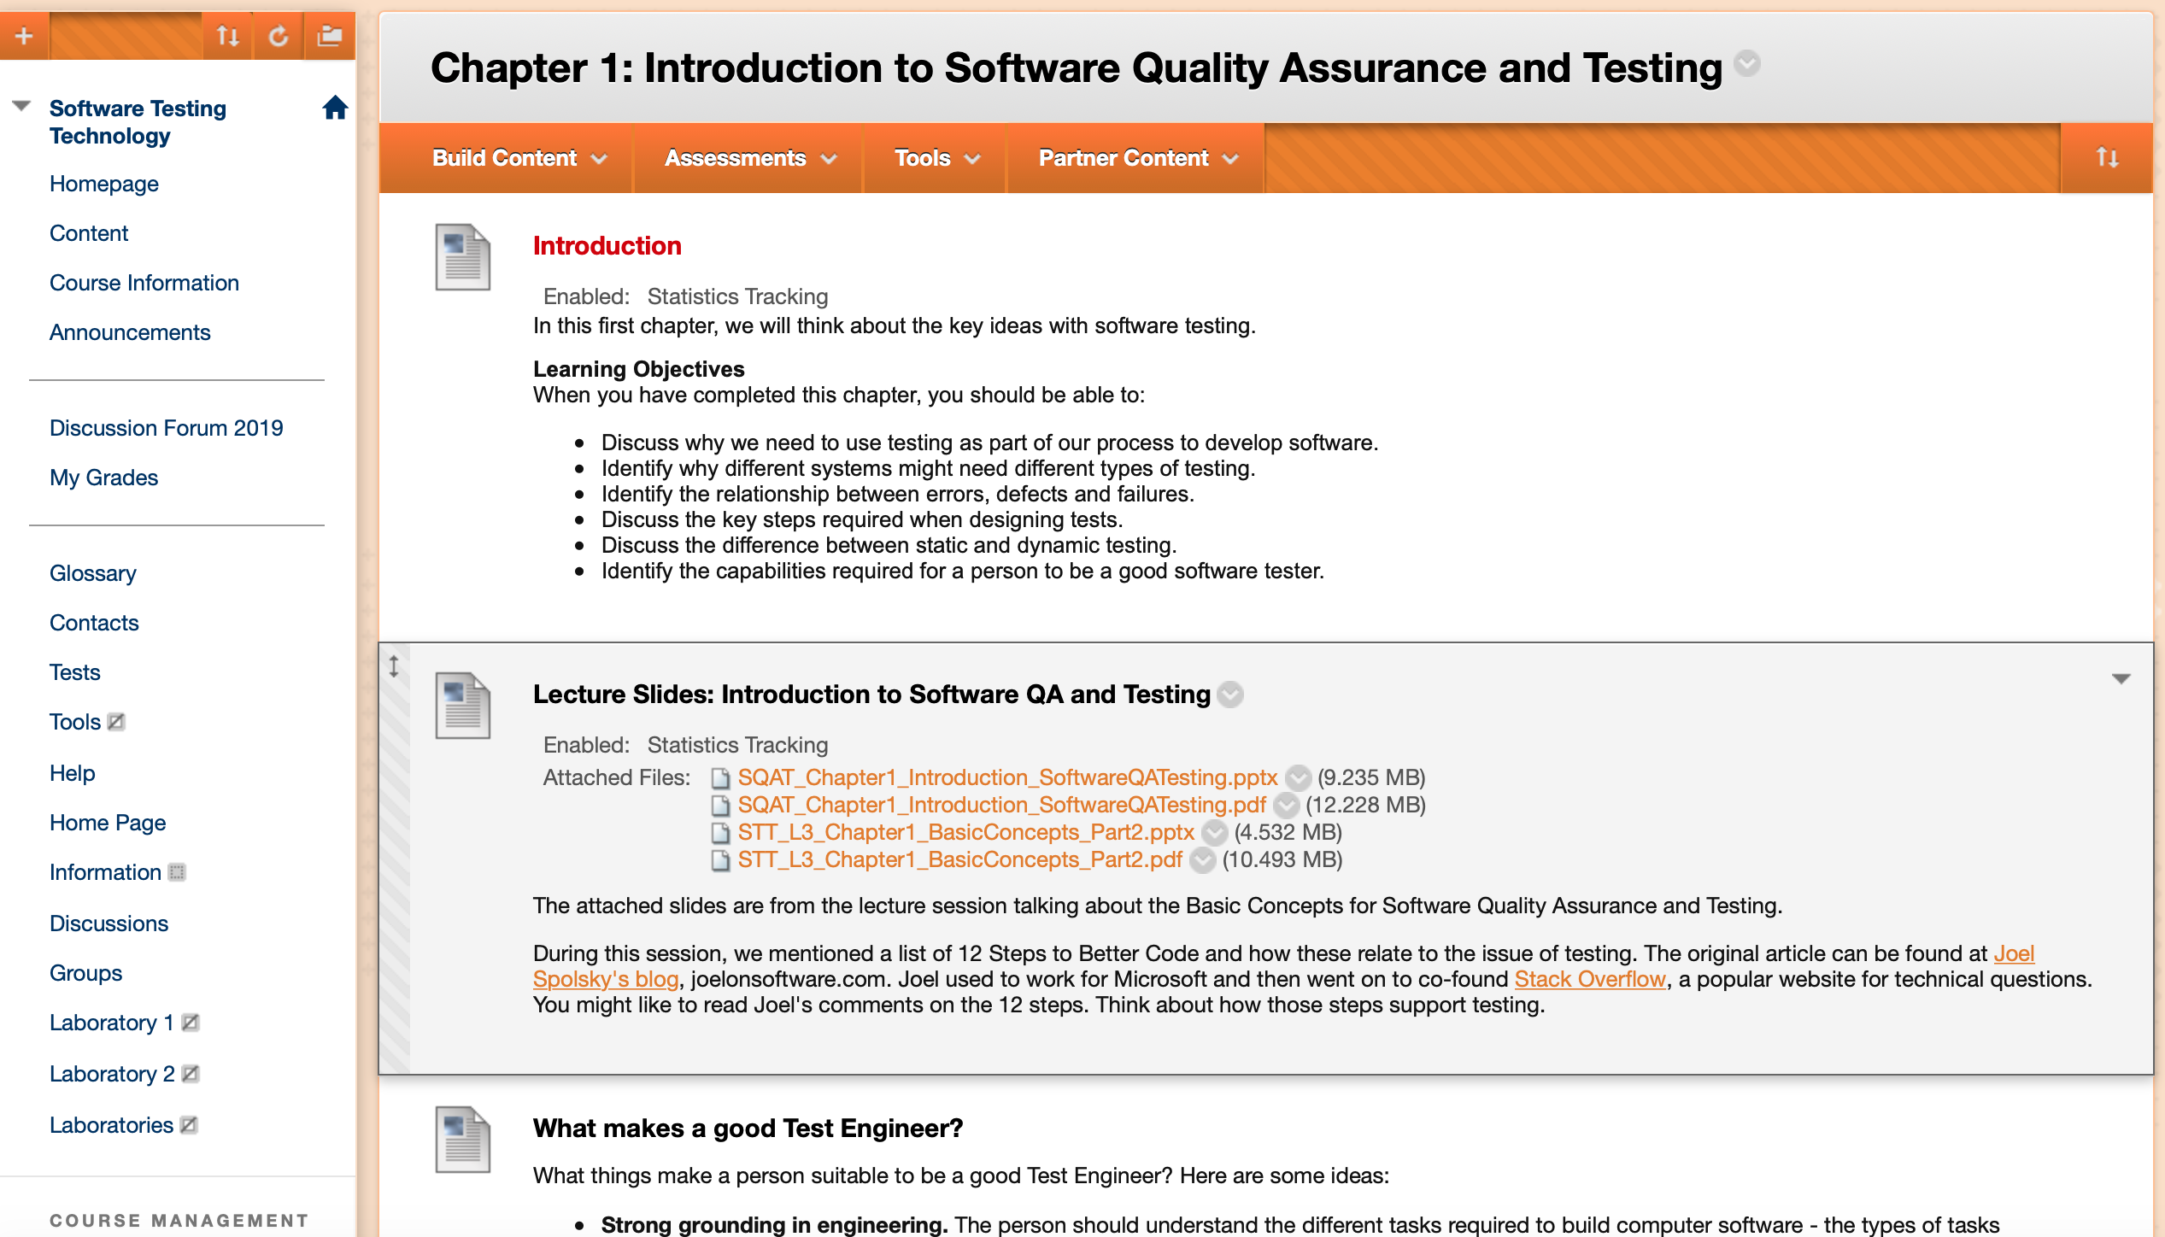
Course Materials on Blackboard
Slides in PowerPoint and PDF
Suggested readings
Link to Slack
Book list
Tests

Slide 10
Assessment
Item | Weighting
Quizzes on Blackboard Up to 5 quizzes on blackboard | 20%
Laboratory Notebooks Notebooks based on work in the laboratories. | 20%
Examination Two-hour paper. | 60%

Slide 11
Any Questions?

