Slide 1
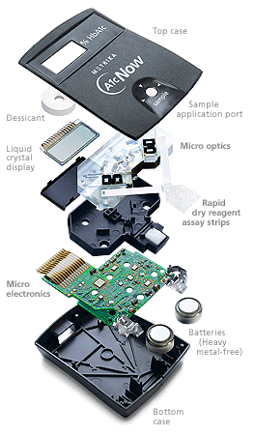
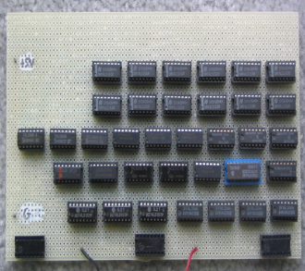

22-03-2013
Workshop On
Control of Power Converters
Using
MATLAB - Xilinx Interface
ZENTILL
Codeless Coding…………………..{ }
Zentill,,,

Slide 2

About the workshop
தாமின் புறுவது உலகின் புறக்கண்டு
காமுறுவர் கற்றறிந் தார்.
தாமின் புறுவது உலகின் புறக்கண்டு
மாடல மற்றை யவை
தாமின் புறுவது உலகின் புறக்கண்டு
மாடல மற்றை யவை

Slide 3
About the workshop
It is in the Desire to share and not to teach…….
Senthil Kumaran Mahadevan
So nothing here is right or wrong every thing is wonderful
ZENTILL
Have a nice Day…….

Slide 4
Thanks …………..
To my Students
M. Banuchandar
V. Vijeyenderan
Senthil Kumaran Mahadevan
For encouraging me
&
For making this happen
ZENTILL

Slide 5
Thanks …………..
To my colleges
Mr. M. Balaji
Mr. K. Murugesan
Senthil Kumaran Mahadevan
For Being with me
Throughout the preparation work
ZENTILL

Slide 6
Thanks …………..
To my Guide
Senthil Kumaran Mahadevan
Dr. Ranganath Muthu
ZENTILL
Who seeded this action in me

Slide 7


Coding a controller & FPGA
Microcontroller
Codes on the Architecture
FPGA
Codes for the Architecture

Slide 8
Coding Methods in FPGA
Behavioral Architecture
{Single unit}
Non modular approach
Structural Architecture
{Interconnected unit}
Modular approach

Slide 9
Before we Code…………… Keywords
File types
*.VHDL file
*.Bit file
*.Mcs file
*.Ucf file
Coding
Entity
Architecture
Process
Xilinx
Synthesize
Implement design
Generate programming file
Configure target device
Boundary scan { initialize chain}
Assign new configuration file

Slide 10
Tutorial - A…………… Behavioral Coding
VHDL Coding
AND Gate
JK Flip Flop
BCD – 7 Segment Converter
Frequency Divider
Counter-7 Segment - Interface

Slide 11
Behavioral…………… Coding
VHDL- LANGUAGE SYNTAX
Coding syntax of VHDL file
< include the library files >
entity <entity name> is
<Define the I/O Ports >
end <entity name>;
architecture Behavioral of <entity name> is
<Define or declare the intermediate signals>
begin
<VHDL Coding >;
process
< VHDL Signal Sensitive Coding >;
end process;
end Behavioral;

Slide 12
Behavioral…………… Coding
UCF-PORT ASSIGNMENT SYNTAX
Coding syntax of UCF file
NET “<Port Variable Name>” LOC= “FPGA Pin Number”

Slide 13
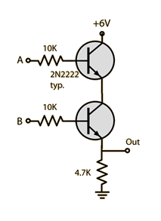
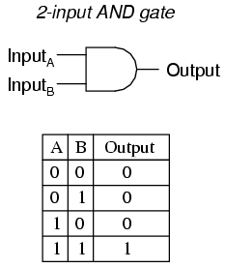
Behavioral…………… Coding
AND . GATE
library IEEE;
use IEEE.STD_LOGIC_1164.ALL;
entity And_Gate is
Port ( In1 : in STD_LOGIC;
In2 : in STD_LOGIC;
Out1 : out STD_LOGIC);
end And_Gate;
architecture Behavioral of And_Gate is
begin
Out1 <= In1 and In2;
end Behavioral;

Slide 14
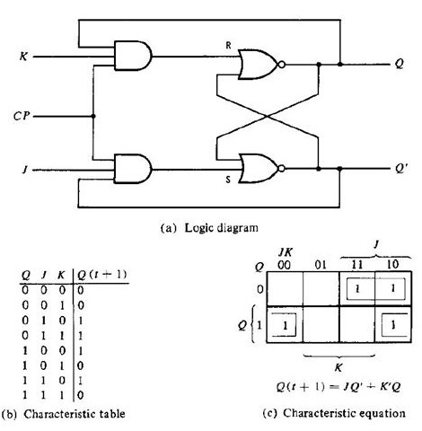
Behavioral…………… Coding
JK FLIPFLOP
entity JKFF is
Port (J,K,CLK:in bit; Q,QN:out bit);
end JKFF;
architecture JKFF1 of JKFF is
signal Qint:bit;
begin
Q<=Qint;
QN<=not Qint;
process(CLK)
begin
if CLK' event and CLK='0' then
Qint<=(J and not Qint) or (not K and Qint);
end if;
end process;
end JKFF1;

Slide 15
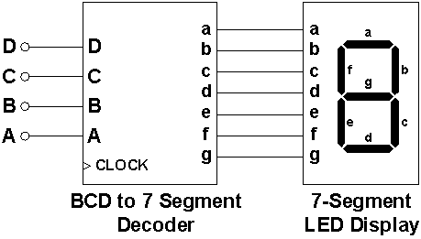
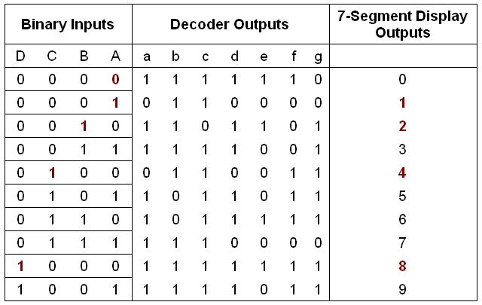
Behavioral…………… Coding
BCD – 7SEGMENT
entity FirstDemo is
Port ( switches : in STD_LOGIC_VECTOR (3 downto 0);
sevenseg : out STD_LOGIC_VECTOR (6 downto 0);
anode : out STD_LOGIC_VECTOR (3 downto 0));
end FirstDemo;
architecture Behavioral of FirstDemo is
begin
with switches select
sevenseg <=
"1000000" when "0000" ,
"1111001" when "0001" ,
"0100100" when "0010" ,
"0110000" when "0011" ,
"0011001" when "0100" ,
"0010010" when "0101" ,
"0000010" when "0110" ,
"1111000" when "0111" ,
"0000000" when "1000" ,
"0010000" when "1001" ,
"0010000" when others;
anode <= "0110";
end Behavioral;
NET "anode<0>" LOC = "F17";

Slide 16
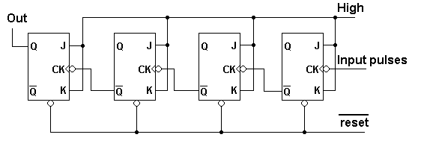
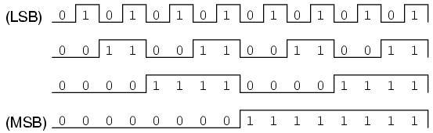
Behavioral… Coding
FREQUENCY - DIVIDER
entity lcd is
port ( led : out STD_LOGIC;
clk : in STD_LOGIC);
end lcd;
architecture Behavioral of lcd is
signal sig : std_logic_vector(25 downto 0)
:= "00000000000000000000000000";
begin
process
begin
wait until clk'event and clk='1';
sig<=sig+1;
case sig(25 downto 25) is
when "0" => led <= '0';
when "1" => led <= '1';
when others => null;
end case;
end process;
end architecture;

Slide 17
Behavioral… Coding
COUNTER – 7 SEGMENT - INTERFACE

Slide 18
entity count7seg is
Port ( sevenseg : out STD_LOGIC_VECTOR (6 downto 0);
anode : out STD_LOGIC_VECTOR ( 3 downto 0);
clk : in STD_LOGIC);
end count7seg;
architecture Behavioral of count7seg is
signal sig : std_logic_vector(25 downto 0) := 00000000000000000000000000";
signal count : std_logic_vector(3 downto 0) := "0000";
Begin
Process
Begin
wait until clk'event and clk='1‘;
sig<=sig+1;
case sig(25 downto 0) is
when "11111111111111111111111111" => count <= count +1;
when others => count <=count;
end case;
end process;

Slide 19
Continued…..
with count select
sevenseg <=
"1000000" when x"0" ,
"1111001" when x"1" ,
"0100100" when x"2" ,
"0110000" when x"3" ,
"0011001" when x"4" ,
"0010010" when x"5" ,
"0000010" when x"6" ,
"1111000" when x"7" ,
"0000000" when x"8" ,
"0010000" when x"9" ,
"0001000" when x"A" ,
"0000011" when x"B" ,
"1000110" when x"C" ,
"0100001" when x"D" ,
"0000110" when x"E" ,
"0001110" when others;
anode <= "0001";
end architecture;

Slide 20
Tutorial - A…………… Behavioral Coding
VHDL Coding
AND Gate
JK Flip Flop
BCD – 7 Segment Converter
Frequency Divider
Counter-7 Segment - Interface
Ends ……..………

Slide 21

Tutorial - B…………… Structural Coding
VHDL Coding
Four Bit Parallel ADDER
Decade Counter-7 Segment - Interface
Ends ……..………

Slide 22
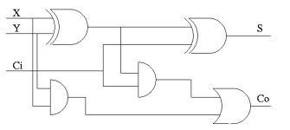
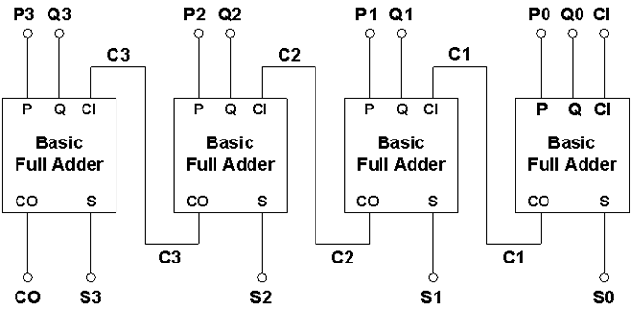
Structural…………… Coding
Four bit Full Adder Circuit
Full Adder (B)
Four bit Full Adder (S)

Slide 23
Structural…………… Coding
Four bit Full Adder Circuit
Fundamental Behavioral Architecture code
Full Adder (B)
entity FA4 is
port(X,Y,Cin: in bit; Sum,Cout: out bit);
end FA4;
architecture Behavioral of FA4 is
begin
Sum <= X xor Y xor Cin;
Cout<= (X and Y )or(Cin and Y) or(Cin and X) ;
end Behavioral;

Slide 24
Structural…………… Coding
Four bit Full Adder Circuit
Inherited Structural Architecture code – With full adders as components
entity FAdd4 is
port(A,B: in bit_vector(3 downto 0); Ans: out bit_vector(4 downto 0));
end FAdd4;
architecture Structure of FAdd4 is
component FA4
port(X,Y,Cin: in bit; Sum,Cout: out bit);
end component;
signal Ctemp :bit_vector(3 downto 0);
begin
Ctemp(0)<='0';
FA0:FA4 port map(A(0),B(0),Ctemp(0),Ans(0),Ctemp(1));
FA1:FA4 port map(A(1),B(1),Ctemp(1),Ans(1),Ctemp(2));
FA2:FA4 port map(A(2),B(2),Ctemp(2),Ans(2),Ctemp(3));
FA3:FA4 port map(A(3),B(3),Ctemp(3),Ans(3),Ans(4));
end Structure;

Slide 25
Structural…………… Coding
Decade Counter – 7 Segment interface – Big Problem
Description of the Architecture plan
AND gate unit -Behavioral Architecture
JK flip-flop unit - Behavioral Architecture
7 segment unit - Behavioral Architecture
Decade counter unit -Structural Architecture
{components AND, JK flip-flop}
Decade counter -7 segment interface
-Structural Architecture
{ components Decade counter ,7 segment unit}

Slide 26
Structural…………… Coding
Big-Problem
entity AND_GATE is
port (A,B:in bit; C:out bit);
end AND_GATE;
architecture Behavioral of AND_GATE is
begin
C<= A and B after 2 ns;
end Behavioral;
entity JKFF is
port (J,K,CLK:in bit; Q,QN:out bit);
end JKFF;
architecture Behavioral of JKFF is
signal Qint:bit;
begin
Q<=Qint;
QN<=not Qint;
process(CLK)
begin
if CLK' event and CLK='0' then
Qint<=(J and not Qint) or (not K and Qint) after 2 ns;
end if;
end process;
end Behavioral;
AND Gate (B)
Fundamental Behavioral Architecture code
JK Flip-flop(B)

Slide 27
Structural…………… Coding
Big-Problem
entity Bin_7 is
port ( switches : in bit_vector (3 downto 0);
sevenseg : out bit_vector (6 downto 0);
anode: out bit_vector (3 downto 0));
end Bin_7;
architecture Behavioral of Bin_7 is
begin
with switches select
sevenseg <=
"1000000" when x"0" , "1111001" when x"1" ,
"0100100" when x"2" , "0110000" when x"3" ,
"0011001" when x"4" , "0010010" when x"5" ,
"0000010" when x"6" , "1111000" when x"7" ,
"0000000" when x"8" , "0010000" when x"9" ,
"0001000" when x"A" , "0000011" when x"B" ,
"1000110" when x"C" , "0100001" when x"D" ,
"0000110" when x"E" , "0001110" when others;
anode <= "0001";
end Behavioral;
7-Segment Decoder
Fundamental Behavioral Architecture code

Slide 28
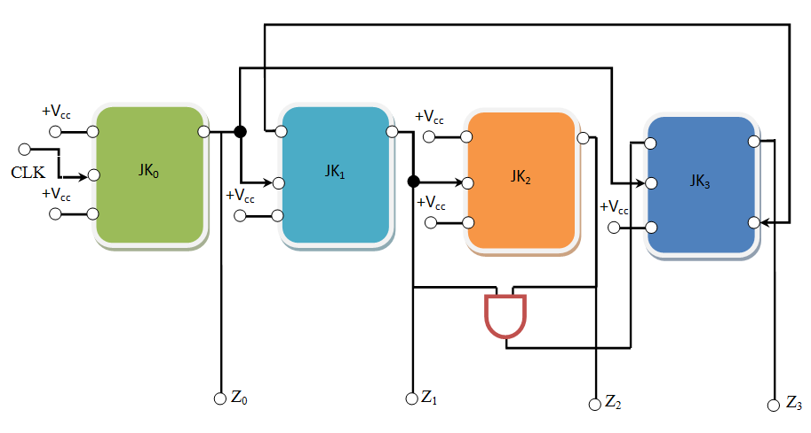
Structural…………… Coding
Decade Counter – 7 Segment interface – Big Problem
Internal Circuit of Decade Counter ASCKTS

Slide 29
Structural…………… Coding
Big-Problem
entity Decade_Counter is
port(Count:in bit; D:out bit_vector(3 downto 0));
end Decade_Counter;
architecture Structure of Decade_Counter is
component AND_GATE
port(A,B:in bit; C:out bit);
end component;
component JKFF
port (J,K,CLK:in bit; Q,QN:out bit);
end component;
signal Z:bit_vector(3 downto 0);
signal S1,S2:bit;
begin
D(0)<=Z(0); D(1)<=Z(1);
D(2)<=Z(2); D(3)<=Z(3);
A1:AND_GATE port map(Z(2),Z(1),S1);
JK1:JKFF port map('1','1',Count,Z(0),open);
JK2:JKFF port map(S2,'1',Z(0),Z(1),open);
JK3:JKFF port map('1','1',Z(1),Z(2),open);
JK4:JKFF port map(S1,'1',Z(0),Z(3),S2);
end Structure;
Inherited Structural Architecture code
Decade Counter

Slide 30
Structural…………… Coding
Big-Problem
entity seg_countASY is
port(C:in bit; S:out bit_vector(6 downto 0); A:out bit_vector(3 downto 0));
end seg_countASY;
architecture Structure of seg_countASY is
component Decade_Counter
port(Count:in bit; D:out bit_vector(3 downto 0));
end component;
component Bin_7
port(switches : in bit_vector (3 downto 0);sevenseg : out bit_vector (6 downto 0);anode : out bit_vector (3 downto 0));
end component;
signal inter:bit_vector(3 downto 0);
begin
Dec1: Decade_Counter port map(C,inter);
Bin_7_1: Bin_7 port map(inter,S,A);
end Structure;
Inherited Structural Architecture code
Total interface

Slide 31
Tutorial - B…………… Structural Coding
VHDL Coding
Four Bit Parallel ADDER
Decade Counter-7 Segment - Interface
Ends

Slide 32


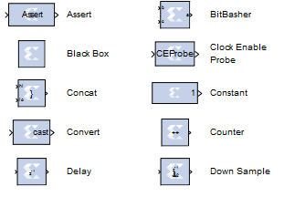
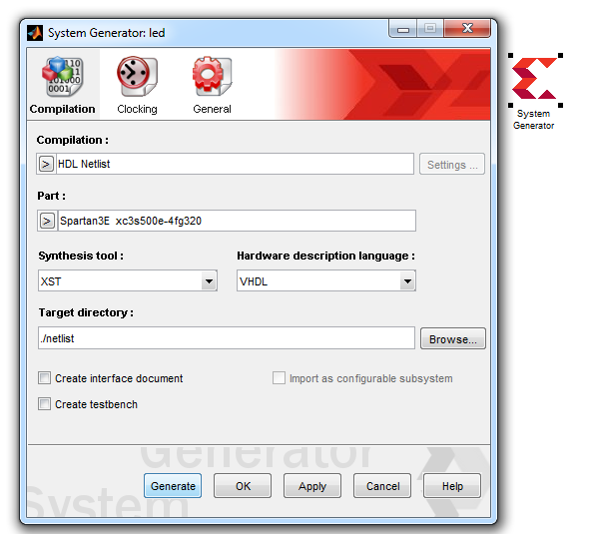
Tutorial - C………………….. MATLAB - Xilinx Interface
Before we start Some ………
Xilinx tool box in MATLAB
UCF_Equivalent
System generator setting
Identify the FPGA& its hardware details
Generate the VHDL file

Slide 33
Tutorial - C………………….. MATLAB - Xilinx Interface
Control algorithm development in MATLAB -Xilinx tool box
Control Algorithm Developed with Xilinx tool box
=
Circuit inside the FPGA
=
=
=
FPGA
FPGA Pins
=
=
FPGA Pins

Slide 34
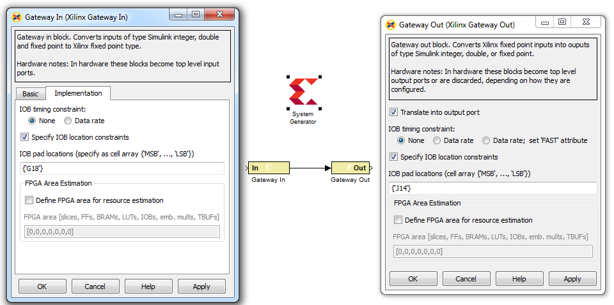

Lighting an LED with a switch MATLAB - Xilinx Interface
Identify the FPGA& its hardware details
Generate the VHDL file

Slide 35
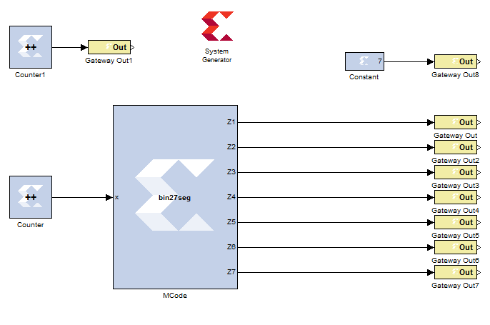
Counter-7Segment -interface MATLAB - Xilinx Interface – Small problem

Slide 36
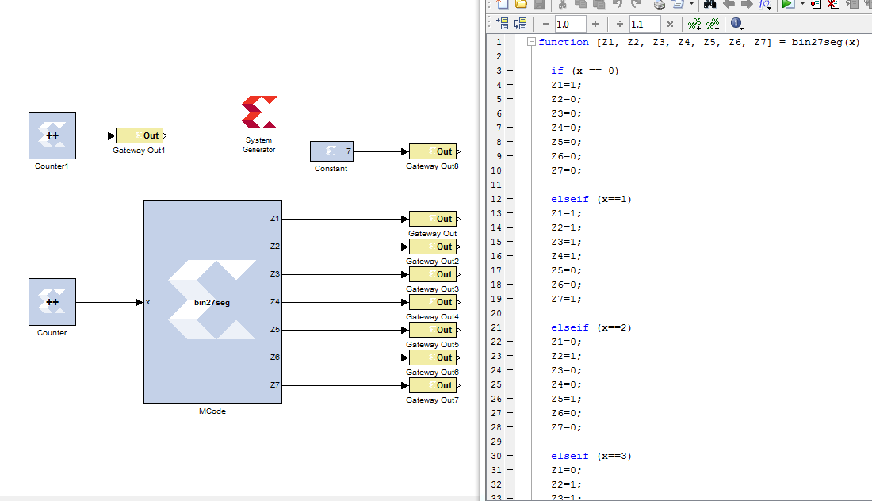
Counter-7Segment -interface MATLAB - Xilinx Interface – Small problem

Slide 37
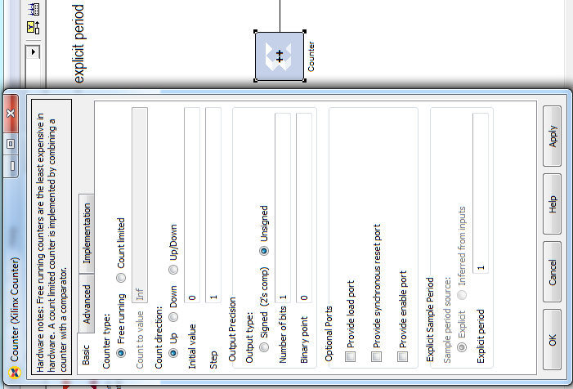
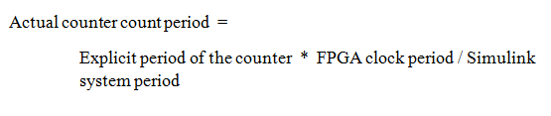
Counter-7Segment -interface MATLAB - Xilinx Interface – Small problem

Slide 38
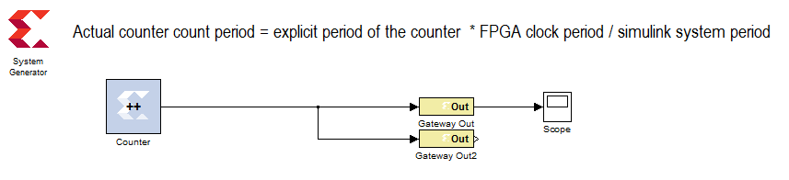
Pulse Generator
MATLAB - Xilinx Interface – Small problem
Can you try - Designing a frequency generator of 25Hz.
Please Check it with the DSO on your table.

Slide 39
PWM Signal Generator for converters
MATLAB - Xilinx Interface – Small problem
Can you try
Design a PWM signal generator which creates a saw tooth wave of 4KHz internally and compares it with a DC signal internally to produce PWM pulses .
Tutorial – Volunteers will now STOP Helping U for a while …
Start Searching……..
Please Check it with the DSO on your table.

Slide 40

PWM Signal Generator for converters
MATLAB - Xilinx Interface – Small problem

Slide 41
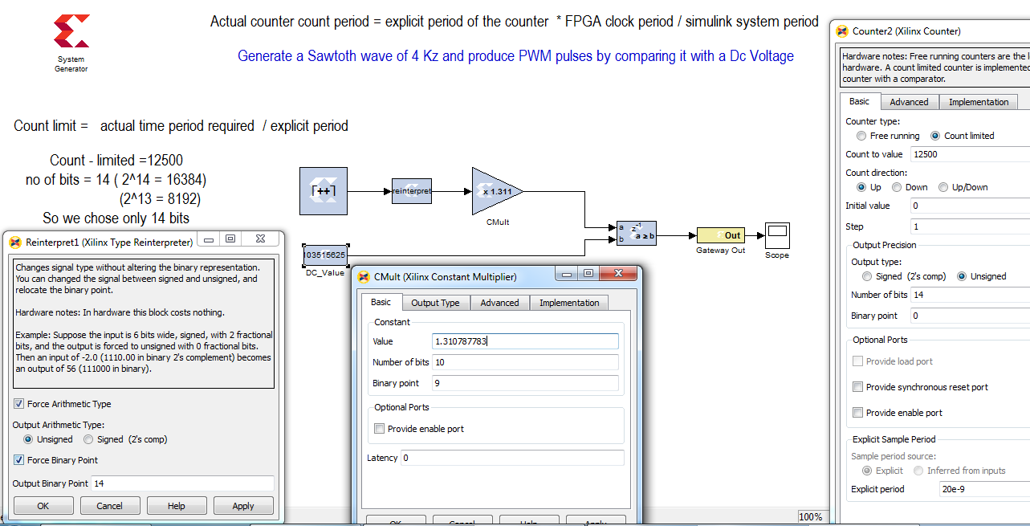
PWM Signal Generator for converters

Slide 42
Tutorial - C………………….. MATLAB - Xilinx Interface
Ends

Slide 43
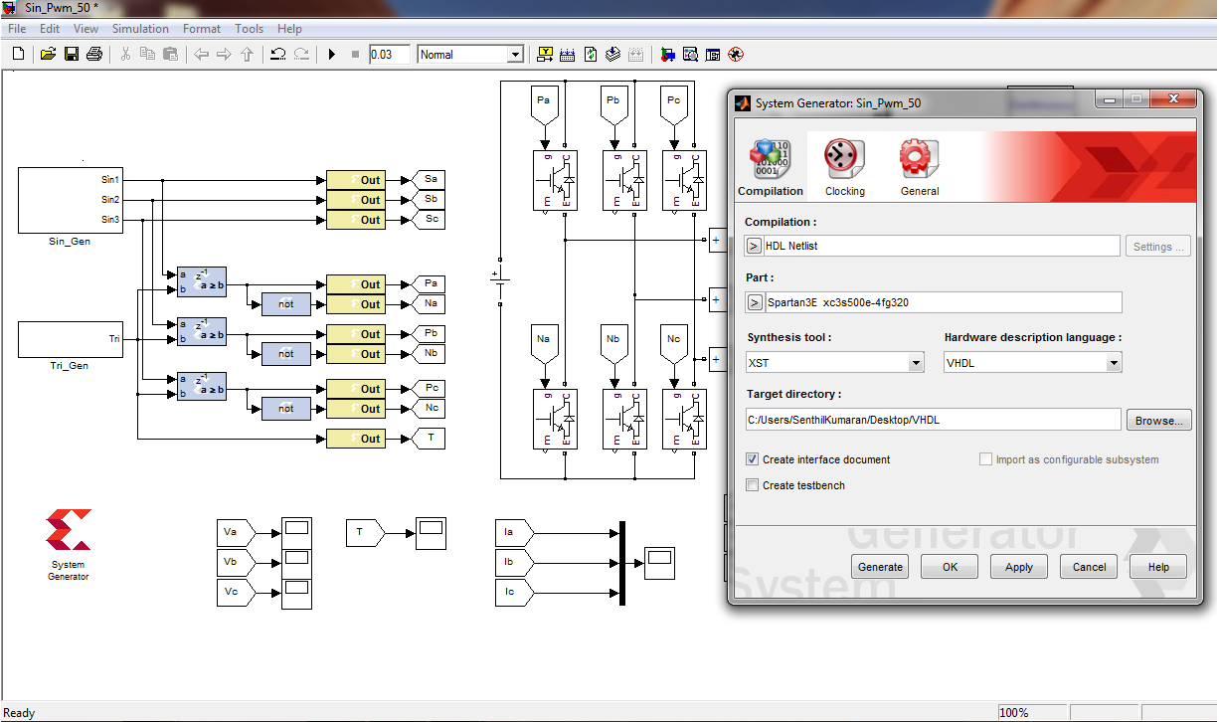
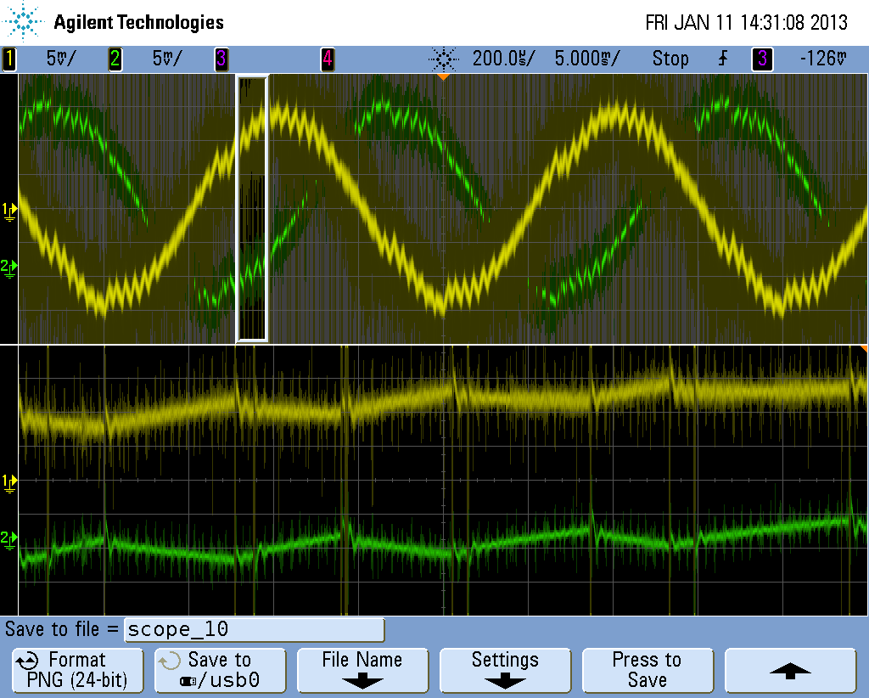
Demonstration……… MATLAB - Xilinx Interface
Sine PWM Based induction Motor Control

Slide 44


Knowledge is collection of dead facts and information .
Knowing is the Melting of the mind into the unknown.
Knowledge is some one else's knowing.
Knowing is your Knowledge.
ZENTILL [Truth@false.com]

Slide 45
Thanks to System Generator Toolbox MATLAB - Xilinx Interface
Expecting you in the next Workshop on MATLAB - DSP Interface with GUI
coming Soon………

