Slide 1



Knowledge is Collection of Dead Facts and Information
Knowing is Melting of Mind into the Unknown
Knowledge is Someone Else's Knowing
Knowing is Your Knowledge
[ ZENTILL]

Slide 2
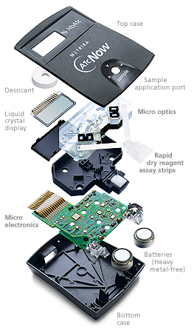

1-09-2015
Workshop On
Design of Digital Controllers in FPGA using Matlab System Generator Toolbox.
Starting Time 8:30 AM
M.Senthil Kumaran
Finishing Time – We Don’t Know

Slide 3


About the Lecture
தாமின் புறுவது உலகின் புறக்கண்டு
மாடல மற்றை யவை
தாமின் புறுவது உலகின் புறக்கண்டு
மாடல மற்றை யவை
கற்றில னாயினுங் கேட்க அஃதொருவற் கொற்கத்தின் ஊற்றாந் துணை
Making Knowing Abundant in India

Slide 4
About the Lecture
தாமின் புறுவது உலகின் புறக்கண்டு
மாடல மற்றை யவை
தாமின் புறுவது உலகின் புறக்கண்டு
மாடல மற்றை யவை
தாமின் புறுவது உலகின் புறக்கண்டு
காமுறுவர் கற்றறிந் தார்.
Making Knowing Abundant in India

Slide 5
About the Lecture
It is in the Desire to share and not to teach…….
Senthil Kumaran Mahadevan
So nothing here is right or wrong every thing is wonderful
ZENTILL
Have a nice Day…….

Slide 6
Thanks …………..
To my Students
S. Adithya B.E.
S. Sibi B.E.
Senthil Kumaran Mahadevan
For encouraging me
&
For Preparing the entire hardware setup for this workshop

Slide 7
A Quick Understanding of VHDL

Slide 8


Coding a controller & FPGA
Microcontroller
Codes on the Architecture
FPGA
Codes for the Architecture

Slide 9
Coding Methods in FPGA
Behavioral Architecture
{Single unit}
Non modular approach
Structural Architecture
{Interconnected unit}
Modular approach

Slide 10
Before we Code…………… Keywords
File types
*.VHDL file
*.Bit file
*.Mcs file
*.Ucf file
Coding
Entity
Architecture
Xilinx
Synthesize
Implement design
Generate programming file

Slide 11
Behavioral Coding
VHDL Coding
AND Gate

Slide 12
Behavioral…………… Coding
VHDL- LANGUAGE SYNTAX
Coding syntax of VHDL file
< include the library files >
entity <entity name> is
<Define the I/O Ports >
end <entity name>;
architecture Behavioral of <entity name> is
<Define or declare the intermediate signals>
begin
<VHDL Coding >;
end Behavioral;

Slide 13
Behavioral…………… Coding
UCF-PORT ASSIGNMENT SYNTAX
Coding syntax of UCF file
NET “<Port Variable Name>” LOC= “FPGA Pin Number”

Slide 14
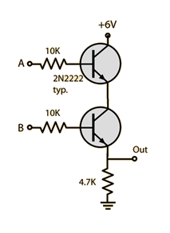
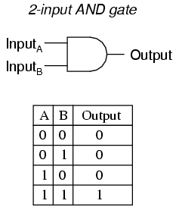
Behavioral…………… Coding
AND . GATE
library IEEE;
use IEEE.STD_LOGIC_1164.ALL;
entity And_Gate is
Port ( In1 : in STD_LOGIC;
In2 : in STD_LOGIC;
Out1 : out STD_LOGIC);
end And_Gate;
architecture Behavioral of And_Gate is
begin
Out1 <= In1 and In2;
end Behavioral;

Slide 15
Coding
10:00 AM
VHDL Coding
AND Gate
Ends ……..………

Slide 16

Coding – Through Model based approach
MATLAB- Xilinx interface
System Generator Tool box

Slide 17


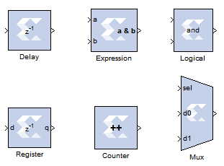


Interfacing Matlab and Xilinx Softwares

Slide 18


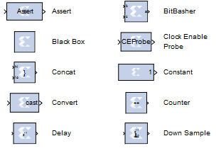
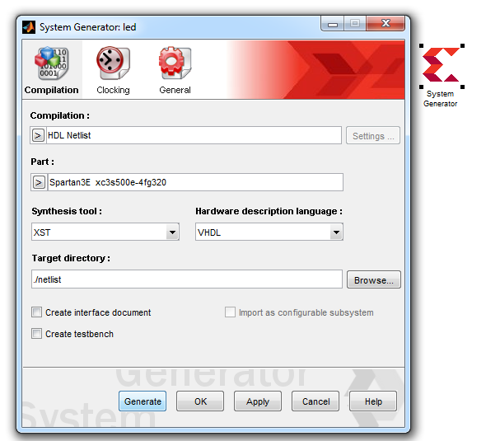
MATLAB - Xilinx Interface
Before we start Some ………
Xilinx tool box in MATLAB
UCF_Equivalent
System generator setting
Identify the FPGA& its hardware details
Generate the VHDL file

Slide 19
Model based design using MATLAB/System Generator Toolbox for Xilinx FPGAs
Control algorithm development in MATLAB -Xilinx tool box
Control Algorithm Developed with Xilinx tool box
Circuit inside the FPGA
FPGA
FPGA Pins
FPGA Pins

Slide 20
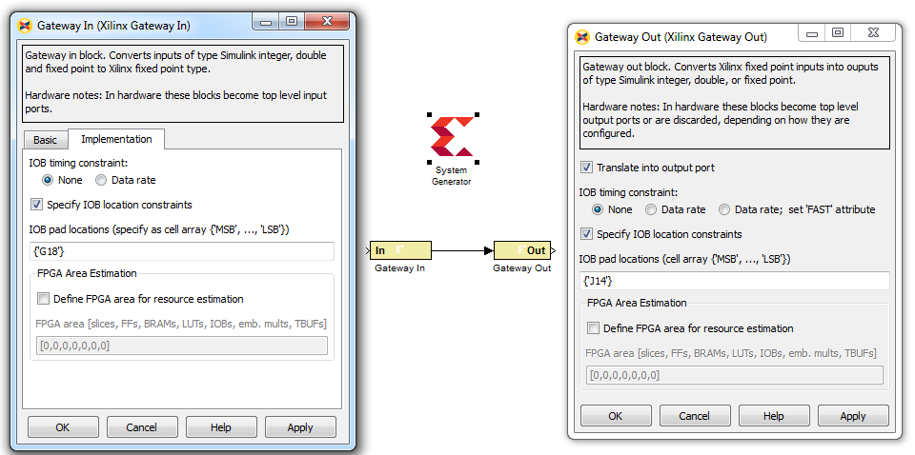

Lighting an LED with a switch MATLAB - Xilinx Interface
1
Nexys 2
G18
J14
Identify the FPGA& its hardware details
Generate the VHDL file

Slide 21
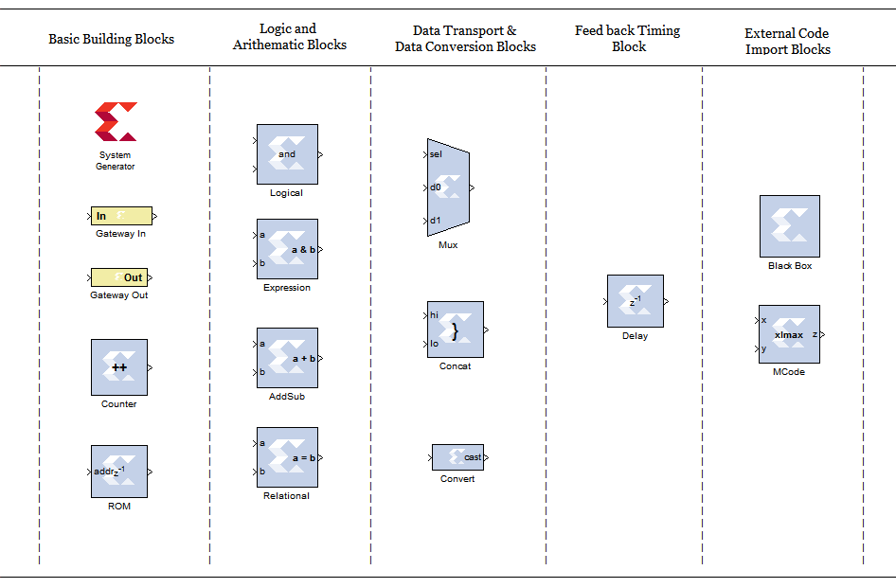
Basic Building Blocks MATLAB - Xilinx Interface

Slide 22
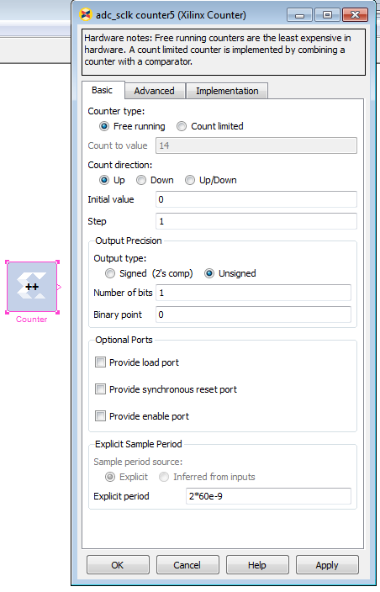
Component - Counter
Counter Parameters Setting MATLAB - Xilinx Interface
Counter
x
Where
X = Counters - Limit of counting
T = Period on which the counter Counts (CLK)
0
T*(x+1)
Conditions for setting counter time period
Time period of the Counter
= Integer
Time period of the System Clock
10:15 AM

Slide 23

Knowledge becomes Wisdom only after it has been put to practical use

Slide 24
Pulse Generator
MATLAB - Xilinx Interface – Small problem
2
Let us try - Designing a Square wave frequency generator of 25Hz.
Use a Counter
x
Where
X = Counters - Limit of counting
N = Period on which the counter Counts (CLK)
0
T* (x+1)
Solution : Determine the value of X any T correctly

Slide 25
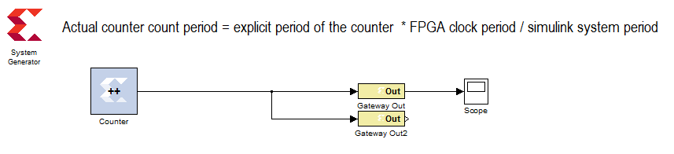
Pulse Generator
MATLAB - Xilinx Interface – Small problem
2
Let us try - Designing a Square wave frequency generator of 25Hz.
Idea- Use a one bit counter that counts at the required time.
X = 1
J14
L15
Nexys 2

Slide 26
Pulse Generator
MATLAB - Xilinx Interface – Small problem
ON
ON
T= 0.02
OFF
OFF
0.02 s
0.04 s
Conditions for setting counter time period
Time period of the Counter [0.02 s]
= Integer [1000000]
Time period of the System Clock [ 20 ns]

Slide 27
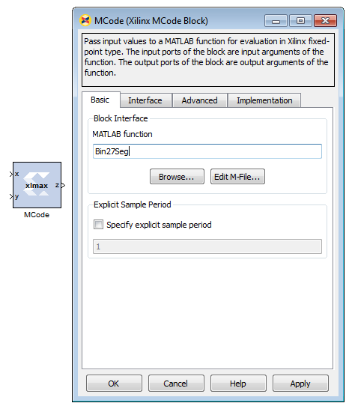
Component – M Code
M code Parameters Setting MATLAB - Xilinx Interface
M Code Parameter
File Name = XXXX .m
Note: File should be present in the folder where Matlab- Xilinx file is present

Slide 28
Counter-7Segment -interface MATLAB - Xilinx Interface – Small problem
3
X=9
T= 1

Slide 29
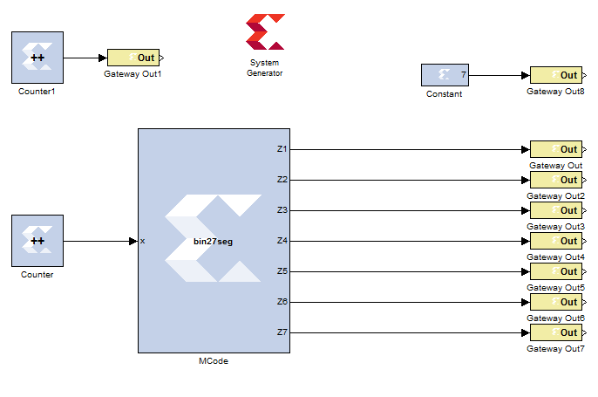
Counter-7Segment -interface MATLAB - Xilinx Interface – Small problem
3
9
0
10s

Slide 30
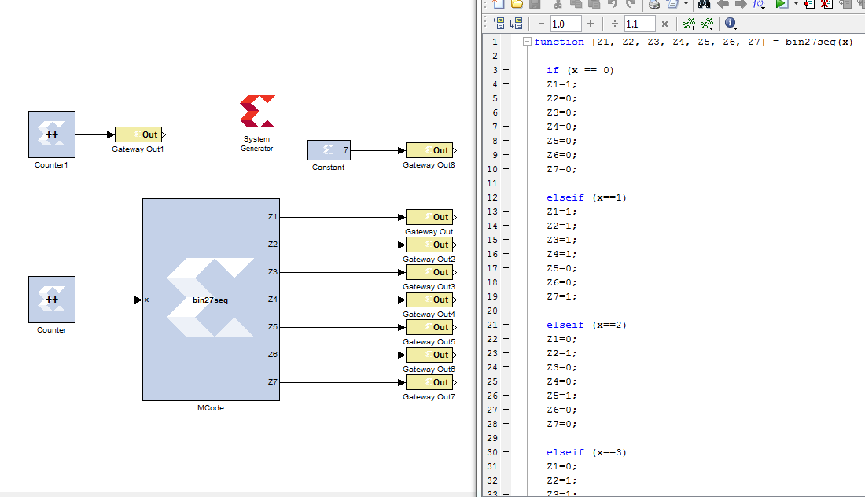
Counter-7Segment -interface MATLAB - Xilinx Interface – Small problem
X2 | X1 | X0 | Z1(g) | Z2(f) | Z3(e) | Z4(d) | Z5(c) | Z6(b) | Z7(a)
0 | 0 | 0 | 1 | 0 | 0 | 0 | 0 | 0 | 0
0 | 0 | 1 | 1 | 1 | 1 | 1 | 0 | 0 | 1
0 | 1 | 1 | 0 | 1 | 0 | 0 | 1 | 0 | 0

Slide 31
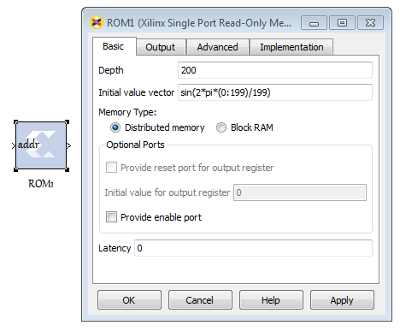
Component – ROM
ROM Parameters Setting MATLAB - Xilinx Interface
0
199
ROM Parameter
Depth = Number of data’s to be Stored
Vector values = Values to be stored
Note: For the specified Index [ Address] passed at the input, the ROM block delivers the value stored at that specified location
11:00 AM

Slide 32
4
PWM Signal Generator for converters
MATLAB - Xilinx Interface – Small problem
Can we try
Design a PWM signal generator which creates a saw tooth wave of 4KHz internally and compares it with a sine signal of 50Hz internally to produce PWM pulses for a single phase inverter.
Setting for Saw tooth Counter
Explicit period = 10* 20e-9 = 20e-8
Setting for Sin Counter
Explicit period = 5000*20e-9
Please Check it with the DSO on your table.

Slide 33
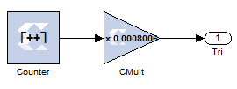
PWM Signal Generator
Triangular wave – 4 kHz
Choose Explicit period as an integer multiple of system clock frequency
Low Explicit period -----> High Resolution
High Explicit period -----> Low Resolution
Explicit period = 10* 20e-9 = 20e-8
Time period of Saw tooth = Count Value * Explicit period
Count Value
Count Value = 0.25ms / 20e-8
Explicit Period of counter
0
Count Value = 1250
0.25ms
Time Period of saw tooth
1
0
0.25ms
Normalizing to 1
1
__________________
Time Period of saw tooth
count value

Slide 34
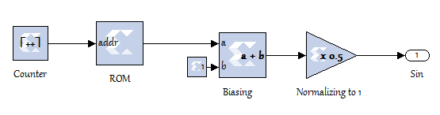
PWM Signal Generator
Sinusoidal wave – 50 Hz
Explicit Period of counter
Choose Explicit period as an integer multiple of system clock frequency
Low Explicit period -----> High Resolution
High Explicit period -----> Low Resolution
Explicit period = 5000*20e-9
Time period of Sin wave = Count Value * Explicit period
1
Count Value = 0.02 / 1e-04
Count Value
Count Value = 200
0
0.02s
-1
2
0.02s
Time Period of sin wave
1
Time Period of saw tooth
0
0

Slide 35
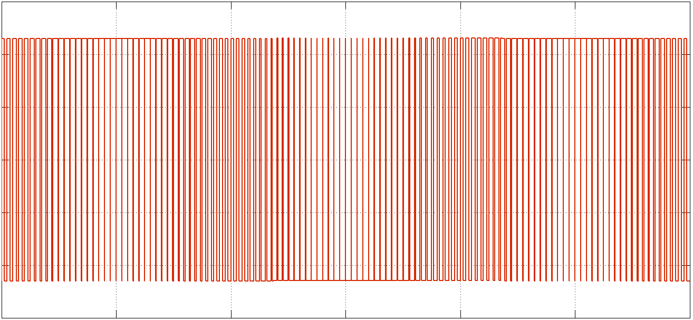
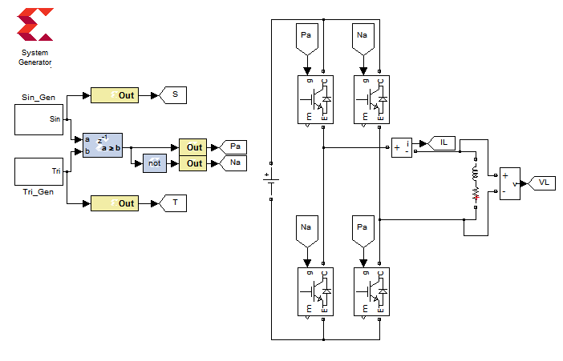
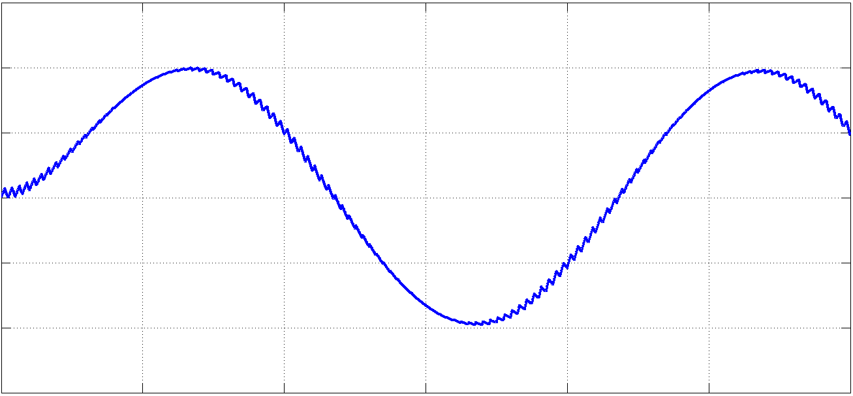
PWM Signal Generator
With Single phase inverter
Nexys 2
L15
M13

Slide 36
Data Acquisition MATLAB - Xilinx Interface
Digital Data Acquisition
Speed Encoder Data Acquisition
12:00 Noon

Slide 37
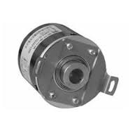
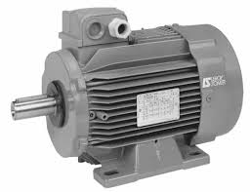
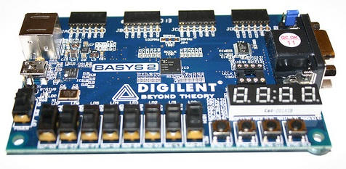
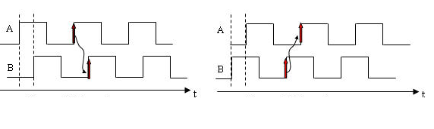

Speed Measurement Using
Encoder Unit
MATLAB - Xilinx Interface – Very Small problem
5
Acquired Digital Signals [ A,B,Z,~Z]
3 Phase Induction Motor
FPGA Kit
Encoder Unit
~Z
Z
B
A
Supply
Mechanical Linkage
Ground
Forward
Reverse

Slide 38
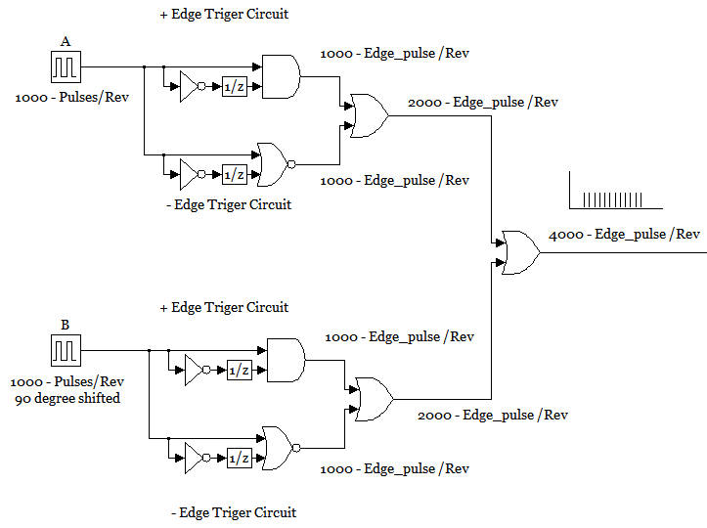
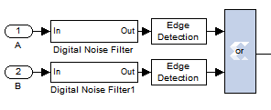
Understanding the Encoder Signals – And utilizing the Maximum PPR
Signals of Encoder
Signals | Meaning
A | 1000 Pulse/Rev
B | 90⁰ ⁻ Shifted - 1000 Pulse/Rev
Z | 1 Pulse /Rev
~Z | ~(Not) of Z
Forward
Reverse
Encoder Unit
~Z
Z
B
A
Supply

Slide 39
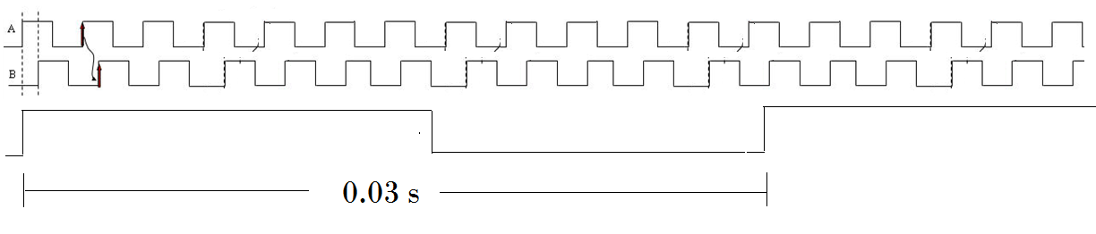
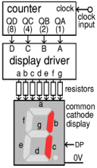

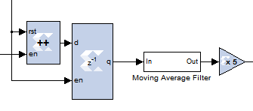
+ , - Edge detect
OR
+ , - Edge detect
+ Edge detect
Scan reset Edge pulses
4000 Edge pulses / Rev→ Signal
Scan Interval
Enable
Counter
4000 Edge Pulse/Rev → Signal
Buffer
?
Reset
Scan Reset Edge Pulses
?

Slide 40

Multiplication Factor for RPM Conversion
?
Let scan period = 0.003 sec
Output of the Buffer [X] = Pulse / 0.003 sec
Encoder Pulse / Revolution [ Y ] = 4000
X / Y = Revolution / 0.003 sec
(X / Y )* (1/0.003)= Revolution / sec
(X / Y )* (1/0.003) *60= Revolution / min (RPM)
(X /4000)* (1/0.003) *60= Revolution / min (RPM)
X*5= Revolution / min (RPM)
Buffer Output
Speed in RPM

Slide 41
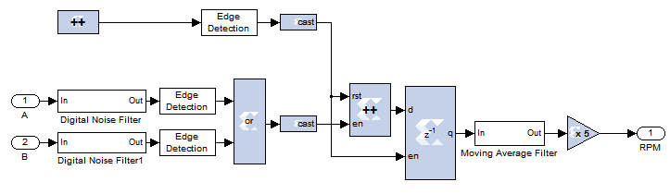
Complete Matlab – System generator Xilinx File
For Speed Sensing using Encoder unit
Sample period = Inferred from Inputs
Number of Bit = 12 ( a high count value)
Explicit period 0.0015 s
Number of Bit = 1

Slide 42


You cannot Swim Without Jumping into waters
First Jump, Swimming Comes automatically
- Zentill [ ]
12:45 PM

Slide 43


To Express is impossible
but
To make it possible is Teaching
- Zentill [ ]
1:30 PM

Slide 44
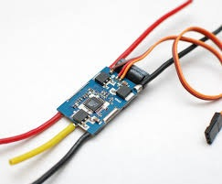
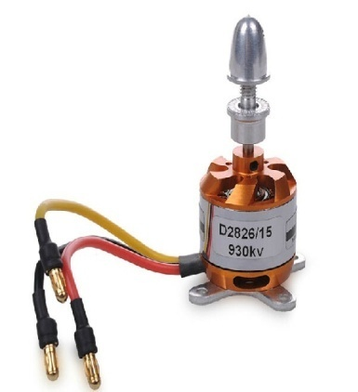
Speed Control OF BLDC Motor
Using ESC Unit
MATLAB - Xilinx Interface – Very Small problem
6
ESC Unit
BLDC Motor
FPGA Kit
Control Signal
W
R
Supply
Not used
B
3 Phase Power Signals
Ground
1:30 PM

Slide 45
Initialization of ESC Unit – Hints from datasheet
Generate your desired pulse between 700us to 2000us using the press button & 7 Segment modules provided to you
ON
ON
Control Signal
1st
2 Sec
OFF
OFF
2000us
2000us
0.02 s
0.02 s
Supply
Not used
ON
ON
2 ^{nd}
2 Sec
OFF
OFF
700us
700us
0.02 s
0.02 s
Ground
After
4 Sec

Slide 46

How to Generate timing pulses
Count Value
Count Value = 19999
Number of bits =15
Explicit period = 1e-6 s
0
Each step is 1 us
0.02 s
Time Period of saw tooth
Count Value = 19999
2000
0
0.02 s
Similarly do it for 700 us Pulse
&
Your speed control signal
Time Period of saw tooth
2000 us
Ist initialization Signal for 2 seconds to the ESC

Slide 47
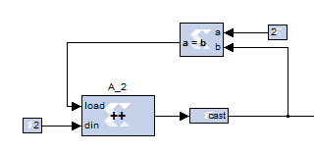
How to Sequence the pulses in Time for
Initialization
A_2 - Counter Setting
Explicit period = 2s
Number of Bits = 2
Free Running Counter
Pulse Sequencing Counter
Counter A_2 - Output
Load | Output of Counter
0 | Counted Output
1 | Newly Loaded Input on din Pin
2s
2s
Time

Slide 48
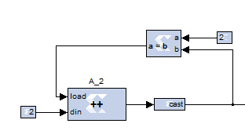
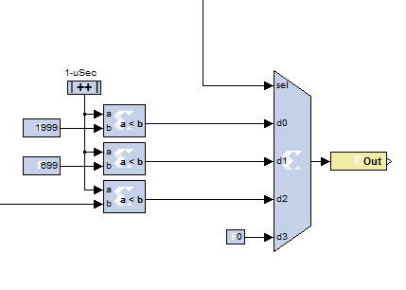
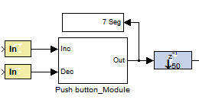
Establishing the control Signal for ESC
Pulse Sequencing Mux Unit
Select | Q
0 | 2000 us pulse
1 | 700 us pulse
2 | Pass your generated pulse
3 | Don’t care state
Nexys_2
Pulse Sequencing Multiplexer Unit
Initialization Signals 2000 us
&
Initialization Signals 700 us
H13
L17
E18
Control Signal to ESC
Given Press Button Input Unit
User Generated Pulse width signal

Slide 49
Initialization and Control of ESC Unit to drive BLDC under various speed
Generate your desired pulse between 700us to 2000us using the press button & 7 Segment modules provided to you
ON
ON
Control Signal
1st
2 Sec
OFF
OFF
2000us
2000us
0.02 s
0.02 s
Supply
Not used
ON
ON
2 ^{nd}
2 Sec
OFF
OFF
700us
700us
0.02 s
0.02 s
Ground
After
4 Sec
2:15 PM

Slide 50
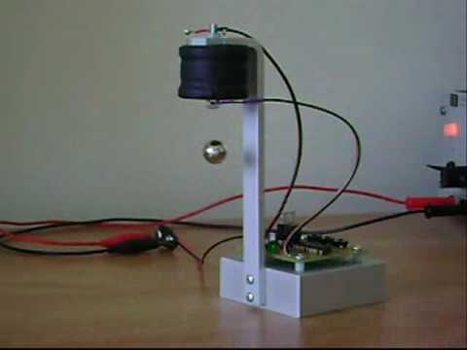
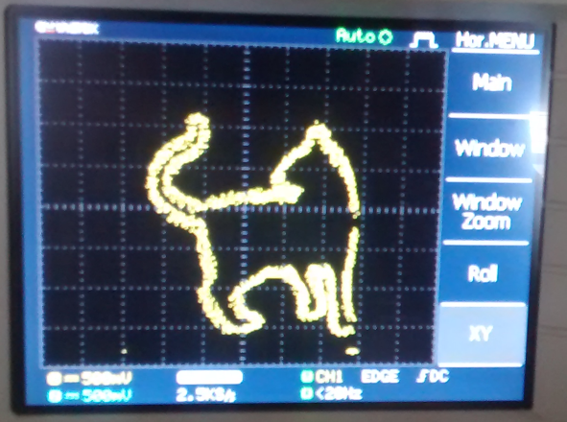
Demonstration……… MATLAB - Xilinx Interface – Beautiful problem
Magnetic Levitation
Digital Painter

Slide 51
Magnetic Levitation System
7
Coil
Sensor
Upper Band
Magnet
Lower Band
Controller
Magnet position
Upper Band
ON
ON
Lower Band
Control Signal
OFF
OFF

Slide 52
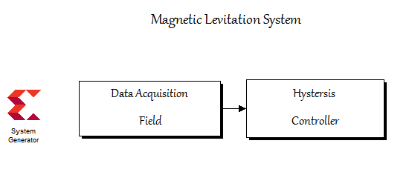
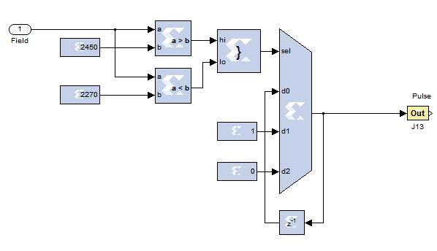
Nexyx_2
MATLAB - Xilinx Interface
Upper Band
Lower Band
J13
2:45 PM

Slide 53
8
Just for Joy Become a Painter Today
Digital Painting
Electronic Artist - FPGA
Canvas - CRO

Slide 54

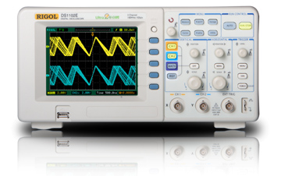
Canvas

Slide 55
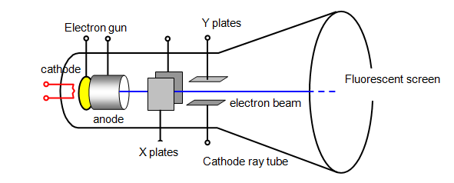

Understanding the internals
Voltages along X and Y plate defines the Coordinates of luminance
X Y Plates are the hands of our Digital Painter

Slide 56
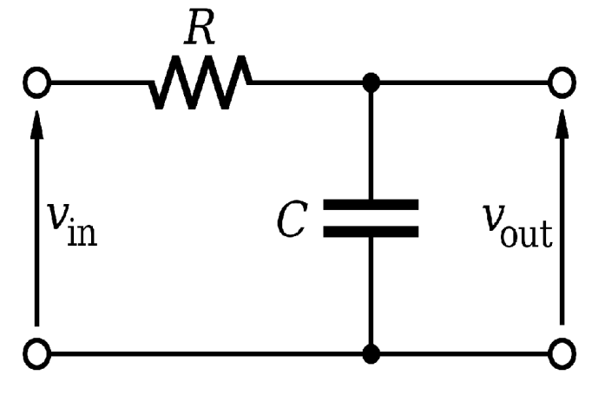
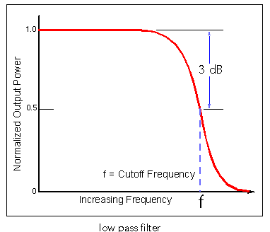
Coordinate Voltage Generation Circuit
Digital information of the X coordinate to be Illuminated
Dx
Modulator
If (Cr > Dx )
Ox = 1;
Else
Ox =0;
Modulator
If (Cr > Dy )
Oy= 1;
Else
Oy =0;
Ox
Low pass Filter ( X)
Low pass Filter(Y)
Vx
High frequency Saw tooth
Cr
Digital information of the Y coordinate to be Illuminated
Oy
Dy
Vy

Slide 57
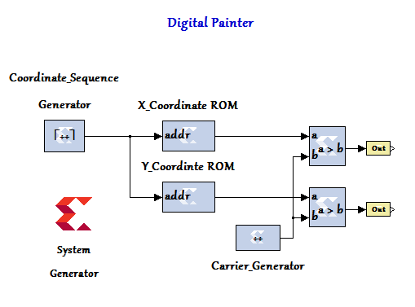
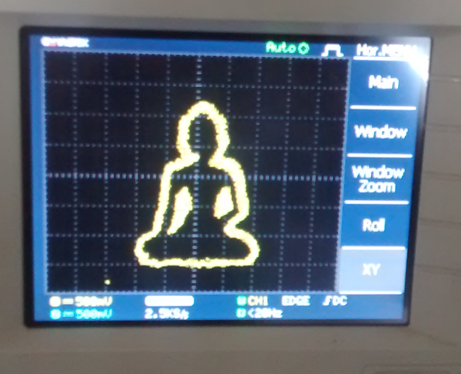
Brain of the Digital Painter - FPGA
Nexys 2
MATLAB - Xilinx Interface
L15
Exp Period = 81e-5
Count Limited = C_P
No Bits = to determine
K12
Exp Period = 20e-9
No of Bits = 8
1081 Coordinate points to plot Buddha
Set Sample rate = 2.5 KS / Sec in the DSO

Slide 58

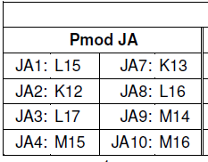
The End.....
May be a new Beginning

Slide 59


Questions
3:10 PM

Slide 60
Choose Heaven or Hell
Without any Choice
Then
Anything is Heaven
If Not
Every thing is Hell
Choicelessness is the Choice of Life
- ZENTILL
[ Dedicated to OSHO ]

Slide 61

Work not
for a Purpose
Work For
The Joy of Working
“ Take up a job you love not a day you will work”
- Thank You
Zentill [ ]
SSNCE /EEE/IC-WS/20-12-2009/S70

Slide 62
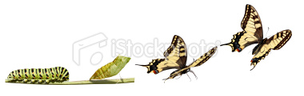
“Follow your heart. Being a caterpillar you will become a butterfly”
- ZnTill [ ]
உவப்பத் தலைக்கூடி உள்ளப் பிரிதல் அனைத்தே புலவர் தொழில்
உவப்பத் தலைக்கூடி உள்ளப் பிரிதல் அனைத்தே புலவர் தொழில்
உவப்பத் தலைக்கூடி உள்ளப் பிரிதல் அனைத்தே புலவர் தொழில்
Thank You …..
Zentill [ ]
3:20 PM

