Slide 1
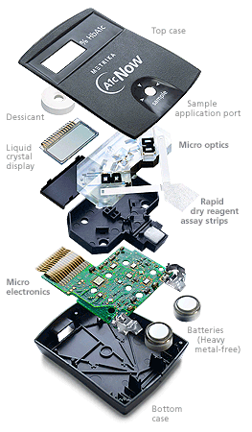
EE6301
Digital Electronics
ZENTILL
Number System - I
Lecture no -1
Teacher’s aren't to cover syllabus They are to uncover the subject .
Zentill
EE6301/L_No -1/2016/Zentill/1

Slide 2

Patten of flow
Jumping from the Heights of analog Electronics to the valley of Digital electronics
1)Points that will not be discussed in the class
a) About Electronic devices
b) About Electronics Circuits
For the reason these are the pre requisites for the registration of this course.
ZENTILL
Logics that’s are necessary to enter into the subject and the number systems which supports such Logics
Moving from the plane Of Transistors and Comos… to the Plane of Gates
Moving from the plane of Gates to the plane of Combinational logic – to work for a purpose which never refers the history of time
Moving from the plane of of Combinational logic – to the plane of Feed back loops (Flip Flop)
Moving from the plane of Flip Flops to the plane of Sequential logic – to work for a purpose which always refers the history of time in slots
Building
Block
Building
Block
EE6301/L_No -1/2016/Zentill/2

Slide 3
Logic and illogic – My Definition
That which the mind understands is logic and that which it cannot understand but still can accept is illogic.
Example of illogic is Life , Love,…….
These are my definitions of Logic and understandings but may be if I have not understood the actual definition of logic in which case my logic is illogic.
So this is a proof for Logic being illogic.
Einstein theory of relativity states that time exists because of the fact that no two events occur simultaneously and not that we exist in time. in which case the illogic is logic.
So this is a proof for Illogic being logic.
ZENTILL
EE6301/L_No -1/2016/Zentill/3

Slide 4
What is the Logic of Others………
* The formal principles of a branch of knowledge.
* A particular mode of reasoning viewed as valid or faulty.
* interrelation or sequence of facts or events when seen as inevitable
or predictable.
* The arrangement of circuit elements (as in a computer) needed for
computation
* The science of the formal principles of reasoning
ZENTILL
This Subject is So easy for the Fact that our Mind is a growth of reasoning and hence we know logic already. We are the Books of Digital electronics and no book can be a better substitute for the Mind. [The king of Logic]
EE6301/L_No -1/2016/Zentill/4

Slide 5
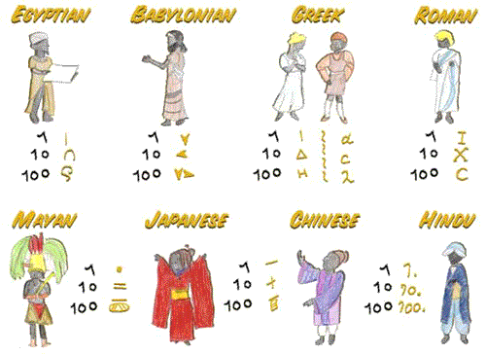
Introduction to Number systems
ZENTILL
EE6301/L_No -1/2016/Zentill/5

Slide 6
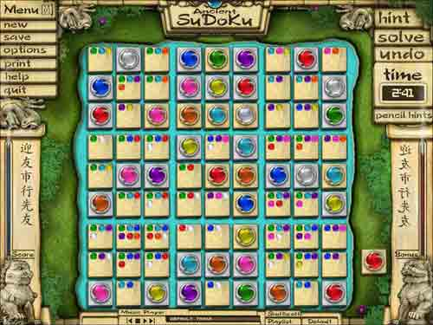
ZENTILL
EE6301/L_No -1/2016/Zentill/6

Slide 7
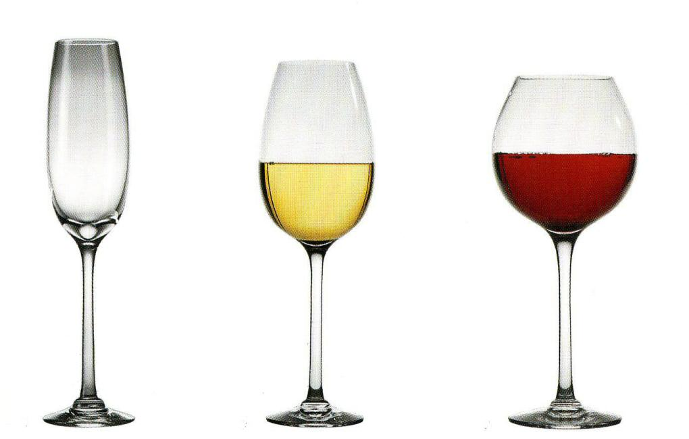
Into the Subject …….
ZENTILL
What is a Number ? What is a Code ?
@ Number is Quantity.
@ Code is that Which Carries an information.
CODE
NUMBER
INFORMATION
In General Number is the Content and the Code is the Container
Be Careful Number is not the only Content. Code is not that which carries only the Number.
EE6301/L_No -1/2016/Zentill/7

Slide 8
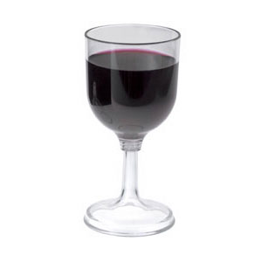
For Example……
People say this is A
But they have forgotten that this is a symbol which represents the Sound Vibration ……
A
ZENTILL
This A is a Code which carries the Sound Information A . Now in this case the Content is the Sound ….. And the Container is the Representation Code A
EE6301/L_No -1/2016/Zentill/8

Slide 9
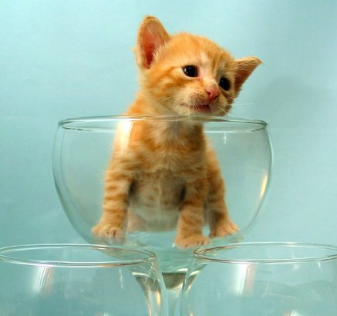
Example to confuse U ……
People say this is 2
But this is not the symbol which represents the Sound Vibration ……
But it represents the Quantity two.
2
ZENTILL
This 2 is a Code which carries the Number 2 . Now in this case the Content is quantity 2 And the Container is the Symbol 2
EE6301/L_No -1/2016/Zentill/9

Slide 10

Number System of Our Times..
Binary
2
Octal
8
ZENTILL
Decimal
10
Hexadecimal
16
EE6301/L_No -1/2016/Zentill/10

Slide 11
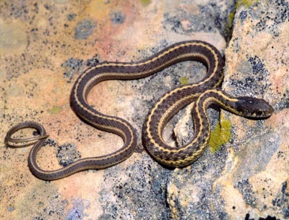
What forms the Basis Of a Number System?
RADIX
What is Radix?
Number of Unique symbols used separately or together in representing all Quantities from Zero to Infinity in a System.
Binary - Base is 2 [ 0,1]
Octal - Base is 8 [0,1,2,3,4,5,6,7]
Decimal - Base is 10 [0,1,2,3,4,5,6,7,8,9]
Hexadecimal - Base is 16 [0,1,2,3,4,5,6,7,8,9,A,B,C,D,E,F]
ZENTILL
Thamnophis radix
EE6301/L_No -1/2016/Zentill/11

Slide 12
Just an Information ……….
Ancient Numbering Systems
Babylonian Number System
In other words the number system is developed by working with base 60:
60^0 = 1
60^1 = 60
60^2 = 3600
60^3 = 216,000 . . . . . .
The Babylonian 5 53 18 would then represent the number
5*60^2 + 53*60^1 + 18*60^0 =
5*3600 + 53*60 + 18*1 = 18,000 + 3,180 + 18 = 21,198 (in our system).
ZENTILL
EE6301/L_No -1/2016/Zentill/12

Slide 13
Assigning Symbols to Quantities In Any Number System….
For Example Octal System
0 1, 2, 3, 4, 5, 6, 7,
10 11, 12, 13, 14, 15, 16, 17,
20 21, 22, 23, 24, 25, 26, 27,
30 31, 32, 33, 34, 35, 36, 37,…...
ZENTILL
In Octal The Quantity 8 is 10
For Example Hexadecimal System
0, 1, 2, 3, 4, 5, 6, 7, 8, 9, A, B, C, D, E, F,
10, 11, 12, 13, 14, 15, 16, 17, 18, 19, 1A, 1B, 1C, 1D, 1E ,1F,
20, 21, 22, 23, 24, 25, 26, 27,…………
In HD The Quantity 8 is 8 but 16 is 10
EE6301/L_No -1/2016/Zentill/13

Slide 14
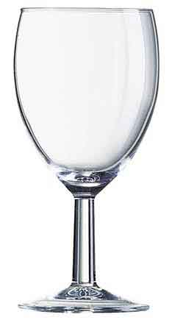
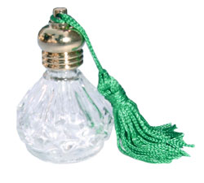

ZENTILL
15
10001
10
10
2
8
Same in Diferent Form
11
17
10
10
10
16
EE6301/L_No -1/2016/Zentill/14

Slide 15
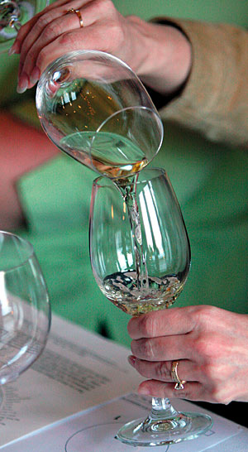

Conversion Between Number System…
Process of Finding the container in each of the number system which contains the same content.
ZENTILL
15
10001
10
10
2
8
10001
=
15
2
8
EE6301/L_No -1/2016/Zentill/15

Slide 16
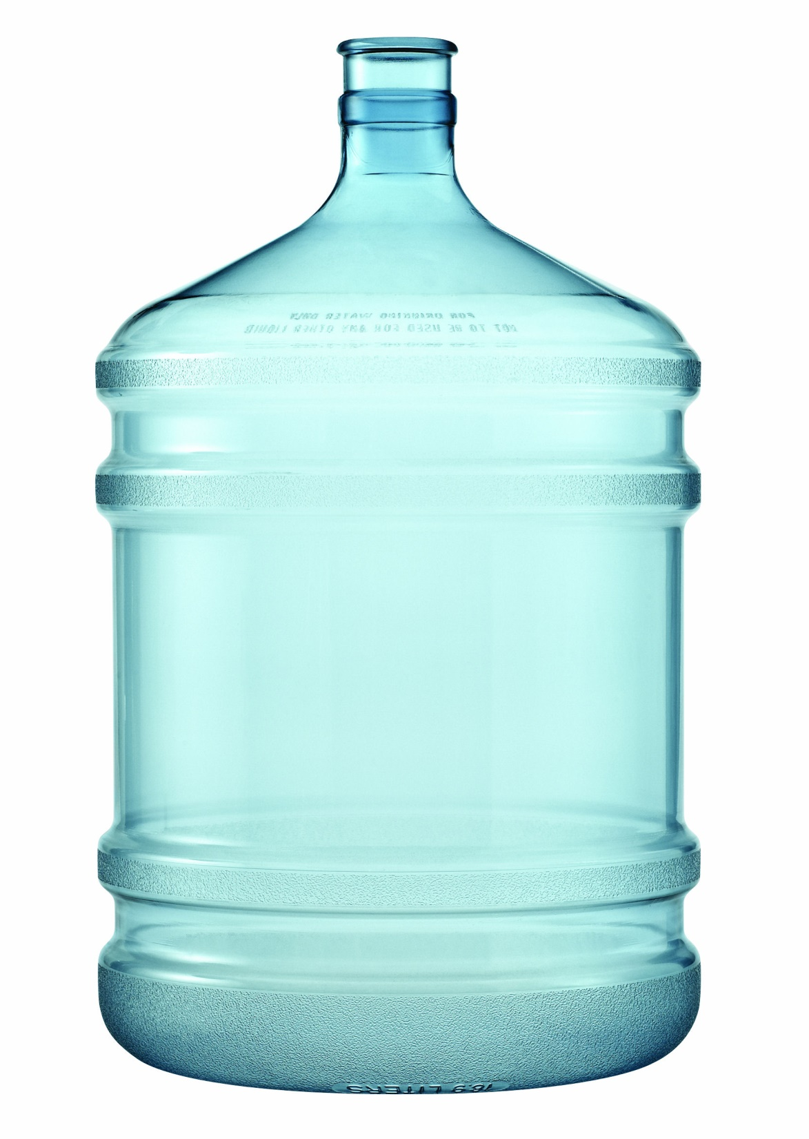
How to Do that for a Lage Number
ZENTILL
EE6301/L_No -1/2016/Zentill/16

Slide 17
Hexadecimal – To Other number Systems
Hexadecimal to Decimal
Convert the Given Hexadecimal number 163 ₁₆ to decimal number
163 ₁₆ = ? ₁₀
16
= 1 * (16)² + 6 * (16)¹ + 3* (16)⁰
= 1*256 + 6*16 + 3*1
= 355 ₁₀
10
ZENTILL
Convert the Given Hexadecimal number 16D ₁₆ to decimal number
16D ₁₆ = ? ₁₀
8
= 1 * (16)² + 6 * (16)¹ +13* (16)⁰
= 1*256 + 6*16 + 13*1
= 365 ₁₀
2
EE6301/L_No -1/2016/Zentill/17

Slide 18
2⁴ =16
Hexadecimal – To Other number Systems
2³ =8
Hex | Binary
0 | 0000
1 | 0001
2 | 0010
3 | 0011
4 | 0100
5 | 0101
6 | 0110
7 | 0111
8 | 1000
9 | 1001
A | 1010
B | 1011
C | 1000
D | 1101
E | 1110
F | 1111
Hexadecimal to Octal
Octal | Binary
0 | 000
1 | 001
2 | 010
3 | 011
4 | 100
5 | 101
6 | 110
7 | 111
163 ₁₆ = ? ₈
Look into the Chart1 and Expand Each Digit into its equivalent4 bit Binary number
ZENTILL
163 ₁₆ = 0001 0110 0011
Look into the Chart2 and Group Every 3 Digits and finds its equivalent Octal and Replace it
163 ₁₆ = 000 101 100 011
163 ₁₆ = 543 ₈
EE6301/L_No -1/2016/Zentill/18

Slide 19
Hexadecimal – To Other number Systems
Hex | Binary
0 | 0000
1 | 0001
2 | 0010
3 | 0011
4 | 0100
5 | 0101
6 | 0110
7 | 0111
8 | 1000
9 | 1001
A | 1010
B | 1011
C | 1000
D | 1101
E | 1110
F | 1111
Hexadecimal to Binary
163 ₁₆ = ? ₂
Look into the Chart1 and Expand Each Digit into its equivalent 4 bit Binary number
ZENTILL
163 ₁₆ = 0001 0110 0011
163 ₁₆ = 101100011 ₂
16D ₁₆ = ? ₂
16D ₁₆ = 0001 0110 1110
16D ₁₆ = 101101110 ₂
EE6301/L_No -1/2016/Zentill/19

Slide 20
Decimal – To Other number Systems
Decimal to Binary
Convert the Given Decimal number 163 ₁₀ to Binary number
163 ₁₀ = ? ₂
10
2
163
2
ZENTILL
81 - 1
40 - 1
20 - 0
8
10 - 0
5 - 0
163 ₁₀ = 10100011 ₂
2 - 1
1 - 0
16
EE6301/L_No -1/2016/Zentill/20

Slide 21
Decimal – To Other number Systems
Decimal to Octal
Convert the Given Decimal number 163 ₁₀ to Octal number
163 ₁₀ = ? ₈
8
163
ZENTILL
20 - 3
2 - 4
163 ₁₀ = 243 ₈
EE6301/L_No -1/2016/Zentill/21

Slide 22
Decimal – To Other number Systems
Decimal to Hexadecimal
Convert the Given Decimal number 163 ₁₀ to Hexadecimal number
163 ₁₀ = ? ₁₆
16
163
ZENTILL
10 (A) - 3
163 ₁₀ = A3 ₈
EE6301/L_No -1/2016/Zentill/22

Slide 23
Octal – To Other number Systems
Octal To Decimal
Convert the Given Octal number 163 ₈ to decimal number
163 ₈ = ? ₁₀
8
= 1 * (8)² + 6 * (8)¹ + 3* (8)⁰
= 1*64 + 6*8 + 3*1
= 155 ₁₀
10
ZENTILL
Convert the Given Octal number 612 ₈ to decimal number
612 ₈ = ? ₁₀
16
= 6 * (8)² + 1 * (8)¹ +2* (8)⁰
= 6*64 + 1*8 + 2*1
= 394 ₁₀
2
EE6301/L_No -1/2016/Zentill/23

Slide 24
2⁴ =16
Octal – To Other number Systems
2³ =8
Hex | Binary
0 | 0000
1 | 0001
2 | 0010
3 | 0011
4 | 0100
5 | 0101
6 | 0110
7 | 0111
8 | 1000
9 | 1001
A | 1010
B | 1011
C | 1000
D | 1101
E | 1110
F | 1111
Octal to Hexadecimal
Octal | Binary
0 | 000
1 | 001
2 | 010
3 | 011
4 | 100
5 | 101
6 | 110
7 | 111
163 ₈ = ? ₁₆
Look into the Chart2 and Expand Each Digit into its equivalent 3 bit Binary number
ZENTILL
163 ₈ = 001 110 011
Look into the Chart1 and Expand Each Digit into its equivalent 4 bit Binary number
163 ₈ = 0 0111 0011
163 ₈ = 73 ₁₆
EE6301/L_No -1/2007/Zentill/24

Slide 25
Octal– To Other number Systems
Octal | Binary
0 | 000
1 | 001
2 | 010
3 | 011
4 | 100
5 | 101
6 | 110
7 | 111
Octal to Binary
163 ₈ = ? ₂
Look into the Chart and Expand Each Digit into its equivalent 3 bit Binary number
ZENTILL
163 ₈ = 001 110 011
163 ₈ = 1110011 ₂
43 ₈ = 100 011
43 ₈ = 100011 ₂
EE6301/L_No -1/2016/Zentill/25

Slide 26
Binary – To Other number Systems
Binary To Decimal
2
Convert the Given Binary number 111011 ₂ to decimal number
111011 ₂ = ? ₁₀
= 1 * (2) ⁵+ 1 * (2) ⁴ + 1* (2) ³+0*(2) ² + 1*(2)¹+1*(2 ) ⁰
= 32 + 16 + 8+ 0+ 2 + 1
= 59 ₁₀
10
ZENTILL
Convert the Given Binary number 111111 ₂ to decimal number
1111111 ₂ = ? ₁₀
16
= 1*(2)⁶ + 1 * (2) ⁵+ 1 * (2) ⁴ + 1* (2) ³+1*(2) ² + 1*(2)¹+1*(2 ) ⁰
=64 +32 + 16 + 8+ 4 + 2 + 1
= 127 ₁₀
8
EE6301/L_No -1/2016/Zentill/26

Slide 27
2⁴ =16
Binary – To Other number Systems
Hex | Binary
0 | 0000
1 | 0001
2 | 0010
3 | 0011
4 | 0100
5 | 0101
6 | 0110
7 | 0111
8 | 1000
9 | 1001
A | 1010
B | 1011
C | 1000
D | 1101
E | 1110
F | 1111
Binary to Hexadecimal
111011₂ = ? ₁₆
Group 4 Digit from LSB and find its Equivalent Hex Code ….
0011 1011
ZENTILL
3 B
111011₂ = 3B ₁₆
EE6301/L_No -1/2016/Zentill/27

Slide 28
Binary – To Other number Systems
Octal | Binary
0 | 000
1 | 001
2 | 010
3 | 011
4 | 100
5 | 101
6 | 110
7 | 111
Binary to Octal
111011₂ = ? ₈
Group 3 Digit from LSB and find its Equivalent Oct Code ….
ZENTILL
111 011
111011₂ = 73 ₈
EE6301/L_No -1/2016/Zentill/28

Slide 29
Simple Mathematics for any number system Exp : ₍₃₎
0 1 2
0 1 2
0
1
2
0 | 1 | 2
1 | 2 | 0 & 1
2 | 0 & 1 | 1 & 1
S
0
1
2
0 | 2 & 1 | 1 & 1
1 | 0 | 2 & 1
2 | 1 | 0
C
Addition a+b
0 1 2
Subtraction a- b
0
1
2
0 | 0 | 0
0 | 1 | 2
0 | 2 | 1 & 1
ZENTILL
Multiplication a * b
EE6301/L_No -1/2016/Zentill/29

Slide 30
General Method For Conversion…
Sounds Difficult than it is really
Iterative Method → Work out on your Own…………..
Polynomial Method
Equation governing the value in a number system
ZENTILL
N_{(r1)} = d _{n-1} _{(r1)} * r1 ^{(n-1)} _{(r1)} +………….+d₀ _{(r1)} * r1⁰_{(r1)} + d_{-1 (r1)} * r1⁻¹ _{(r1)}
+ … ……………………….d _{- m} _{(r1)} * r ^{- m} _{(r1)}
Where
d_{(n-1) (r1)} → Indicates the digit in ( n-1)^{th} position in the particular radix system
r1_{(r1)} → Indicates the base in its own system
EE6301/L_No -1/2016/Zentill/30

Slide 31
Note:
if one tries representing r1 in its own system it always happens to be [10]
Hence the Previous equation can be always written as
N_{(r1)} = d _{n-1} _{(r1)} * 10 ^{(n-1)} _{(r1)} +………….+d₀ _{(r1)} * 10 ⁰_{(r1)} + d_{-1 (r1)} * 10 ⁻¹ _{(r1)}
+ … ……………………….d _{- m} _{(r1)} * 10 ^{- m} _{(r1)}
ZENTILL
Understanding the equation governing the value in a number system … its quite simple to evolve a generalized procedure for conversion between number systems.
Method :
Replace all the variables in the RHS of the equation by its equivalent symbols in the base (r2) to which we need to convert →
EE6301/L_No -1/2016/Zentill/31

Slide 32
Sample Problems - I
Convert the given Binary to its Ternary System…
11101 ₍₂₎ = ? ₍₃₎
Writing the governing equation in (r1) ……System
= 1 ₍₂₎ * 10 ⁴ ₍₂₎ + 1 ₍₂₎ * 10 ³ ₍₂₎ + 1₍₂₎ * 10 ² ₍₂₎ +
0 * 10 ¹ ₍₂₎ +1 * 10 ⁰ ₍₂₎
Re writing the equation in the (r2) …System
= 1₍₃₎ * 2 ⁴ ₍₃₎ + 1 ₍₃₎ * 2 ³ ₍₃₎ + 1₍₃₎ * 2 ² ₍₃₎ + 0 * 2¹ ₍₃₎
+ 1₍₃₎ * 2 ⁰ ₍₃₎
ZENTILL
EE6301/L_No -1/2016/Zentill/32

Slide 33
Value | Ternary
0 | 0
1 | 1
2 | 2
3 | 10
4 | 11
5 | 12
6 | 20
7 | 21
8 | 22
9 | 100
10 | 101
11 | 102
12 | 110
13 | 111
14 | 112
15 | 120
16 | 121
17 | 122
Value | Ternary
18 | 200
19 | 201
20 | 202
21 | 210
22 | 211
23 | 212
24 | 222
25 | 1000
26 | 1001
27 | 1002
28 | 1010
29 | 1002
30
31
1 * 121 + 1 * 22 + 1 * 11 +
0 * 2 + 1 * 1
121 +22 +11 + 0 +1
1002 ₍₃₎
ZENTILL
EE6301/L_No -1/2016/Zentill/33

Slide 34
Sample Problems - II
Convert the given Ternary to its Binary Equ…
222 ₍₃₎ = ? ₍₂₎
Writing the governing equation in (r1) ……System
= 2 ₍₃₎ * 10 ² ₍₃₎ + 2 ₍₃₎ * 10 ¹ ₍₃₎ + 2 ₍₃₎ * 10 ⁰ ₍₃₎
Re writing the equation in the (r2) …System
= 10₍₂₎ * 11 ² ₍₂₎ + 10₍₂₎ * 11¹ ₍₂₎ + 10*11⁰ ₍₂₎
= 10 * 1001 + 10* 11 +10
= 11010₍₂₎
ZENTILL
EE6301/L_No -1/2016/Zentill/34

Slide 35

Nanin
Says “ Empty the Cup…. “
Osho
Says “ Break the Cup… “
I Say
“The Class Is Over …Find your way out….”
ZENTILL
EE6301/L_No -1/2016/Zentill/35

Slide 36

Thank U
“ if U have Understood “
Sorry
“ if U have Not”
“ Its Better not be Dependent on others
Just Find Ur Way”
→ ZENTILL
Ec1312/L_No -1/2007/Zentill/36

