Slide 1
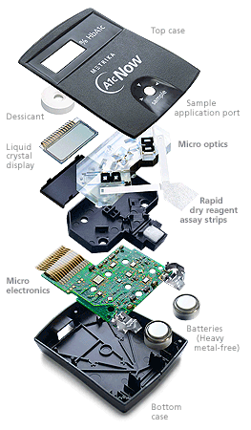
EE6301
Digital Electronics
ZENTILL
Number System – II
[ Arithmetic's for the Processor ]
Lecture no -2
Teacher’s aren't to cover syllabus They are to uncover the subject .
Zentill
EE6301/L_No -2/2016/Zentill/1

Slide 2

Classification Of Number Systems
Number System Which has Weighted values for each position is known as Positional Number Systems
Non Positional
Number systems
Positional
Number Systems
ZENTILL
Number
Systems
Number System Which has No Weighted values for each position (Digit ) is known as Non Positional Number Systems
EE6301/L_No -2/2016/Zentill/2

Slide 3
Positional Number Systems
Equation that Governs all the Positional Number Systems ….
N = d _{n-1} * r ^{n-1} + d _{n-2} * r ^{n-2} +…………..d₀ * r⁰ + d₋₁* r⁻¹ +…….d_{-m}* r^{-m}
Where N → Is the Value (Quantity) Indicated by the Representation…..
r → Base of the Number System
d_{n}→ Digit at the n^{th} Position
n→ Position of the Digit { Variable from ( inf ……, 2, 1, 0 -1, 2 ,……- inf) }
Note: LSB of the Number indicates the zero^{th} position and increases towards the MSB ….
if the number contains fractional values then the Position before the fractional value (decimal point) is Zero and the Position after the fractional value is -1 and decreases towards the Left….
ZENTILL
EE6301/L_No -2/2016/Zentill/3

Slide 4
For Example ………..Binary Number
1101.101₍₂₎ → The Value it indicates is calculated as …..
= 1 * 2 ³ + 1 * 2 ² + 0 * 2 ¹+ 1 * 2⁰ +1 * 2 ⁻¹ + 0 * 2 ⁻² + 1 * 2 ⁻³
= 8 + 4 + 0 + 1 + 0.5 + 0 + 0.125
= 13.625
347.427₍₈₎ → The Value it Indicates is calculated as …..
= 3 * 8 ² + 4 * 8 ¹ + 7 * 8 ⁰ +4 * 8 ⁻¹ +2 * 8 ⁻² + 7 * 8⁻³
= 192 +32 +7 +0.5 +0.3125 +0.0136
= 231.8261
ZENTILL
EE6301/L_No -2/2016/Zentill/4

Slide 5
All the Number System that we studied in Day – 1 are positional Number Systems…….
Octal (8), Hexadecimal (16) , Decimal(10) , Binary(2) ,Ternary(3) , Quaternary(4) , Quinary(5) , Duodecimal (12)
Imagine a Non positional Number System……
ROMAN NUMBER SYSTEM
ZENTILL
EE6301/L_No -2/2016/Zentill/5

Slide 6
Mathematics of the Processor ……………….
Processor Knows Only to add……….
  The whole Idea till now was to represent the magnitude
  of a number in a Computer ( Binary System).
  Now the Mind Has to turn and Look around to find a way
  to represent The Sign (ie Negative numbers …) in a
  Computer
ZENTILL
  Don’t think its as simple as we do it with a Paper… [-34]
EE6301/L_No -2/2016/Zentill/6

Slide 7

Normal Graphical Representation of Negative Numbers ( on a Graph Sheet)
3
ZENTILL
- 3
EE6301/L_No -2/2016/Zentill/7

Slide 8


Graphical Representation of Negative Numbers
( on a Computer Architecture Sheet)
12 *
-3
3
ZENTILL
Offset Origin
True Origin
EE6301/L_No -2/2016/Zentill/8

Slide 9
Concept of Sign Bit…………………
12 *
ZENTILL
-3
3
Offset Origin
True Origin
0
0
0
0
0
0
1
1
1
0
0
0
1
1
0
0
MSB → Sign Bit : 0 ( +) , 1 (-)
So we can say 12* to be the complement of 3 in our work
EE6301/L_No -2/2016/Zentill/9

Slide 10

Standard Complements In The Book of Engineers
ZENTILL
Radix -1 Complement
Diminished Complement
Radix Complement
True Complement
25
24
EE6301/L_No -2/2016/Zentill/10

Slide 11
Turning the Page…………….. For Tuning your Mind
ZENTILL
---------
---------
---------
----------
---------
--------
-------------------------------------
-------------------------------
---------------------------
Radix Complement
True Complement
25
27
24
EE6301/L_No -2/2016/Zentill/11

Slide 12
(r-1) ^{s} Complement of N
= ( r^{n} – r ^{-m} – N )
Where
n = number of digits in N
N= number rep in the system
r= radix represented in its Base
m= number of fractional digit
r^{s} Complement of N
= ( r^{n} – N )
Where
n = number of digits in N
N= number rep in the system
r= radix represented in its Base
Alter :
(r-1) ^{s} Complement + 1
ZENTILL
26
27
EE6301/L_No -2/2016/Zentill/12

Slide 13
Sample Problem – I ……. In the Defined Way
123 ₍₁₀₎ ^{s} r ^{s} Complement ? → 10 ^{s} Complement
10³ -123 = 1000 -123
= 877
123₍₁₀₎ ^{s} ( r-1)^{s} Complement ? → 9 ^{s} Complement
10 ³ - 10⁻² - 123 = 1000 – 1 -123
= 999 -123
= 876
ZENTILL
EE6301/L_No -2/2016/Zentill/13

Slide 14
Sample Problem – I ……. By Observation
123 ₍₁₀₎ ^{s} r-1 ^{s} Complement ? → 9 ^{s} Complement
= 8 7 6 (9 -3)
(9-2)
(9-1)
123₍₁₀₎ ^{s} r ^{s} Complement ? → 10 ^{s} Complement
= 8 7 6 +1
= 8 7 7
ZENTILL
(r-1)^{s} Complement
EE6301/L_No -2/2016/Zentill/14

Slide 15
Sample Problem – II ……. In the Defined Way
1101 ₍₂₎ ^{s} r ^{s} Complement ? → 2 ^{s} Complement
10 ⁴ - 1101 = 10000 - 1101
= 0011
1101₍₂₎ ^{s} ( r-1)^{s} Complement ? → 1 ^{s} Complement
10 ⁴ - 10⁻³ - 123 = 1000 –1101
= 1111- 1101
= 10
ZENTILL
EE6301/L_No -2/2016/Zentill/15

Slide 16
Sample Problem – II ……. By Observation
1101 ₍₂₎ ^{s} r-1 ^{s} Complement ? → 1 ^{s} Complement
= 0 0 1 0 (1 -1)
(1-0)
(1-1)
(1-1)
1101₍₂₎ ^{s} r ^{s} Complement ? → 2 ^{s} Complement
= 0010 +1
= 0011
By inference we find that the Ones Complement of a Binary number can be obtained by just inverting each bit in the stream Given…….
ZENTILL
(r-1)^{s} Complement
EE6301/L_No -2/2016/Zentill/16

Slide 17
Subtraction made possible through Addition
Fitting to the abilities of the Processor.
Subtraction through r ^{s} Complement
Procedure:
1) N1 - N2 [ to be obtained]
2) Find N2 ( N2 is r ^{s} complement of the number)
3) N1 + N2
4) If Carry is Generated at MSB then By ignoring the carry we get the answer
If No Carry is Generated at MSB then the answer is the r ^{s} complement of
the expected answer
ZENTILL
EE6301/L_No -2/2016/Zentill/17

Slide 18
Subtraction made possible through Addition
Fitting to the abilities of the Processor.
Subtraction through r-1 ^{s} Complement
Procedure:
1) N1 - N2 [ to be obtained]
2) Find N2 ( N2 is r-1 ^{s} complement of the number)
3) N1 + N2
4) If Carry is Generated at MSB then By adding the carry to the LSB we get the answer
If No Carry is Generated at MSB then the answer is the r-1 ^{s} complement of the expected answer.
ZENTILL
EE6301/L_No -2/2016/Zentill/18

Slide 19
Sample Problem – I [ r ^{s} complement Subtraction]
575₍₁₀₎ -146₍₁₀₎
Find 146 = 853 +1 = 854
575 + 854 = 1 429
Carry Generated thus the answer is 429.
ZENTILL
Sample Problem – II [ r ^{s} complement Subtraction]
146₍₁₀₎ -575 ₍₁₀₎
Find 575 = 424 +1 = 425
146 + 425 = 571
No Carry Generated so the the answer is r ^{s} Complement of the Obtained Result. 571 = 428 + 1 = 429
EE6301/L_No -2/2016/Zentill/19

Slide 20
Sample Problem – I [ r-1 ^{s} complement Subtraction]
110₍₂₎ -011₍₂₎
Find 011₍₂₎ = 100 ₍₂₎
110 ₍₂₎ + 100 ₍₂₎ = 1 010 ₍₂₎
Carry Generated hence the answer is 010 ₍₂₎ + 1 = 11 ₍₂₎
ZENTILL
Sample Problem – II [ r-1 ^{s} complement Subtraction]
011₍₂₎ -100₍₂₎
Find 100₍₂₎ = 001 ₍₂₎
011 ₍₂₎ + 001 ₍₂₎ = 100 ₍₂₎
No Carry Generated hence the answer is (r-1) ^{s} Complement of the expected answer. 100 = 011 ₍₂₎
EE6301/L_No -2/2016/Zentill/20

Slide 21
Once again Conversion --- To be in touch
7D. 6 A ₍₁₆₎ = ? ₍₁₀₎
= 7 * 10 ¹ + D * 10 ⁰ + 6 * 10 ⁻¹ + A * 10 ⁻² [ Base – 16 ]
= 7 * 16 ¹ + 13 * 16 ⁰ + 6 * 16 ⁻¹ + 10 * 16 ⁻² [Base –10]
= 112 + 13 + 0.375 + 0.0390625
= 125.4140625 ₍₁₀₎
ZENTILL
7D. 6 A ₍₁₆₎ = ? ₍₈₎
= 7 * 10 ¹ + D * 10 ⁰ + 6 * 10 ⁻¹ + A * 10 ⁻² [ Base – 16 ]
= 7 * 20 ¹ + 15 * 20 ⁰ + 6 * 20 ⁻¹ + 12 * 20 ⁻² [Base –8]
= 160 + 15 + 0.3 + 0.02
= 175.32 ₍₈₎
EE6301/L_No -2/2016/Zentill/21

Slide 22
B₍₃₎ | B₍₉₎
0 | 0
1 | 1
2 | 2
10 | 3
11 | 4
12 | 5
20 | 6
21 | 7
22 | 8
21021₍₃₎ = ? ₍₉₎
Writing the governing equation in (r1) ……System
= 2₍₃₎* 10 ⁴₍₃₎ + 1₍₃₎* 10 ³₍₃₎+ 0₍₃₎ * 10 ² ₍₃₎ + 2₍₃₎ * 10 ¹₍₃₎ + 1₍₃₎ * 10 ⁰ ₍₃₎
Re writing the equation in the (r2) …System
= 2₍₉₎* 3 ⁴ ₍₉₎ + 1₍₉₎* 3 ³₍₉₎+ 0₍₉₎ * 3 ²₍₉₎ + 2 ₍₉₎ * 3 ¹₍₉₎ + 1₍₉₎ * 3 ⁰₍₉₎
= 2 * 90 + 1 * 30 + 0 * 10 + 2 * 3 + 1 * 1
= 180 + 30 + 0 + 6 + 1
= 237 ₍₉₎
ZENTILL
Work made simple through inference from
Ec1312/L_No -1/2007/Zentill/28
3² = 9
02 10 21
2 3 7 ₍₉₎
From Table
EE6301/L_No -2/2016/Zentill/22

Slide 23
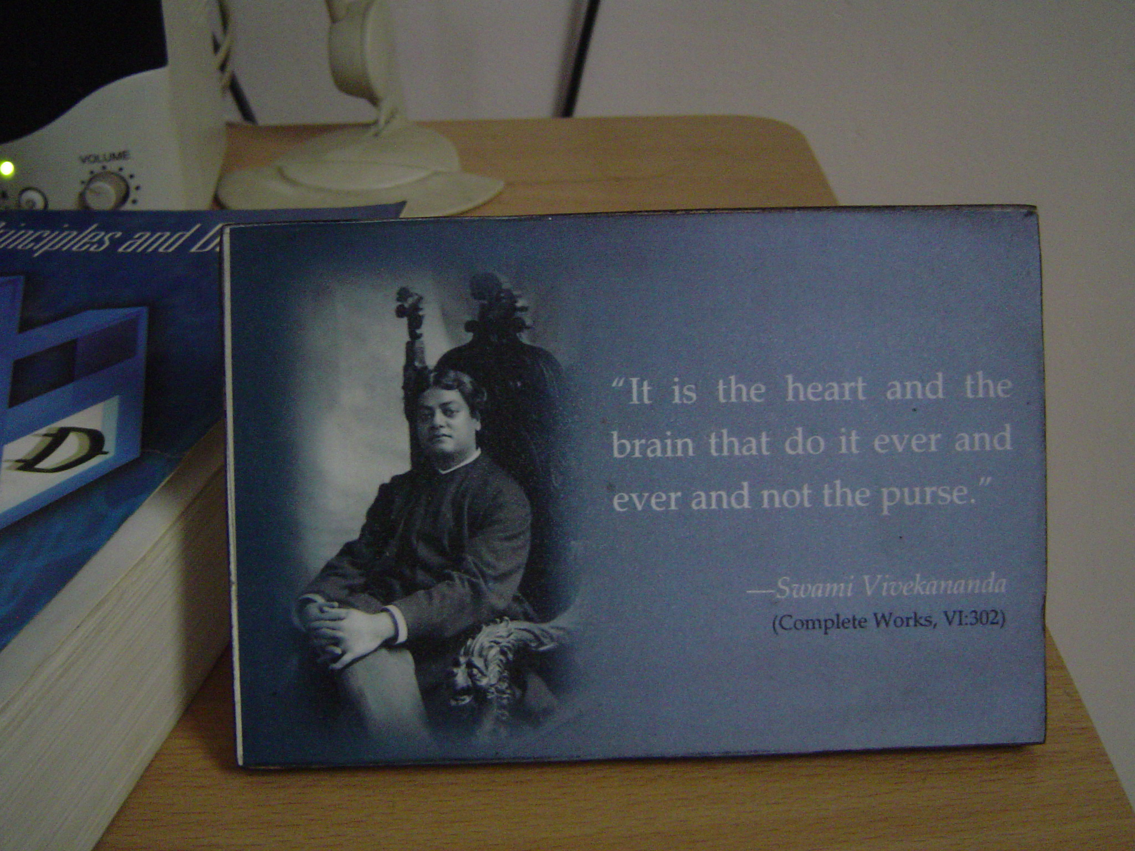
ZENTILL
EE6301/L_No -2/2016/Zentill/23

Slide 24

Work not
for a Purpose
Work For
The Joy of Working
“ Take up a job you love not a day you will work”
- Thank You
EE6301/L_No -2/2016/Zentill/24

