Slide 1



Knowledge is Collection of Dead Facts and Information
Knowing is Melting of Mind into the Unknown
Knowledge is Someone Else's Knowing
Knowing is Your Knowledge
[ ZENTILL]
SSNCE /EEE/IC-WS/20-12-2009/S0

Slide 2
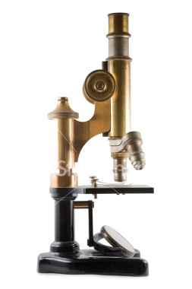

GENETIC - ALGORITHMS
GAME OF DIES & COINS
PRESENTED
By
M.SENTHIL KUMARAN [ ZENTILL]
BASED ON
SSNCE /EEE/IC-WS/20-12-2009/S1

Slide 3








Terminologies - of - GA
Population
Chromosome
Genes
Evaluation Function
Next Generation
Crossover
Offspring
Mutation
Inversion
SSNCE /EEE/IC-WS/20-12-2009/S2

Slide 4





Total Population
Collection of several alternative solutions to a given problem
Initial Population size
Determines the amount of information stored in GA
Initial Population Selection
Is Selected on a Random Probability - PI
Population evolves over a number of generations
SSNCE /EEE/IC-WS/20-12-2009/S3

Slide 5


Chromosome
Each individual in a population is called String or Chromosome
Chromosome – Coding
Chromosomes are coded usually in binary
Chromosome length
Is decided by the user – more the string length [finer the resolution and hence greater chance to be nearer to the solution]
1 | 1 | 0 | 0 | 0 | 0 | 1 | 0 | 1 | 1 | 1 | 0 | 1 | 1
SSNCE /EEE/IC-WS/20-12-2009/S4

Slide 6


Gene
Individual character or symbol of a Chromosome or string is known as Gene
1
1
0
0
0
0
1
1
1
1
0
1
1
Chromosome
0
Gene
SSNCE /EEE/IC-WS/20-12-2009/S5

Slide 7
Mapping the Search Space
0
2 Power (String Length)
X_{(L)}
0
6
X_{(H)}
Expected Value of X = X_{(L)} + [X_{(H)} – X_{(L)} ]/ [ 2^{L} -1 ] * Decoded Value of Binary String
SSNCE /EEE/IC-WS/20-12-2009/S6

Slide 8



Evaluation Function – Fitness Function
The function that evaluates the fitness of each candidate solution
Fitness function [ Maximization]
The objective function becomes the Fitness function
fitness_function[x]= f(x)
Fitness function [ Minimization]
The objective function is modified
fitness_function[x]= [1/1+f(x)]
SSNCE /EEE/IC-WS/20-12-2009/S7

Slide 9


Next Generation – Selection [ Roulette - Wheel ]
Types : roulette wheel , stochastic universal selection ,tournament selection
Selection : one of the key operations in Genetic Algorithms
Based on survival of the fittest
Selection Process:
(1) Based on random selection
(2) Probability of selection of each individual is proportional to its fitness evaluated
SSNCE /EEE/IC-WS/20-12-2009/S8

Slide 10

I4
I1
I2
I5
I3
I4
Selection
SSNCE /EEE/IC-WS/20-12-2009/S9

Slide 11


Parents – Selection [ Random ]
Parents :
Pair the individuals randomly to form parents for the next
generation
SSNCE /EEE/IC-WS/20-12-2009/S10

Slide 12
Crossover
Crossover is a process of exchange of sub strings between the selected parents
The position and length of sub string is decided by the type of cross over performed – Probability of cross over [Pc] – [ Large]
Types of Crossover
Single Point Cross Over , Multi Point Cross Over, Uniform Cross Over
Parents
Offspring's
Random – site selection
Cross Over probability -80%
P1
1 | 1 | 0 | 0 | 0 | 0 | 1 | 0 | 1 | 1 | 1 | 0 | 1 | 1
O1
1 | 1 | 0 | 0 | 0 | 1 | 0 | 0 | 0 | 0 | 1 | 0 | 1 | 0
P2
1 | 1 | 1 | 0 | 1 | 1 | 0 | 0 | 0 | 0 | 1 | 0 | 1 | 0
O2
1 | 1 | 1 | 0 | 1 | 0 | 1 | 0 | 1 | 1 | 1 | 0 | 1 | 1
SSNCE /EEE/IC-WS/20-12-2009/S11

Slide 13



1
1
1
0
1
1
0
0
0
0
1
0
1
0
1
1
0
0
0
0
1
0
1
1
1
0
1
1
Cross OVER
SSNCE /EEE/IC-WS/20-12-2009/S12

Slide 14


Mutation
Mutation :
is an operation performed on each gene in a chromosome
Mutation Process :
with a random probability of PM – [Low] each gene in the chromosome is altered
In case of binary coded chromosome [ bits are flipped]
In case of other systems a new character is formed randomly
Before Mutation - 110100010011
After Mutation - 110000010011
Mutation probability -5%
SSNCE /EEE/IC-WS/20-12-2009/S13

Slide 15
1
1
1
0
1
1
0
0
0
0
1
0
1
0
0
Mutation
SSNCE /EEE/IC-WS/20-12-2009/S14

Slide 16


Do we Know
SSNCE /EEE/IC-WS/20-12-2009/S15

Slide 17
Initial population
SSNCE /EEE/IC-WS/20-12-2009/S16

Slide 18
Select
SSNCE /EEE/IC-WS/20-12-2009/S17

Slide 19

Crossover
SSNCE /EEE/IC-WS/20-12-2009/S18

Slide 20
Another Crossover
SSNCE /EEE/IC-WS/20-12-2009/S19

Slide 21
Mutation
SSNCE /EEE/IC-WS/20-12-2009/S20

Slide 22
Another Mutation
SSNCE /EEE/IC-WS/20-12-2009/S21

Slide 23
Old population + Children
SSNCE /EEE/IC-WS/20-12-2009/S22

Slide 24
New Population: Generation 2
SSNCE /EEE/IC-WS/20-12-2009/S23

Slide 25
Generation 3
SSNCE /EEE/IC-WS/20-12-2009/S24

Slide 26
Generation 4, etc…
SSNCE /EEE/IC-WS/20-12-2009/S25

Slide 27
After
500
Generations
SSNCE /EEE/IC-WS/20-12-2009/S26

Slide 28
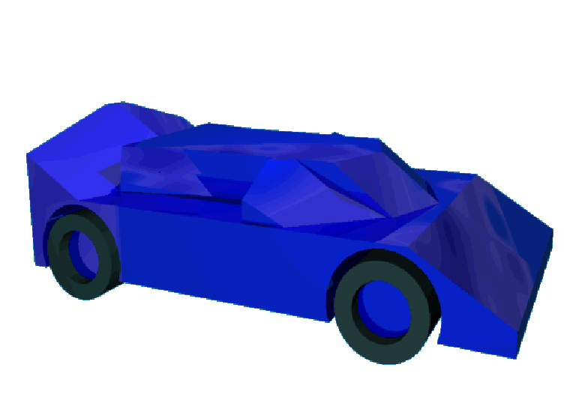
SSNCE /EEE/IC-WS/20-12-2009/S27

Slide 29
After
550
Generations
SSNCE /EEE/IC-WS/20-12-2009/S28

Slide 30

SSNCE /EEE/IC-WS/20-12-2009/S29

Slide 31
Benefits of Genetic Algorithms
Concept is easy to understand
Modular, separate from application
Supports multi-objective optimization
Good for “noisy” environments
Always an answer; answer gets better with time
Inherently parallel; easily distributed
SSNCE /EEE/IC-WS/20-12-2009/S30

Slide 32



Using The GA Tool In MatLab
Using The Graphical Editor
Using the Inbuilt Functions
SSNCE /EEE/IC-WS/20-12-2009/S31

Slide 33
Problem Used for Optimization Using GA
Source:
Book Title:
Optimization Techniques for Solving Engineering Problem
Author
Kalyanmoi Deb
Problem:
F( x1 , x2 ) = (x₁ ² + x₂ – 11) ² + (x₁ + x₂² – 7) ²
Boundary condition:
0 < x₁ , x₂ <6
Solution:
x₁ = 3 , x₂ = 2
SSNCE /EEE/IC-WS/20-12-2009/S32

Slide 34
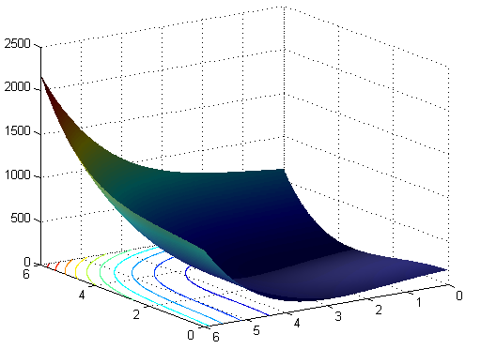
Graph Indicating all possible solutions for all possible combination of the input variable x₁ and x₂
SSNCE /EEE/IC-WS/20-12-2009/S33

Slide 35

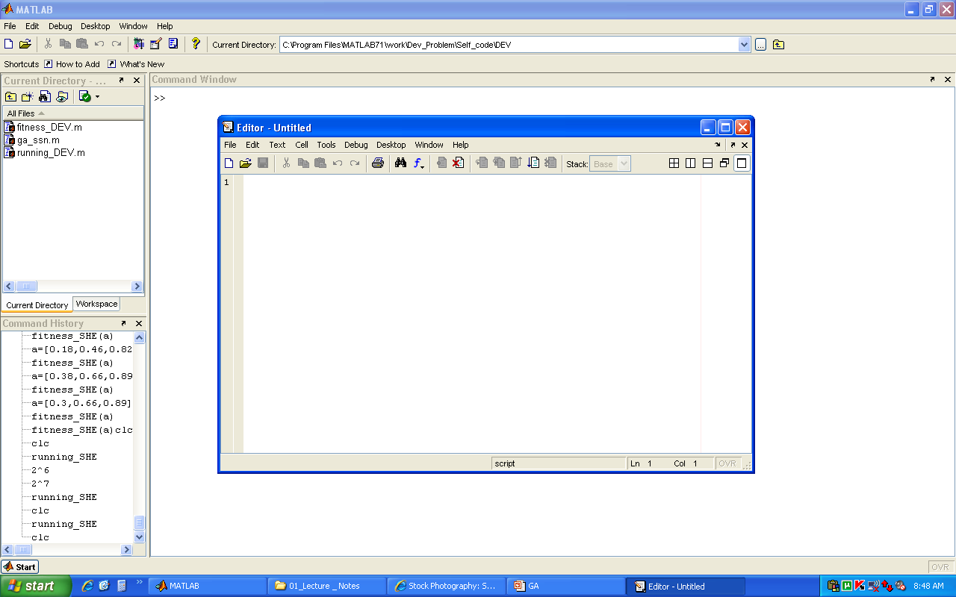
USING GATOOL GUI
Creating a MFILE To Write the Fitness Function
Step - 1
Note: Click on the File→ New→MFile an Proceed
SSNCE /EEE/IC-WS/20-12-2009/S34

Slide 36
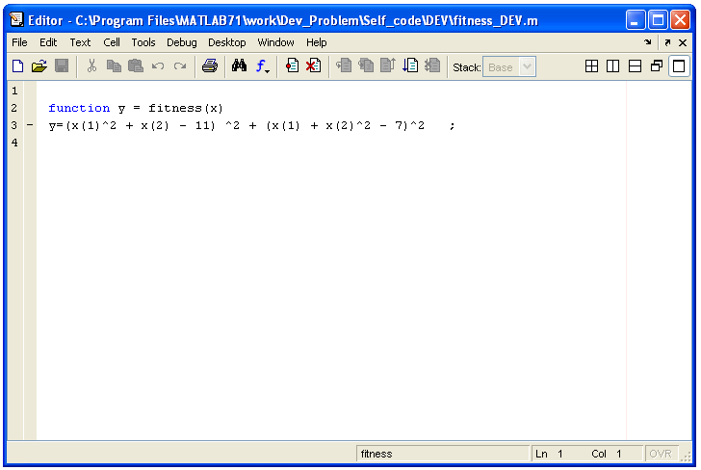
Writing to the MFILE the Fitness Function
Step - 2
Note: Where x is an Array of All The Variables of the Function
SSNCE /EEE/IC-WS/20-12-2009/S35

Slide 37
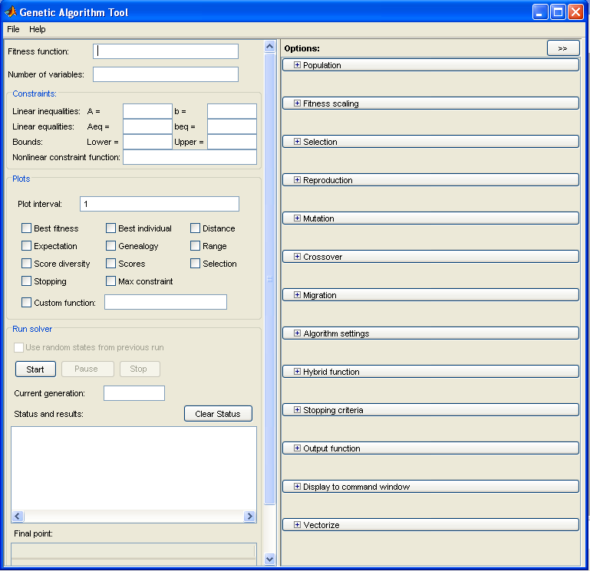
Opening the GA Tool GUI
Step - 3
Note: Type on the Command Prompt gatool
Note:
Version 7
Gatool contains Unconstrained Optimization
Version 7.1
Gatool contains Constrained Optimization
Version 2007Rb
Gatool contains Constrained Multiple Objective Optimization
SSNCE /EEE/IC-WS/20-12-2009/S36

Slide 38

Minimum Inputs Required To run the GATOOL
Create a Handle to the Fitness Function Created
Step - 4
@fitness
Set the number of variables of the fitness Function
2
Other Inputs are Set to Default
→ if needed can be changed according to the need
SSNCE /EEE/IC-WS/20-12-2009/S37

Slide 39

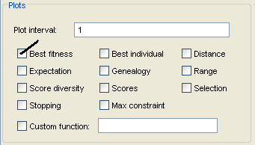
Setting the Output Graphs from GATool GUI for knowing the Process of Evolution
Step - 5
NOTE : Click the needed check box of the plot Frame
SSNCE /EEE/IC-WS/20-12-2009/S38

Slide 40
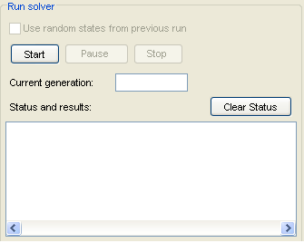
Running the GA Tool
Step - 6
NOTE : Click the Start button on the Run Solver Frame
SSNCE /EEE/IC-WS/20-12-2009/S39

Slide 41
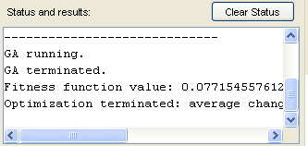

Observing the Results of the GA Tool GUI
Status – Terminating Condition
Step - 7
Final Result
SSNCE /EEE/IC-WS/20-12-2009/S40

Slide 42
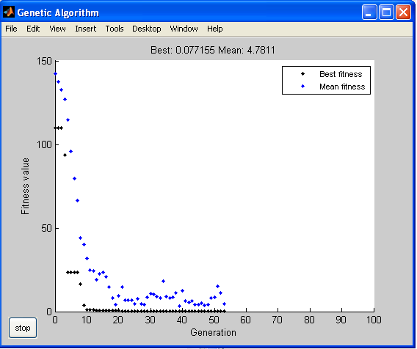
Observing the Way the Solution was attained
Step - 8
SSNCE /EEE/IC-WS/20-12-2009/S41

Slide 43

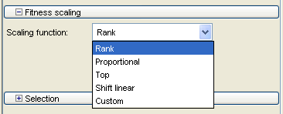
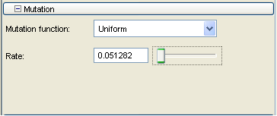
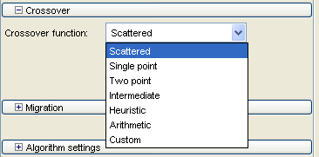
Changing other parameters in tune to your problem
Step - 9
SSNCE /EEE/IC-WS/20-12-2009/S42

Slide 44

END
OF
USING
GATOOL -GUI
Step - 10
SSNCE /EEE/IC-WS/20-12-2009/S43

Slide 45

USING MATLAB INBUILT GA FUNCTIONS
Follow Step -1 and Step -2 of the Previous Discussion
Open an another M file and Write the following Code
ObjectiveFunction = @fitness;
nvars = 2; % Number of variables
[x,fval] = ga(ObjectiveFunction,nvars)
Step - 3
Execute the Created M File To get the ans on the Command Prompt
SSNCE /EEE/IC-WS/20-12-2009/S44

Slide 46
Use GAOPTIMSET Function to Change GA OPTIONS
Step - 4
options = gaoptimset('PopulationSize', 1000,'StallTimeLimit',100)
[x,fval] = ga(ObjectiveFunction,nvars,options)
NOTE : Many other parameters can be changed
To know all the available Parameters Type gaoptimset on the command prompt
SSNCE /EEE/IC-WS/20-12-2009/S45

Slide 47
END
OF
USING
GA INBUILT FUNCTIONS
Step - 5
SSNCE /EEE/IC-WS/20-12-2009/S46

Slide 48


SSNCE /EEE/IC-WS/20-12-2009/S47

Slide 49
Programming - Genetic Algorithm
M.Senthil Kumaran [Zentill]
SSNCE /EEE/IC-WS/20-12-2009/S48

Slide 50
Flow – Chart
Generate Initial Population
Evaluate Each Individual
Select Np Individuals with repetition ,such that the probability of selection
Of each individual is proportional to its fitness
Pair the individuals randomly to form parents
With high probability Pc Perform cross over on the pairs to generate two offspring.
If cross over is not performed then the parents are copied unchanged to the offspring.
Mutate the offspring with a small Probability PM
Replace all individuals of the previous generation
With Np Offspring.
No
Stopping criterion
Met?
yes
SSNCE /EEE/IC-WS/20-12-2009/S49

Slide 51



Language of Programming - "MatLab - M File"
Program - structure
Input Values
Input _Program
Inputs Value to Function
Main _Function
Operates on the Input Values
& writes the results of Each Generation to
The Command Prompt of Matlab
SSNCE /EEE/IC-WS/20-12-2009/S50

Slide 52
Program Description
fitness()
Fitness Function is Created as discussed in the Previous Slides
ga_ssn()
Function is Created following all the rules of GA
Such as [ Selection , Roulette wheel, Cross over, Mutation….etc]
major inbuilt functions used
dec2bin() , round(), rand(), num2str(), bin2dec()……
SSNCE /EEE/IC-WS/20-12-2009/S51

Slide 53


Description and order of Parameter Passed
ga_ssn(@fitness_DEV,2,[5,5],[0,0],[6,6],10,0,100,0.8,0.0001)
Parameters
fitness_DEV → File name in which the fitness function is present
2 → Number of Variables
[5,5] → String Length of Variables [ Not compulsory to be same]
[0,0] → Lower Limit of Variables[ Constraints on Variable]
[6,6] → Upper Limit of Variables[ Constraints on Variable]
10 → Initial Population
0/1 → 0- Minimization , 1- Maximization
100 → Number of Generations
0.8 → Cross Over Probability
0.0001 → Mutation Probability
SSNCE /EEE/IC-WS/20-12-2009/S52

Slide 54
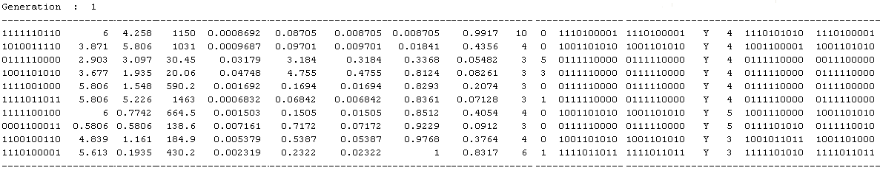
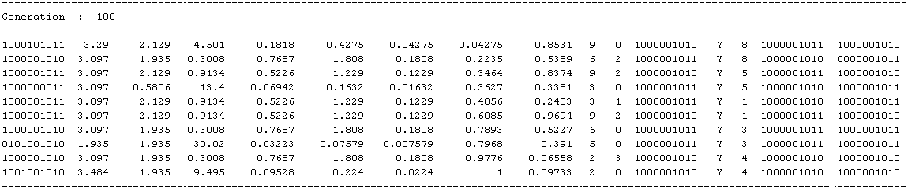


OUTPUT OF THE PROGRAM
SSNCE /EEE/IC-WS/20-12-2009/S53

Slide 55

Observations:
In the Initial population we find that the Population is scattered along the entire search space
But in the final population we would see that the population is crowed nearer to the solution
If we use Crossover probablity higher we see that the solutions evolve faster
If we use the mutation probability higher we find that the search includes the diversification at a greater rate (so that the solution is not heled in local minima)
SSNCE /EEE/IC-WS/20-12-2009/S54

Slide 56
Try This Now
Problem
Find The Minimum of the Given function
F(x₁ , x₂) = 20 + x₁ ² + x₂ ² - 10 (Cos (2*Pi* x₁₎ + Cos (2* Pi* x₂)
Solution : X1 = 0 , X2 = 0
SSNCE /EEE/IC-WS/20-12-2009/S67

Slide 57
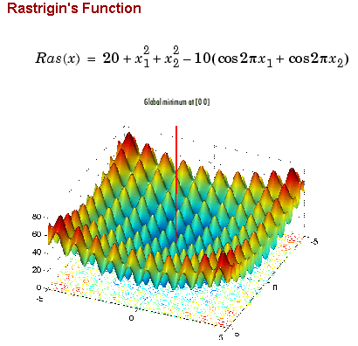
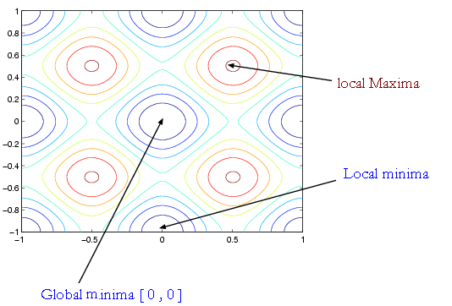

Slide 58
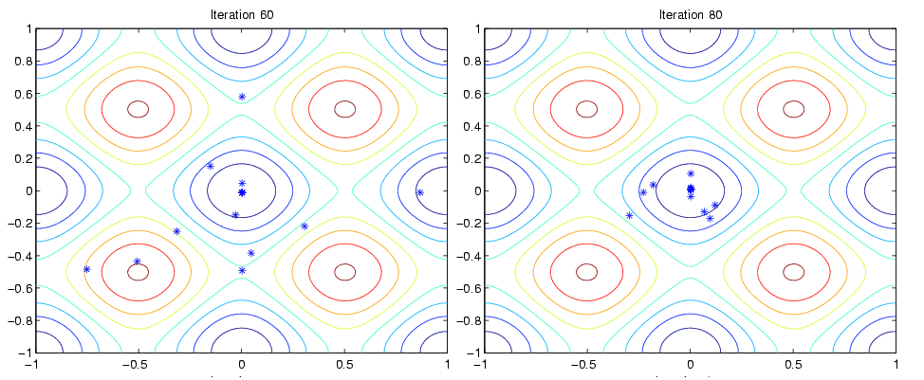
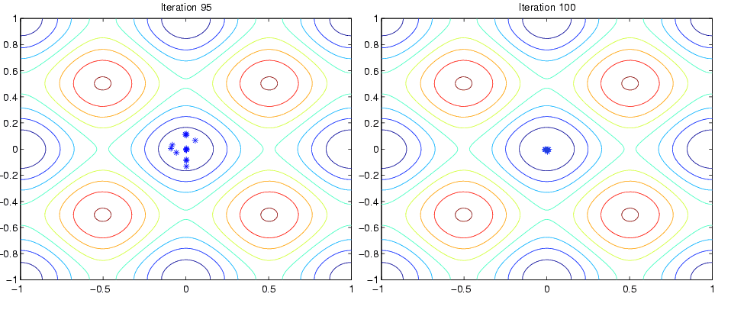

Slide 59
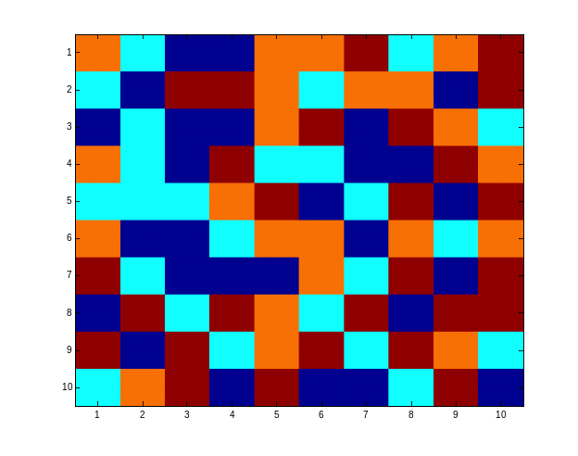
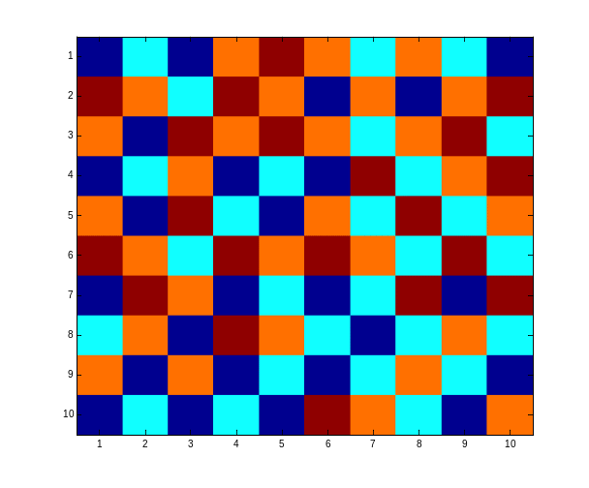
Try it Yourself
  We are given an n by n checkboard in which every field can have a different colour from a set of four colours.
  Goal is to achieve a checkboard in a way that there are no neighbours with the same colour (not diagonal)
One Possible Solution
SSNCE /EEE/IC-WS/20-12-2009/S55

Slide 60
HINTS FOR SOLVING THE PROBLEM
  Chromosomes represent the way the checkboard is coloured.
  Chromosomes are not represented by bitstrings but by bitmatrices
  The bits in the bitmatrix can have one of the four values 0, 1, 2 or 3, depending on the colour
  Crossing-over involves matrix manipulation instead of point wise operating. Crossing-over can be combining the parential matrices in a horizontal,vertical, triangular or square way
  Mutation remains bitwise changing bits in either one of the other numbers
SSNCE /EEE/IC-WS/20-12-2009/S56

Slide 61

GENETIC - ALGORITHMS
FOR
AN
ELECTRICAL PROBLEM
Selective harmonic Elimination in Three Level Inverter
Extended to Five level ………….
SSNCE /EEE/IC-WS/20-12-2009/S57

Slide 62

Selective harmonic Elimination in Three Level Inverter
B3 =cos(3*a1)-cos(3*a2)+cos(3*a3)
B5=cos(5*a1)-cos(5*a2)+cos(5*a3)
B7= cos(7*a1)-cos(7*a2)+cos(7*a3)
After Fourier Analysis it is Derived that the third ,fifth and seventh harmonics [B3,B5,B7]
Can be represented as a function of three firing angle a1,a2,a3 as given by the above equation
Making B3, B5,B7 = 0 is the Objective of the work………
We try to eliminate 3 ,5 ,7 th Harmonics
SSNCE /EEE/IC-WS/20-12-2009/S58

Slide 63


Constraints
0<a1 < 90
0<a2< 90
0<a3<90
Bound Constraints
Quarter Symmetry
a1
a2
a3
Inequality Constraints
a1 < a2
a2< a3
a3<90
SSNCE /EEE/IC-WS/20-12-2009/S59

Slide 64
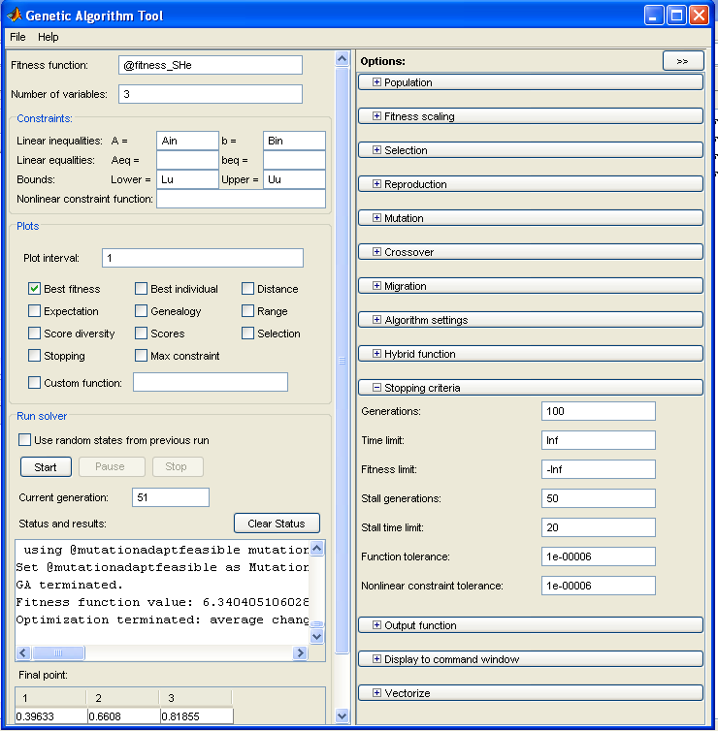

Solution Obtained with gatool
a1= 22⁰
a2 = 38⁰
a3 =47⁰
SSNCE /EEE/IC-WS/20-12-2009/S60

Slide 65
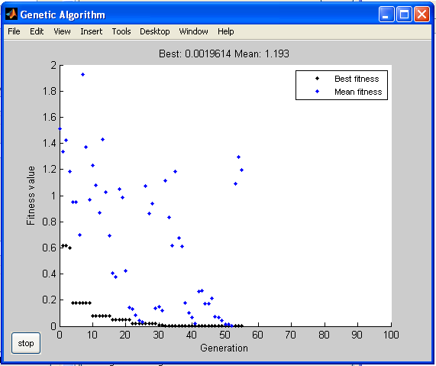

Process of Evolution of the Solution
SSNCE /EEE/IC-WS/20-12-2009/S61

Slide 66
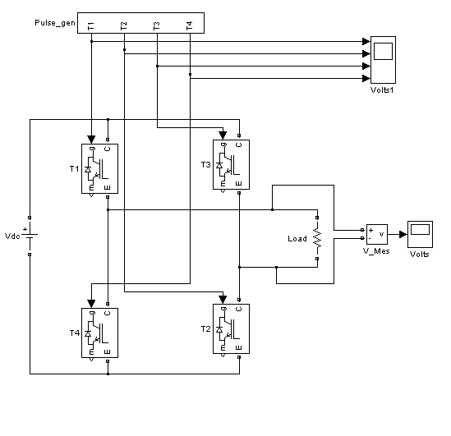
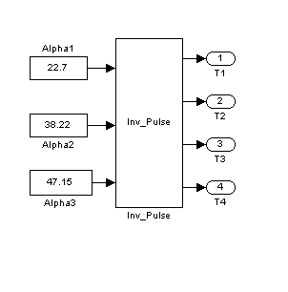
Simulink Model of 3 Level Inverter
SSNCE /EEE/IC-WS/20-12-2009/S62

Slide 67

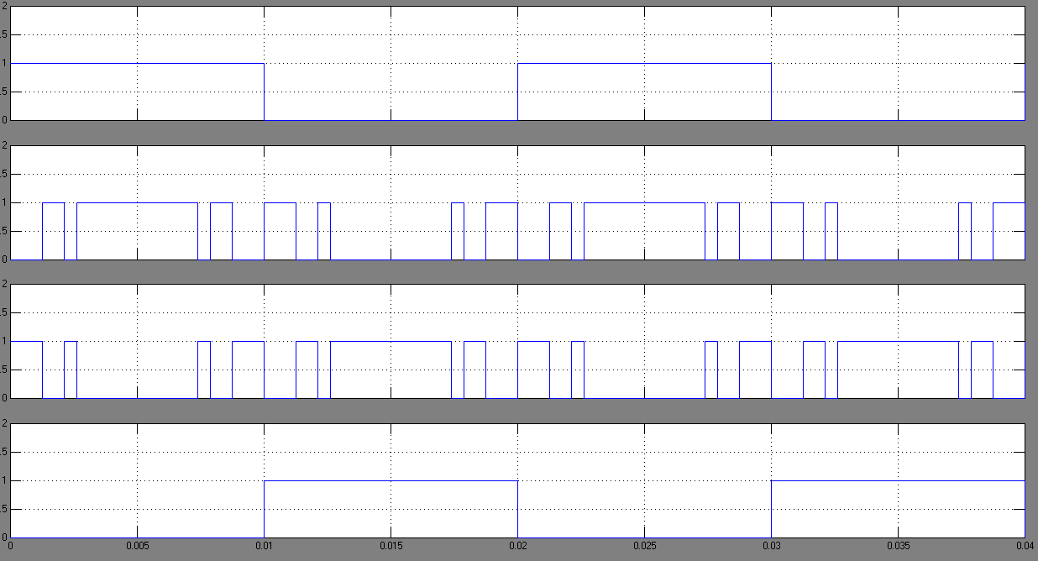
Firing Pulses
SSNCE /EEE/IC-WS/20-12-2009/S63

Slide 68
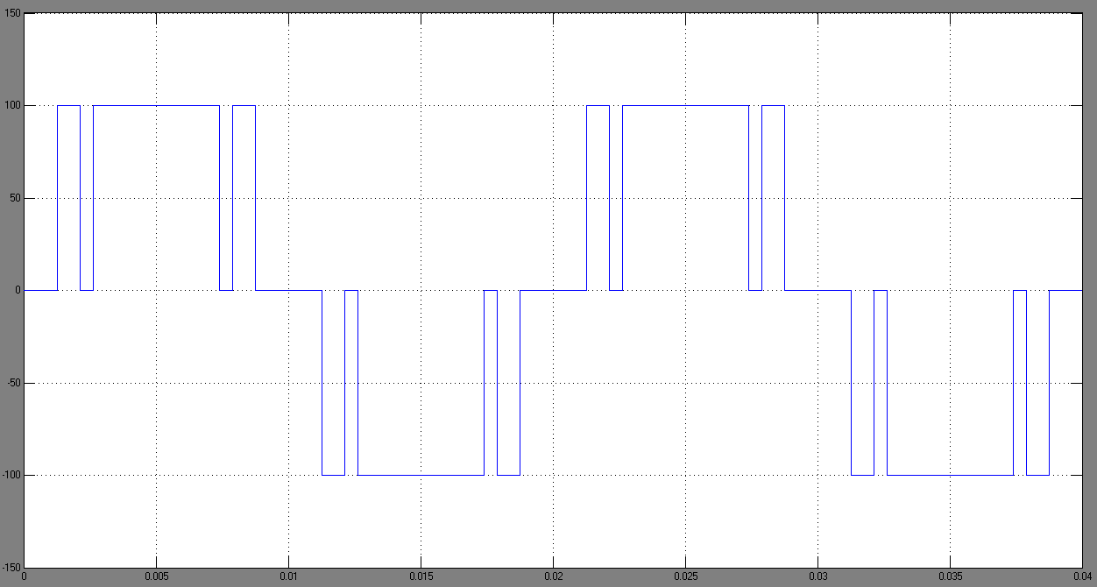
Output Waveform of 3 Level Inverter
SSNCE /EEE/IC-WS/20-12-2009/S64

Slide 69

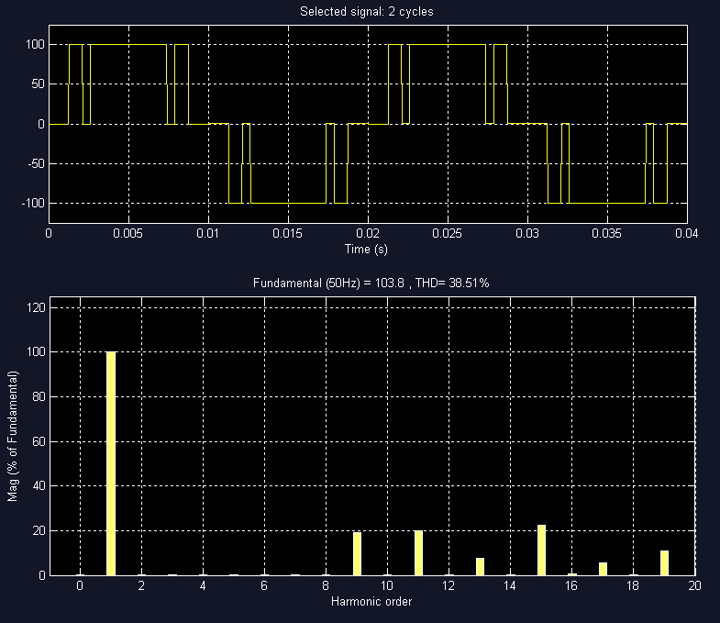
Proof for 3 , 5 , 7 Harmonic Elimination
SSNCE /EEE/IC-WS/20-12-2009/S65

Slide 70
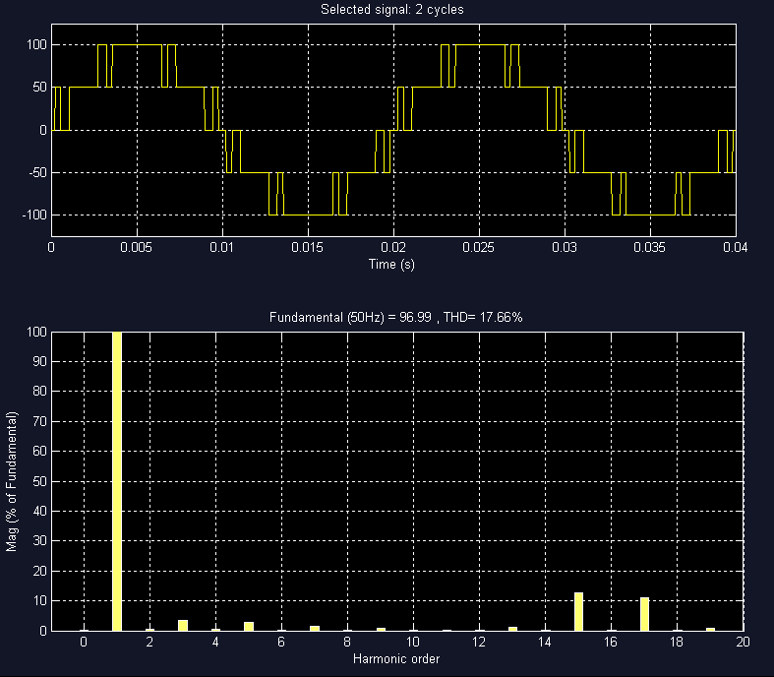

5 Level Inverter Output [3,5,7,9,11,13th Harmonic Elimination]
SSNCE /EEE/IC-WS/20-12-2009/S66

Slide 71
The End.....
May be a new Beginning
SSNCE /EEE/IC-WS/20-12-2009/S67

Slide 72

Choose Heaven or Hell
Without any Choice
Then
Anything is Heaven
If Not
Every thing is Hell
Choicelessness is the Choice of Life
- ZENTILL
[ Dedicated to OSHO ]
SSNCE /EEE/IC-WS/20-12-2009/S68

Slide 73

Questions
SSNCE /EEE/IC-WS/20-12-2009/S69

Slide 74

Work not
for a Purpose
Work For
The Joy of Working
“ Take up a job you love not a day you will work”
- Thank You
Zentill [ ]
SSNCE /EEE/IC-WS/20-12-2009/S70

