Slide 1
BEGINNING
Analysis of Aviation Incident Data
Name:Zeena Lisa Karari
Date:25thSeptember,2024

Slide 2
OVERVIEW
Purpose of the Analysis: To analyze aviation incident data to identify trends and provide actionable recommendations for enhancing safety.
Scope: Focus on incidents recorded in the dataset, examining factors such as aircraft category, airport name, and injury severity.

Slide 3
BUSINESS UNDERSTANDING
Importance of Aviation Safety: Discuss the critical nature of safety in aviation, emphasizing how incidents can lead to loss of life, financial costs, and reputational damage.
Objective: Explain that understanding incident data can lead to better safety protocols, training, and ultimately safer air travel.

Slide 4
DATA UNDERSTANDING
Dataset Description: The dataset contains records of aviation incidents with key features such as Airport name.
I identified the target variable and properties of different variables and also got basic information from the dataset.

Slide 5
DATA ANALYSIS
Cleaned my data and made it easy to work with by dealing with missing values, aggregating and visualizaing data so as to help the organization make data driven decisions. I related my findings to business intelligence by making recommendations for how the business should move forward with the new aviation opportunity.

Slide 6
FINDINGS
Identify trends such as certain airports may have higher incident rates for specific aircraft categories.
Patterns in injury severity related to aircraft type or airport location.

Slide 7
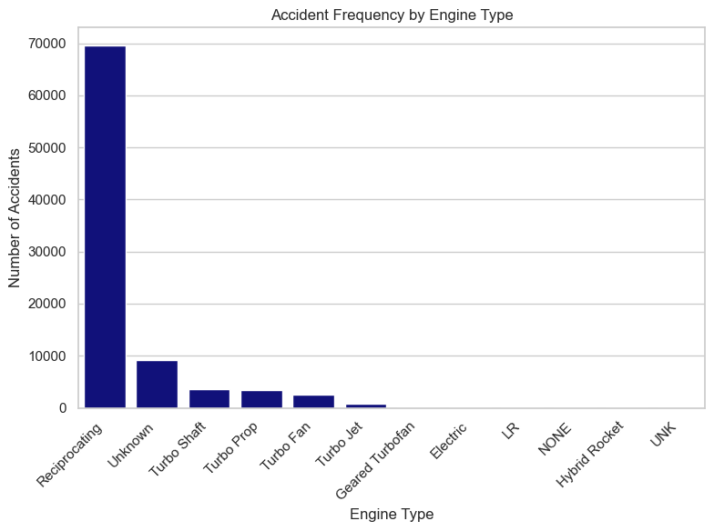
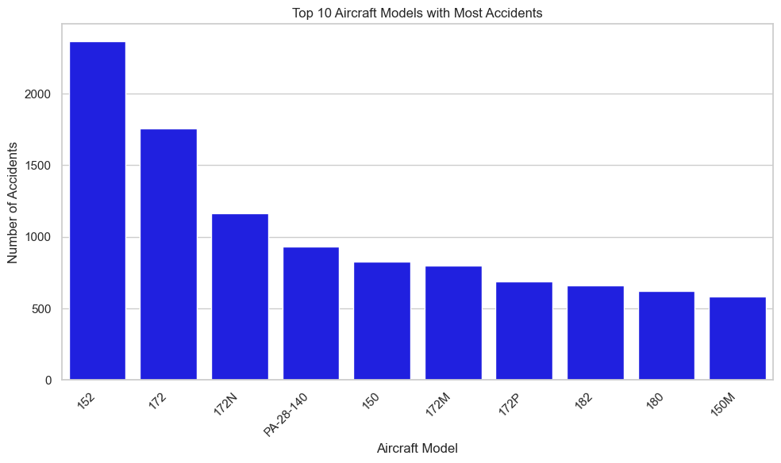
DATA VISUALIZATION
On the left it represents accident frequency by engine type
On the right there is the top 10 Aircrafts with most accidents

Slide 8
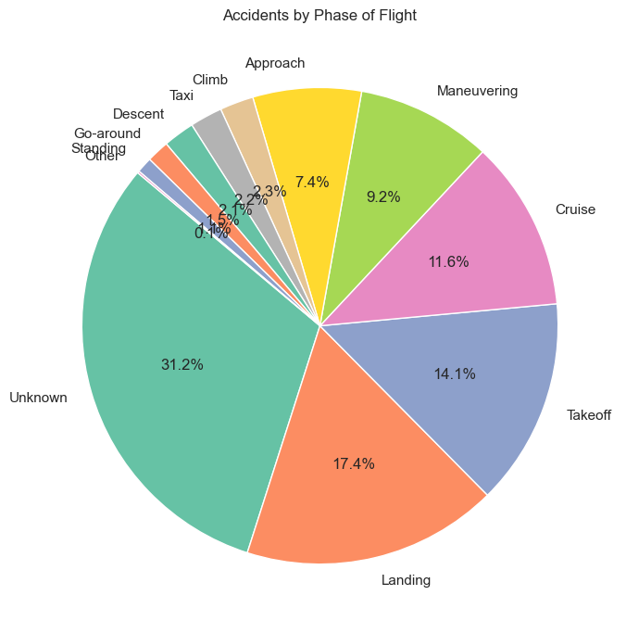
MIDDLE
ACCIDENTS BY PHASE OF FLIGHT

Slide 9
END
RECOMMENDATIONS
1.Purchase safer aircraft categories and makes - Invest in aircraft models with the lowest accident rates and the best safety records. Avoid purchasing models with historically high severe accident rates.
2. Avoid high-risk locations for operations- Prioritize setting up operations in locations with lower accident frequencies. Implement additional safety protocols if operating in highrisk areas.
3.Enhance safety measures during critical flight phases - Focus on improved pilot training for takeoff and landing phases. Invest in better aircraft maintenance and monitoring systems to prevent mechanical failures.

