Slide 1

Huffman Coding
Presented By
Zena Poudel

Slide 2
Communication system
System that transfer information from it’s source to destination some distance away.
Information are obtained from the message. Some message have higher information and some have lower.
Information is inversely proportional to probability.
Source (Input signal) -> input transducer (converts to electric signal) -> encoder[ Source encoder and channel encoder]-> modulator -> transmission channel (added noise)- > demodulator -> decoder [ channel decoder and source decoder] -> output transducer -> Destination

Slide 3
Modulation and coding
Modulation = signal-processing by varying one or more of the amplitude, frequency or phase of waveforem -> modulating signal * carrier signal = modulated signal.
Coding = symbol processing
Encoding = digital messages -> new sequence of symbols.
Consider digital source having M >> 2 symbols. Uncoded transmission of messages require M different waveforms, one for each symbol.

Slide 4
Coding (contd)
Alternatively each symbol could be represented by binary codeword consisting of k binary digits. 2^k possible codewords made up of k binary digits, we need k>= log_2 M digits/codeword to encode M source symbols.

Slide 5
_Coding (contd)_
Less complicated hardware is required -> just two different waveform (adv)
Noise have less effect in binary signal. (adv).

Slide 6
_4 main reason for coding._
Adapt to electrical or accidental characteristics of the channel
Reduce the amount of data to be transmitted -> Source Coding
Control errors -> Error Coding - (Channel encoding)
Conceal and hide data -> Cryptography

Slide 7
_Source coding_
Source coding is the process of encrypting the information such that unnecessary data are removed which leads to :
Effective transmission
Adjust bandwidth: Example: Information is inversely proportional to probability. Hence small no. of bits are provided for the event that have higher probability and vice versa.
Eliminate data redundancy
Here the main motto of source coding is to compress the size of data .

Slide 8
_Fixed length and variable length encoding_
Fixed length coding :- codeword generated for every symbol will be having fixed length or equal no. of bits.
Variable length coding:- Various symbols of any message will be represented with different no. of bits. Example: Huffman coding, Shannon Fano coding.
[ Prefix free code helps to solve the issues in variable length coding.].

Slide 9
_Lossless and lossy coding_
Lossless:- Data can be decoded to form exactly the same bits. Better for text, code. Huffman coding.
Lossy:- Some of the original data is removed. After the message is decoded it is not as same as original. coding algorithms that are characterized by an irreversible loss of information. Image, video, audio.

Slide 10
_Greedy Algorithm Paradigm_
Builds up a solution piece by piece.
Next choice will be most obvious and immediate benefit.
i.e It makes the choice that seems to be best at the moment.

Slide 11
_Huffman Coding_
Variable length encoding.
Prefix free code.
Lossless
Most probable elements are coded with less or few bits and least probable coded with greater no. of bits.
Greedy algorithm.
Optimum Prefix source coding in O(N.log N) time.
Generally include 2 steps:-
Build Huffman tree
Traverse Huffman tree and assign codes.

Slide 12
_Huffman Tree_
Binary tree with each non terminal node having 2 children.
Select the two letters ai and aj with the smallest probabilities and create a parent node for the nodes that represent these two letters in the binary code tree.
Replace the letters ai and aj by a new letter with an associated probability of p(ai) + p(aj ).
If more than one letter remains, repeat the previous steps.
Convert the binary code tree into a prefix code
_Algorithm:_

Slide 13
_Complexity of an alg
Time complexity :- O(n.logn) + O(n) = O(n.logn)
Hence complexity = O(n.logn)
Min heap tree (deleting ->logn done for n times = nlogn ) and merging -> n

Slide 14
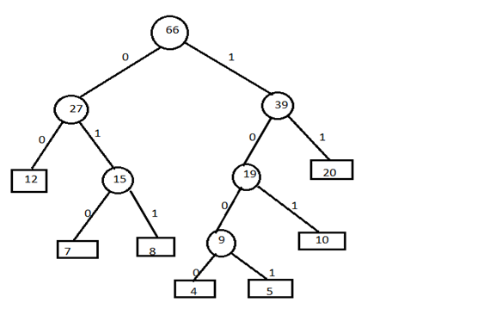
_Example

Slide 15
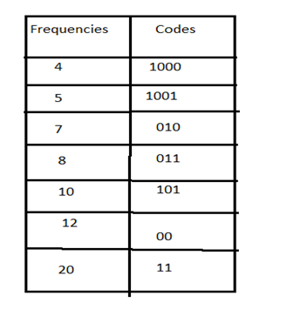

Slide 16
_Optimality of prefix code
Given any two letters aj and a k, if P(aj) >= P(a k) , then lj <= l k, where lj is the length of the codeword aj .
The two least probable letters have codewords with the same maximum length lm.
In the tree corresponding to the optimum code, there must be two branches stemming from each intermediate node.
Suppose we change an intermediate node into a leaf node by combining all the leaves descending from it into a composite word of a reduced alphabet. Then if the original tree was optimal for the original alphabet, the reduced tree is optimal for the reduced alphabet.

Slide 17
_Optimality of prefix code
Given any two letters aj and a k, if P(aj) >= P(a k) , then lj <= l k, where lj is the length of the codeword aj .
The two least probable letters have codewords with the same maximum length lm.
In the tree corresponding to the optimum code, there must be two branches stemming from each intermediate node.
Suppose we change an intermediate node into a leaf node by combining all the leaves descending from it into a composite word of a reduced alphabet. Then if the original tree was optimal for the original alphabet, the reduced tree is optimal for the reduced alphabet.

Slide 18
_Reference
https://web.stanford.edu/class/ee398a/BookWiegandSchwarz.pdf
https://www.u-aizu.ac.jp/~hamada/IT/L7-IT.pdf
http://www.csc.lsu.edu/~kundu/dstr/4-huffman.pdf
http://home.cse.ust.hk/faculty/golin/COMP271Sp03/Notes/MyL17.pdf
https://indico.cern.ch/event/48127/attachments/956600/1357608/Error_Control_Coding.pdf
http://people.math.harvard.edu/~ctm/home/text/others/shannon/entropy/entropy.pdf

Slide 19
Thank you

