Slide 1
DFT-D3 for Solid-State Materials
A Data-Driven Perspective on Accuracy
An exhaustive mathematical and physical evaluation of empirical dispersion corrections in extended solid-state networks
D Zenas zephaniah,23321010
Department of chemistry, iit roorkee

Slide 2
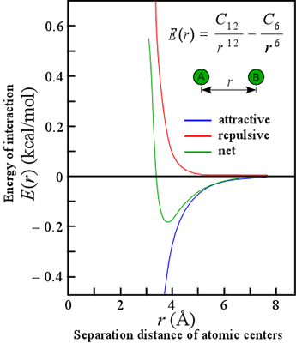
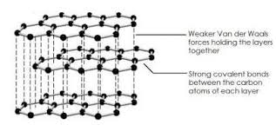
Motivation and The Challenge of Dispersion
Accurately predicting atomic interactions is foundational for understanding chemical bonding, forecasting material properties, and designing novel materials.
Van der Waals (vdW) dispersion forces govern the weak interaction regime.
These forces dictate the stability of molecular crystals, layered materials (e.g., graphite), and surface adsorption phenomena.
Physically, they originate from instantaneous dipole fluctuations and electron correlation effects between atoms.
The interaction potential decays asymptotically as, where $r$ is the interatomic distance.
Notes:
Even in neutral atoms, electrons are in constant motion. At any exact moment, the electron cloud might randomly shift to one side, creating a temporary "instantaneous dipole" (a slight positive charge on one side, negative on the other). This temporary dipole exerts a force on a neighboring atom's electrons, creating an "induced dipole." The attraction between these synchronized, shifting electron clouds is the dispersion force. "Electron correlation" is the quantum mechanical term for how electrons constantly adjust their positions to avoid each other. Yes, for dispersion forces, the fluctuations must be instantaneous. In non-polar atoms, the time-averaged dipole moment is zero. Dispersion forces strictly rely on fleeting, non-zero instantaneous fluctuations in the electron cloud to induce a corresponding dipole in a neighboring atom. If the dipole were permanent, it would be a standard dipole-dipole interaction, not a dispersion force. Long-Range Cutoffs: Because R −6 approaches zero so rapidly, the dispersion energy between distant atoms is infinitesimally small. To save computational time, DFT codes apply a radial cutoff distance, ignoring pairs that are too far apart.
Short-Range Damping: If you look at the R −6 math, as distance R approaches 0, the energy drops to negative infinity (a singularity). To prevent the math from breaking down when atoms are close together (where standard DFT already calculates chemical bonds perfectly well), the D3 model multiplies the R −6 term by a damping function (f damp ). This function smoothly kills the dispersion correction at short distances.

Slide 3
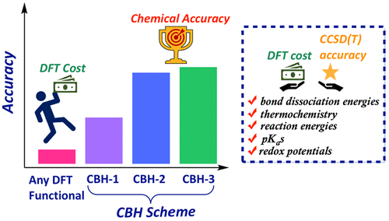
The Computational Dilemma
High-accuracy quantum chemistry methods, such as Coupled Cluster (CC) theory, capture electron correlation and dispersion naturally.
However, the computational cost of CC scales steeply at $O(N^{7})$.
This extreme scaling renders it fundamentally impractical for periodic solids or large molecular assemblies.
Density Functional Theory (DFT) serves as the primary alternative, offering a critical balance between accuracy and computational speed.
source https://pubs.acs.org/doi/10.1021/acs.jctc.3c00301
Notes:
Coupled Cluster (CC) and Density Functional Theory (DFT) are computational methods for calculating electronic structure, with CC prioritizing high accuracy (systematic, wave-function based) and DFT prioritizing computational efficiency (density-based). CC is ideal for small molecules needing precise energies, while DFT is the standard for large systems and materials
CC, particularly, is often considered the "gold standard" for accuracy in quantum chemistry. It converges toward the exact solution. DFT accuracy depends on the functional; while very good for many systems, it can fail for strong correlation.
Electron Correlation: Electrons repel each other, meaning their movements are strictly linked (correlated) to constantly avoid collisions.
Capturing it "Naturally": Standard DFT tries to save time by treating electrons as a blurry, average cloud, which misses these tiny synchronized movements. CC theory, however, explicitly calculates the exact, coupled movements of every single electron.
Because CC theory perfectly tracks these instantaneous electron shifts, the resulting temporary dipole fluctuations (dispersion forces) automatically emerge as a natural result of the core math. It doesn't need an external "-D3" correction term tacked onto the end.
In computational chemistry, $N$ represents the size of your system (specifically, the number of electrons or basis functions you define in a solver like PySCF). $O(N^7)$ means the required computing time grows to the 7th power of that size.If you double the size of your system ($2 \times N$), the calculation does not take twice as long—it takes $2^7$ (or 128) times longer.
A simple 10-atom molecule might take 1 hour to compute using CC theory.A 20-atom molecule would take 128 hours (over 5 days).A periodic solid—which consists of crystal lattices repeating infinitely in three dimensions—has a massive $N$ value. Raising that massive number to the 7th power means the calculation would take supercomputers millions of years to complete Because CC theory is physically impossible to run on large systems, scientists are forced to use Density Functional Theory (DFT). Standard DFT scales much more gently (around $O(N^3)$ or $O(N^4)$), making it fast enough to handle solid-state materials. However, because DFT is an approximation that misses dispersion, empirical mathematical patches like Grimme's DFT-D3 must be manually added back in to correct the total energy.

Slide 4
A Look at dft
states that the total energy is a functional of the electron density, $ρ(r)$:
1.The Kohn-Sham’s DFT$E[ρ]=T_{s}[ρ]+∫V_{ext}(r)ρ(r)dr+E_{H}[ρ]+E_{xc}[ρ]$
2. Generalized Gradient Approximation (GGA)
In GGA, the exchange-correlation energy $E_{xc}$ evaluates both the local electron density ($ρ$) and how fast that density is changing (the gradient, $∇ρ$): $E_{xc}^{GGA}[ρ]=∫ϵ_{xc}(ρ(r),∇ρ(r))ρ(r)dr$
3. Hybrid Functionals
Hybrid functionals attempt to increase accuracy by mixing GGA exchange mathematically with exact (Hartree-Fock) exchange: $E_{xc}^{Hybrid}=aE_{x}^{HF}+(1-a)E_{x}^{GGA}+E_{c}^{GGA}$
Notes:
While this gradient improves accuracy over older models, standard GGA functionally mathematically cannot calculate the long-range, non-local fluctuations required for van der Waals dispersion forces.
Despite this improvement in chemical bonding accuracy, hybrid functionals still inherently fail to capture non-local electron correlation effects necessary to describe dispersion forces.

Slide 5
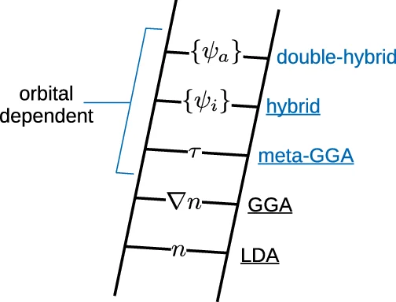
The Blind Spot of Standard DFT
Standard exchange-correlation functionals, including Generalized Gradient Approximations (GGA) (e.g., PBE, BLYP) and hybrid functionals (e.g., B3LYP, PBE0), inherently fail to capture long-range non-local electron correlations.
Consequently, they cannot describe dispersion interactions properly.
This intrinsic limitation produces systemic errors in calculating binding energies, lattice constants, and cohesive energies.
The standard mathematical remedy is the addition of an external dispersion correction.
source - https://www.researchgate.net/figure/The-Jacobs-ladder-of-density-functional-approximations-56-57-Families-of_fig3_341201729
Notes:
GGA (Generalized Gradient Approximation) and Hybrid functionals are key DFT approaches for calculating electronic structure. GGA (e.g., PBE, BLYP) is a computationally efficient, semilocal method approximating exchange-correlation based on density and its gradient. Hybrid functionals (e.g., B3LYP, PBE0) mix GGA with Exact Hartree-Fock exchange, providing superior accuracy for band gaps, reaction barriers, and geometries at higher computational cost.
For example, Generalized Gradient Approximations (GGA) calculate energy by looking at the electron cloud's density at one specific point and how it changes immediately around that point (the gradient).
Non-Local Correlation (The Blind Spot): "Local" means the math only sees what is happening right next door. "Non-local" refers to an electron in one atom feeling and reacting to the instantaneous movement of an electron in a completely different atom far away
Because standard DFT is mathematically nearsighted, it is completely blind to those long-distance, synchronized electron fluctuations. Since those fluctuations are the dispersion force, standard DFT fails to predict the attractive van der Waals force entirely, leading to incorrect predictions for how materials bind together

Slide 6
The Additive Dispersion Framework
The corrected total energy of the system is formulated as an additive expansion: $E_{Total}=E_{Base}+E_{disp}$
Here, $E_{Base}$ is the self-consistent energy derived from the chosen DFT functional.
$E_{disp}$ acts as a perturbative correction for the missing long-range correlation effects.
These correction schemes branch into two main categories: pairwise additive approaches and many-body approaches.
Notes:
In Density Functional Theory (DFT), you cannot solve the equations in a single step. The software (like PySCF or VASP) takes an initial mathematical guess at the shape of the electron density, calculates the resulting potentials, and uses those to generate a new, better density. It loops this process iteratively until the input density and output density match—meaning the system has reached a "self-consistent field" (SCF). $E_{Base}$ is the final, locked-in energy calculated at the exact end of this iterative loop, representing standard DFT's best answer.
"Perturbative" means the correction is treated as a minor, independent add-on. Instead of forcing the software to redo the complex, iterative SCF loop to account for dispersion, the $E_{disp}$ term is simply calculated mathematically after the fact and tacked onto the total. It is an external patch applied without altering the fundamental electron density calculated in $E_{Base}$.
This describes the two fundamentally different ways to calculate that $E_{disp}$ patch: Pairwise Additive Approaches (e.g., DFT-D3): This method calculates the van der Waals pull strictly between two isolated atoms at a time (Atom A and Atom B), then Atom B and C, etc., and simply sums them all up. It is computationally cheap but assumes the interaction between A and B is completely unaffected by Atom C sitting right next to them.
Many-Body Approaches (e.g., MBD): This method recognizes that in dense systems, surrounding atoms will shield, enhance, or "screen" the interactions between any two specific atoms. It calculates the collective, synchronized electron fluctuations of the entire system simultaneously. It is highly accurate but computationally expensive.

Slide 7
Grimme's Pairwise DFT-D APPROACH
The most widely implemented pairwise schemes belong to Grimme's DFT-D series (D2, D3, D3(BJ)).
The generalized expression for the total dispersion energy added to the DFT base is: $E_{disp}=-\underset{n=6,8,10...}{∑}\underset{A<B}{∑}s_{n}\frac{C_{n}^{AB}}{R_{AB}^{n}}f_{damp,n}(R_{AB})$ where,
$R_{AB}$ denotes the scalar interatomic distance between atoms A and B.
$C_{n}^{AB}$ represents the specific dispersion coefficients for that atomic pair.
$s_{n}$ are global scaling factors mathematically parameterized for the specific density functional approximation (DFA) being used.
Notes:
This formula is the exact mathematical engine behind Grimme's pairwise additive DFT-D correction methods. It calculates the total dispersion energy by mathematically isolating every pair of atoms, calculating their specific attraction, and summing them all up
The Negative Sign ($-$): Dispersion forces are attractive. In computational chemistry, an attractive force lowers the total potential energy of the system, making it mathematically more stable.
The Multipole Expansion ($\sum_{n=6,8,10...}$): Dispersion isn't just a single force; it is a series of increasingly complex electron cloud interactions. $n=6$ represents the dominant, long-range dipole-dipole interaction (the $R^{-6}$ decay we looked at).$n=8$ represents the shorter-range dipole-quadrupole interaction.While earlier versions like D2 stopped at $n=6$, D3 improves accuracy by including both the $n=6$ and $n=8$ terms.
The Pairwise Summation ($\sum_{A<B}$): This instructs the computer to calculate the interaction for every unique pair of atoms (Atom A and Atom B) in the entire system, one by one, and sum them together. The $A < B$ notation simply ensures the algorithm doesn't double-count pairs (i.e., it counts the A-B interaction, but skips B-A).
The Global Scaling Factors ($s_n$): Different standard DFT functionals (like PBE or HSE) have different inherent accuracies and baseline errors. These $s_n$ values are empirical constants fitted and adjusted specifically for the functional you chose, ensuring the patch is the exact right "size" for your specific DFT method.
The Dispersion Coefficient ($C_{n}^{AB}$): This is the core variable that dictates the fundamental strength of the dispersion pull between those two specific elements. (In D3, this changes based on the atomic environment, which is where the artifacts in your paper originate).The Distance Decay ($R_{AB}^n$): This is the denominator representing the interatomic distance raised to the power of $n$. It enforces the physical rule that the force weakens drastically as the atoms move apart.
The Damping Function ($f_{damp,n}(R_{AB})$): If atoms A and B get perfectly close, $R_{AB}$ becomes $0$. Dividing by zero would cause the energy to crash to negative infinity. This function acts as a mathematical "shock absorber." It smoothly shuts off the dispersion correction at very short ranges, preventing singularities where standard DFT already perfectly models the chemical bond.

Slide 8
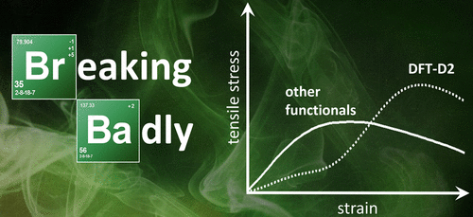
Mathematical Formulation of DFT-D2
The earlier D2 formulation simplifies the expansion primarily to the dominant $n=6$ term.
The correction equation is: $E_{disp}^{D2}=-s_{6}\underset{A<B}{∑}\frac{C_{6}^{AB}}{R_{AB}^{6}}f_{damp}(R_{AB})$
The pairwise coefficient $C_{6}^{AB}$ is approximated using a simple geometric mean of isolated atomic coefficients: $C_{6}^{AB}=\sqrt{C_{6}^{A}C_{6}^{B}}$
In D2, the individual atomic coefficients are entirely fixed, calculated via elemental properties. The derivation is given by: $C_{6}^{a}=0.05N_{p}^{a}I_{p}^{a}α^{a}$ where,
$N_{p}^{a}$ is the effective number of electrons for atom .
$I_{p}^{a}$ represents the isolated atomic ionization potential.
$α^{a}$ is the static polarizability of the atom.
Notes:
Simplifying to the $n=6$ term: Dispersion forces are physically made up of a mathematical series of interactions (dipole-dipole, dipole-quadrupole, etc.). The D2 model ignores the highly complex, shorter-range interactions (like $n=8$ or $n=10$). It only calculates the most dominant, longest-range pull: the $n=6$ instantaneous dipole-dipole interaction.
The D2 Equation:$$E_{disp}^{D2}=-s_{6}\sum_{A<B}\frac{C_{6}^{AB}}{R_{AB}^{6}}f_{damp}(R_{AB})$$Because it drops the higher-order terms, the equation becomes much simpler than the generalized one. It simply takes the functional-specific scaling factor ($s_6$), calculates the $C_6$ attraction over the distance ($R_{AB}^6$) for every unique pair of atoms, applies the short-range damping function ($f_{damp}$), and adds them all up.
The Geometric Mean ($C_{6}^{AB}=\sqrt{C_{6}^{A}C_{6}^{B}}$): This is the most critical limitation of the D2 model. To figure out the interaction strength between Atom A and Atom B, D2 relies on fixed, pre-calculated constants for isolated atoms.It takes the standalone, theoretical dispersion value for Atom A ($C_6^A$) and Atom B ($C_6^B$).It multiplies them and takes the square root (the geometric mean) to estimate their combined interaction.The Physical Flaw: Because these individual $C_6^A$ values are rigid constants, a Carbon atom is mathematically treated exactly the same way whether it is tightly bound in a hard diamond lattice or floating freely in a $CO_2$ gas molecule. The math has absolutely no "environmental awareness.”
1. "Entirely fixed, calculated via elemental properties"
This means D2 treats an atom of Carbon the exact same way no matter what molecule or crystal it is sitting inside. The software uses a hardcoded, pre-calculated constant for Carbon, a constant for Hydrogen, etc., based purely on what those atoms look like floating completely alone in a vacuum.
2. The Formula BreakdownThe formula calculates that constant using three specific physical properties of the isolated atom:$$C_{6}^{a}=0.05 N_{p}^{a} I_{p}^{a} \alpha^{a}$$$N_{p}^{a}$ (Effective number of electrons): This does not count every single electron in the atom. It mostly represents the outer (valence) electrons. These are the only electrons with enough freedom to actually slosh around and create the instantaneous dipole fluctuations we talked about. The inner core electrons are locked down too tightly to contribute to dispersion.$I_{p}^{a}$ (Ionization potential): This is a measure of how fiercely the nucleus holds onto those outer electrons. If the ionization potential is high, the electrons are locked into place. If they cannot shift around easily, they cannot form strong temporary dipoles, which directly impacts the strength of the dispersion force.$\alpha^{a}$ (Static polarizability): Think of this as the "squishiness" of the atom's electron cloud. It measures how easily the cloud can be distorted or pulled out of shape by a neighboring atom's charge. Atoms with massive, loose electron clouds (like Iodine or Cesium) are highly polarizable and generate very strong dispersion forces.
The Flaw This Creates:
Because D2 uses these fixed isolated values, it is completely blind to chemistry. It assumes Carbon's electron cloud is equally "squishy" ($\alpha^{a}$) whether it is locked in a rigid diamond lattice or floating in a loose gas.This exact flaw is why DFT-D3 was invented. D3 replaces these fixed constants with dynamic values that adapt to the atom's environment—which ironically causes the mathematical artifacts your presentation is critiquing.

Slide 9
Advancing to DFT-D3: Higher-Order Expansion
DFT-D3 introduces a higher level of mathematical rigor by expanding the series to include both two-body ($E^{(2)}$) and three-body ($E^{(3)}$) interactions.
The total D3 dispersion energy is: $E_{disp}^{D3}=E^{(2)}+E^{(3)}$
The two-body term incorporates both $n=6$ and $n=8$ multipole expansions: $E^{(2)}=-\underset{n=6,8}{∑}\underset{A<B}{∑}s_{n}\frac{C_{n}^{AB}(CN^{A},CN^{B})}{R_{AB}^{n}}f_{damp,n}(R_{AB})$
Crucially, the $C_{n}$ coefficients are no longer fixed; they are dynamically interpolated based on coordination numbers (CN).
Notes:
Two-Body ($E^{(2)}$) vs. Three-Body ($E^{(3)}$) InteractionsThe limitation of D2: It only calculated dispersion by isolating pairs of atoms (Atom A pulling on Atom B).The D3 Upgrade: D3 recognizes that in dense materials, three atoms can interact with each other's electron clouds simultaneously (Atom A, B, and C all fluctuating and pulling on each other at the same time). The total dispersion energy is now the sum of the standard pairwise interactions ($E^{(2)}$) plus these new triplet interactions ($E^{(3)}$).
2. The $n=6$ and $n=8$ Multipole ExpansionsThe limitation of D2: It only calculated the $n=6$ interaction, which physically represents an instantaneous dipole inducing a dipole in a neighboring atom.The D3 Upgrade: The D3 model explicitly adds the $n=8$ term into its two-body equation. Physically, this represents an instantaneous dipole inducing a more complex quadrupole (an electron cloud distortion with four poles instead of two) in a neighbor. Adding this higher-order term drastically improves the accuracy of the physics when atoms are at medium-to-short distances.
3. Dynamic $C_n$ via Coordination Number (The Most Critical Change)This is the core innovation of D3, and the exact reason why it fails in the specific solid-state systems your paper examines.The limitation of D2: It assigned a rigid, fixed dispersion constant to every atom.The D3 Upgrade: D3 throws out the fixed constants. Instead, it calculates the Coordination Number (CN)—a mathematical tally of exactly how many neighbors surround Atom A and Atom B at any given moment.High CN (Crowded): If an atom is densely packed with many neighbors, its outer electrons are tightly tied up in chemical bonds. The software dynamically shrinks the $C_n$ coefficient because the electron cloud is less "squishy" (less polarizable).Low CN (Isolated): If the atom has few neighbors, its electron cloud is loose. The software dynamically increases the $C_n$ coefficient to reflect a stronger dispersion pull.
Because D3 constantly recalculates and "interpolates" (blends) these $C_n$ coefficients based on the atom's shifting Coordination Number, the math becomes highly sensitive to interatomic distances. As your paper points out, in polarizable solids, a tiny change in distance causes the Coordination Number to drop abruptly, which causes the $C_n$ coefficient to spike erratically, creating the fake "artifact" energy minimum

Slide 10
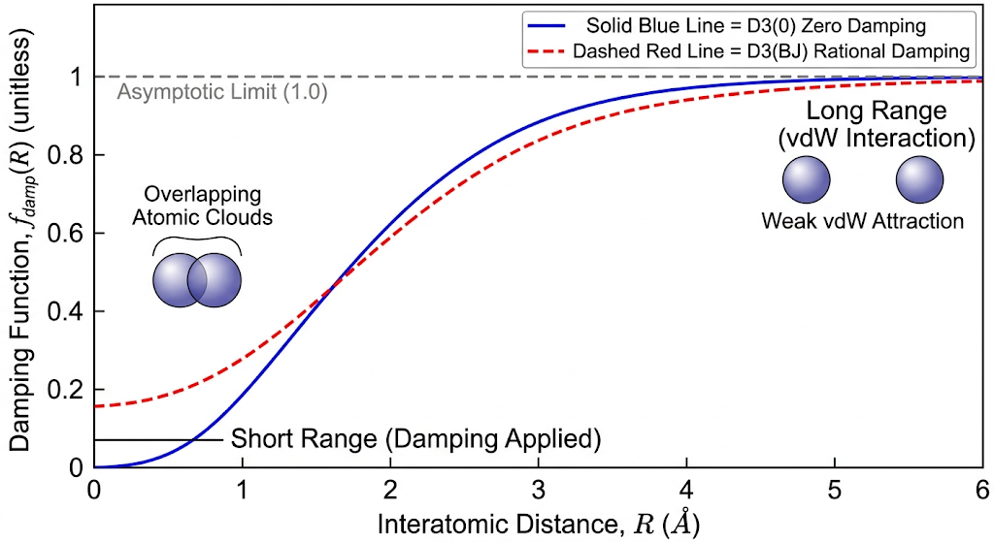
The Necessity of Damping Functions
Damping functions ($f_{damp}$) are mathematically required to prevent non-physical singularities (approaching infinity) at very short interatomic distances.
The zero-damping variant, denoted as D3(0), uses the following form: $f_{damp,n}^{D3(0)}(r_{ij})=\frac{1}{1+6{\left(\frac{r_{ij}}{s_{R,n}R_{0ij}}\right)}^{-α_{n}}}$
The empirical parameters, $α_{6}=14$, and $s_{R,8}=1$ are fixed constants.
The parameter is optimized specifically for the underlying DFT
Notes:
The "Non-Physical Singularity" ProblemThe core formula for dispersion relies on dividing by the distance between atoms ($R^6$ and $R^8$).The Math Problem: If two atoms get extremely close together, the distance $R$ approaches $0$. In math, dividing by zero creates a "singularity"—the result shoots to negative infinity.The Physics Problem: In reality, atoms don't have infinite attractive energy when smashed together. Instead, their electron clouds overlap, and Pauli repulsion violently pushes them apart. If we didn't fix the math, the D3 model would tell the computer that overlapping atoms are infinitely stable, which is physically impossible.
The Zero-Damping Solution ($D3(0)$)To fix this, Grimme introduced the damping function ($f_{damp}$). You multiply the dispersion energy by this function to control it. $$f_{damp,n}^{D3(0)}(r_{ij})=\frac{1}{1+6\left(\frac{r_{ij}}{s_{R,n}R_{0ij}}\right)^{-\alpha_{n}}}$$Here is how the fraction acts as a smart switch:At Long Distances (vdW range): The interatomic distance ($r_{ij}$) is large. The complex denominator shrinks down to basically $1$. The fraction becomes $1/1 = 1$. Multiplying the dispersion energy by $1$ leaves it fully active.At Short Distances (Chemical Bonds): As the atoms get close ($r_{ij} \to 0$), the denominator explodes into a massive number. The fraction becomes $1 / \text{Huge Number} \approx 0$. Multiplying the dispersion energy by $0$ "kills" the dispersion correction entirely. It is called "Zero-Damping" because the correction drops exactly to zero at short ranges.
These parameters dictate the specific shape and steepness of the curve when it drops to zero.$\alpha_6 = 14$ and $\alpha_8 = 16$: These are the steepness controls. They ensure the cutoff isn't a slow fade, but a relatively sharp drop-off right at the edge of the atom's van der Waals radius.$s_{R,8} = 1$: This locks the cutoff distance for the $n=8$ (dipole-quadrupole) interaction in place. Grimme's team determined these numbers once via massive benchmarking, and they are hardcoded into the software so no one ever changes them
This is the most critical variable. Standard DFT is already perfectly capable of calculating short-range chemical bonds; it only fails at long-range dispersion. Therefore, there needs to be a "handover" point where standard DFT stops acting alone and the D3 correction kicks in.However, every single DFT functional (PBE, B3LYP, HSE, etc.) has different innate errors. Some naturally capture a tiny bit of medium-range electron correlation, while others capture none.$s_{R,6}$ scales the cutoff radius. It shifts the damping curve left or right.If your chosen DFT functional is naturally "farsighted" and handles medium distances reasonably well, the $s_{R,6}$ parameter is optimized to delay the D3 correction until the atoms are further apart.It ensures the D3 patch perfectly dovetails with the underlying DFT functional without double-counting the correlation energy.

Slide 11
The Becke-Johnson (BJ) Damping Variant
An alternative, heavily adopted damping geometry is the Becke-Johnson function, producing the D3(BJ) variant.
Its mathematical formulation is: $f_{damp,n}^{D3(BJ)}(R_{AB})=\frac{R_{AB}^{n}}{R_{AB}^{n}+(a_{1}R_{0AB}+a_{2})^{n}}$ where,$a_{1}$ and $a_{2}$ are independent empirical damping parameters.
These are rigorously optimized against high-level quantum mechanical reference interaction energies to ensure accuracy.
Notes:
The Core Difference: "Rational" vs. "Zero" DampingThe Flaw of Zero-Damping: As we established, D3(0) forces the dispersion correction to drop exactly to zero when atoms get close. However, physicists realized that even when electron clouds overlap (in chemical bonds), there is still a small, finite amount of electron correlation (dispersion) happening. Zero-damping aggressively deletes this physics, which can cause artificial repulsive errors.The BJ Solution: The Becke-Johnson damping function is mathematically designed so that as the interatomic distance $R_{AB}$ approaches zero, the dispersion energy levels off to a finite, constant value instead of crashing to zero.
To understand the genius of this formula, you have to remember that it gets multiplied by the main dispersion equation, which divides by $R_{AB}^{n}$.Let's look at what happens at short distances ($R_{AB} \to 0$):In the damping fraction, the $R_{AB}^{n}$ terms become tiny, leaving essentially just the constant denominator: $(a_{1}R_{0AB}+a_{2})^{n}$.When this damping fraction is plugged back into the main energy equation, the $R_{AB}^{n}$ in the numerator of the damping function perfectly cancels out the $R_{AB}^{n}$ in the denominator of the main dispersion equation.The Result: You are no longer dividing by zero. The distance variable ($R$) vanishes from the equation at short ranges, leaving a constant, non-zero energy value. The singularity is fixed without deleting the physics.
Because this is a "patch," these numbers are not derived from pure fundamental physics equations; they are "empirical," meaning they are found through rigorous trial, error, and fitting.
How do we know what values to use for $a_1$ and $a_2$?
Grimme's team took massive databases of standard molecular complexes (like the S22 dataset of non-covalent interactions) and calculated their exact binding energies using incredibly expensive, highly accurate Coupled Cluster methods (which, as we discussed, capture dispersion "naturally").They then ran those exact same molecules using standard DFT (e.g., the PBE functional).Finally, they used algorithms to tweak the $a_1$ and $a_2$ "knobs" until the DFT-D3(BJ) answers matched the Coupled Cluster answers as perfectly as possible.This optimization is done individually for every major DFT functional. The optimal $a_1$ and $a_2$ values for PBE will be different than those for B3LYP.

Slide 12
D3's Core Innovation: Environmental Sensitivity
The defining feature of D3 is that dispersion coefficients $C_{6}^{AB}$ depend dynamically on the local chemical environment.
This environmental dependency is mathematically quantified using a fractional coordination number (CN).
The CN for atom A is formulated as a continuous, distance-dependent exponential function: $CN^{A}=\overset{N}{\underset{B≠A}{∑}}\frac{1}{1+exp\left[-k_{1}\left(\frac{k_{2}(R_{A,cov}+R_{B,cov})}{r_{AB}}-1\right)\right]}$
Within the CN formula, $N$ represents the total number of atoms in the system.
$R_{A,cov}$ and $R_{B,cov}$ are the scaled covalent radii of the interacting atomic pair.
$r_{AB}$ is the actual measured interatomic distance.
$k_{1}=16$ and $k_{2}=4/3$ are predefined empirical steepness and scaling constants.
This function allows D3 to adapt to different hybridization and bonding states.
Notes:
In older models (like D2), an atom was assigned a single, permanent dispersion value. A Carbon atom was mathematically treated exactly the same whether it was tightly locked in a diamond crystal or floating in a loose gas. DFT-D3 fixes this. It recognizes that an atom's electron cloud is "tighter" (less polarizable) when it is crowded by many bonds, and "looser" when it is isolated. The math dynamically adjusts the dispersion coefficient ($C_6$) to adapt to the atom's real-time surroundings.
In basic chemistry, a coordination number is an integer (e.g., an atom has exactly 3 or 4 neighbors). In quantum mechanics, atoms do not have hard edges, so D3 uses "fractional" counting. A strongly bonded, close neighbor might count as 1.0, a neighbor slightly further away might count as 0.4, and a distant atom might count as 0.01. Summing all these partial values together gives the total CN, which acts as a mathematical score of how "crowded" the atom's environment is.
his describes the exact formula used to calculate those fractional neighbor values.Distance-dependent: It compares the actual measured distance between two atoms ($r_{AB}$) to what their standard covalent bond distance should be.Continuous exponential: Instead of a harsh "on/off" cutoff (e.g., "if distance is greater than 2 Å, it stops being a neighbor"), it uses an exponential curve.
If the atoms are at a normal bonding distance, the math outputs a value near 1. As the atoms are pulled further apart, the exponential function ensures the neighbor score smoothly and continuously decays toward 0.
$N$: The formula scans every other atom in the entire simulation to sum up their individual fractional neighbor scores.
$R_{A,cov}$ and $R_{B,cov}$: These are the theoretical, standard sizes of the atoms. Their sum provides a baseline expectation for what a "normal" chemical bond distance should be between those specific elements.
$r_{AB}$: This is the actual 3D distance between the atoms in your model. The formula divides the theoretical baseline by this actual distance to see if they are close enough to be considered neighbors.
$k_1$ and $k_2$: These numbers shape the mathematical curve. $k_2$ shifts the cutoff threshold, while $k_1$ dictates how aggressively the neighbor score drops from 1 (definitely a neighbor) to 0 (too far away) as the atoms separate.Adaptation to Hybridization: Different bonding states (e.g., a carbon-carbon single bond vs. a double bond) naturally sit at different distances. By constantly comparing the actual geometry ($r_{AB}$) to the expected covalent radii, the math automatically "senses" the local molecular structure and outputs an accurate coordination number without needing you to manually input the bond types.

Slide 13
The Mathematics of $C_{6}$ Interpolation
Once the coordination numbers are calculated, the final $C_{6}^{AB}$ is derived via a complex interpolation over precomputed reference systems.
The governing equation is: $C_{6}^{AB}(CN^{A},CN^{B})=\frac{∑_{i}^{A}∑_{j}^{B}C_{ref}^{AB}(CN_{i}^{A},CN_{j}^{B})L_{ij}}{∑_{i}^{A}∑_{j}^{B}L_{ij}}$ where, $C_{ref}^{AB}$ contains the fixed reference coefficients for specific coordination environments.
The interpolation relies heavily on the weighting factor $L_{ij}$, which acts as a Gaussian penalty function.
It is defined as: $L_{ij}=exp\left[-k_{3}\left((CN^{A}-CN_{i}^{A})^{2}+(CN^{B}-CN_{j}^{B})^{2}\right)\right]$
The parameter $k_{3}=4$ controls the sharpness (or strictness) of the interpolation between reference states.
As we will see, this specific fixed parameter is the root cause of systemic failures in solids.
Notes:
Grimme’s team ran highly expensive, rigorous quantum calculations for atoms in perfectly standard, common geometries.For example, they calculated the exact $C_6$ value for a Carbon atom with exactly 4 neighbors ($sp^3$ diamond-like), 3 neighbors ($sp^2$ graphite-like), 2 neighbors, etc.These perfect, isolated cases are the "reference systems" ($C_{ref}^{AB}$). They are hardcoded into the D3 software as anchor points.
In the real world, your molecule or solid won't have perfect whole-number coordination numbers. Because of bond stretching or crystal packing, an atom might have a calculated fractional Coordination Number (CN) of 3.2.The $L_{ij}$ term acts as the weight for the average.Because 3.2 is very close to 3, the formula assigns a massive weight ($L_{ij}$) to the $C_{ref}$ value for 3 neighbors.Because 3.2 is also slightly close to 4, it assigns a small weight to the $C_{ref}$ value for 4 neighbors.It assigns a weight of practically zero to the reference values for 1 or 6 neighbors.
Instead of calculating a new dispersion coefficient from scratch, the D3 model looks at an atom's fractional Coordination Number, finds the nearest pre-calculated "anchor" points, and blends them together smoothly to guess the correct $C_6$ value for that specific environment.
1. A "Gaussian Penalty Function"
This formula calculates a matching score based on a bell curve. It measures how closely an atom's actual Coordination Number (CN) matches a pre-calculated reference CN. If the actual CN matches the reference perfectly, it gets a full weight of 1. If it deviates, the weight exponentially drops toward 0.2. The Sharpness Parameter ($k_3$)
The $k_3$ parameter is fixed at 4. This high value makes the bell curve extremely narrow and strict. Even a tiny mismatch between the actual CN and the reference CN causes the weighting score to plummet drastically.3. The Root Cause of Failure
In dense solids (like metals), a small change in atomic distance causes the calculated CN to jump abruptly. Because $k_3$ is so strict, the D3 math cannot smoothly transition between reference states. Instead, the $C_6$ dispersion coefficient violently collapses. This sudden mathematical drop creates a massive, artificial spike in attractive energy, which manifests as the fake "secondary minimum" artifact on the potential energy surface.

Slide 14
Alternative: The Tkatchenko-Scheffler (TS) Method
The TS method bypasses empirical interpolation by computing dispersion coefficients directly from the system's electron density.
It employs a Hirshfeld-type partitioning scheme to derive environment-dependent atomic polarizabilities.
The formulation is: $α_{A}=α_{A}^{free}\left(\frac{V_{A}}{V_{A}^{free}}\right)$ where, $α_{A}$ and $V_{A}$ represent the calculated atomic polarizability and volume within the molecule.
This physics-based approach naturally captures complex phenomena like varying oxidation states and charge transfer.
Notes:
1. "Bypasses empirical interpolation"
As we discussed, the D3 method calculates dispersion by looking at how many neighbors an atom has (Coordination Number) and then "guessing" the dispersion coefficient by blending pre-calculated constants from a reference chart. The TS method throws away the charts and guesswork. It calculates the exact dispersion force from scratch for every specific calculation.
2. "Computing directly from the system's electron density... using Hirshfeld partitioning"In a molecule or solid, electrons don't belong to single atoms anymore; they form one giant, continuous, lumpy cloud.Electron Density: The exact shape and thickness of this cloud.Hirshfeld Partitioning: A mathematical tool used to slice up that continuous cloud. It draws borders to determine exactly what percentage of the total electron cloud "belongs" to Atom A, Atom B, etc. This allows the software to calculate the exact, real-time Volume ($V_A$) of every individual atom inside the molecule.
This is the ultimate advantage of the TS method over D3.
In D3: If an Iron atom loses two electrons (Fe²⁺) or three electrons (Fe³⁺), D3 doesn't know. It only looks at where the atomic nuclei are located, treating both ions exactly the same.
In TS: If Iron loses an electron to a neighbor (charge transfer), its physical electron cloud shrinks. The TS method sees this shrunken density, mathematically calculates a smaller volume, and automatically outputs a weaker dispersion coefficient. It perfectly adapts to the actual chemistry happening in the material.

Slide 15
The Blind Spot of Pairwise Models
While D3 and TS offer excellent computational efficiency, they fundamentally operate on a pairwise additive approximation.
Consequently, they inherently neglect many-body polarization and long-range electronic screening effects.
These omitted physical effects are highly critical in extended periodic solids, metallic systems, and densely packed crystalline phases.
Notes:
Here is the exact breakdown of what this means, focusing on the physics of why these methods fail in complex materials.
It completely assumes that the presence of Atom C has absolutely zero effect on how Atom A and Atom B interact.
Because A and B's electron clouds have been distorted by C, the dispersion force between A and B will fundamentally change.
Since D3 and TS only look at atoms strictly two at a time, they are completely blind to this "many-body" interference.
If Atom A tries to exert a long-range van der Waals pull on Atom B, that thick soup of free-floating electrons gets in the way.
The free electrons act like a shield, blocking or "screening" the interaction, making the actual pull between A and B much weaker than it would be in a vacuum.
In small molecules (e.g., water, methane): Electrons are tightly bound and atoms are relatively isolated. The pairwise shortcut works beautifully here, saving massive amounts of supercomputer time.
In extended solids and metals: Atoms are densely packed, and electrons are heavily delocalized (flowing everywhere). Because D3 ignores the "screening" shield of these electrons and the "many-body" interference, it calculates the attractive forces as if the atoms were in an empty vacuum.

Slide 16
The Ultimate Reference: Many-Body Dispersion (MBD)
The MBD method solves the pairwise limitation by modeling atoms as a network of quantum harmonic oscillators (QHOs).
These oscillators interact comprehensively via long-range dipole-dipole couplings.
The Hamiltonian is defined as: $H_{MBD}=\underset{i}{∑}\left(\frac{p_{i}^{2}}{2m}+\frac{1}{2}mω_{i}^{2}x_{i}^{2}\right)+\underset{i<j}{∑}V_{dip}(x_{i},x_{j})$
MBD captures collective dipolar fluctuations, offering superior accuracy for molecular crystals and van der Waals heterostructures.
Notes:
Here is the exact breakdown of how the Many-Body Dispersion (MBD) method works, and why it completely solves the failures of the pairwise DFT-D3 model.
"Modeling atoms as a network of quantum harmonic oscillators (QHOs)"Instead of treating atoms as rigid spheres that only interact two at a time, MBD treats the electron cloud of every single atom as a "mass on a spring" (a harmonic oscillator).Because it is quantum mechanical, this "spring" is never completely at rest. It is constantly vibrating, representing the instantaneous fluctuations of the electron cloud.When you look at a solid crystal through the MBD lens, you are no longer looking at isolated pairs of atoms. You are looking at a massive, interconnected 3D web of vibrating springs.
"Interact comprehensively via long-range dipole-dipole couplings"If you pluck one string on a spider web, the entire web vibrates. This is exactly how MBD calculates dispersion.If Atom A's electron cloud wobbles (creating a temporary dipole), that electrical fluctuation travels through the "springs" and instantly pushes on Atom B.Atom B wobbles in response, which pushes on Atom C, which pushes on Atom D.MBD calculates this entire "ripple effect" simultaneously. It maps how the electric fields of all atoms couple together across long distances.
The Hamiltonian Equation BreakdownThe Hamiltonian ($H_{MBD}$) is simply the master equation used to calculate the total energy of this massive vibrating web.$$H_{MBD}=\sum_{i}\left(\frac{p_{i}^{2}}{2m}+\frac{1}{2}m\omega_{i}^{2}x_{i}^{2}\right)+\sum_{i<j}V_{dip}(x_{i},x_{j})$$The First Half $\sum_i (...)$: This calculates the internal energy of every single atom on its own. It adds up the kinetic energy ($\frac{p^2}{2m}$, how fast the electron cloud is wobbling) and the potential energy ($\frac{1}{2}m\omega^2x^2$, how tightly the "spring" is holding the cloud to the nucleus).The Second Half $\sum_{i<j} V_{dip}(x_i, x_j)$: This is the magic "coupling" term. It calculates the interaction voltage ($V_{dip}$) between the wobble position ($x_i$) of one atom and the wobble position ($x_j$) of another atom. It mathematically connects the entire grid.
"Captures collective dipolar fluctuations"Because the MBD equation connects everything together, it naturally captures "many-body" physics.It sees the "collective" sloshing of the entire electron sea.If a dense wall of metal atoms is sitting between Atom A and Atom B, the MBD math will naturally show that the "wobble" from Atom A gets absorbed and scattered by the wall before it reaches B.This perfectly solves the "electronic screening" blind spot that caused standard DFT-D3 to artificially over-calculate attraction in dense solids.

Slide 17
The Computational Trade-Off
While MBD is highly accurate, the increased computational cost makes it impractical for high-throughput materials screening or massive unit cells.
Conversely, DFT-D3 remains globally adopted because of its extreme simplicity and negligible computational overhead.
The Core Problem: D3 is fast, but when does its pairwise approximation fail fundamentally in solids?
Notes:
Here is the exact breakdown of the practical dilemma computational chemists face, which serves as the entire motivation for the research paper you are presenting.
1. The Impracticality of MBD (The Cost of Accuracy)
High-Throughput Materials Screening: Modern materials science relies on computers to test thousands of potential new materials (like new battery cathodes or solar panel perovskites) before anyone tries to build them in a physical lab. To screen 10,000 materials, a calculation must be fast.
Massive Unit Cells: A "unit cell" is the repeating 3D puzzle piece that makes up a crystal. If a material is highly complex, its unit cell might contain hundreds of atoms.
The MBD Bottleneck: Because MBD calculates the complex, synchronized vibrations of every atom's electron cloud at the same time, the math is incredibly heavy. Running an MBD calculation on a massive unit cell could take a supercomputer weeks or months. You simply cannot use it to screen thousands of materials.
"Negligible computational overhead": "Overhead" means the extra computing power required to run the patch. Calculating standard DFT takes a lot of time. However, once the DFT part is done, calculating the D3 correction takes virtually zero extra time (often just fractions of a second).
"Extreme Simplicity": The computer just measures the distance between pairs of atoms, checks their coordination numbers, and runs a basic algebra equation.
The Result: Because D3 is mathematically "free" to run, it is turned on by default in almost every computational chemistry lab in the world.
Because everyone uses D3 by default, researchers often trust its answers blindly.
The authors of your paper are highlighting a dangerous blind spot:We know D3 is a "pairwise approximation" (a mathematical shortcut that ignores the surrounding sea of electrons).We know this shortcut works perfectly fine for small, isolated molecules like drugs or gases.
The burning question: When you take this cheap mathematical shortcut and apply it to a dense, metallic, or highly polarizable solid crystal, at what exact point does the math break down and start feeding us completely fake physics?The rest of your presentation essentially answers this exact question by showing where it fails (the spurious secondary minima) and why it fails (the steep $C_6$ interpolation).

Slide 18
Research Objectives and Methodology
Goals: Identify specific conditions where D3 fails in solids, isolate the origin of artificial minima, and develop diagnostic tools.
Setup: Electronic structure calculations executed via VASP utilizing the PAW method and PBE functional.
Parameters: Plane-wave energy cutoff of 500 eV, Monkhorst-Pack k-point mesh at $0.05Å^{-1}$ resolution.
Scope: Systematic comparison of D3(0), D3(BJ), and MBD across interatomic scans ranging from $0.75×R_{e}$ to $2.5×R_{e}$.
Notes:
he researchers want to know exactly when the D3 mathematical patch breaks down in solid crystals, figure out the mathematical reason it creates fake energy wells (artificial minima
PBE Functional (Perdew-Burke-Ernzerhof): This is the specific "baseline" Density Functional Theory (DFT) math equation they chose. It is a standard GGA functional. Because PBE is known to be blind to dispersion, it is the perfect blank canvas to test the D3 dispersion patches on Plane-wave energy cutoff of 500 eV: In solid-state physics, electron clouds are modeled as a series of interacting 3D waves (plane waves). A 500 eV cutoff tells the computer to stop calculating the ultra-high-frequency, tiny ripples in the wave that don't matter much. 500 eV is considered a very rigorous, high-accuracy setting for these types of materials.Monkhorst-Pack k-point mesh at $0.05 \text{ \AA}^{-1}$: Because a crystal lattice repeats infinitely, you can't calculate every atom. Instead, you sample specific points in the crystal's momentum space (the Brillouin zone). A "Monkhorst-Pack mesh" is a standardized grid of these sampling points. A resolution of $0.05 \text{ \AA}^{-1}$ means the grid points are packed very closely together, resulting in a highly accurate, high-definition calculation of the crystal's electronic structure.
$R_e$ (Equilibrium Distance): This is the normal, perfectly relaxed distance between two atoms where they are most stable (the very bottom of the potential energy well).The Scan ($0.75 R_e$ to $2.5 R_e$): To find the fake mathematical artifacts, the researchers couldn't just look at the atoms at rest. They forced the software to physically push the atoms 25% closer together than normal ($0.75 \times R_e$), and then mathematically pulled them apart step-by-step until they were two-and-a-half times further apart than normal ($2.5 \times R_e$).
The Comparison: At every single step of pulling them apart, they calculated the energy three separate times using D3(0), D3(BJ), and the highly accurate MBD method. By overlaying these three energy curves, the exact moment the D3 math fails and creates a false minimum becomes instantly visible

Slide 19
High-Throughput Dataset Construction
Extracted a massive dataset of 2,080 thermodynamically stable crystalline binary compounds.
Composition breakdown: 400 Cu, 321 K, 453 Li, 422 Mg, 319 Mn, and 165 Zn-based structures.
For every structure, the exact dispersion energy contributions, interatomic distances, and fractional coordination numbers were extracted.
Compiled an array of atomic descriptors (polarizability, electronegativity, ionic radius, etc.) to establish error correlations.
Notes:
Massive dataset: 2,080 is a huge number of materials for quantum mechanics. Instead of testing just a few molecules, they are using a "big data" approach to find statistical patterns of failure
Why this matters: By testing such a diverse cross-section of the periodic table, they can figure out if the D3 math fails globally for everything, or if it only breaks down for specific types of chemistry (like highly polarizable metals).
Atomic descriptors: These are just physical traits of the atoms—like their size (ionic/vdW radius), how hard they pull on electrons (electronegativity), or how easily their electron cloud distorts (polarizability).
Error correlations: They fed all these traits into a statistical matrix to find patterns. They were asking the computer questions like: "Do D3 errors always happen when the electronegativity is low?" or "Does a massive atomic radius guarantee a fake energy minimum?" The Goal: By doing this, they aimed to create a rulebook. If they can correlate the math failures to specific atomic traits, they can warn future scientists, "Do not use DFT-D3 if your material contains atoms with high polarizability and low electronegativity, because the math will give you fake results."

Slide 20
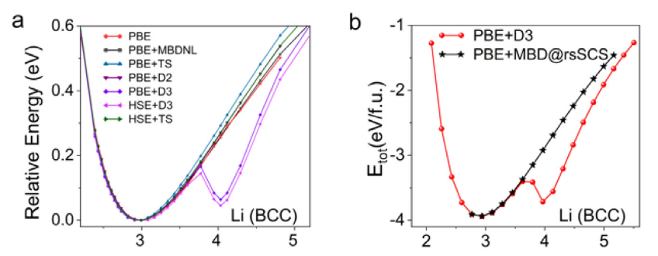
Diagnostic Tool: Potential Energy Surfaces (PES)
The primary diagnostic tool is the Potential Energy Surface (PES), plotting total system energy against atomic configuration (bond length).
Physically, a stable solid should exhibit a single, well-defined global minimum representing the equilibrium lattice structure.
However, scans using DFT-D3 frequently reveal a secondary, unphysical minimum appearing at extended bond distances.

Slide 21
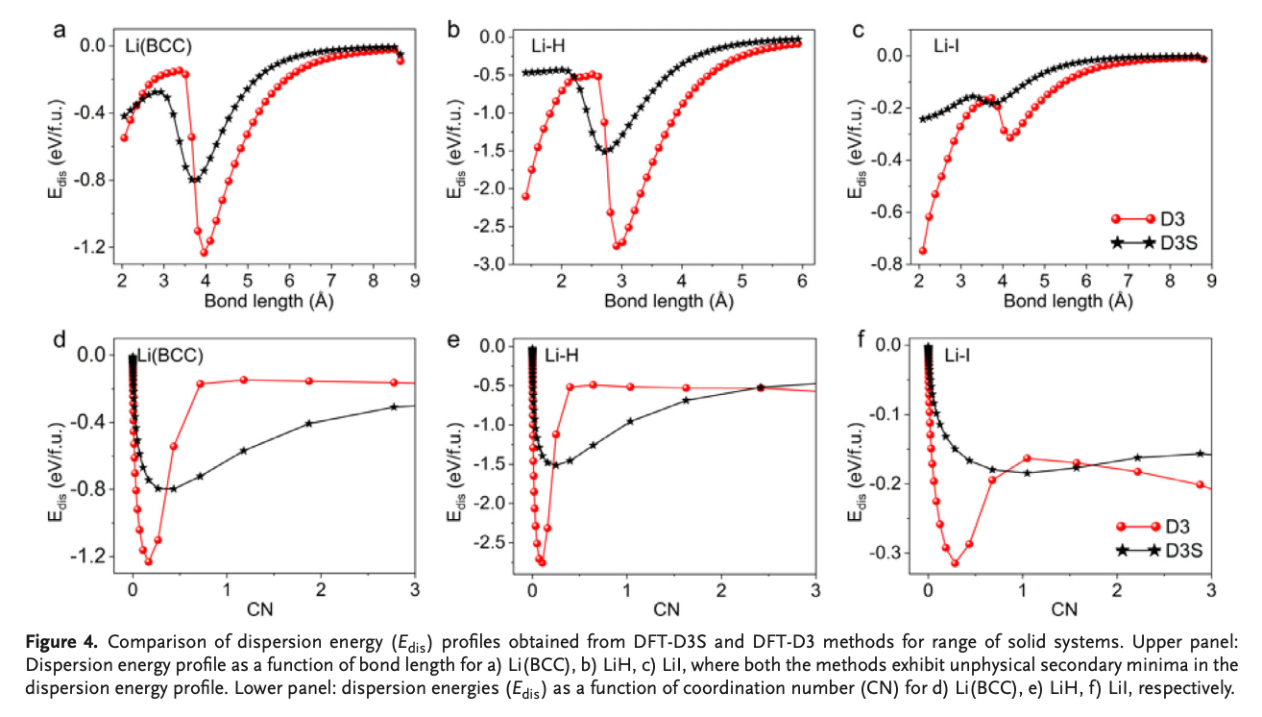
Visualizing the Artifact in Bulk Lithium
Examining the PES of body-centered cubic (BCC) Lithium.
Both standard PBE+D3 and hybrid HSE+D3 calculations manifest a massive, erroneous secondary energy well near 4 $Å$.
This secondary minimum suggests a false stable phase that physically does not exist.
When recalculated using the rigorous PBE+MBD method, this second minimum completely vanishes, proving it is a pure D3 artifact.

Slide 22
Cross-Chemical Manifestation of Errors
This overbinding artifact is not isolated to Lithium metal.
Identical unphysical secondary minima appear clearly in the PES of Cesium Chloride (Cs-Cl) and Lithium Hydride (Li-H) under D3 corrections.
A computational method predicting fake energy minima leads to severe downstream consequences.
Errors manifest as incorrect lattice parameters, false phase stabilities, and highly misleading thermodynamic predictions.
Notes:
Overbinding: This means the D3 math is adding too much artificial "glue." It is over-calculating the attractive force, making the atoms stick together much harder than they do in reality.
Not isolated: The researchers proved this isn't just a quirky bug that only happens in pure Lithium. It systematically corrupts calculations for a wide variety of materials, particularly ionic salts (like CsCl) and hydrides (LiH), because they contain highly polarizable ("squishy") electron clouds.

Slide 23
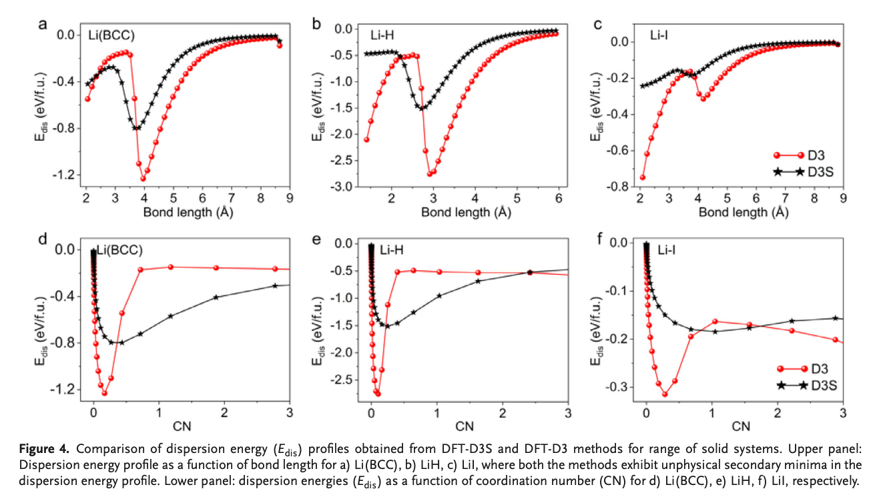
Isolating the Dispersion Term
To definitively prove the functional is not to blame, the authors isolated and plotted the dispersion energy ($E_{disp}$) component independently.
For systems like Li-H and Li(BCC), the isolated dispersion energy curve itself violently dips, creating a deep minimum.
This irrefutably confirms the artifact originates entirely within the mathematical logic of the D3 correction term.

Slide 24
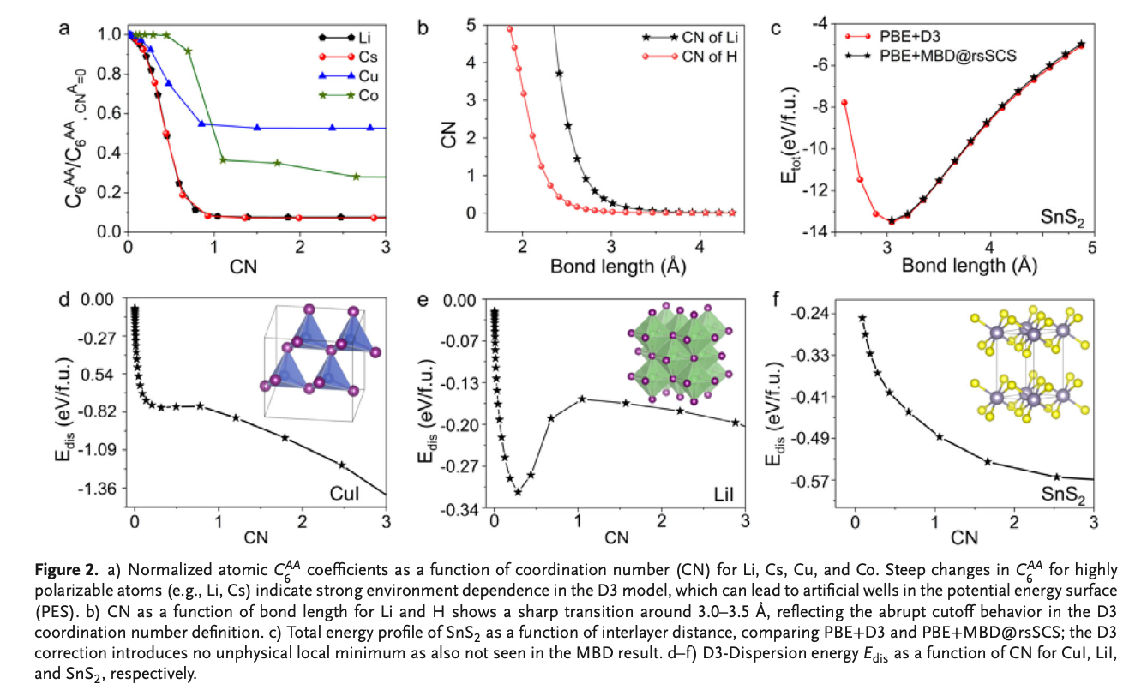
The Contrast: When D3 Works Perfectly
Interestingly, the anomaly is not universally present across all solid states.
The PES curves for Copper Iodide (Cu-I) and Tin Disulfide ($SnS_{2}$) exhibit perfectly smooth, monotonic behavior under D3.
For these systems, D3 matches the physical accuracy of MBD without introducing spurious wells.
This system-dependent behavior hints that atomic polarizability and specific bonding regimes trigger the mathematical failure.
Notes:
D3 works perfectly for some materials: In specific systems (like standard organic molecules or tightly bound insulators), the computationally cheap D3 method is just as accurate as the highly expensive MBD method. It correctly predicts the physical structure without creating any fake energy valleys.
The glitch is conditional: Because the D3 math doesn't break every time, the researchers deduced that the failure is entirely dependent on the specific chemistry of the material being simulated.
The specific triggers: The artificial energy wells are specifically activated when the material contains atoms with highly flexible, "squishy" electron clouds (atomic polarizability) placed in dense, crowded environments (bonding regimes, such as metallic or ionic lattices).

Slide 25
Diagnosing the Mathematical Root Cause
Why does the D3 term randomly collapse? The flaw lies in its core innovation: environmental adaptability.
D3 dispersion coefficients strictly depend on the computed coordination number (CN).
Highly polarizable atoms (like Li and Cs) have vastly different electronic screening properties depending on their environment.
The D3 model attempts to adapt to this by interpolating $C_{6}$ values, but the mathematical transition is severely flawed.
Notes:
The "Smart" Feature is the Bug: D3's biggest upgrade—dynamically changing its dispersion strength ($C_6$) based on how many neighbors an atom has (Coordination Number)—is exactly what causes the failure.The Problem with "Squishy" Atoms: Highly polarizable elements like Lithium (Li) or Cesium (Cs) have massive, loose electron clouds. When packed into a dense crystal, these clouds get heavily distorted and shielded by their neighbors. This means their true van der Waals pull drops drastically compared to when they are isolated.The Mathematical Crash: To account for this drop, the D3 software uses a formula to blend (interpolate) between "high dispersion" and "low dispersion" settings as atoms get closer together. However, for these specific squishy atoms, this mathematical switch isn't smooth. It triggers too aggressively, causing the calculated $C_6$ value to suddenly plummet. This abrupt mathematical collapse creates the fake energy valley on your graph.

Slide 26
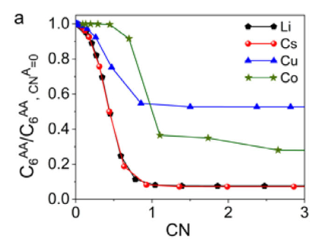
The Extreme Sensitivity of $C_{6}$ Interpolation
Plotting normalized $C_{6}$ coefficients against coordination number reveals the mechanical failure.
For highly polarizable metals like Li and Cs, the $C_{6}$ value plummets drastically and sharply as CN increases.
By contrast, elements like Cu and Co experience much shallower, more gradual transitions.
Because of the fixed $k_{3}=4$ parameter in the $L_{ij}$ weighting function, small shifts in CN cause massive, violent shifts in dispersion energy for polarizable metals.

Slide 27
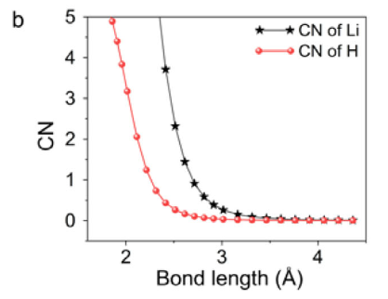
The Cutoff Function Anomaly
The second layer of the failure lies in how CN responds to bond distance.
In systems like LiH, plotting CN versus bond length shows that CN does not change smoothly.
Instead, it jumps rapidly and abruptly at a critical threshold (around 3.0-3.5 $Å$).
This is a direct artifact of the exponential cutoff function defined in the initial D3 coordination math.

Slide 28
The Cascade of Failure (Mechanism)
The spurious minimum is the result of a predictable, step-by-step mathematical cascade.
1. The atomic bond distance increases slightly.
2. The exponential D3 formula triggers a rapid, discontinuous change in Coordination Number.
3. The sharp interpolation logic forces an abrupt collapse in the $C_{6}$ dispersion coefficient.
4. The total dispersion energy drops suddenly, yielding an artificial energy well.
Notes:
The Physical Trigger: You stretch the crystal slightly, moving the atoms just a fraction further apart.The "Lost Neighbor"
Glitch: Because the D3 formula for calculating the Coordination Number (CN) uses a harsh exponential curve, it overreacts to this tiny stretch. It mathematically decides an atom abruptly "lost" a neighbor, causing the CN score to plummet instantly instead of fading smoothly.
The Math Snaps: D3 relies on that CN score to choose the correct $C_6$ dispersion strength. Because the CN dropped so violently, the strict mathematical blending function (the $k_3$ parameter) cannot transition smoothly. The $C_6$ coefficient snaps abruptly to a new value.
The Fake Valley Forms: This sudden mathematical collapse registers as a massive, artificial shift in total attractive energy. On your potential energy graph, this sudden drop carves out the fake valley (the spurious minimum), tricking the software into thinking it found a stable physical state.

Slide 29
Evaluating the D3S Successor Model
Recognizing these steep interpolation flaws, researchers previously developed the D3S variant.
D3S was explicitly engineered to mathematically smooth the interpolation of dispersion coefficients.
It abolishes the fixed global $k_{3}$ parameter, replacing it with element-specific interpolation parameters and pair-dependent smoothing factors.
This adjustment forces the variation of $C_{6}$ to become physically smoother across coordination changes.

Slide 30
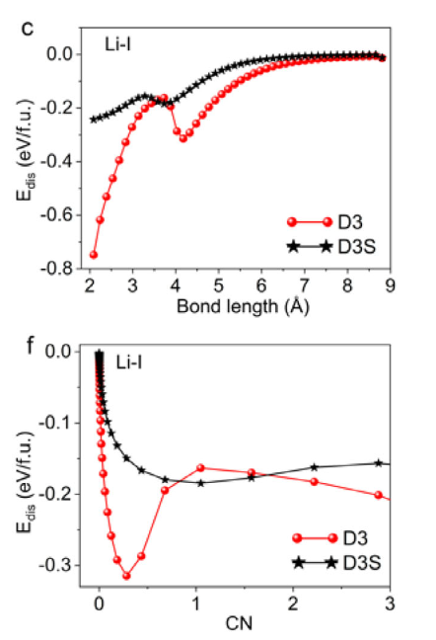
The Failure of D3S in Extended Solids
Does D3S solve the problem for periodic solid materials? No.
While D3S successfully reduces the absolute magnitude of the dispersion errors, it fails to eliminate the artifacts entirely.
Unphysical secondary minima continue to persist in the energy profiles of ionic and metallic systems like Li-I and Cs-Cl.
D3S was parameterized for isolated molecules; its pairwise smoothing cannot replicate the complex many-body electronic screening required in dense solids.

Slide 31
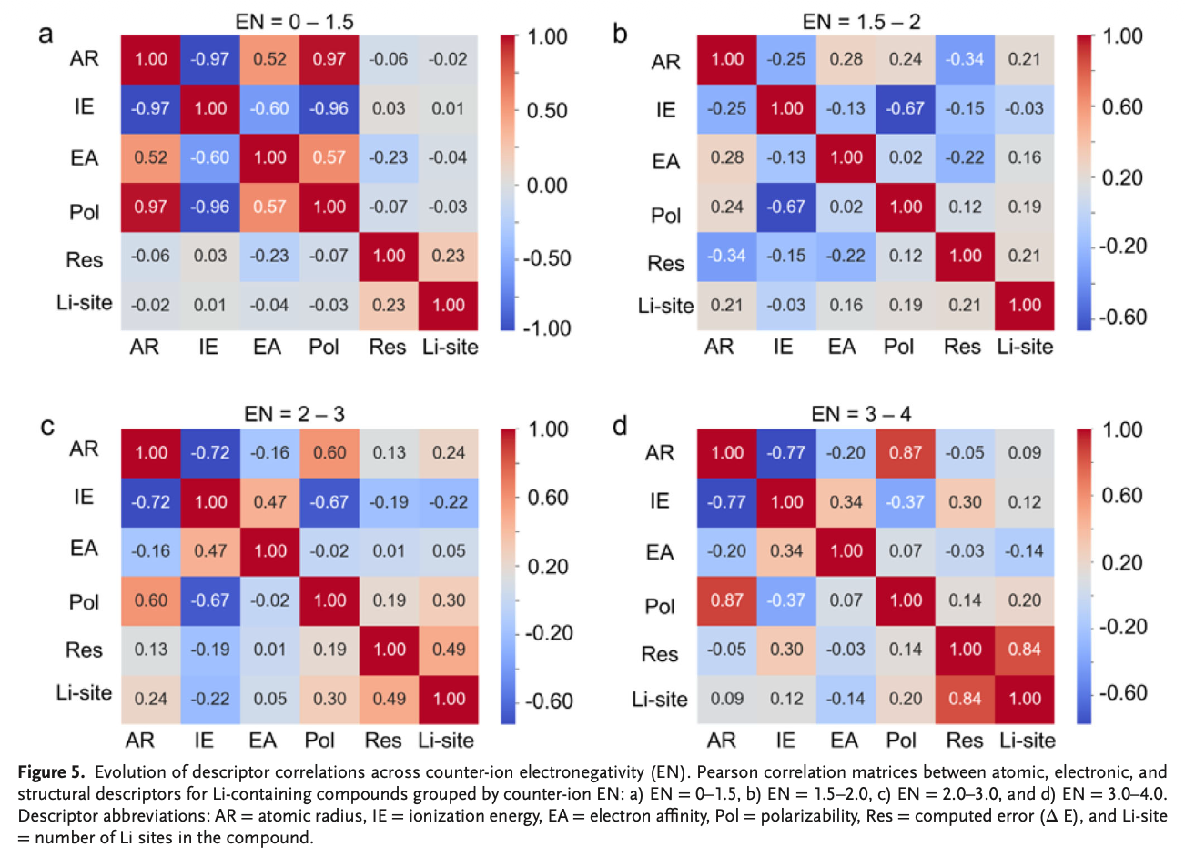
Data-Driven Descriptor Analysis
To predict failure states without running MBD references, the authors mapped errors against chemical descriptors.
Evaluated atomic radius, polarizability, electronegativity, ionization energy, and electron affinity.
In regimes with low counter-ion electronegativity (EN = 0 - 1.5), error correlations are highly complex.
Atomic radius and static polarizability show intense covariance, but no single descriptor perfectly predicts the magnitude of the D3 error.

Slide 32
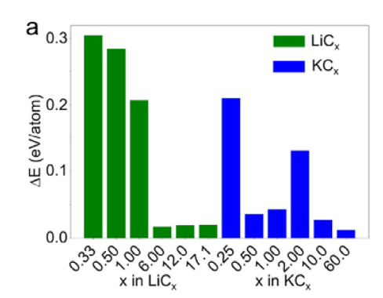
The Impact of Stoichiometry
Error magnitudes are exceptionally sensitive to exact stoichiometry and specific bonding motifs.
Comparing Lithium Carbides ($LiC_{x}$) and Potassium Carbides ($KC_{x}$) reveals massive disparities.
At low carbon stoichiometries ($LiC_{0.33}$), the unphysical D3 error is massive.
As carbon content increases (e.g., $LiC_{12}$ or $KC_{60}$), the error effectively vanishes.

Slide 33
Covalency as a Mitigation Mechanism
Why does increased carbon content erase the artifact?
Higher carbon content fundamentally shifts the solid from a metallic/ionic regime into an extended covalent $π$-network.
Strong covalent bonding physically restricts atomic fluctuations and dominates the energy landscape, overpowering the artificial pairwise dispersion artifacts.

Slide 34
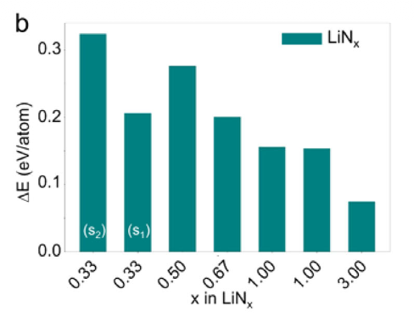
Structural Polymorphs: The Final Proof
Even if chemical stoichiometry is held constant, the physical packing density dictates D3's failure.
Evaluating different crystal polymorphs of Lithium Nitride ($LiN_{x}$) proves this concept.
Denser atomic packing drastically amplifies the mathematical overbinding caused by the D3 interpolation.
Tighter geometries force atoms into the exact transitional coordination zones where the $C_{6}$ interpolation acts erratically.

Slide 35
Systems Where DFT-D3 Excels
Despite these severe warnings, DFT-D3 remains a powerful tool when applied to appropriate material classes.
Covalent Frameworks: Systems dominated by strong orbital overlap (e.g., bulk silicon, diamond).
Layered Materials: Systems governed by distinct, well-separated vdW gaps (e.g., graphite, $MoS_{2}$, $SnS_{2}$).
Low Metal-Content Structures: Intercalation compounds where highly polarizable metals are dilute.

Slide 36
Systems Where DFT-D3 Must Be Avoided
Applying standard DFT-D3 or D3S to the following systems requires extreme caution and ideally MBD validation.
Metallic Solids: Bulk alkali and transition metals where delocalized electrons dominate and require many-body screening.
Dense Ionic Compounds: Tightly packed lattices with steep coordination gradients.
Highly Polarizable Lattices: Any dense structure containing a high density of elements like Li, Cs, or heavy halides.

Slide 37
Synthesis of the Research
The Diagnosis: DFT-D3 produces systemic, spurious secondary energy minima in solids due to mathematical artifacts.
The Root Cause: The fixed interpolation logic linking $C_{6}$ coefficients to abrupt changes in calculated coordination numbers.
The Successor Limit: D3S smooths the math but fundamentally lacks the physics (many-body effects) required to truly fix the issue in metallic/ionic solids.
The Variable Scope: Errors are heavily amplified by local structural density and atomic polarizability.

Slide 38
Conclusion and Best Practices
DFT-D3 cannot be treated as a universally reliable "black box" solution for extended solid-state periodic calculations.
Uncritical application can lead to the discovery of "ghost phases"—structures mathematically stabilized by dispersion artifacts rather than physics.
Recommendation: When modeling novel dense ionic or metallic systems, computational chemists must validate D3 structural phase predictions against rigorous Many-Body Dispersion (MBD) frameworks

