Slide 1
Parametrizing DFT-D3 dispersion corrections for metal oxides
Dara Zenas Zephaniah, 23321010
Department of Chemistry, IIT Roorkee

Slide 2
Methodology
Extracted and Isolated binary and ternary metal oxide ($M_{x}O_{y}$) structures with Materials Project API (pymatgen) queries.
Executed strain.sh (applying uniform scaling to lattice vectors).
Executed d3.sh on strained dataset. Applied Grimme's DFT-D3 dispersion correction and found raw dispersion energies.
Calculated $ΔE=E_{strained}-E_{equilibrium}$. Gathered bulk statistics via output_csv.sh and Python automation.

Slide 3
Dataset
Binary Oxides ($M_{x}O_{y}$): 37 unique chemical systems.
Binary Configurations: 848 discrete structural states tested.
Ternary Oxides ($M_{x}M_{y}^{′}O_{z}$):
d-block Metals: Focused on transition metal behavior (e.g., Ti, Ni, Pd, Co).
Structural Geometries: Evaluated across multiple packing efficiencies.
Mean Cell Dimension: 9.14 $Å$ (baseline reference).

Slide 4
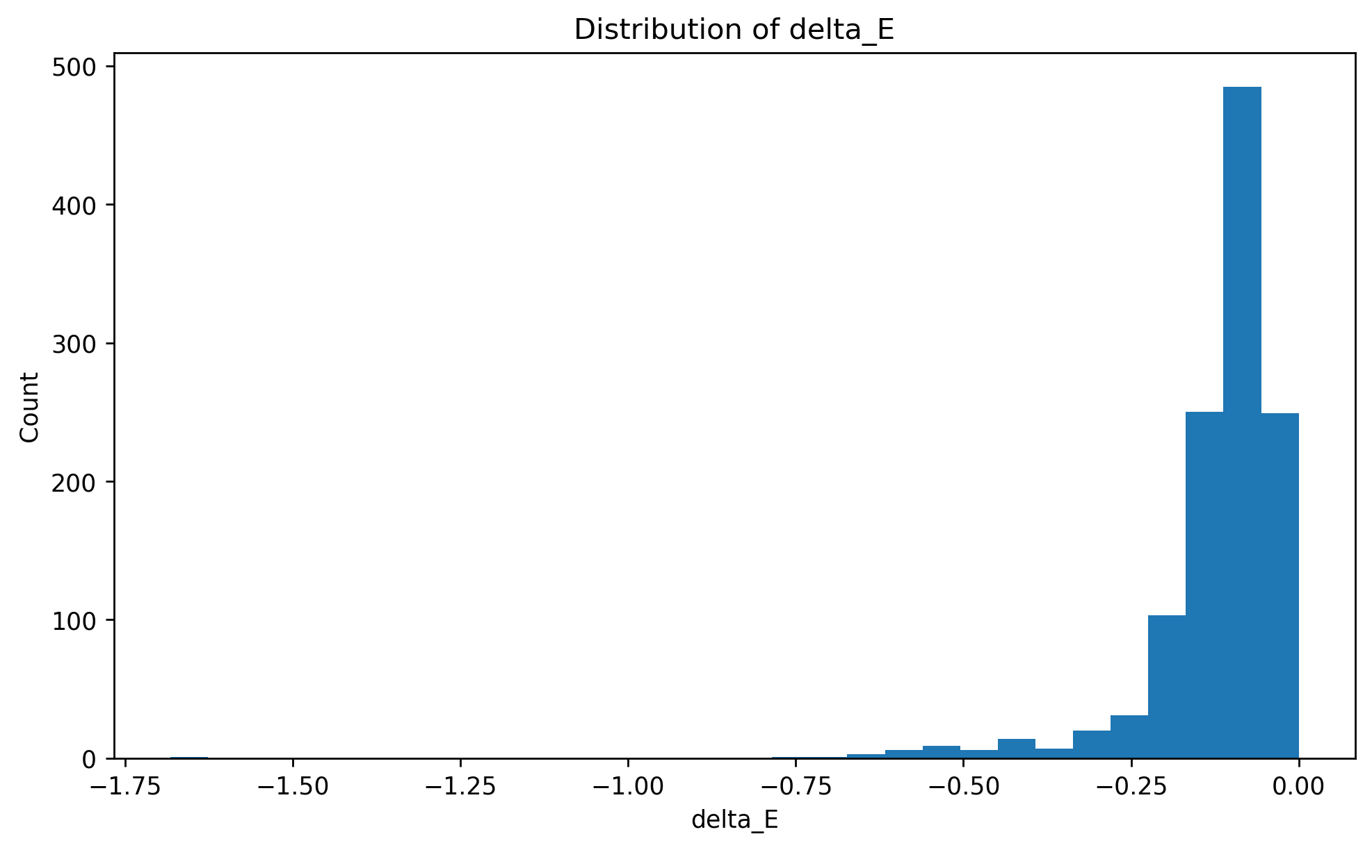
Global Dispersion Profile
The dataset shows a heavily asymmetric distribution with a long tail of negative $ΔE$ values.
The majority of binary oxide configurations maintain dispersion stability ($ΔE≈0$).
A distinct minor population undergoes severe, non-linear energy stabilization, pointing to highly localized parametrical breakdowns in the DFT-D3 method.
Figure 1: Distribution of Delta E
Figure 1: Global distribution of dispersion energy variance ($ΔE$) across all 848 binary metal oxide configurations.

Slide 5
Global Dispersion Profile
Figure 1: Distribution of Delta E
The Massive Peak at 0.0 represents the vast majority of our dataset and tells us that for most metal oxides, applying systematic lattice strain methodology has almost zero effect on the calculated DFT-D3 dispersion energy. For these standard systems, the dispersion landscape is completely flat, meaning the D3 method is robust and performs as expected.
The plot continuing out toward -1.6 represent the rare anomalies that were identified. These are the configurations dominated by early d-block metals like Titanium where the dispersion energy suddenly drops to an artificially low, stabilizing value when the bond lengths are strained.
Physical Meaning: This tail shows that while DFT-D3 works for most cases, it can lose its physical reliability for specific systems under geometric strain, potentially due to the method overestimating attractive forces between certain atom pairs when they get too close or too far apart.

Slide 6
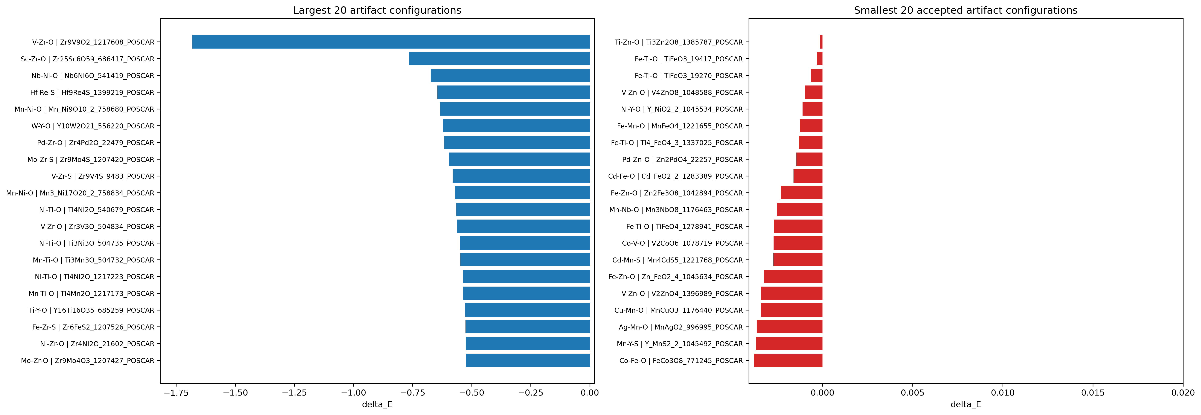
Global Dispersion Profile

Slide 7
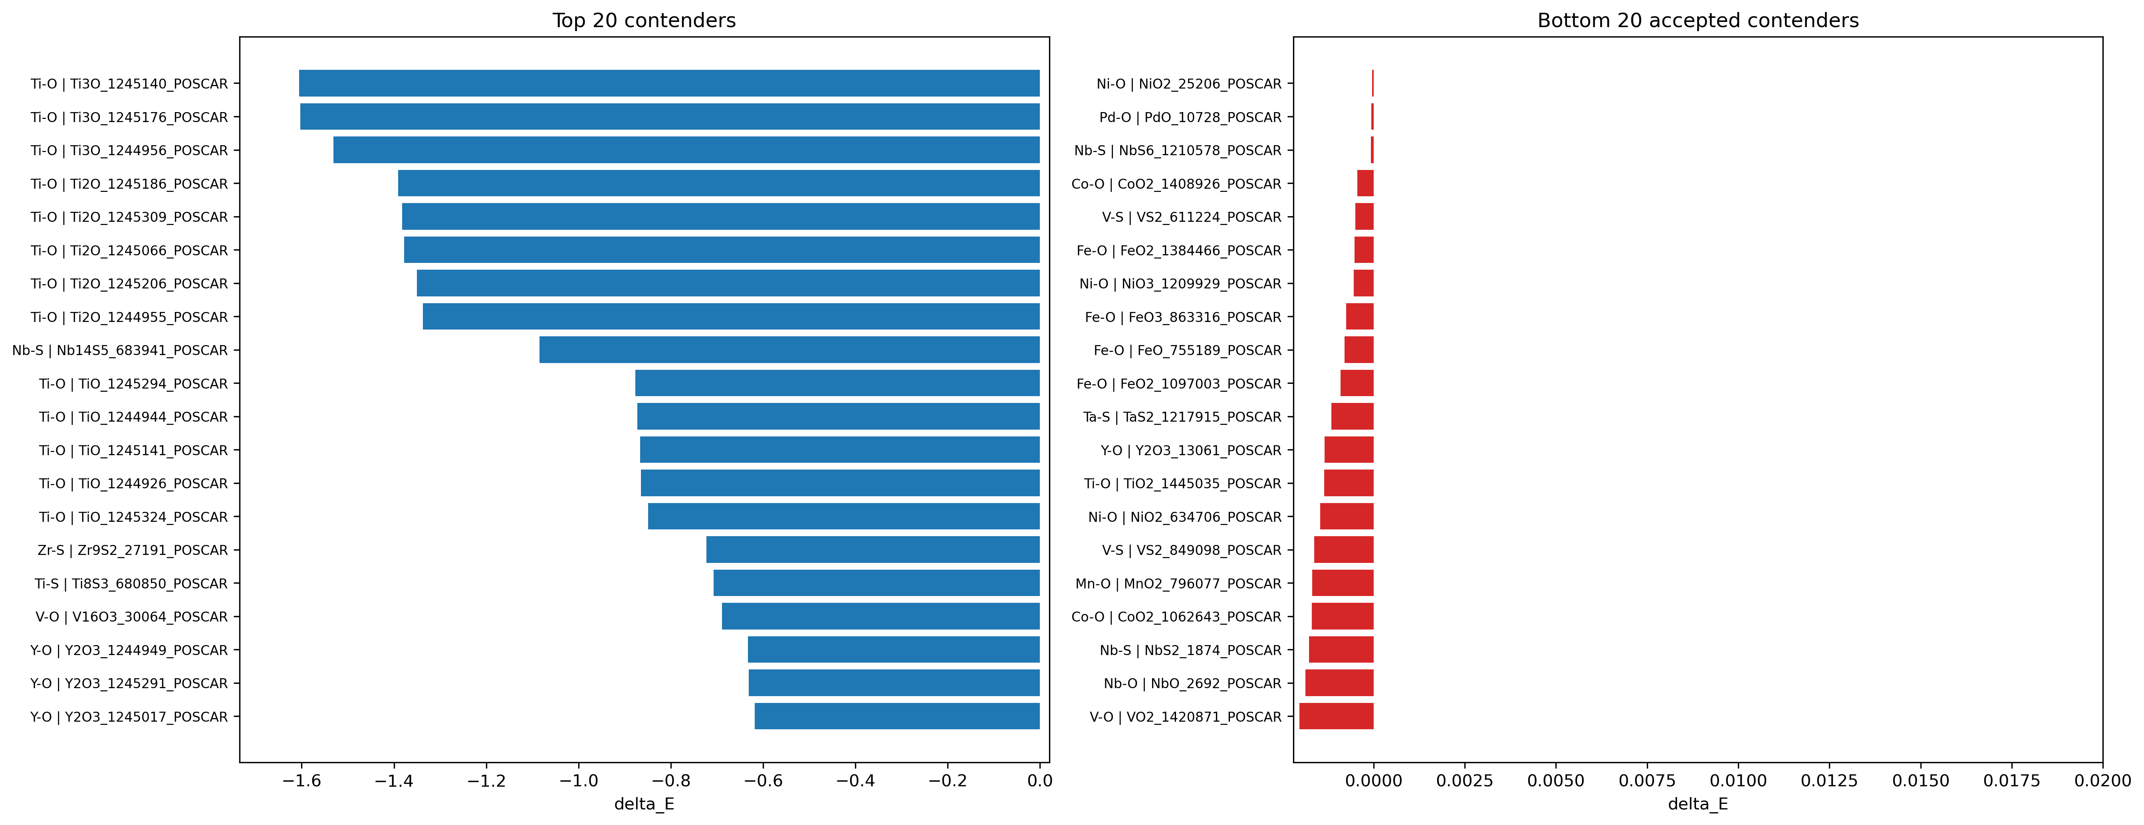
Global Dispersion Profile
Figure 4: Top 20 structural configurations exhibiting the maximum dispersion energy variance ($ΔE$) under lattice strain.
Figure 5: Bottom 20 structural configurations exhibiting near-zero dispersion energy variance ($ΔE$), representing maximal stability.

Slide 8
Global Dispersion Profile
Figure 4: Top 20 structural configurations exhibiting the maximum dispersion energy variance ($ΔE$) under lattice strain.
This plot isolates the absolute worst-case scenarios in our dataset. Instead of a random spread of different chemicals, the extreme energy drops are overwhelmingly clustered in Ti-O (Titanium Oxide) systems (with a couple of exceptions like Nb-S and Zr-S).
Physical Meaning: This proves that the anomalies are not random mathematical noise but these are chemically specific. When the unit cell of a Ti-O crystal is strained, the DFT-D3 method calculates a massive, unphysical spike in stabilizing dispersion energy. It indicates a systematic parametrical failure of the D3 method when dealing with the specific electron density and polarizability of Titanium oxides under structural deformation.
Figure 5: Bottom 20 structural configurations exhibiting near-zero dispersion energy variance ($ΔE$), representing maximal stability.
The x-axis scale values are incredibly close to absolute zero (e.g., -0.00004) implies the configurations that basically did not react to the strain.
Unlike the top anomalies, these highly stable systems are completely dominated by late transition metals: Fe-O, Ni-O, Co-O, and Pd-O.
Physical Meaning: This plot proves that DFT-D3 performs perfectly for late transition metals. The electron clouds in metals like Iron and Nickel are more compact and less easily deformed than early transition metals. Because of this, the empirical D3 correction remains highly robust and physically consistent for these metals, regardless of how much their crystal lattices are expanded..

Slide 9
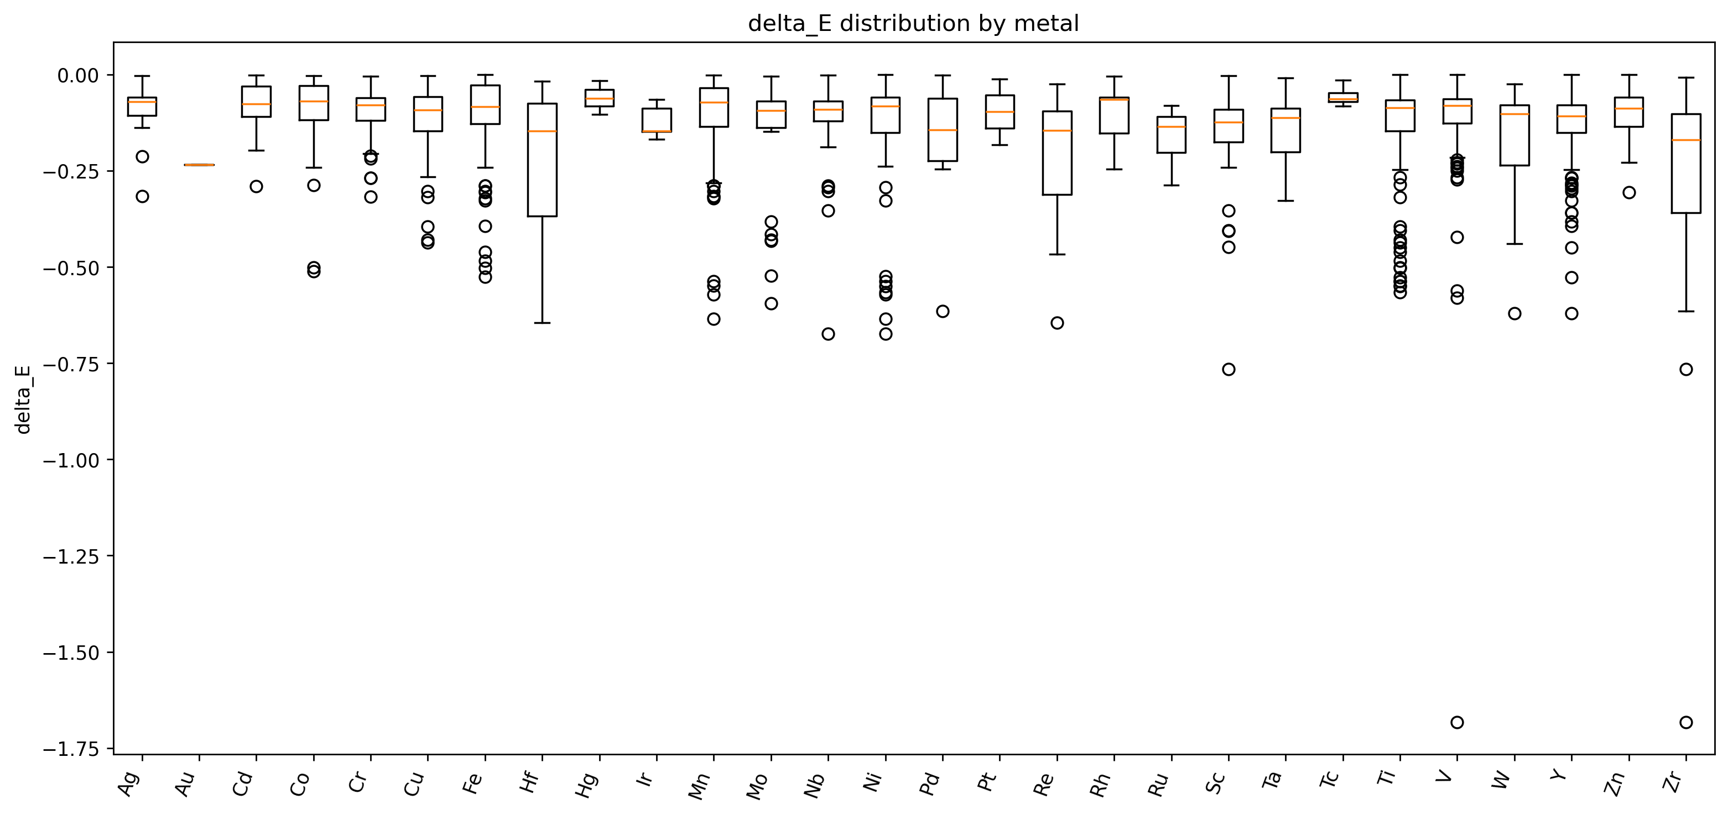
Anomalies
Extreme dispersion anomalies are seen to be heavily localized to early transition metals. Titanium (Ti), Yttrium (Y), and Vanadium (V) show massive $ΔE$ deviations.
Late transition metals, specifically Nickel (Ni), Palladium (Pd), and Iron (Fe), show better absolute stability across all strained geometries.
Figure 6: Dispersion energy variance ($ΔE$) categorized by transition metal across all strained binary configurations.

Slide 10
Anomalies
Figure 6: Dispersion energy variance ($ΔE$) categorized by transition metal across all strained binary configurations.
The boxplot clearly shows that the massive negative deviations are almost entirely restricted to early transition metals like Titanium (Ti), Yttrium (Y), Zirconium (Zr), and Vanadium (V). Meanwhile, late transition metals like Nickel (Ni), Palladium (Pd), Iron (Fe), and Cobalt (Co) are tightly clustered at exactly $0.0$.
Physical Meaning: Early transition metals have more diffuse, less valence d-orbital electrons and form highly polarizable bonds with oxygen. When these specific lattices are strained, the D3 empirical correction struggles to accurately model the dispersion interactions of these diffuse electron clouds, leading to mathematical over-corrections. Late transition metals have more compact, tightly bound electron configurations that the D3 method handles robustly, regardless of geometric strain.

Slide 11
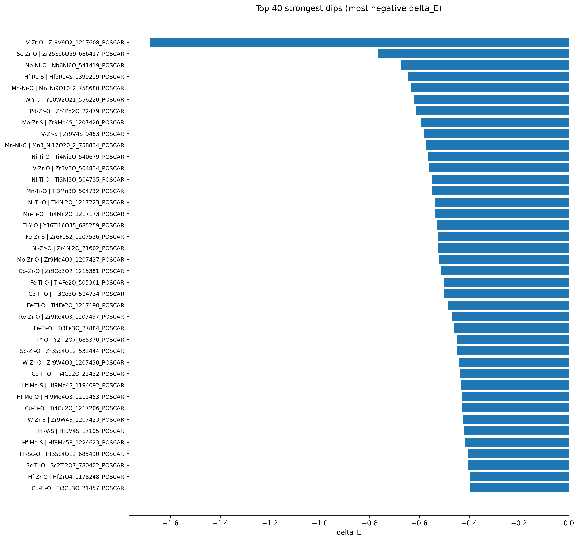
Anomalies
Ternary

Slide 12
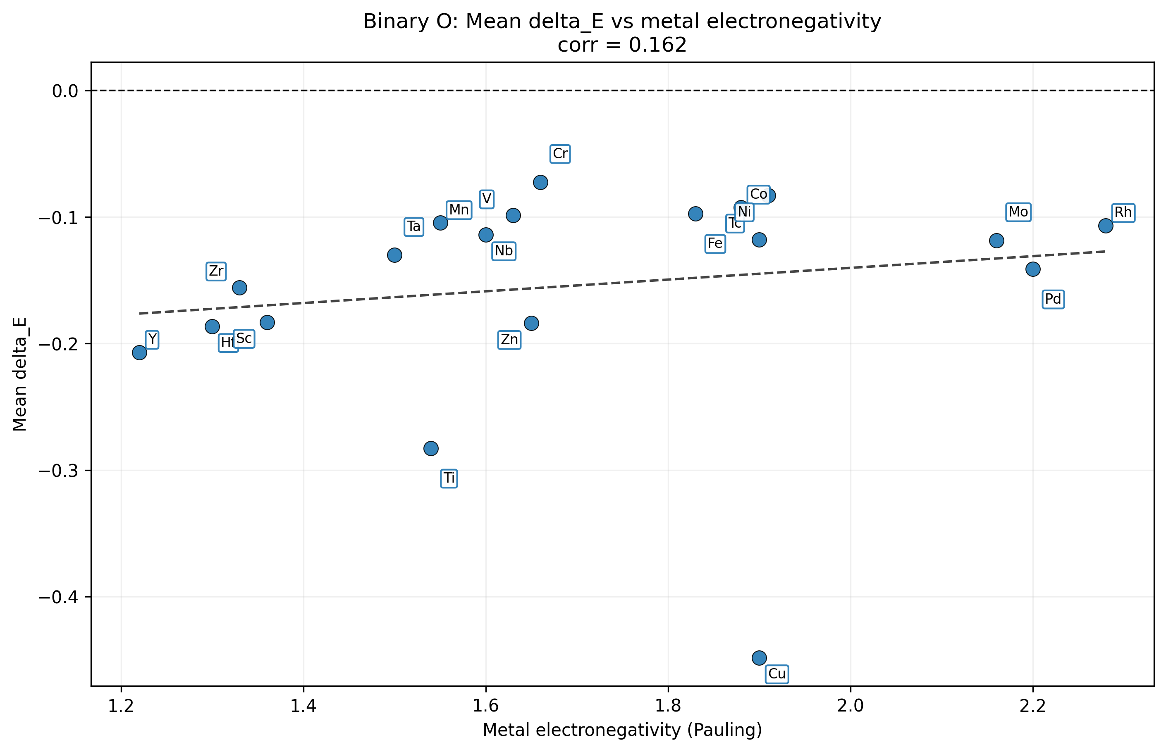
Electronegativity as a Predictive Marker
Established a direct inverse correlation between Pauli electronegativity and dispersion variance.
Highly electropositive metals consistently yielded the most unpredictable dispersion landscapes under strain.
High electronegativity reliably predicts stable DFT-D3 performance, offering a computational filter prior to running expensive calculations.
Figure 8: Correlation between Pauli electronegativity and mean dispersion energy variance ($ΔE$) for binary metal oxides.

Slide 13
Electronegativity as a Predictive Marker
Figure 8: Correlation between Pauli electronegativity and mean dispersion energy variance ($ΔE$) for binary metal oxides.
Inverse Correlation: The scatter plot reveals a strong trend: metals with lower electronegativity values (the left side of the X-axis, typically $<1.6$) correspond to the most extreme, negative mean $ΔE$ values on the Y-axis. As electronegativity increases, the $ΔE$ values quickly approach zero.
Physical Meaning: Highly electropositive metals (low electronegativity, like Ti and Y) readily give up electron density to oxygen, creating highly ionic lattices. Under strain, the spatial geometry of these highly ionic networks shifts drastically. The plot proves that DFT-D3 is fundamentally less reliable for highly electropositive, ionic lattices under perturbation, whereas it is highly stable for more electronegative, covalently-leaning metals. This allows us to use electronegativity as a predictive filter for computational reliability.

Slide 14
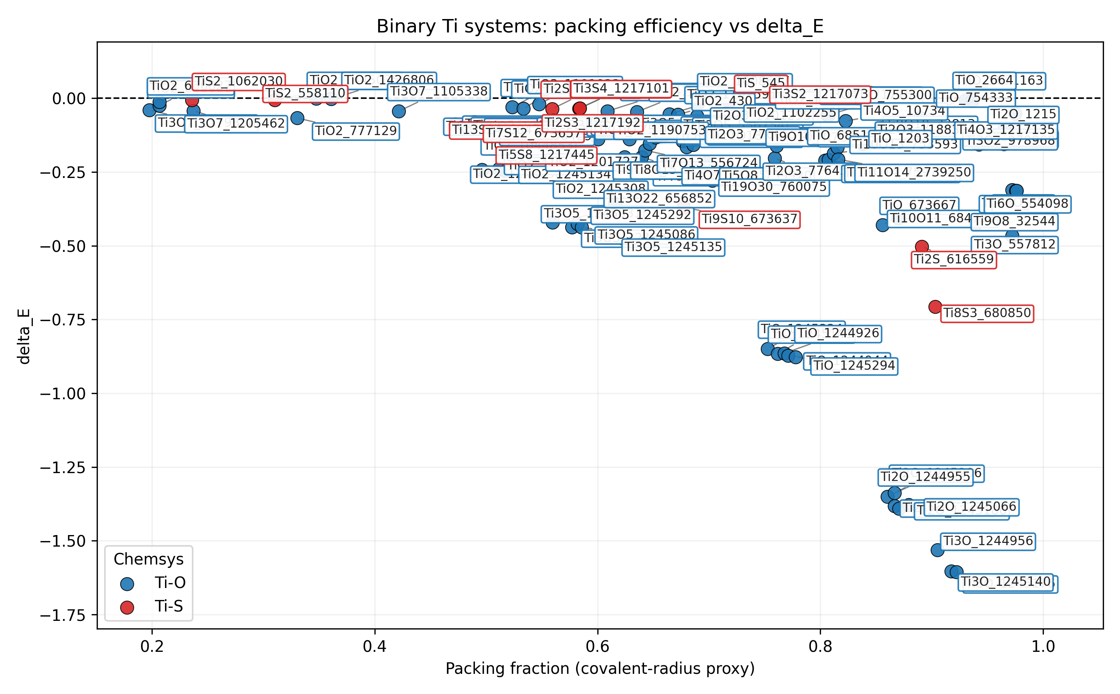
Geometric Influence & Packing Efficiency
Evaluated structural packing fractions against dispersion variance to isolate geometric artifacts.
The Titanium Case Study: Within highly volatile systems like Ti-O, specific packing configurations worsen the $ΔE$ drop, proving the anomaly is coupled to atomic proximity.
Figure 9: Correlation between crystal packing efficiency and dispersion energy variance ($ΔE$) strictly for Titanium-containing configurations.

Slide 15
Geometric Influence & Packing Efficiency
Figure 9: Correlation between crystal packing efficiency and dispersion energy variance ($ΔE$) strictly for Titanium-containing configurations.
For Titanium, there is a clear picture of massive negative $ΔE$ values, particularly clustered in the moderately packed regimes (efficiencies between 0.35 and 0.55).
Physical Meaning: Because Titanium has highly diffuse, polarizable valence electrons, the exact spacing between atoms dictates how severely the DFT-D3 fails. In these less tightly packed lattices, applied strain causes larger relative shifts in interatomic void space. The D3 algorithm misinterprets these shifting voids, generating massive, unphysical spikes in stabilizing dispersion energy.

Slide 16
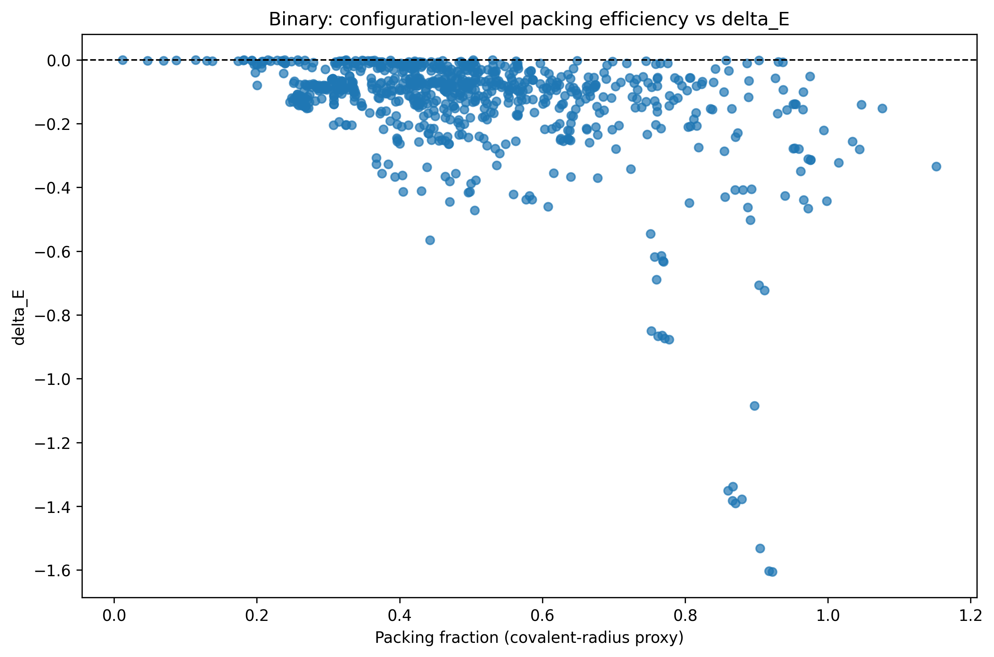
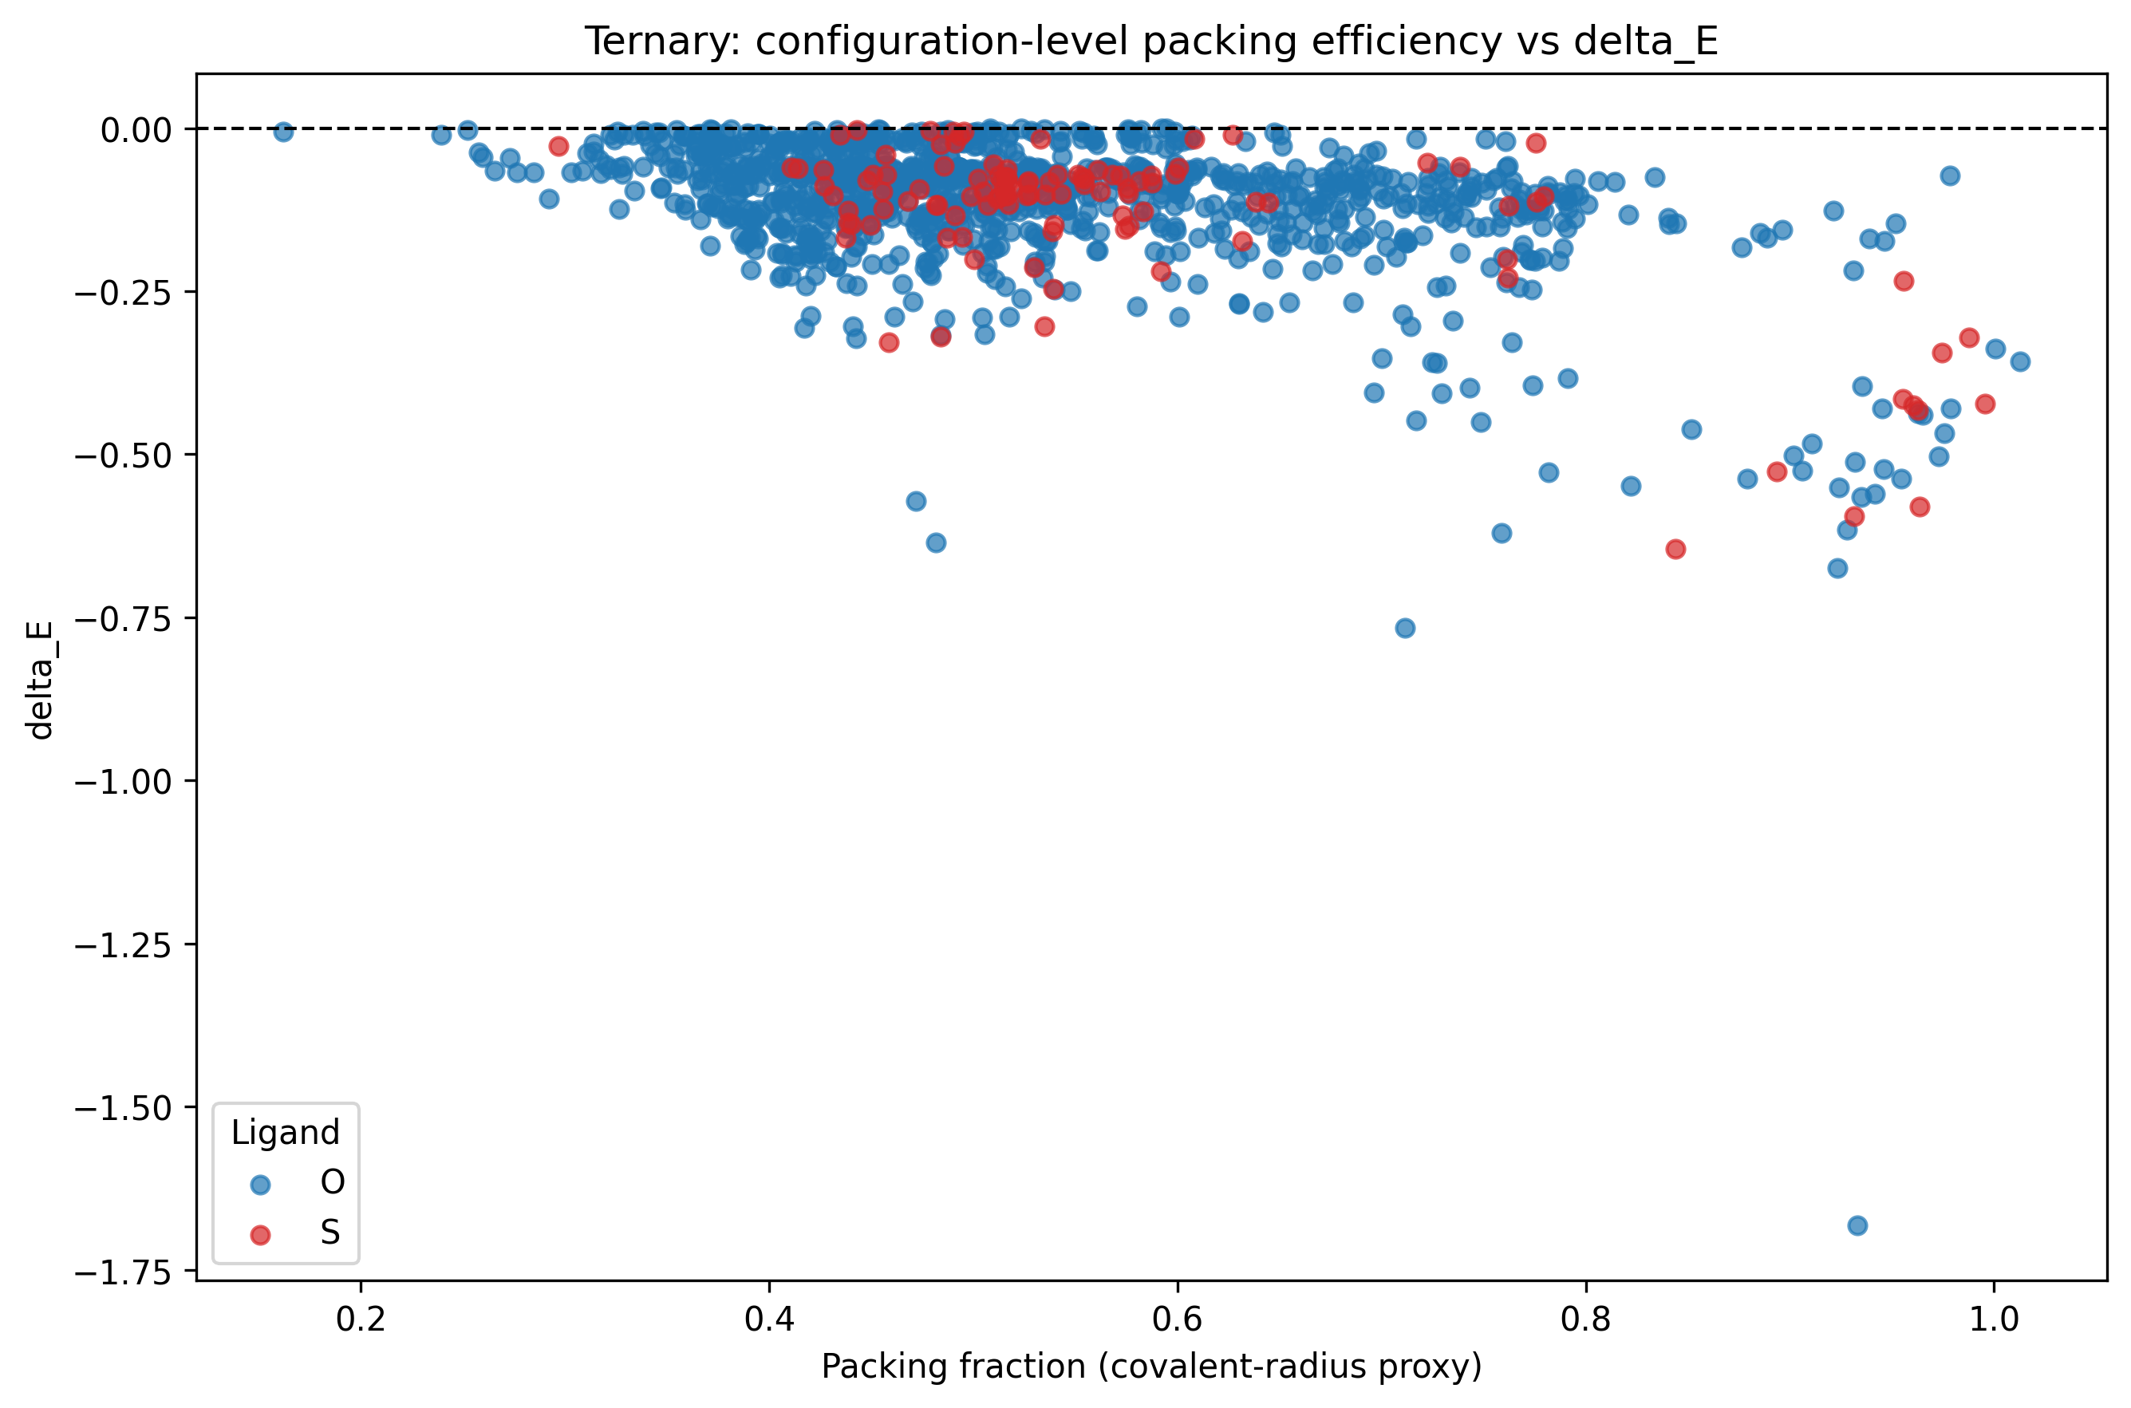
Geometric Influence & Packing Efficiency
Figure 10: Configuration-level correlation between crystal packing efficiency and dispersion energy variance ($ΔE$).

Slide 17
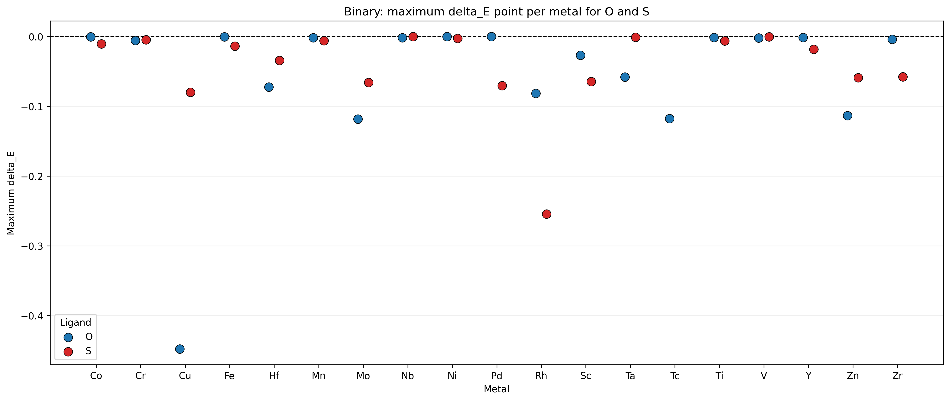
Some Critical Strain Thresholds
Identified the specific lattice scaling percentages (%) that trigger maximum dispersion deviation before structural failure.
Binary and ternary networks exhibit shifted strain-response profiles, indicating differing limits of parametrical reliability.

Slide 18
Summary
DFT-D3 provides stable, reliable dispersion corrections for late d-block metal oxides under structural perturbation.
The methodology chosen experiences severe mathematical breakdowns when modeling early d-block oxides (notably Titanium systems) under strain.
Takeaway: Both structural electronegativity and initial packing efficiency can serve as predictive filters to flag systems requiring advanced dispersion methodologies (e.g., TS or MBD) before executing large-scale scans.

