Slide 1

CROWD COUNTING
Presented By:
Aditi Vishwakarma (02)
Priyal Sanklecha (18)
Tanaya Kathale (31)
Zainab Ali(35)
Anshul Chauhan(56)
Guided By:
Prof. Sweta Jain
Shri Ramdeobaba College Of Engineering And Management

Slide 2
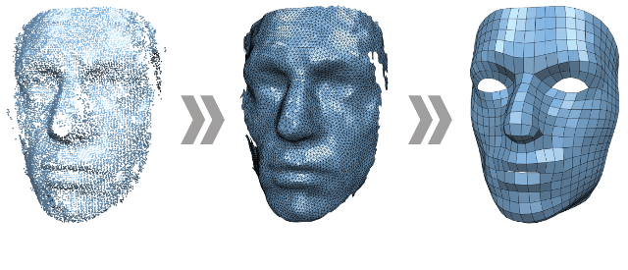
Problem Definition
Increasing population has been an important subject since many years.
Crowd disasters, uncleaned washrooms, poor analysis of crowd leading to improper customer satisfaction
Crowd Counting combines preprocessing the image , counting the number, doing analysis and taking actions accordingly.

Slide 3

Key Ideas
2. The web application accepts images, videos and preprocesses it with the help of algorithm.
1. Aim is to capture and image and count number of faces with maximum accuracy.
3. Count has been calculated from the processed image
4. Analysis can be done on the basis of crowd count in certain place and actions taken accordingly.

Slide 4
What have we done yet??

Slide 5
..
What have we done yet?

Slide 6
Image Processing

Slide 7
What is image processing?
Image processing is the use of computer algorithms to process digital images.
It is used for analysis and manipulation of a digitized image, especially in order to improve its quality.
Opencv is used for object detection.
Keras and tensorflow are used for perception, understanding, discovering,prediction and creation of image.

Slide 8
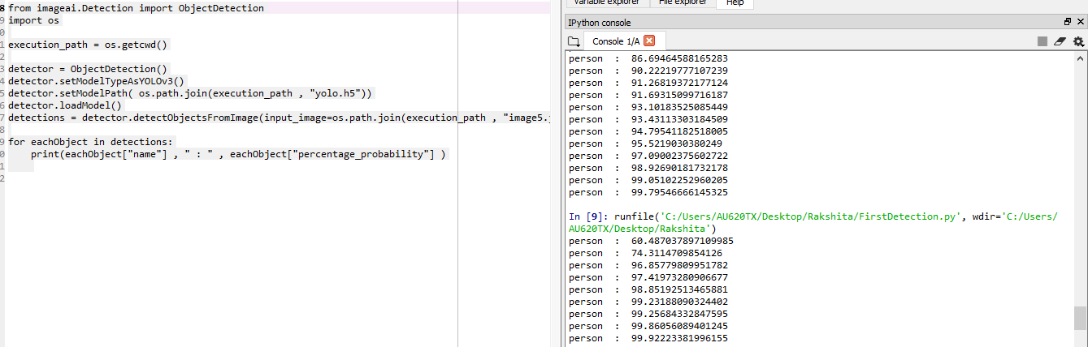

Slide 9
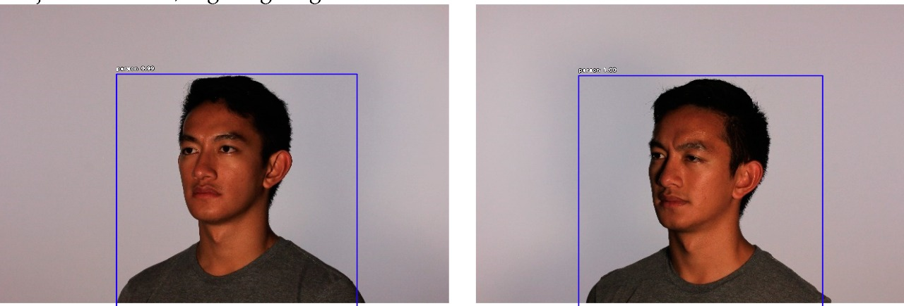
An example to make it clear

Slide 10
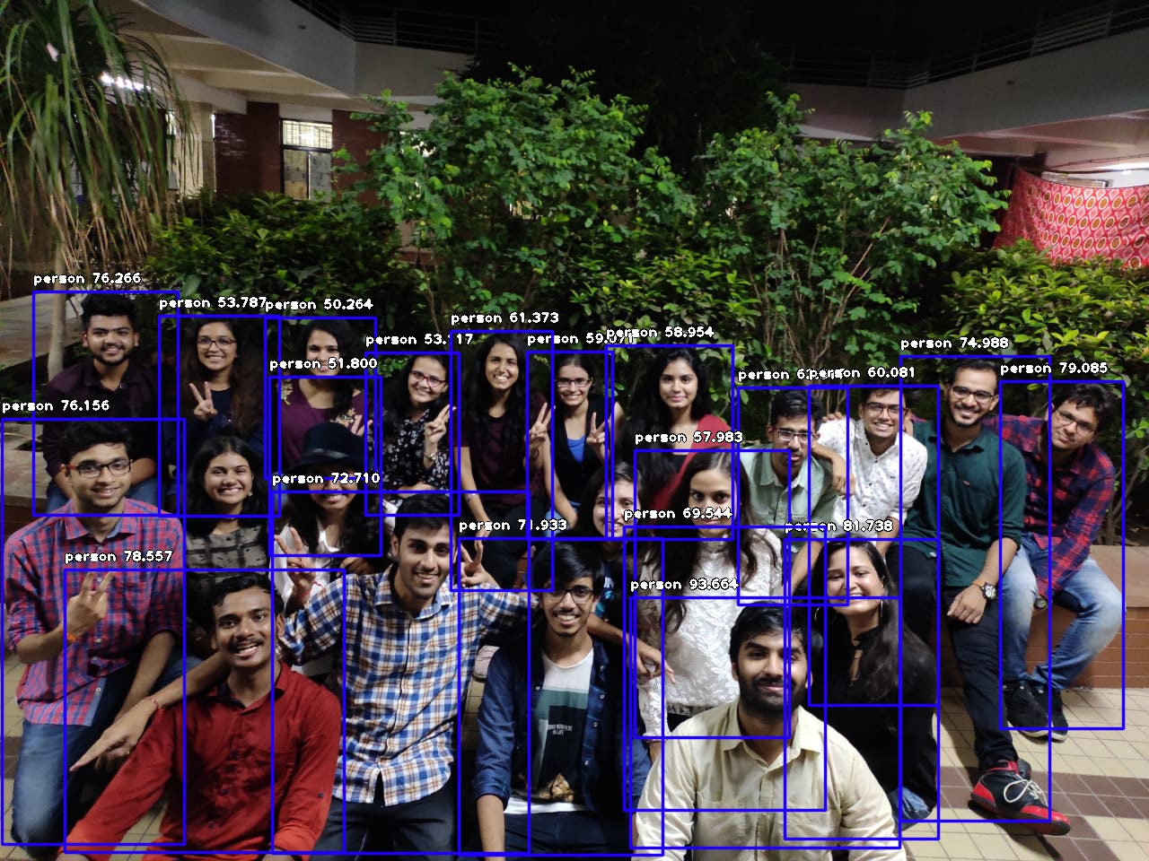
An example to make it clear

Slide 11
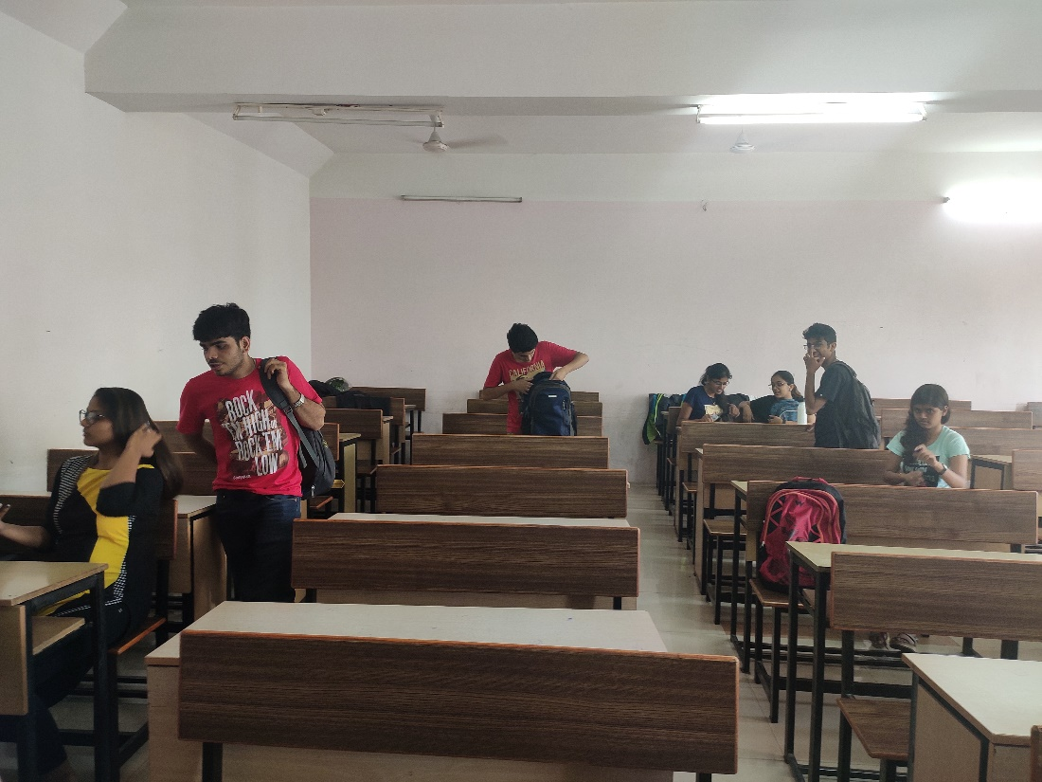
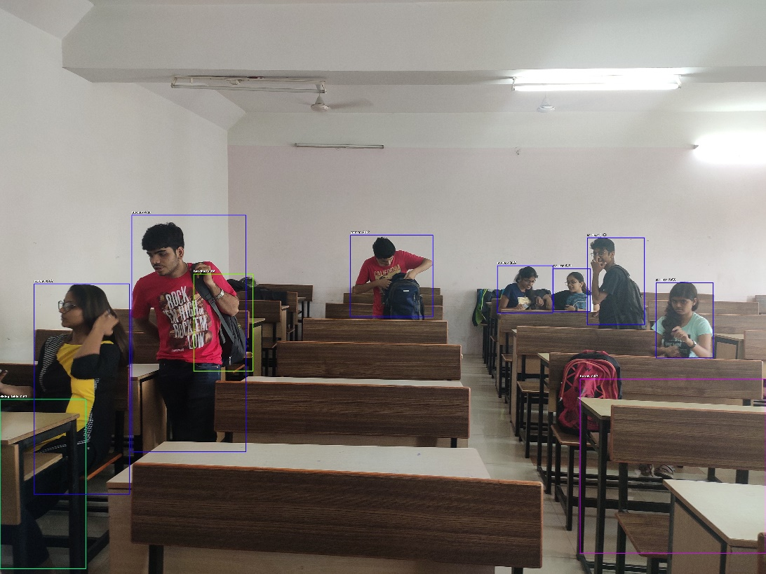
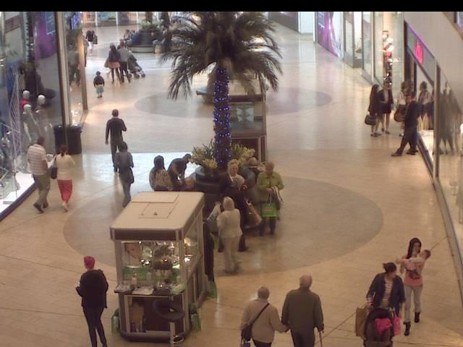
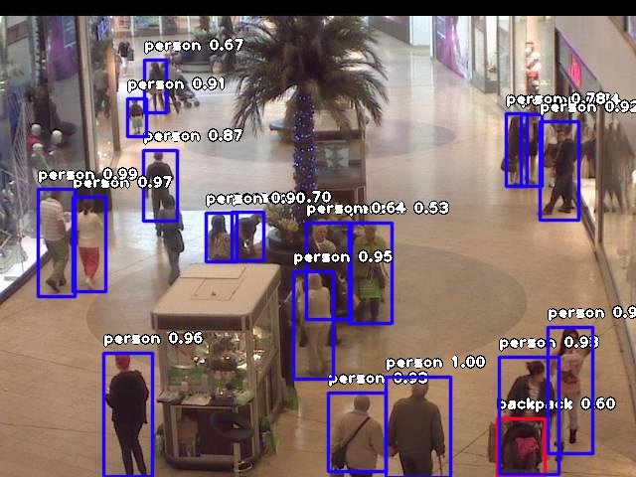

Slide 12
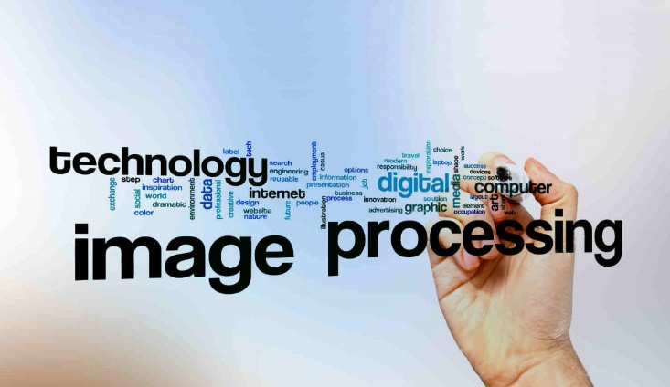
Image processing is used for analysis and manipulation of a digitized image.
Input is given as an image or a video. This can be real time or pre stored.
Process the images based on certain parameters and attributes.
Uses libraries such as OpenCV for implementation and YOLO for detection.

Slide 13
YOLO
You only look once algorithm is clever convolutional neural network used for doing object detection in real time.
It applies single neural network to full image and then divides the image into regions and predicts bounding boxes and probabilities for each region.
It processes images at 30 FPS and gives much accurate results for real time object detection.

Slide 14
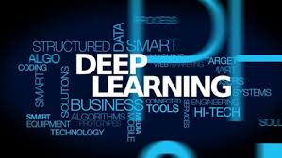
It is a broader family of machine learning.
DEEP LEARNING
Primarily used in natural language processing, computer vision ,etc.
Tensor Flow is one of the best deep learning frameworks.
Model learns to perform classification tasks directly from images and the patterns that naturally occurs in photos.

Slide 15
Usage of Keras and Tensor-flow
Keras is high level neural network API written in Python and runs on the top of tensorflow.
Tensor flow is a foundation library used to create deep learning models directly or by using wrapper libraries.
It is mainly used for classification, perception prediction, understanding and creation.
Keras specifies loss functions, fit the model, execute the model using available data and then make predictions.
Further it is used to generate predictions on new data.

Slide 16
Front End
Front end will be constructed in Bootstrap4.
Bootstrap is a framework used for frontend development and has modules for CSS and javascript.
Features like navigation Bar, carousel etc. are used

Slide 17
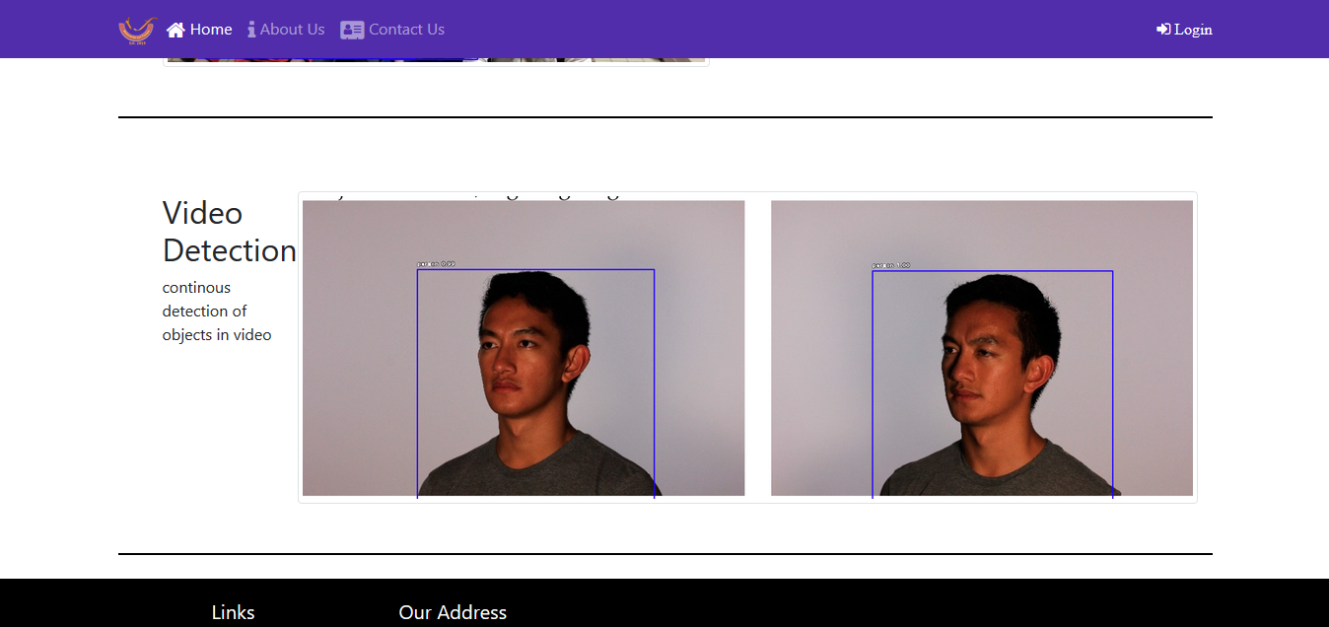
,m
Website Snapshot

Slide 18
Tentative backend framweork
FLASK
It is the micro web framework used in python.
IT specifically doesn’t require any tools or libraries.
Basically it is an API in python to develop web applications.
We are using flask for maintaining the database to store the information about the processed images.

Slide 19
Django or Flask?
The main reason of choosing Flask over Django is full-stack web framework while flask is lightweight web framework.
Flask accelerate development of simple web applications by providing required functionality.
Keeping in mind the requirement of the application, we are using flask in backend as the database for the web application.

Slide 20


Methodology
User captures an image which will be subjected to frontend.
User uses web application
Image will be sent to backend
Output count will be displayed and certain actions will be taken to control the crowd.
Image will get stored in the database.
object detection will be done with the help of YOLO

Slide 21
Plan of Action
Implementing Front End using bootstrap
Storing images with standard sizes
PHASE 1
Deciding an Algorithm to train Dataset

Slide 22
Generating the count of persons
Training the dataset.
PHASE 2
Storing the images.

Slide 23
Linking the Backend and Frontend
Backend Creation
PHASE 3
Linking database to Backend

Slide 24
Hospital management analysis
Retail shop Analysis
Crowd maintainance at railway station
Crowd Safety
Applications of Project
Hotel management
Management of provision of services

Slide 25
Thank you

