Slide 1

1bit quantization
BiLLM
曾子瑄
2024.03.23
Notes:
照片为学生拍摄的礼堂

Slide 2
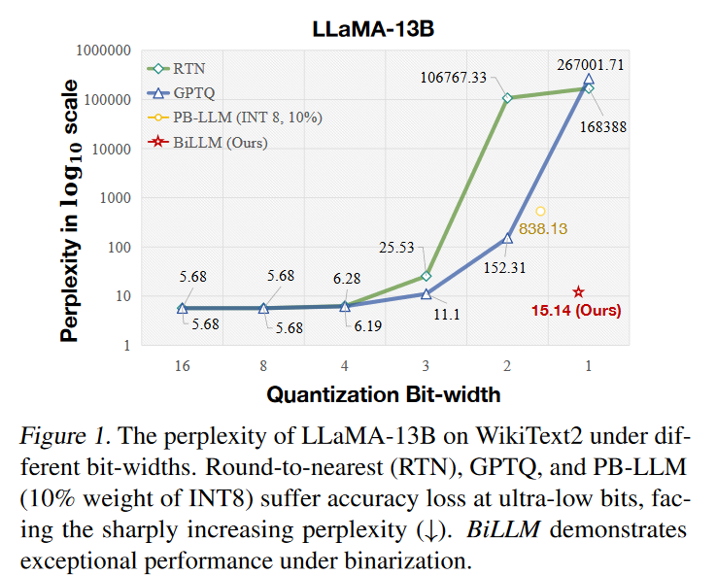
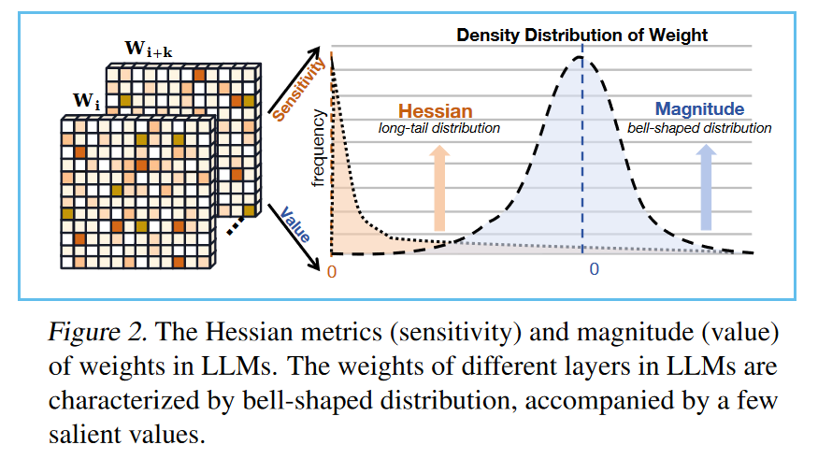
BiLLM
Two key observations
Huang W, Liu Y, Qin H, et al. BiLLM: Pushing the Limit of Post-Training Quantization for LLMs[A]. arXiv, 2024.

Slide 3
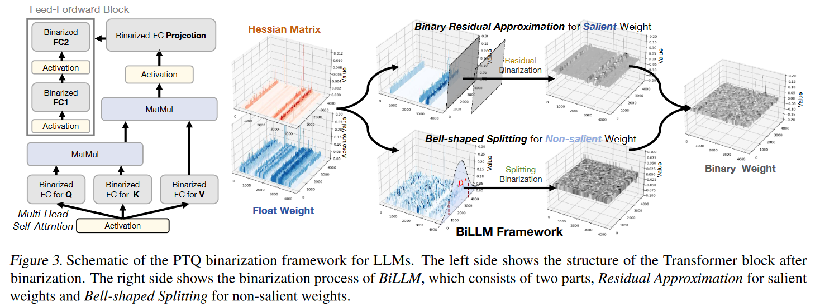
BiLLM
Two core designs
Structural Searching Selection
Binary Residual Approximation

Slide 4
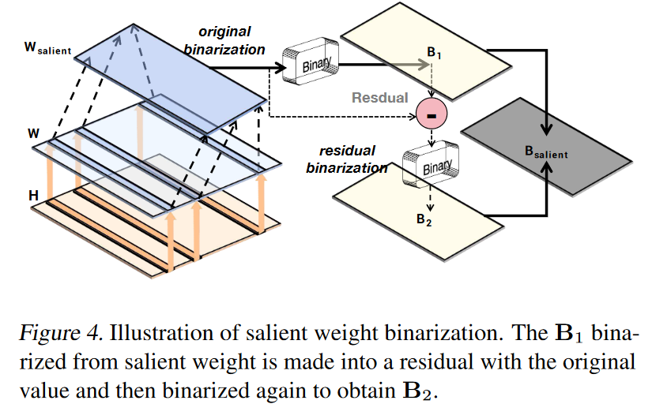

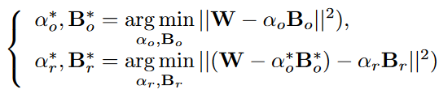





BiLLM
Salient Weight Binarization for LLMs
Criterion:
the majority of the weights’ sensitive Hessian values are predominantly concentrated in specific columns or rows
determine salience through a per-column segmentation on the whole weight matrix
optimization function for selecting salient columns is defined as:

Slide 5
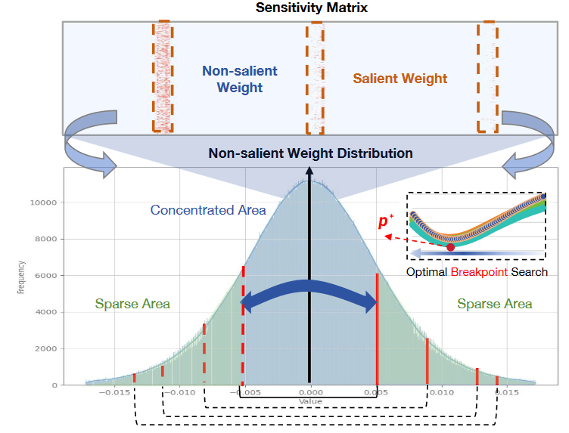




BiLLM
Bell-shaped Distribution Splitting for Binarization
the remaining weights maintain a bell-shaped distribution
MSE:
employ a percentile search method to identify the optimal break-point based on the objective function
7B LLM merely 30 minutes

Slide 6
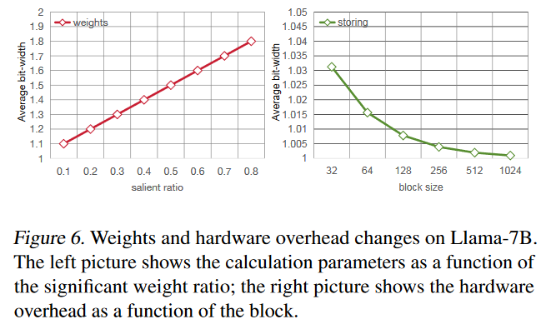
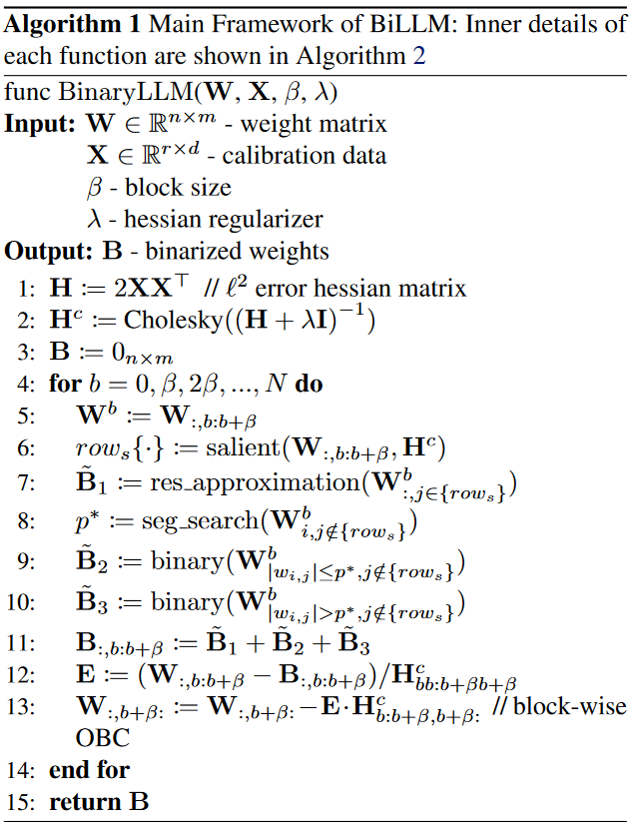
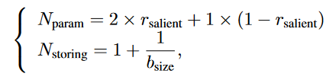
BiLLM
Binarization Workflow
extra storing bits:
Frantar E, Ashkboos S, Hoefler T, et al. GPTQ: Accurate Post-Training Quantization for Generative Pre-trained Transformers[A]. arXiv, 2023.

Slide 7
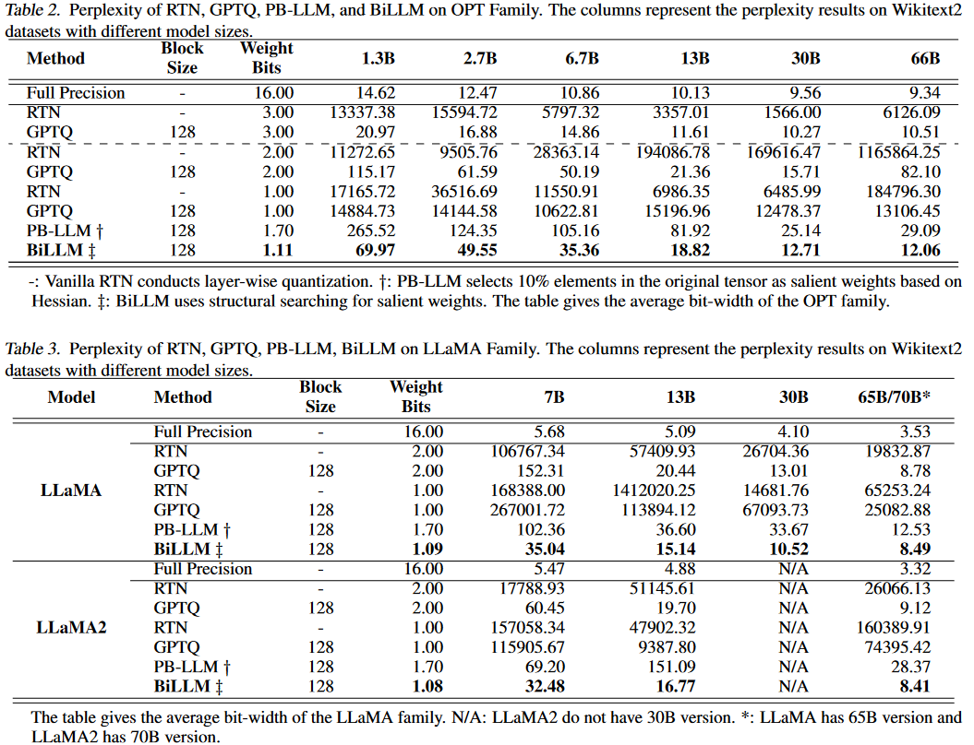
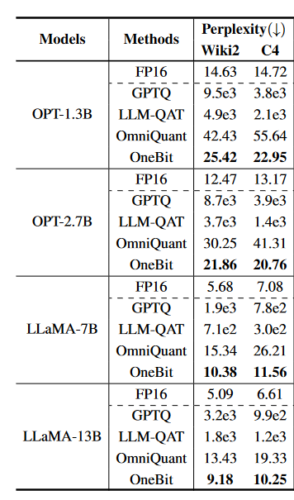
BiLLM
Experiments
a single 80 GB NVIDIA A100
Results of OneBit

Slide 8
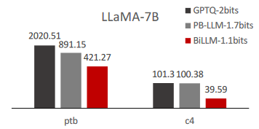
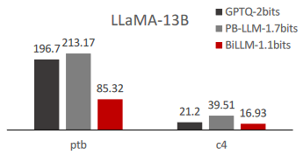
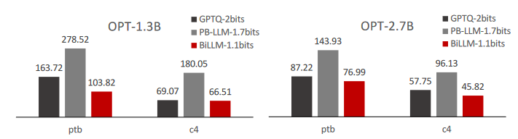
BiLLM
Experiments
a single 80 GB NVIDIA A100
Results of OneBit

Slide 9
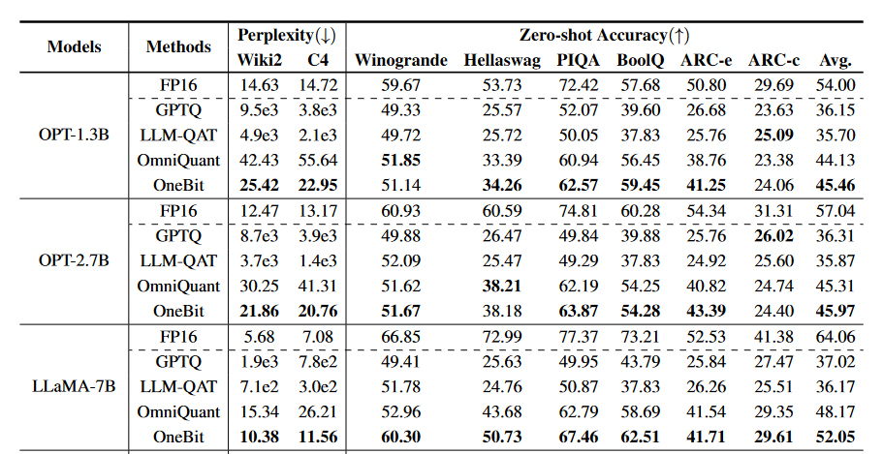
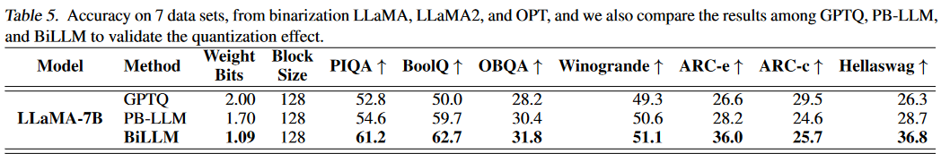
BiLLM
Experiments
a single 80 GB NVIDIA A100
Results of OneBit

Slide 10
BiLLM
Only weight quantization
Open source
New quantization methods
Compare it to PB-LLM and OneBit

Slide 11


