Slide 1
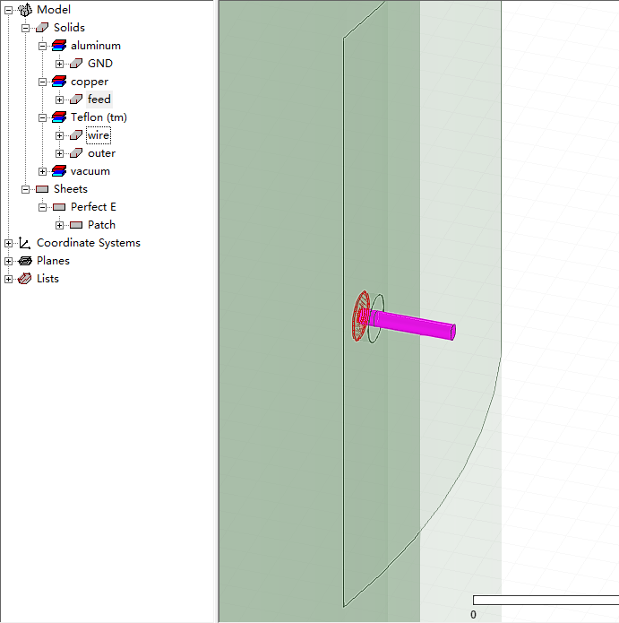
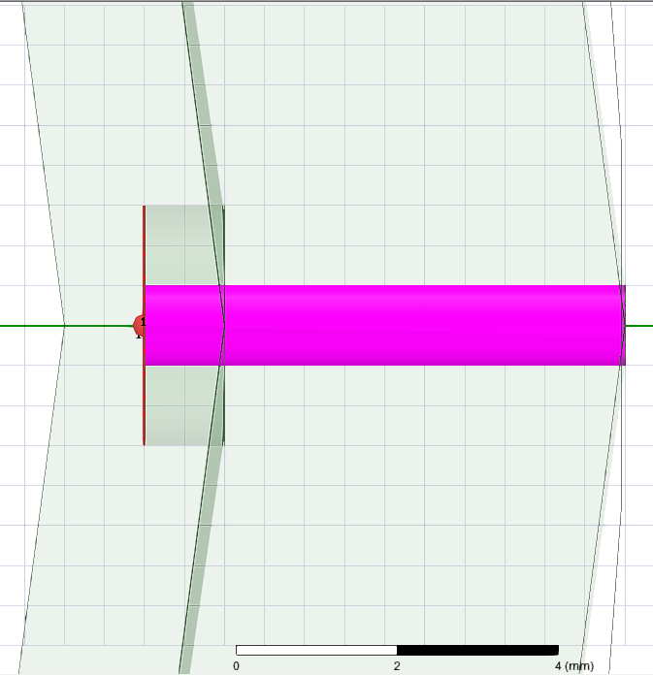

Slide 2
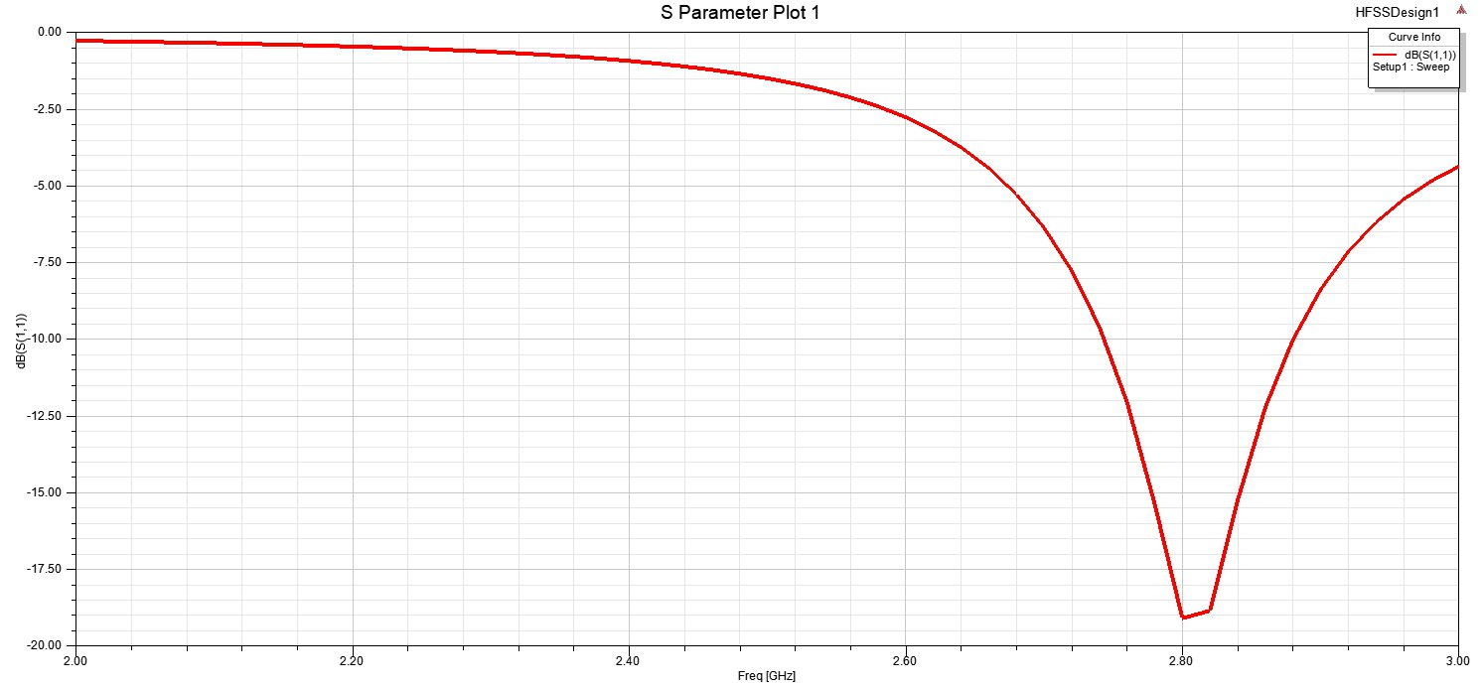

Slide 3
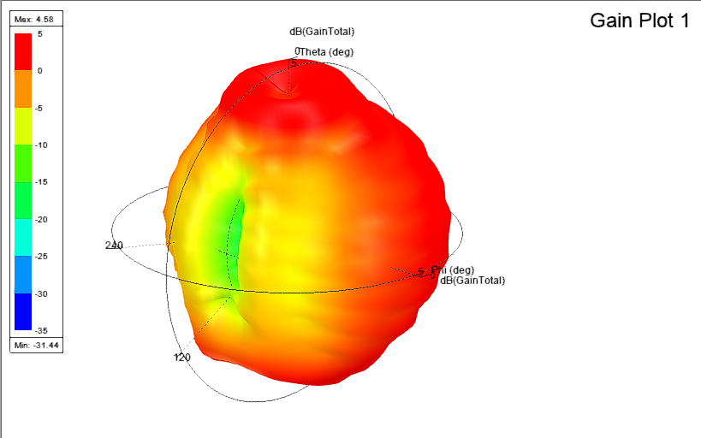

Slide 4
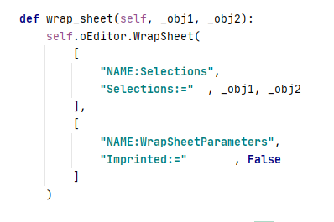
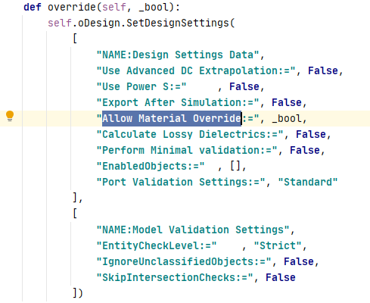
共形
metal/smaller object优先

Slide 5
[info] Solving adaptive frequency ..., process hf3d: '1' conductors touch lumped port '1', typically a lumped port contains 2 conductors. Please verify conducting boundaries and objects are correctly assigned and touch the port. If a Radiation boundary touches the port and it is desired for use during the port solution, select 'Use Radiation Boundary on Ports' under the Advanced tab in the Solution Setup.
[info] Fast sweep setup, process hf3d: '1' conductors touch lumped port '1', typically a lumped port contains 2 conductors. Please verify conducting boundaries and objects are correctly assigned and touch the port. If a Radiation boundary touches the port and it is desired for use during the port solution, select 'Use Radiation Boundary on Ports' under the Advanced tab in the Solution Setup.

