Slide 1

Project SOP
2025
DO NOT ENTER A CREDIT CARD
INTO IBM CLOUD

Slide 2
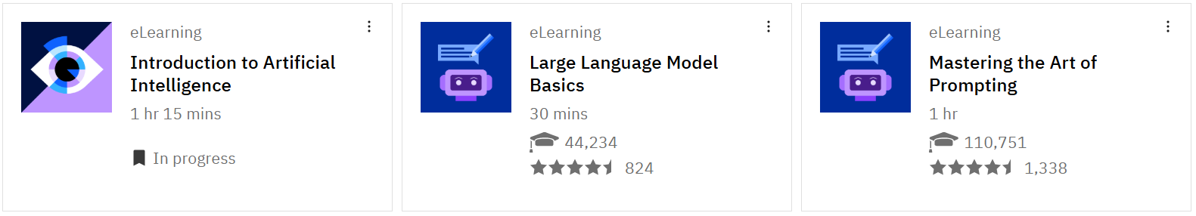
A.I Project Pathway Introduction
1. Register for Skills Build - Sign up & log in with your Gmail/Google id when using the links below
Complete: Getting Started with AI – covering Intro to AI and Intro to GenAI (3 mini courses 1hr each)
https://ibm.biz/StartwithAI
3. Complete:Build your own AI Assistant (1hr) – some hands on practical for AI
https://ibm.biz/BuildAIAssistant
4. Review: Classifying Data using GenAI – effectively how to simplify data tasks with GenAI
(good intro into useful GenAI)
https://ibm.biz/GenAiforDataClassification
5 https://skillsbuild.org/college-students - open, start and review all AI courses (no need to complete)

Slide 3
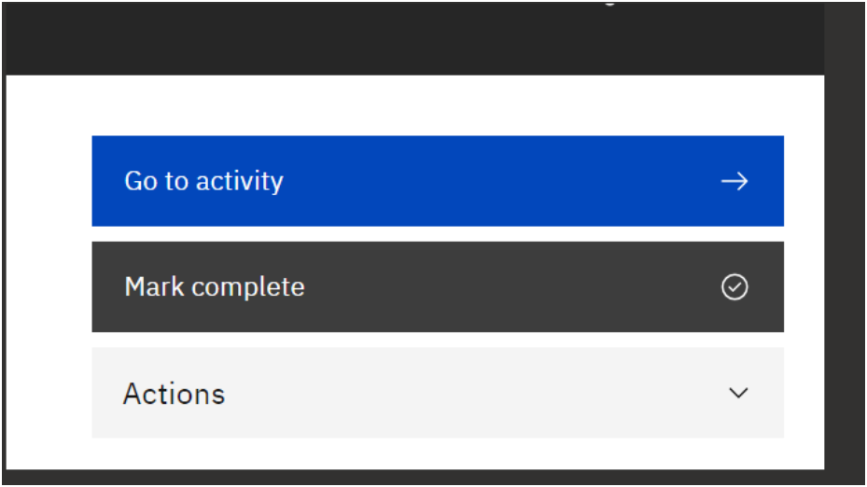
Achievement for your micro credentials
1. Get your certificate of achievement
Can each team member register with an email here - https://bit.ly/IBMAcademicInnovation and simply Mark complete
Look under Actions to get your certificate

Slide 4
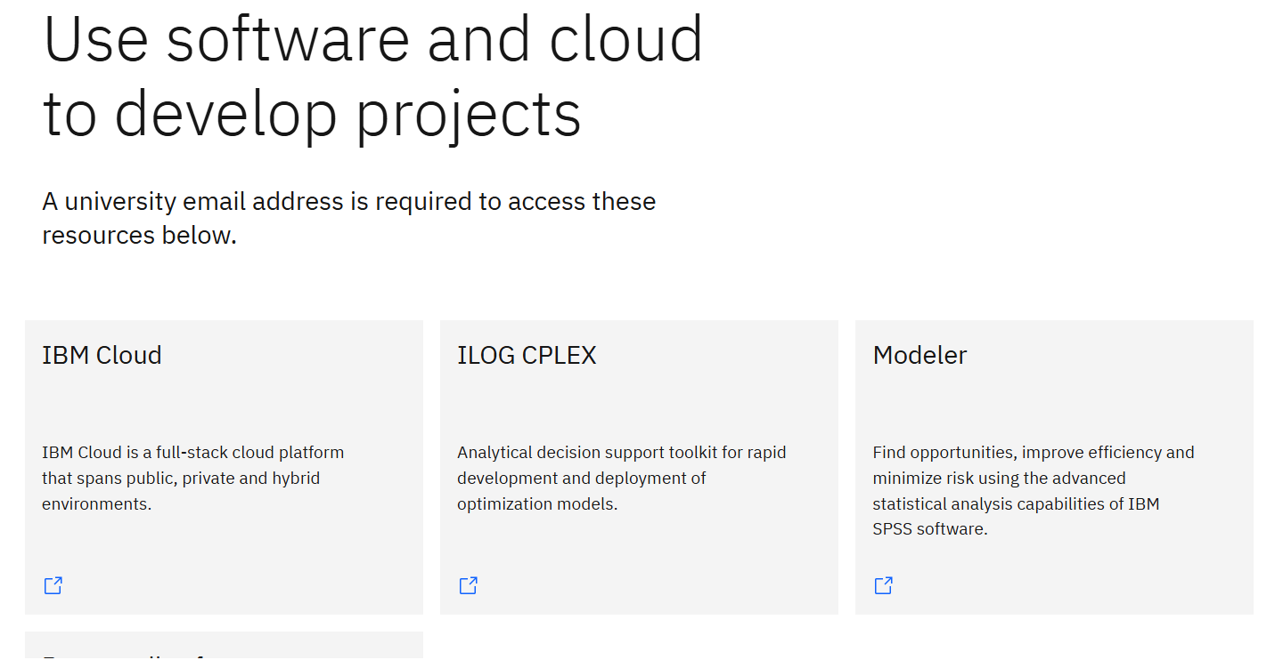
2. Tools
Find, request / download the following tools from IBM Skills Build:
https://skillsbuild.org/college-students

Slide 5
4. Videos
Please create a 5 minute video every 4 weeks of status and a demo your project so far
– place a reminder invite for 5 minutes in your calendar every 4 weeks– inviting me
Send videos to j0nnymac@uk.ibm.com
5. Management
Create a project Trello board to manage your project
This is an ideal Trello board - https://trello.com/templates/project-management/simple-project-board-6QW0Ciu8

Slide 6
6. Communications
We receive hundreds of project emails a week – so to allow us to determine whos project your note refers to please include in your note
Learning Journal– which badges you/your team have completed / are completing
Project Trello Board
GitHub Repo (if relevant)
Name of Project (in the subject header)
Link to repository videos you have created
Link to any blogs you have created

Slide 7
Only proceed if you are building a chatbot DO NOT ENTER A CREDIT CARD

Slide 8
Watsonx chatbot walkthrough
Do NOT enter a credit card

Slide 9
Register for IBM Skills Build
(you may have already done this – in which case move on to
Create IBM Cloud Account section)
https://www.ibm.com/academic/home

Slide 10
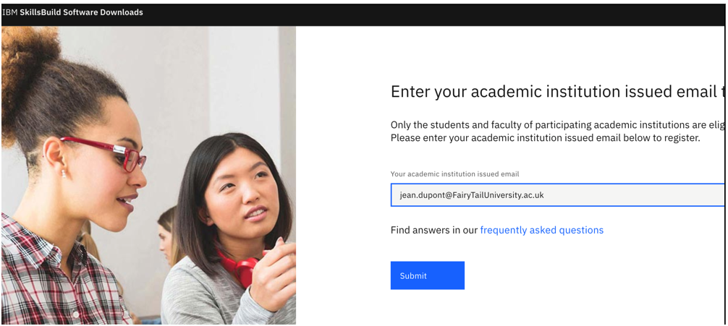
Enter academic email

Slide 11
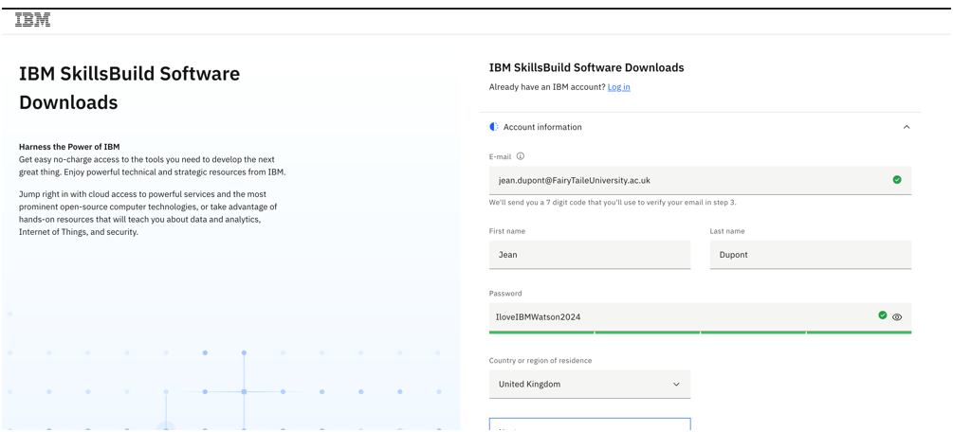
Fill account information

Slide 12
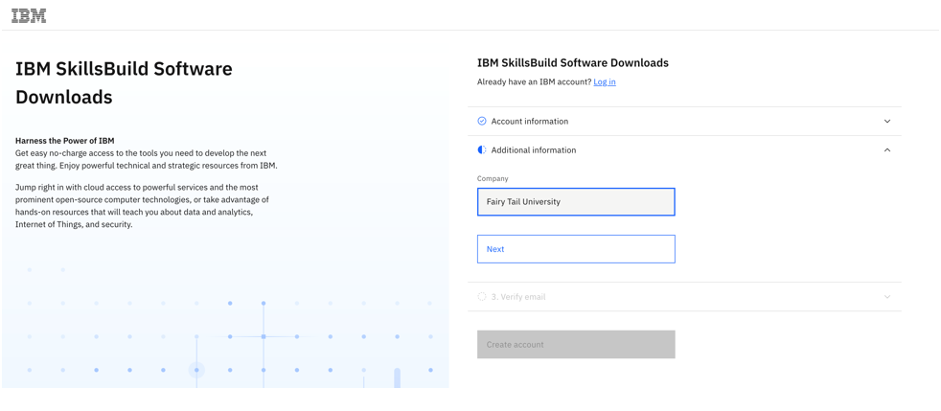
Fill additional information

Slide 13
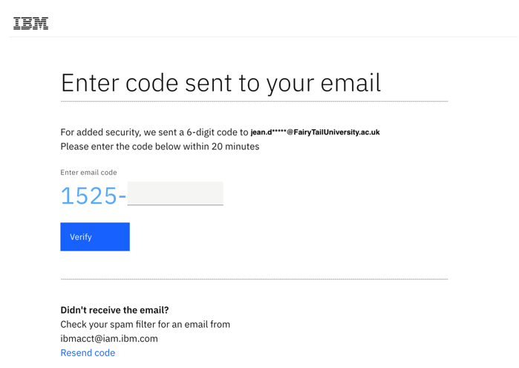
Code sent to your email

Slide 14
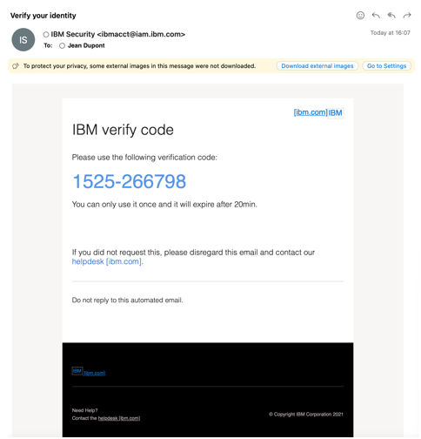
The code you should receive

Slide 15
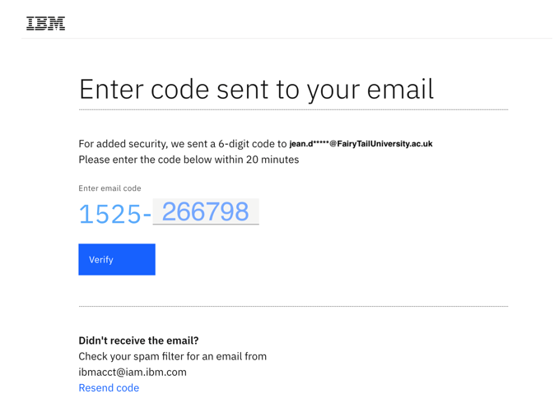
Copy the code

Slide 16
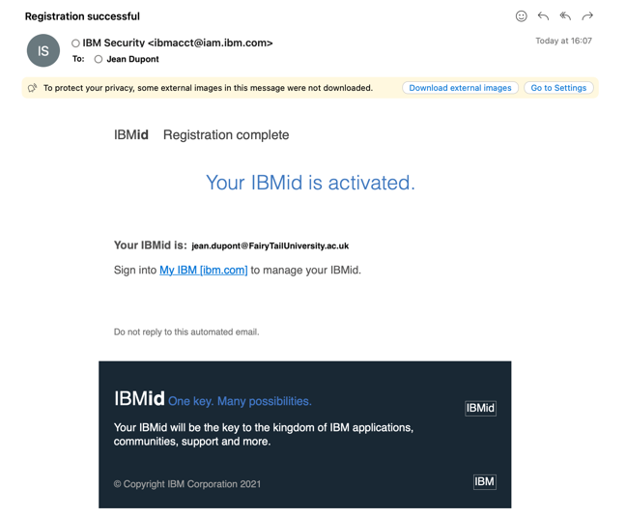
You should receive this email of registration

Slide 17
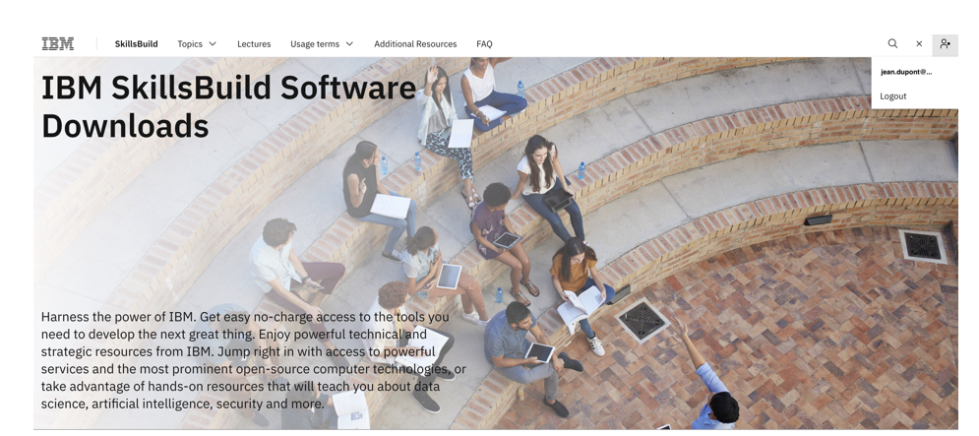
Welcome to IBM skill software

Slide 18
Create IBM Cloud account
Do NOT enter a credit card

Slide 19
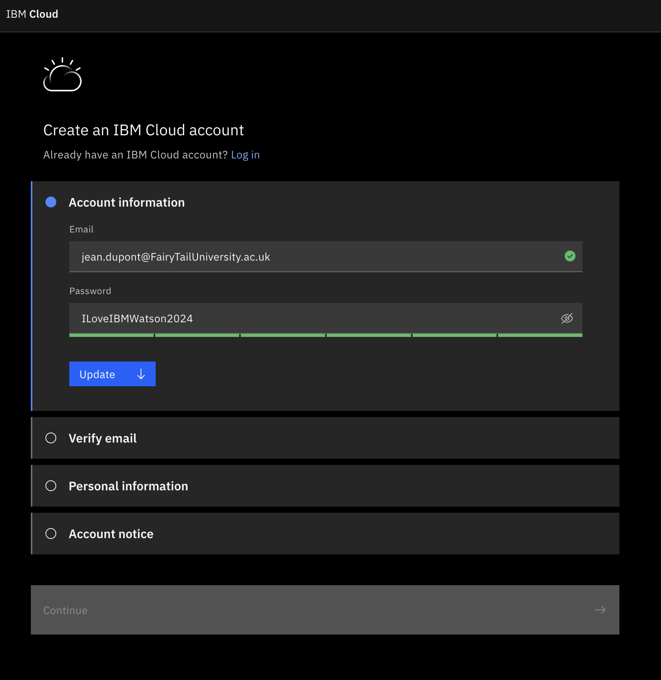
Go to https://cloud.ibm.com/login and create an account

Slide 20
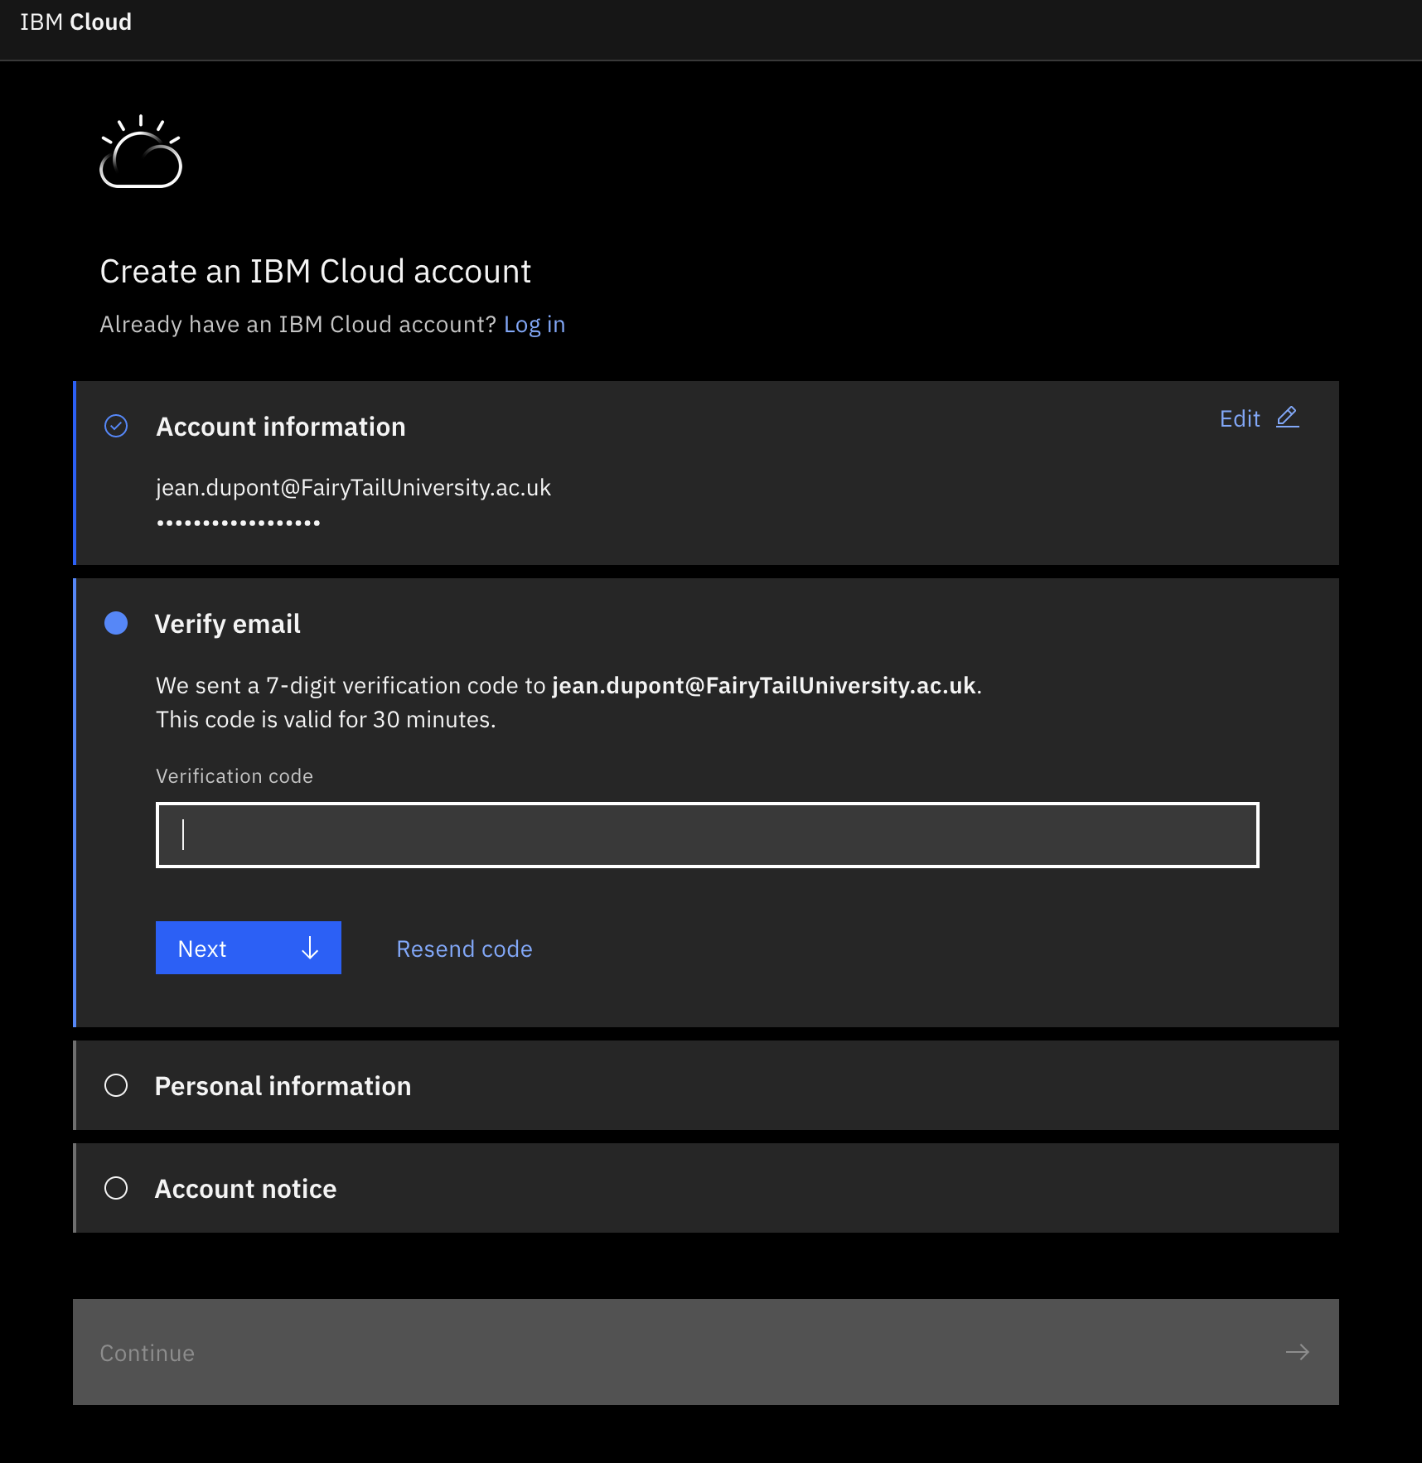
Check your email to obtain the code

Slide 21
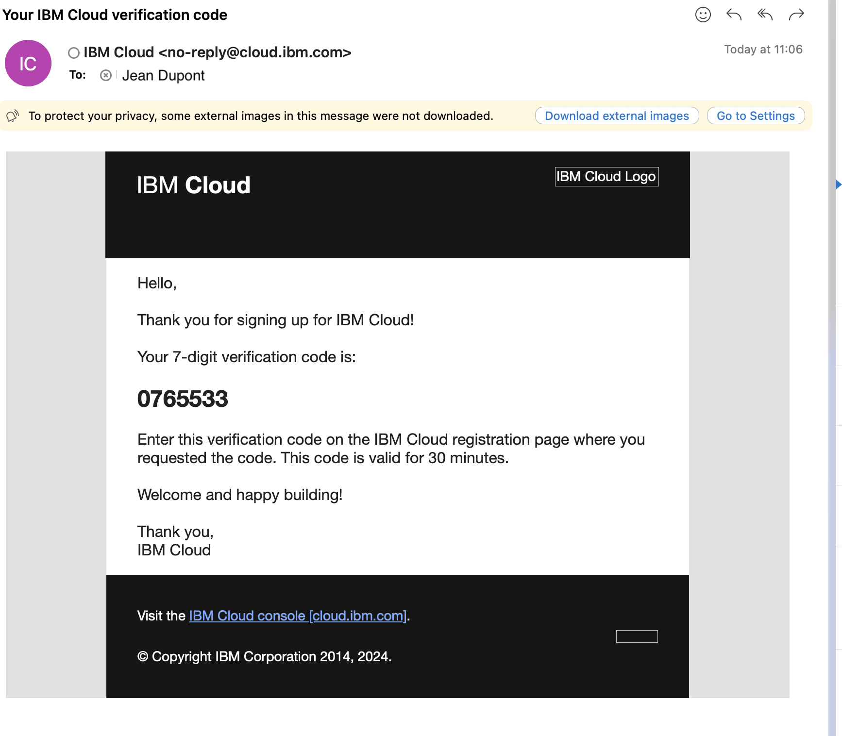
Copy the code

Slide 22
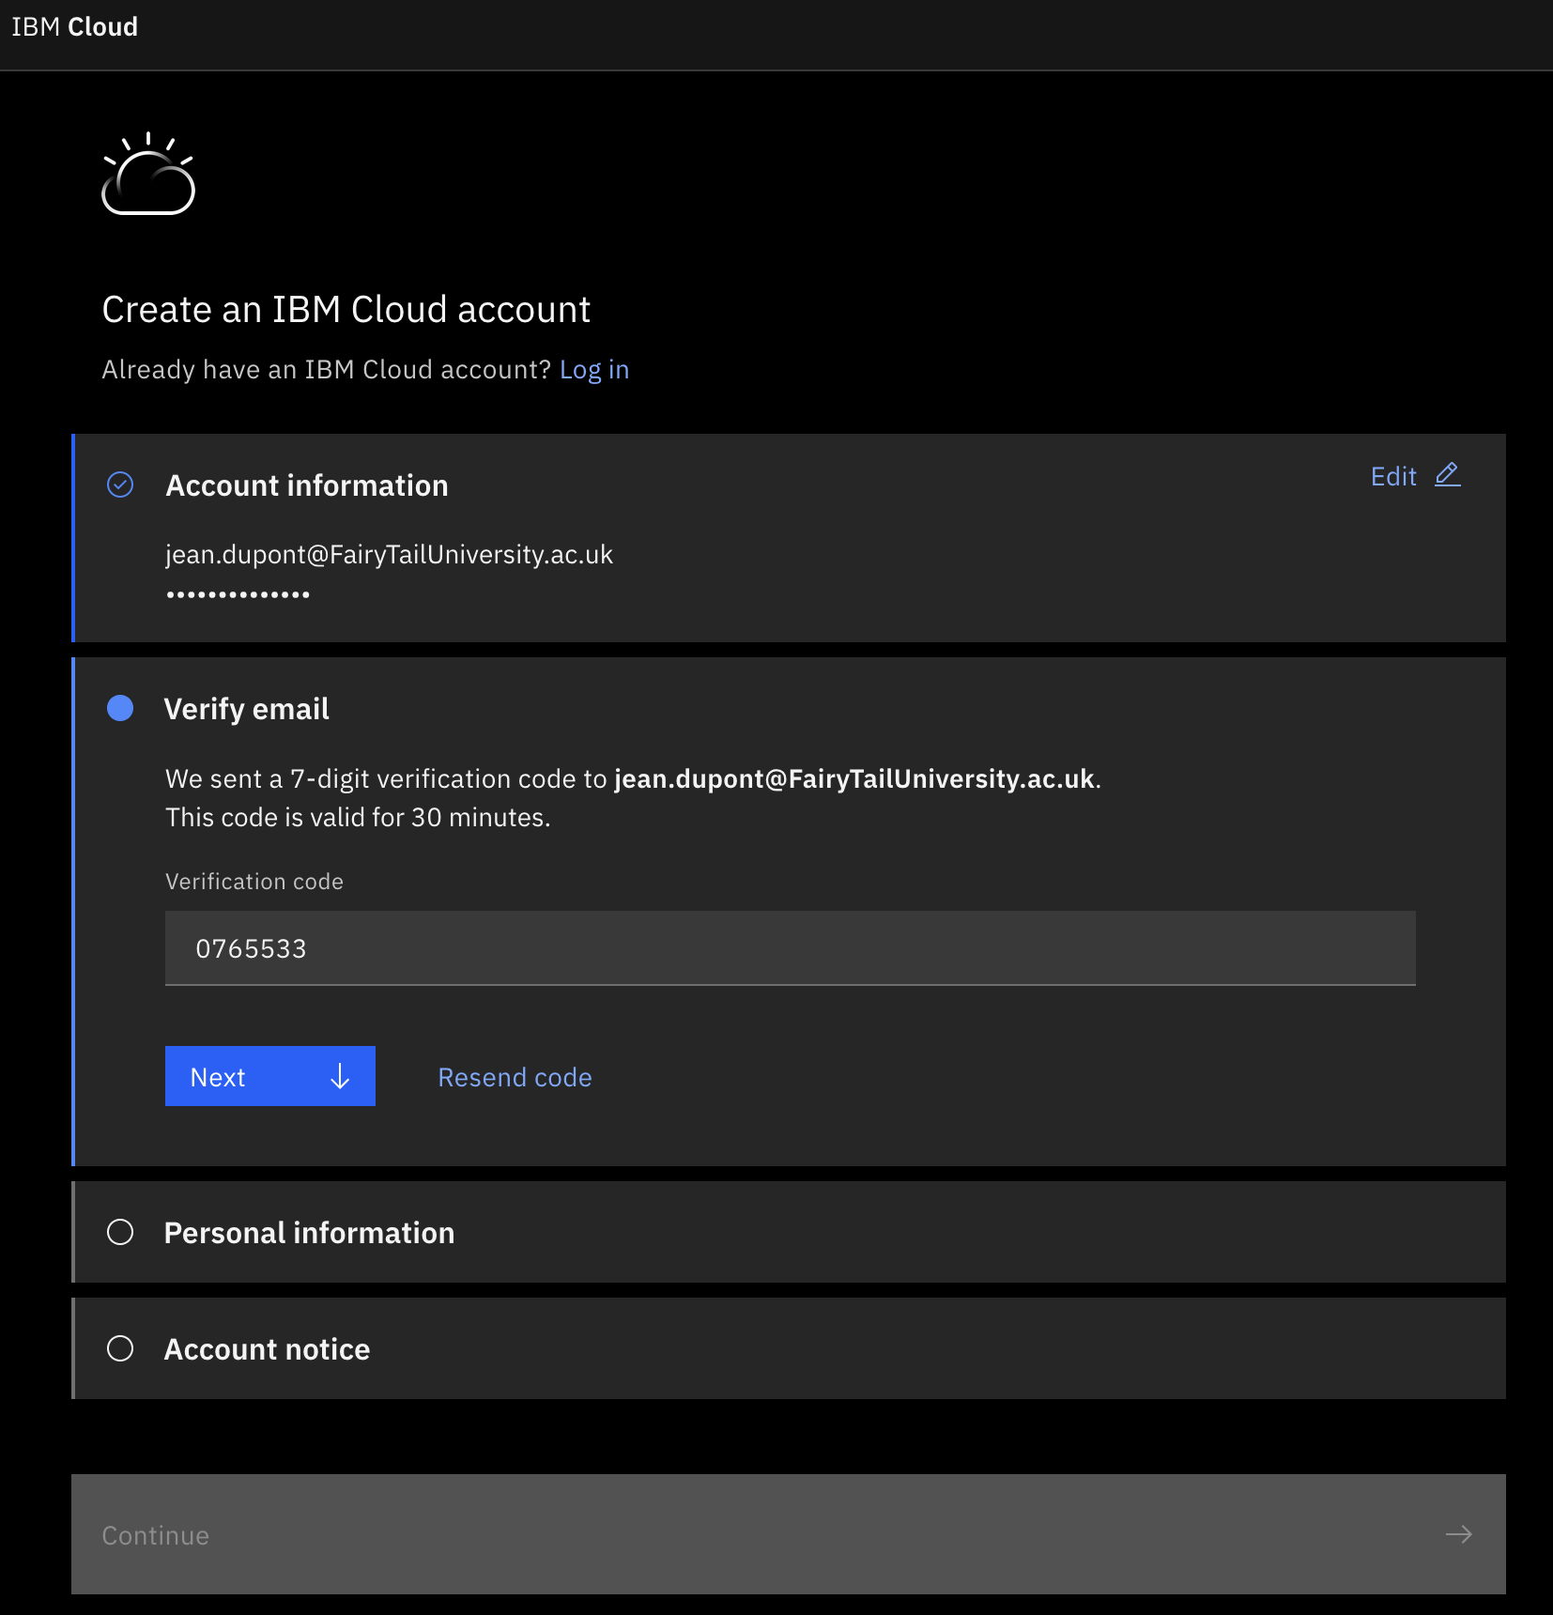
Paste the code

Slide 23
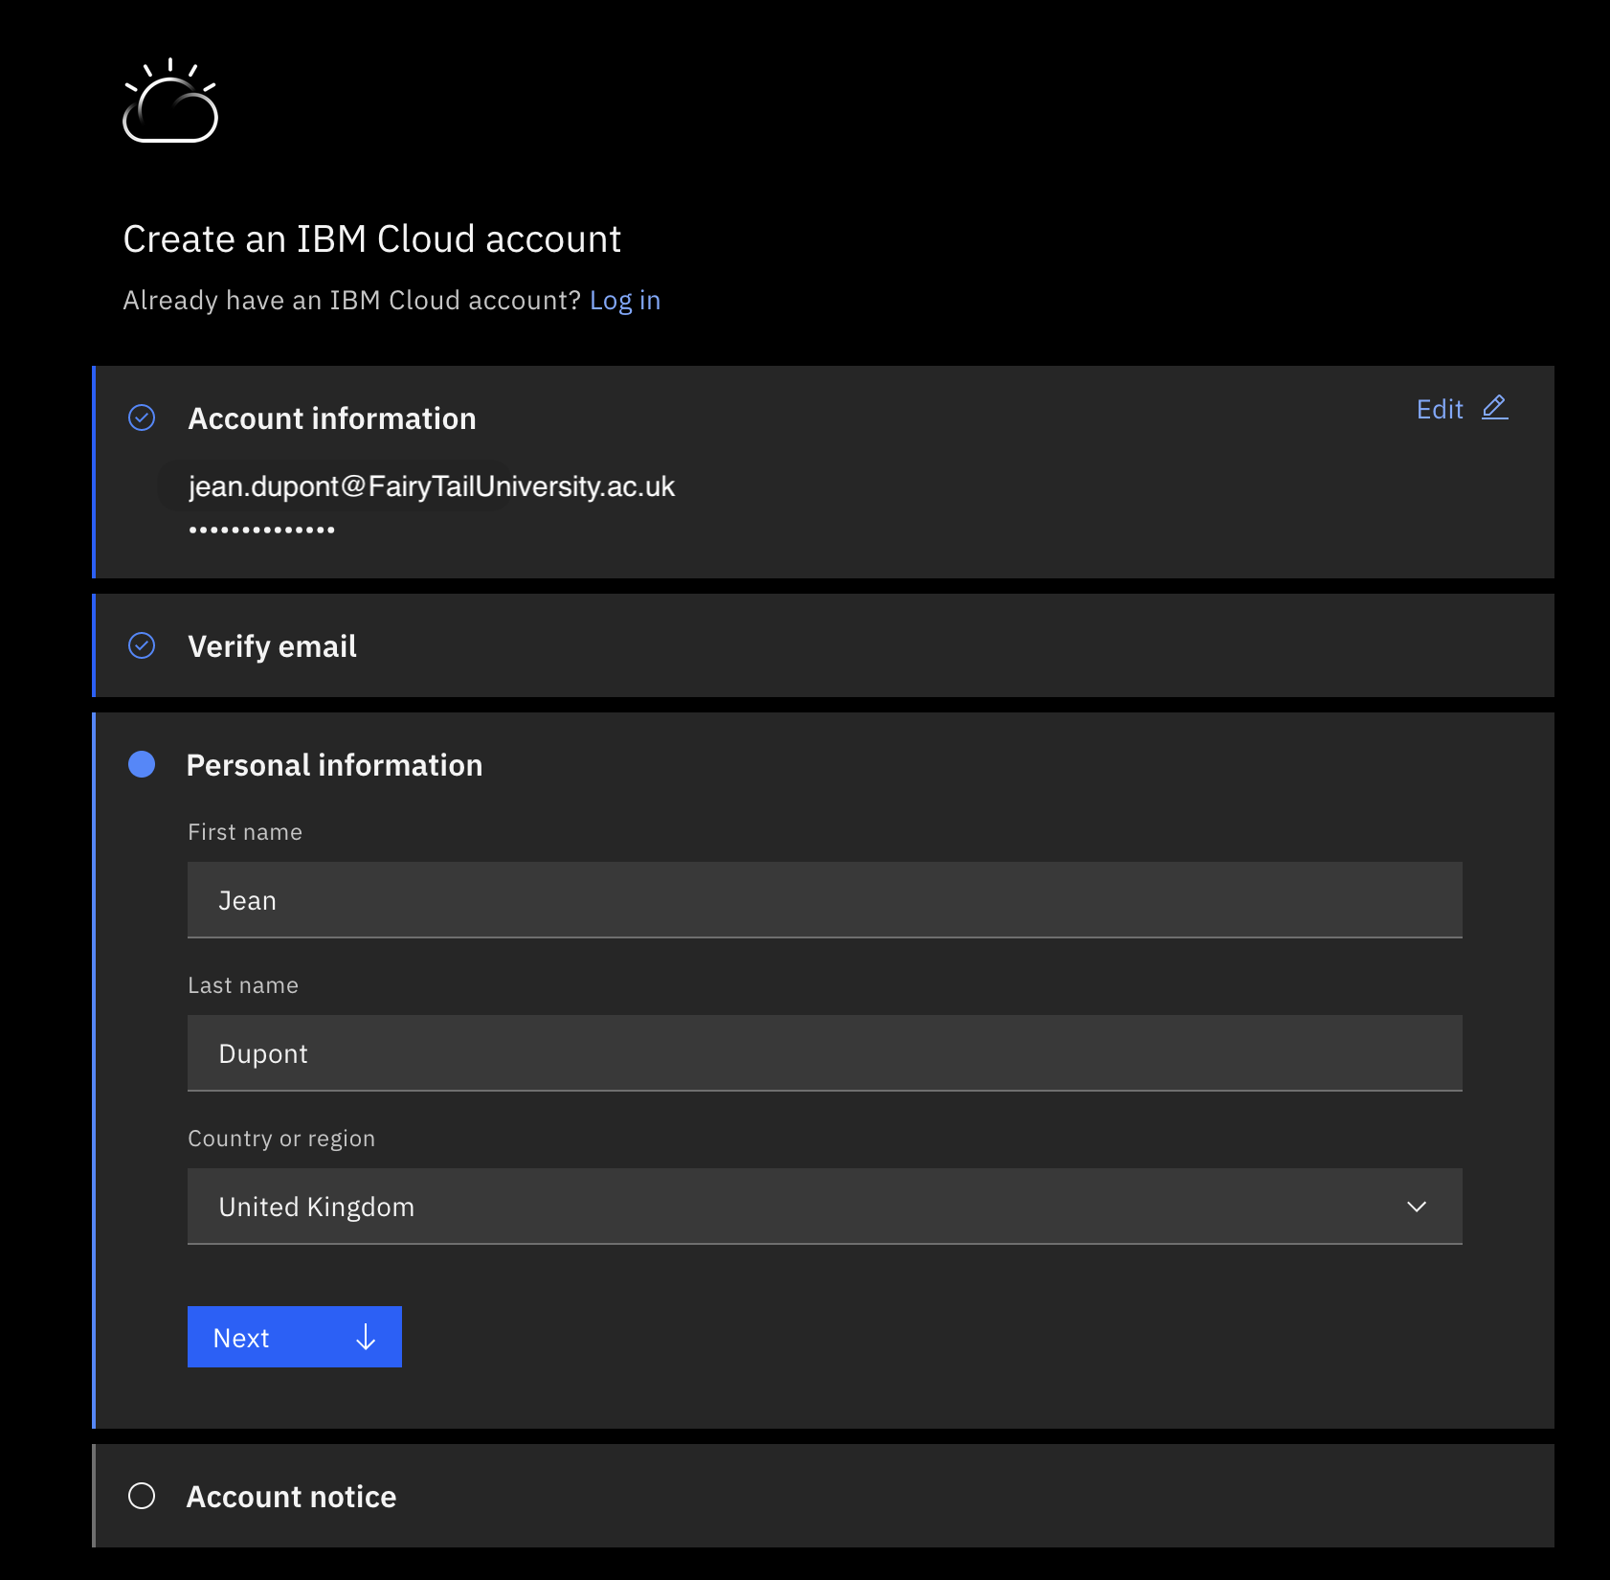
Fill personal information

Slide 24
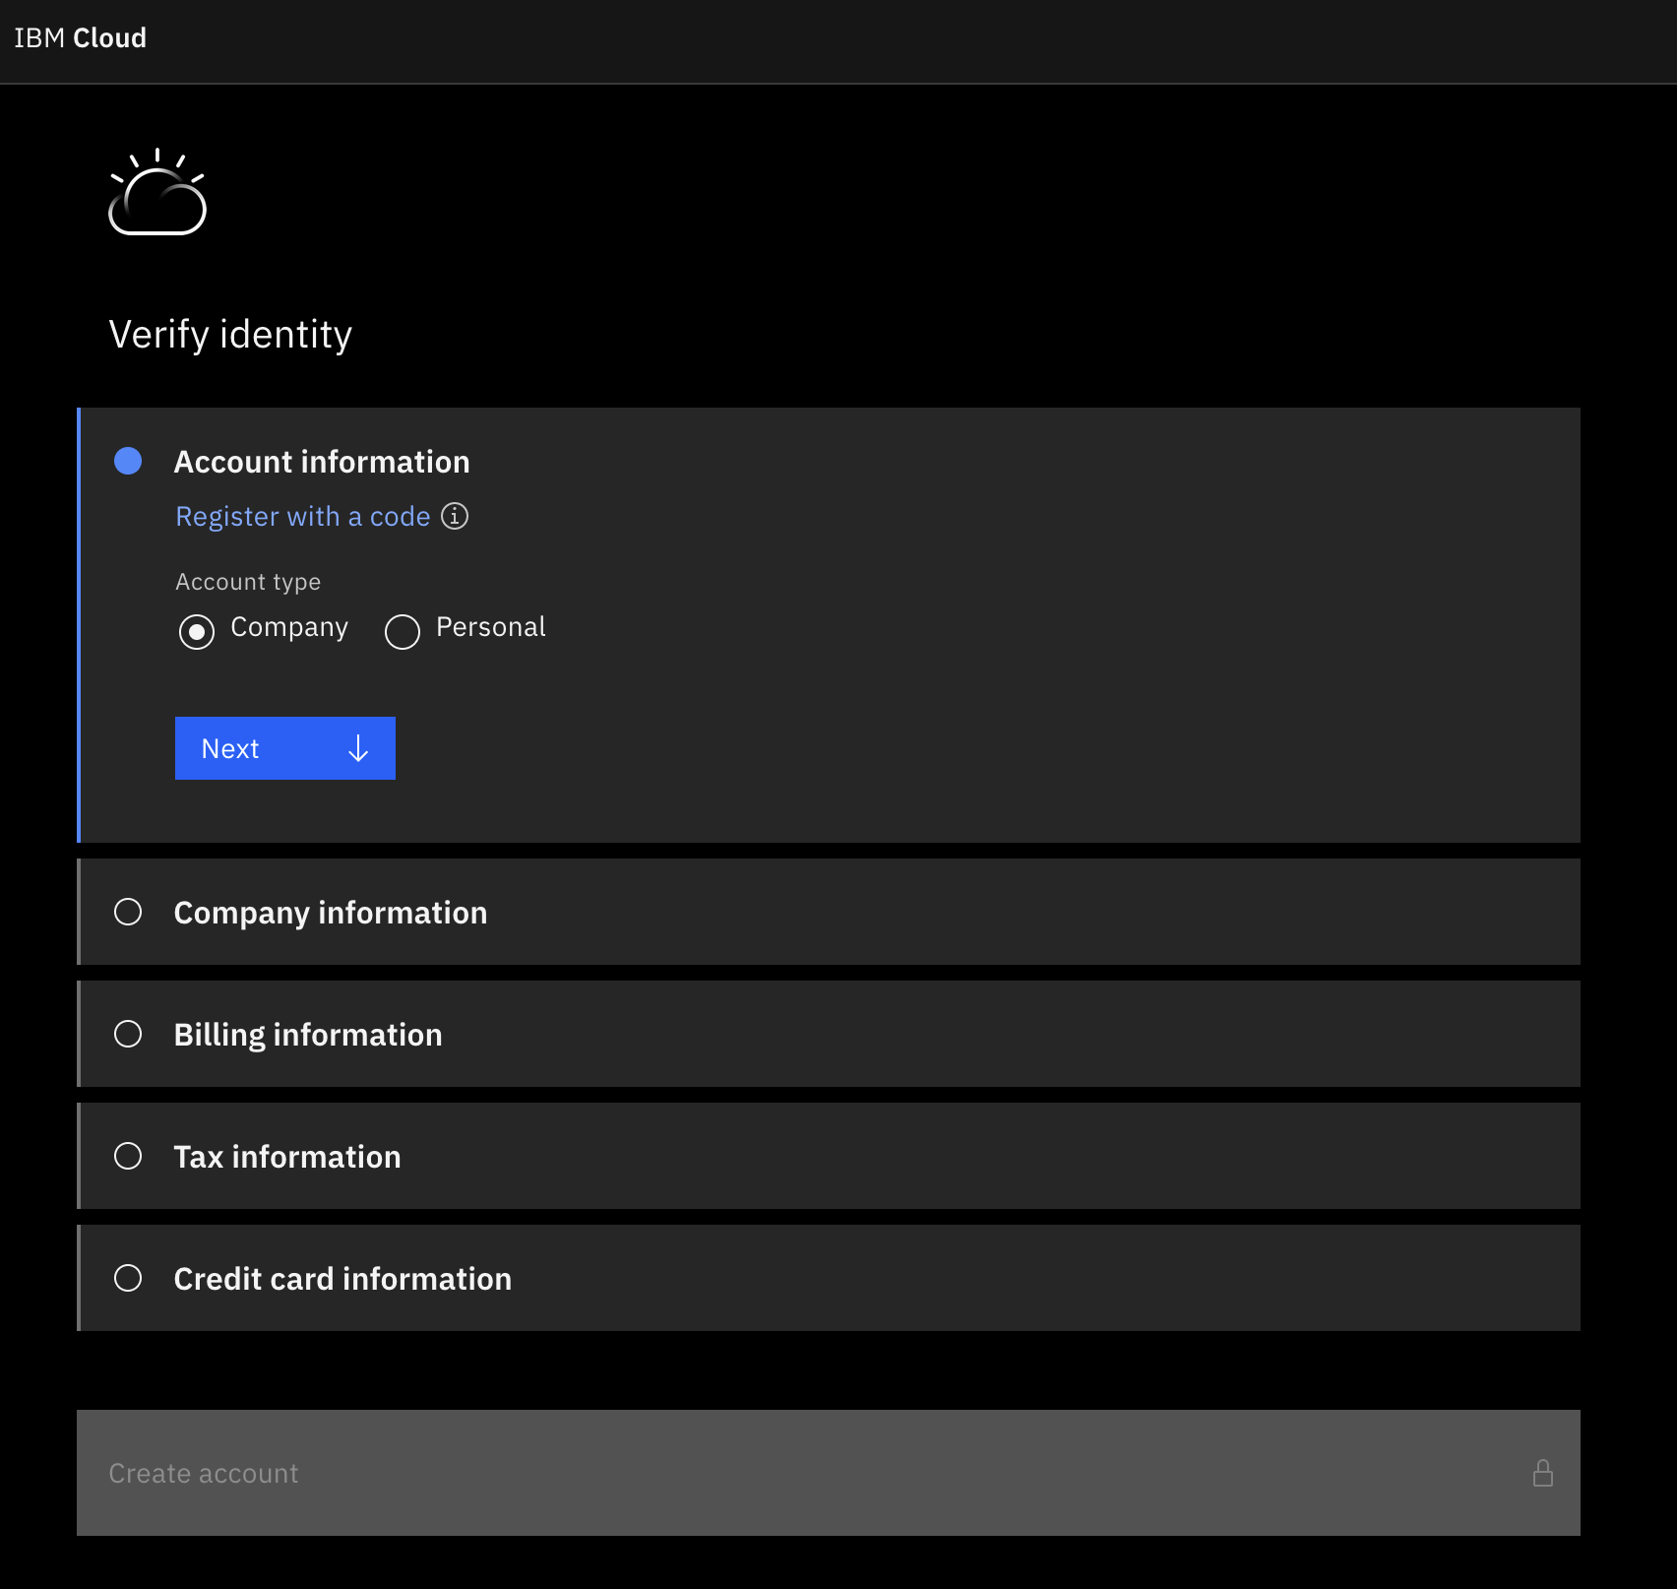
Click on “Register with a code”
Do NOT enter a credit card

Slide 25
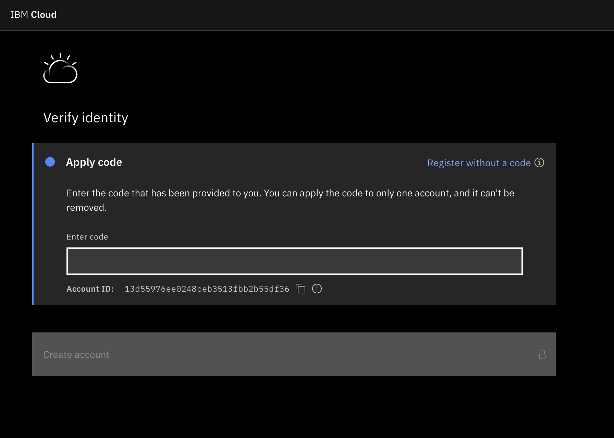
Register with the code that you can find in your IBM skill software account

Slide 26
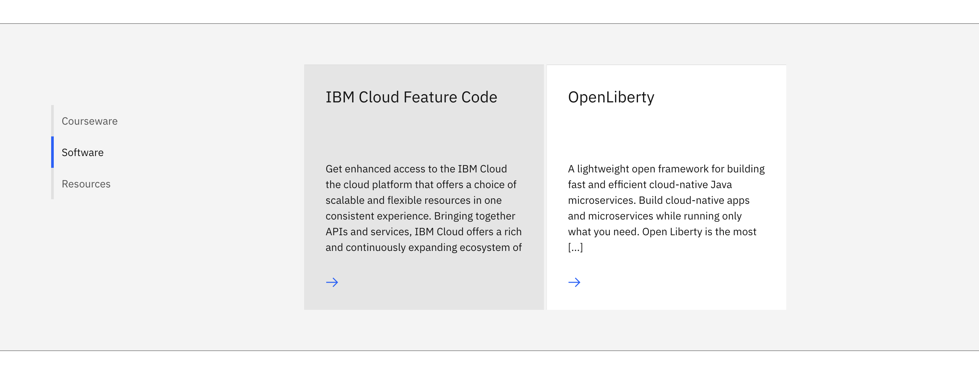
Go to https://www.ibm.com/academic/topic/cloud and software section. Click on “IBM Cloud Feature Code”

Slide 27
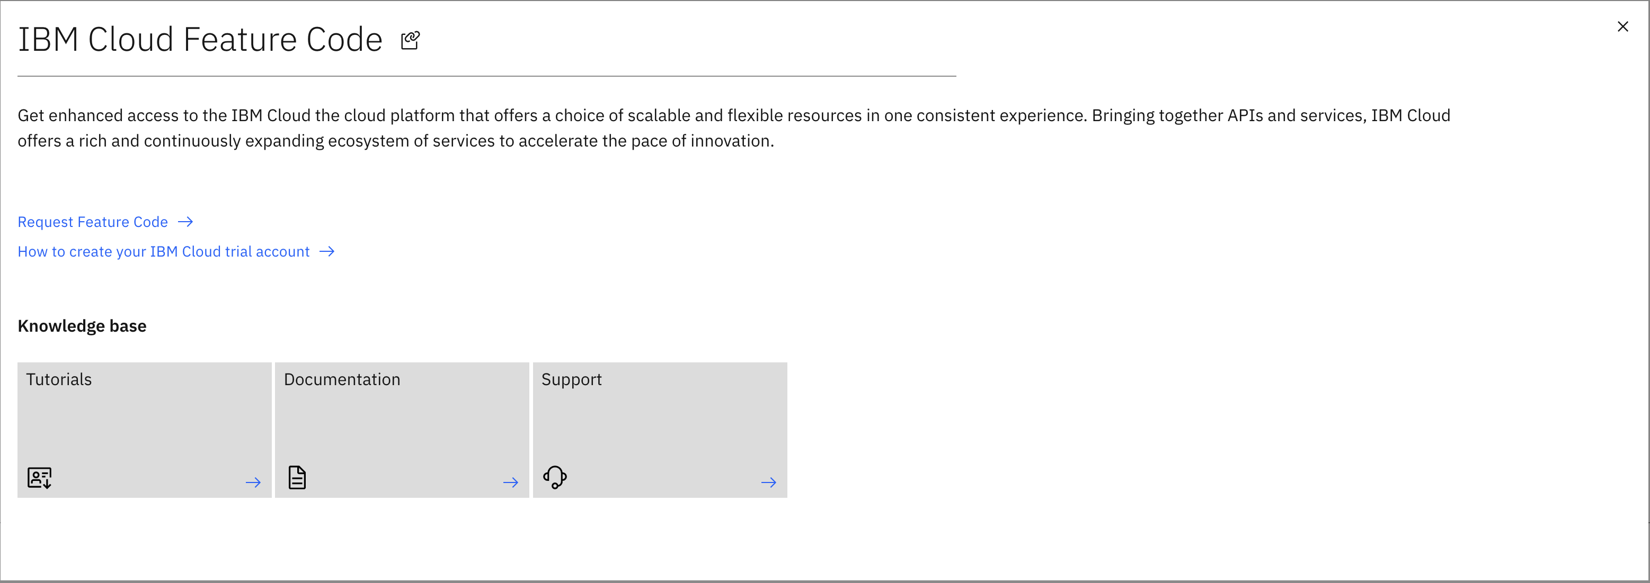
Click on “Request Feature Code”

Slide 28
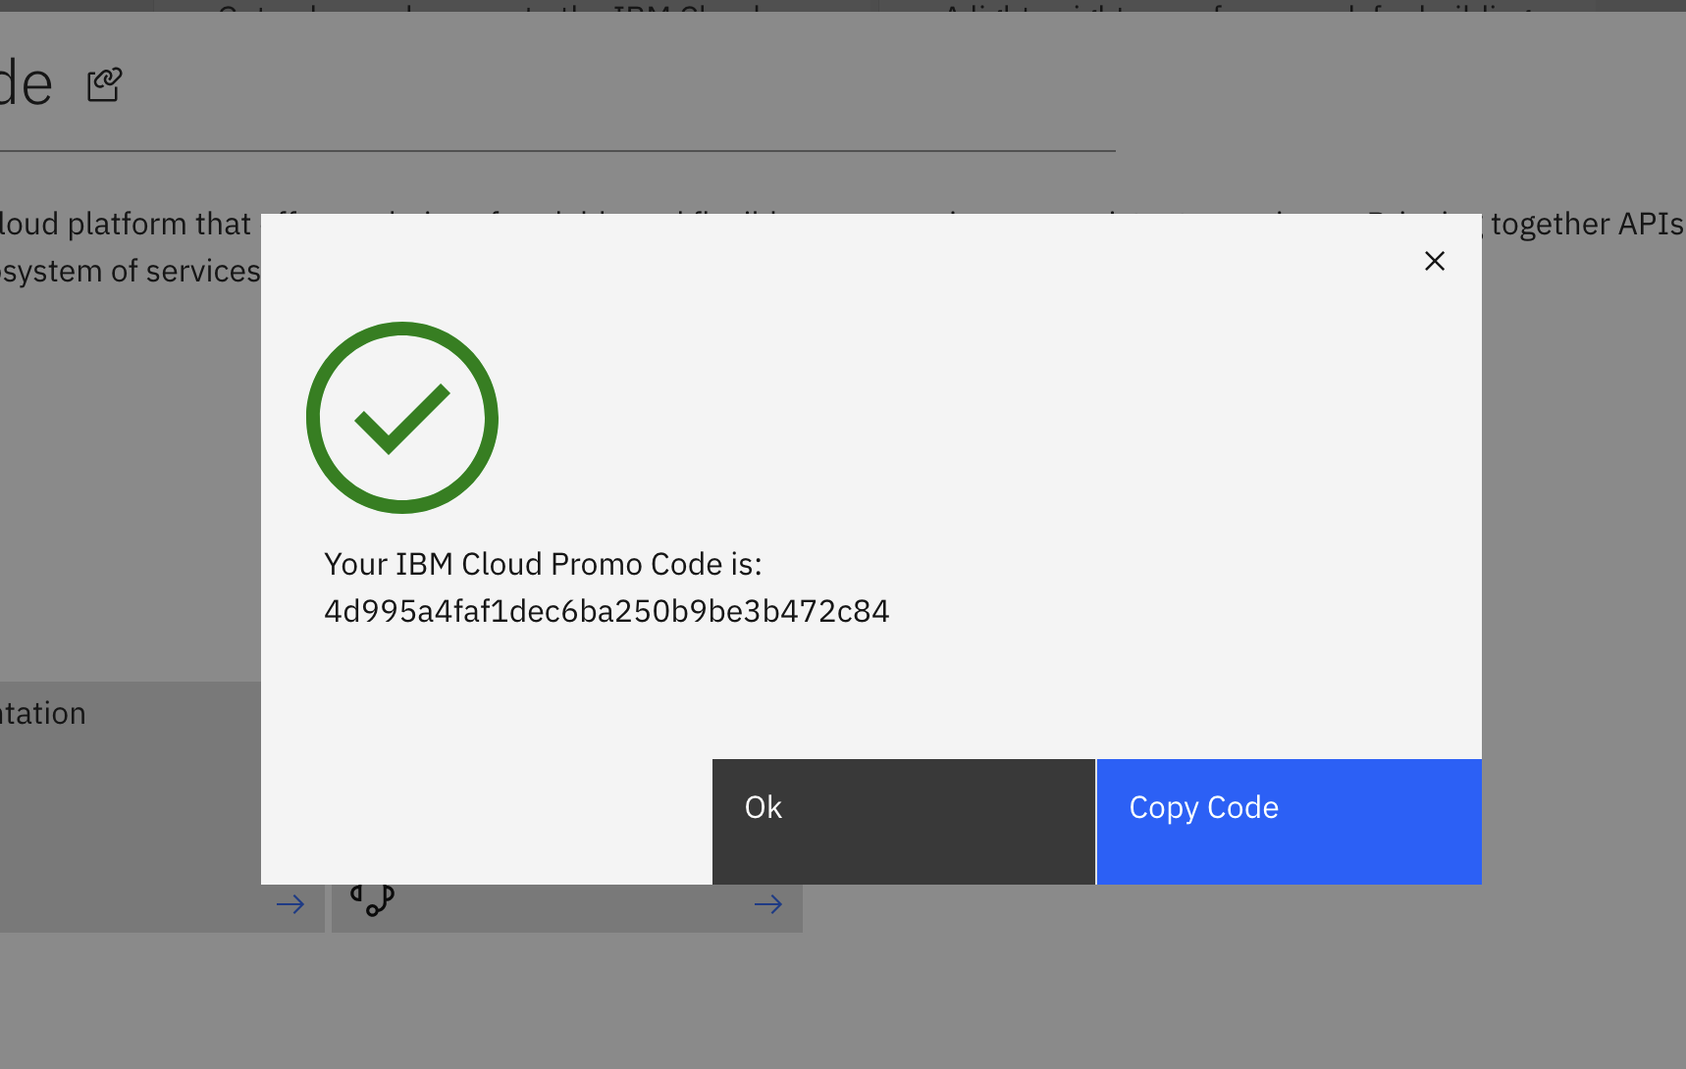
Copy the code

Slide 29
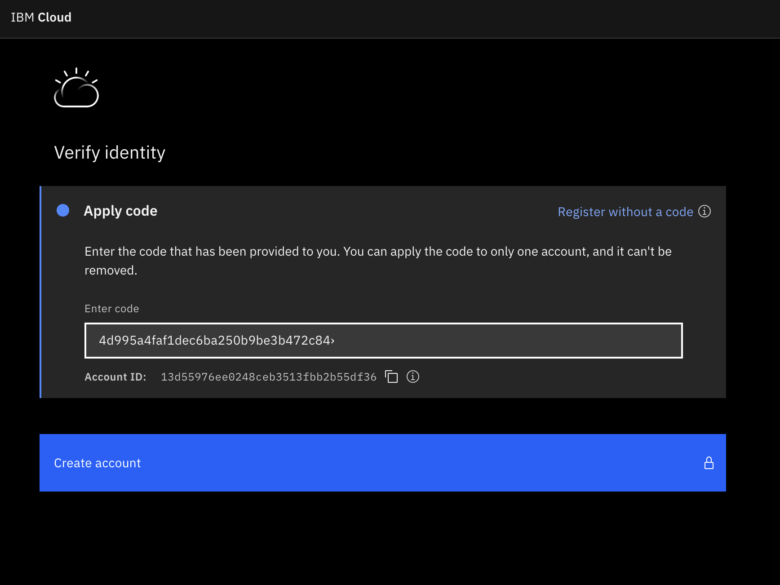
Paste the code and create your account

Slide 30
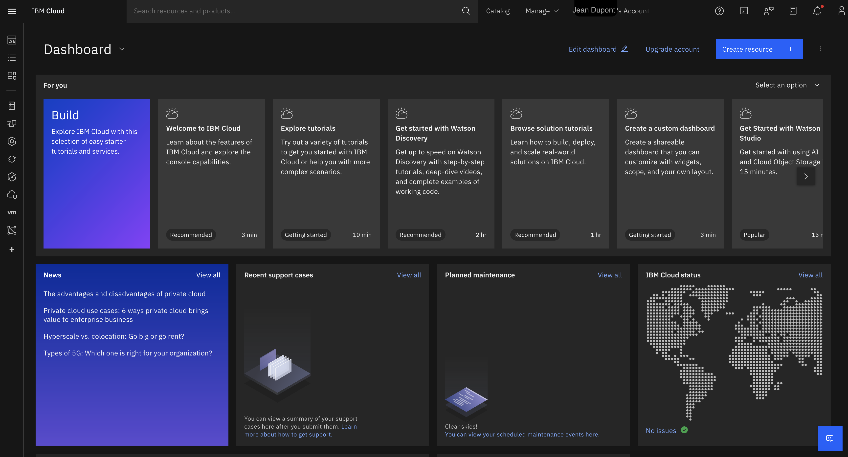
Now, you have access to IBM Cloud Resources

Slide 31
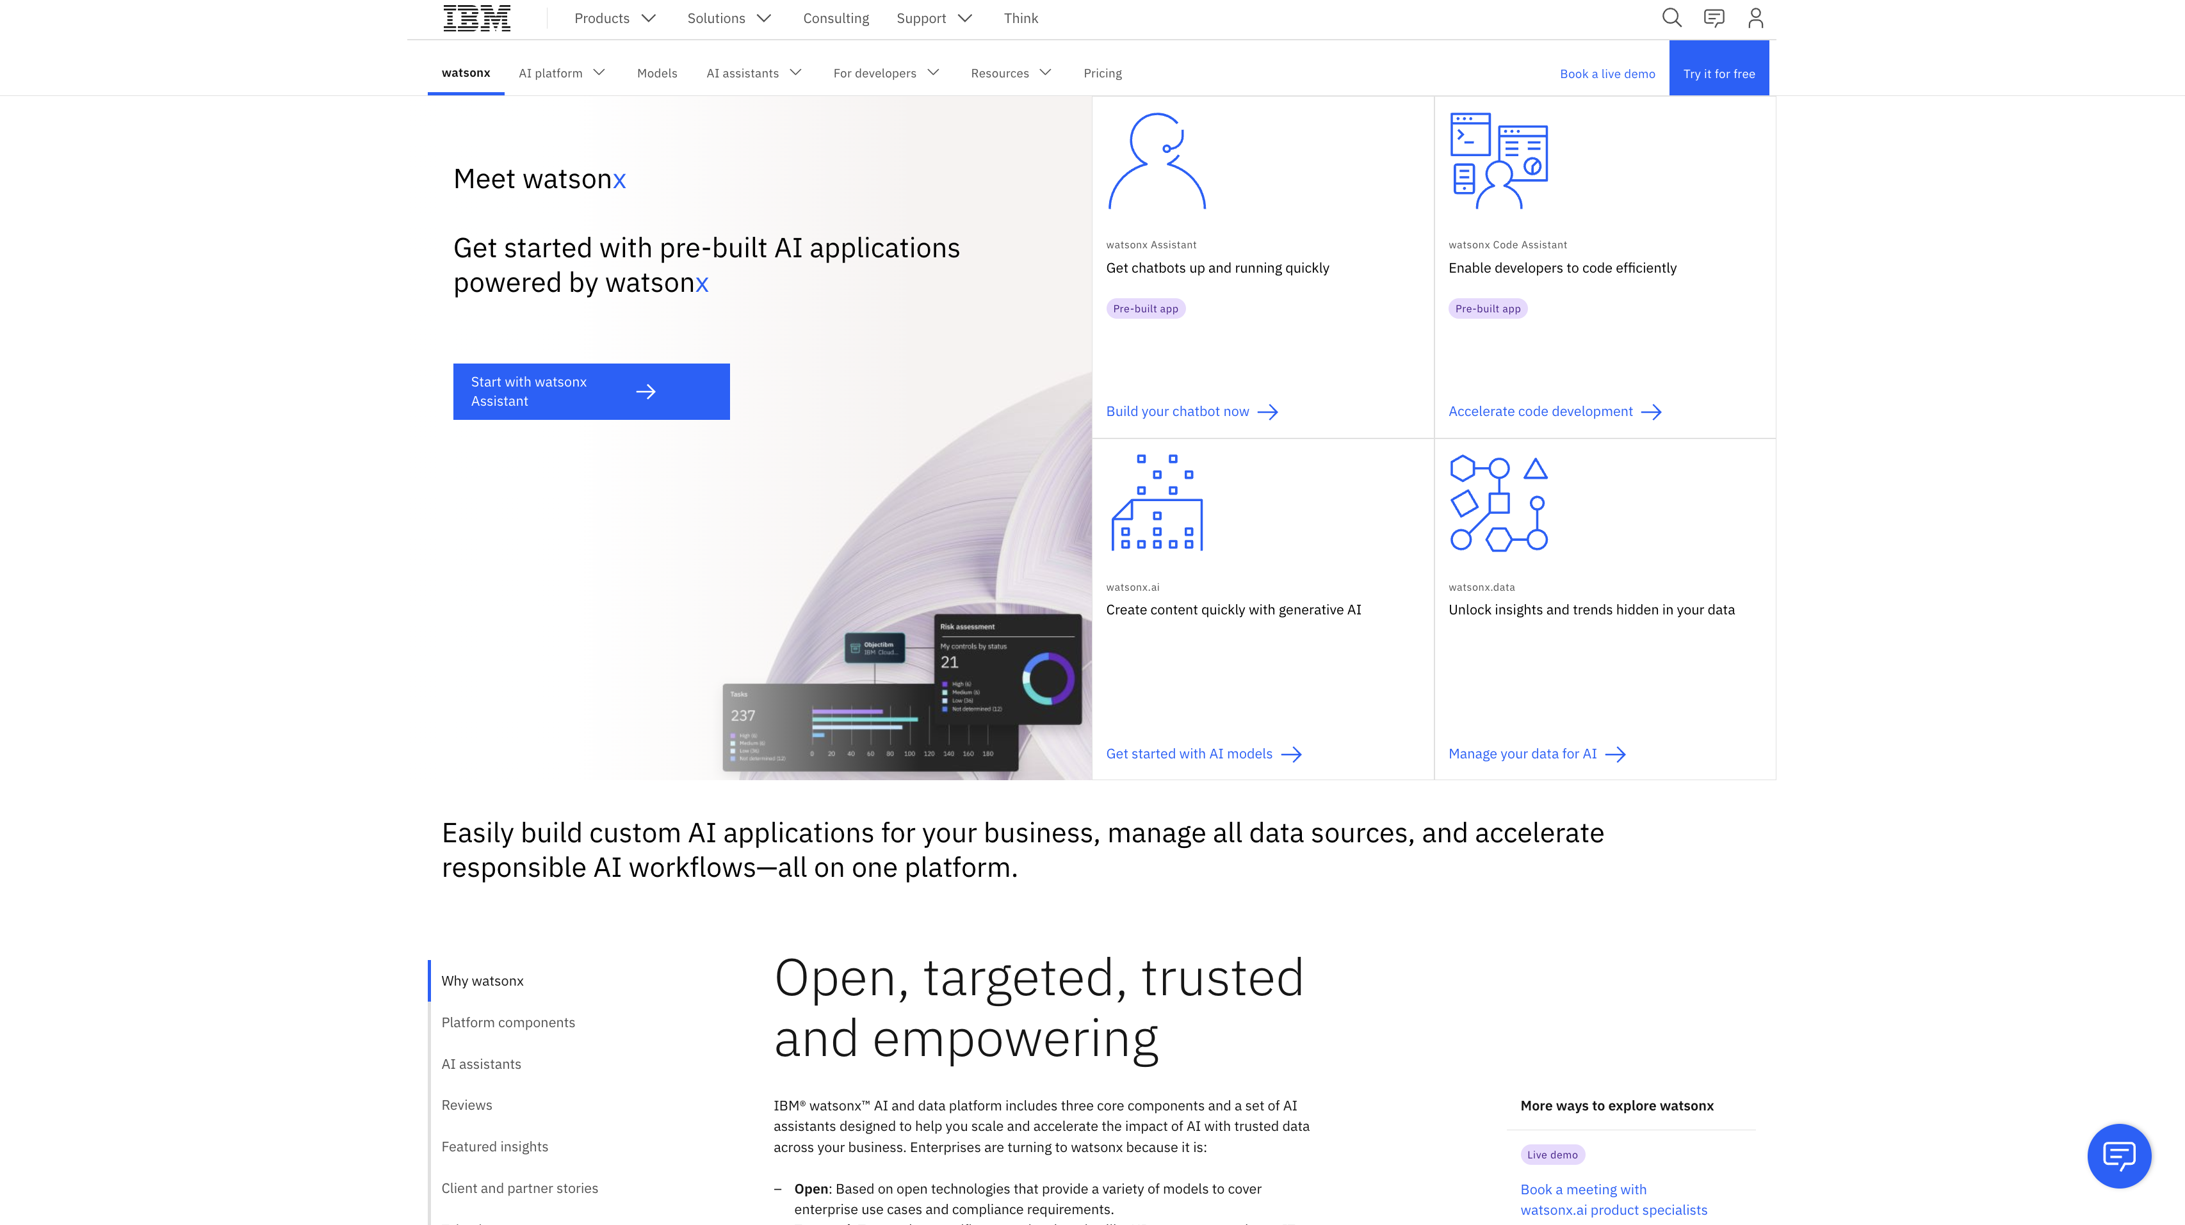
IBM Chatbot
Go to: https://www.ibm.com/watsonx and click on Start with WatsonX Assistant

Slide 32
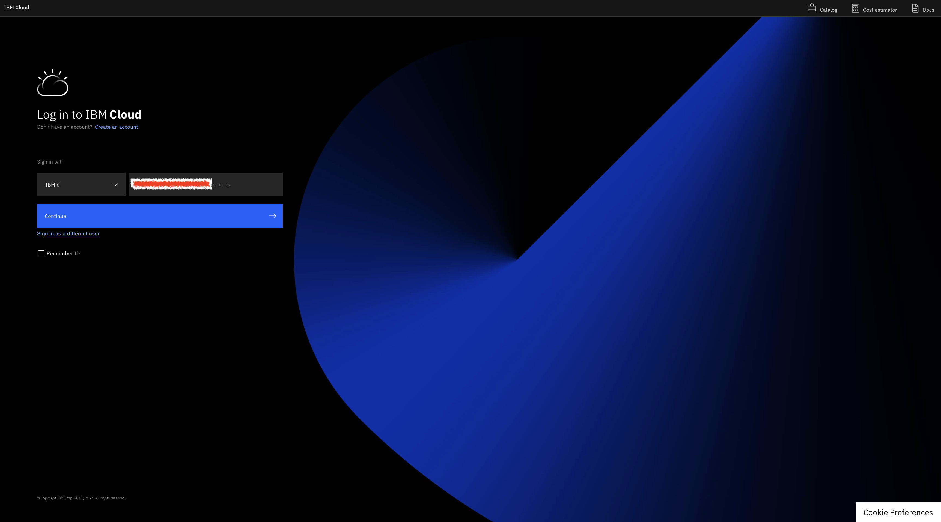
IBM Chatbot
Login with credential that was created from previous slides

Slide 33
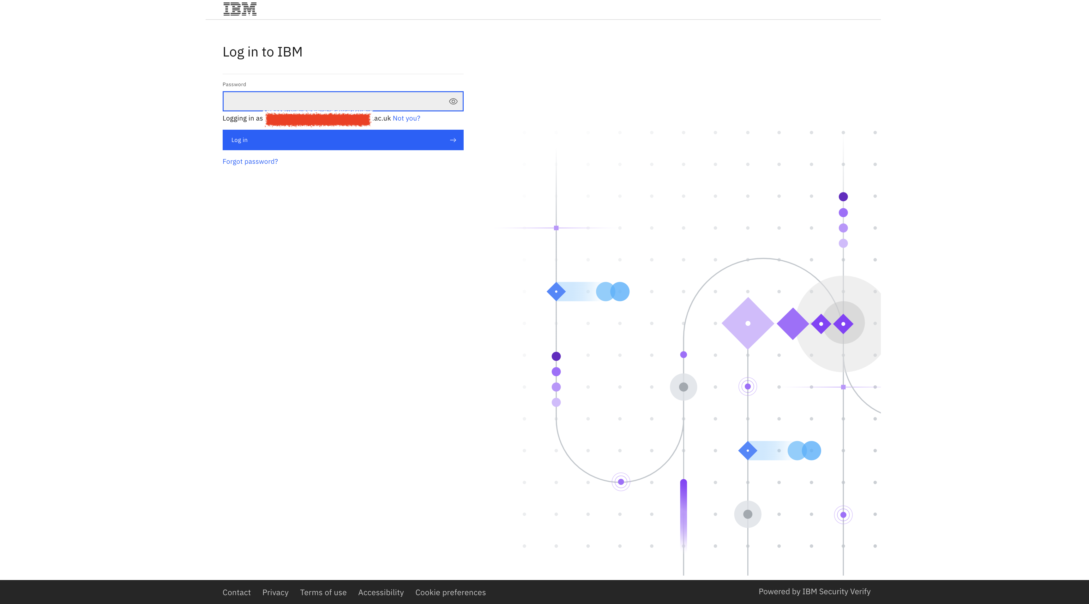
IBM Chatbot
Login with credential that was created from previous slides

Slide 34
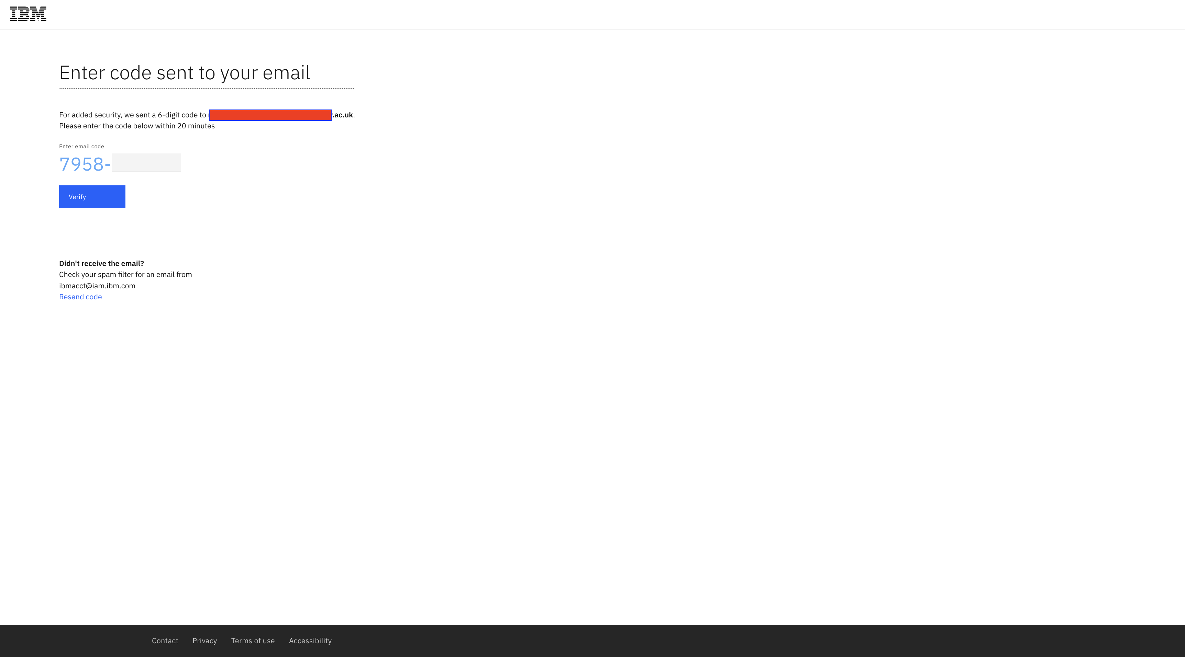
IBM Chatbot
Login with credential explained before

Slide 35
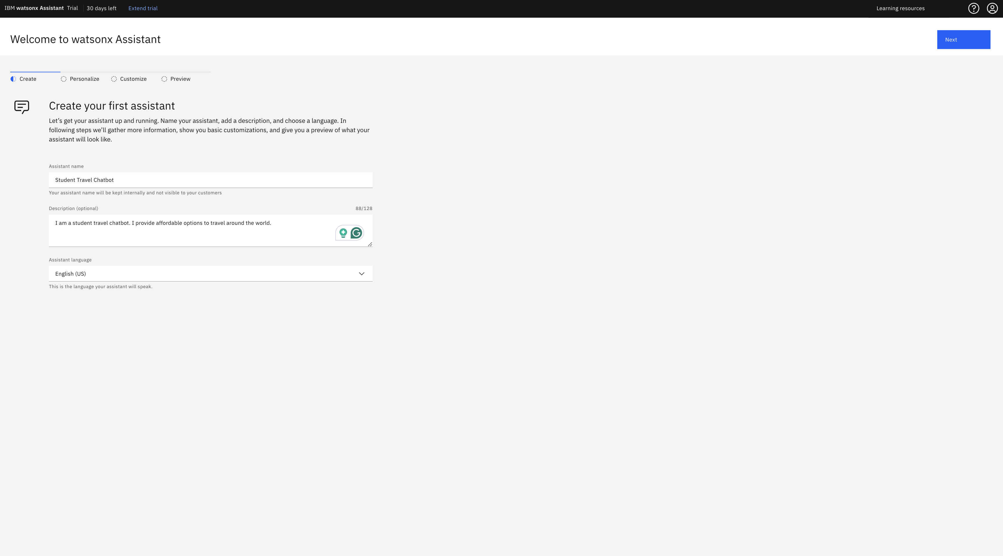
IBM Chatbot
Give the Chatbot name and some information.

Slide 36
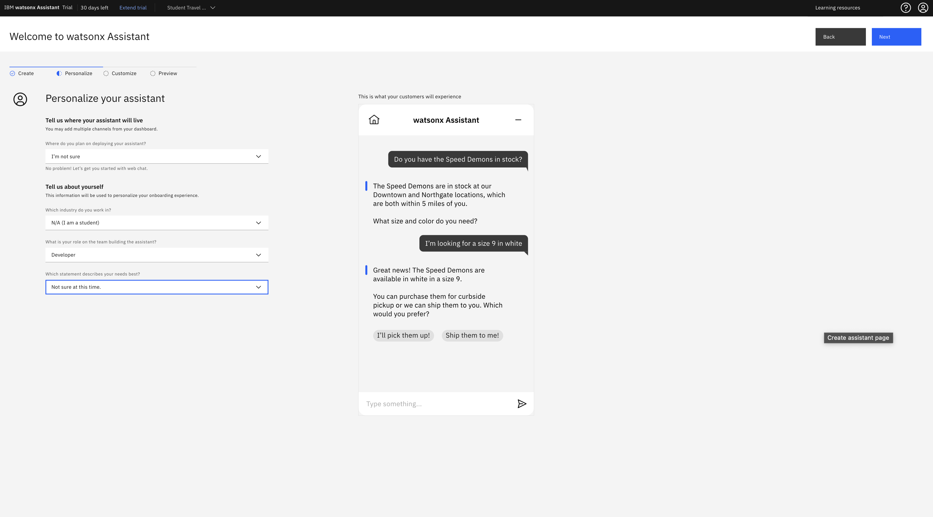
IBM Chatbot
Give the Chatbot name and some information.

Slide 37
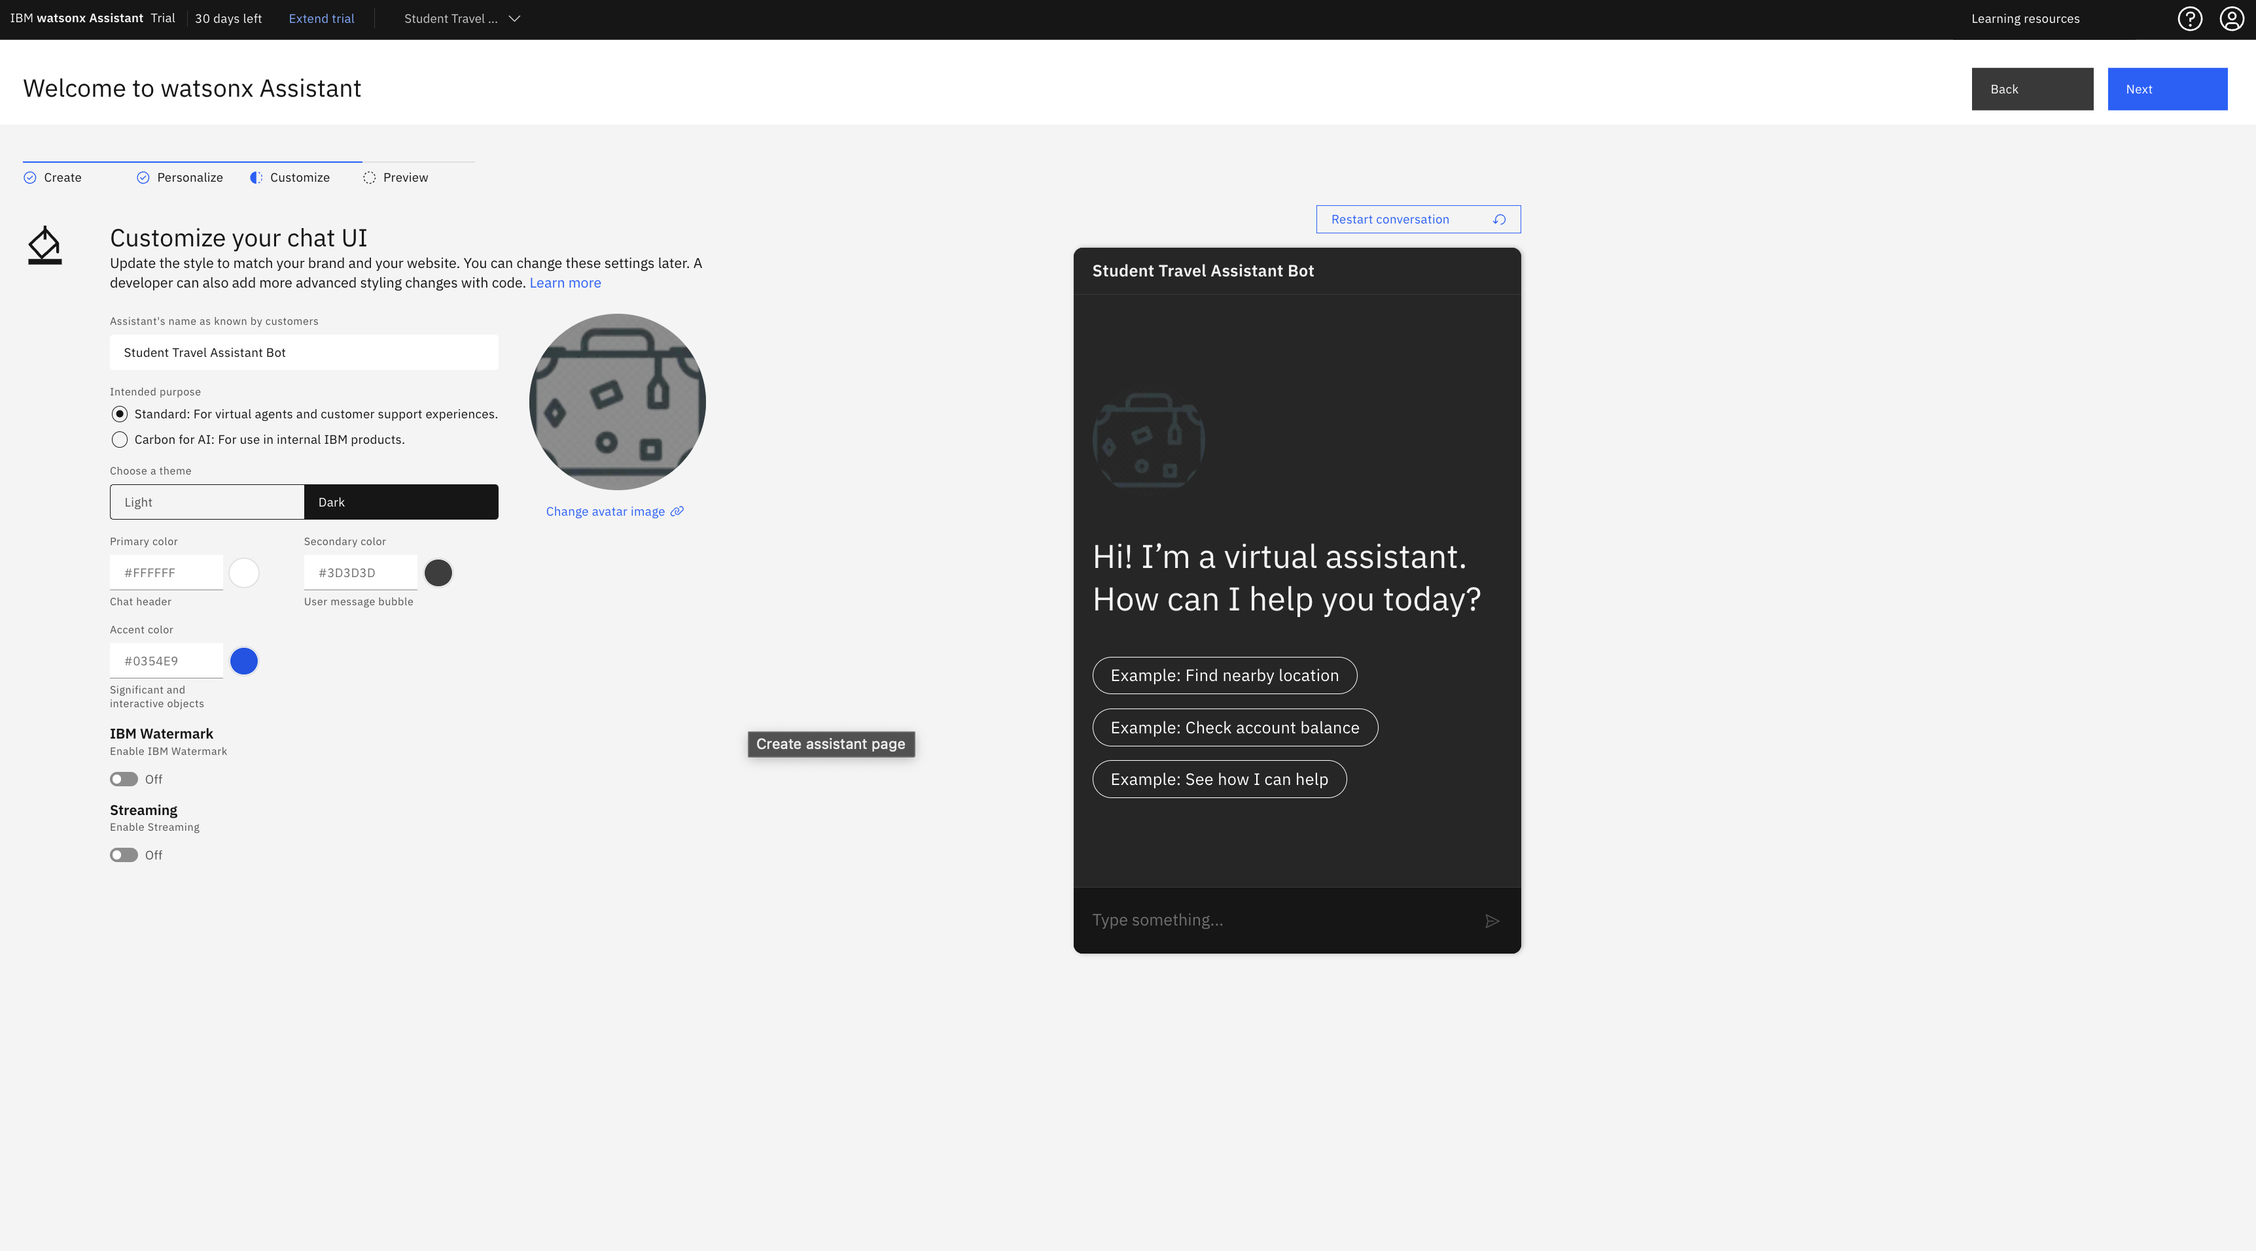
IBM Chatbot
Give the Chatbot name and some information.

Slide 38
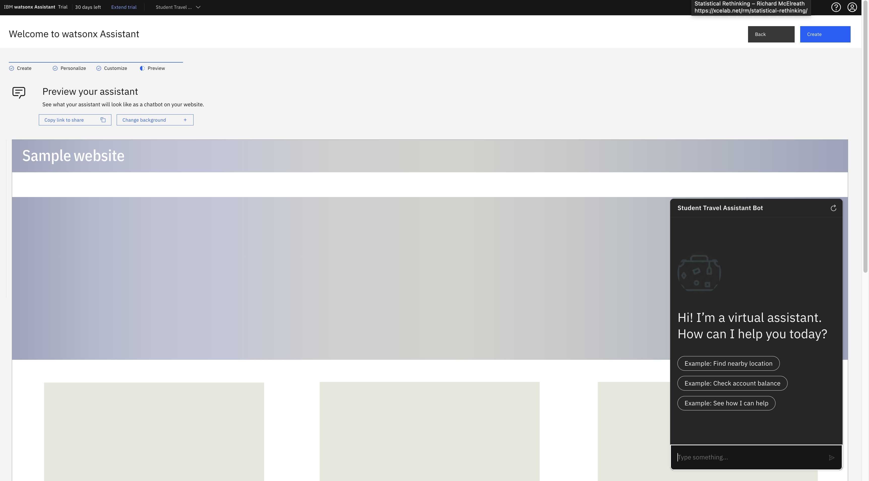
IBM Chatbot
Finally the initial of Chatbot is completed

Slide 39
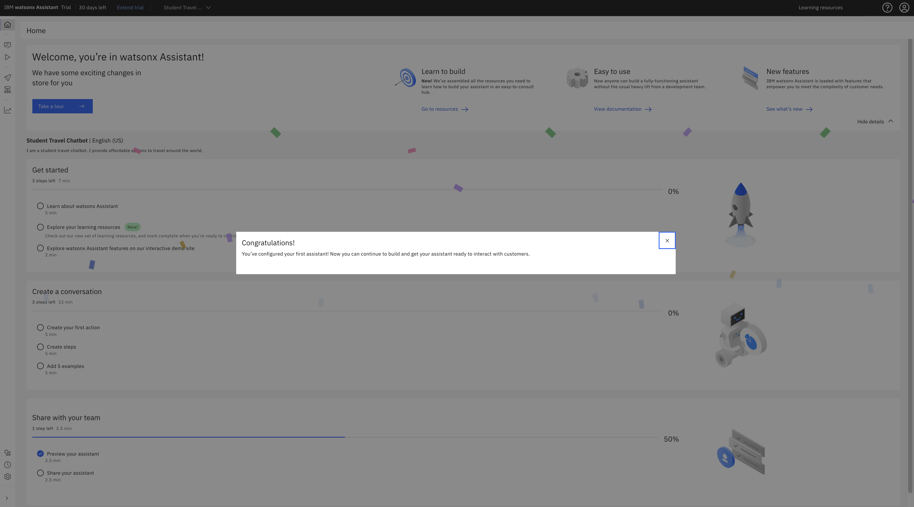
IBM Chatbot
Finally the initial of Chatbot is completed

Slide 40
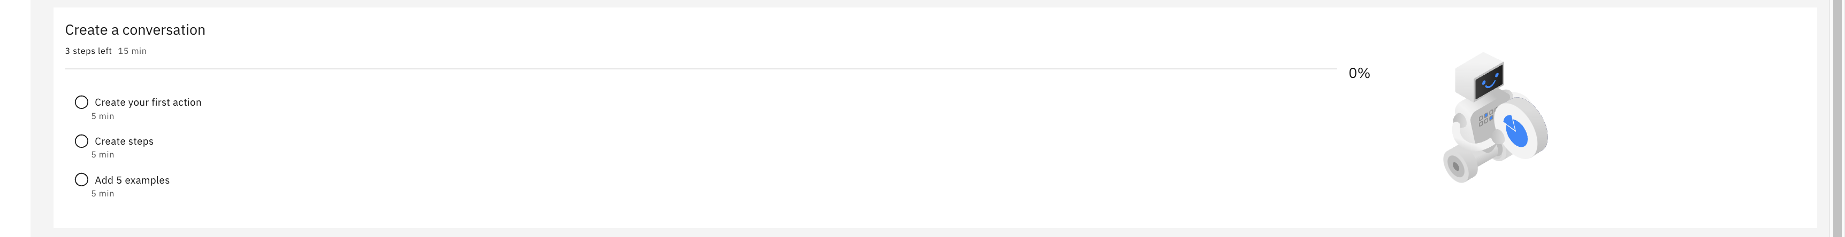
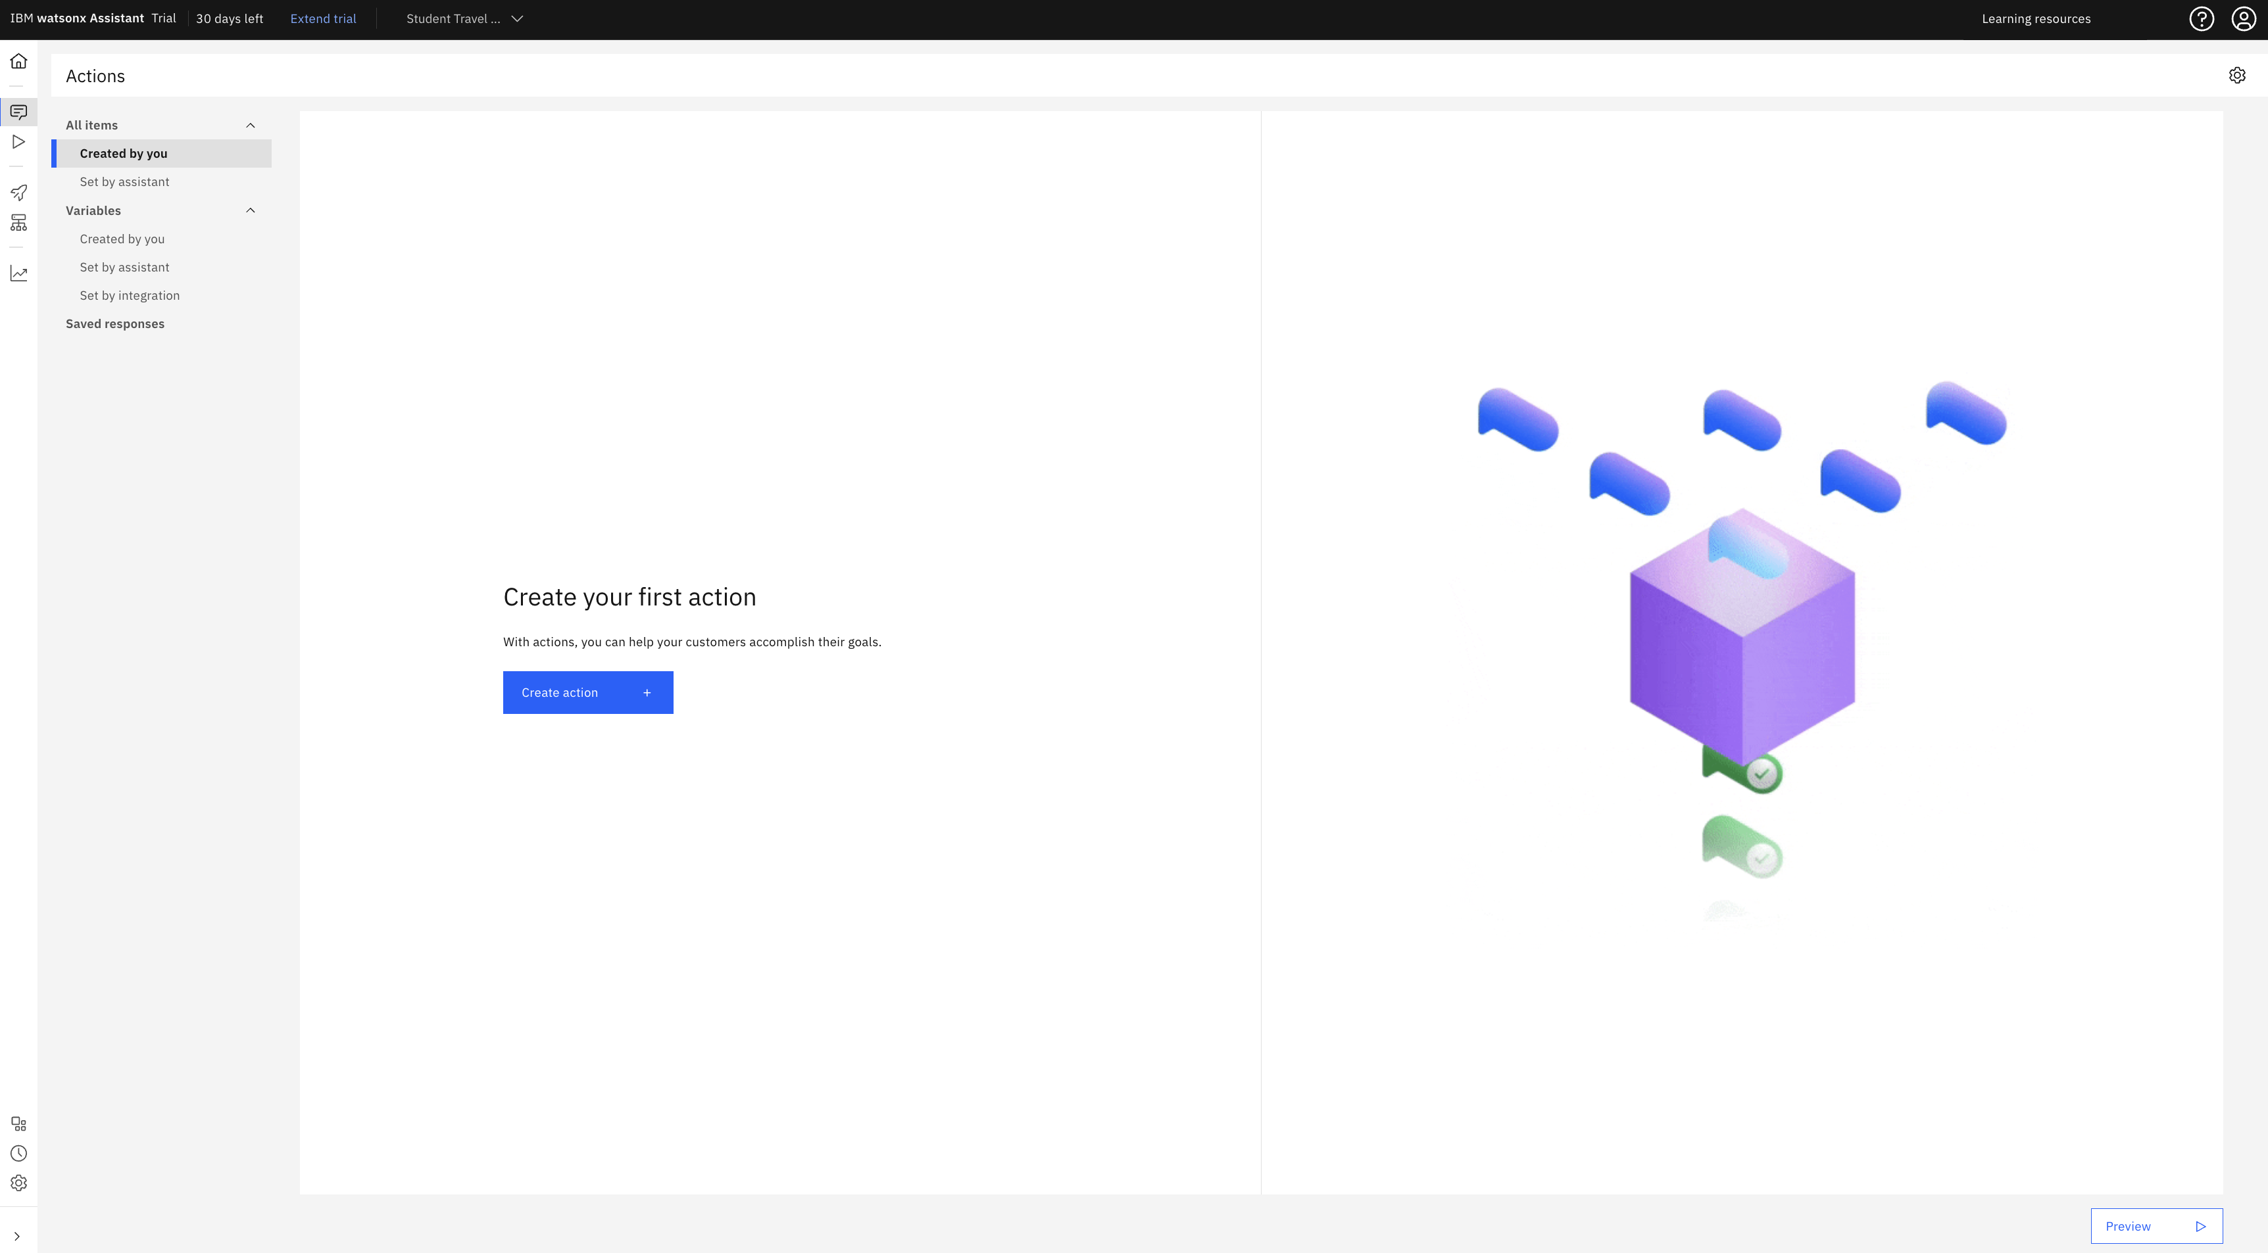
IBM Chatbot
By clicking on Create your first action, we will make chatbot to do certain tasks

Slide 41
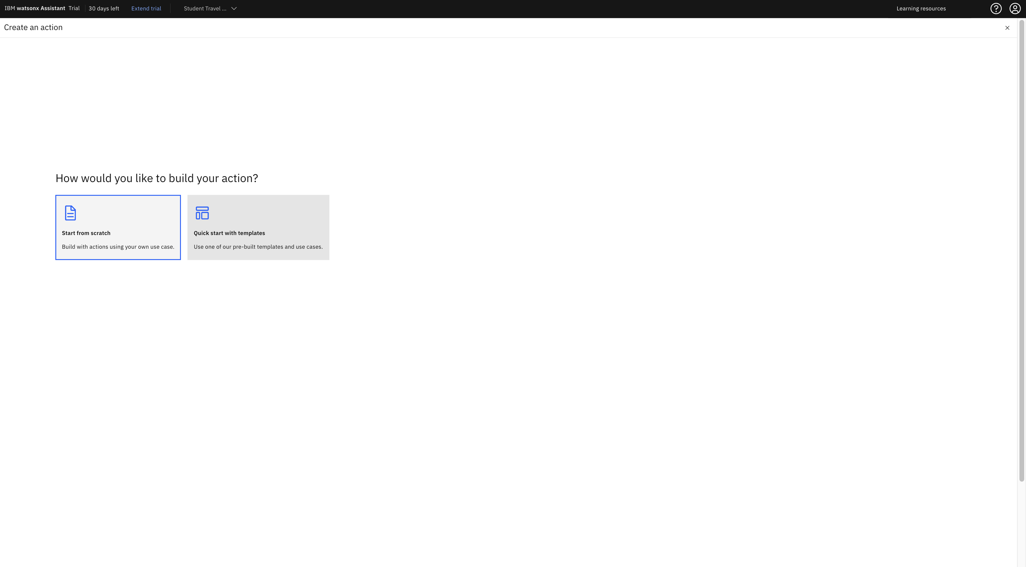
IBM Chatbot
We create the chatbot action from start by clicking on Start from Scratch

Slide 42
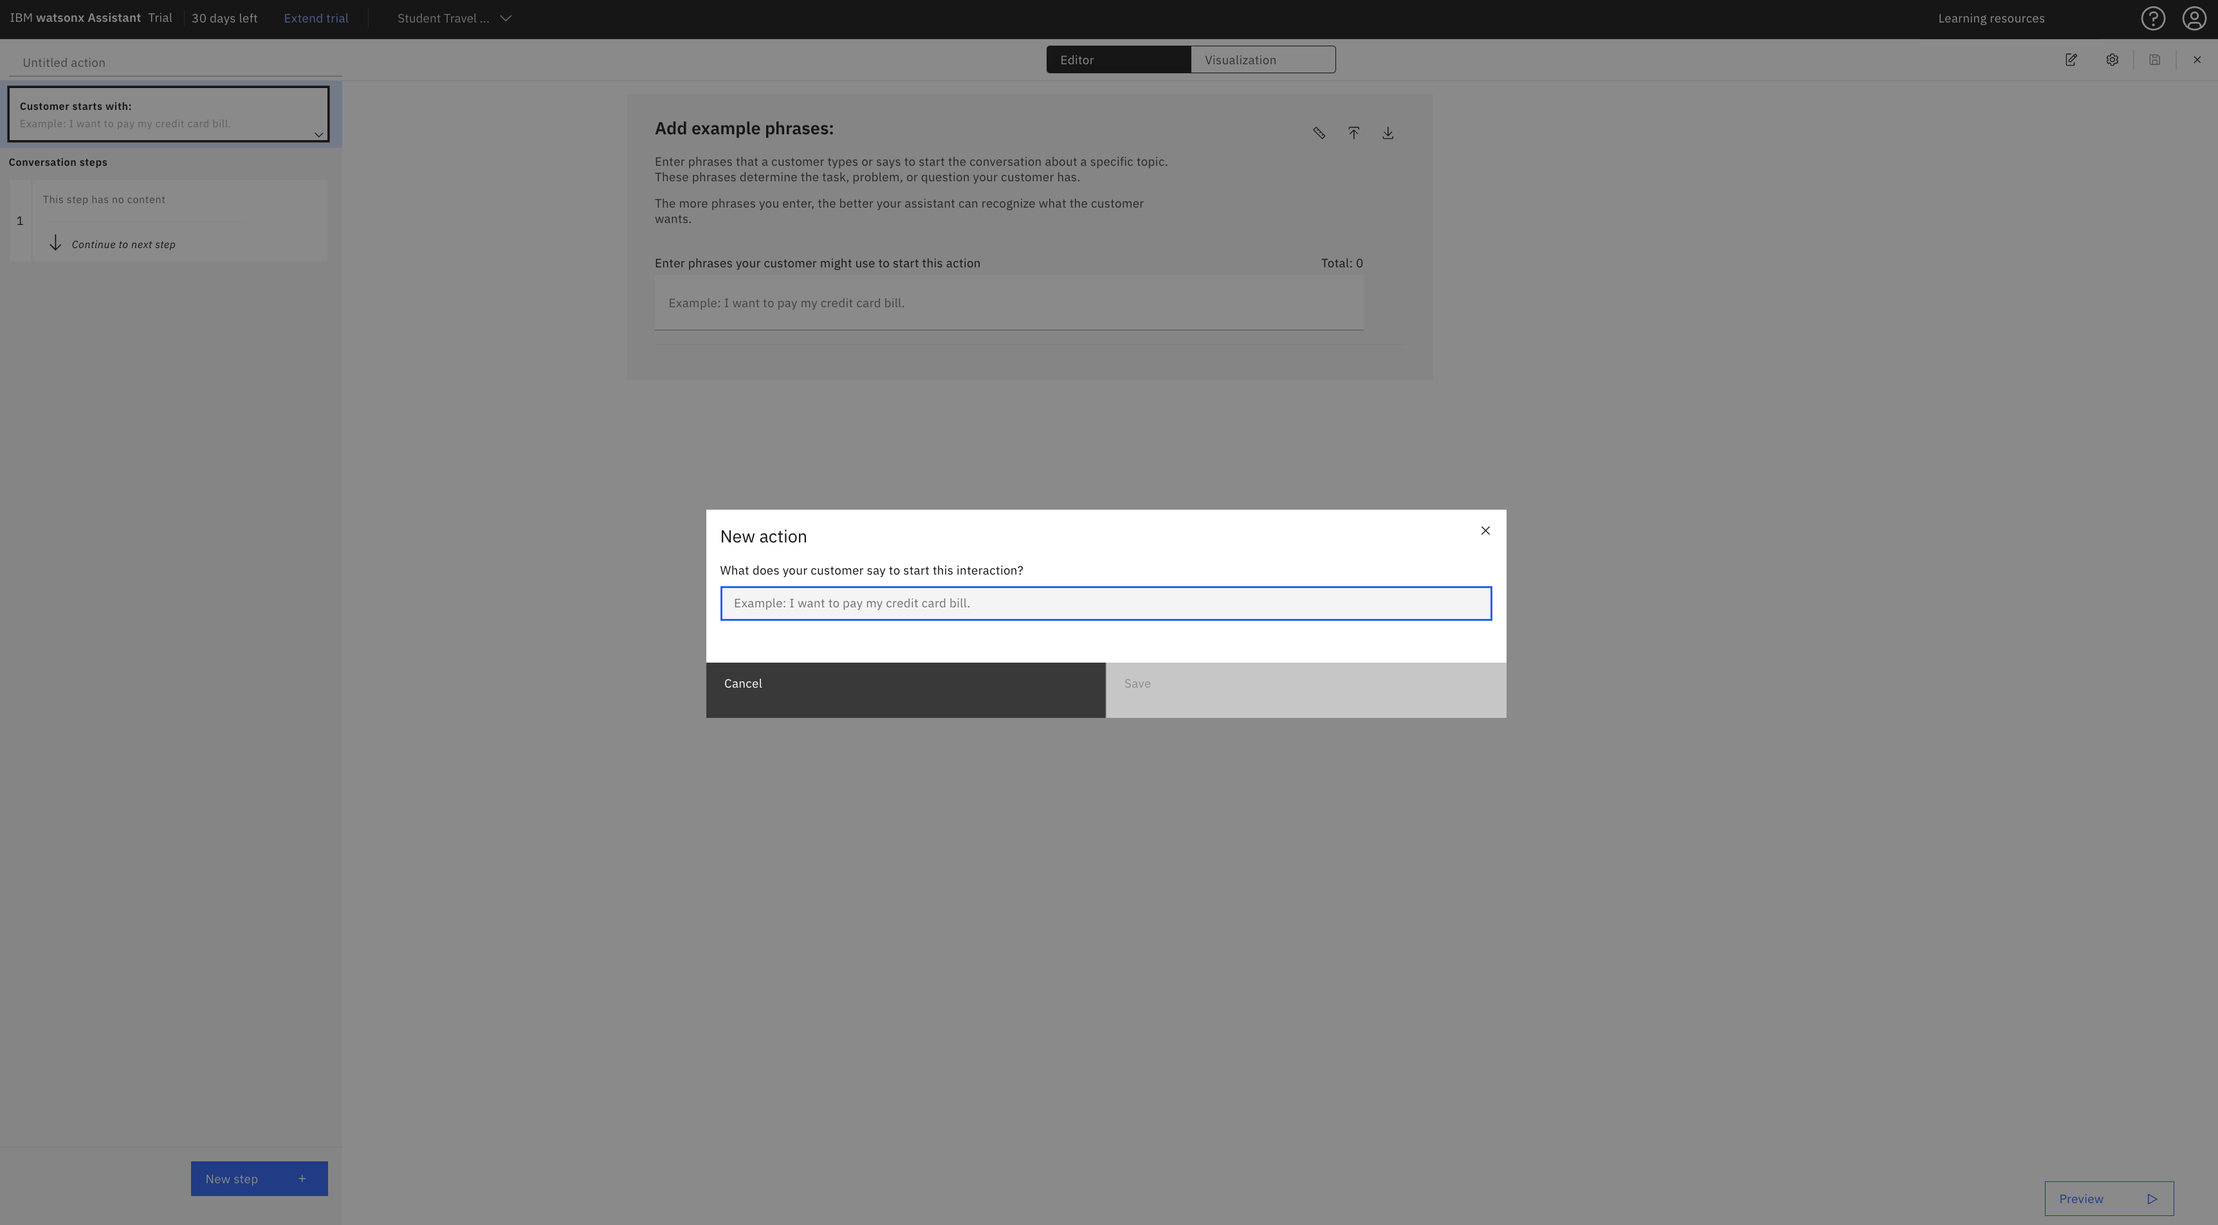
IBM Chatbot
You can provide the first action by adding a phrase.

Slide 43
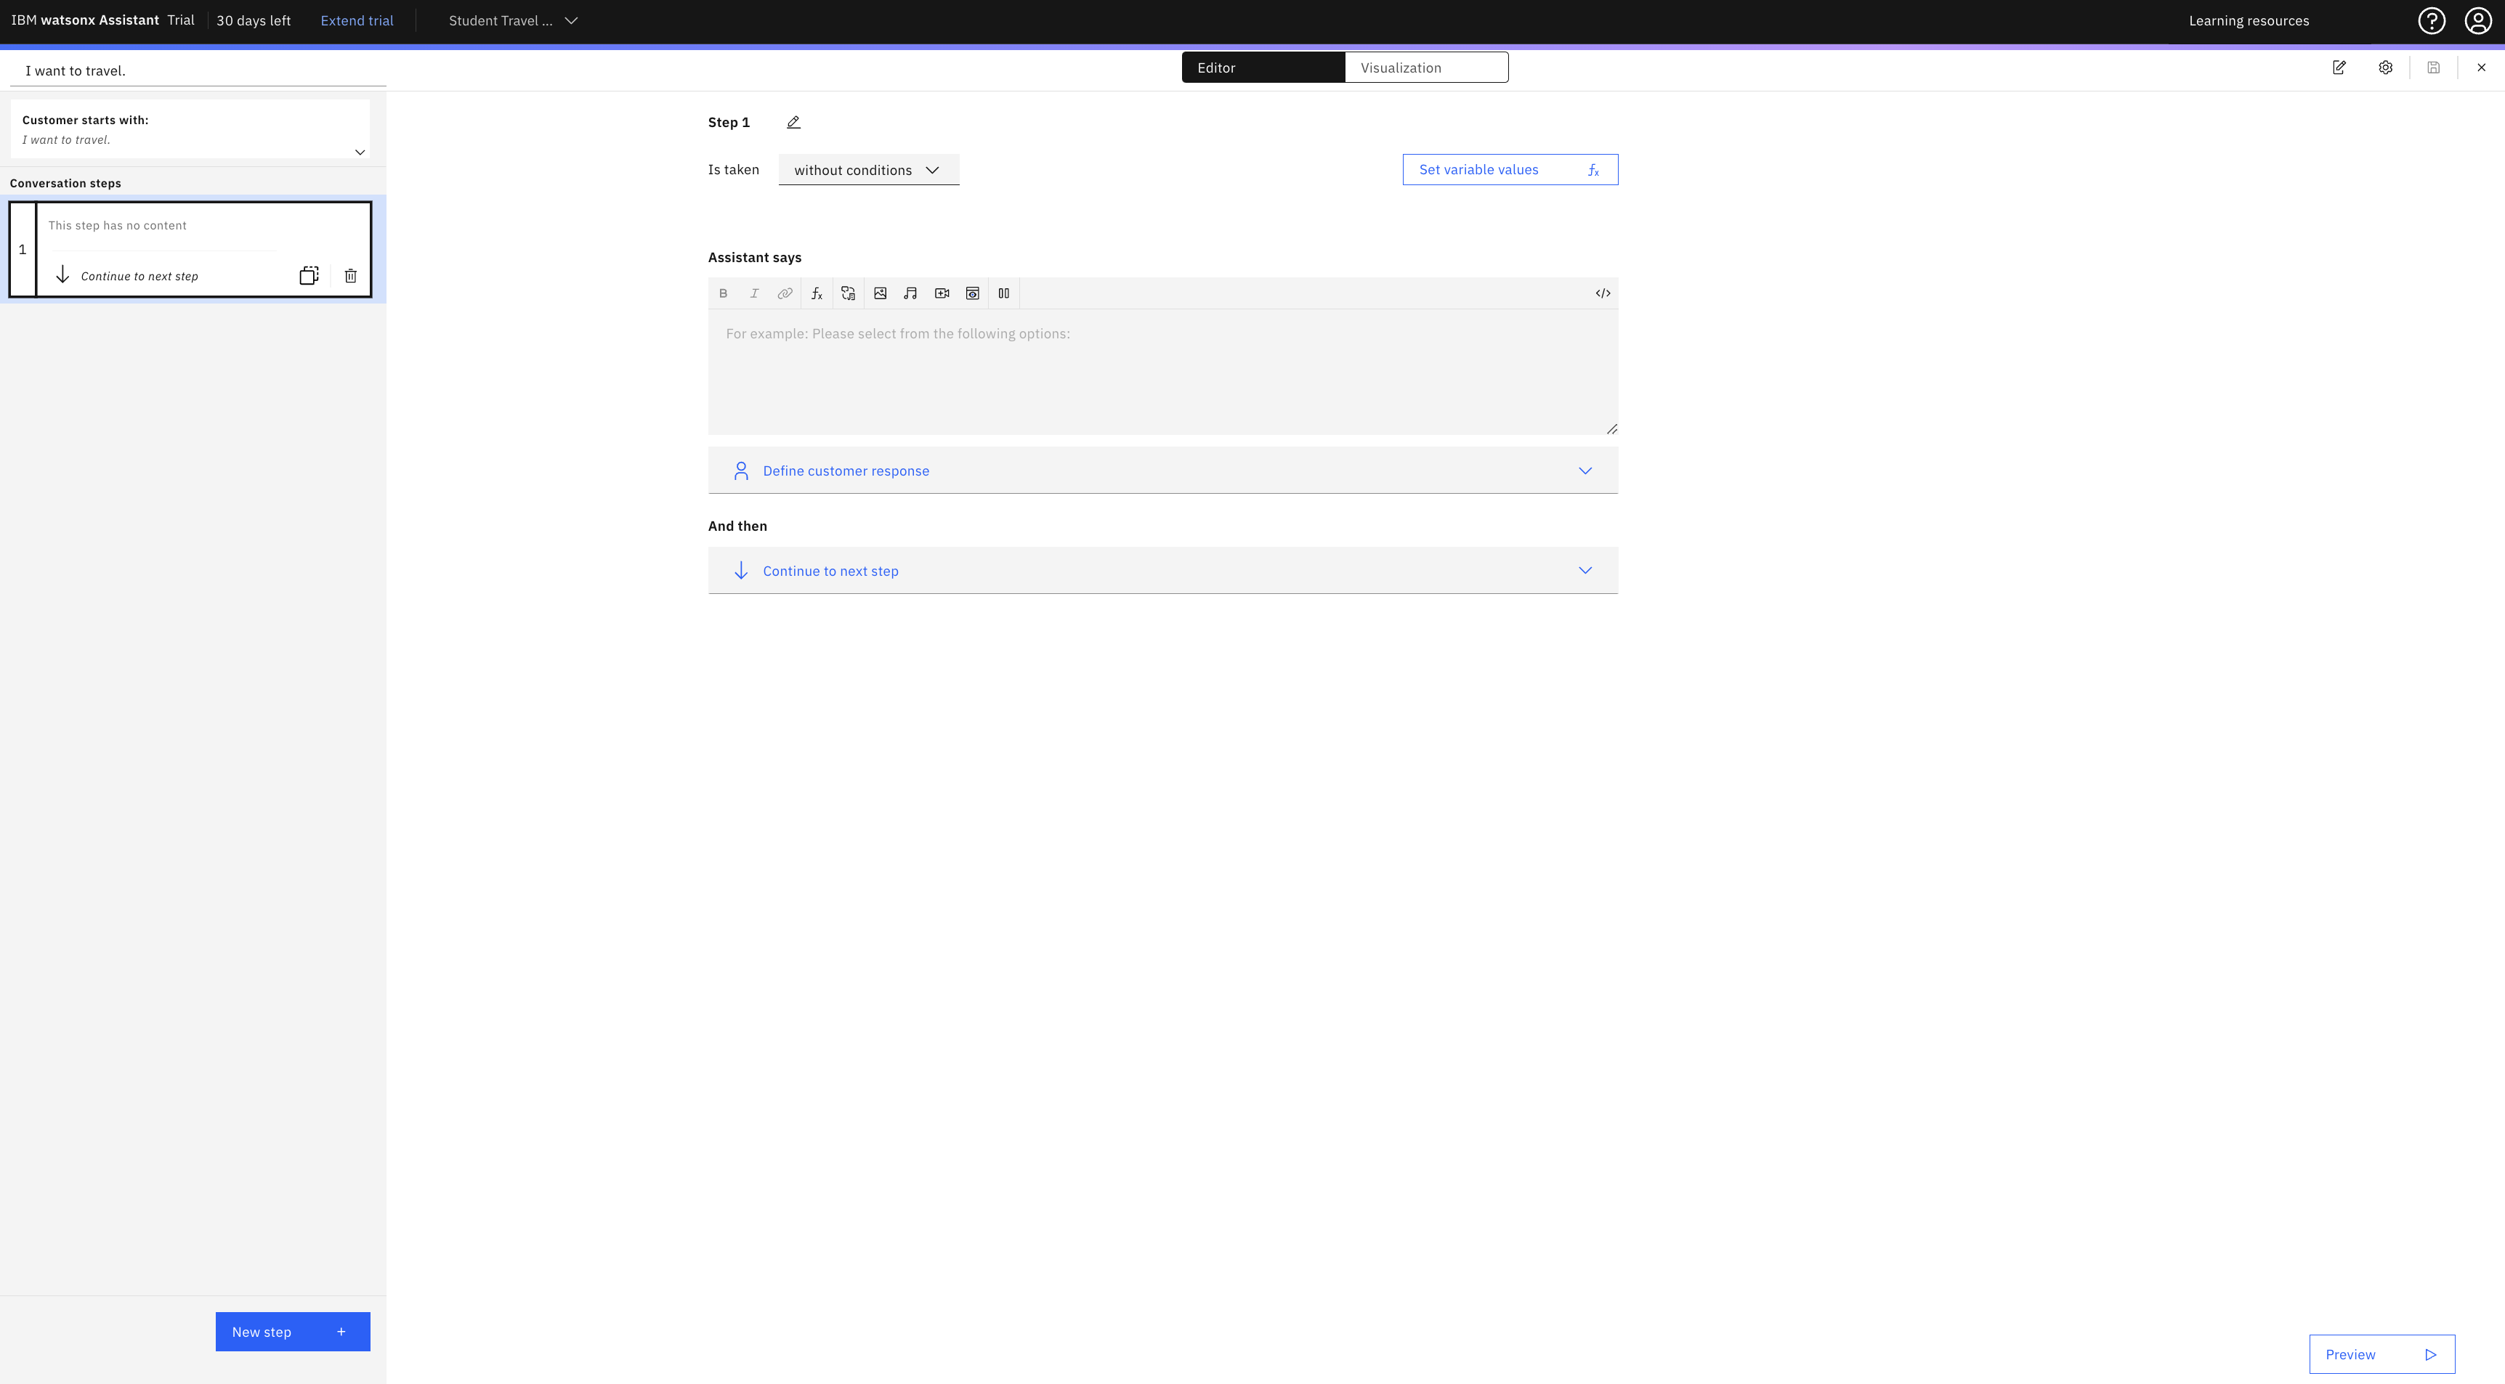
IBM Chatbot
We add more steps by clicking Next Step

Slide 44
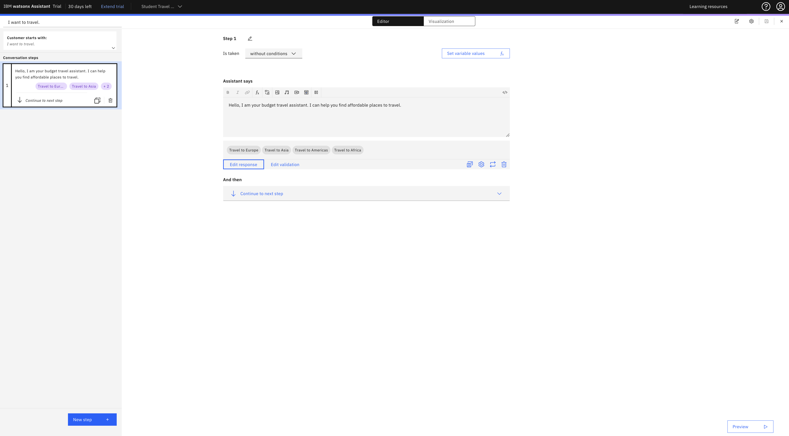
IBM Chatbot
We add more steps by clicking Next Step

Slide 45
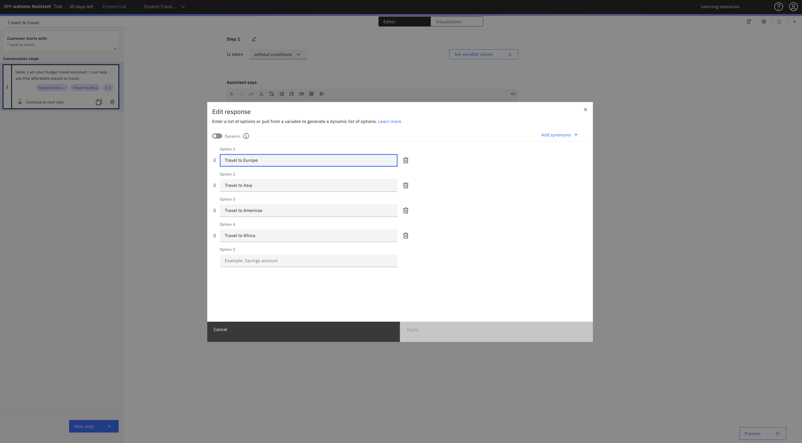
IBM Chatbot
We can provide option that users can select for more details

Slide 46
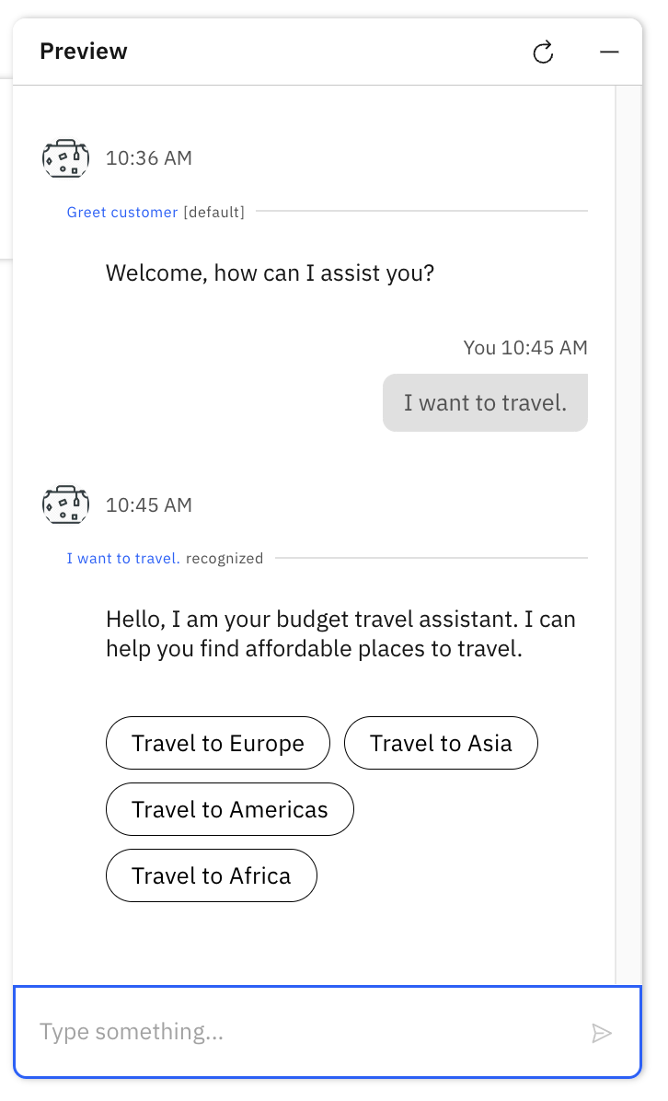
IBM Chatbot
We can provide an option that users can select for more details

Slide 47
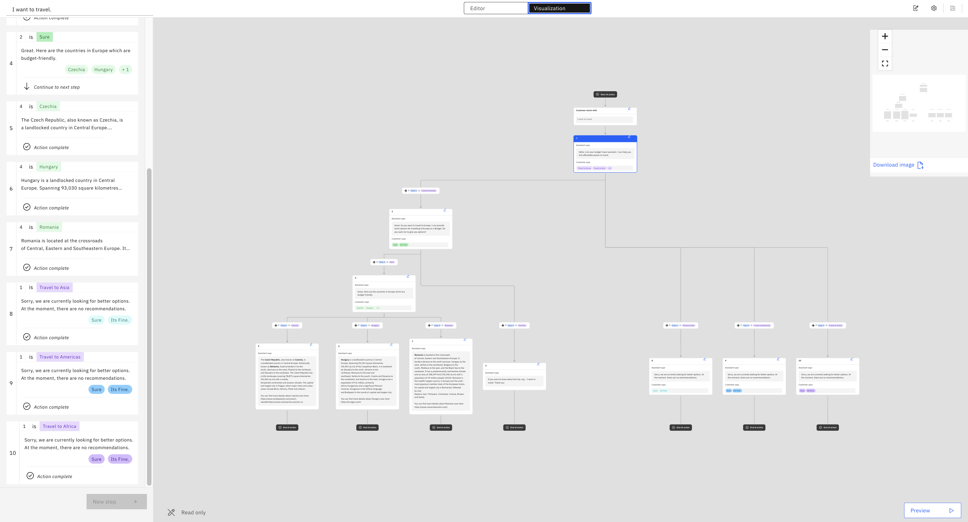
IBM Chatbot
Further we can visualize the action graphically

Slide 48
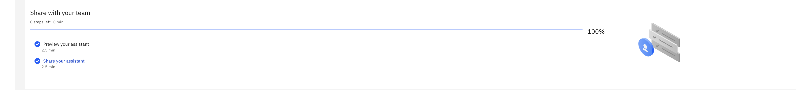
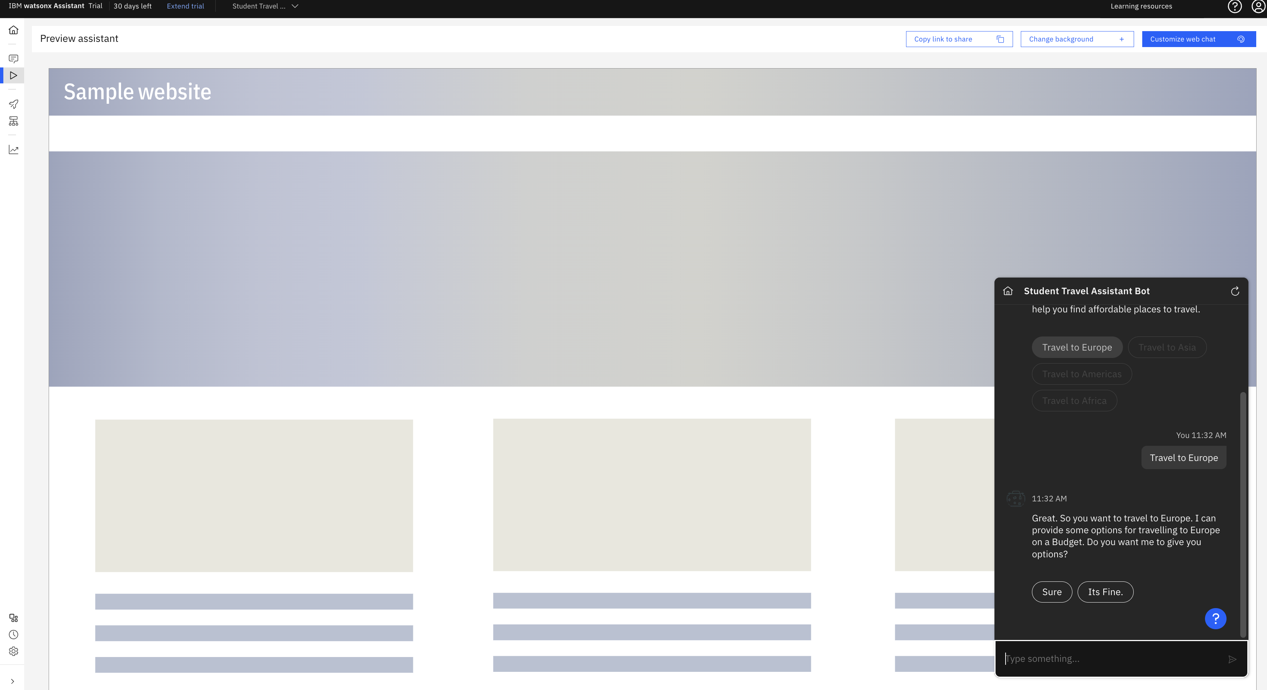
IBM Chatbot
Chatbot being deployed

