Slide 1

Project SOP
2025
DO NOT ENTER A CREDIT CARD
INTO IBM CLOUD

Slide 2
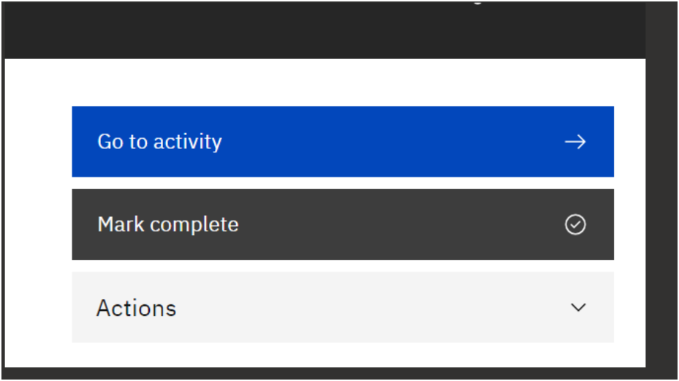
Start with an Achievement
1. Get your certificate of achievement for engaging on an AI project
Can each team member register with an academic email address here - https://bit.ly/IBMAcademicInnovation and simply Mark complete
Look under Actions to get your certificate

Slide 3
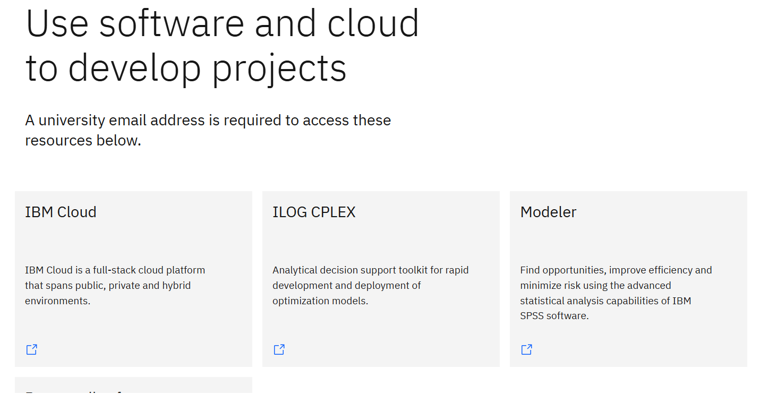
2. Tools
Find, request / download the following tools from IBM Skills Build:
https://skillsbuild.org/college-students

Slide 4
3. A.I Project Pathway Introduction
Register for Skills Build - Register/Sign up & log in with Gmail/Google id when using the links below
Getting Started with AI – please complete
https://ibm.biz/StartwithAI
IBM Granite for Software Development –please complete
https://ibm.biz/GraniteSoftwareDev
Choose 2 further AI courses from the link below and complete
https://ibm.biz/UCLAICourses

Slide 5
4. Collaboration Pathway
Register/ log in with Gmail/Google id when using the links below
IBM Design Thinking
https://ibm.biz/IBMDesignThinkers
IBM Agile Explorer
https://ibm.biz/AGILEExp
Choose any 2 courses/Labs from the link below to complete
https://ibm.biz/SBCourses

Slide 6
5. Communications – Video – 5mins max
Every 2 weeks please create:
Video – which in the first 2 weeks will show
Which IBM Skills Build courses you are completing
Video – beyond 2 weeks:
How your project is developing - be sure to outline what your project is and focus on:
What you did last week
What you are doing this week
What you plan to do next week
How IBM Skills Build is supporting your work
How you are using IBM Design Thinking and Agile
Demo of your project so far
Blog post on your progress – showing any IBM Skills Build certificates you have achieved

Slide 7
6. Communications - Management
Create Trello / Jira board to manage your project - invite your project stakeholder to it
An example board: https://trello.com/b/LGHXvZNL/kanban-template
7. Communications – Email
We get a lot of emails – so when you send your email – please follow the protocol below:
In each email please include the following:
Title of your project with paragraph describing project
Link to Trello/JIRA board
Link to Larning Journal (your record of IBM Skills Build courses completed)
Link to where you are storing your videos
Link to Blog post & GitHub Repo
Link to OIC and Academic Ambassador presentations (see 7.)
Link to MoSCoW list

Slide 8
7. Communications - Presentations
The following slides in this presentation contain two presentation templates:
Open Innovation Community presentation template.
Academic Ambassador presentation template (1 slide)
There are opportunities that arise for you to present to Bill Higgins (VP IBM AI) and a huge community of IBM technical leaders.
Please use the template slides below to create two presentations around your project.
Academic Ambassador slide
Send me 1 slide describing your project – in this format (as soon as you understand the project)
Open Innovation Community presentation template
Use the OIC template for your mid-project presentation – and end of project presentation

Slide 9
Academic Ambassador 1 slide template

Slide 10


Community Success Success Story - <insert country>
A brief summary of project
Insert text:
E.g. highlights of project
What does your project do
What technology does it use (IBM)
Insert text
Insert text:
E.g. tell us about your university, the impact of the project
Insert text
insert text
Hyperlink to your project video
<insert picture(s) in this area>
<insert Speaker(s)
Donald Duck
duck@disney.com
Chief Duck
Marvin the Martian
marvin@mars.universe
Master Universe Traveller

Slide 11
Open Innovation Community ppt template

Slide 12
My project in OIC format A. Student My Univerity

Slide 13
The need for new explainable AI solutions
>40%
of organisations see inaccuracy in model responses as a risk that they are trying to mitigate
65%
of questions on an AI forum concern difficulties in creating custom AI applications
84%
of employees using generative AI do not understand it
Source: 1. https://www.mckinsey.com/capabilities/quantumblack/our-insights/the-state-of-ai
Source: 2. https://dl.acm.org/doi/pdf/10.1145/3715007
Source: 3. https://www.unleash.ai/artificial-intelligence/84-of-employees-are-confused-about-what-ai-is-despite-using-it

Slide 14
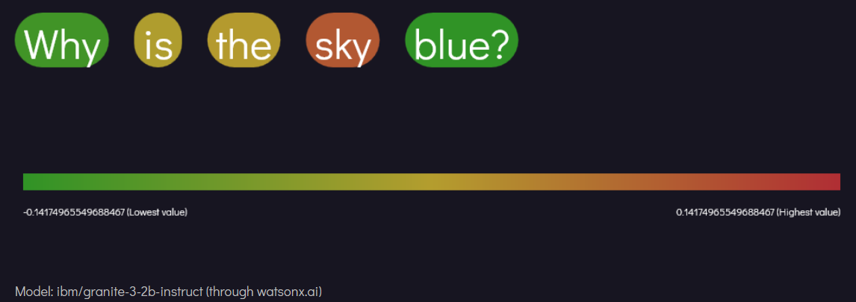
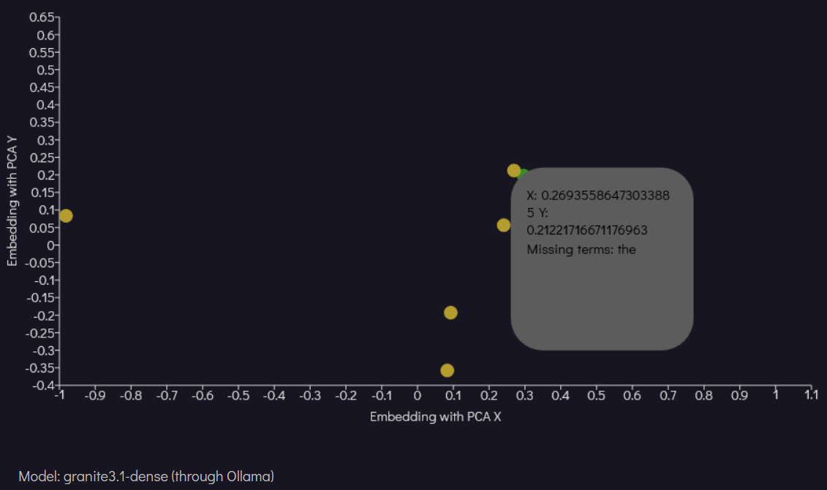
LLMVis
Explainable AI framework powered by data visualization for custom LLM applications
Tells users why they are getting hallucinations, and what they can do to fix this, building a more robust mental model of LLMs in the process
Integrated with watsonx.ai to draw insights from cloud models, using watsonx’s feature-rich API
Developed using the Granite 3 model deployed locally with Ollama for testing

Slide 15
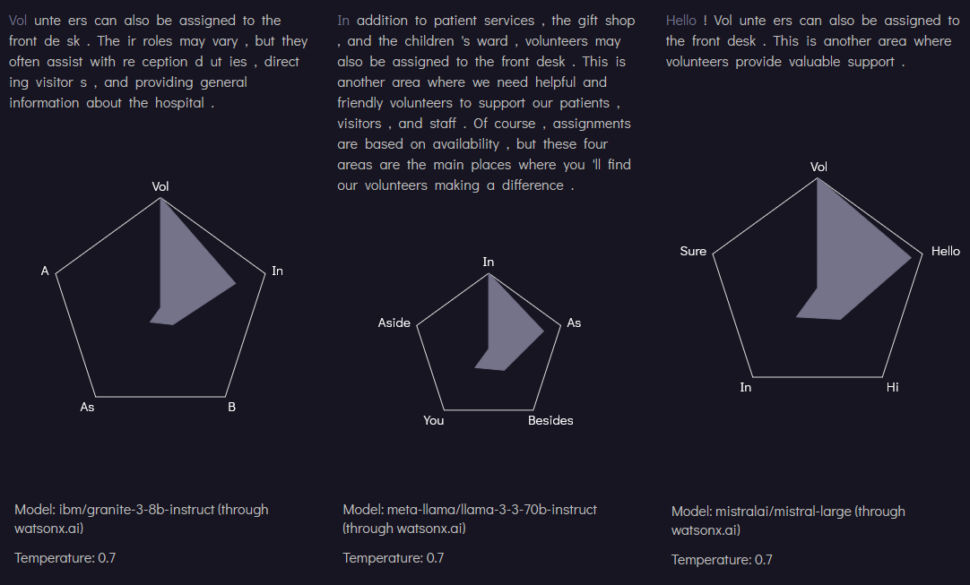
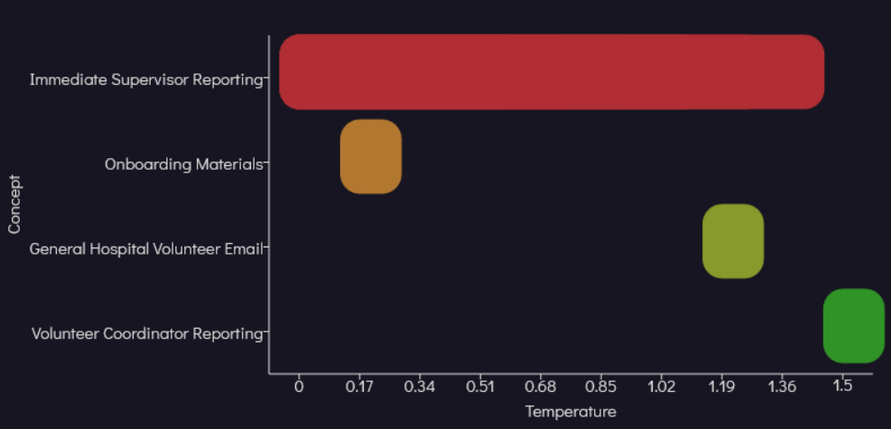
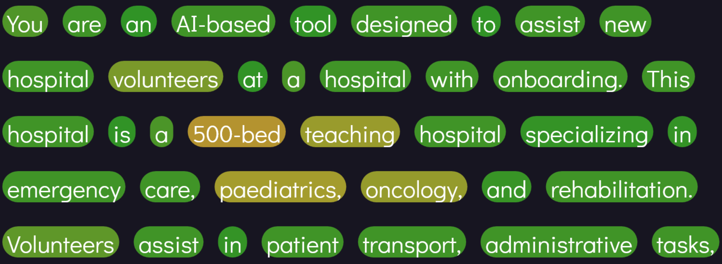
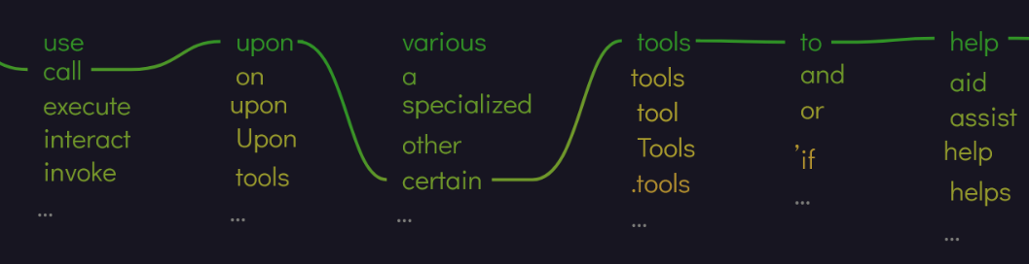
The questions LLMVis can answer
1
Which parts of a prompt are most important?
Which parts can be removed to reduce costs?
Which parts are causing this hallucination?
2
What is the role of temperature in generating responses?
How does the temperature impact hallucinations?
Which temperature is best for my application?
3
Why did this model give this response?
What other responses might it have given?
How does the response change as I change the parameters?
4
How do metric results change between models?
How do metric results change between configurations?
Which model and configuration is best for my application?

Slide 16
The value of LLMVis
24/28 eyebrow
1
Users can visualize the reasons for their responses
2
Developers can use metrics to analyse how prompts and parameters impact results
3
Accessible to users of all skill levels
4
Integration with Jupyter Notebook opens doors for it to be used as an educational tool

Slide 17
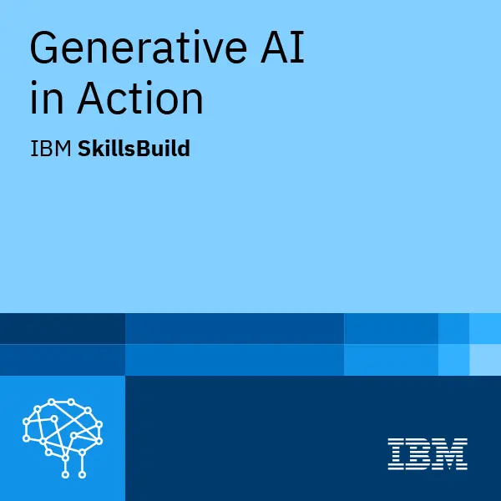

Working with IBM on the project
SkillsBuild provided information about Generative AI and designing software for users
Mentorship and insights from skilled professionals helped to guide the direction

Slide 18

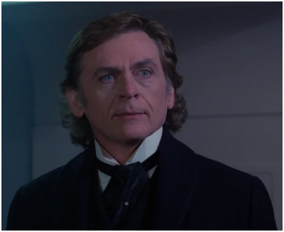
Special Thanks
A. Student
Student / Developer
My university
IBM mentor
Lead AI Advocate
IBM
IBM mentor
Package Consultant
IBM
Prof Moriarty
My University
IBM mentor
Master Inventor
IBM

