Slide 1
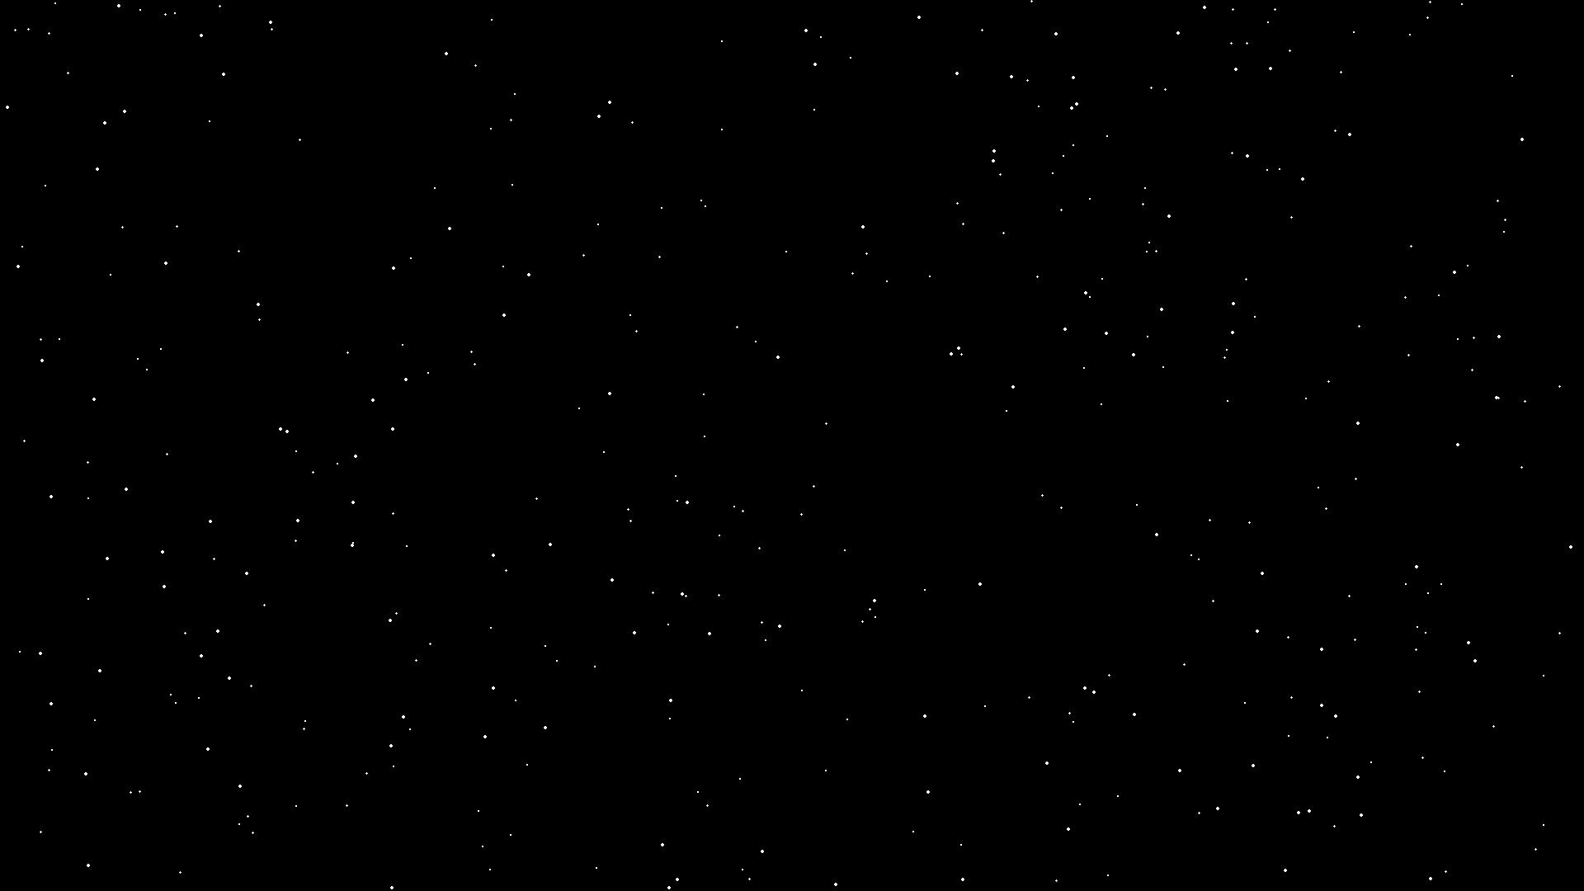
⚡ REALISTIC SOLAR SYSTEM SIMULATION ⚡
Created Using OpenGL + GLUT

Slide 2
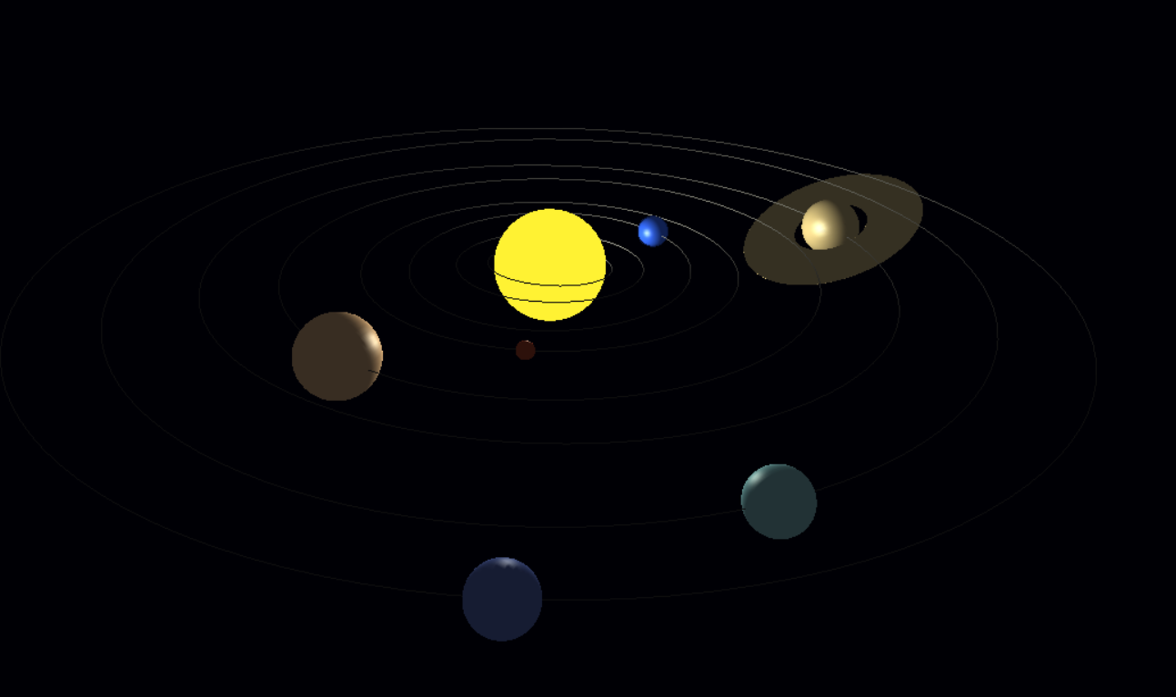
Project Overview
• Built using OpenGL + GLUT
• Fully 3D Solar System
• Lighting, revolution, rotation
• Camera movement & realistic shadows

Slide 3
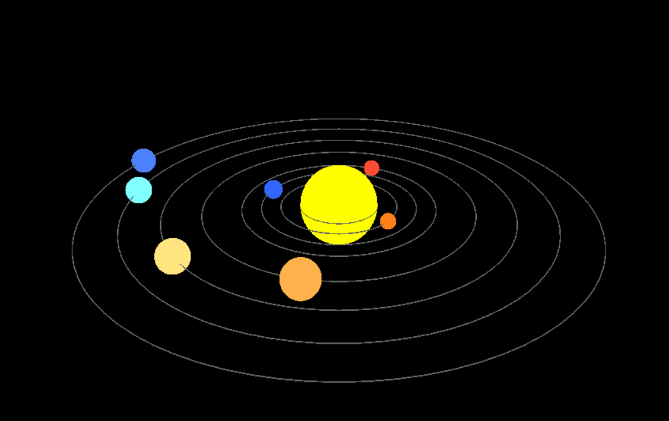
How It Works
✔ Planets = GLUT solid spheres
✔ Revolution = circular trig motion
✔ Rotation = glRotatef()
✔ Camera = gluLookAt()
✔ Orbits = line loops
.

Slide 4
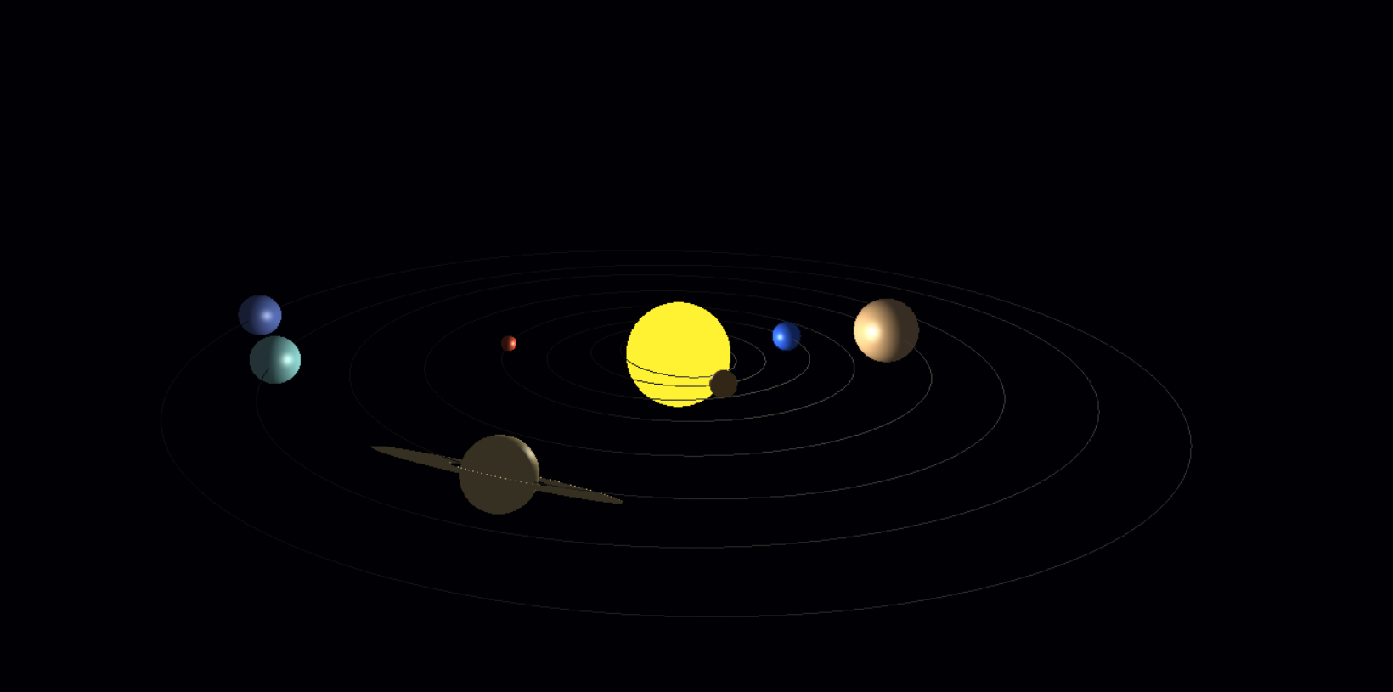
Features
• Smooth animation
• Light reflections
• Space-themed UI
• Realistic scaling
• Saturn rings

Slide 5
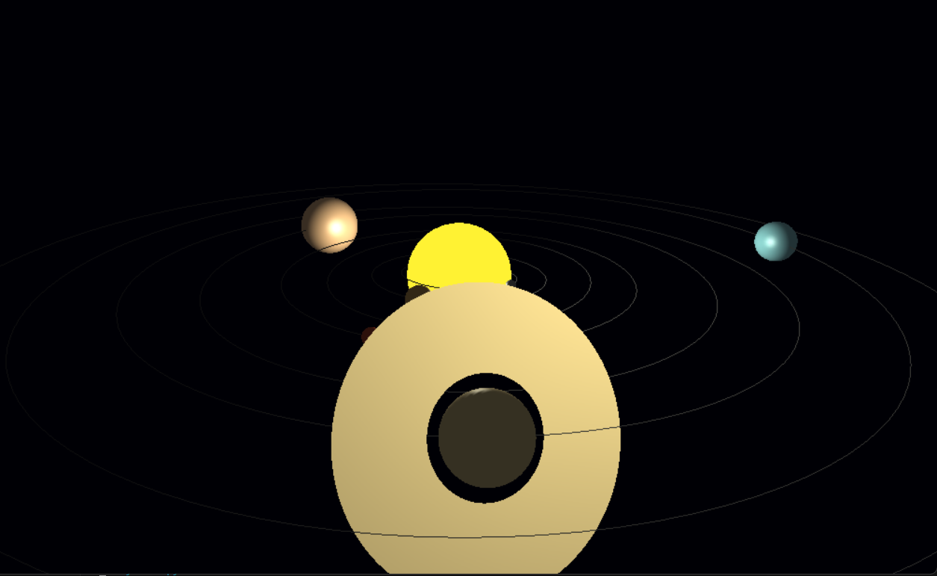
Screenshot 1
Captured from the OpenGL solar system simulation.

Slide 6
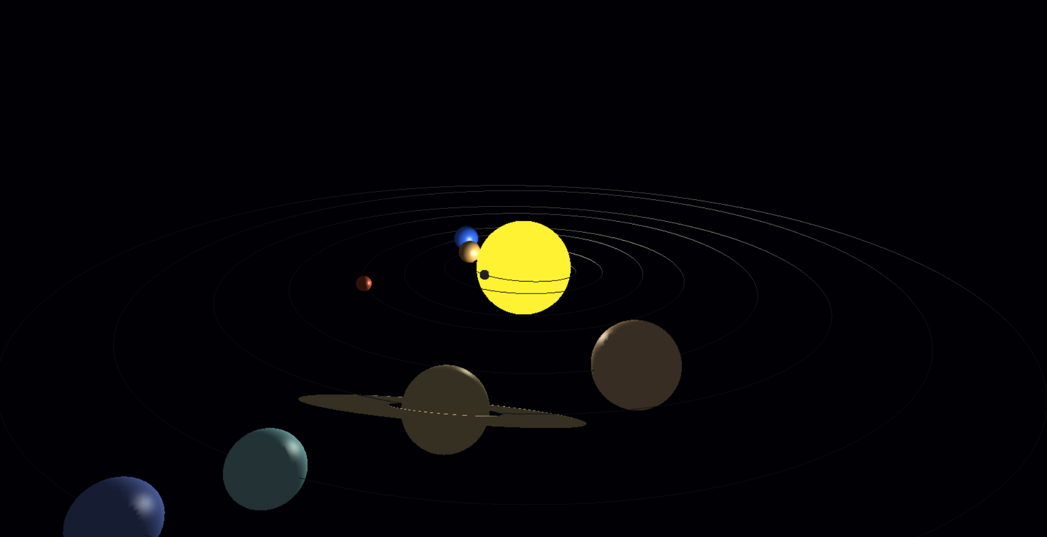
Screenshot 2
Captured from the OpenGL solar system simulation.

Slide 7
Screenshot 3
Captured from the OpenGL solar system simulation.

Slide 8
Screenshot 4
Captured from the OpenGL solar system simulation.

Slide 9
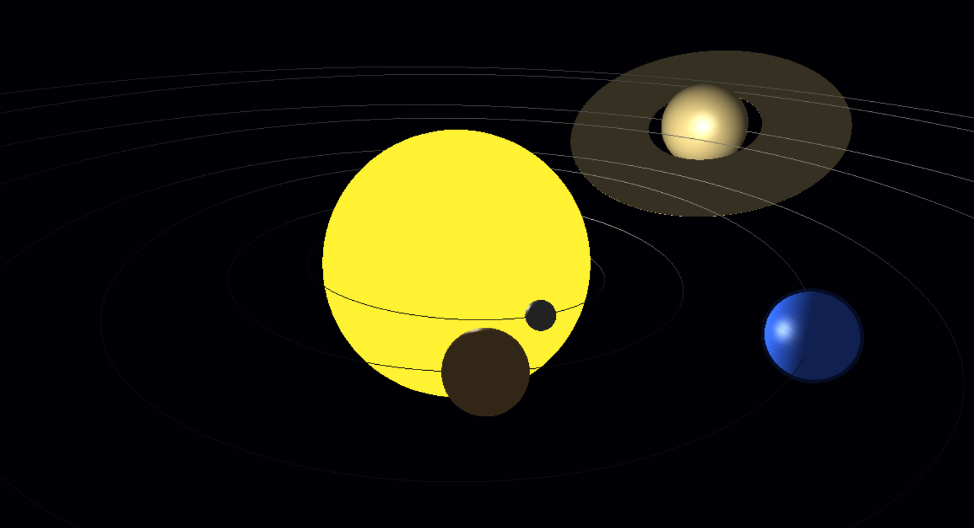
Screenshot 5
Captured from the OpenGL solar system simulation.

Slide 10
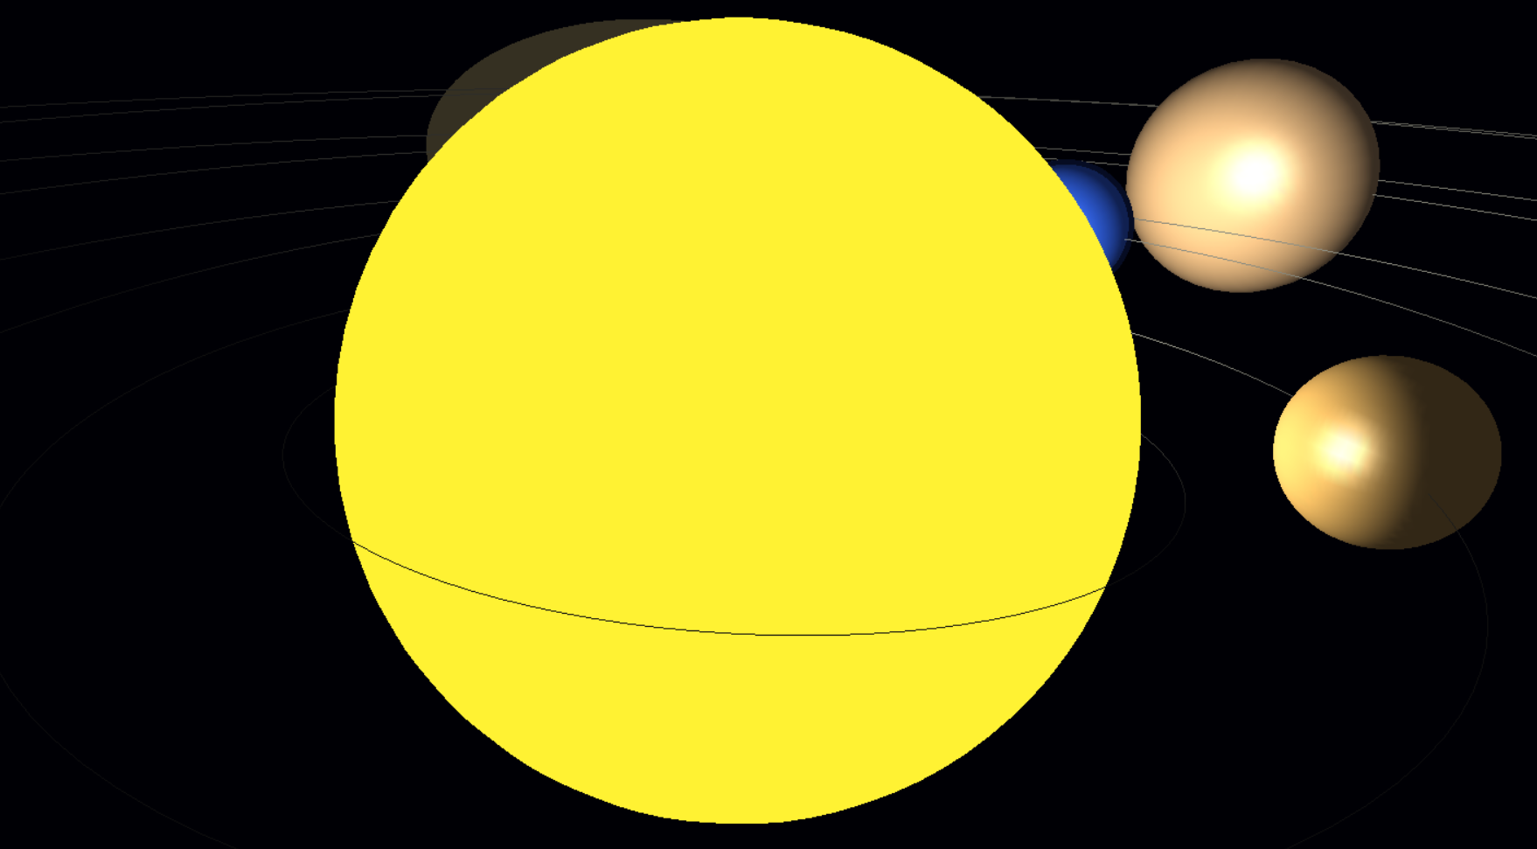
Screenshot 6
Captured from the OpenGL solar system simulation.

Slide 11
Thank You!
Made by Vineet — OpenGL Solar System Project

