Slide 1
MobileNet
Yushu Li,
Qiheng Tan,
Qingfeng Wang,
Zening Lin

Slide 2
Citation
[1] Andrew G. Howard, Menglong Zhu, Bo Chen, Dmitry Kalenichenko, Weijun Wang, Tobias Weyand, Marco Andreetto, Hartwig Adam. MobileNets: Efficient Convolutional Neural Networks for Mobile Vision Applications. arXiv preprint arXiv:1704.08461v1, 2017
[2] Mark Sandler, Andrew Howard, Menglong Zhu, Andrey Zhmoginov, Liang-Chieh Chen. MobileNetV2: Inverted Residuals and Linear Bottlenecks. arXiv preprint arXiv:1801.04381v4, 2019
[3] L. Sifre. Rigid-motion scattering for image classification. PhD thesis, Ph. D. thesis, 2014.

Slide 3

Conv1d
$$y\left[n\right]=\sum_{k=−∞}^{∞}{x\left[k\right]h\left[n−k\right]}$$

Slide 4




Conv1d
$$y\left[n\right]=\sum_{k=−∞}^{∞}{x\left[k\right]h\left[n−k\right]}$$
$$h\left[n−k\right]$$
$$x\left[k\right]$$
$$y\left[k\right]$$

Slide 5

Conv1d
$$y\left[n\right]=\sum_{k=−∞}^{∞}{x\left[k\right]h\left[n−k\right]}$$
$$h\left[n−k\right]$$
$$x\left[k\right]$$
$$y\left[n\right]$$

Slide 6
Conv1d
$$y\left[n\right]=\sum_{k=−∞}^{∞}{x\left[k\right]h\left[n−k\right]}$$
$$h\left[n−k\right]$$
$$x\left[k\right]$$
$$y\left[n\right]$$

Slide 7
Conv1d
$$y\left[n\right]=\sum_{k=−∞}^{∞}{x\left[k\right]h\left[n−k\right]}$$
$$h\left[n−k\right]$$
$$x\left[k\right]$$
$$y\left[n\right]$$

Slide 8
Conv1d
$$y\left[n\right]=\sum_{k=−∞}^{∞}{x\left[k\right]h\left[n−k\right]}$$
$$h\left[n−k\right]$$
$$x\left[k\right]$$
$$y\left[n\right]$$

Slide 9
Conv2d

Slide 10
Conv2d

Slide 11
Conv2d（channel = 1, kernel_size = 3, input_size = 8, stride = 1, padding = 0）

Slide 12
Conv2d（channel = 1, kernel_size = 3, input_size = 8, stride = 1, padding = 0）

Slide 13
Conv2d（channel = 1, kernel_size = 3, input_size = 8, stride = 1, padding = 0）

Slide 14
Conv2d（channel = 1, kernel_size = 3, input_size = 8, stride = 1, padding = 0）

Slide 15
Conv2d（channel = 1, kernel_size = 3, input_size = 8, stride = 1, padding = 0）

Slide 16
Conv2d（channel = 1, kernel_size = 3, input_size = 8, stride = 1, padding = 0）

Slide 17
Conv2d（channel = 1, kernel_size = 3, input_size = 8, stride = 1, padding = 0）

Slide 18
Conv2d（channel = 1, kernel_size = 3, input_size = 8, stride = 1, padding = 0）

Slide 19
Conv2d（channel = 1, kernel_size = 3, input_size = 8, stride = 1, padding = 0）
Kernel size: size of the filter
Input size: size of the input feature map
Stride: distance that the kernel moves each step
Padding: ?

Slide 20
Conv2d（channel = 1, kernel_size = 3, input_size = 8, stride = 1, padding = 0）
Kernel size: size of the filter
Input size: size of the input feature map
Stride: distance that the kernel moves each step
Padding: ?

Slide 21
Conv2d（channel = 1, kernel_size = 3, input_size = 8, stride = 1, padding = 0）
Kernel size: size of the filter
Input size: size of the input feature map
Stride: distance that the kernel moves each step
Padding: ?

Slide 22
Conv2d（channel = 1, kernel_size = 3, input_size = 8, stride = 1, padding = 0）
Kernel size: size of the filter
Input size: size of the input feature map
Stride: distance that the kernel moves each step
Padding: ?

Slide 23
Conv2d（channel = 1, kernel_size = 3, input_size = 8, stride = 1, padding = 0）
Kernel size: size of the filter
Input size: size of the input feature map
Stride: distance that the kernel moves each step
Padding

Slide 24
Conv2d for multiple channels

Slide 25
Conv2d for multiple channels

Slide 26
Conv2d for multiple channels

Slide 27
Conv2d for multiple channels

Slide 28
Conv2d for multiple channels

Slide 29
Conv2d for multiple channels

Slide 30
Conv2d for multiple channels

Slide 31
Conv2d for multiple channels

Slide 32
Conv2d for multiple channels

Slide 33
Conv2d for multiple channels
Amount of output channel
Amount of
Input
Channel
Amount of kernels

Slide 34
Conv2d for multiple channels
Amount of output channel
Amount of
Input
Channel
Amount of kernels

Slide 35
Conv2d for multiple channels
Amount of
Input
Channel
Amount of kernels

Slide 36
Conv2d for multiple channels
Amount of
Input
Channel
Amount of kernels

Slide 37
Conv2d for multiple channels

Slide 38
Conv2d for multiple channels

Slide 39
Conv2d
Drawbacks：
  Too much operation
  May cause overfitting with too many variables

Slide 40
Depthwise Separable Convolution
Factorize a standard convolution into a depthwise convolution and a 1×1 convolution called a pointwise convolution.[1][3]
Reduce the amount of multiplication

Slide 41
Depthwise Separable Convolution

Slide 42
Depthwise Separable Convolution

Slide 43
Depthwise Separable Convolution

Slide 44
Depthwise Separable Convolution

Slide 45
Depthwise Separable Convolution

Slide 46
Depthwise Separable Convolution

Slide 47
Depthwise Separable Convolution

Slide 48


Computational Cost
Conventional Conv2d
kernel size $D_{k}×D_{k}$
amount of channels M
feature map size $D_{W}×D_{H}$

Slide 49


Computational Cost
$$D_{k}×D_{k}×D_{W}×D_{H}×M$$
Conventional Conv2d
kernel size $D_{k}×D_{k}$
feature map size $D_{W}×D_{H}$
amount of channels M

Slide 50
Computational Cost
$$D_{k}×D_{k}×D_{W}×D_{H}×M$$
Conventional Conv2d
kernel size $D_{k}×D_{k}$
feature map size $D_{W}×D_{H}$
amount of channels M

Slide 51
Computational Cost
$$D_{k}×D_{k}×D_{W}×D_{H}×M$$
Conventional Conv2d
kernel size $D_{k}×D_{k}$
amount of channels M
amount of kernels N

Slide 52

Computational Cost
$$D_{k}×D_{k}×D_{W}×D_{H}×M×N$$
Conventional Conv2d
kernel size $D_{k}×D_{k}$
amount of channels M
amount of kernels N

Slide 53
Computational Cost
Conventional Conv2d
$$D_{k}×D_{k}×D_{W}×D_{H}×M×N$$

Slide 54



Computational Cost
$$D_{k}×D_{k}×D_{W}×D_{H}×M$$
Depthwise Separable Conv2d
kernel size $D_{k}×D_{k}$
amount of channels M
feature map size $D_{W}×D_{H}$

Slide 55


Computational Cost
Depthwise Separable Conv2d
$$D_{k}×D_{k}×D_{W}×D_{H}×M$$
kernel size $D_{k}×D_{k}$
amount of channels M
feature map size $D_{W}×D_{H}$

Slide 56
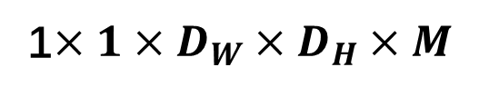
Computational Cost
Depthwise Separable Conv2d
$$D_{k}×D_{k}×D_{W}×D_{H}×M$$
1$×1×D_{W}×D_{H}×M$
kernel size $D_{k}×D_{k}$
amount of channels M
feature map size $D_{W}×D_{H}$

Slide 57
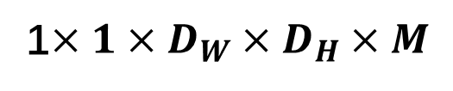
Computational Cost
Depthwise Separable Conv2d
$$D_{k}×D_{k}×D_{W}×D_{H}×M$$
1$×1×D_{W}×D_{H}×M$
kernel size $D_{k}×D_{k}$
amount of channels M
amount of kernels N
feature map size $D_{W}×D_{H}$

Slide 58
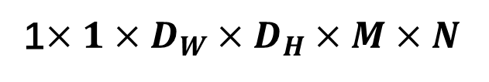
Computational Cost
Depthwise Separable Conv2d
$$D_{k}×D_{k}×D_{W}×D_{H}×M$$
1$×1×D_{W}×D_{H}×M×N$
kernel size $D_{k}×D_{k}$
amount of channels M
amount of kernels N
feature map size $D_{W}×D_{H}$

Slide 59
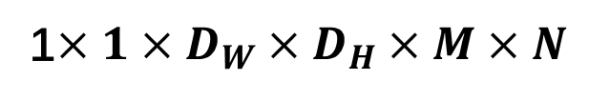


Computational Cost
Depthwise Separable Conv2d
$$D_{k}×D_{k}×D_{W}×D_{H}×M$$
1$×1×D_{W}×D_{H}×M×N$
$$D_{W}×D_{H}×M(D_{k}×D_{k}+N)$$

Slide 60


Computational Cost
$$D_{W}×D_{H}×M(D_{k}×D_{k}+N)$$
Depthwise Separable Conv2d
$$D_{W}×D_{H}{×M×D}_{k}×D_{k}×N$$
Conventional Conv2d

Slide 61

Computational Cost
$$D_{W}×D_{H}×M(D_{k}×D_{k}+N)$$
Depthwise Separable Conv2d
$$D_{W}×D_{H}{×M×D}_{k}×D_{k}×N$$
Conventional Conv2d
$$\frac{1}{N}+ \frac{1}{D_{k}^{2}}$$
Reduction in Computation

Slide 62
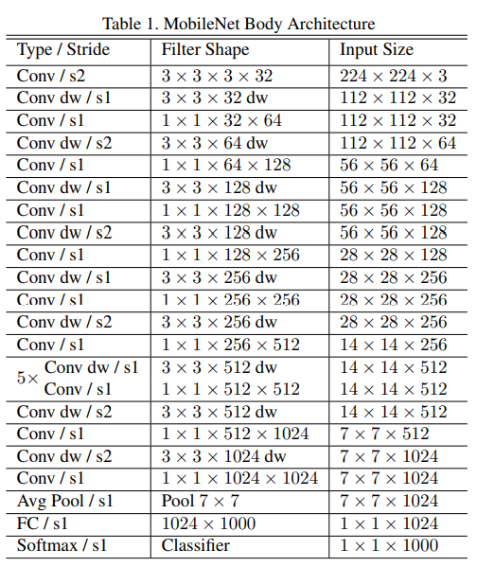
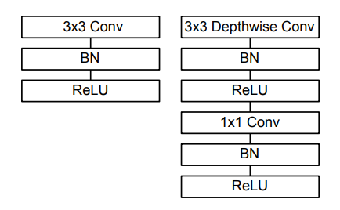
MobileNet [1]

Slide 63
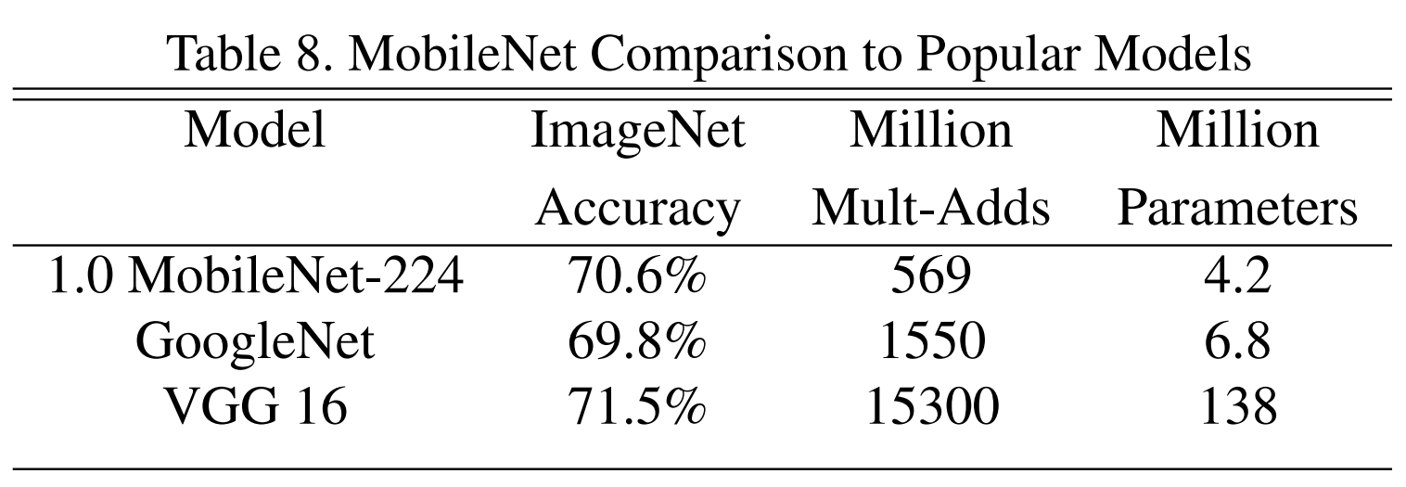
MobileNet[1]

Slide 64
Experiments
We did an experiment based on MobileNetV2[2], using the machine learning framework PyTorch
Due to the limitation of computing resource, we used the CIFAR10 dataset, which contains 60,000 images sized 32*32 and divided into 10 categories
Epoch = 300
Batch Size = 128

Slide 65
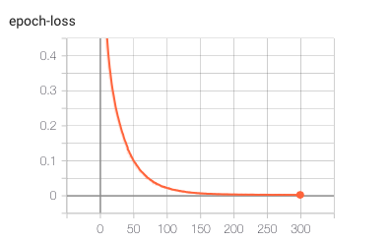
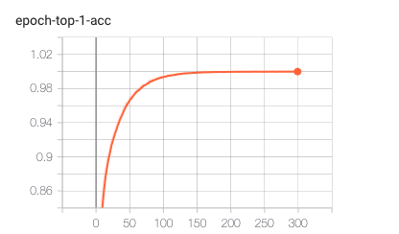
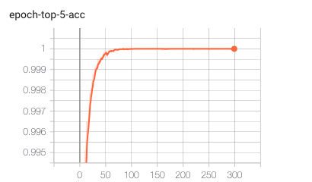
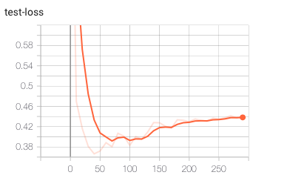
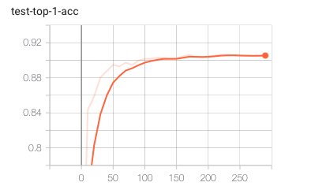
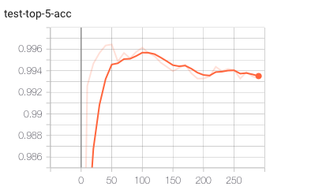
Experiment

