Slide 1
Distributed Computing(CS332) L-3, T-0, P-2, C-4

Slide 2
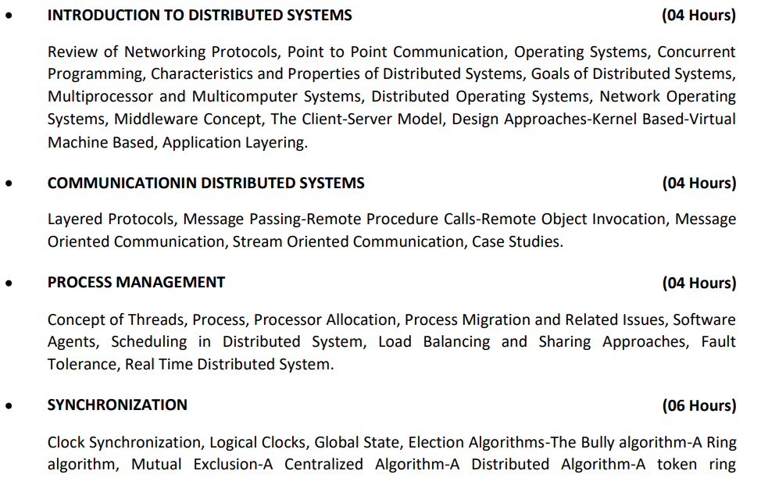
Syllabus

Slide 3
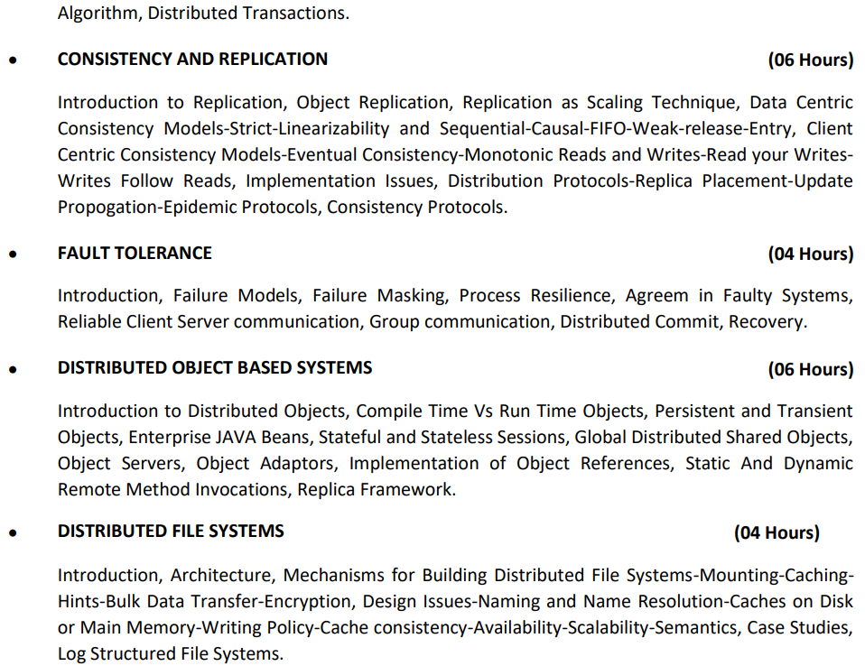

Slide 4
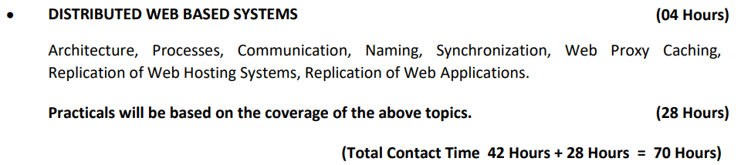

Slide 5
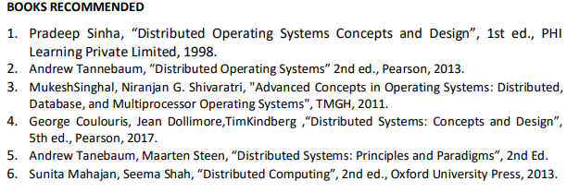
Textbook & Readings

Slide 6
Assignments:
This course will involve listening to lectures, reading papers, writing reviews of papers, participating in class discussions, presenting papers and leading class discussions.
Students will be required to write reviews for papers they read.

Slide 7
Prologue
Since 1945, computer systems are undergoing a revolution
Until 1985, computers were large and expensive
After 1980, two advances in technology began – microprocessors, computer networks
Result – computer networks/distributed systems

Slide 8
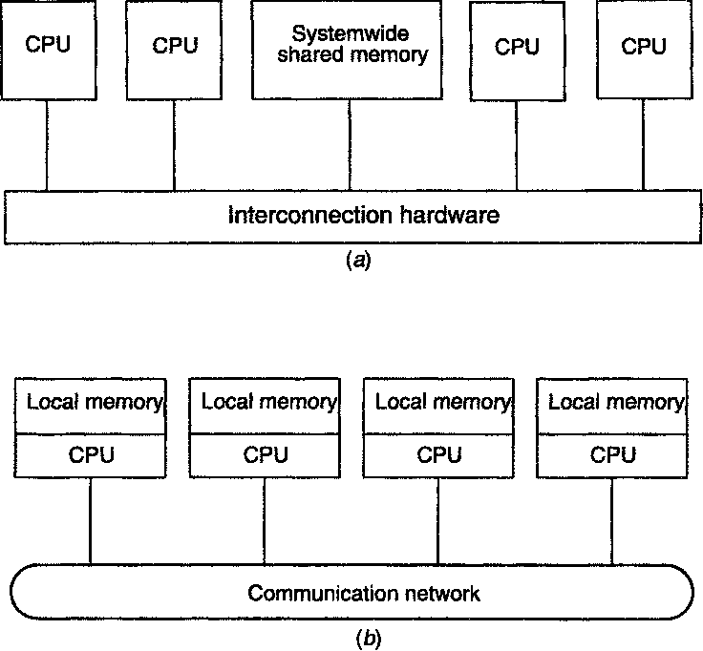
Distributed (Computing) System (DCS): Definition
(a) tightly coupled – parallel processing systems
(b) Loosely coupled – distributed computing systems

Slide 9
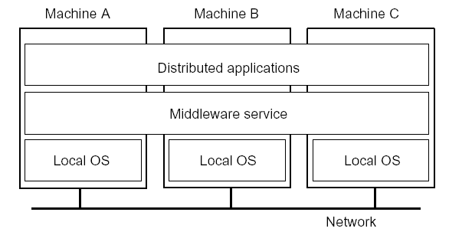
Distributed System (DS): Definition
A distributed system is - a collection of independent computers that appears to its users as a single coherent system
- one in which components located at networked computers communicate and coordinate their actions only by passing messages
Two aspects:
(1) hardware - autonomous computers
(2) software – users think they are dealing with a single system
Notes:
9

Slide 10
Characteristics of DS
Hidden from the users: differences between various computers and the way they communicate in between
Users and applications interact with DS in a consistent and uniform way regardless of time and place
Should be easy to expand and scale
Continuous available

Slide 11
Why DS gaining popularity?
Inherently distributed applications
Information sharing among distributed users
Resource sharing
Better price-performance ratio
Shorter response times and higher throughput
Higher reliability – degree of tolerance against failures/errors
Extensibility and incremental growth
Better flexibility in meeting users’needs

Slide 12
Examples of DS
Network of workstations (NOW): a group of networked personal workstations connected to one or more server machines.
The Internet/WWW
An intranet: a network of computers and workstations within an organization, separated from the Internet via a protective device (a firewall).
A large-scale distributed system – eBay
Collection of Web servers: distributed database of hypertext and multimedia documents.
Distributed file system on a LAN
Domain Name Service (DNS)
DBMS
ATM network

Slide 13
Types of DS
Distributed Computing Systems – cluster, grid, cloud, etc.
Distributed Information Systems – TPS, Enterprise application integration
Distributed Pervasive Systems – Home systems, Electronic health care systems, Sensor networks

Slide 14
Goals of DS
Allow users to access and share resources
Transparency
To hide the fact that its processes and resources are physically distributed across multiple computers
A DS that is able to present itself to users and applications as if it were only a single computer system is said to be transparent
Openness
To offer services according to standard rules that describe the syntax and semantics of those services
E.g., specify interfaces using an interface definition language (IDL)
Scalability
Notes:
14

Slide 15
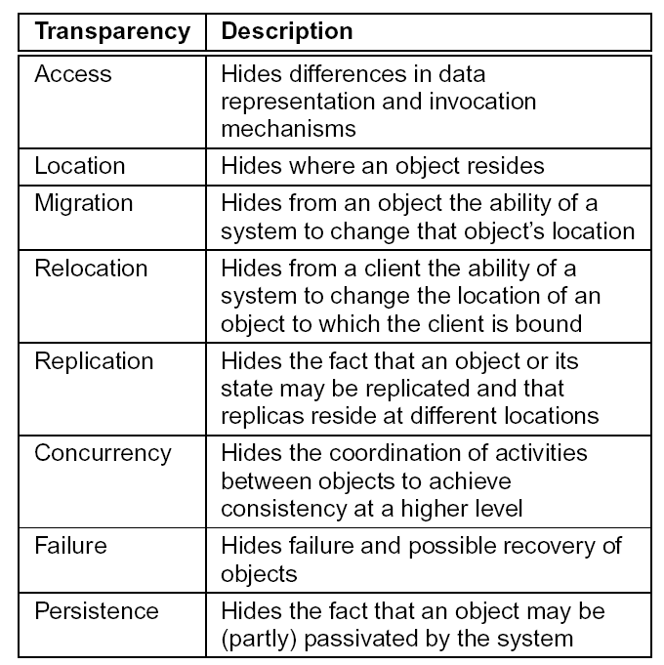
Transparency
Notes:
15

Slide 16
Cont..
Access Transparency
ex. Send an integer from Intel system(little endian) to SPARC(big endian)
Difference in data representations due to different Oss
Location Transparency
Can be achieved by assigning only logical names
Ex. URL framing
Replication Transparency
It is necessary to have same name to all replicas
Should support ???? transparency
Concurrency Transparency
Should leave shared resource in a consistent state
Possible using locking mechanisms

Slide 17
Cont..
Failure Transparency
Masking failures – one of the hardest issues in DS
Inability to differentiate between a dead resource and a painfully slow resource
Ex – time out response of web server? Really down or busy?
Persistence Transparency
Ex. Object oriented databases provide facilities for directly invoking methods on stored objects
User should unaware that server is moving state between primary and secondary memory

Slide 18
Degree of Transparency
In general transparency is preferred, but not always good to blindly hid all distribution aspects from users
Ex. Requesting your e-news paper in your mailbox at 7am while you are at the other end of the globe living with different time zone
Due to computer network/switches/routers/gateways – it is not possible to send message from one process(China) to another(Europe) in predefined time
Trade-off between high degree of transparency and performance of system
Ex. Many internet applications try to contact server before finally giving up. Attempting to mask a transient server failure before trying another one may slow down the system as a whole
Hiding several replicas located on different continents – changes take time due to network and other aspects
Conclusion – transparency is required but should also consider performance.
Notes:
18

Slide 19
Openness of DS
Open distributed system: that offers services according to standard rules that describes the syntax and semantics of those services like in computer networks protocols are implemented.
- Be able to interact with services from other open systems, irrespective of the underlying environment:
Systems should conform to well-defined interfaces
Systems should support portability of applications
Systems should easily interoperate
Systems should be flexible
Achieving openness: At least make the distributed system independent from heterogeneity of the underlying environment:
Hardware
Platforms
Languages
Notes:
19

Slide 20
Scalability in DS
Most important design goals
It can be measured along at least three different dimensions (Neuman, 1994):
Number of users and/or processes (size scalability)
- Maximum distance between nodes (geographical scalability)
- Number of administrative domains (administrative scalability)
Most systems account only, to a certain extent, for size scalability.
Today, the challenge lies in geographical and administrative scalability.
Notes:
20

Slide 21
Techniques for Scaling
Hiding communication latencies
Applicable to geographical scalability
Try to avoid waiting for responses to remote service requests as much as possible
Possible using asynchronous communication
2. Distribution
Partition data and computations across multiple machines
Move computations to clients (Java applets)
Decentralized naming services (DNS)
Decentralized information systems (WWW)
Notes:
21

Slide 22
Cont…
Replication
Make copies of data available at different machines
Replicated file servers (mainly for fault tolerance)
Replicated databases
Mirrored Web sites
Large-scale distributed shared memory systems
Helps to balance the load -> better performance
Caching(special form of replication)
Allow client processes to access local copies:
Web caches (browser/Web proxy)
File caching (at server and client)
Caching is a decision made by the client of a resource and not by the owner of a resource
Problem with replication/caching - consistency
Notes:
22

Slide 23
Distributed System Architecture
Hardware Architecture: Software Architecture:
- Uniprocessor - Uniprocessor OS
- Multiprocessor - Multiprocessor OS
- Multicomputer - Network OS (NOS)
- Distributed OS (DOS)
- Middleware
A key characteristic of distributed systems that includes
a hardware aspect (independent computers)
and a software aspect (performing a task and providing a service)

Slide 24
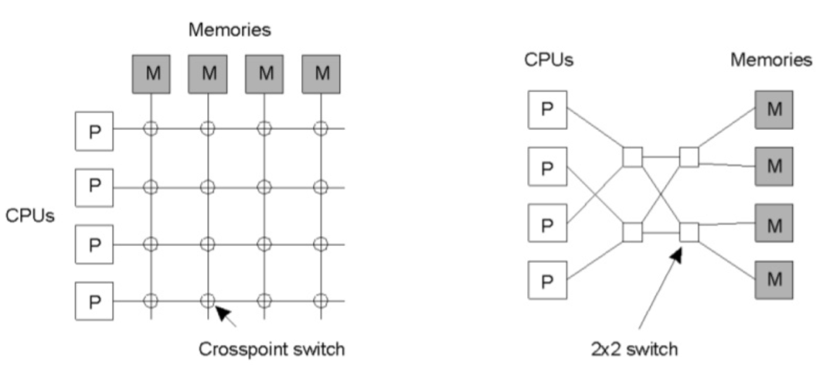
Distributed Systems: Hardware Concepts
Multiprocessors
All the CPUs have direct access to the shared memory
bus based – limited scalability
crosspoint switch – for large n, nxn switches are required
omega switching network – less switches
NUMA
Multicomputers
Homogeneous
Heterogeneous
Networks of Computers
- High degree of node and network heterogeneity
Notes:
24

Slide 25

Uniprocessor
Properties:
Single processor
Direct memory access

Slide 26
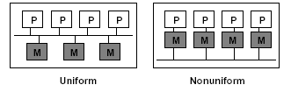
Multiprocessors
Those that have shared memory, usually called multiprocessors
Those that have NOT shared memory, usually called Multicomputers.
Typically, there are 2 major types of Parallel Architectures that are common in the industry: Shared Memory Architecture and Distributed Memory Architecture.
Shared Memory Architecture, again, is of two types
- Uniform Memory Access (UMA)
- Non-Uniform Memory Access (NUMA).
Properties:
Multiple processors
Direct memory access
Uniform memory access -access time to a memory location is independent of which processor makes the request
Non-uniform memory access- the memory access time depends on the memory location relative to a processor.

Slide 27
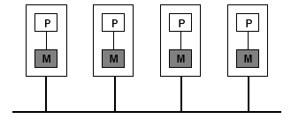
Multicomputers
Properties:
Multiple computers
Network Connection (to support higher bandwidth)
Homogeneous (all nodes support same physical architecture – SAN, MPPs, COWs) vs. Heterogeneous (does not support same physical architecture)

Slide 28
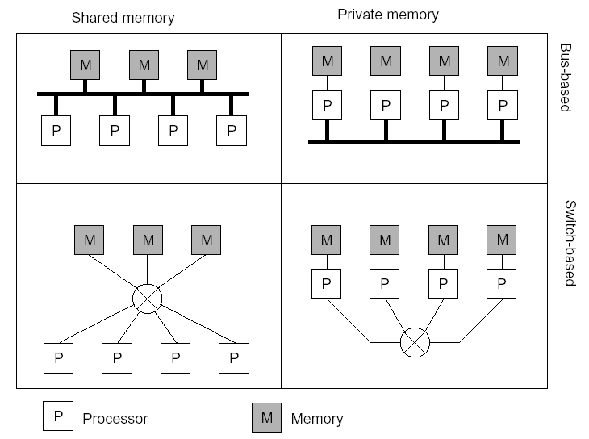
Multiprocessors and Multicomputers
Distinguishing features:
Private versus shared memory
Bus versus switched interconnection
Notes:
28

Slide 29
Distributed Systems : Software Concepts
OS for DS divided into two categories due to hardware
Loosely coupled
Tightly coupled
Tightly coupled – OS tries to maintain a single, global view of the resources it manages
– DOS – manages multiprocessors and homogeneous multi computer system – aim is to hide intricacies
Loosely coupled – collection of computers and each running their own OS
– NOS – heterogeneous multi computer system –local services available to remote clients
– Middleware – enhanced NOS – better support for distribution transparency – recent concept of DS – eq. cloud computing – running VM on top of hypervisor/middleware
Notes:
29

Slide 30
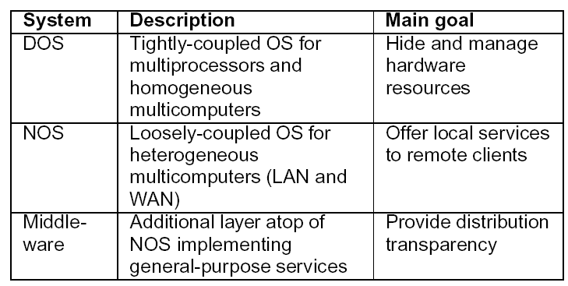
Distributed Systems : Software Concepts
Distributed Operating system(DOS)
Network Operating System(NOS)
Middleware
Notes:
30

Slide 31
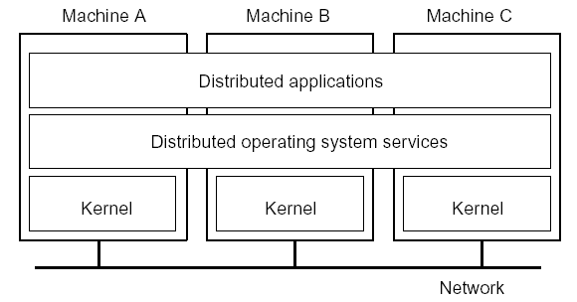
Distributed Operating System
Some characteristics:
OS on each computer knows about the other computers
OS on different computers generally the same
Services are generally (transparently) distributed across computers (services may include distributed shared memory, assignment of tasks to processors, distributed storage, interprocess communication, transparent sharing of resources, distributed resource management, etc.)
High degree of transparency (single system image)
Homogeneous hardware
Notes:
31

Slide 32
Multicomputer Operating System
Harder than traditional (multiprocessor) OS: Because memory is not shared, emphasis shifts to processor communication by message passing:
Often no simple global communication:
Only bus-based multicomputers provide hardware broadcasting
Efficient broadcasting may require network interface programming techniques
No simple system-wide synchronization mechanisms
Virtual (distributed) shared memory requires OS to maintain global memory map in software
Inherent distributed resource management: no central point where allocation decisions can be made
Example: Amoeba
Notes:
32

Slide 33
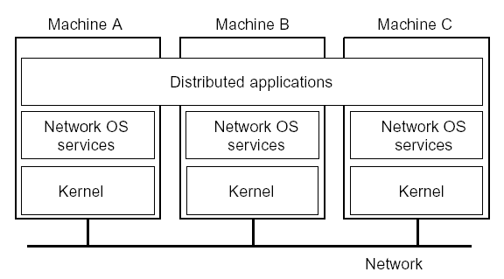
Network Operating System
Some characteristics:
Each computer has its own operating system with networking facilities
Computers work independently (i.e., they may even have different operating systems)
Highly file oriented (basically, processors share only files)
Services are tied to individual nodes (ftp, telnet,WWW)
Access to resources of various machines is done explicitly by:
- Remote logging into the appropriate remote machine (telnet )
- Transferring data from remote machines to local machines, via the File Transfer Protocol (FTP) mechanism
Examples: Linux, Windows
Notes:
33

Slide 34
Need for Middleware
Too many networked applications were difficult to integrate:
- Departments are running different NOSs
- Integration and interoperability only at level of primitive NOS Services
Need for federated information systems:
– Combining different databases, but providing a single view to applications
– Setting up enterprise-wide Internet services, making use of existing information systems
– Allow transactions across different databases
– Allow extensibility for future services (e.g., mobility, teleworking, collaborative applications)
Notes:
34

Slide 35
Middleware
As per definition, neither DOS or NOS really qualifies as a distributed system
DOS does not intended to handle a collection of independent computers
NOS does not provide a view of a single coherent system
Is it possible to develop distributed system with both worlds:
Scalability and openness of NOS
Transparency and ease of use of DOS
Solution: one more layer – middleware; may be a separate or part of NOS
Notes:
35

Slide 36
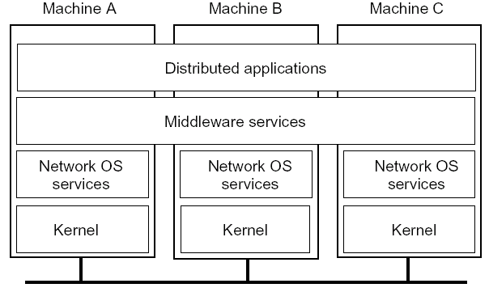
Middleware
Some characteristics:
OS on each computer need not know about the other computers
OS on different computers need not generally be the same
Services are generally (transparently) distributed across computers
System independent interface for distributed programming
Improves transparency (e.g., hides heterogeneity)
Provides services (e.g., naming service, transactions, etc.)
Provides programming model (e.g., distributed objects)
Notes:
36

Slide 37
Middleware Services
Communication services: Abandon primitive socket-based message passing in favor of(for access transparency):
Procedure calls across networks
Remote-object method invocation
Message-queuing systems
Advanced communication streams
Event notification service
Information system services: Services that help manage data in a distributed system:
Large-scale, system-wide naming services
Advanced directory services (search engines)
Location services for tracking mobile objects
Persistent storage facilities
Data caching and replication
Notes:
37

Slide 38
Middleware Services
Control services: Services giving applications control over when, where, and how they access data:
Distributed transaction processing
Code migration
Security services: Services for secure processing and communication:
Authentication and authorization services
Simple encryption services
Auditing service
Notes:
38

Slide 39
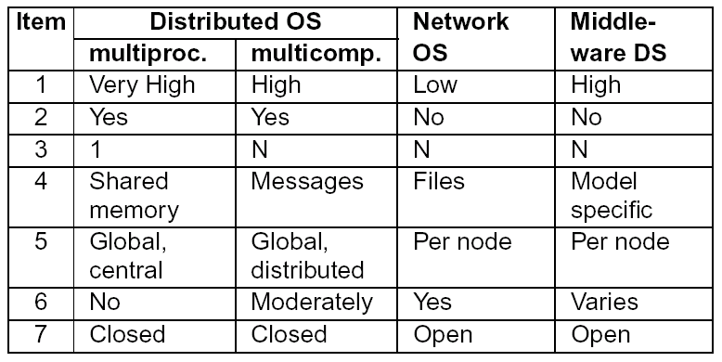
Comparison of DOS, NOS, and Middleware
1: Degree of transparency 2: Same operating system on each node? 3: Number of copies of the operating system 4: Basis for communication 5: How are resources managed? 6: Is the system easy to scale? 7: How open is the system?
Notes:
39

Slide 40
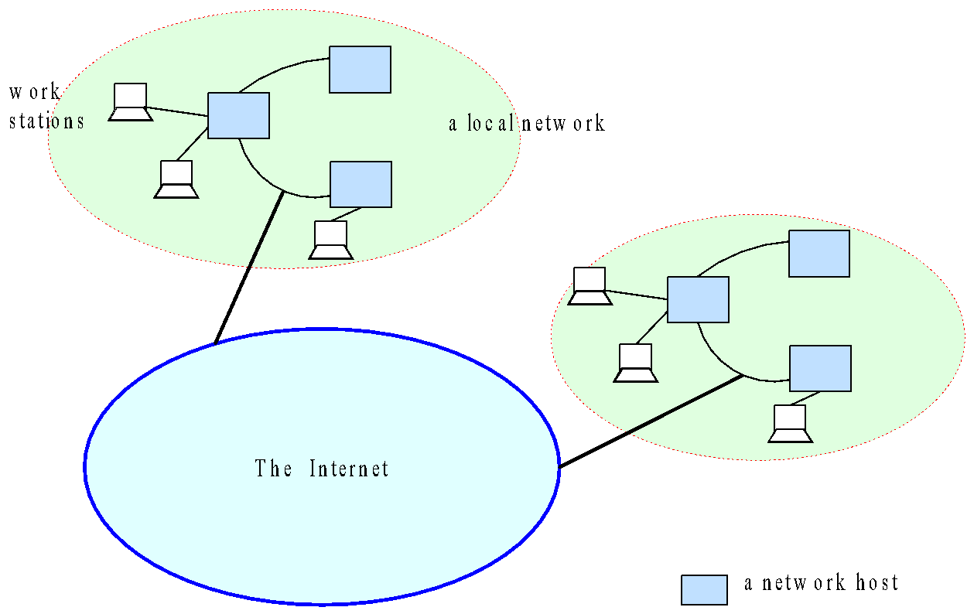
Distributed Systems

Slide 41
Why Distributed?
Resource and Data Sharing
Printers, databases, multimedia servers etc.
Availability, Reliability
The loss of some instances can be hidden
Scalability, Extensibility
System grows with demands (e.g. extra servers)
Performance
Huge power (CPU, memory etc.) available
Horizontal distribution (same logical level is distr.)
Inherent distribution, communication
Organizational distribution, e-mail, video conference
Vertical distribution (corresponding to org. struct.)

Slide 42
Problems of Distribution
Concurrency, Security
Clients must not disturb each other
Partial failure
We often do not know, where is the error (e.g. RPC)
Location, Migration, Replication
Clients must be able to find their servers
Heterogeneity
Hardware, platforms, languages, management
Convergence
Between distributed systems and telecommunication

Slide 43
The Advantages Of Distributed Systems
Economics:
Performance: By using the combined processing and storage capacity of many nodes, performance levels can be reached that is out of the scope of centralized machines.
Scalability: Resources such as processing and storage capacity can be increased incrementally.
Inherent distribution: Some applications, such as email and the Web (where users are spread out over the whole world), are naturally distributed. This includes cases where users are geographically dispersed as well as when single resources (e.g., printers, data) need to be shared.
Reliability: By having redundant components, the impact of hardware and software faults on users can be reduced.
Better flexibility in meeting users’ needs.

Slide 44
The Disadvantages Of Distributed Systems
Multiple Points of Failures: the failure of one or more participating computers, or one or more network links, can bring trouble.
Security Concerns: In a distributed system, there are more opportunities for unauthorized attack.
Software complexity: Distributed software is more complex and harder to develop than conventional software.
Distributed systems are hard to build and understand.

Slide 45
Basic Problems And Challenges In Distributed Systems
The distributed nature of a systems gives rise of the following challenges:
Transparency
Scalability
Dependability
Performance
Flexibility

Slide 46
Principles
There are several key principles underlying all distributed systems. As such, any distributed system can be described based on how those principles apply to that system.
• System Architecture
• Communication
• Synchronization
• Replication and Consistency
• Fault Tolerance
• Security
• Naming

Slide 47
Paradigms
To make development and integration of distributed applications as simple as possible, most middleware of distributed systems are built based on a particular paradigm (or model) for describing distribution and communication.
Shared memory
Distributed objects
Distributed file system
Distributed documents
RPC
Shared documents
Distributed coordination
Agents

