Slide 1
Deep learning for survival and DNA mutation prediction of brain tumor
Xiaolong Zhang
Liang Tao

Slide 2
Brain Tumor
A brain tumor or intracranial neoplasm occurs when abnormal cells form within the brain.
The majority of the brain is separated from the blood by the blood-brain barrier (BBB) which exerts a restrictive control as to which substances are allowed to pass.
Therefore many tracers that reach tumors in the body very easily would only reach brain tumors once there is a disruption of the BBB (blood-brain-barrier). Therefore the disruption of the BBB can be easily detected by MRI and CT etc.

Slide 3
MRI
Magnetic resonance imaging (MRI) is a medical imaging technique used in radiology to investigate the anatomy and physiology of the body in both health and disease.
MRI scanners use strong magnetic fields and radio-waves to form images of the body.
Because MRI has a higher sensitivity for detecting the presence of, or changes within, a tumor, it is used as the primary brain tumor imaging diagnosis.

Slide 4
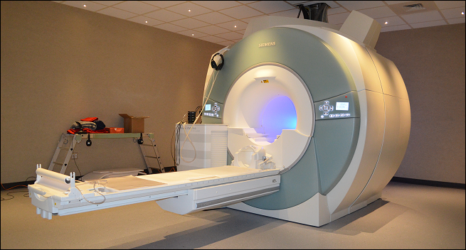
MRI

Slide 5
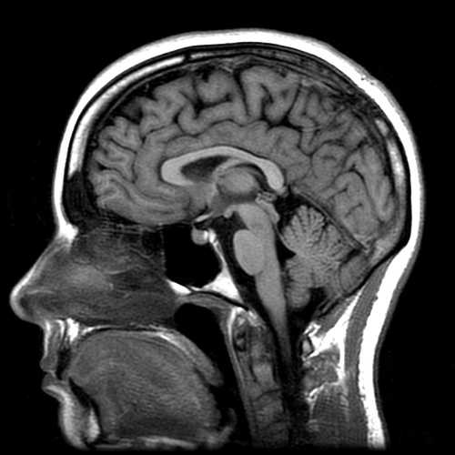
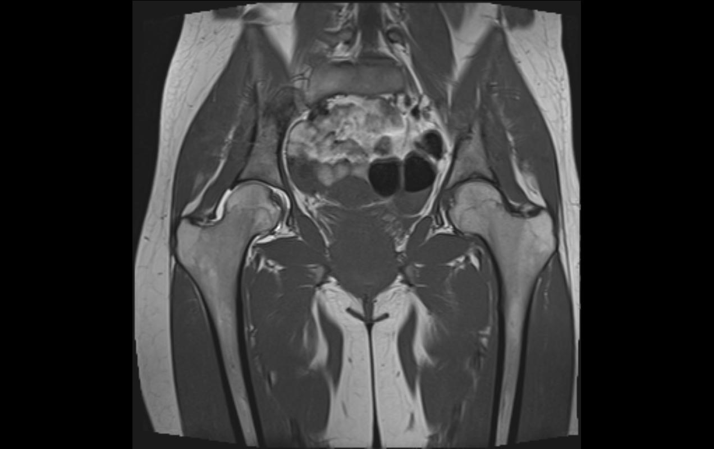
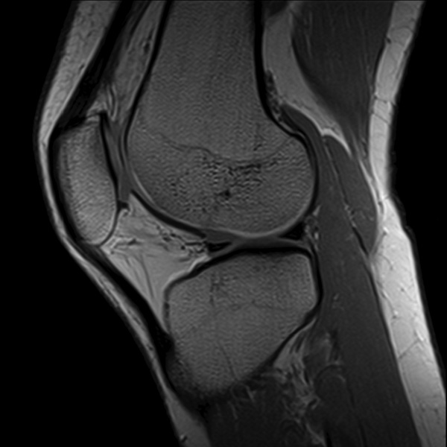
MRI Images

Slide 6
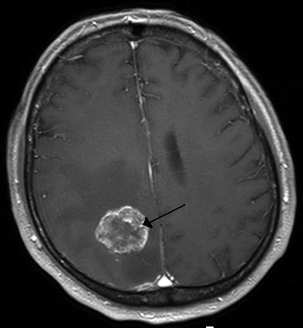
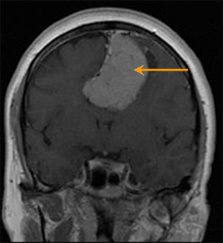
Brain Tumor MRI images

Slide 7
Brain Tumor Survival
The average five year survival rate for brain cancer in the United States is 33%.
Colon Cancer: 61.7%
Rectum Cancer:62.6%
Ovary Cancer: 55.0%
Kidney and renal: 61.8%
….

Slide 8
DNA Mutation in Brain Tumor
EGFR (epidermal growth factor receptor)
IDH1 (Isocitrate dehydrogenase 1)
IDH2 (Isocitrate dehydrogenase 2)
PTEN (Phosphatase and tensin homolog)
TP53 (Tumor protein p53, cellular tumor antigen p53, tumor
suppressor p53)

Slide 9
Motivation
Past research on brain tumor were focusing using the image processing and machine learning techniques to extract features from MRI records to diagnose the tumor itself (size/progress).
Few had conducted research on the clinical data (survival time/rate) and molecular data (DNA mutations) .
Actually these associations could be important because they can not only reflect the effects of current therapy, but also provide directions and inspiration of future diagnosis and treatment.

Slide 10
Goal
To extract the most important and discriminating features from the preprocessed MRI images and then predict the survival rate and DNA mutation of patients with brain tumor.
Deep learning
-Convolutional Neural Networks (CNN)

Slide 11
Materials
Dataset:
The dataset is offered by Dr. Cooper and Dr. Gutman.
It consists of 185 MRI Brain image volumes with tumor masks.
The MRI images were acquired from the Winship Cancer Institute at Emory University.

Slide 12
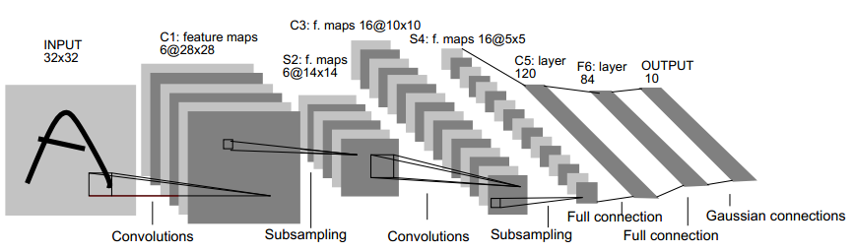
Methods
Convolutional Neural Networks (CNN)
Handwritten Example

Slide 13
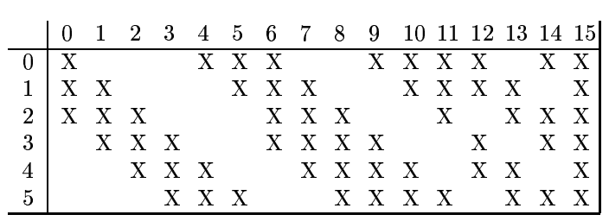
CNN
Relation map
Hidden Layer m:
16 images
10*10
0 | 1 | 2 | 3 | 4 | 5 | 6 | 7 | 8 | 9 | 10 | 11 | 12 | 13 | 14 | 15
6 Convolution
Kernels
5*5
5*5
5*5
5*5
5*5
5*5
Layer m-1:
6 Images
14*14
14*14
14*14
14*14
14*14
14*14

Slide 14
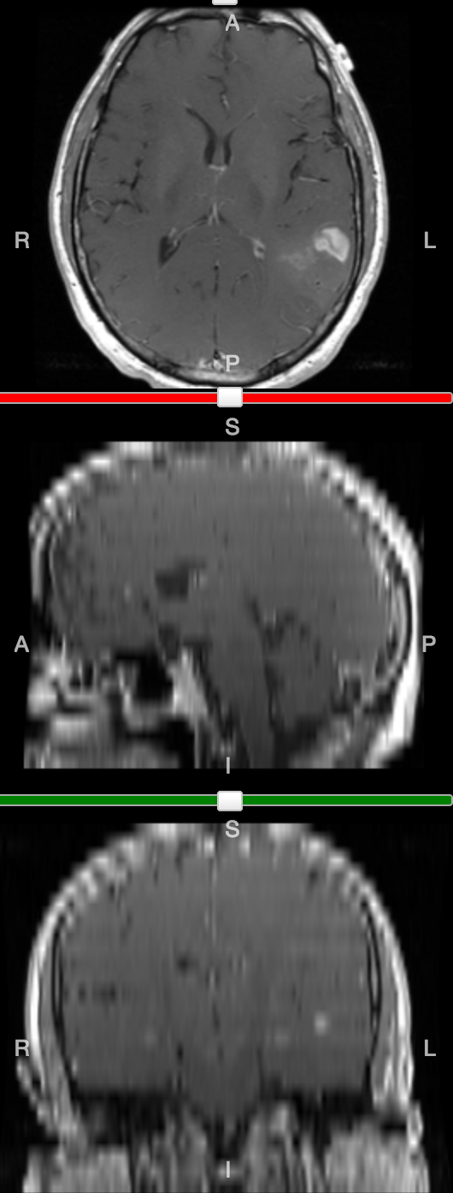
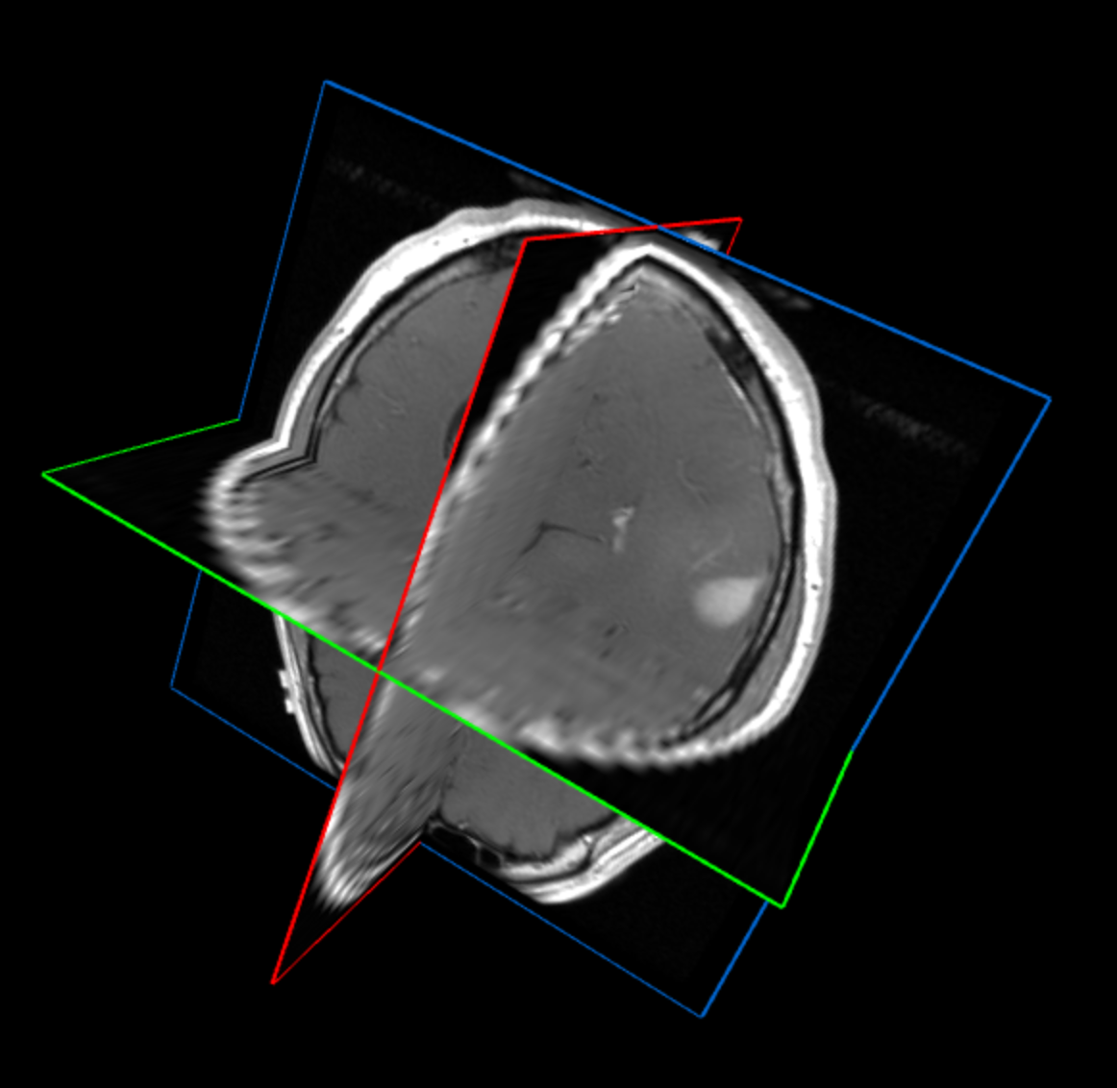
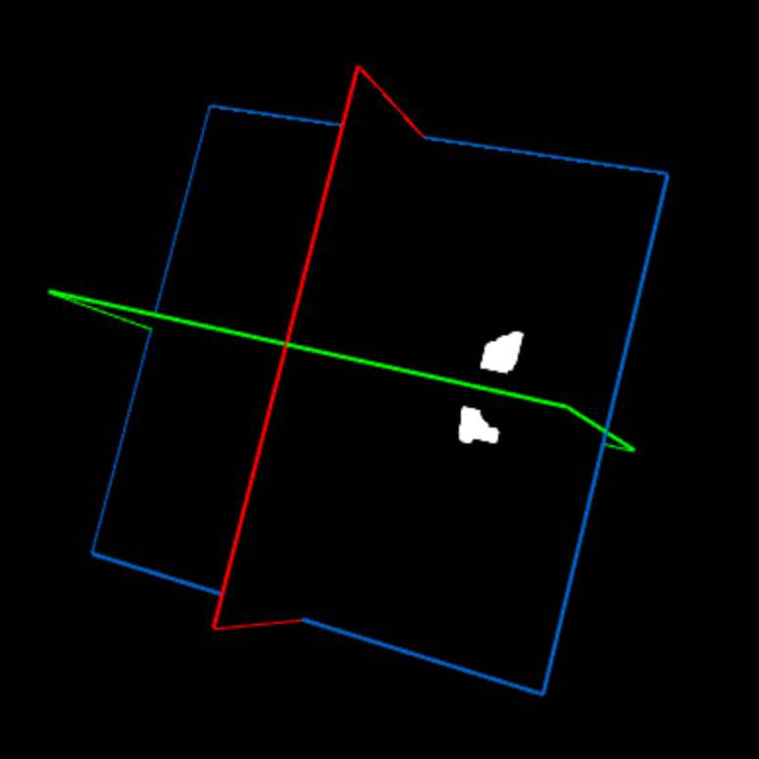
Data Pre-processing
The data contains MRI images with tumor tasks.
Slices of 3 planes.
3D Brain Structure
3D Binary Mask
Images size:
(25,256,256)
Horizontal Plane
Sagittal Plane
3D Brain Structure
Coronal Plane
3D Tumor Mask

Slide 15
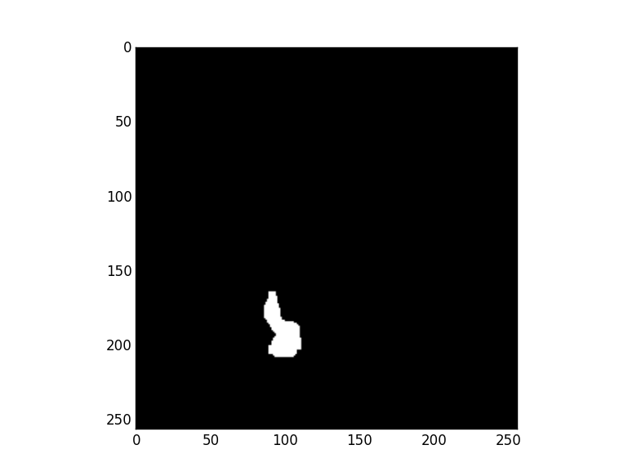
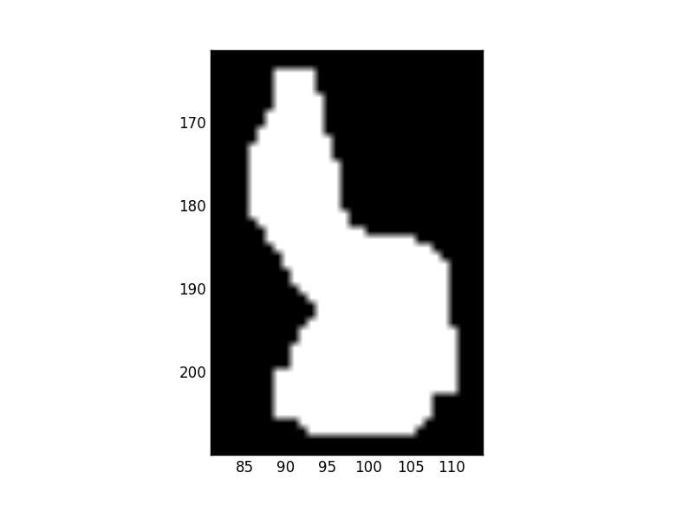
Find Bounding Box
Example:
The 13th slice of a voxel has the
largest bounding box.
Save it and the tumor center.
 | X | Y
1 | X1 | Y1
2 | X2 | Y2
… | … | …
K | Xn | Yn
Max | M | N
 | X | Y
1 | X1 | Y1
2 | X2 | Y2
… | … | …
K | Xn | Yn
Tumor Center
Bounding Box
Original Mask
Tumor Mask

Slide 16
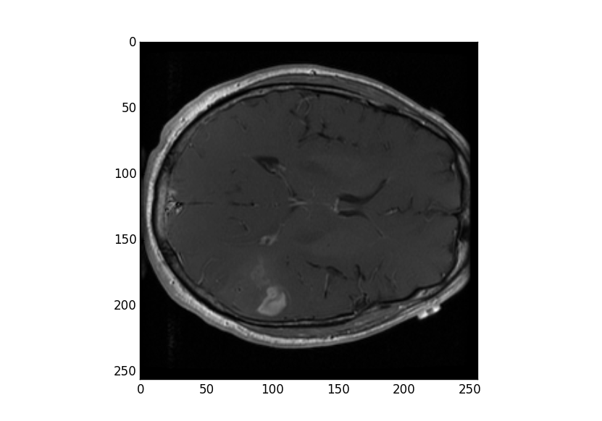
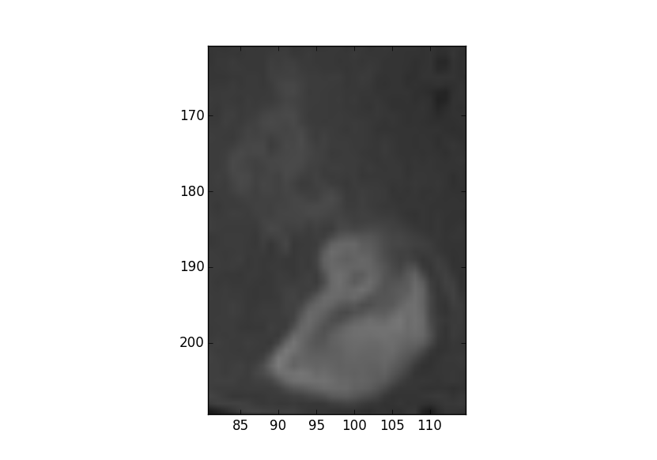
Extract Tumor Image
Using the determined bounding box (M,N) and center (X,Y) to extract the tumor region from the original MRI image.
The tumor region should be [(X-M/2):(X+M/2), (Y-N/2):(Y+N/2)].
In our case, it’s size is (113,139).
Original MRI Image
Extracted Tumor Image

Slide 17
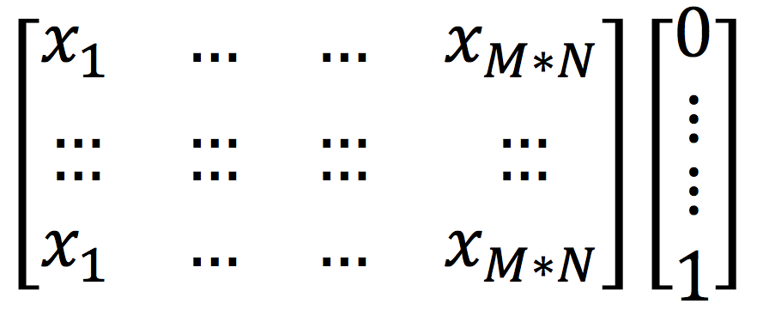
CNN Implement
Input data format:
The previous step has generated K tumor images (size: M*N)
Input data is tuple contains X and Y. X are the reshaped images. Y are the binary labels. (e.g. Survival; Gene Mutation)
1
M*N
1
K
Input_X
Input_Y

Slide 18
Python Deep Learning
Python Library:
Theano, Logistic Regression, Multilayer Perceptron
CPU vs GPU:

Slide 19
Results
Survival:
Parameters:
Errors:
Dataset size | Training size | Validation size | Test size
133 | 90 | 20 | 23
Layers | n_epoch | n_kernels | Kernel size | Pooling size
4 | 100 | [40, 100] | [16, 16] | [4, 4]
Validation Error | Test Error
35.0% | 40.0%

Slide 20
Results
Gene Mutation:
Parameters:
Errors:
Dataset size | Training size | Validation size | Test size
59 | 40 | 9 | 10
Layers | n_epoch | n_kernels | Kernel size | Pooling size
4 | 100 | [10, 30] | [16, 16] | [4, 4]
Gene | Validation Error | Test Error
EGFR | 12.5% | 30.0%
IDH1 | 12.5% | 10.0%

Slide 21
Discussion
Parameters:
Number of kernels; Kernel size; Pooling size
Future:
Mutation: IDH2, PTEN, TP53
CNV (Copy Number Variation)

Slide 22
Q&A

Slide 23
Thank you!

