Slide 1
Welcome to my first presentation
Hey there, I %hope you will like it!!

Slide 2
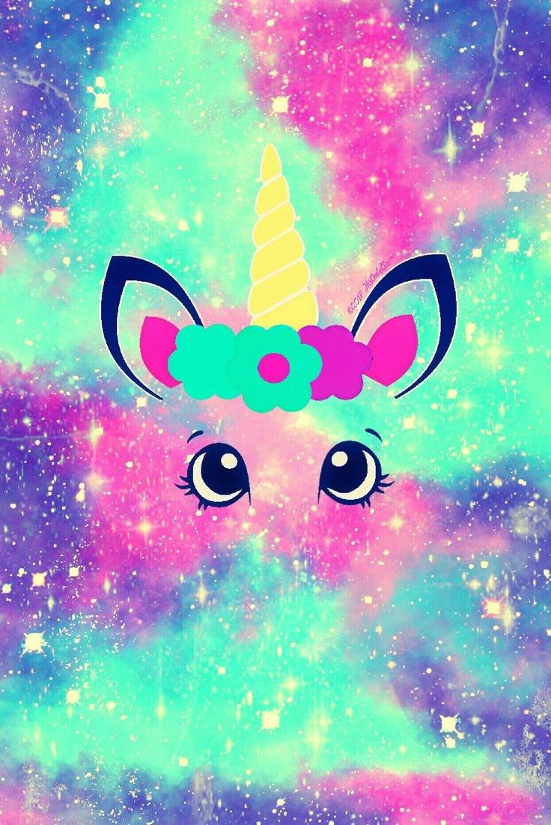

Slide 3
That was a cute picture

Slide 4
THANK YOU FOR WATCHING

