Slide 1
Mocha A JavaScript Testing Framework

Slide 2
Table of contents
01
Introduction
Something about Mocha
03
Feature
Some wonderful features
provide by Mocha
02
Concepts
Some concepts, terms while
testing with Mocha
04
How to start using
Setup environments, tools to start using Mocha

Slide 3
Introduction
1
Something about Mocha

Slide 4

Mocha
Is a JavaScript framework for NodeJS that allows asynchronous (bất đồng bộ) testing.
Extensibility and test quite fast, used in Unit test or Integration test.
And it is a great choice for BDD (Behavior Driven Development - a software development process based on Agile methodology).

Slide 5
Feature
2
Some wonderful features provide by Mocha

Slide 6



Highlight Features
Supports multiple hooks before, after, before each, after each
Simple asynchronous support, including Promise.
There are many libraries that support the determination of the value to be tested (assertion).
Assertion(chai)

Slide 7
MOCHA VS JEST
3

Slide 8


VS

Slide 9
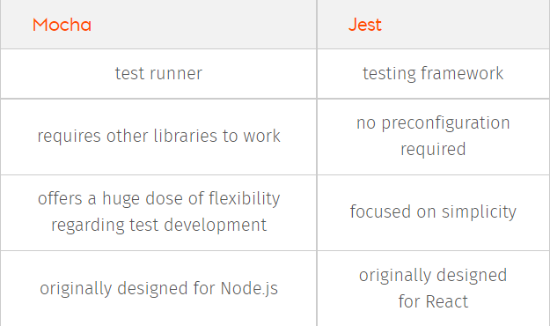

Slide 10
Concepts
4

Slide 11
module.exports = {name: function()}
module contains a set of functions related to an object of Module
Module are pieces of code that are packaged together. Code in a Module is usually private for use outside of the Module you need to use exports.

Slide 12
describe(name, callback)
Method describe() have two parameters:
The first one is name of test (similar with class’s name in JUnit)
The second one is a callback function of testing which may includes one or many method test()

Slide 13
assert.equal(value1, value2, message)
Method assert.equal() tests if two values are equal, using the == operator.
Method equal(), notEqual(),… determine the expected value of function
Usually be:
assert.equal(actual,expected[,message])

Slide 14
expect(actualResult), toBe(expectedValue)
Method expect() determine the actual result
Method toBe(),equalsTo(),... determine the expected value of function
Usually be:
expect(actualResult).toBe(expectedValue)
expect(actualResult).equalsTo(expectedValue)

Slide 15
How to start using
5

Slide 16
JavaScript Test Framework: Mocha
Assertion Library: Chai
VSCode Extensions:
ES6 Mocha Snippets
Chai snippets.

Slide 17
Project Setup
mkdir mochatest
cd mochatest
npm init
npm install mocha chai --save-dev
npm run test

Slide 18
Let's just demo

Slide 19
Thanks!
Any questions?

