Slide 1
IR Tx and Rx Schematics

Slide 2
IR Transmitter
LED 0805 IR
Wavelength = 950 nm

Slide 3
IR Receiver/Decoder
Hardware
Vishay Semiconductors, Part#: TSOP57238
Output pulse range of approx. 400 to 800 us.
Chose 0.5ms (500 us) because the frequency is a nice even 2 kHz and because
Already creating a 1 kHz clock , so minimal logic was added to create a 2 kHz clock.

Slide 4
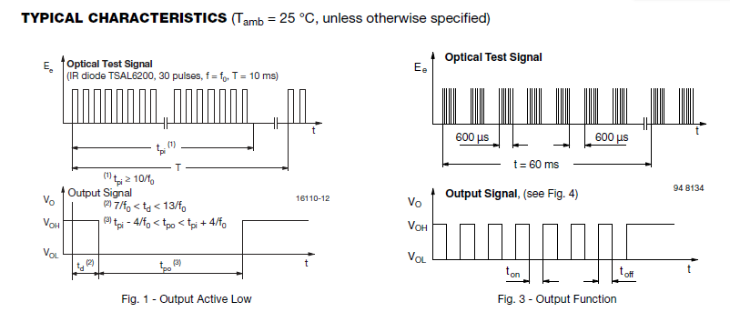
IR Receiver/Decoder
Note: Instead of 600 us, 500 us is used ( (2 kHz)⁻¹ pulse width)
Source: TSOP57238 Data Sheet

Slide 5
IR Tx & Rx Serial Protocol
Using UART hardware protocol but for IR light.
A single burst contains:
1x start bit,
8x data bits, and a
1x Stop bit
Asynchronous Serial IR (SIR)
(9600 - 115200 Baud)

Slide 6
UART Frame (refresher material)
Start bit
Logic 0
Word data
Parity bit
(optional)
Stop bit
Logic 1
START
D0
D1
D2
D3
D4
D5
D6
D7
PB
STOP
Start by detecting transition from logic 1 to
logic 0
Incoming data sampled at the bit-pulse center
Sample stop bit

Slide 7
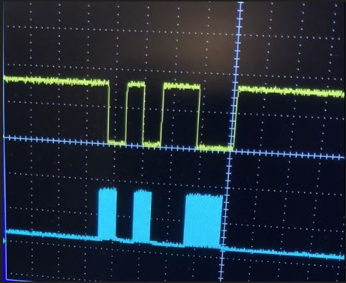
IR Pulse Translation from Source to End
A test pattern sent from an IR LED (blue) and the received pattern generated at the IR decoder’s (yellow).
Pattern sent:
('1', '0', '1', '0’, '0', '1', '1', ‘0’)
Decoder output (inverted):
Presence of a pulse = Gnd
Absence of a pulse = Vcc

Slide 8
So, How to Implement IR Tx/Rx into UART Format?
For the decoder to produce UART format at its output:
Data ( '1’, '0’, '1’, '0’, '0’, '1’, '1’, ‘0’ )
IR LED needs to send this inverted format:
Off ... ST'1’, ‘0’, ‘1’, ‘0’, ‘1’, ‘1’, ‘0’, ‘0’, ‘1’) Stop’0’ … Off
Start bit
Logic 0
Word data
Stop bit
Logic 1
START
D0
D1
D2
D3
D4
D5
D6
D7
STOP

Slide 9
irDA Protocol for Comparison

Slide 10
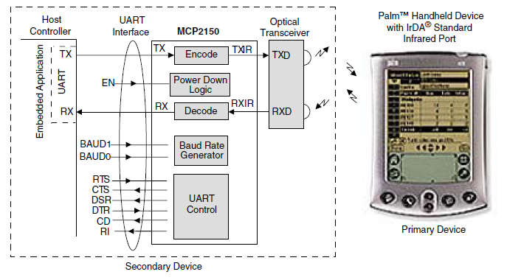
IR Tx & Rx Serial Protocol Example: irDA
Fig. 1: The Primary Device (PDA) sends data through the infrared interface to the MCP2150. The MCP2150 then decodes this data into the UART standard. After translation, the data is sent to the Host Controller through the UART interface. The Host Controller can also send data to the MCP2150 where the data is encoded and made ready for transmission to the Primary device.
Source: Wireless Communication Using the IrDA® Standard Protocol – Microchip Tech, ADN006

Slide 11
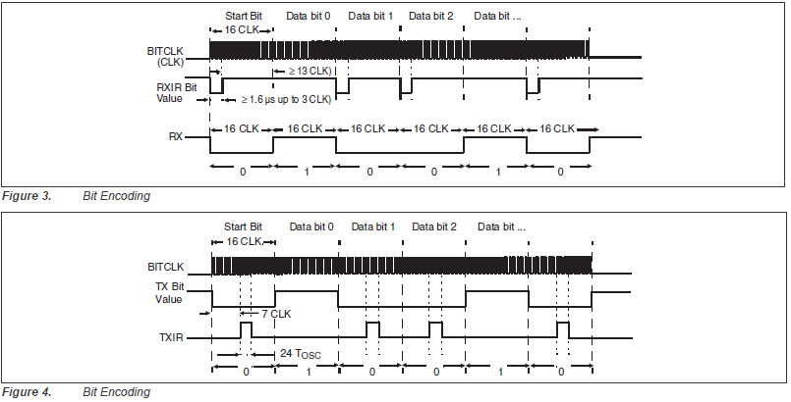
IR Tx & Rx Serial Protocol: irDA
Figures: The encode/decode translation format. Fig. 3 Received IR data from a PDA is decoded to UART-formatted data. Fig. 4 demonstrates how data is taken from the Host Controller.
Source: Wireless Communication Using the IrDA® Standard Protocol – Microchip Tech, ADN006

